Slide 1
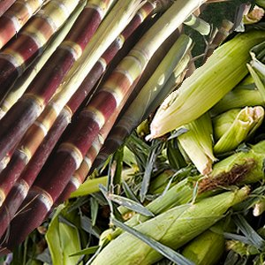
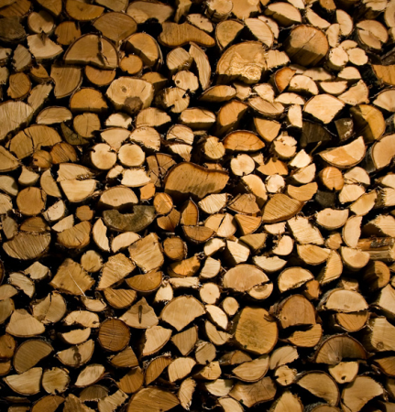
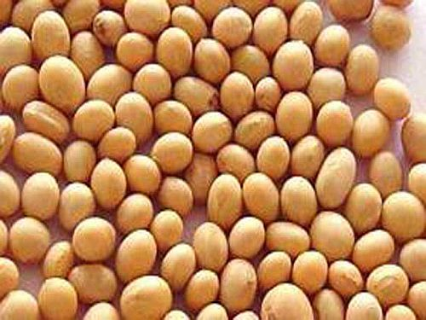
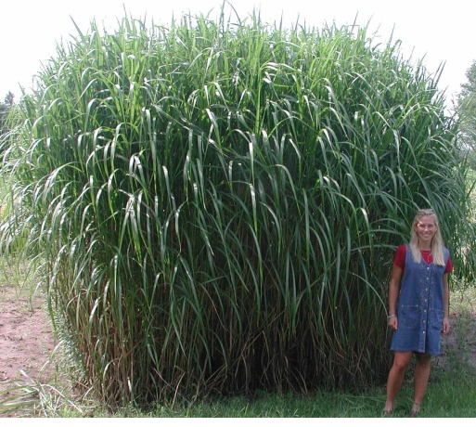
Biomass Energy
Botkin - Chapter 18
http://ecolocalizer.com/2008/07/30/us-public-has-zero-desire-for-brazils-ethanol-should-it/
http://en.wikipedia.org/wiki/Wood_fuel
http://www.w-healthy.com/is-soybean-oil-healthy/
http://www.aces.uiuc.edu/news/News_Photos/miscanthus2/pages/miscanthus2.html
Notes:
Introduction: Energy can be derived from many different forms but one of the most common forms of energy is biomass energy. Humans use biomass energy for many things including food and fuel. Today we will consider the different forms of biomass energy and the considerations that go into making fuel from biomass.

Slide 2
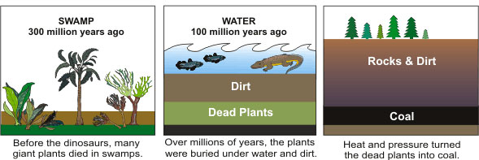
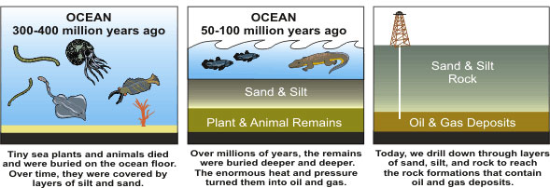
Biomass
Fossil Fuel Formation
Biomass Energy = energy recovered from biomass – organic matter such as plant material and animal waste
Biomass = recently living organisms
Fossil Fuels = partially decomposed ancient organisms
http://www.ctrade.com.au/LocalPower/Schools/Learn/Wheredofossilfuelscomefrom/tabid/101/Default.aspx
Notes:
Read the definition of biomass energy and explain the key difference between biomass energy and fossil fuels. To explain the similarities between fossil fuels and biomass explain that they both start from the same living organisms. Explain that fossil fuels are formed from ancient organisms that were covered over by sediments and were exposed to heat and pressure before they formed fossil fuels like coal and oil. When we talk about biomass this encompasses all recently living organisms, not just certain types like corn and soybeans.

Slide 3
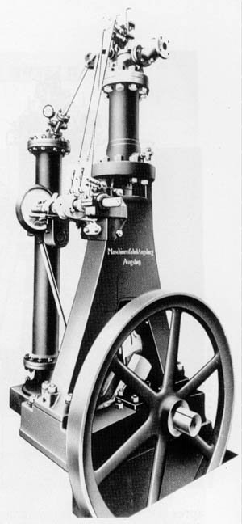
History of Biomass Energy
Wood was the major fuel source until the end of 19th century
  Today developing countries use wood for ~35% of total energy supply
Early diesel engines were designed and tested to run on peanut oil
http://en.wikipedia.org/wiki/Wood_fuel
http://www.uniquecarsandparts.com.au/history_diesel.htm
Notes:
Biomass energy is the original fuel source and was still that way until the end of the 19th century. Early engines were actually designed and tested to run on biofuel made from peanut oil.

Slide 4
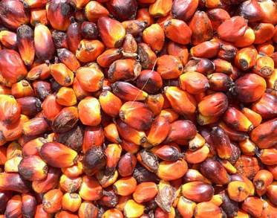
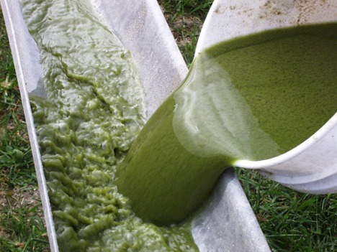
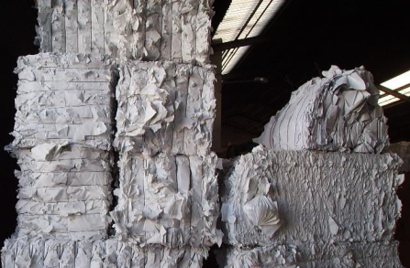
Types of Biomass Energy
Wood
Coconut husks
Palm Oil Biodiesel
Soybean Biodiesel
Algae Biodiesel
Sugar Cane Ethanol
Corn Ethanol
Cellulosic Ethanol
Manure
Waste Paper
http://en.wikipedia.org/wiki/Wood_fuel
http://www.treehugger.com/files/2009/03/seventh-generation-buys-sustainable-palm-kernal-oil-credits-for-entire-product-line.php
http://www.cepk.tk/1_2_Products.html
http://ecolocalizer.com/2008/07/30/us-public-has-zero-desire-for-brazils-ethanol-should-it/
http://www.celsias.com/article/us-doe-releases-finalized-national-algal-biofuels/
http://www.w-healthy.com/is-soybean-oil-healthy/
Notes:
Explain that there are a huge variety of sources for biomass energy. The most commonly considered are listed here. As stated in the previous slide wood is the most commonly used biomass. Each of these listed types are currently being considered for biomass energy production.

Slide 5
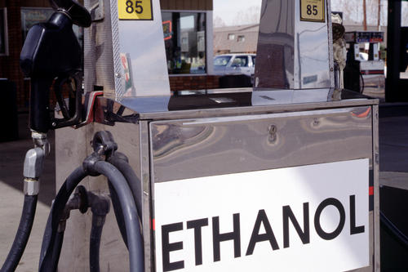
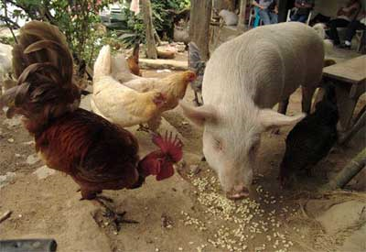
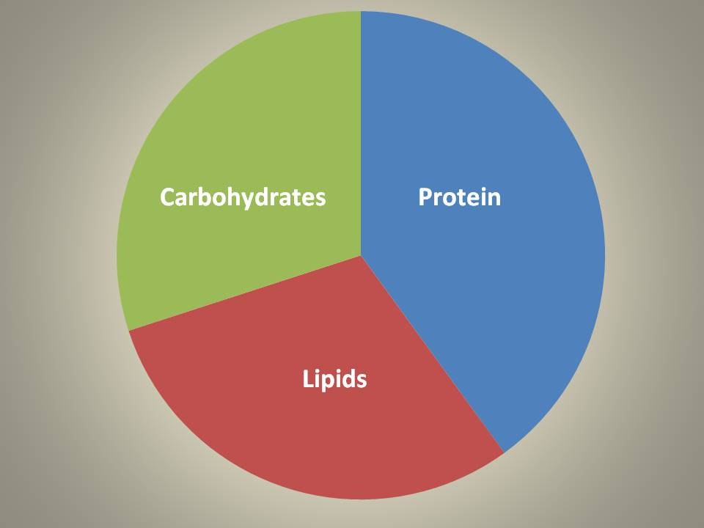
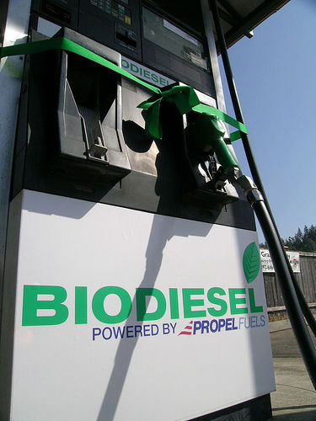

Biomass Composition
http://www.openmarket.org/2010/12/09/lame-ducks-need-some-backbone-to-let-ethanol-subsidy-and-tariff-expire/
Animal Feed
Ethanol
http://www.flickr.com/photos/robseattle/34083190/
Whole Biomass
Biodiesel
Notes:
So what is biomass made of? Mostly carbohydrates, protein and lipids. Each of these various components are valuable. Carbohydrates could be converted to ethanol, lipids could be used as biodiesel, protein could be used for animal feed and the whole biomass could be burned for energy. The concept of using every part of the biomass for different purposes is currently considered the only way to make biofuel cost competitive.

Slide 6
What is Biodiesel?
Biodiesel – vegetable oil or animal fat-based diesel fuel
Biodiesel has a slightly different chemical structure than petrodiesel
Most commonly made from soybean, palm, or canola oil
Fatty Acid Methyl Ester – FAME
Biodiesel
Petrodiesel
Notes:
Biodiesel is fuel made from vegetable or animal fat. Although biodiesel is different that petroleum diesel it can run in unmodified diesel engines.

Slide 7

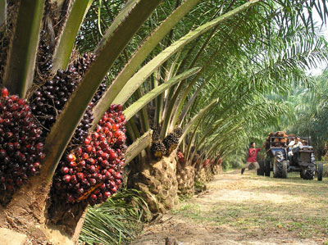
Trade-Offs
Advantages
Reduced CO emissions
Reduced CO₂ emissions (-78%)
Reduced Hydrocarbon Emissions
Better Gas Mileage (+40%)
Renewable
Disadvantages
Slightly increased nitrogen oxide (Nox) emissions
Higher cost than regular diesel
Competes with growing food and cropland
Loss of biodiversity from crop plantations
Poor cold temperature performance
http://www.flickr.com/photos/robseattle/34083190/
http://upload.wikimedia.org/wikipedia/commons/e/e4/Biodiesel_3.jpg
http://www.forward.net.nz/ForwardThinking/tabid/967/articleType/ArticleView/articleId/167/Asias-Progress-with-Corporate-Social-Responsibility-Is-Business-Really-Taking-the-Issues-Seriously.aspx
Notes:
Biodiesel is fuel made from vegetable or animal fat. Although biodiesel is different that petroleum diesel it can run in unmodified diesel engines.

Slide 8

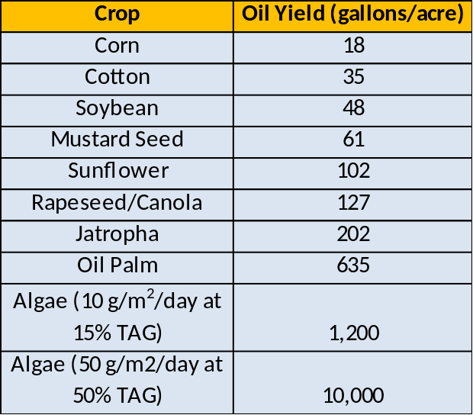
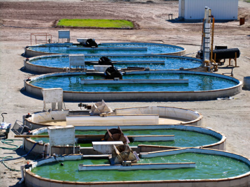
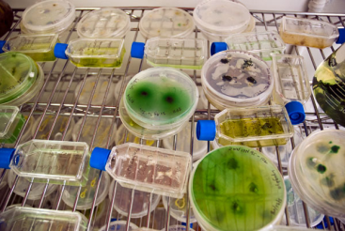
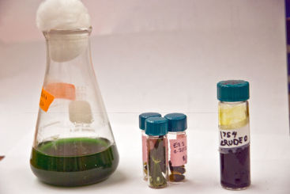
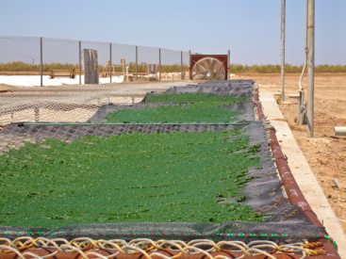
Algae Biodiesel – A possible solution
Algae are highly productive
Can grow on non-arable land
Non-fuel protein can be used as animal feed
Absorbs CO₂ for growth
Use nutrients/water more efficiently
Potential use of wastewater nutrients
Growth in salt/brackish water
Diverse metabolism
http://www.nrel.gov/docs/fy08osti/42414.pdf
Notes:
One potential solution to the challenges that other sources of biodiesel face is to make biodiesel from algae. Algae has many advantages over other sources of biomass fuel. Algae grow in water and don’t need to invest energy into support structures like land plants and can therefore grow rapidly and invest more energy into the lipids that will be turned into biofuel. This is part of the reason why they are so production. Looking at the table you can see that the amount of oil that algae can produce is at least two times if not 10 times better than the next best option (palm oil). Algae can also grow on non-arable land. Non-arable land is land that cannot be used for crops like deserts or places with nutrient poor soils. The non-fuel fraction of the algae (protein and carbohydrates) could also be used for other purposes like animal feed. Algae, like all plants absorb CO₂ however, they can do this more efficiently because they grow in water which can absorb high concentrations of CO₂ before algae take it up. Algae also have been shown to utilize nutrients and water more efficiently than other land crops. Additionally, there is potential to use wastewater, which is high in nitrogen and other nutrients, to grow the algae. Because there are many algae that tolerate salty or brackish water we would not necessarily need to use our precious freshwater resources for growth. Algae have evolved in a large variety of habitats over millions of years and have developed a very diverse metabolism and can therefore make a variety of valuable things like pharmaceuticals, antioxidants, and can even absorb toxins which could add value to algae biofuel production.

Slide 9
Algae Biodiesel - Challenges
High Cost (~$20-120/gal, need $1-2/gal)
Contamination
Limited Understanding of Lipid Biosynthesis
High Value Co-Products
High Cost to Harvest
Notes:
There are some significant challenges to using algae as a source of biofuel. This biggest challenge is the high cost to produce it. There are a number of projects that claim they can produce algae biofuel at low costs but they haven’t shown that they can do it at large scales yet. Growing algae in outdoor ponds leaves them very susceptible to contamination or grazing just like other crops. Other algae or grazing organisms can easily land in the ponds and reduce yields by killing off the growing algae. Scientists still don’t fully understand how and when algae make lipids so more research on the biosynthetic steps involved with help scientist find ways to get algae to produce more oil at a faster rate which would help bring down cost. Algae can make a variety of things other than oil that can be sold as “co-products” like protein, pigments, antioxidants, omega 3 fatty acids, and carbohydrates. However, there has been very little research into how much of these co-products can be produced and how valuable they will be once they are produced at the massive scale needed to make algae biofuel commercially viable.

Slide 10
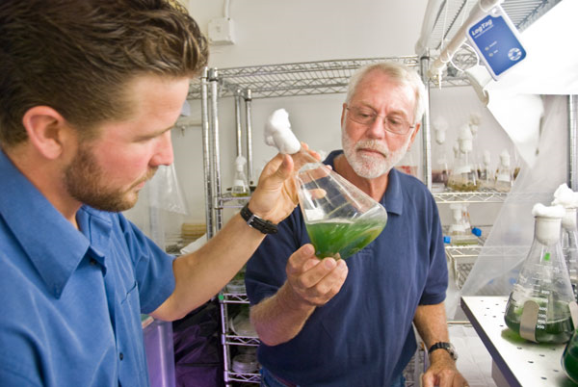
Research on Algae Biodiesel
GREEN BULLET VIDEO – Research into Algae Biofuel at Scripps Institution of Oceanography
http://explorations.ucsd.edu/Features/2008/Green_Bullet/
Notes:
Many of the previously described challenges are being researched at companies and universities around the world. At Scripps Institution of Oceanography researchers are actively trying to find ways to increase oil yields and reduce cost of algae biofuel production. Watch this 8-min video to introduce students to algae biofuel research. If the video doesn’t work then you can click on the link at the bottom and find the video on the upper right of the screen,

Slide 11
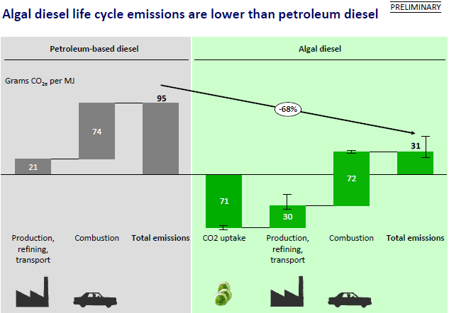
Life Cycle Analysis – Algae Biofuel
http://client-ross.com/lifecycle-workshop/docs/2.3_Attia_Sapphire_6-9-09pm.pdf
Notes:
Here is an example of a life cycle analysis of the emissions for petroleum diesel compared to algae diesel. This analysis was done by Sapphire Energy, a San Diego-based algae biofuel company. Orient the students to the chart by pointing out that the left side of the chart is analyzing petroleum based diesel and the left is looking at algae-based diesel. When comparing the amount of CO₂ emissions (in grams per MJ(mega joule) or energy unit) the algae diesel produces significantly less emissions. Both petroleum-based diesel and algae-based diesel produce about the same emissions from production and combustion but the big difference comes from the algae absorbing carbon dioxide. This analysis shows that algae diesel has a 68% reduction in total emissions due to the CO2 uptake by the algae when they are growing.

