Slide 1
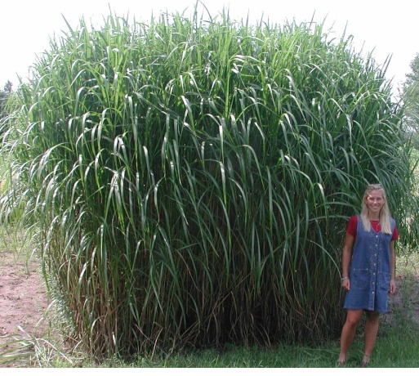
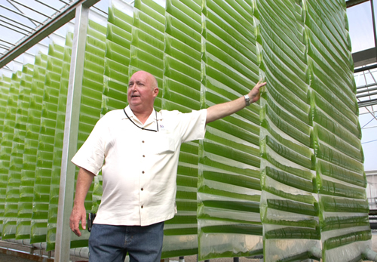
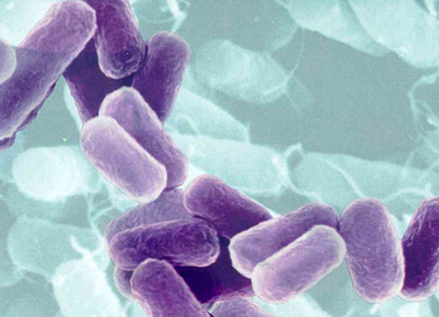
Next Generation Biofuels
http://www.aces.uiuc.edu/news/News_Photos/miscanthus2/pages/miscanthus2.html
http://www.greenoptions.com/wiki/algae-biofuel
http://wondersmania.blogspot.com/2009/11/is-rain-is-produced-through-bacteria.html
Notes:
Introduction: When folks think about biofuels they often think about corn ethanol or waste grease biodiesel but there are actually many different types of biofuels. Each type of biofuel has its advantages and disadvantages. Research into biofuels has advanced very rapidly over the past few years with many of the challenges of early biofuel types being solved or traded for new challenges. Today we will review the different advancements that have been made in biofuels and discuss the various new technologies that are on the horizon for next generation biofuels.

Slide 2
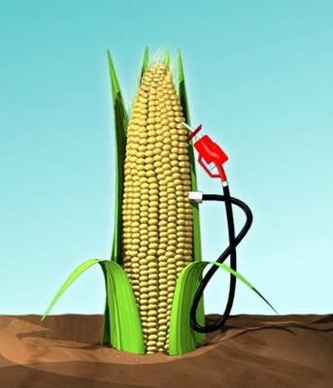
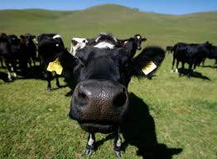
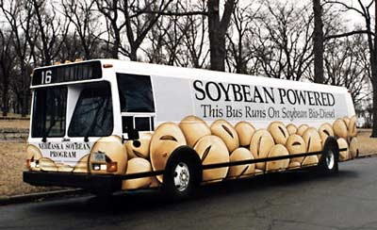
First Generation Biofuels – fuels used today
Corn Ethanol
More energy in than out
Low Yield
Competes for cropland
Heavily subsidized by government
Vegetable oil biodiesel
Compete for cropland
Low Yield
Reduces diversity in cleared areas
Biogas
Not concentrated enough
Not enough demand
http://www.etftrends.com/2010/10/corn-etfs-powered-ethanol-shift/
http://knowledge.allianz.com/
http://www.biofuels.ru/biodiesel/what_bd/
Notes:
Biofuel advancements have been described in terms of generations. This term is commonly used in the industry and by the media. First generation fuels are what we are using today. Review the disadvantages of each of these biofuels. A cow is shown for biogas because cows are a major source of methane which is the same as biogas. Cow manure can be digested and the methane trapped and used for energy.

Slide 3
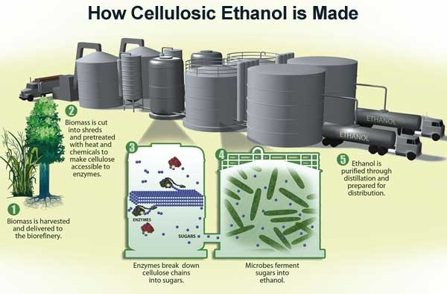
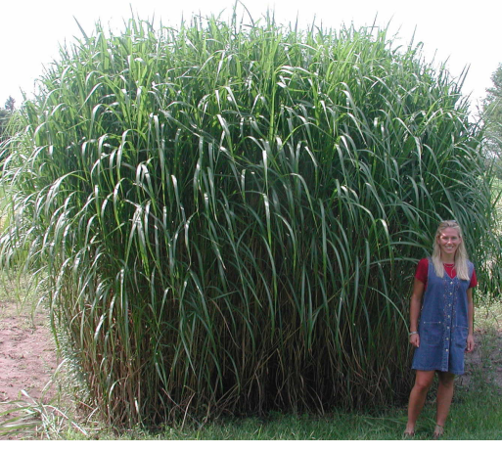
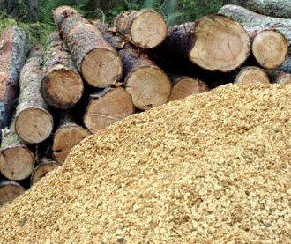
Second Generation Biofuels – fuels used tomorrow
Cellulosic Ethanol – ethanol produced from wood, grasses, or the non-edible parts of plants
Cellulose – a complex carbohydrate that supports plant structure. Most abundant naturally occurring molecule on the planet
http://www.aces.uiuc.edu/news/News_Photos/miscanthus2/pages/miscanthus2.html
http://energytechstocks.com/wp/?m=200804&paged=2
http://www.theresilientearth.com/?q=content/killing-biofuels
Notes:
Cellulosic fuels are considered the next phase of biofuel development because there is an abundant supply of cellulose (The most abundant organic compound in nature).

Slide 4
Second Generation Biofuels – fuels for tomorrow
Cellulosic Ethanol – ethanol produced from wood, grasses, or the non-edible parts of plants
Cellulose – a complex carbohydrate that supports plant structure. Most abundant naturally occurring molecule on the planet
Problems – expensive enzymes, requires fertilizers and land-use problems
http://www.aces.uiuc.edu/news/News_Photos/miscanthus2/pages/miscanthus2.html
http://energytechstocks.com/wp/?m=200804&paged=2
http://www.theresilientearth.com/?q=content/killing-biofuels
Notes:
The problem is that the enzymes (such as those shown in 3 on the figure) are expensive to make. Cellulosic ethanol is currently very expensive and not made at commercially viable scales.

Slide 5
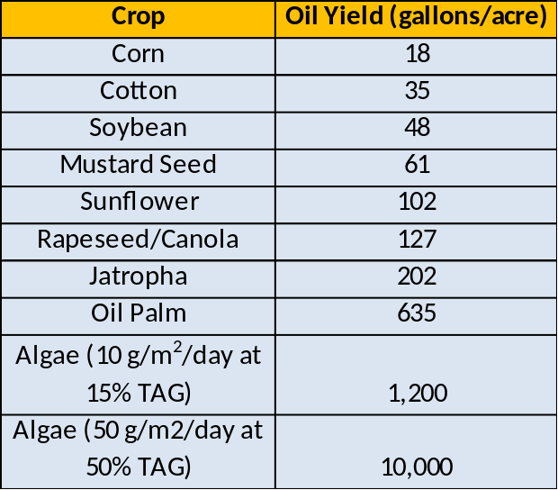
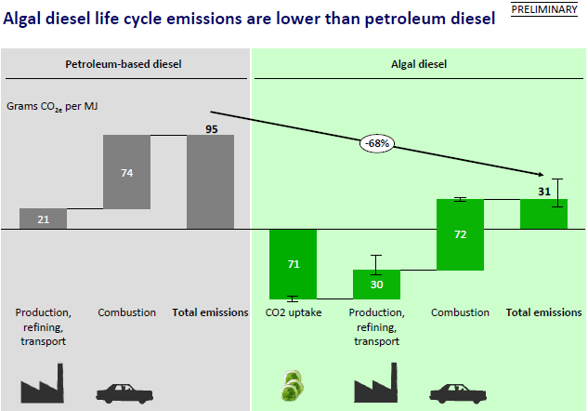
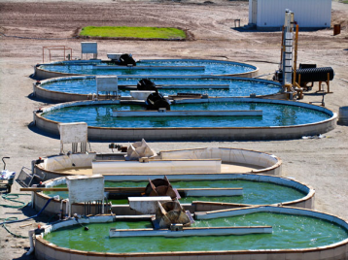
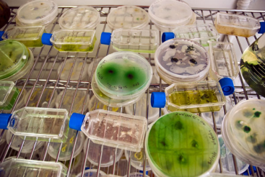
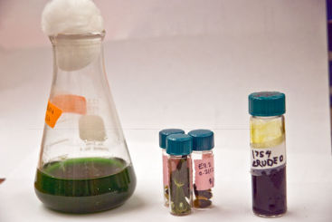
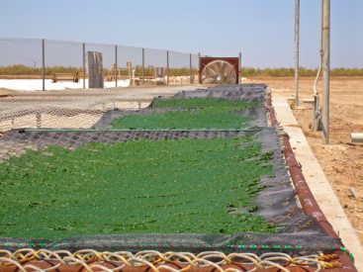
Third Generation Biofuels – fuels for the future
Algae Biofuel – ethanol or biodiesel derived from algae biomass
Advantages – Fast growing, absorbs CO₂, can use wastewater and non-arable land
Problems – Expensive to grow and harvest, contamination, unknown co-product yields
NREL
http://client-ross.com/lifecycle-workshop/docs/2.3_Attia_Sapphire_6-9-09pm.pdf
Notes:
Slide is animated. Don’t click until you ask students for examples of advantages and disadvantages. As we covered yesterday, algae biofuel offers many advantages over other biofuels. Multiple types of biofuel can be made from algae biomass. The most common is the production of biodiesel from the oils that algae make but the carbohydrates (sugars) could also be fermented into ethanol. Ask the students to offer a few advantages (fast growing, absorbs CO2, can grow on wastewater, doesn’t require arable land, diverse metabolism) click for animation and disadvantages (Expensive, we don’t know enough about lipid metabolism, not enough known about using co-products). click for animation

Slide 6
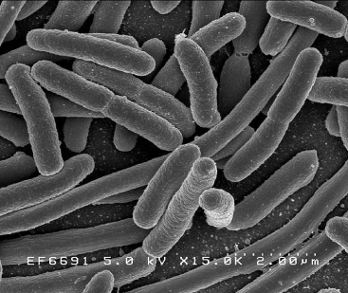


Fourth Generation Biofuels – fuels for the future
What is a microbe?
Microbes – organisms that can only be observed using a microscope such as a bacteria, fungus, protozoa or a virus (not a technical term)
Bacteria
Cyanobacteria
Yeast
Fungus
http://en.wikipedia.org/wiki/File:Agarplate_redbloodcells_edit.jpg
http://en.wikipedia.org/wiki/File:EscherichiaColi_NIAID.jpg
http://www.theperfectpantry.com/2008/04/yeast.html
http://www.microscopesblog.com/2010/01/protozoa.html
Notes:
Fourth generation biofuels (if there is such a thing) is fuel derived from engineered microbes. Explain that a microbe is any organism that you need a microscope to observe.

Slide 7
Fourth Generation Biofuels – fuels for the future
What is a microbe?
Microbes – organisms that can only be observed using a microscope such as a bacteria, fungus, protozoa or a virus (not a technical term)
Bacteria
Cyanobacteria
Yeast
Fungus
Why Use Microbes?
Easily Genetically Modified
Material for growth already in use (Fermenters)
Cyanobacteria
Bacteria
Protozoa
Yeast
http://en.wikipedia.org/wiki/File:Agarplate_redbloodcells_edit.jpg
http://en.wikipedia.org/wiki/File:EscherichiaColi_NIAID.jpg
http://www.theperfectpantry.com/2008/04/yeast.html
http://www.microscopesblog.com/2010/01/protozoa.html
Notes:
Engineered microbes are already used for a variety of industrial processes (making pharmaceuticals, alcohol fermentation). They provide many advantages over other types of systems to make biofuels. The most important advantage is that they can be relatively easily genetically modified to poduce fuels or specialty chemicals of interest. Additionally, the materials that are used to grow and manipulate microbes already exist because they have been used for other process like fermentation

Slide 8

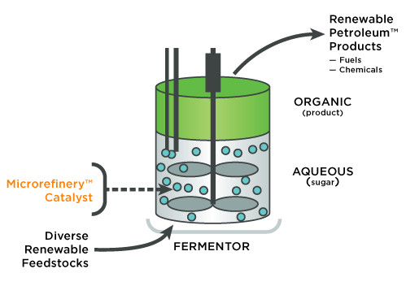
Fourth Generation Biofuels – fuels for the future
http://www.ls9.com/technology/
Notes:
LS9 is a company based in the San Francisco Bay Area that is currently engineering microbes to produce fuels that ca be put directly into a jet without processing. They are one of many different companies that are looking to microbes to make the high quality fuel that is needed for jets and diesel engines.

Slide 9
Fourth Generation Biofuels – fuels for the future
http://www.ls9.com/technology/
Notes:
Their basis process is to allow their engineered microbe to secrete fuel and let it float to the top so that they can use it while keeping the microbes growing at the bottom.

