Slide 1
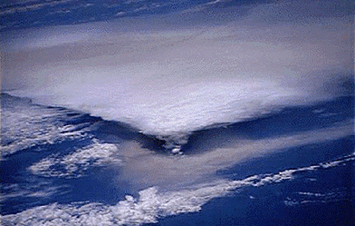
Effects on the atmosphere
Notes:
Picture taken from http://www.aerospaceweb.org/question/propulsion/q0293.shtml. It shows a “massive cloud of ash spreading from a Rabaul eruption as seen from Earth’s orbit.”
Introduce the lesson: tell the students that we will be learning about how volcanoes affect Earth’s atmosphere now, and how they affected the atmosphere in the past.

Slide 2
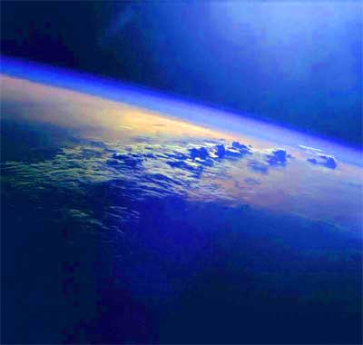
Outgassing
The Earth’s atmosphere was established by volcanoes
The first atmosphere was composed primarily of hydrogen and helium
The second atmosphere was produced by outgassing
Our atmosphere now contains approximately 78% nitrogen and 21% oxygen followed by argon, carbon dioxide, neon, helium, methane, krypton, and hydrogen
Notes:
Picture taken from NASA. Earth’s atmosphere viewed from space.
Volcanoes created our atmosphere. When the Earth was first forming, the atmosphere was composed of mostly hydrogen and helium. However, solar wind and early earth bombardment with space debris kept blasting away what atmosphere the Earth did have into the outer solar system, and Earth was too small yet to hold gases in. Over time, volcanoes emitted gases continuously including water, carbon dioxide, sulfur dioxide, carbon monoxide, sulfur, chlorine, nitrogen, hydrogen, ammonia, and methane. There was no free oxygen available at that time. As bombardment decreased, the Earth began to cool and the water vapor emitted from volcanoes condensed and formed the oceans. The oxygen in our atmosphere was created by photosynthesis where cyanobacteria removed the carbon from the air (from CO₂) and allowed oxygen to build up over hundreds of millions of years to the amount we have now. The atmosphere now contains approximately 78% nitrogen and 21% oxygen with small amounts of other gases.
It was by the steady emission of gases from volcanoes that provided the carbon dioxide, methane, water, and other gases necessary for life to begin on Earth and for the greenhouse effect to begin that made conditions suitable for humans to eventually populate the Earth. Gases such as carbon dioxide trap heat so that less energy from the sun escapes into space and is radiated back towards Earth instead. Without volcanoes, we wouldn’t exist! Volcanoes emit very little gases now, and only a small fraction of total yearly carbon dioxide emissions comes from volcanoes, but outgassing was very important early on.

Slide 3
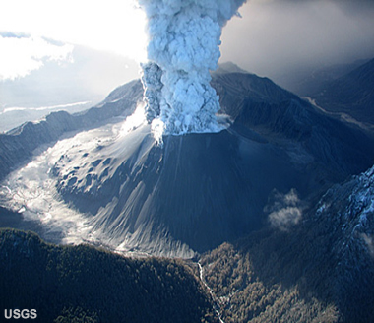
Effects
Worldwide:
  Large molecules warm the earth (CO₂)
  Small particles cool the earth (Ash)
  Only worldwide effects if the eruption column enters the stratosphere
Local: Rain, lightning, and thunder
Yearly CO₂ from volcano: 3%
Yearly CO₂ from human activities: 97%
Notes:
Picture taken by J. N. Marso of the U. S. Geological Survey. Taken from http://geology.com/volcanoes/chaiten/: “View of an eruption column from Chaitén Volcano, Chile, photographed on May 26, 2008. The caldera is about 3 km (1.9 miles) in diameter from rim to rim. The knobby feature between the eruption column and the left rim is part of a lava dome that formed after the 7,400 BC eruption.”
All volcanic eruptions have some effect on worldwide atmosphere, but only the largest eruptions cause noticeable effects. If the eruption column is large enough to reach the stratosphere, winds in the stratosphere can distribute the volcanic ash around the globe. The ash reflects sunlight back into space, therefore cooling the Earth. Once the ash makes it into the stratosphere, it stays around for a long time, increasing earth’s albedo and wreaking havoc with local climate. For example, the eruption of Pinatubo in the Philippines in 1991 ejected about 4 km² of ash into the atmosphere, which resulted in a worldwide cooling of 0.5-0.7ºC. The eruption of Tambora in 1815 blew 40 km³ of ash into the atmosphere and caused the “years without summers” from 1816-1818 creating widespread crop failure and famine. It is responsible for at least 80,000 deaths due to famine in the northern hemisphere. Toba erupted approximately 73,500 years ago and released 2,800 km³ of magma. This eruption would have been large enough to cause a global cooling of 3-5ºC with regional drops of up to 15ºC for 6 years. It is believed that it caused the world population to drop to as little as 10,000 people or less, which caused a significant decrease in genetic diversity.
Volcanoes are constantly emitting gasses, including carbon dioxide, which enhances the greenhouse effect. However, volcanoes are not the cause of the recent global warming. The total output of all volcanoes on Earth accounts for only 3% of all carbon dioxide entering the Earth’s atmosphere. The other 97% can be attributed to human activities.
Volcanoes can cause rain, lightning, and thunder in the immediate area surrounding them. The ash that is ejected mixes with moisture in the air causing it to rain.

Slide 4
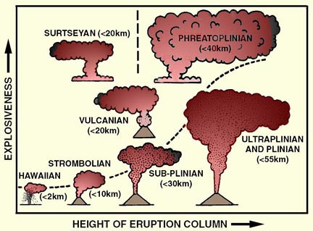
Notes:
Diagram taken from http://www.geology.sdsu.edu/how_volcanoes_work/Thumblinks/erupttypes_page.html. It was modified from Cas et al. (1988).
This is a diagram comparing the size of the eruption column of different types of eruptions. This is an opportunity to remind the students of the different types of eruptions. You can ask the students how much area they think each eruption might cover and which eruption is large enough to reach the stratosphere and send ash around the world. Why are some more explosive but do not reach as high as others?

Slide 5
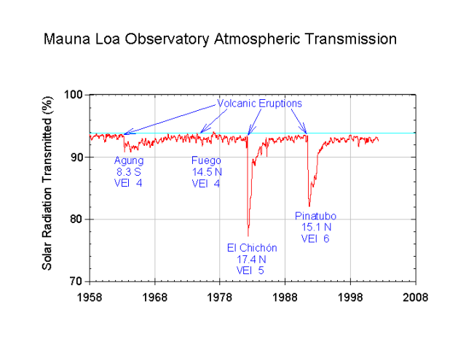
Notes:
Image taken from http://www.cmdl.noaa.gov/albums/cmdl_overview/Slide18.sized.png
Photograph of lightning caused by the April 2010 eruption of a volcano in Iceland. The eruption of Eyafjallajökull was relatively small, but caused enormous disruption to air traffic over western and northern Europe because it is located directly beneath the jet stream.

Slide 6
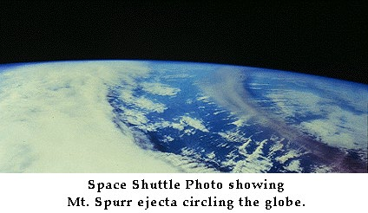
Notes:
Photograph taken from http://www.vulkaner.no/v/volcan/alaska/spurr.html. The eruption of Mt. Spurr that created this ash cloud began on September 16, 1992.
Photograph of ash dispersing around the planet. Volcanic ash clouds can be difficult to see from the surface of the Earth, but are very obvious when viewed from space. This ash cloud is very high in the atmosphere, well above the clouds.

Slide 7
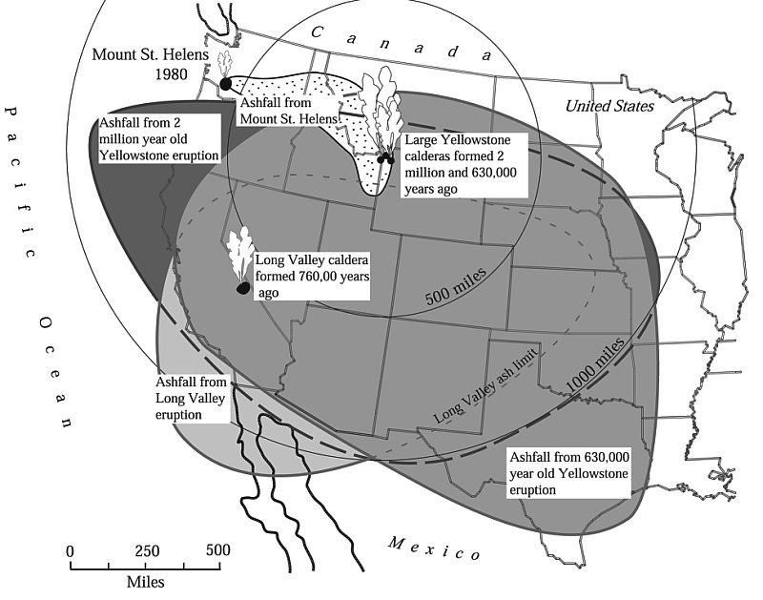
Volcanic ash fall
Notes:
Map taken from http://www.thelivingmoon.com/41pegasus/02files/Volcanoes_Yellowstone_Park.html. It was adapted from Sarna-Wojcicki, 1991.
Map showing the extent of area covered by ash ejected from the Yellowstone caldera in previous eruptions. Ash from Yellowstone can be found more than 1000 miles away from the source. There are eruptions in 3 different locations on this map. The eruption of Mt. Saint Helens in 1980 produced much less ash than the eruptions at Yellowstone and Long Valley, so if Yellowstone was to erupt again, it would be even more disastrous.

Slide 8
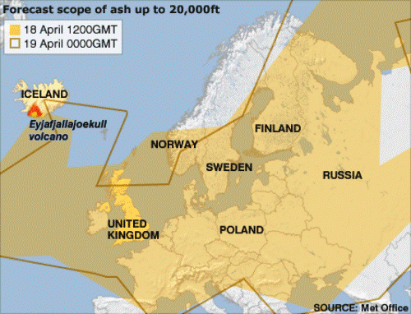
Ash fall from Iceland
Notes:
Map taken from the UK met office showing the forecasted extent of ash in the atmosphere during the April 2010 eruption of Eyjafjallajokull.
Map of areas covered in ash from the eruption in Iceland. This slide can be replaced with a more recent eruption. The point here is to bring in current events that students have heard about. The eruption began rather peacefully then stopped for several days. When the eruption began again, a new set of craters opened up beneath the volcano’s ice covered central summit caldera. The eruption occurred beneath 200 meters of ice. The resulting meltwater flowed back into the erupting volcano and significantly increased the explosivity of the eruption. It cooled the lava very quickly, which caused it to erupt in a cloud of highly abrasive, glass-rich ash. Since the eruption was more explosive due to the meltwater, it ejected ash high enough to enter the jet stream and paralyze air traffic over Europe.

Slide 9
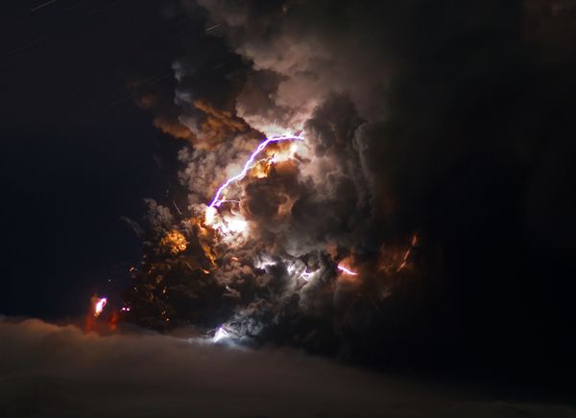
Notes:
Photograph taken from news.nationalgeographic.com, photograph taken by Marco Fulle, Barcroft/Fame Pictures.
Photograph of lightning caused by the April 2010 eruption of a volcano in Iceland. The eruption of Eyafjallajökull was relatively small, but caused enormous disruption to air traffic over western and northern Europe because it is located directly beneath the jet stream.

Slide 10
Key Points
Volcanoes created the Earth’s atmosphere
Volcanic gases warm the Earth
Volcanic ash cools the Earth
Notes:
This slide gives a chance to reemphasize the main points of the lesson.

