Slide 1
Volcanic Hazards
Notes:
Introduce the lesson: students will learn about the different hazards that are caused by volcanic eruptions as well as the benefits that volcanoes provide to humans.

Slide 2
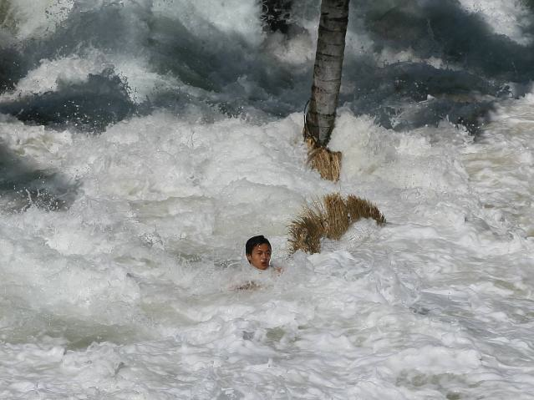
Tsunamis
Floods cities
Standing water can lead to disease
1883 Krakatau: main cause of death was due to tsunamis
Waves reached as high as 35 meters and killed greater than 30,000 people
Notes:
Image taken from http://scrapetv.com/News/News%20Pages/Everyone%20Else/pages-3/New-Zealand-comes-within-richter-points-of-a-tsunami-Scrape-TV-The-World-on-your-side.html. This was taken during the 2004 Indian Ocean Tsunami.
Volcanoes can cause tsunamis when they displace large masses of water in the force of their explosion (tsunamis can also be caused by large earthquakes on the seafloor). This water displacement creates a tidal wave (Tsunami) that can flood low-lying cities and cause massive destruction as the wave floods low-lying land and retreats again, carrying with it any debris it finds along the way (including ships, houses, cars, lumber). The 1883 eruption of Krakatau caused a tsunami with waves as high as 35 meters that killed more than 30,000 people.

Slide 3
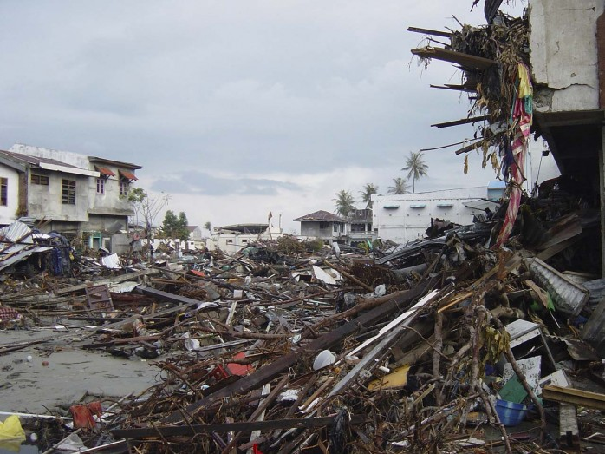
Notes:
Photograph taken from http://50.usaid.gov/usaid-builds-back-better-following-the-2004-indian-ocean-tsunami/. This photograph shows the aftermath of the 2004 Indian Ocean Tsunami.
Photograph of flooding and damage caused by a tsunami.

Slide 4
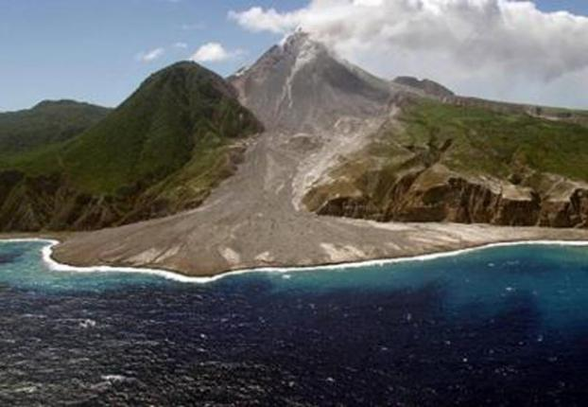
Landslides
Can dam rivers and lakes and produce flooding
Damages property
Notes:
Picture taken from http://www.ouramazingplanet.com/active-volcano-holds-clues-to-violent-landslides-0197/. “This is an aerial view of the Soufriere Hills volcano on the island of Montserrat in the Lesser Antilles. The photograph was shows one of the volcanic domes that grew and then collapsed into the sea since the volcano became active in 1995. However, there have been far bigger collapse events in the distant past that involve the entire volcanic edifice. Credit: NOC.”
Volcanoes can create landslides if they displace dirt and rock from their own slopes or neighboring mountains when they erupt. Landslides crush people and property in their path. If a landslide reaches a river or a lake, it can fill it in and cause the water to flood the surrounding area.

Slide 5
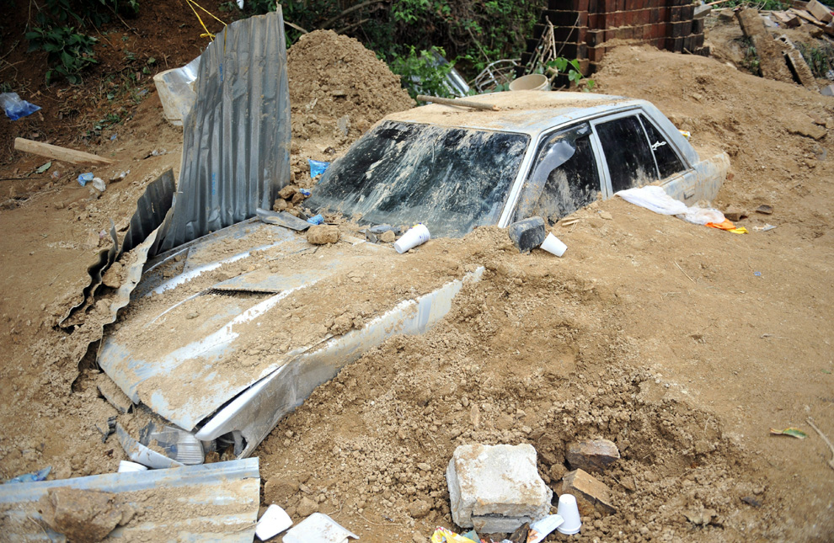
Notes:
Picture taken from http://anumasharmabhattarai.blogspot.com/2011/03/disaster-2010-till-now.html. “A car remains buried near the area where 11 people died when a landslide destroyed their home on the northern outskirts of Guatemala City on May 31, 2010. (Johan Ordonez)” This landslide was a result of a volcanic eruption in Guatemala.
Photograph of damage caused by a landslide.

Slide 6
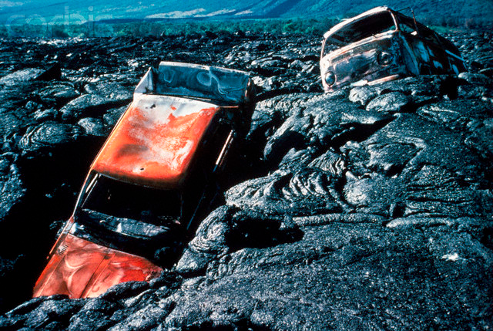
Lava Flows
Destroys property
Notes:
Photograph taken from http://www.smate.wwu.edu/teched/geology/vo-HA-impact.html. “Cars trapped in Lava Flow. Two automobiles are all that remain on October 7, 1987, after this section of Royal Gardens subdivision was overrun by lava. During October the footpath from a road into the housing area was covered, cutting residents off from the few homes that remained. Photograph Credit: J.D. Griggs, Hawaii Volcano Observatory, U.S. Geological Survey.”
Lava flows rarely harm people because they travel so slowly that people can run or even walk away from them. However, they do destroy property. Lava incinerates everything it touches and can only rarely be blocked or diverted.

Slide 7
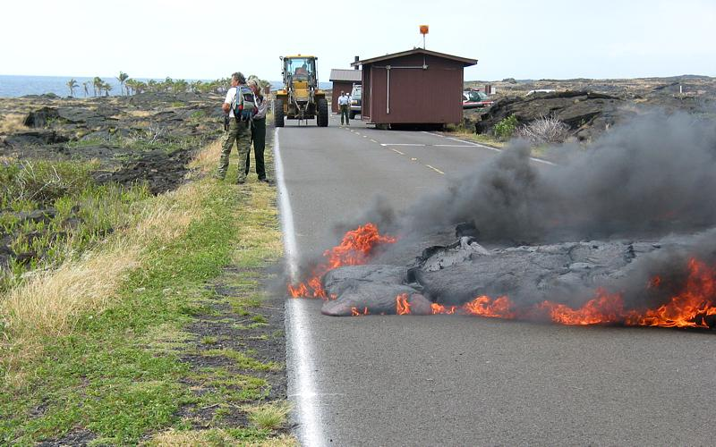
Notes:
Picture taken from http://www.outdoor.com/places/parks-and-monuments/hawaii-volcanoes-national-park/ of lava crossing a road in Hawaii.
Photograph of lava burning a road in Hawaii

Slide 8
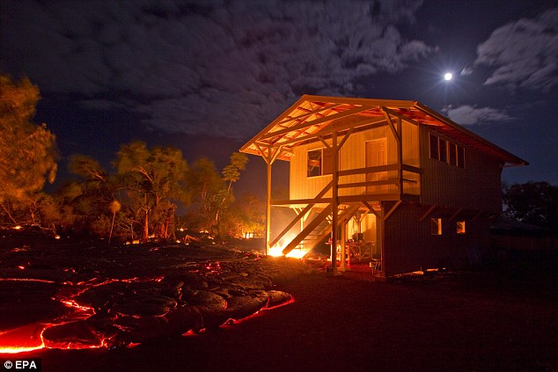
Notes:
Picture taken from http://bigthink.com/ideas/23820. “Lava flows from Kilauea in Hawai`i move towards a home in Kalapana.” –July 2010
Photograph of a house that was burned and destroyed by a lava flow in July 2010 in Hawaii

Slide 9
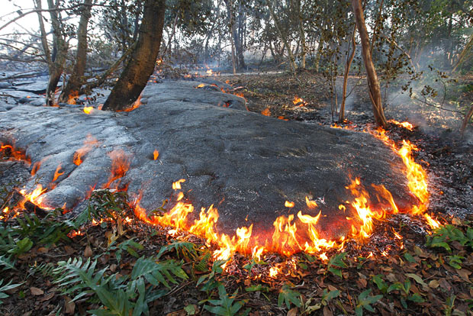
Notes:
Photograph taken from http://www.telegraph.co.uk/earth/earthpicturegalleries/7910626/Kilauea-volcano-on-Hawaii-homes-destroyed-by-lava-from-volcano-that-has-been-erupting-since-1983.html?image=2. “Lava enters Gary Sleik's back garden, burning trees and shrubbery. Picture: EPA”
Photograph of trees and vegetation being burned by a lava flow

Slide 10
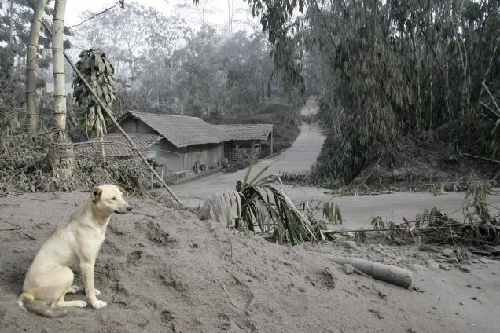
Ash
Mixes with moisture in the lungs to create liquid cement
Scratches the surface of the eyes
Only 4 inches of ash can cause roofs to collapse
Disrupts air traffic
Blocks out sunlight, cooling the Earth
Notes:
Photograph taken from http://www.thehindu.com/news/international/article859179.ece. “A dog sits at an abandoned village covered with volcanic ash from the eruption of Mount Merapi in Kepuharjo, Yogyakarta, Indonesia, on Saturday.” –October 2010
Volcanic ash can be deadly if it is breathed in. The ash mixes with moisture in the lungs to create liquid cement that prevents breathing. The ash can also scratch the surface of the eyes. It can cause roofs to collapse, disrupt air traffic, and block out so much sunlight it seems like nighttime during the day.

Slide 11
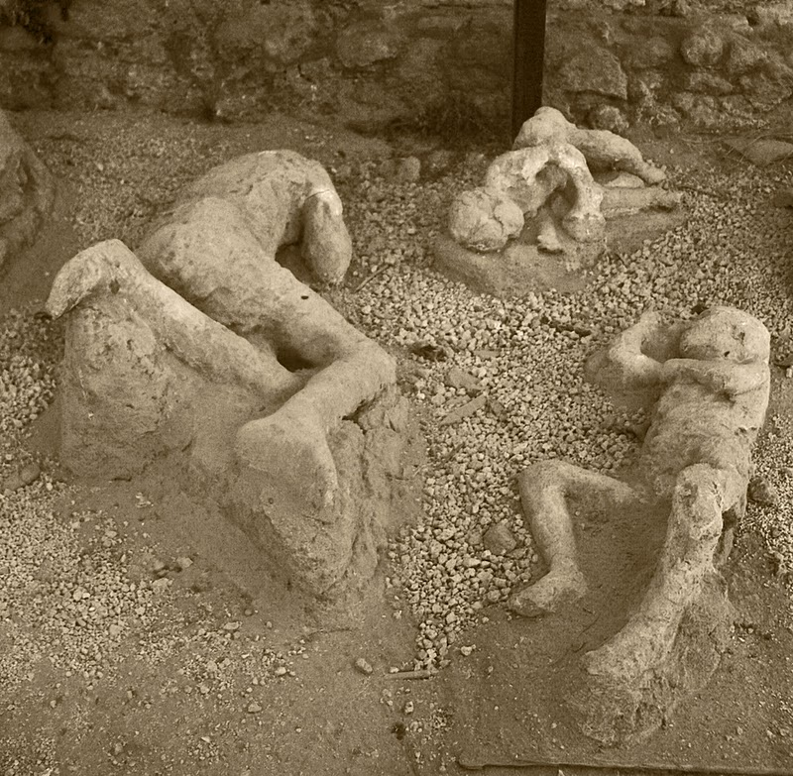
The famous Pompeii eruption of 79 A. D.
Notes:
Picture taken from http://thelastdaysofpompeii.blogspot.com/2010/12/personal-account-of-day-of-destruction.html
The eruption of Mt. Vesuvius in 79 AD destroyed the city of Pompeii. Super hot ash covered the inhabitants, the bodies decayed, and cavities were left where their bodies used to be. These cavities were preserved for nearly 2000 years before they were discovered. When plaster was poured in the cavities and the ash was removed, perfect casts of the bodies were left behind.

Slide 12
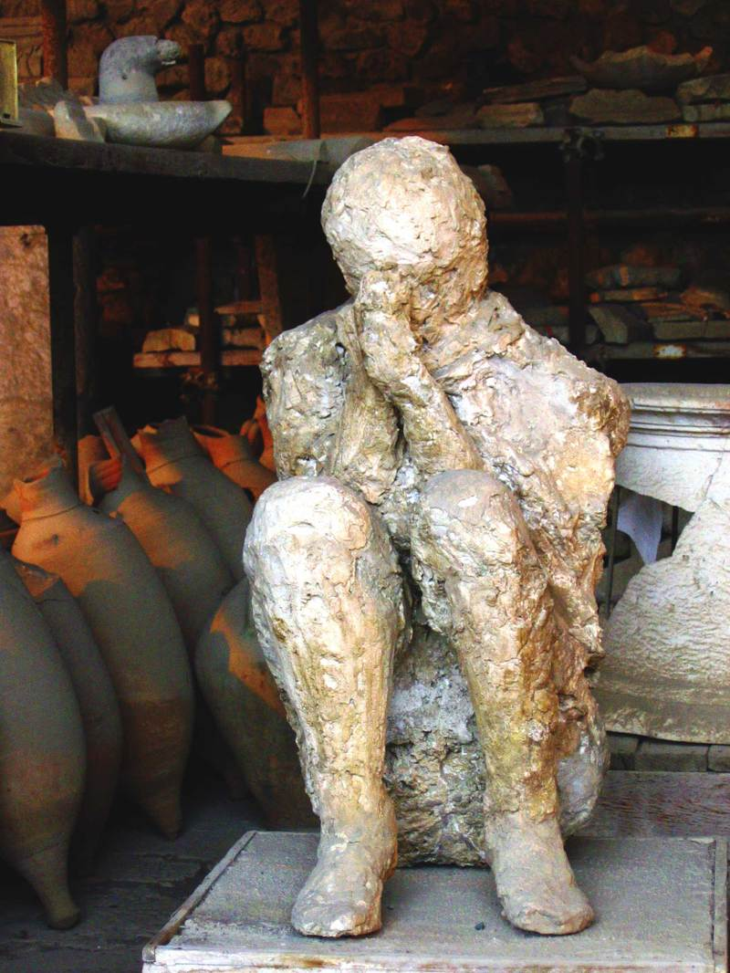
Notes:
Image taken from http://rometopompeii.wordpress.com/.
Photograph of a cast of a person killed in the eruption of Mt. Vesuvius. Note that this person was covering her nose indicating that she had a problem breathing, her likely cause of death.

Slide 13
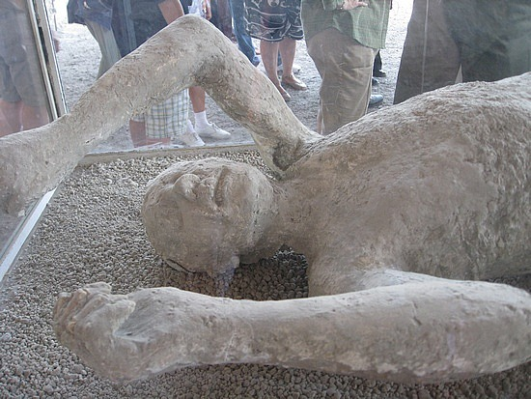
Notes:
Picture taken from http://www.forensicmed.co.uk/pathology/fire-deaths/was-deceased-alive-or-dead-at-the-time-of-the-fire-/
Another cast of a person covered by volcanic ash

Slide 14
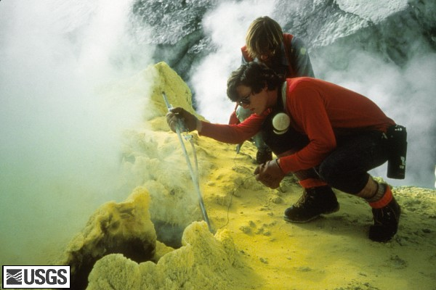
Volcanic Gases
Poisonous to humans
Can cause acid rain
Includes:
  Carbon dioxide (CO2)
  Sulfur dioxide (SO2)
  Hydrochloric acid (HCl)
  Carbon monoxide (CO)
Notes:
Photograph taken from http://vulcan.wr.usgs.gov/Glossary/Emissions/description_gases_fumaroles.html. “Sampling gases, fumarole, on top of Mount Baker, Washington. USGS Photograph taken in 1981 by W. Chadwick.”
Volcanic gases are hazardous to humans and can cause acid rain. Volcanoes emit many gases including carbon dioxide, sulfur dioxide, hydrochloric acid, and carbon monoxide.

Slide 15
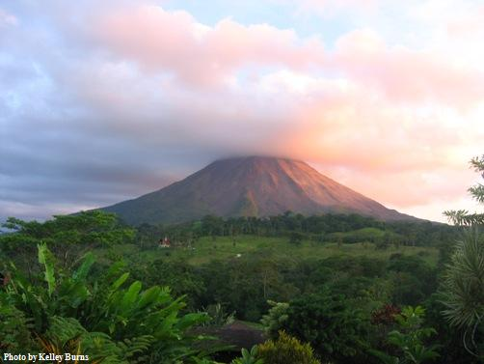
Notes:
Photograph taken from http://www.nowpublic.com/environment/lava-rocks-and-volcanic-gases-costa-rica-comes-galapagos-islands-0. “Lava, rocks and volcanic gases in Costa Rica comes from Galapagos Islands”
Photograph of a volcano emitting volcanic gases that are visible in the sunset.

Slide 16
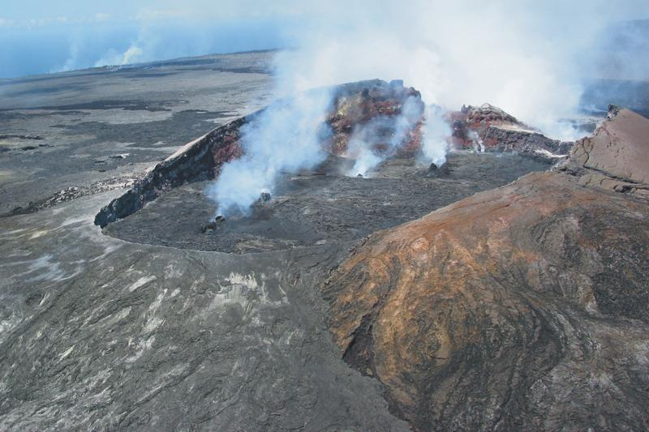
Notes:
Photograph taken from http://pubs.usgs.gov/fs/2002/fs144-02/. “Volcanic gases escape from vents on the crater floor of the Pu‘u ‘O‘o cone, located 12 miles (19 km) east of the summit of Kīlauea Volcano. Since 1987, repeated collapses of the cone have resulted in a crater more than 1,300 feet (400 m) long. The crater floor is 40 feet (13 m) below the lowest part of the rim. In the distance (upper left), steam plumes rise where lava flows pour into the sea, about 7 miles (11 km) south of Pu‘u ‘O‘o. USGS photo by Richard Hoblitt, May 2002”
Volcanic gases rising from a crater

Slide 17
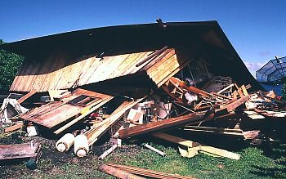
Earthquakes
Ground cracks
Ground deformation
Damage to manmade structures
Notes:
Photograph taken from http://www.digitaljournal.com/article/270695. “This damaged building is evidence of the consequences of seismic activity and earthquakes associated with the Kilauea volcano”
Volcanoes can also cause earthquakes. Magma pushing up inside the volcano forces the crust apart, and cracks and deforms the ground. Earthquakes caused by volcanoes tend to be smaller than most large tectonic earthquakes but they commonly cause local property damage and disrupt services (electricity, gas, water, etc.).

Slide 18
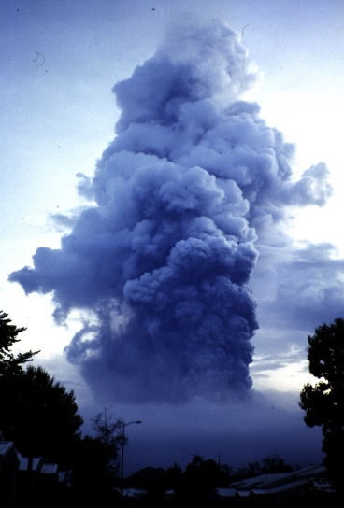
Pyroclastic Flows and Surges
More people have died due to these hazards than any other volcanic hazard
Can incinerate, burn, and asphyxiate people
Travel long distances so their threat is far reaching
Fast, no way to outrun
Notes:
Photograph taken from http://www.geo.mtu.edu/volcanoes/hazards/primer/pyro.html. Mount Pinatubo in the Philippines (photo by M.T. Dolan)
A pyroclastic flow is an extremely hot current of gas and rock that can reach temperatures of 1800ºF and speeds of 450 mph. They hug the ground and travel down the side of the volcano and spread out laterally. Pyroclastic flows and surges along with lahars are the most deadly volcanic hazards. They are common in explosive eruptions and there is no way to outrun them. They incinerate, burn and asphyxiate people. They travel for long distances so they have a far-reaching impact.

Slide 19
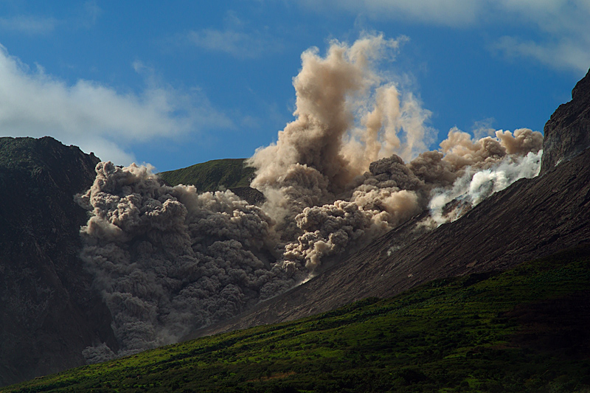
Notes:
Photograph taken from http://www.stcolmcilles.org/pupil%20zone/Extreme%20Earth%20Webpages/volcanoes.htm. It depicts a pyroclastic flow on Montserrat in 1997.
Photograph of a pyroclastic flow rushing down a mountain. Students may have seen this picture previously in the video “In the Path of a Killer Volcano”.

Slide 20
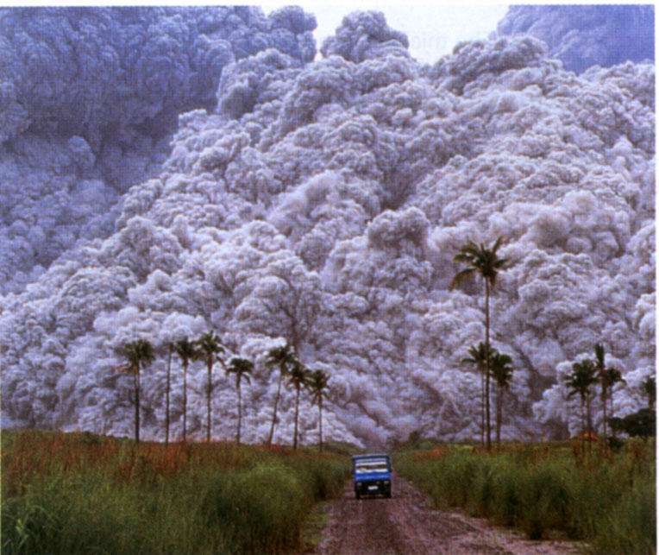
Notes:
Photograph taken from http://www.stcolmcilles.org/pupil%20zone/Extreme%20Earth%20Webpages/volcanoes.htm. This car is attempting to escape the pyroclastic flow from Pinatubo in 1991. They did escape.
Photograph of a car about to be engulfed by a pyroclastic flow

Slide 21
Lahars
Bury and destroy manmade structures including roads and bridges.
Nevado del Ruiz 1985: lahars destroyed an entire city; breaking windows, floating cars, and leaving debris in the tops of trees
  23,000 people killed
Undercut banks and cause houses on those banks to be destroyed.
Notes:
Lahars are massive flows of mud created when a volcanic eruption occurs below snow or ice or when associated with rainfall. Volcanic ash and water mix to flow downhill carrying mud, rocks, and debris along with it. They can also be created after an eruption with heavy rainfall. Lahars have the consistency of concrete and can flow at 60 mph for more than 200 miles. They can undercut riverbanks and cause houses on the banks to be destroyed, and they can bury and destroy manmade structures such as roads and bridges. An eruption of Nevada del Ruiz in Columbia in 1985 destroyed the city of Armero, killing 23,000 people.

Slide 22
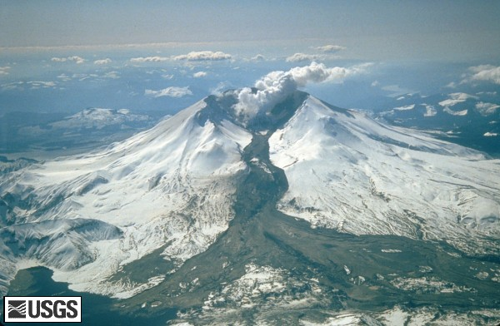
Notes:
Photograph taken from http://vulcan.wr.usgs.gov/Volcanoes/MSH/Images/mudflow_images.html. “Mount St. Helens erupted often between 1980 and 1986. An explosive eruption on March 19, 1982, sent pumice and ash 9 miles (14 kilometers) into the air, and resulted in a lahar (the dark deposit on the snow) flowing from the crater into the North Fork Toutle River valley. Part of the lahar entered Spirit Lake (lower left corner) but most of the flow went west down the Toutle River, eventually reaching the Cowlitz River, 50 miles (80 kilometers) downstream. USGS Photograph taken on March 21, 1982, by Tom Casadevall.“
Photograph of a lahar on Mt. St. Helens during the eruption in 1980.

Slide 23
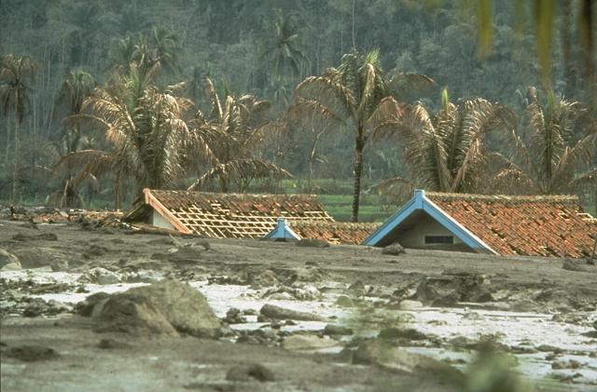
Notes:
Photograph taken from http://pariwisatadunia.blogspot.com/2010/11/laharmudflows-mudflows-are-somewhat-of.html. Photo by Robin Holcomb, 1983 (U.S. Geological Survey). “These lahars from the 1982 eruption of Galunggung volcano on the Indonesian island of Java caused extensive damage to houses and croplands.”
Houses inundated by a lahar in Indonesia in 1982

Slide 24
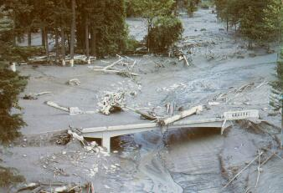
Notes:
Photograph taken from http://www.dinojim.com/DantesPeak.htm.
Bridge destroyed by a lahar

Slide 25
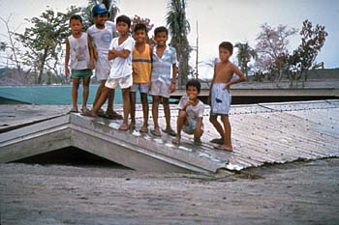
Notes:
Picture taken from http://pubs.usgs.gov/fs/1997/fs064-97/. “In June 1991, after 2 months of increasing unrest, Mount Pinatubo volcano in the Philippines exploded in a climactic volcanic eruption. Even months after the eruption, heavy rains caused giant mudflows of volcanic ash (lahars). These children stand atop their schoolhouse in the village of Bamban, which was buried by one of these lahars. In April 1991, after Pinatubo had reawakened, U.S. Geological Survey scientists with the Volcano Disaster Assistance Program's crisis-response team joined Philippine scientists to quickly evaluate the threat from the volcano. Their timely warnings permitted the safe evacuation of more than 75,000 people, including about 18,000 American servicemen and dependents from the two largest U.S. military bases in the Philippines, before Pinatubo's climactic eruption.”
Children standing on the roof of their schoolhouse that was covered by a lahar

Slide 26
What are the benefits of volcanoes to humans?
Notes:
Transition and introduction to the benefits of volcanoes. For example: so we all know that volcanoes are dangerous, but can you think of some of the benefits of volcanoes?

Slide 27


Positive effects:
Geothermal energy: hot water, electric power
Resources: sulfur, building materials, pumice, granite, gravel driveways
Formation of our climate: Outgassing
Soil rejuvenation: Fertile soils
Building topography: Islands, Mountains, New Land
Notes:
Photograph of pumice from http://www.blackpearlbotanicals.com/pumice_stick.htm. Background photograph taken from http://www.metromarble.com/.
Humans can use volcanoes as a source of geothermal energy. For example, people in Iceland use geothermal energy to heat their water. The water has a smell of sulfur (rotten eggs), but it is a very cheap way to heat homes and hot water for showers.
Volcanoes also provide resources such as building materials. Pumice is a volcanic rock that is used to scrape off calluses. Granite is a popular countertop for kitchen and bathroom cabinets.
Some scientists believe that volcanoes provided the necessary elements for life (hence humans) to begin.
The soil surrounding volcanoes is excellent for growing crops. It is a popular location for farms.
Volcanoes build topography on Earth. Most islands, such as Hawaii, owe their existence to the presence of volcanoes.

Slide 28
Key Points
Volcanic Hazards:
  Lahars
  Pyroclastic flows
  Tsunamis
  Ash
  Lava Flows
  Earthquakes
  Landslides
  Gases
Benefits:
  Geothermal energy
  Soil rejuvenation
  Resources
  Formation of our atmosphere
  Building topography
Notes:
Give a summary of the important points of the lesson.

