Slide 1
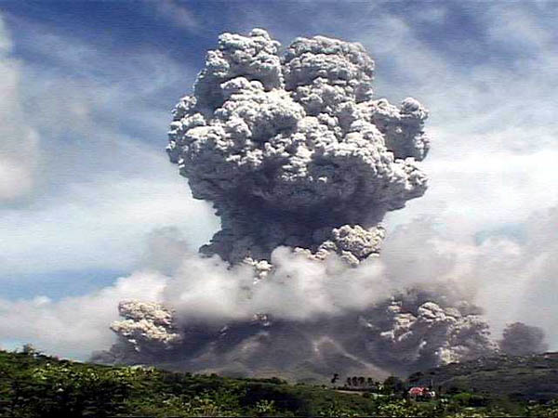
Historic Volcanic Eruptions
Notes:
Photograph taken from http://thisistheendoftheworldasweknowit.com/archives/the-earth-is-breaking-up-the-number-of-volcano-eruptions-in-2010-is-more-than-a-bit-alarming
Introduce the lesson: we can learn from studying the past, in particular from catastrophic events that are not daily experiences. Knowing about past events prepares you to deal with the next one, avoiding loss of life. It is possible to predict eruptions and in one of these examples, Nevado del Ruiz, officials were warned, but did not act on the warnings and thousands of people lost their lives. In another case, at Pinatubo, residents were evacuated and many lives were saved. All of the examples in this lesson come from convergent plate boundaries, which are the most explosive and most dangerous ones.

Slide 2
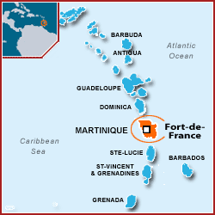
MT. PELÉE ERUPTION (1902)
Notes:
Map from Google Maps, inset map taken from http://www.easyvoyage.co.uk/martinique/pointe-du-bout-2309.
Describe the location of Martinique and Mt. Pelee.

Slide 3
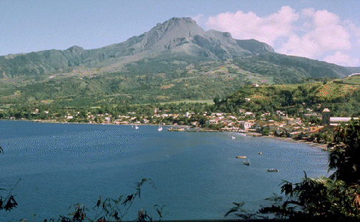
St. Pierre, Martinique
  Vibrant colonial city
  Tropical paradise renowned for its beauty
April 23rd 1902
  Minor explosions, earthquakes, sulfurous gas, ash
Notes:
Photograph taken from http://www.geology.sdsu.edu/how_volcanoes_work/Pelee.html.
We travel to the vibrant French colonial city of St. Pierre of about 28,000 residents in 1902. It is located on an island named Martinique, which is a tropical paradise renowned for its beauty. It is April 23rd and minor explosions are occurring on the volcano directly above the city. Earthquakes begin to occur and sulfurous gas and ash begin spewing from the volcano. Insects and snakes on the volcano realize the danger and begin to evacuate to the outlying villages around St. Pierre. In their fright, they bite and kill 50 humans and 200 animals.

Slide 4
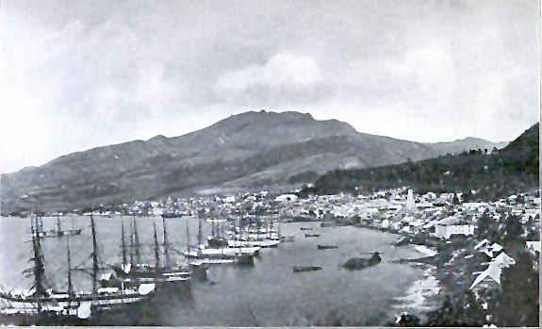
Days before the eruption…
May 5th, the crater rim gave way
  Scalding water from the crater lake mixed with pyroclastic debris, generating a lahar
The governor downplayed the danger
  The governor sent troops to patrol the roads sending back anyone who tried to leave the city
Notes:
Photograph taken from http://magnificent50.com/index.php/science/harbingers-of-human-destruction-6-apocalypse-islands/.
The image on this slide shows what the city looked like before the eruption.
It is May 5th, 12 days after the first signs of an impending eruption began. The crater rim suddenly collapses and scalding water from the crater lake mixed with ash and rock begin pouring down the mountain in a lahar. The lahar runs out to the ocean and creates a 3 m high tsunami. The residents of outlying villages run to the city for safety while others attempt to escape the entire area, but the governor says that nothing is wrong and sends troops to prevent residents from leaving.

Slide 5
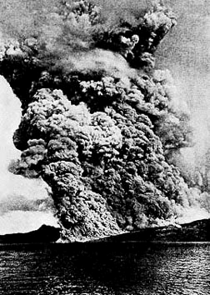
The eruption
7:50 am on May 8th, the volcano erupted with a deafening roar
  Large black cloud of superheated gas, ash, and rock rolled down the mountain at 100 mph
Notes:
Photograph taken from http://www.geology.sdsu.edu/how_volcanoes_work/Pelee.html.
At 7:50 am on May 8th, 15 days after the first warning signs, the eruption begins. The volcano erupts with a deafening roar, sending a large black cloud of superheated gas, ash, and rock pummeling down the mountain at 100mph. A V-shaped notch sends the cloud directly towards St. Pierre.

Slide 6
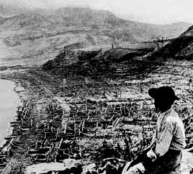
A city destroyed
The pyroclastic flow reached St. Pierre in less than a minute
The searing heat ignited huge bonfires
The cloud continued over the harbor destroying 20 ships anchored offshore
Notes:
Photograph taken from http://www.geology.sdsu.edu/how_volcanoes_work/Pelee.html
The superheated cloud, or pyroclastic flow, reaches the city in less than a minute. A three-ton statue is blown 16 meters from its base. A 1-meter thick masonry wall is blown to rubble. The searing heat of the pyroclastic flow ignites fires across the city, blowing up barrels of whiskey along the way. The pyroclastic flow continues over the harbor and destroys all ships that lay in its path.

Slide 7
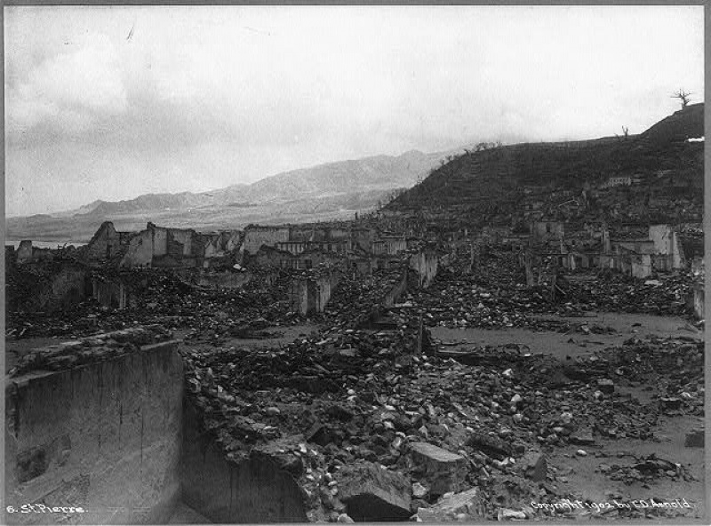
Cause of Death
Of ~28,000 people in St. Pierre, there were only 2 survivors
  Most died within a few seconds after inhaling the scorching fumes and ash of the pyroclastic flow
Notes:
Picture taken from http://popartmachine.com/item/pop_art/LOC+1089504/%5BVIEW-OF-RUINS-AFTER-THE-VOLCANIC-ERUPTION-OF-MOUNT-PELEE,-ST.... “View of ruins after the volcanic eruption of Mount Pelee, St. Pierre, Martinique”
All but 2 of the residents of St. Pierre are killed in the eruption. One survived simply by luck, the other survived because he was locked deep inside of a prison. The shear force of the explosion may have killed some, but most were killed when they inhaled the scorching ash and gas from the pyroclastic flow. The bodies that were found were badly burned and their lungs were seared.

Slide 8
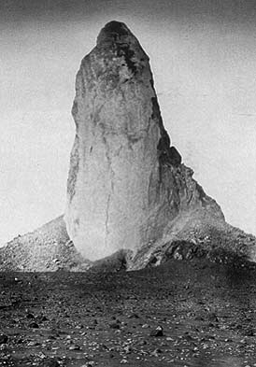
The tower of Pelee
In October, a lava dome rose out of the crater
It grew for a year
In 1903, the dome collapsed
Notes:
Photograph taken from http://www.geology.sdsu.edu/how_volcanoes_work/Pelee.html.
Five months later in October, a lava dome begins to rise out of the crater. The dome is extremely viscous and emerges from the volcano like toothpaste from a tube. For a year it continues to grow at rates up to 50 ft/day. It grew to 350-500 feet thick and 1000 feet tall before collapsing.
What lessons can we learn from this eruption?
Possible answers:
Volcanoes are incredibly dangerous and deadly; they can kill tens of thousands of people in minutes
Volcanoes give warning signs that should be taken seriously
Officials do not always make the right decisions: not only did they not evacuate the city, they prevented citizens from leaving

Slide 9
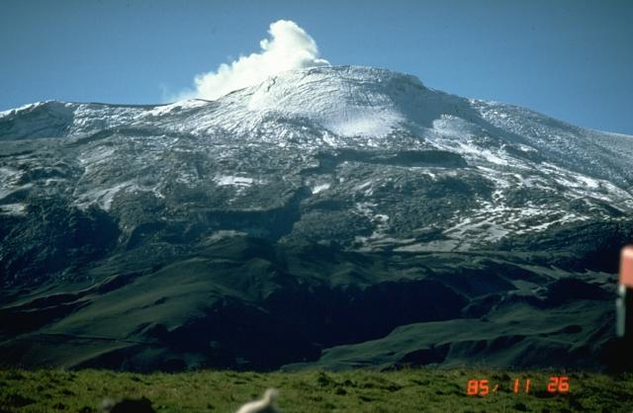
Nevado del Ruiz (1985)
Armero, Columbia
  City of 27,000 residents built on top of 1845 mudflows
Nevado del Ruiz
  Over 17,500 ft tall
  500km from equator, but covered in snow due to its elevation
Notes:
Photograph taken from http://www.volcano.si.edu/world/volcano.cfm?vnum=1501-02=&volpage=photos. “Two weeks after the November 13, 1985 eruption, steam rises from Las Arenas, the summit crater of Nevado del Ruiz. This view from the NNW shows pyroclastic-surge and pyroclastic-flow deposits mantling the summit icecap. Radial grooves descending the upper glacier surface were scoured by pyroclastic surges, which reached 5.5 km NW and NE of the summit. Melting of the summit icecap led to the formation of devastating lahars that traveled as far as 100 km from the volcano and caused 23,000 fatalities.Photo by Norm Banks, 1985 (U.S. Geological Survey).”
Now we move forward in time to 1985 in the city of Armero, Columbia. This city has been built on top of mudflows from two previous eruptions. One eruption in 1595 killed 636 people, and one in 1845 killed over 1,000 people. There are 27,000 residents that live in Armero. The nearby mountain is the volcano that produced these lahars, called Nevado del Ruiz. It reaches over 17,500 feet tall and although it is only 500 kilometers from the equator, the height allows snow to cover the mountain.

Slide 10
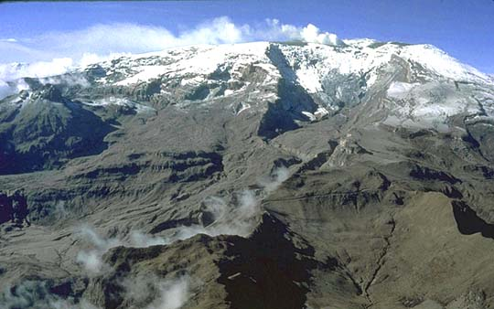
1 year of minor earthquakes preceded the eruption
Ash and pumice began raining on Armero
Red Cross orders an evacuation at 7 pm
The ash stopped falling, so the evacuation was canceled
Notes:
Photograph taken from http://volcanoes.usgs.gov/hazards/lahar/ruiz.php. Photograph by T. Pierson on November 26, 1985
Small earthquakes have been occurring for a year before the eruption that began at 3 pm. Two hours later, ash and pumice begin raining on Armero. The mayor and a local priest calm the residents over the radio and tell them that there is nothing to worry about. Four hours after the eruption began, the Red Cross orders an evacuation. Shortly the ash and pumice that was falling on the city stops. Thinking that the eruption has stopped, the evacuation is called off.

Slide 11
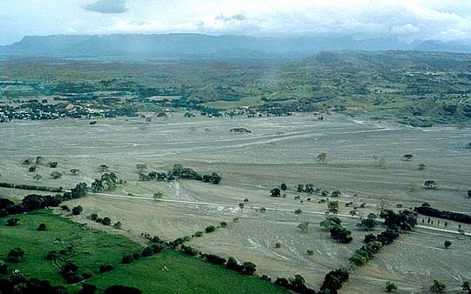
9 pm molten rock erupts from the summit and pyroclastic flows melt the snow
A lahar broke through a dam and reached Armero 2 hours later
The town was swept away or buried in only a few minutes
Notes:
Photograph taken from http://volcanoes.usgs.gov/hazards/lahar/ruiz.php. Photograph by J. Marso in late November 1985
At 9 pm, 6 hours after the eruption began, molten rock erupts from the summit, melting the snow. Residents might have been concerned if they saw it, but a storm was blocking the view of the volcano. The pyroclastic flow mixes with the melted snow and rushes first to the village of Chinchina, killing 1,927 people. Another lahar in a different location breaks through a dam and rushes towards Armero. It crushes a dam along the way and reaches Armero 2 hours later. The town is swept away or buried in minutes.

Slide 12
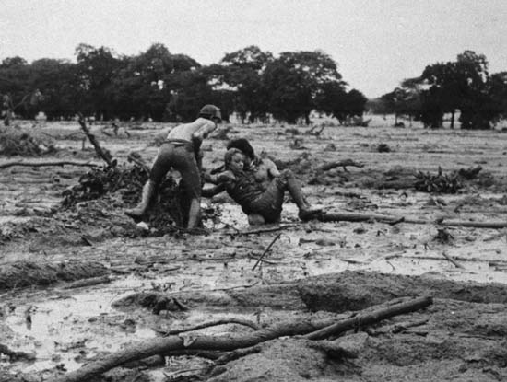
Rescuers arrived in the morning to find a tangled mass of trees, cars, and mutilated bodies
23,000 people and 15,000 animals killed
Notes:
Photograph taken from http://www.bilinguallibrarian.com/2007/11/14/its-been-22-years-since-the-tragedy-of-el-nevado-del-ruiz/
Rescuers reach the city in the morning and find a tangled mass of trees, cars, and mutilated bodies floating in gray mud. The lahar had killed 23,000 people and 15,000 animals, injured 4,500 people, and left 8,000 people homeless.

Slide 13
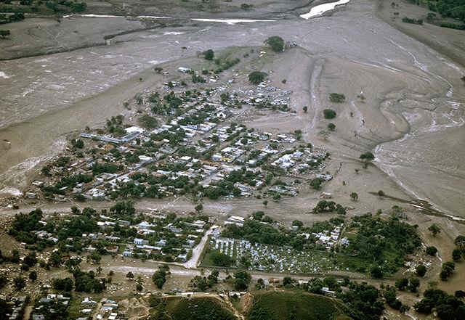
Notes:
Photograph taken from http://scienceblogs.com/eruptions/2008/11/23rd-anniversary-of-the-ruiz-disaster.php
Photograph of the river of gray mud that ran through Armero

Slide 14
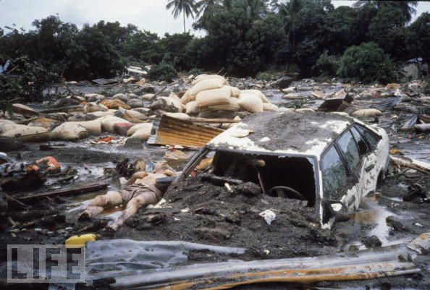
Notes:
Photograph taken from http://geoclass.info/?p=5
Photographs of cars and bodies covered in mud.

Slide 15
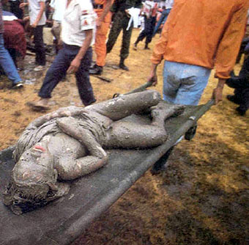
Notes:
Photograph taken from http://w3.ualg.pt/~jdias/GEOLAMB/GAn_Casos/NevadodelRuiz/.
Photograph of a person rescued from the mud

Slide 16
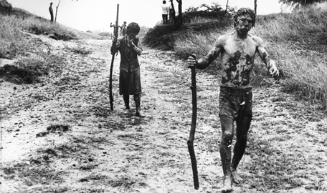
Notes:
Photograph taken from http://www.findingdulcinea.com/news/on-this-day/November/On-this-Day--Mudslide-in-Colombia-Kills-23-000.html. “Two muddy survivors of the eruption of the volcano Nevado del Ruiz carry sticks as they walkdown a dirt road, Nov. 15, 1985, near Armero, Colombia.”
Survivors of the lahar

Slide 17
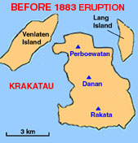
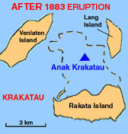
Krakatau, Indonesia (1883)
Notes:
Map taken from Google Maps. Inset images taken from http://www.geology.sdsu.edu/how_volcanoes_work/index.html.
Explain the location of Krakatau. The two maps below show the extent of the island before and after the eruption.

Slide 18
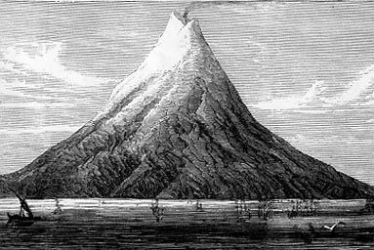
May 20, eruptions began on the uninhabited island of Krakatau
For two months, small eruptions occurred with explosive noises and churning clouds of black to incandescent ash and pumice
Notes:
Picture taken from http://encyclopedia.tfd.com/Krakatoa. “An early 19th-century illustration of Krakatoa”
Now we travel back in time, before the eruption of Mt. Pelee. It is the year 1883. An island in the Pacific begins erupting on May 20th, but no one lives on the island so no one is in immediate danger. Eruptions continue for 2 months sending out churning clouds of black to incandescent (red) ash and pumice accompanied by explosive noises. Although no one lived on the island, two nearby islands called Java and Sumatra were highly populated. Residents looked at these explosions in awe and happily celebrated the fireworks show.

Slide 19
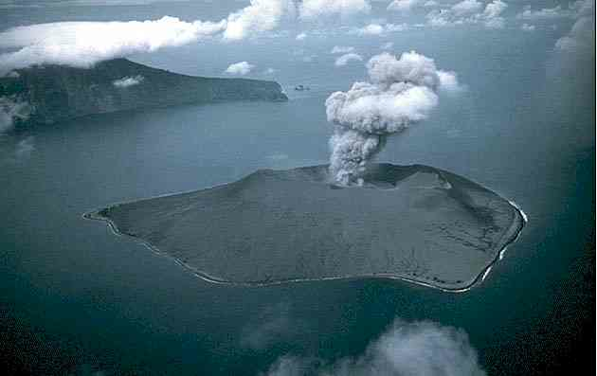
5:30 am August 27th a series of at least 4 eruptions culminated in a blast that blew Krakatau apart
  The noise was heard across the Indian ocean from Sri Lanka to Australia
Notes:
Picture taken from http://withfriendship.com/user/neeha/1883-eruption-of-krakatoa.php.
On August 26th, the big eruption begins at 12:53 pm. A churning black cloud of volcanic debris rises 36 km in the air. The eruption continued throughout the day, constantly intensifying. At 5:30 am the next morning, a series of at least 4 eruptions culminated in the eruption that blew the island apart. The noise was heard all across the Indian Ocean from Sri Lanka to Australia.

Slide 20
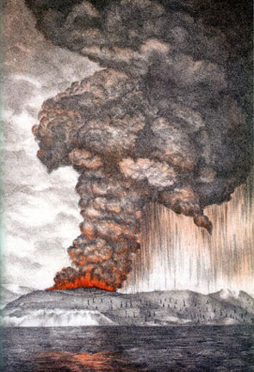
Blasts of debris generated tsunamis up to 40 m tall
On Sebesi Island, the tsunami washed ~3000 people out to sea, and destroyed all signs of human occupation
Notes:
Photograph taken from http://www.geology.sdsu.edu/how_volcanoes_work/index.html.
Blasts of debris from the explosion created a 40-meter tall tsunami that completely submerged several nearby islands. On Sebesi Island, an island only 8 miles from Krakatau, the tsunami stripped away all vegetation, washed approximately 3000 people out to sea, and destroyed all signs of human occupation. The Thousand Islands were covered by 2 meters of seawater and the only residents to survive escaped the tsunami by climbing trees.

Slide 21
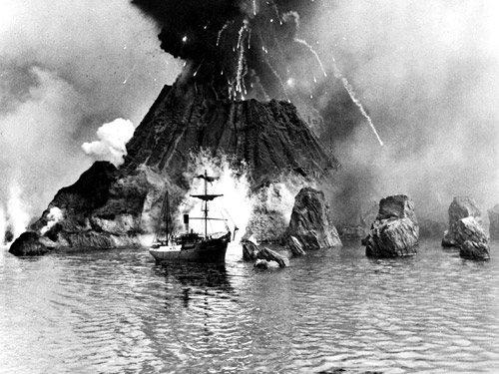
36,417 died, 90% of which were killed by the tsunamis
After travelling 40 km over the Sunda Straits, pyroclastic flows struck southern Sumatra, remaining hot enough to incinerate entire villages and burn all vegetation
Notes:
Picture taken from http://www.newscientist.com/gallery/biggest-bangs/3. (Image: Everett Collection / Rex Features)
A total of 36,417 people died in locations around the Indian Ocean, 90% of who were killed by the tsunami. Most of the others were killed by a pyroclastic flow that skimmed 40 km over the ocean to Southern Sumatra, incinerating entire villages and burning all vegetation. For months afterwards, the Sundra Straits surrounding Krakatau were filled with rafts of floating black pumice carrying corpses.

Slide 22
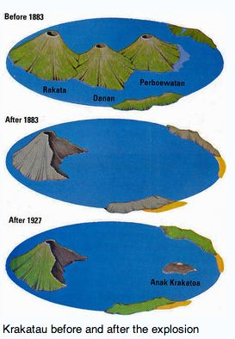
The resulting veil of areosols caused global temperatures to drop by several degrees
Anak Krakatau awoke in 1927 and has erupted most years since
Notes:
Image taken from http://awesomeappenings.blogspot.com/2011/03/anuk-krakatoa.html
For several years after the eruption, global temperatures fell by several degrees due to the enormous amount of ash released by Krakatau. The eruption blasted apart an entire island, but less than fifty years later a new volcano arose from the ocean, named Anuk Krakatau, and has erupted almost every year since.

Slide 23
Tambora, Indonesia (1815)
Notes:
Map taken from Google Maps
This map shows the location of the volcano.

Slide 24
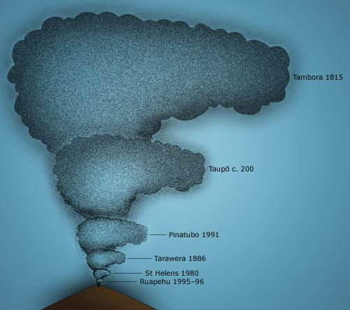
Largest observed eruption in recorded history
Four times larger than the eruption of Krakatau
On 5 April 1815, a moderate-sized eruption occurred
Notes:
Image taken from http://www.teara.govt.nz/en/historic-volcanic-activity/1/2/2
We travel even further back in time to the largest eruption in recorded history. As shown in the diagram, this eruption was four times larger than the eruption of Krakatau, and makes the eruption at Mt. St. Helens look insignificant. Tambora, a volcano in Indonesia, became highly active in 1812. On the 5th of April 1815, a moderate eruption occurred followed by thunderous detonation sounds.

Slide 25
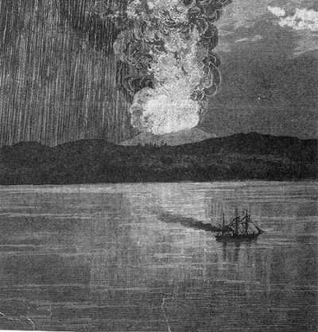
Hot pyroclastic flows cascaded down the mountain, wiping out the village of Tambora
Notes:
Picture taken from http://hotnichenews.blogspot.com/2010/05/top-10-most-terrifying-natural.html
The next day, on the 6th, volcanic ash began to fall on the island of Java. Four days later, at 7 pm on April 10th, the eruptions intensified. The entire mountain burst into flames and turned into a flowing mass of liquid fire. Pyroclastic flows cascaded down every side of the mountain and destroyed the village of Tambora.

Slide 26
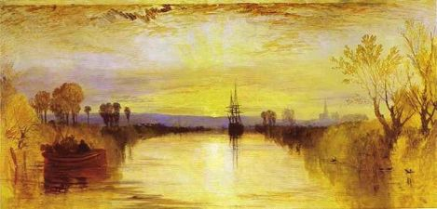
The death toll was at least 71,000 people
Most deaths from the eruption were from starvation and disease
The eruption created global the “Year without a summer”
Notes:
Image taken from http://184.106.231.42/ideas/23389. J.M.W. Turner painting of Chichester Canal in 1816
At least 71,000 people were killed as a result of the eruption, but only about 12,000 were directly killed by the eruption itself. The rest died from starvation as a result of crops failing because of the eruption. The eruption also caused a global “year without a summer” because of all of the ash that was emitted from Tambora. Distant locations were affected as well because of the climate disruption. Crops failed and livestock died over much of the Northern Hemisphere.
Note that the bright and colorful sunsets caused by Tambora and in particular Krakatau were famously depicted by painters in Europe and in the US. The painting on this slide is one of these and was painted by J.M.W. Turner.

Slide 27
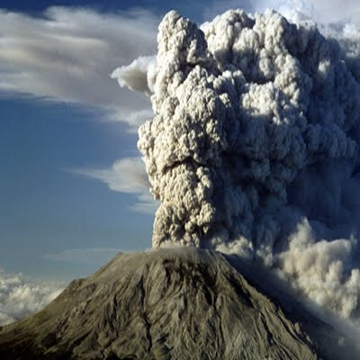
Pitch darkness was observed as far away as 370 mi from the summit for up to two days
Before the eruption, Mount Tambora was one of the tallest mountains in Indonesia at 14,100 ft high
It is now only 9,354 ft tall
Notes:
Photograph taken fromhttp://www.javabackpacker.blogspot.com/2010/07/top-10-deadly-volcanoes-eruption-in.html
People living 370 miles from the volcano were cast in pitch darkness for two days following the eruption. Tambora, which was one of the tallest mountains in Indonesia, lost almost 5,000 feet of elevation.

Slide 28
Pinatubo, Philippines (1991)
Notes:
Map from Google Maps
This map shows the location of Pinatubo.

Slide 29
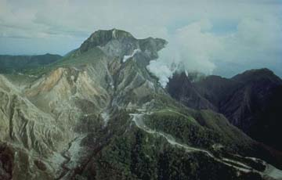
Covered in a dense forest which supported a population of several thousand
Successful predictions led to the evacuation of tens of thousands of people from the surrounding areas
Notes:
Photograph taken from http://volcano.oregonstate.edu/vwdocs/volc_images/southeast_asia/philippines/pinatubo_prior.html. “Mt. Pinatubo prior to the 1991 eruption. Photograph courtesy of the U.S. Geological Survey.”
We now move forward in time to something much more recent. Pinatubo is a mountain in this Philippines that was quiet and inconspicuous before its eruption. It was covered in a dense forest that supported thousands of native inhabitants. Luckily, scientists were able to predict the eruption and save tens of thousands of lives.

Slide 30
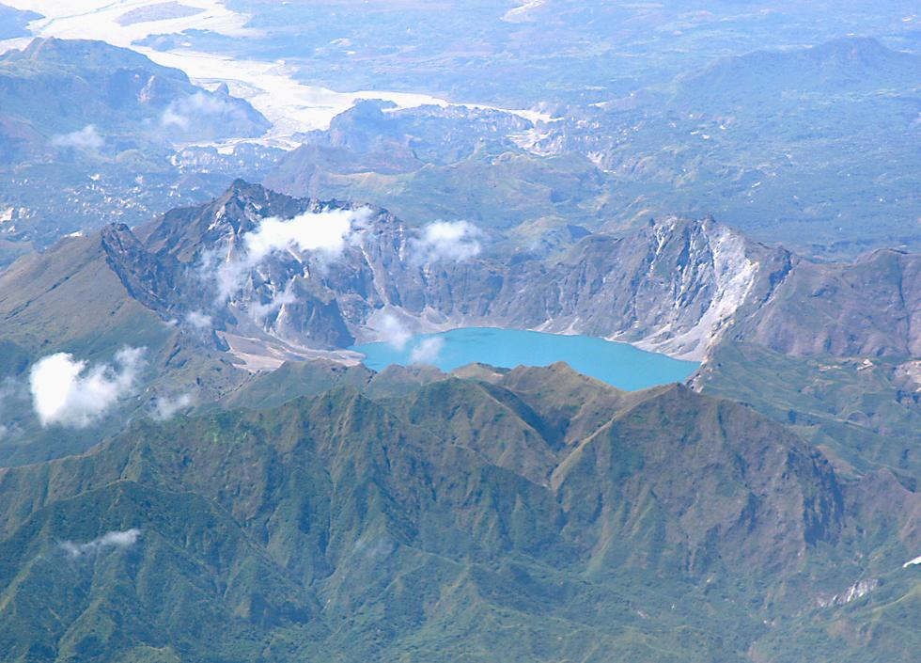
March 15, 1991, a succession of earthquakes was felt by villagers
April 2nd, eruptions began, dusting the surrounding areas with ash
Seismographs recorded hundreds of earthquakes every day
Notes:
Photograph taken from https://thelavazone.wikispaces.com/Mt.+Pinatubo
On March 15th 1991, earthquakes began that increased in intensity over the next two weeks. Eruptions began on April 2nd, dusting the surrounding areas with ash. Hundreds of earthquakes occurred every day and the volcano continued to erupt more violently every day throughout May. Evacuations were ordered for everyone living within 10 km of the volcano.

Slide 31
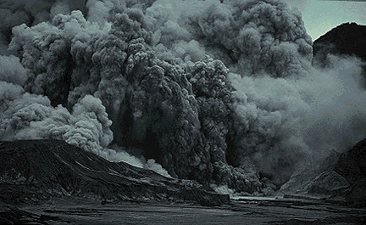
Measurements of sulfur dioxide emissions showed a rapid increase from 500 to 5,000 tons/day
June 7th: first large explosion generated an ash column 7 km high
Notes:
Photograph taken from http://volcano.oregonstate.edu/vwdocs/volc_images/southeast_asia/philippines/pinatubo.html. “This photo depicts a secondary eruption on Mt. Pinatubo in May 1994. This eruption lasted about four hours. Copyrighted photo by Marko Riikonen.”
Scientists recorded a ten-fold increase in sulfur dioxide emissions in the span of two weeks. Suddenly, on May 28th, the emissions made a rapid decline. Something terrible must be on the horizon if the gas is blocked from escape. On June 3rd, magma begins shooting out of the volcano. The first large explosion happened four days later and generated a column of ash that reached 7 km in the sky. The Philippine Institute of Volcanology and Seismology was keeping track and issued a warning that a major eruption could occur within the next 2 weeks.

Slide 32
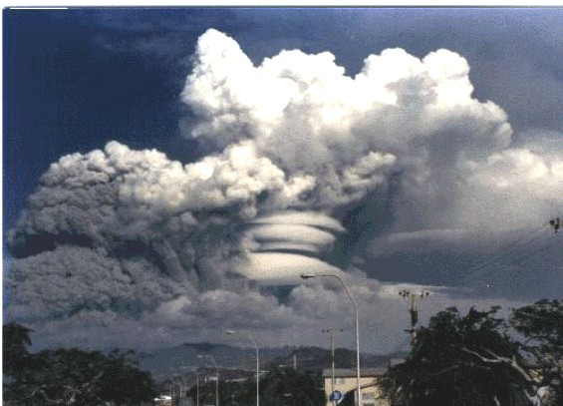
Magmatic eruptions create a lava dome
60,000 people had left the area within 30 km of the volcano before June 15th
Notes:
Picture taken from http://cuscoperuexperience.com/en/admin/pinatubo-volcano-eruption-1991&page=5
Scientists recorded tilt changes indicating that the volcano was inflating. In addition, earthquakes that had been occurring deep beneath the volcano had shifted to shallow depths within the volcano. Now, everyone living within 20 km of the volcano was ordered to evacuate. A lava dome began rising out of Pinatubo and on June 13th, the evacuation radius was expanded to 40 km around the volcano. By June 15th, 60,000 people living within 30 km of the volcano had evacuated.

Slide 33
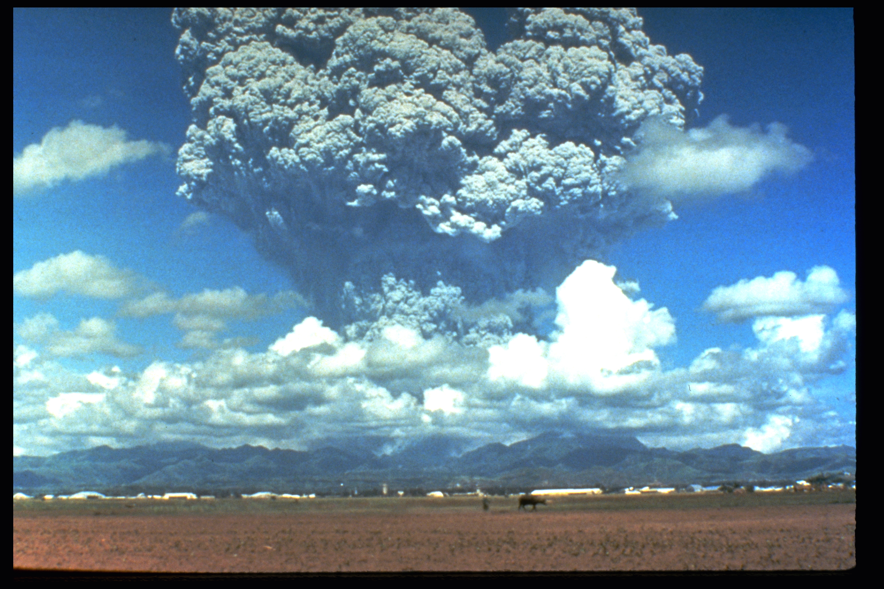
June 15th the main eruption occurred
Pyroclastic flows poured from the summit
Typhoon rains mixed with ash deposits causing massive lahars
The ash cloud brought total darkness to much of central Luzon
Notes:
Image taken from http://vulcan.wr.usgs.gov/Volcanoes/Philippines/Pinatubo/description_pinatubo.html. “The June 12, 1991 eruption column from Mount Pinatubo taken from the east side of Clark Air Base. U.S. Geological Survey Photograph taken on June 12, 1991, by Dave Harlow “
A series of small eruptions causing pyroclastic flows occurred between June 12th and 15th. Finally, on June 15th, the major eruption everyone had prepared for, occurred. The view of the eruption was blocked by the arrival of a typhoon. The eruption sent ash 34 km into the sky and pyroclastic flows rushing down the mountain out to 16 km from the summit. Rain from the typhoon mixed with the ash from the eruption causing lahars. The city of Luzon was cast into total darkness.

Slide 34
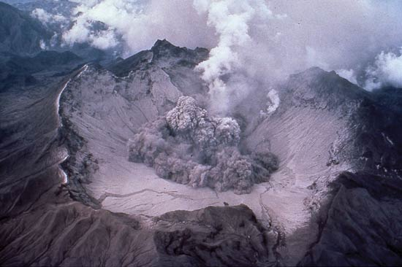
Over 800 people were killed by the eruption
The evacuation saved tens of thousands of lives, and has been hailed as a great success for volcanology and eruption prediction
Notes:
Photograph taken from http://www.volcano.si.edu/world/volcano.cfm?vnum=0703-083&volpage=photos. “The beginning of a small explosion within the new summit caldera of Pinatubo volcano is seen from the NE on August 1, 1991. After the 2.5-km-wide caldera formed during the June 15 climactic eruption, continuous ash emission lasted through much of July. The caldera floor became visible for the first time when activity changed to intermittent explosions. By September 1991, a caldera lake began to form from the accumulation of rainwater and groundwater from within the volcano. The lake eventually expanded to cover the caldera floor. Photo by Tom Casadevall, 1991 (U.S. Geological Survey).”
Only around 800 residents were killed out of the potential tens of thousands that could have been killed. Most were killed by roofs that collapsed under the weight of the ash mixed with rainwater. The successful prediction and evacuation has been hailed as a major achievement in volcanology. Around 500,000 people still live within 40 km of Pinatubo.

Slide 35
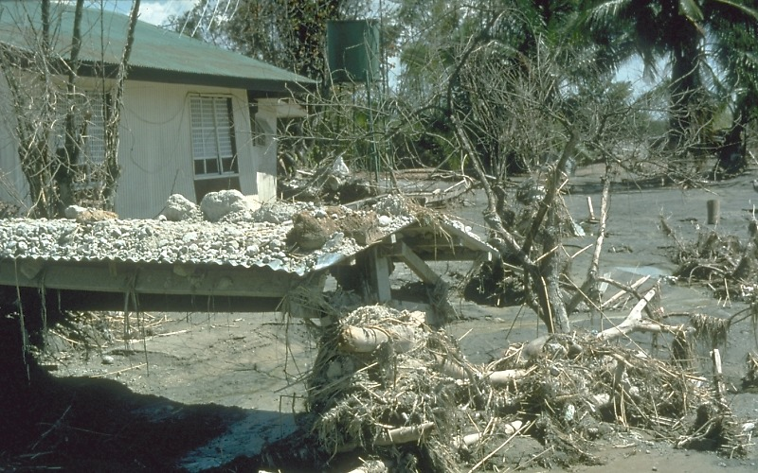
Notes:
Photograph taken from http://volcanoes.usgs.gov/hazards/lahar/rain.php. “Destroyed home. The human consequences of these post-eruption lahars at Mount Pinatubo have been enormous. In the first five years following the eruption, lahars destroyed the homes of more than 100,000 people; each year during the rainy seasons, the threat of lahars forced another 100,000 people to evacuate their homes and farmland. Lahars also covered about 120,000 hectacres (roughly 300,000 acres) with sediment to an average depth of about one meter, and floods spread rock debris over an area at least several times larger.”
A roof covered in ash and tephra as well as damage created by a lahar.

Slide 36
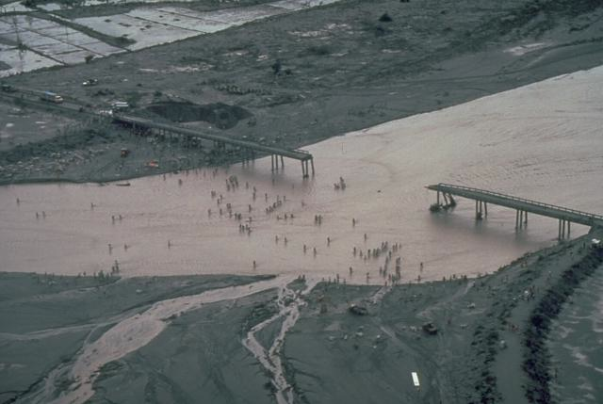
Notes:
Photograph taken from http://www.volcano.si.edu/world/volcano.cfm?vnum=0703-083&volpage=photos. “Residents in this July 1991 photo are forced to wade across the shallow Santo Tomás River, SW of Pinatubo, when lahars destroyed the bridge between the villages of San Rafael and Santa Fe. Devastating lahars (volcanic mudflows) affected broad lowland areas on all sides of Pinatubo in the years following the 1991 eruption.Photo by Chris Newhall, 1991 (U.S. Geological Survey).”
Photograph of a bridge that was destroyed, forcing residents to ford a river of mud.

Slide 37
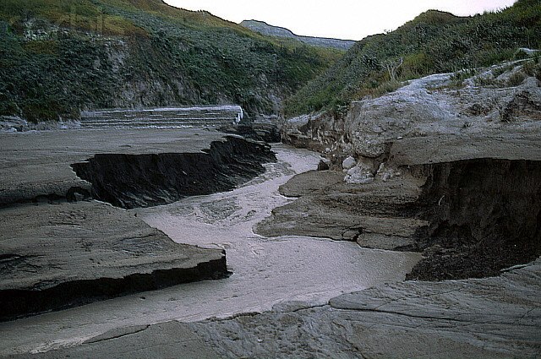
Notes:
Image taken from http://www.corbis.co.in/searchresults.php?s=Volcanic+ash&rm=&rf=&mr=&loc=&col=&listRF=&orient=&view=&people=&pht=&max=&p=1. Volcanic ash from Pinatubo
In this photograph, a small creek has cut a new creek bed into deposits from the lahar, giving an idea of how thick the deposits were.

Slide 38
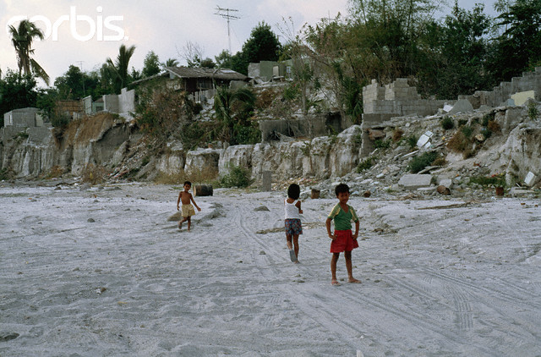
Notes:
Photograph taken from http://www.corbisimages.com/stock-photo/rights-managed/RR012955/damage-done-by-mount-pinatubo-eruption/?ext=1. DATE PHOTOGRAPHED: February 20, 1992. PHOTOGRAPHER: Roger Ressmeyer. “Damage Done by Mount Pinatubo Eruption. Just outside Clark Air Base in the Philippines, mudflows caused by the eruption of Mount Pinatubo destroyed houses and ruined the economy.”
Photograph of a mudflow from the eruption that undercut riverbanks.

Slide 39
Key Points
Pelee 1902
  Devastating pyroclastic flows
  Volcanoes give warning signs and they should be taken seriously
Nevado del Ruiz 1985
  Thousands of lives could have been saved if officials had heeded scientists’ warnings
  Deadly lahars
Krakatau 1883
  Catastrophic tsunamis
Tambora 1815
  Largest eruption in recorded history
  Caused the “year without a summer”
Pinatubo 1991
  Successful prediction and evacuation saved tens of thousands of lives
Notes:
This slide emphasizes the important concepts in this lesson.

