Slide 1
Volcanoes Introduction and Review
Notes:
Photograph taken from http://www.edupics.com/photo-vulcano-volcanic-eruption-i7673.html. “This image is a work of a United States Geological Survey employee. Pu'u 'O'o, a Volcanic cone on Kilauea, Hawaii.”
Video clips of eruptions:
http://www.youtube.com/watch?v=cPih-0Fx0vc
http://www.youtube.com/watch?v=bgRnVhbfIKQ
http://www.youtube.com/watch?v=fRU22t1BhNY&feature=channel
http://www.youtube.com/watch?v=488BkTUsMa4&NR=1&feature=fvwp
http://www.youtube.com/watch?v=CgpNqrR318U&feature=channel
http://www.youtube.com/watch?v=2PRkSFkxgmw&feature=channel
http://www.youtube.com/watch?v=-LHwI62uJfk
http://www.youtube.com/watch?v=y3aqFCT87_E
http://www.youtube.com/watch?v=RgoNJ0CfdSQ&feature=fvst
This lecture provided a review of longitude and latitude and some volcanic topics that students may already know. We assume that many students will have learned how to use maps but may have struggled with it or forgotten it. We help them review their mapping skills by mapping the locations of volcanoes as a way of introduce volcanoes and get the students thinking about what causes volcanoes. They may have already learned that earthquakes occur on plate boundaries and/or that evidence for plate tectonics includes the location of earthquakes and volcanoes along plate boundaries. Hopefully this lecture and activity will remind them of these lessons.
Introduce the topic of discussion: we will review some things the students might already know about volcanoes. We will discuss the locations of volcanoes and the types of volcanoes. The links on this slide open videos on the Internet of volcanic eruptions. These short 30 sec – 3 min videos are intended to motivate the topic and get students excited and interested in learning about what makes the volcanoes work.

Slide 2
What is latitude?
Longitude?
Notes:
Elicit explanations of latitude and longitude from the students.

Slide 3
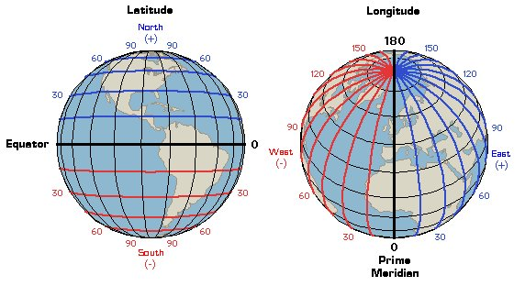
Notes:
Diagram taken from http://www.learner.org/jnorth/tm/LongitudeIntro.html.
Explain that lines of latitude cut the Earth like someone would cut an onion into onion rings, and that they give the position north or south of the equator. The equator is the widest part of the earth. It separates the Northern hemisphere from the Southern hemisphere. Positions north of the equator are positive and positions south of the equator are negative.
Lines of longitude cut the Earth like slices of an orange. They give the position on earth east or west of the prime meridian. The prime meridian runs approximately through London. It serves simply as a reference point. Anything east of the prime meridian is positive and west of the prime meridian is negative.
Latitude and longitude are imaginary lines that humans have made to help locate a position on Earth. Ask the students approximately what latitude and longitude we are located in.

Slide 4
Latitude
Latitude gives the position on Earth north or south of the equator
  Positive north of the equator, negative south of the equator
Notes:
This slide restates the definition of latitude so that the students can write it in their notes.

Slide 5
Longitude
Longitude gives the position on Earth east or west of the Prime Meridian
  Positive east of the Prime Meridian, negative west of the Prime Meridian
Notes:
This slide restates the definition of longitude so that the students can write it in their notes.

Slide 6
Where on Earth are volcanoes located?
Notes:
Photograph taken from http://www.edupics.com/photo-vulcano-volcanic-eruption-i7673.html. “This image is a work of a United States Geological Survey employee. Pu'u 'O'o, a Volcanic cone on Kilauea, Hawaii.”
Take the time to allow the students to think about it a little and make guesses. If they have an idea of what creates volcanoes that can help them figure out where they might be located.

Slide 7
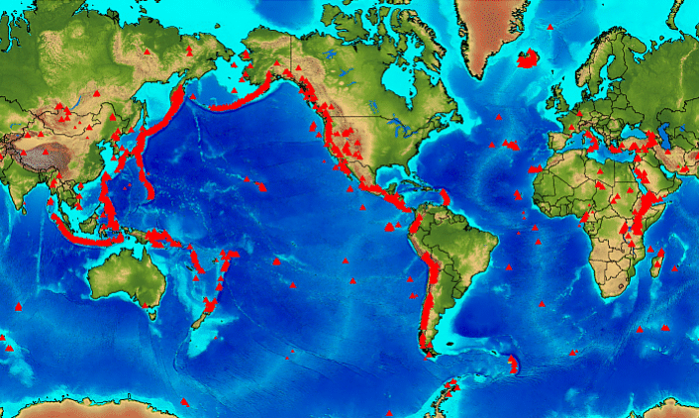
Volcanoes around the world
Notes:
Map taken from http://www.volcano.si.edu/world/find_regions.cfm.
This map shows the location of all of the known volcanoes around the world. Ask the students to make observations about patterns in the location of volcanoes. Are they randomly located or do they have some sort of order?

Slide 8
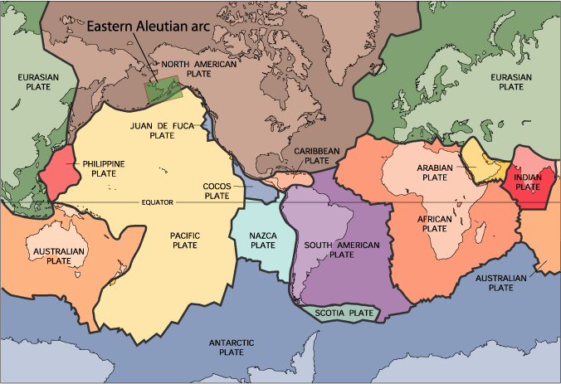
Plate boundaries
Notes:
Map taken from http://geology.com/plate-tectonics.shtml.
This map shows the boundaries of the tectonic plates on Earth. Is there any correlation between the boundaries of the plates and the location of volcanoes?

Slide 9
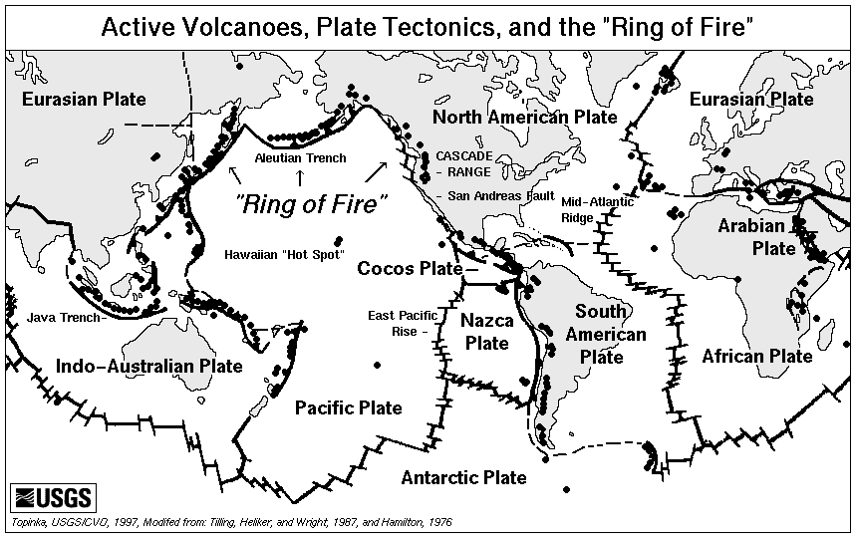
Notes:
Map taken from http://vulcan.wr.usgs.gov/Glossary/PlateTectonics/Maps/map_plate_tectonics_world.html.
This map plots both the location of volcanoes around the world as well as the boundaries of the plates. The volcanoes fall neatly along the plate boundaries, with the exception of a few. What might be causing those exceptions?

Slide 10
Most (but not all) volcanoes are located on plate boundaries.
Notes:
This slide is intended for the students to copy into their notes.

Slide 11
What earth processes can create volcanoes?
Animations
Notes:
Animations can be found on http://esminfo.prenhall.com/science/geoanimations/animations/ in the link labeled “35_VolcanicAct.html”
This slide asks students to make inferences about what causes volcanoes based on the knowledge that volcanoes are located along plate boundaries. The link on this page takes you to a website with animations of the different causes of volcanoes.

Slide 12
1. Subduction zones
2. Spreading centers
3. Hotspots
Locations of Volcanoes
Notes:
There are three types of locations where volcanoes can be found: subduction zones, spreading centers, and hotspots. The students should record this list in their notes. Subduction happens when one tectonic plate dives beneath another. The plate drags water-rich sediments and oceanic crust down that release their water upon heating causing the overlying mantle rock to melt. These melts rise to the surface, and erupt to create volcanoes. Most volcanic activity on earth occurs at spreading centers. This is the location where new crust is made. As the plates spread apart from one another, pressure is released on the mantle rock below, which makes it rise and then melt. Hotspots can occur in the middle of plate boundaries. A column of hot, buoyant mantle material rising and breaking through the crust to form a volcano forms the hotspots. As the plate moves, the column of mantle material stays in one place and the magma from the mantle must break through in another place in the crust. As the plate continues to move, a chain of volcanoes is formed.

Slide 13
What are the three types of volcanoes?
Notes:
Now that we know what causes volcanoes to form, how does the cause determine what shape the volcano will be?

Slide 14
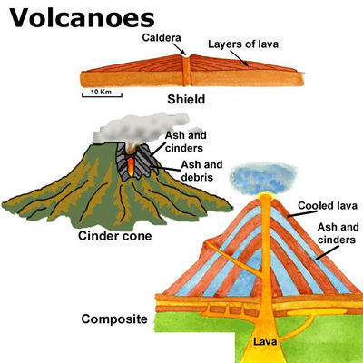
Notes:
Diagram taken from http://www.climatechangematters.net.au/LOTS/Earth/sub/volcanoes/volcanoes.htm
This picture shows the three different types of volcanoes. Keep in mind the figure is not to scale. The shield volcano is the largest of the three and is made of very fluid lava that flows quickly. Layers of lava build up over time. It is very wide, but not nearly as tall as it is wide. It has very gently sloped sides.
Cinder cones are the most common type of volcanoes on earth. They explode once or perhaps a few times and then never erupt again. Because they erupt for a brief period of time, they are the smallest type of volcano. They are made up of mostly ash and cinders (hot rocks). They have a broad, flat top.
Composite volcanoes, or stratovolcanoes, can erupt with lava at times and with ash and cinders at others. Its slopes are quite steep and it has a sharp peak since it alternates between lava and ash and cinders. Stratovolcanoes can be fairly large, but not nearly as large as some shield volcanoes.

Slide 15
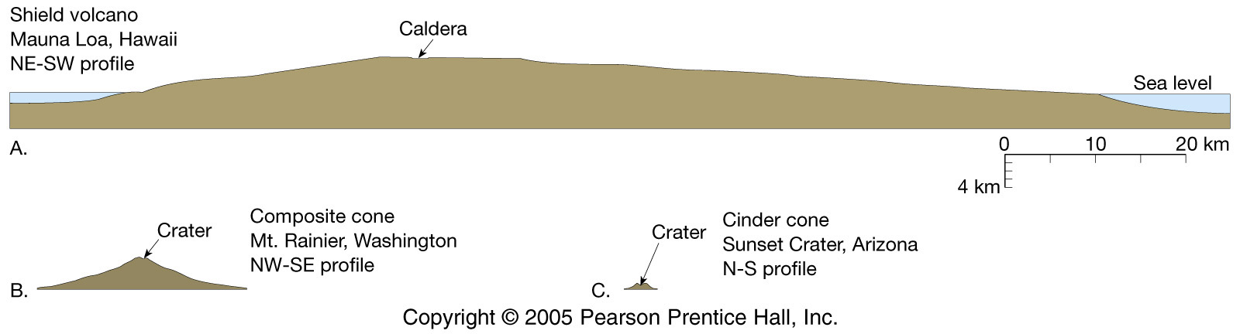
Relative sizes of volcanoes
Notes:
Diagram taken from http://geophysics.ou.edu/geol1114/notes/volcanoes/volcanic.html
This slide puts the relative size of volcanoes into prospective. The shield volcano is enormous compared with the composite volcano and cinder cone.

Slide 16
Types of volcanoes
1. Shield volcanoes
- Largest
- Usually formed at hotspots
2. Stratovolcanoes
- Most explosive
- Usually formed at subduction zones
3. Cinder cones
- Most common
- Smallest
- Usually formed at subduction zones
- Short lived
Notes:
This slide summarizes the information from the previous two slides. Shield volcanoes are the largest and are formed at hot spots; stratovolcanoes are the most explosive and are usually formed at subduction zones; and cinder cones are the most common, the smallest, they are short-lived, and they also form at subduction zones. Cinder cones can be found at shield volcanoes as well as stratovolcanoes. They are more common on the latter but can also be found on the former.

Slide 17
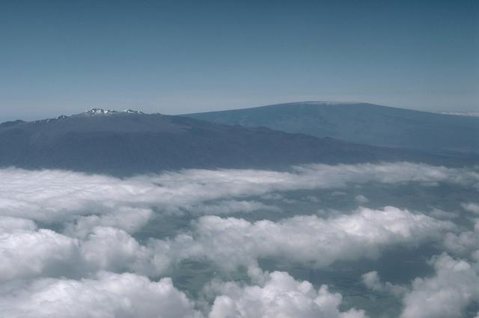
Shield volcanoes: Mauna Loa and Mauna Kea
Notes:
Picture taken from http://www.volcano.si.edu/world/volcano.cfm?vnum=1302-03-&volpage=photos. “Mauna Kea (left) and Mauna Loa (right), both over 4000 m above sea level, are the world's largest active volcanoes, rising nearly 9 km above the sea floor around the island of Hawaii. This aerial view from the NW shows the contrasting morphologies of these two shield volcanoes. In contrast to the smooth profile of Mauna Loa, Mauna Kea's early shield volcano morphology is modified by the late-stage products of explosive eruptions. Photo by Lee Siebert, 1987 (Smithsonian Institution).”
This slide shows the shield volcanoes Mauna Loa and Mauna Kea in Hawaii.

Slide 18
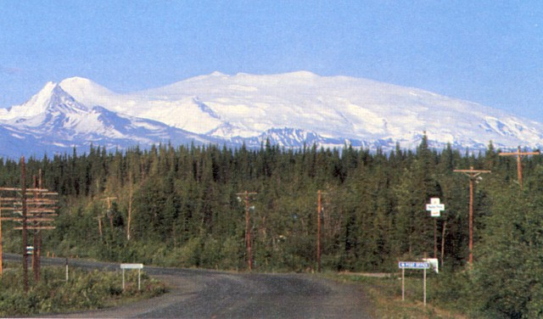
Shield volcano: Mt. Wrangell, Alaska
Notes:
Photograph taken from http://www.volcano.si.edu/world/volcano.cfm?vnum=1105-02-&volpage=photos. “Alaska's Mount Wrangell is one of the most voluminous andesitic shield volcanoes in the world and is more than three times the volume of Mount Rainier. The massive volcano has a diameter of 30 km at 2000 m elevation and a volume of about 900 cu km. Eruption of unusually fluid andesitic lavas at high eruption rates produced long lava flows that contributed to its low-angle shield morphology. The small snow-covered peak on the left is Mount Zanetti, a flank vent about the same volume as St. Helens. Wrangell is seen here from Glenallen, 80 km to the west.Photo by Chris Nye (Alaska Division of Geological and Geophysical Surveys).”
This slide shows the shield volcano Mt. Wrangell in Alaska.

Slide 19
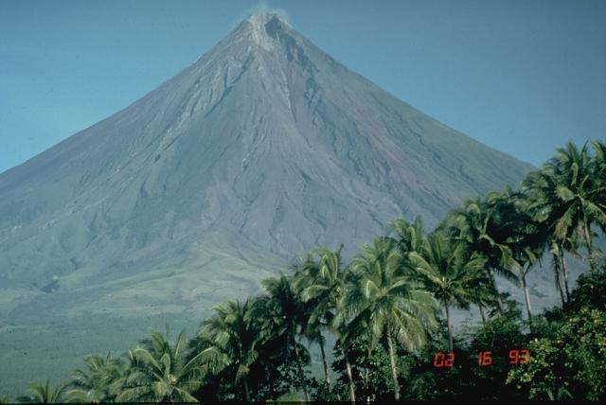
Stratovolcano: Mayon, Philippines
Notes:
Photograph taken from http://www.volcano.si.edu/world/volcano.cfm?vnum=0703-03=&volpage=photos. “Mayon volcano in the Philippines is one of Earth's best examples of a classic, conical stratovolcano. Its symmetrical morphology is the exception rather than the rule, and is the result of eruptions that are restricted to a single central conduit at the summit of the volcano. Eruptions are frequent enough at Mayon, the most active volcano in the Philippines, to overcome erosive forces that quickly modify the slopes of most volcanoes.Photo by Chris Newhall, 1993 (U.S. Geological Survey).”
This slide shows the stratovolcano Mayon in the Philippines.

Slide 20
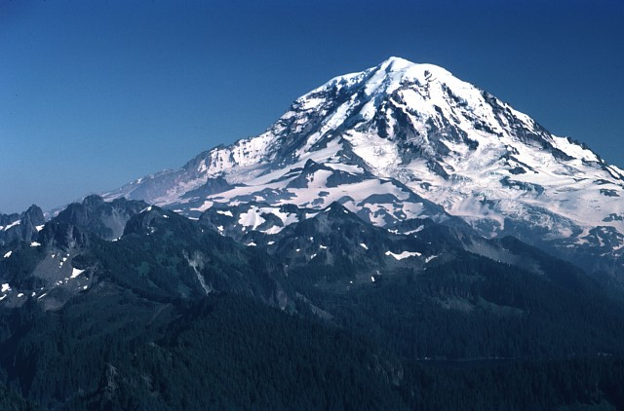
Stratovolcano: Mt. Rainier, Washington
Notes:
Picture taken from http://www.volcano.si.edu/world/volcano.cfm?vnum=1201-03-&volpage=photos. “Stratovolcanoes, also known as composite volcanoes, are built up by accumulated layers of lava flows and fragmental material from explosive eruptions. Glacier-clad Mount Rainier, seen here from the NW, is the most prominent stratovolcano in the Cascade Range. Most eruptions originate from a central conduit, which produces the common conical profile of stratovolcanoes, but flank eruptions also occur. Both isolated stratovolcanoes like Mount Rainier and compound volcanoes formed by overlapping cones are common.Photo by Lee Siebert, 1983 (Smithsonian Institution).”
This slide shows the stratovolcano Mt. Rainier in Washington.

Slide 21
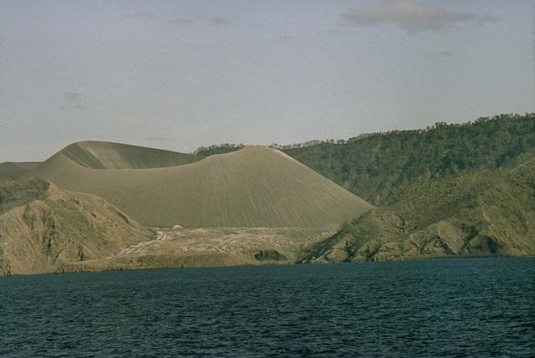
Cinder cone: Barren Island, Andaman Islands
Notes:
Picture taken from http://www.volcano.si.edu/world/volcano.cfm?vnum=0600-01=&volpage=photos. “The 1991 eruption dramatically modified the morphology of the central cinder cone on the small Barren Island, one of the Andaman Islands, north of Sumatra. During the eruption the height of the cinder cone was lowered from 305 m to 225 m, and the diameter of its crater increased from 60 m to about 200 m. Two small cinder cones also formed in the lava field west of the main cone.Photo courtesy of D. Haldar, 1992 (Geological Survey of India).”
This slide shows the cinder cone Barren Island in the Andaman Islands.

Slide 22
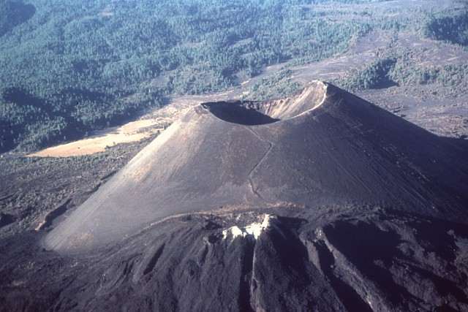
Cinder cone: Parícutin, Mexico
Notes:
Photograph taken from http://www.volcano.si.edu/world/volcano.cfm?vnum=1401-06=&volpage=photos. “At the end of the 9-year-long eruption of Parícutin, the new cinder cone rose 424 m above the surface of the original cornfield. The 900-m-wide oval-shaped cone is elongated in a NW-SE direction and is truncated by a circular, 280-m-wide crater. The western peak (right) is the highest point on the crater rim. The NE-flank peak of Nuevo Juatita in the foreground, its top covered by white fumarolic sublimate minerals, was the main source of lava flows during the last five years of the eruption.Photo by Jim Luhr, 1997 (Smithsonian Institution).”
This slide shows the cinder cone Paricutin in Mexico.

Slide 23
Key Points
Latitude vs. Longitude
Most volcanoes are located on plate boundaries
Locations of volcanoes
  Subduction zones
  Spreading centers
  Hotspots
Types of volcanoes
  Shield volcanoes
  Stratovolcanoes
  Cinder cones
Notes:
This slide gives an opportunity to review the main points of the lesson.

