Slide 1
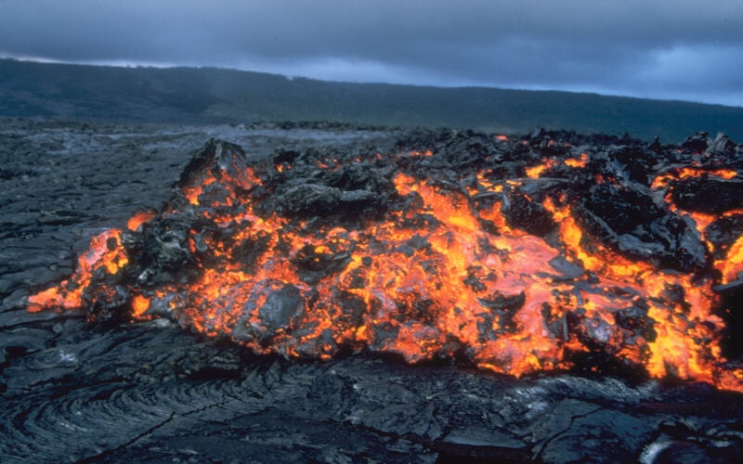
Types of lava flows
Pahoehoe: smooth
A’a: rough
Pillow lava: submarine
Notes:
Photograph taken from http://volcanoes.usgs.gov/images/pglossary/aa.php. “Glowing `a`a flow front advancing over pahoehoe on the coastal plain of Kilauea Volcano, Hawai`i. `A`a (pronounced "ah-ah") is a Hawaiian term for lava flows that have a rough rubbly surface composed of broken lava blocks called clinkers. The incredibly spiny surface of a solidified `a`a flow makes walking very difficult and slow. The clinkery surface actually covers a massive dense core, which is the most active part of the flow. As pasty lava in the core travels downslope, the clinkers are carried along at the surface. At the leading edge of an `a`a flow, however, these cooled fragments tumble down the steep front and are buried by the advancing flow. This produces a layer of lava fragments both at the bottom and top of an `a`a flow.”
This slide lists three different types of lava flows. Pahoehoe is the least viscous and has a smooth, ropy texture. A’a lava is more viscous and has a sharp, broken texture. Pillow lava flows beneath the ocean and it forms bulges of pillow shaped lava. Pahoehoe and A’a are Hawaiian words pronounced pa-hoy-hoy and ah-ah.

Slide 2
http://vimeo.com/16516332
Notes:
This is a pahoehoe lava flow. The black part is cooled magma and it forms a sort of crust that insulates the hot interior. You can see pieces of the crust breaking off and being carried by the molten lava beneath. The video is played at a faster rate halfway through to show what the lava flow looks like after some time. After about a minute, there is a scene where the interior of the lava flow has continued on leaving the crust exposed to air from below and you can see lava dripping off of the crust.
This is a short video showing a pahoehoe lava flow.

Slide 3
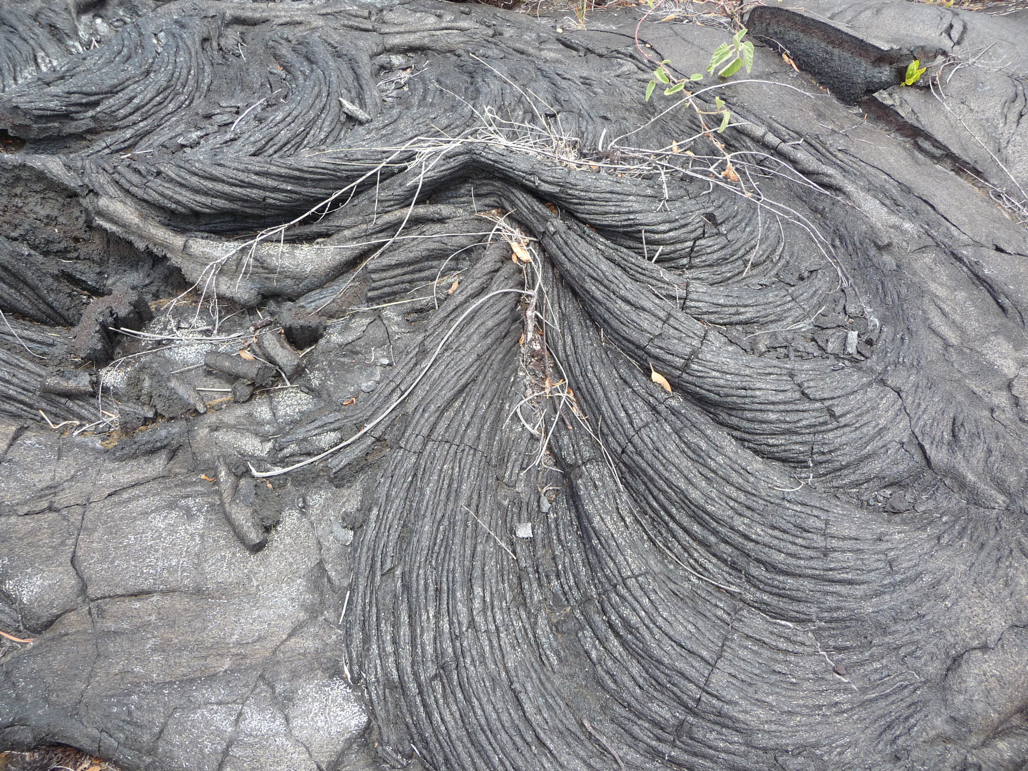
Notes:
Photograph taken by myself, Hawaii 2010.
This photograph shows the smooth, ropy texture of pahoehoe.

Slide 4
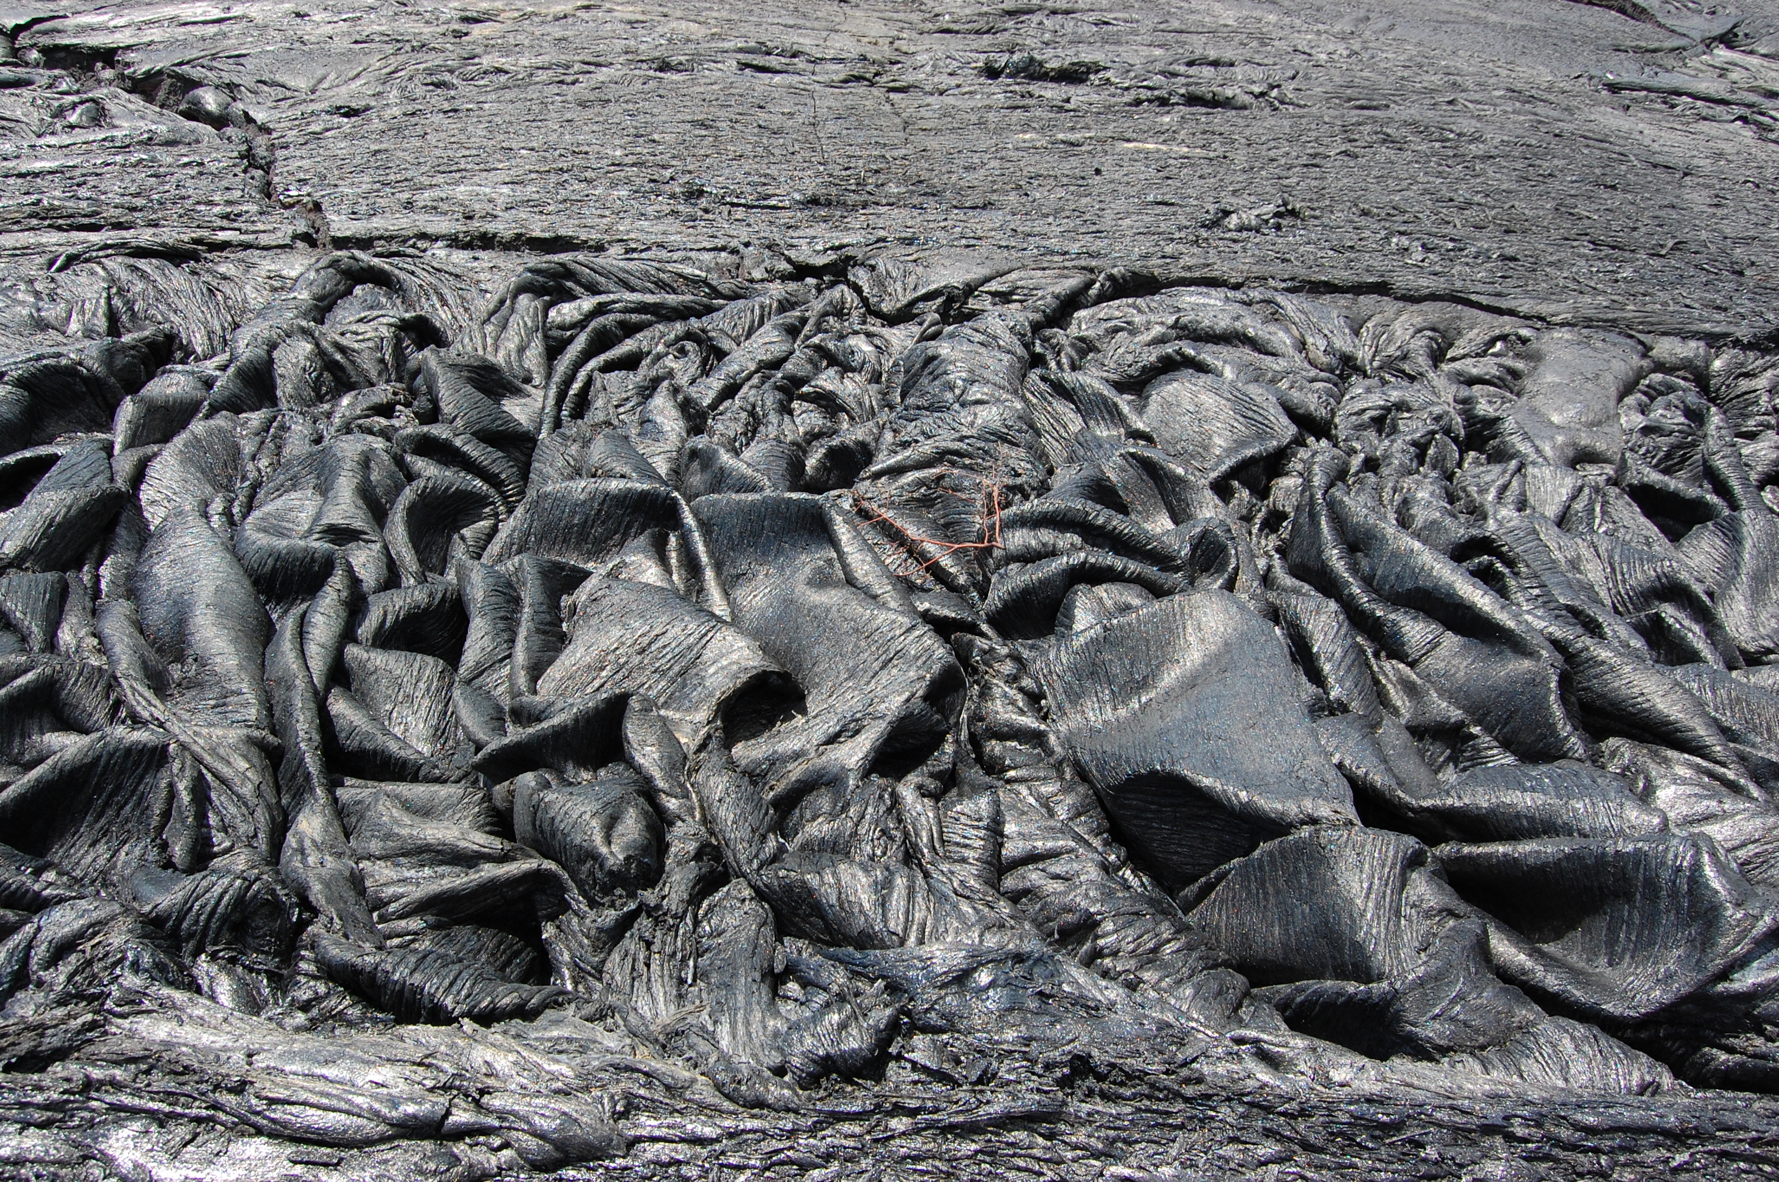
Notes:
Photograph taken by myself, Hawaii 2010.
This photograph shows an interesting pahoehoe texture like drapes of linen lying on the ground.

Slide 5
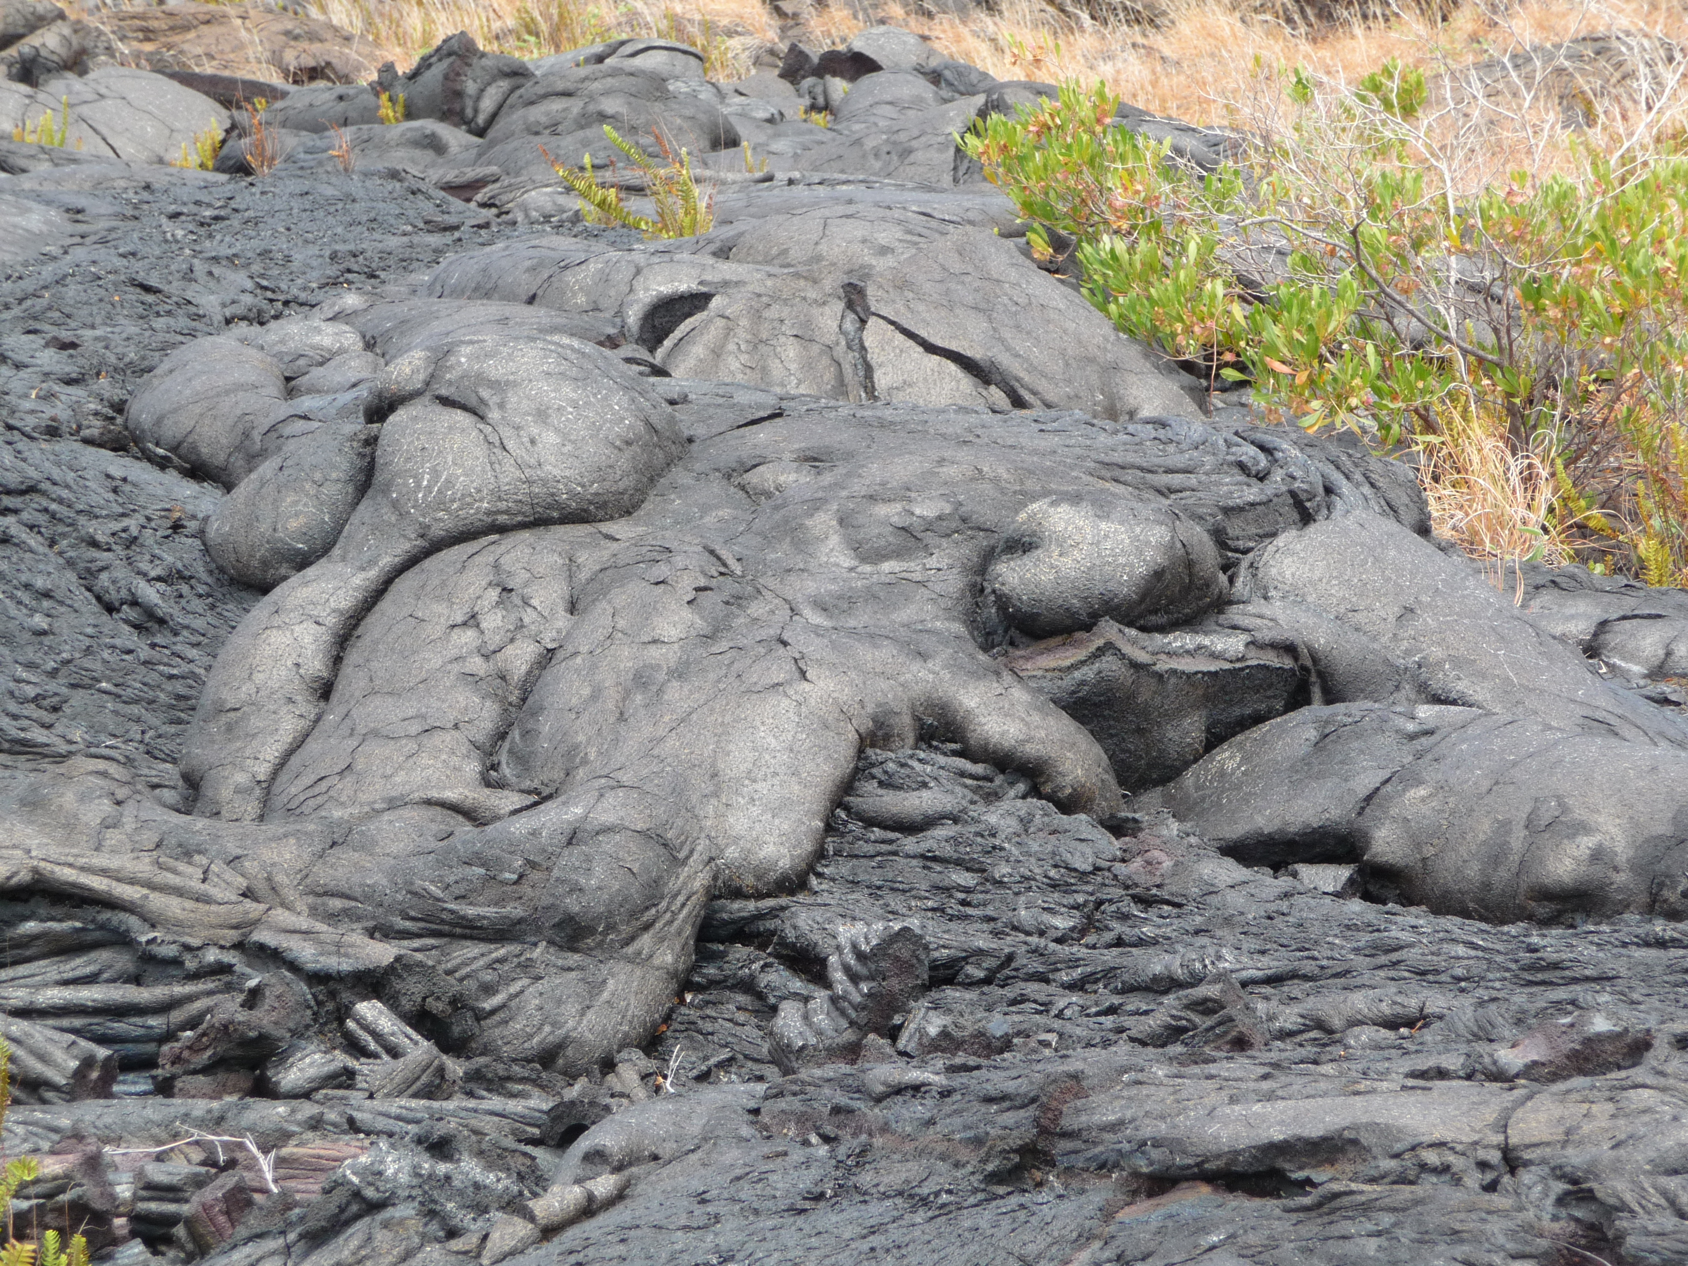
Notes:
Photograph taken by myself, Hawaii 2010.
This photograph shows yet another pahoehoe texture, a smooth bulbous texture. Note the similarity to pillow lavas.

Slide 6
http://vimeo.com/16516247
Notes:
“On Kilauea, several aa flows meander along gentle slopes, then cascade down the steep pali. Clinker falls forward, exposing the hot molten interior of the flows; vegetation is buried. Footage shot in 2008 (private property) and in 1992 & 1993 (above Kamoamoa, in HVNP). Video shot & edited by UHH Center for the Study of Active Volcanoes (CSAV). “
This is a short video showing an A’a lava flow.
This video shows an a’a lava flow. The fire in the video is caused by methane degassing from below.

Slide 7
http://www.youtube.com/watch?v=iyIV5fd1Aww
Notes:
“This video shows a sluggish a'a lava flow from the ongoing July 21 fissure” – 2007
This is another video of an A’a flow. This lava flow is moving very slowly. Aa flow can be compared to a moving pile of burning coal. It move like caterpillars where fragments fall down in front and become later buried by the same flow, resulting in a basal breccia and a top breccia.
This is another short video showing an A’a lava flow. This video emphasizes how slowly some lava flows travel.

Slide 8
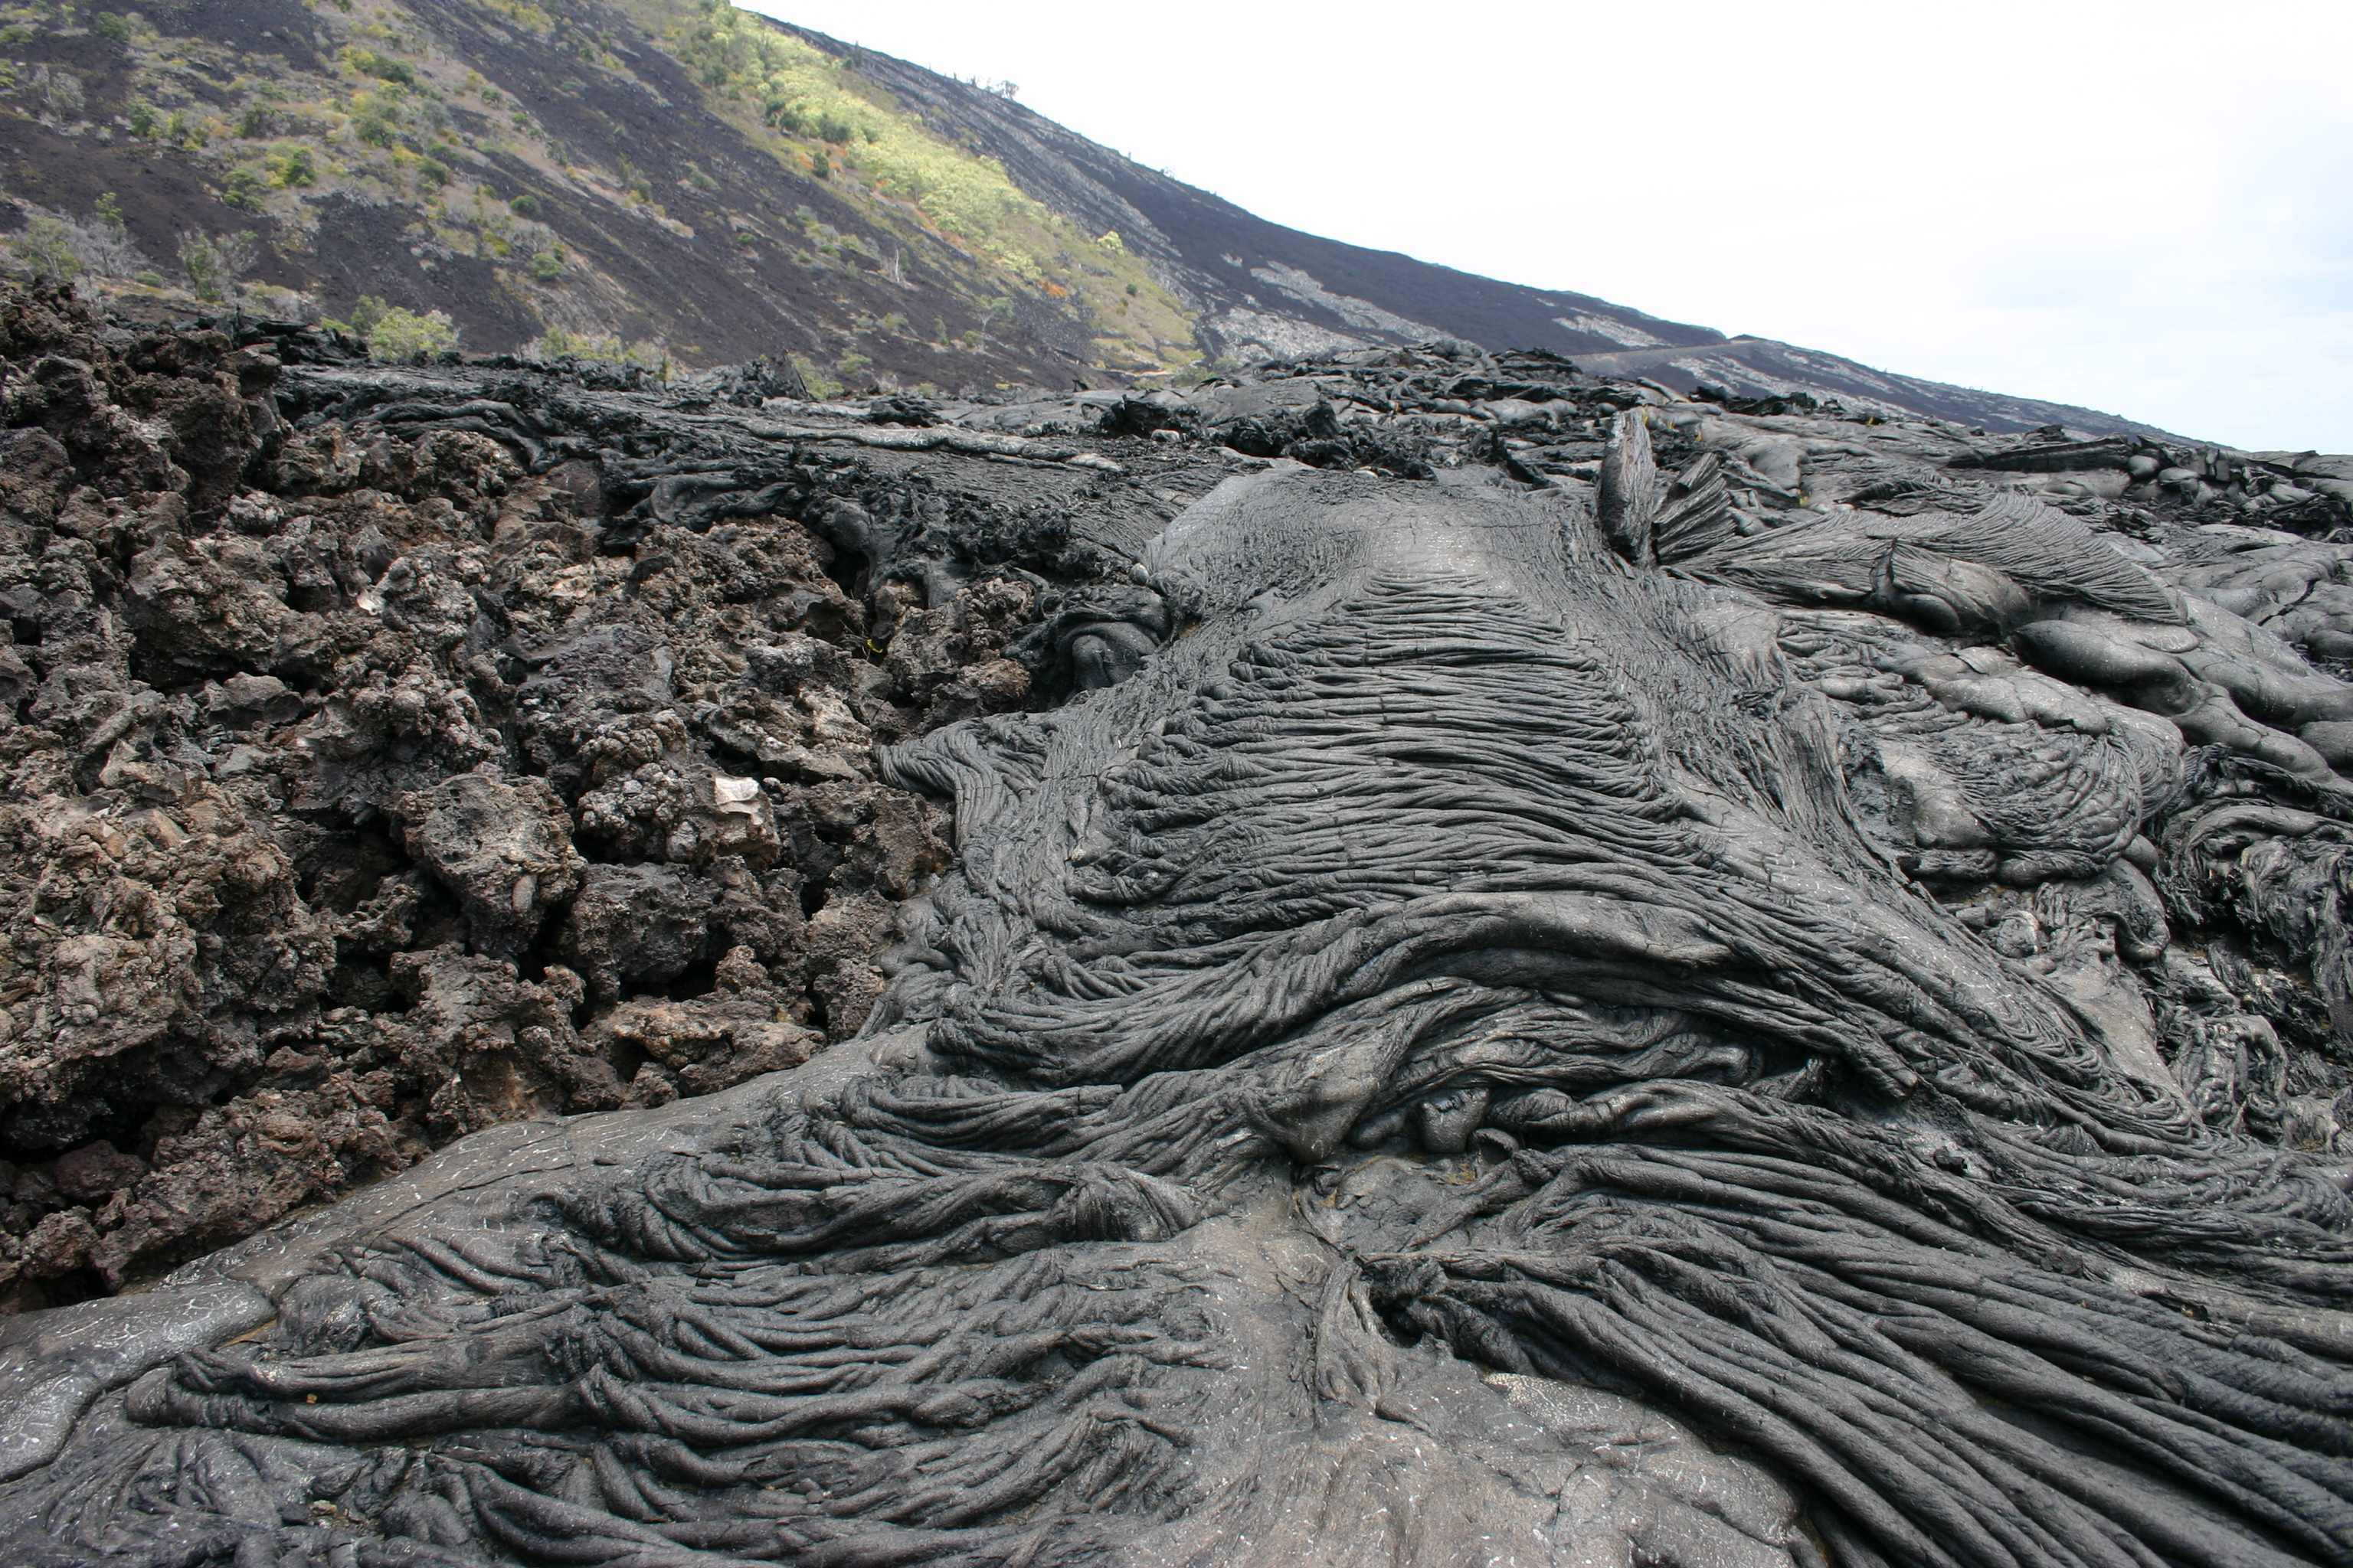
Notes:
Photograph taken by myself, Hawaii 2010.
This photograph shows Pahoehoe lava on the right and A’a lava on the left. Both types of lava flows can occur in the same location at different times. This is a good place to clear up confusion and show students the difference between the two types of lava flows since they can be seen next to each other.

Slide 9
http://www.youtube.com/watch?v=scGvM_VoPwk&feature=fvw
Notes:
This video shows a lava flow entering the ocean. It drips into the water. This video can be used to transition to pillow lavas. This is a good place to point out how dangerous it really is, and that the quiet interaction of lava and water can turn into a disastrous explosion without any warning.
This is a short video showing a lava flow entering the ocean. Explosions can occur at the ocean entry since water cools the lava very quickly (in the same way a hot glass dish from the oven breaks when it is placed in water). This video can be used to transition to pillow lava.

Slide 10
http://www.youtube.com/watch?v=5G8W9sZtBTM&NR=1
Notes:
This video shows the formation of pillow lava and gives a brief narrative.
This is a short video showing pillow lava flowing in the ocean with a narrative given.

Slide 11
http://www.youtube.com/watch?v=DdIUuUY0L9c&NR=1
Notes:
Water cools lava very quickly and it takes a bit of momentum to build up so a large amount lava bursts forward and is quenched by the ocean water. Then more momentum builds up again before another bulge of lava bursts forward.
This is a short video that more clearly shows pillow lava flowing.

Slide 12
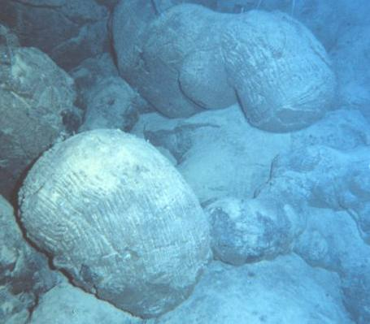
Notes:
Photograph taken from http://www.solarnavigator.net/volcanoes.htm. “Pillow lava (NOAA). Submarine volcanoes are common features on the ocean floor. Some are active and, in shallow water, disclose their presence by blasting steam and rocky debris high above the surface of the sea. Many others lie at such great depths that the tremendous weight of the water above them prevents the explosive release of steam and gases, although they can be detected by hydrophones and discoloration of water due to volcanic gases. Even large submarine eruptions may not disturb the ocean surface. Submarine volcanoes often form rather steep pillars and in due time, may break the ocean surface as new islands. Pillow lava is a common eruptive product of submarine volcanoes.”
This is a photograph of pillow lava on the ocean floor.

Slide 13
Key Points
Types of lava flows:
  Pahoehoe
  A’a
  Pillow lava
Notes:
This slide gives a chance to emphasize the key points.

