Slide 1
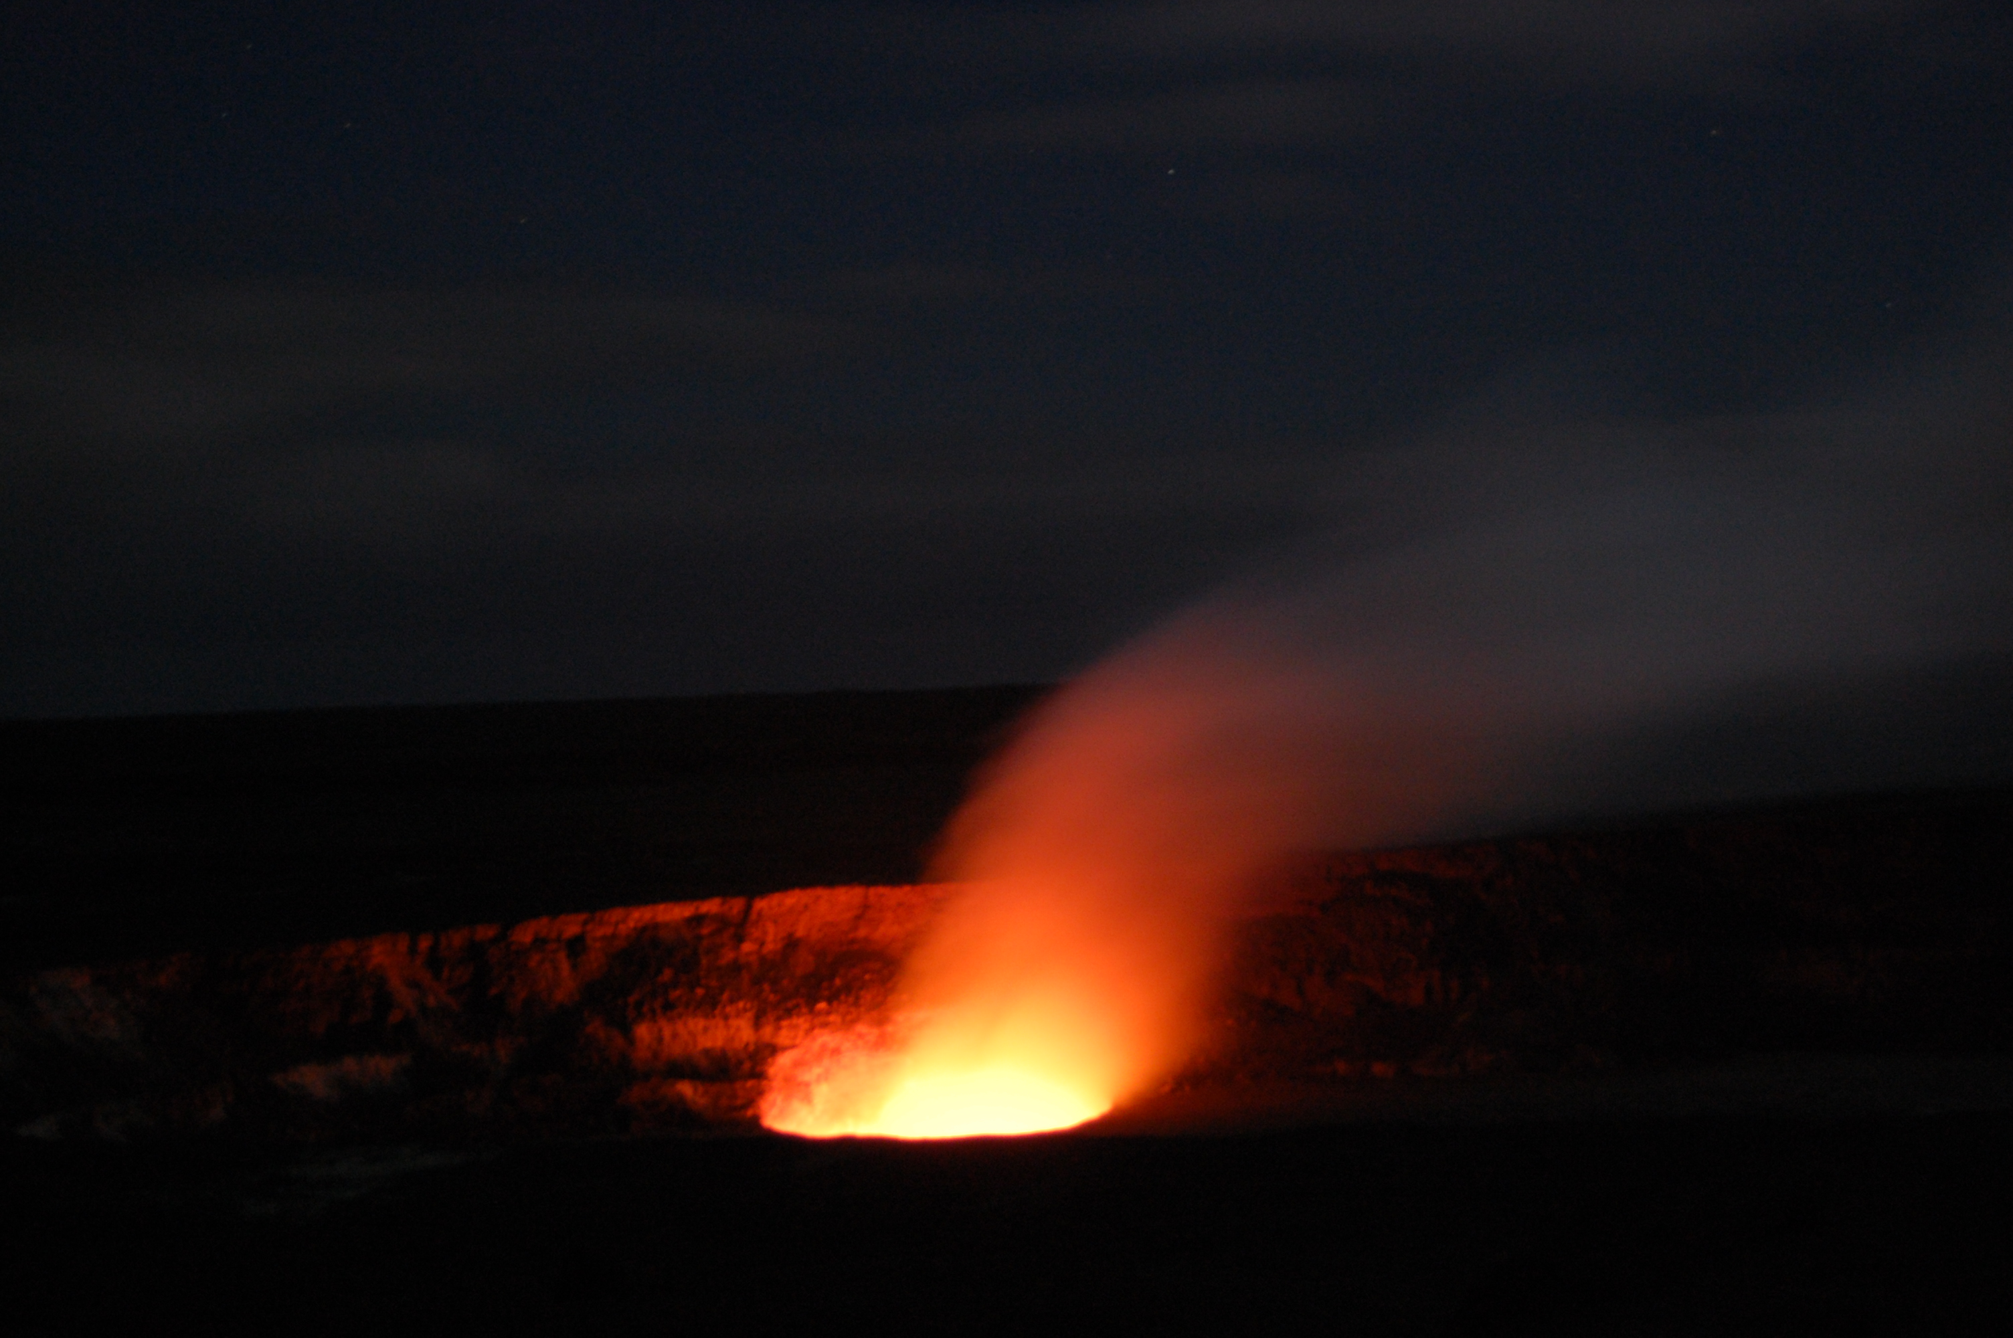
Types of magma
Notes:
Photograph taken by Caitlin Traver in Hawaii.
Explain the topic of the lesson: discussion of magma chemistry that dominates the minerals that form when it cools, the wide range in chemistry in terms of silica and alumina versus iron and magnesium, and the consequences for viscosity. We will also learn what makes some volcanic eruptions more explosive than others.

Slide 2
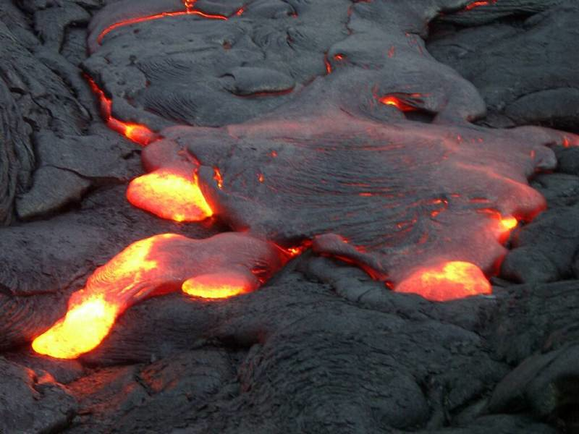
Characteristics of magma
Composition: types of elements and amount of gases in the magma
  Felsic: contains more silica and alumina
  Mafic: contains more iron and magnesium
  Gas content (water vapor, carbon dixoide, and sulfur dioxide)
Viscosity: a liquid’s resistance to flow
  Determined by its composition and temperature
  Hotter liquids are less viscous
  More viscous fluids hold more gas
High viscosity, gas content = more explosive
Notes:
Image taken from http://reegnum.co.cc/magma-photo-946.html.
This slide summarizes the different characteristics of magma that determine the way they look, what kind of lava flows form, and how explosive it can be when it erupts.
The chemical composition, or the elements that make up the magma, influences the viscosity of the magma, which in turn can make the eruption more or less explosive. Felsic magma has more silica and alumina content, which makes magma more viscous. Mafic magma has less silica content and more iron and magnesium in it.
The amount of gas in the magma helps determine how explosive the eruption will be. Gas dissolved in magma (mostly water, carbon dioxide, and sulfur dioxide) makes the magma less viscous.
Viscosity describes a fluid’s resistance to flow, or how thick or sticky the fluid is. Viscous lava flows tend not to flow far and therefore build up steep slopes. Viscosity is determined by its composition and temperature: Felsic lava is more viscous than mafic lava. Hotter liquids are less viscous than cold ones (put honey into the fridge and see how it flows and compare to honey at room temperature).
Viscosity, together with the amount of gas dissolved in magma, can determine the explosivity of the eruption. More viscous magma with volatiles is more explosive than less viscous magma, where gases can bubble out relatively easily. High volatile contents (gas and water) make magma less viscous but when they escape during eruption, the lava becomes more viscous, which allows the bubbles to build up pressure and which eventually will tear the highly viscous magma apart and make a big explosion. Note: gases can be dissolved in liquid or can be mixed in with the liquid. When gases are only mixed in with the liquid in the form of bubbles, they want to rise out of the liquid. For example, soda has gases dissolved in it that only come out of solution when it is shaken. The bubbles rise quickly to the surface because soda has a very low viscosity.
In summary, the more viscous a liquid is, and the more gas it contains, the more explosive the eruption will be.

Slide 3
Types of magma
SiO₂ Content | Composition | Magma type | Temperature | Viscosity
45-55% | Mafic | Basaltic | 1000-1200 ºC | Low
55-65% | Intermediate | Andesitic | 800-1000 ºC | Intermediate
65-75% | Felsic | Rhyolitic | 650-800 ºC | High
Increasing
Increasing
Increasing
Notes:
This slide gives a visualization and summary of the different characteristics of magma and the terms that are used to describe the different types of magma. Basaltic magma is mafic, has a low viscosity, a high temperature, and a low silica content. These factors make basalt erupt peacefully.
Andesitic lava was named after the Andes Mountain range along the Pacific Coast of South America. Andesite has an intermediate composition, an intermediate viscosity, a mid-range temperature, and a moderate amount of silica. It can be explosive, but it is not the most explosive.
Rhyolitic lava has a felsic composition, a high viscosity, a low temperature, and a high silica content. It can be very explosive, but it may also form steep sided flows or domes, such as in Glass Mountain in Owens’ Valley, CA.

Slide 4
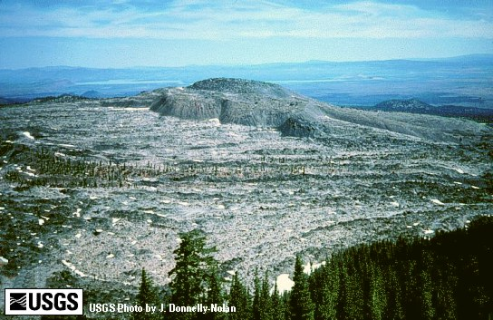
Glass Mountain, CA
Notes:
Photograph taken from http://seismo.berkeley.edu/~manga/EPS214/lab4.html. This shows how rhyolitic lava can create very steep sided flows.
This mountain is made of rhyolitic lava that erupted but did not explode.

Slide 5
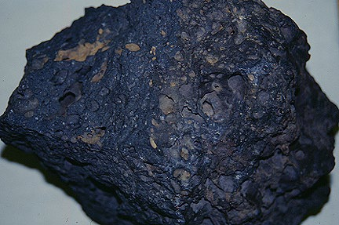
Basalt
Notes:
Image taken from http://volcano.oregonstate.edu/vwdocs/vwlessons/volcanic_rocks.html.
This is a photograph of a basaltic rock. The dimples in the rock are places where gas was trapped inside when the rock cooled and solidified. It has a dark, black color.

Slide 6
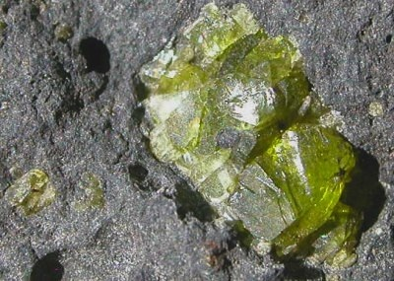
Olivine crystal inside basalt
Notes:
Photograph taken by Paula Chojnacki.
This photograph shows an olivine crystal embedded in basalt. It is tiny and can be found sparsely scattered throughout basaltic lava. Olivine is the most important mineral on earth as the bulk of the mantle is made of it and that it can form a gem called peridote if it is clear.

Slide 7
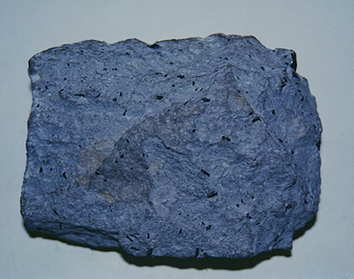
Andesite
Notes:
Image taken from http://volcano.oregonstate.edu/vwdocs/vwlessons/volcanic_rocks.html. “Volcanic rocks from continental volcanoes can also be identified by their mineralogy. For example, rocks from stratovolcanoes in the western United States, like Mount Shasta (shown above), have pyroxene, Ca-rich plagioclase, and hornblende. This mineral assemblage indicates that the rock is an andesite.”
This is a photograph of Andesite. It has a slightly lighter color than basalt.

Slide 8
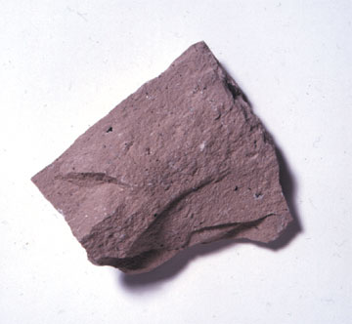
Rhyolite
Notes:
Image taken from http://www.mii.org/Minerals/photorhyolite.html.
This is a photograph of a piece of rhyolite. It has a much lighter color than andesite and basalt.

Slide 9
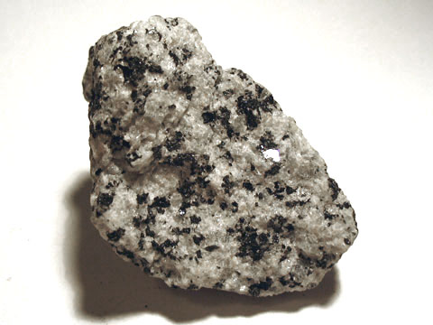
Granite
Notes:
Image taken from http://www.bgsd.k12.wa.us/hml/jr_cam/science/rocks/igneous.htm.
This is a photograph of a granitic rock. Granite is rhyolite that cooled very slowly beneath the surface of the earth. The rock looks speckled because it had a lot of time to cool off, so many minerals crystallized while the rock was cooling. Each type of volcanic rock that erupts from a volcano has an analogous rock that cools inside of the volcano instead of erupting. Basaltic magma that cools inside the earth is called gabbro. Granite is a common material used to make countertops.

Slide 10
Key Points
Magma can be felsic or mafic
Viscosity and gas content determine how explosive an eruption will be
Three types of igneous rock include basalt, andesite, and rhyolite
Notes:
Use this slide to emphasize the important topics covered in the lesson.

