Slide 1
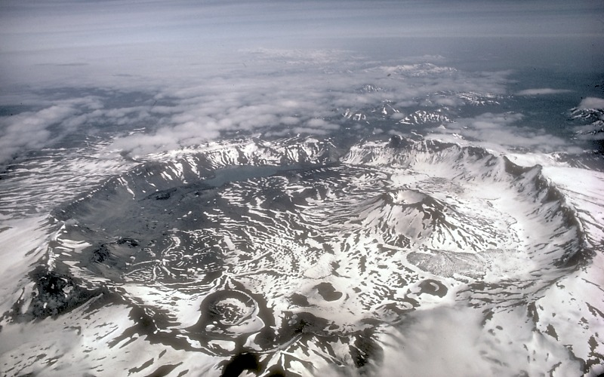
Formation of a Caldera
Notes:
Picture taken from http://volcanoes.usgs.gov/images/pglossary/caldera.php. Photograph by M. Williams, National Park Service, 1977. “A caldera is a large, usually circular depression at the summit of a volcano formed when magma is withdrawn or erupted from a shallow underground magma reservoir. The removal of large volumes of magma may result in loss of structural support for the overlying rock, thereby leading to collapse of the ground and formation of a large depression. Calderas are different from craters, which are smaller, circular depressions created primarily by explosive excavation of rock during eruptions. Aniakchak Caldera, pictured here, formed during an enormous explosive eruption that expelled more than 50 km³ of magma about 3,450 years ago. The caldera is 10 km in diameter and 500-1,000 m deep. Subsequent eruptions formed domes, cinder cones, and explosion pits on the caldera floor.”
Introduce the topics of discussion in this lecture, calderas and predicting eruptions. Calderas are introduced in this lecture because we need to know basic principles of the plumbing system of volcanoes, and this is best done by looking at calderas/craters and how they form.

Slide 2
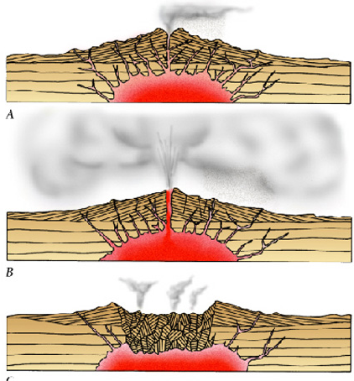
Inflation: magma rises beneath the volcano, lifting the sides of the volcano
The volcano erupts and the magma chamber is emptied.
Deflation: without support, the volcano collapses, forming a depression
Notes:
Diagram modified from http://higheredbcs.wiley.com/legacy/college/levin/0471697435/chap_tut/chaps/chapter15-04.html.
The top figure shows magma rising beneath a volcano, inflating it. The middle figure shows the volcano erupting. Notice that the magma chamber is somewhat smaller. The bottom figure shows the end of the eruption when the chamber has emptied, leaving a void that the center collapses into forming a caldera.

Slide 3
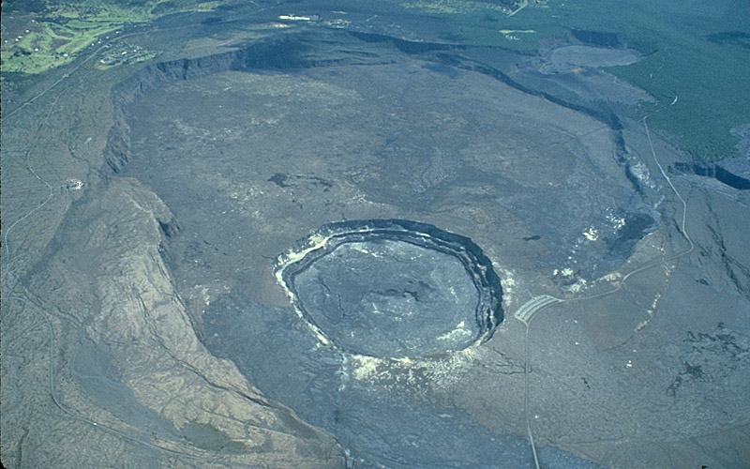
Notes:
Image taken from http://pacificislandparks.com/page/15/. It shows the Kilauea caldera in Hawaii.
This is a photograph of a caldera.

Slide 4
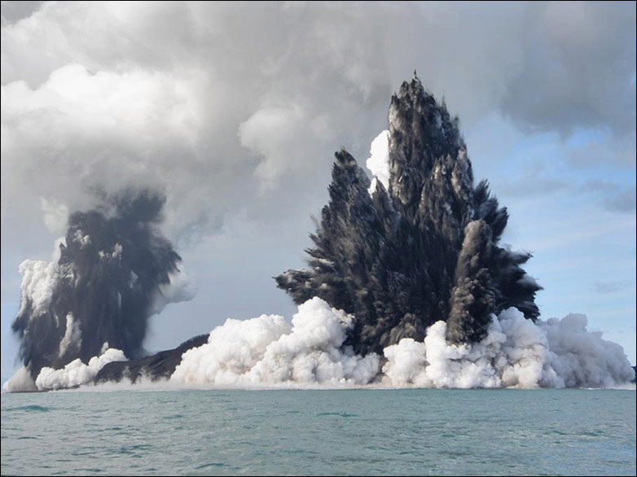
Predicting Eruptions
Increase in number of earthquakes, and earthquakes occur shallower within the volcano
Tilt changes
Gas emissions increase
http://volcanoes.usgs.gov/about/edu/predict.php/
Notes:
Photograph taken from http://www.boston.com/bigpicture/2009/03/undersea_eruptions_near_tonga.html. “An undersea volcano erupts off the coast of Tonga, sending plumes of steam, ash and smoke up to 100 meters into the air, on March 18, 2009, off the coast of Nuku'Alofa, Tonga. (Dana Stephenson/Getty Images)”
There are several indications of an impending volcanic eruption. One sign is an increase in earthquakes on the volcano. The number of earthquakes increases and the location of the earthquakes moves from deep within the volcano towards the surface as magma rises within the chambers scraping against rocks along the way. Another indication is inflation in parts of the volcano. When magma rises, it pushes the rock on top of it outwards. A bulge might form in the top or side of a volcano signaling that an eruption could occur from that side. A third and lesser indicator is an increase in emissions of gases. Volcanoes may constantly be emitting gases, but a large increase in gas emissions might mean that the plug that has been holding the magma in is breaking down and letting the gas escape. The key to prediction is the acceleration of earthquakes, and the shoaling of hypocenters. When it reaches an unsustainable frequency and the quakes are too shallow, an eruption is imminent.

Slide 5
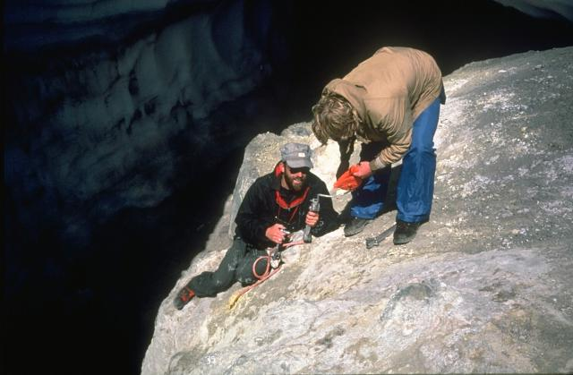
Scientists from the U.S. Geological Survey take gas samples at Devils Kitchen near the Crater Rock lava dome on the upper SW flank of Mount Hood.
Notes:
Photograph taken from http://www.volcano.si.edu/education/tpgallery.cfm?category=Volcano%20Monitoring. “Scientists from the U.S. Geological Survey take gas samples at Devils Kitchen near the Crater Rock lava dome on the upper SW flank of Mount Hood. The Crater Rock area is the largest fumarole field in the Oregon Cascades, producing vigorous gas emission and extensive hydrothermal alteration of rock masses over broad areas.Photo by Bill Chadwick, 1982 (U.S. Geological Survey).”
Most monitoring of volcanoes in the United States now comes from permanent stations that constantly measure and transmit data to observatories. However, at one time this was how scientists gathered data about the gases coming from volcanoes.

Slide 6

Deformation
Notes:
Photograph taken from http://www.flickr.com/photos/15042591@N06/1844760471/. “2002, Legazpi, Luzon Island, Philippines --- Mount Mayon volcano, on Luzon in the Philippines, rises 8,125 ft in elevation and has the most perfectly symmetrical cone of any volcano in the world. --- Image by © Rob Howard/CORBIS”
Tiltmeters are now installed in many locations constantly measuring inflation and deflation of volcanoes, tracking the movement of magma within them. They can measure a change in height of just the thickness of a dime over a distance of 1 kilometer. We are going to look at how tilt can be measured.

Slide 7
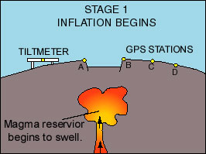
Notes:
Picture taken from http://pacificislandparks.com/2010/08/30/inflation-and-deflation-of-hawaiian-volcanoes/
This diagram shows a tiltmeter on the left side of the volcano. GPS stations are located on the right side. Note that before the volcano inflates, the tiltmeter is flat. Notice the amount of magma inside of the volcano.

Slide 8
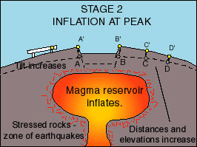
Notes:
Picture taken from http://pacificislandparks.com/2010/08/30/inflation-and-deflation-of-hawaiian-volcanoes/
The magma chamber expanded significantly as it was filled with magma. The mountain has visibly increased in height and the tiltmeter is now higher on the right side than on the left. The GPS stations have increased in both height and separation from one another, very much like the behavior of a balloon that is being inflated. Dots on a balloon separate as you inflate it.

Slide 9
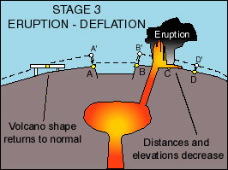
Notes:
Picture taken from http://pacificislandparks.com/2010/08/30/inflation-and-deflation-of-hawaiian-volcanoes/
When the volcano erupts, it returns to its previous shape and the tiltmeter is level again.

Slide 10
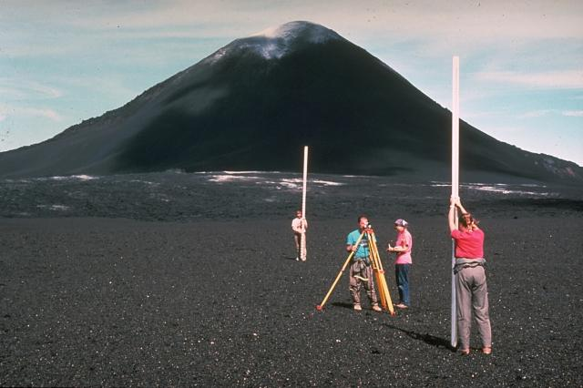
Hawaiian Volcano Observatory staff at Kilauea volcano use precision leveling. Millimeter-scale variations in the elevation of two fixed points can be detected with an optical-level instrument.
Notes:
Photograph taken from http://www.volcano.si.edu/education/tpgallery.cfm?category=Volcano%20Monitoring. “Among the many monitoring techniques used by Hawaiian Volcano Observatory staff at Kilauea volcano is precision leveling. Millimeter-scale variations in the elevation of two fixed points can be detected with an optical-level instrument by measuring the precise difference in elevation on leveling rods placed above them. Slight inflation of a volcanic edifice commonly occurs prior to eruptions. Measurements such as these in 1968, with the Puu O'o cinder cone in the background, are one of several techniques used to help forecast eruptive events.Photo by Richard Fiske, 1986 (Smithsonian Institution).”
These scientists are measuring the distance between two points so that if the volcano inflates, the distance between the points increases and an eruption might occur.

Slide 11
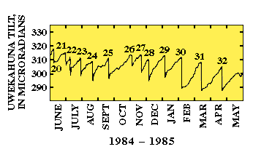
Notes:
Graph taken from http://www.absoluteastronomy.com/topics/Tiltmeter
This chart shows a steady and slow increase in tilt, and then a sudden drop associated with an eruption. Many such cycles are recorded over this one-year period.

Slide 12
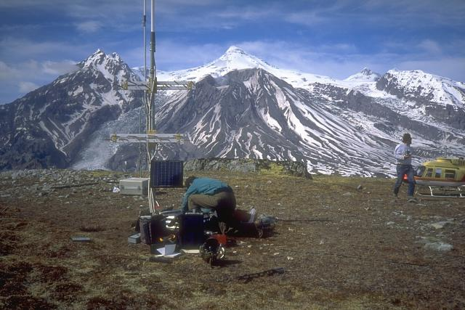
Seismometers such as this one installed near Mount Spurr volcano (on skyline in background) provide the Alaska Volcano Observatory with a continuous, radio-telemetered record of volcanic earthquakes.
Notes:
Photograph taken from http://www.volcano.si.edu/education/tpgallery.cfm?category=Volcano%20Monitoring. “Seismometers such as this one installed near Mount Spurr volcano (on skyline in background) provide the Alaska Volcano Observatory with a continuous, radio-telemetered record of volcanic earthquakes. These data are used to monitor the state of activity at the volcano and are essential for issuing timely warnings of eruptions. Ash from its 1992 eruption darkens the slopes of Crater Peak, in the center below the sharp-peaked summit of Mount Spurr, in this 1993 photo from the south.Photo by Christina Neal, 1993 (Alaska Volcano Observatory, U.S. Geological Survey).”
These scientists are installing a seismic station that will constantly record any seismic activity on the volcano. If seismic activity increases, an eruption might occur. This is a seismic station that was placed on Mt. Spurr in Alaska on a location that could only be reached by helicopter.

Slide 13
Key Points
Formation of calderas
Predicting eruptions
  Earthquakes increase
  Tilt changes
  Gas emissions increase
Notes:
This slide can be used to summarize the topics of this lesson.

