Slide 1
Volcanic Eruptions
Notes:
Introduce the topic that will be discussed in this lecture: the different styles of eruptions including Hawaiian, Strombolian, Vulcanian, and Plinian.

Slide 2
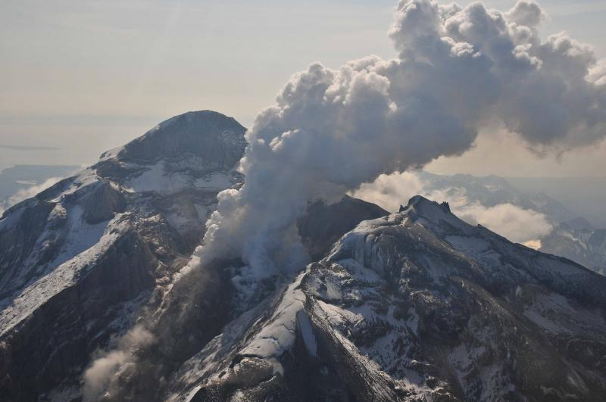
Types of volcanic eruptions
Hawaiian
  Creates shield volcanoes
  Least explosive
Strombolian
  Creates cinder cones and sometimes stratovolcanoes
Vulcanian
  Creates stratovolcanoes
Plinian
  Most explosive
Notes:
Photograph taken from http://www.avo.alaska.edu/images/image.php?id=18562. “Summit crater, active lava dome, and steam plume of Redoubt volcano, May 8, 2009. View is toward the southeast.” Photographer/Creator: Waythomas, Chris Image courtesy of AVO/USGS.
Eruptions can be classified based on their explosivity, the cause of the eruption, as well as other characteristics. Four different types of eruptions will be explained here, and we will go into depth on each in the following slides. Hawaiian style eruptions create shield volcanoes and are the least explosive. Strombolian eruptions can make either cinder cones or stratovolcanoes and are slightly more explosive. Vulcanian eruptions are even more explosive and create stratovolcanoes. Plinian eruptions are the most explosive and most of the time they just blow the mountain apart.

Slide 3
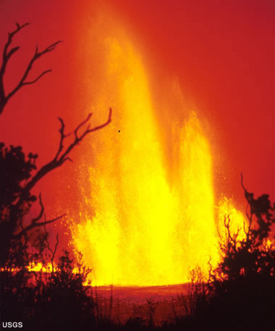
Hawaiian Eruptions
Fluid basalt
Can travel miles before cooling and hardening
Lava fountaining
Non-explosive
http://current.com/1i4bm4c
Notes:
Image taken from http://geology.com/volcanoes/types-of-volcanic-eruptions/. “Hawaiian eruption. In a Hawaiian eruption, fluid lava is ejected from a vent as fire fountains or lava flows. The 1969 eruption at Mauna Ulu, a vent of Kilauea Volcano in Hawaii, was a spectacular example of fire fountaining. Photo by D.A. Swanson, USGS, August 22, 1969.”
When a Hawaiian style eruption occurs, fluid basalt flows out of the volcano. Lava fountaining can occur when there is enough pressure to spew the fluid basalt into the air. This is a non-explosive type of eruption. The fluid basalt can flow for miles before it entirely cools and hardens. The link in the bottom right hand corner (http://current.com/1i4bm4c) is a video of a lava fountain eruption.

Slide 4
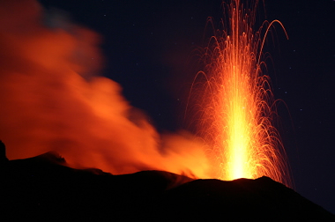
Strombolian Eruptions
Fluid basalt or andesite
Bubbles accumulate and rise to the top
Short distinct explosions caused by bursting gas bubbles
Slightly explosive
http://www.flickr.com/photos/roel/2596553511/
Notes:
Image taken from http://geology.com/volcanoes/types-of-volcanic-eruptions/. “Strombolian eruption. Short bursts of glowing lava, created from the bursting of large gas bubbles at the summit vent of a volcano typify a Strombolian eruption. This photo, taken from the summit of Stromboli, a volcano in the Aeolian Islands, Italy, shows a classic example of this activity. Photo by Andrew Hague, Istockphoto.com.”
Either fluid basalt or andesite can cause a Strombolian eruption. This type of eruption occurs when gas bubbles accumulate into a large bubble that rises to the top and bursts. It is akin to boiling pasta sauce that splatters when the gas bubbles form in the pot and burst. The pasta sauce splattering outside the pot is like lava that comes out of a volcano during a Strombolian eruption. Short distinct explosions characterize Strombolian eruptions. They are slightly explosive. The link shows a video clip of a Strombolian eruption.

Slide 5
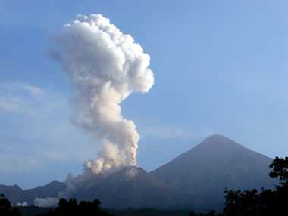
Vulcanian Eruptions
Viscous andesite or rhyolite
Viscosity does not allow gas to escape
Fragmentation and explosion of a plug of lava
Short but violent
Notes:
Image taken from http://geology.com/volcanoes/types-of-volcanic-eruptions/. “Vulcanian eruption. Relatively small but violent explosions of viscous lava create columns of ash and gas and occasional pyroclastic flows, as seen at this eruption of the Santiaguito volcanic dome complex in Guatemala. Photo by Jessica Ball, March 15, 2009.”
Viscous andesite or rhyolite can cause a Vulcanian style of eruption. It is a short but violent eruption because the high viscosity of the magma does not allow the gas bubbles to escape; so much more pressure builds up before an eruption occurs. Often a plug of lava blocks the magma from escaping until enough pressure builds up and the plug is blown to pieces.

Slide 6
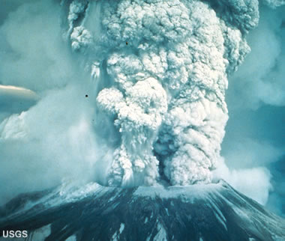
Plinian Eruptions
Very viscous rhyolite
Fragmentation of gassy magma
Largest and most violent
Can obliterate the entire top of a mountain
Destructive!
Notes:
Image taken from http://geology.com/volcanoes/types-of-volcanic-eruptions/. “Plinain eruption. The largest and most violent of all explosive eruptions, Plinian eruptions send columns of pulverized rock, ash, and gases that rise miles into the atmosphere in a matter of minutes. Mount St. Helens in Washington State experienced a Plinian eruption following a major flank collapse in 1980. Photo by Austin Post, USGS, May 18, 1980.”
Plinian eruptions are caused by very viscous rhyolite. It involves the fragmentation of gassy magma. It is the largest and most violent style of eruption. Instead of building a volcano, it blows the volcano apart. It is destructive and it can obliterate the entire top of a mountain.

Slide 7
Key Points
Types of volcanic eruptions
  Hawaiian
  Strombolian
  Vulcanian
  Plinian
Notes:
This slide can be used to summarize the four types of eruptions discussed in this lesson.

