Slide 1
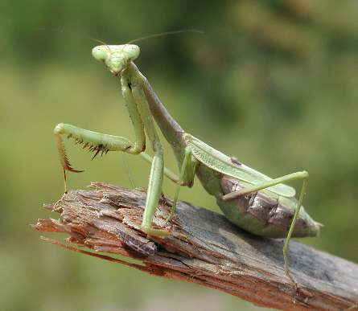
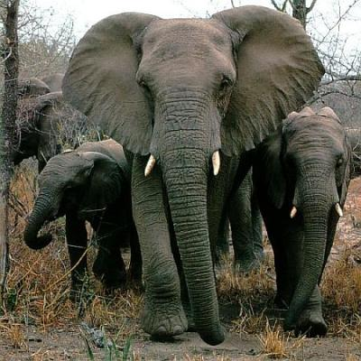
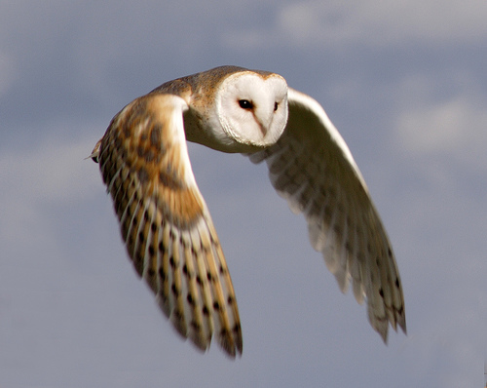
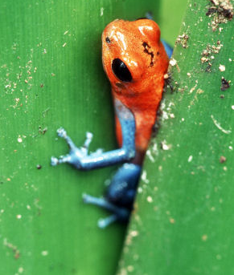
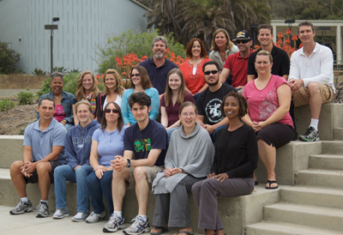
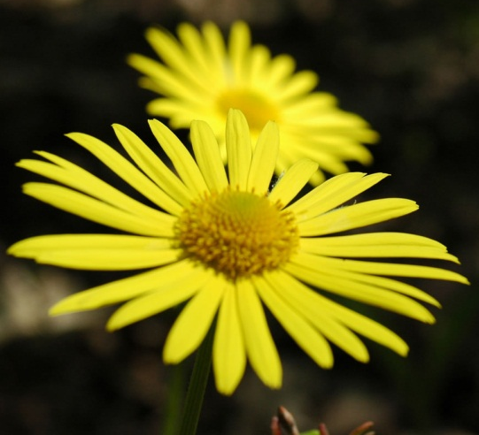
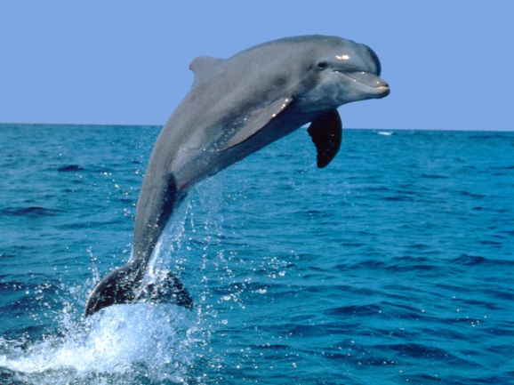
BIODIVERSITY
quantumbiologist.com
curiosanimals.net
Biology-blog.com
flower-show.com
earthref.org
dolphinsc.com
tropicalrainforest.com
Damien Cie – UCSD/SIO
Jennifer Ogo – Lincoln HS
Notes:
In this lecture you will learn about the various forms of biodiversity
Biodiversity is the degree of variation within can be characterized by biomes are simply large geographic areas containing similar plants and animals. Most scientists agree that the Earth is composed of 8 major biomes, however, this is still highly debated. Depending on the scale you are considering biomes may consist of tropical rainforest filled with hundreds of micro and macro organisms or hydrothermal vents on the ocean floor composed mainly of microscopic organisms. For the purpose of this lecture we will focus on the larger 8 major biomes.
As you flip through the slides you will notice the 8 major biomes with key points bulleted. This is of course not an exhaustive list and additional information can easily be found on the internet. Before continuing on feel free to follow the activity below.
Activity:
Let the students look at the pictures for a few seconds and then ask them what is biodiversity?
Notes:
Emphasize that biodiversity comes in all shapes and sizes…humans included.
Activity:
Ask the class if they can name a few additional diverse species…smallest…largest.
Notes:
Try and get them to realize that diversity can begin at the microscopic level and end with the largest living organism the giant sequoia tree.

Slide 2
WHICH ONE DO YOU LIKE?
Notes:
Here we have two rectangular images one of which has a unique pattern of colored circles and the other all white circles.
Activity:
Ask the class which one they would prefer by a raise of hands.
Notes:
This allows the class to see the preferences of their classmates. Of course, you will get a coupe of students who will choose the box with all white circles; however, this will actually strengthen the argument showing that the majority prefer diversity.

Slide 3
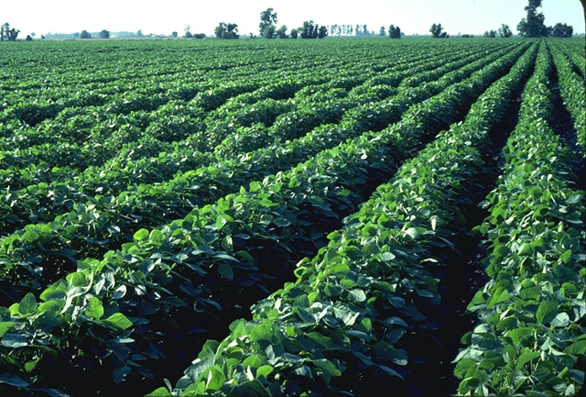
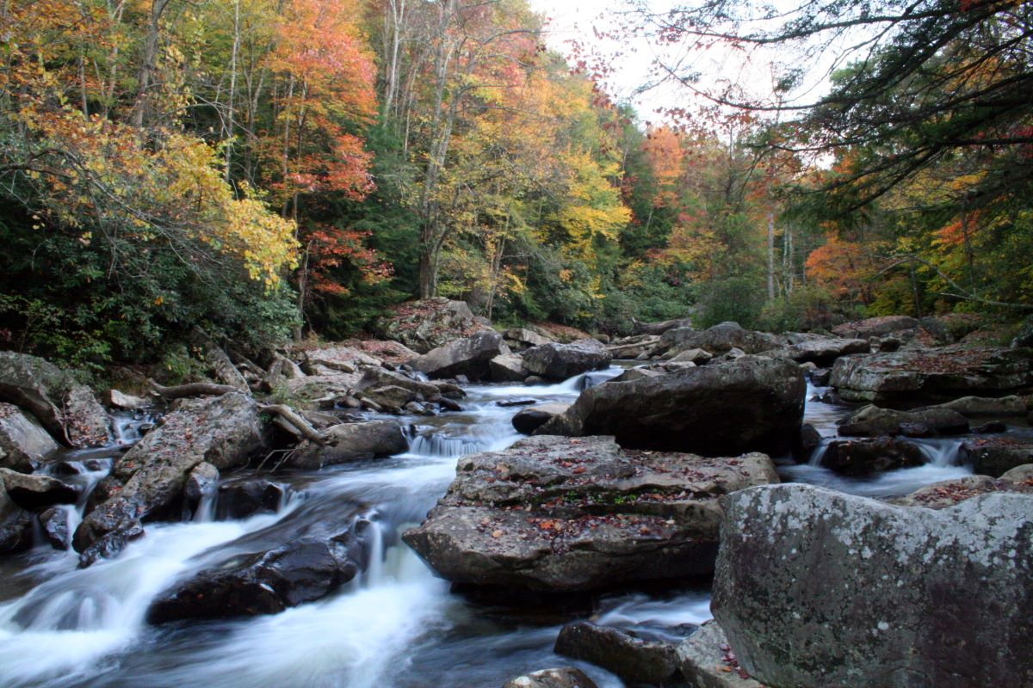
WHICH ONE DO YOU LIKE?
agriculturesc.gov
city-data.com
Notes:
Here we have two images of different ecosystems, one showing crops growing in rows on a farm and the other a temperate forest with a river flowing through it.
Activity:
Ask the class which one they would prefer by a raise of hands.
Notes:
This allows the class to see the preferences of their classmates. Of course, you will get a coupe of students who will choose the corn rows; however, this will actually strengthen the argument showing that the majority prefer diversity.

Slide 4
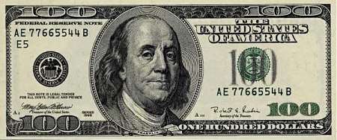
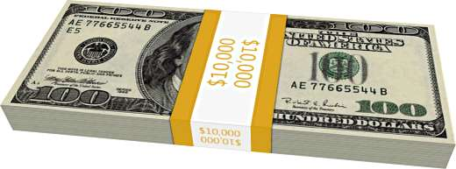
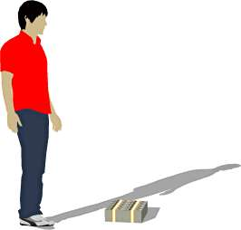
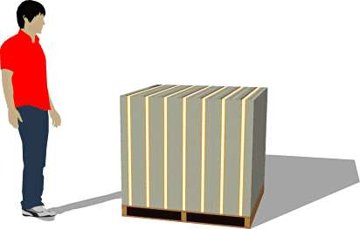
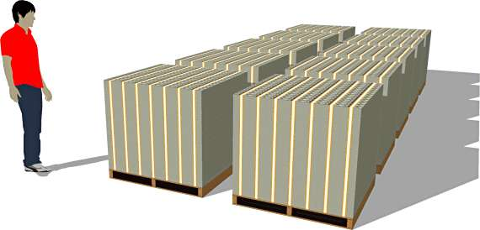

HOW MANY SPECIES?
2 million
10 million
20 million
100 million
1 billion
senseofevents.com
Notes:
Activity: How many species have been discovered and classified?
Notes: Recent records show that we have discovered approximately 2 million species.
Activity: How many species do you think are undiscovered?
Notes: Scientists believe it is over 100 million but no one knows for sure.
Activity: Show money images to show the students the enormous difference between 1 million (small stack on ground) and 1 billion (10 pallets). Image order:
$100; $10,000 (stack of one hundred $100’s); $1,000,000 (stack of one hundred $10,000 bundles); $100,000,000 (stack of one hundred $1,000,000 stacks); $1,000,000,000 (ten pallets of $100,000,000)
Notes: Many students will be amazed on the differences. Use this time to emphasize once again the amount of species unknown.

Slide 5
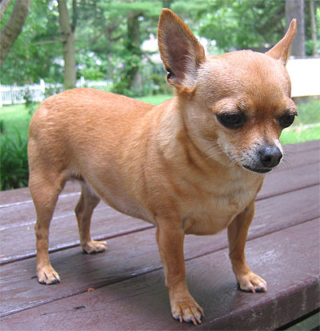
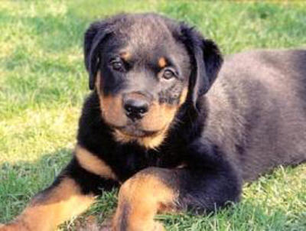
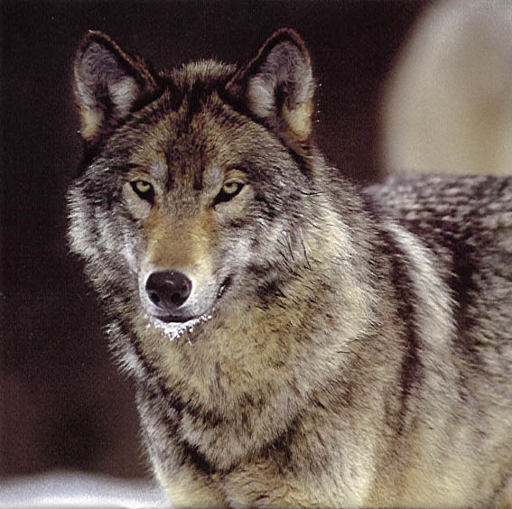
COMPONENTS OF BIODIVERSITY
1 of 3
dogsindepth.com
americanrottweiler.org
animals-nationalgeographic.com
Genetic – types of dogs (canine family)
Notes:
A simplified way of explaining 3 basic components of biodiversity will be discussed in the following 3 slides.
Here we see 3 different types of canines (left to right), a Chihuahua, Rottweiler, and wolf. Each one has their own unique set of physical traits, such as body shape and size and hair/fur color. These traits are determined by sets of genes that are different for each canine giving them their physical uniqueness. Remember that although they all possess genes that make them different, they also possess genes that make them very similar.
Notes: Emphasize to the students that although they are genetically similar they come in various sizes, shapes, colors, etc.
Activity: Can anyone give me another example of genetic diversity?
Notes: Humans: All similar genetically regardless of skin tone, ethic background, language, etc.

Slide 6
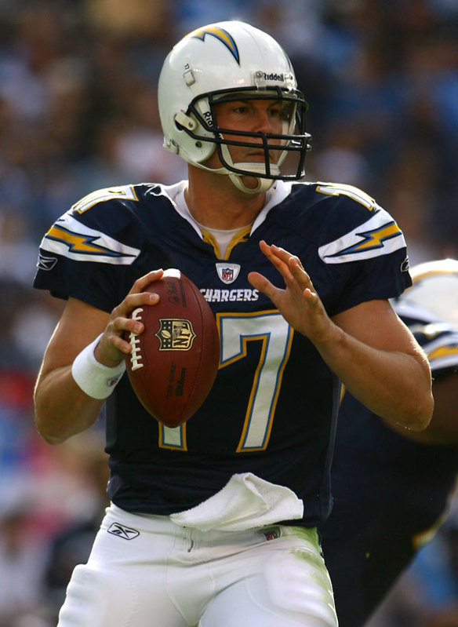
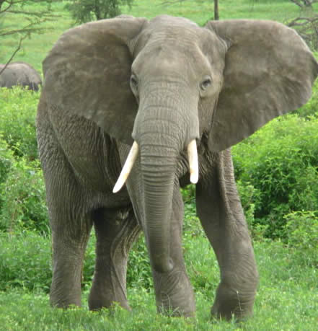
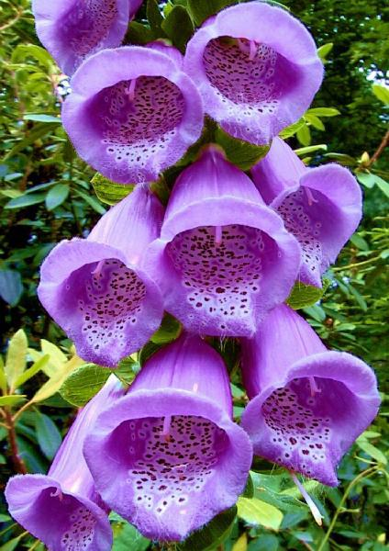
COMPONENTS OF BIODIVERSITY
2 of 3
rollinsd.com
africanelephantlearningzone.com
allthingscool.com
Species – types of living organisms
Notes:
Here we see 3 completely different types of organisms (left to right), a football player, elephant, and flowers. Just like genetic biodiversity, these organisms also have their own unique set of physical traits, such as shape, size, and cellular structure (the type of cells the organism is composed of). However, unlike genetic diversity these organisms are not classified by genes but into small biological units called “species”. Many scientist disagree on what a species actually is, however, to simplify things we will use this basic definition.
“A species is often defined as a group of organisms capable of interbreeding and producing fertile offspring.”
For example, a bird would also fall under species diversity, but a rock would not.
Activity: Biodiversity can be easily broken up into 3 parts, the second of which is species biodiversity. Species is a basic unit of biological classification to describe a group of organisms. Most have genetic similarities, however, not to the level of genetic diversity.
Notes: This is usually the one that students understand quickly.

Slide 7
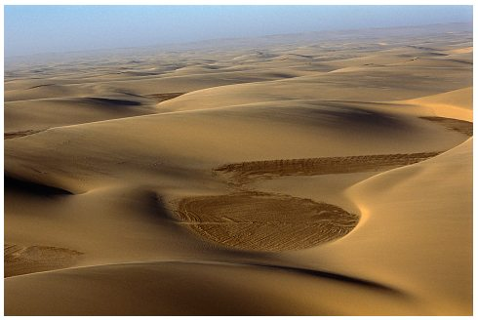
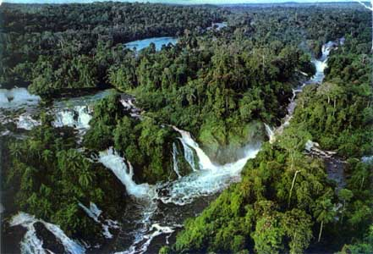
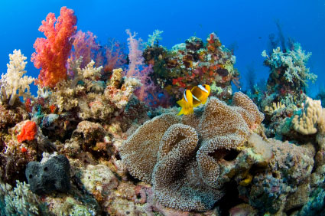
COMPONENTS OF BIODIVERSITY
3 of 3
phototravels.net
us-africa.tripod.com
coralreefinfo.com
Ecosystems – various global environments
Notes:
Here we see 3 completely different types of ecosystems (left to right), a desert, forest, and coral reef. This type of biodiversity takes into account both living organisms and non-living objects. Each ecosystem is physically different (e.g. sand vs. trees vs. underwater) and is composed a diverse assemblage of living organisms and non-living objects. These differences are what distinguishes ecosystems from one another.
Activity: Biodiversity can be easily broken up into 3 parts, the third of which is ecosystem biodiversity. Variations in global environments with many organisms that are uniquely adapted to surviving in that specific location.
Notes: Emphasize to the students that ecosystems are not scale dependent. Multiple ecosystems can be found in a simple front yard. (e.g. shaded area, soil, tree canopy, constantly moist areas.)

Slide 8
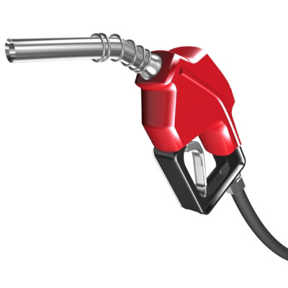
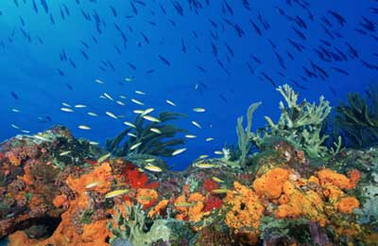
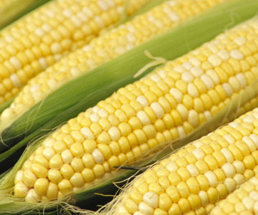
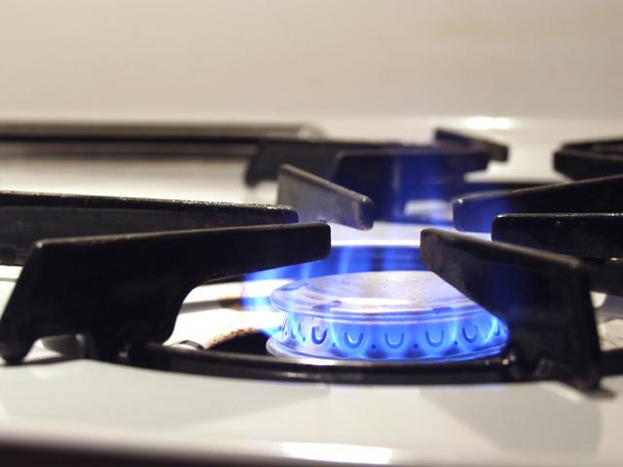
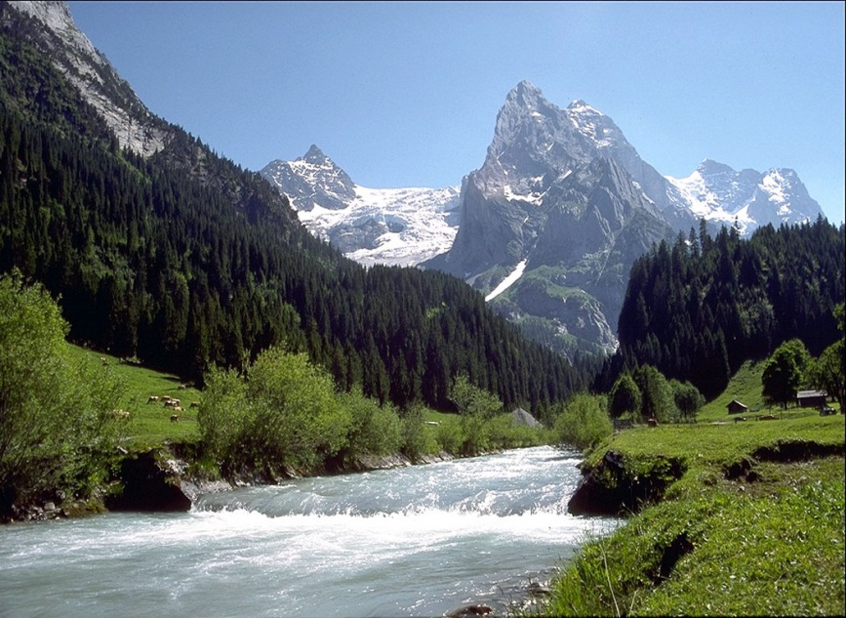
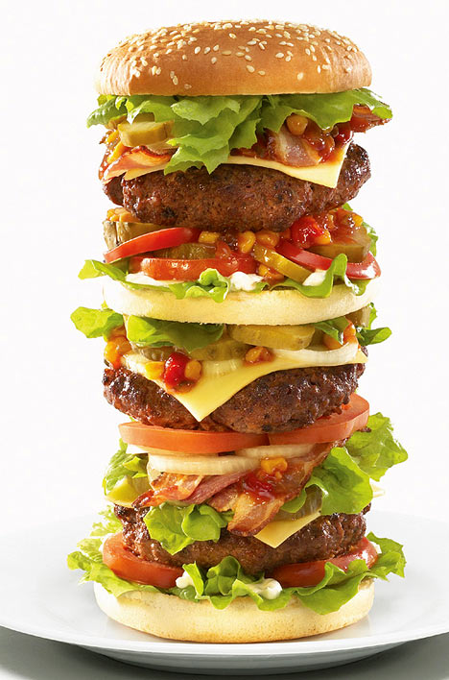
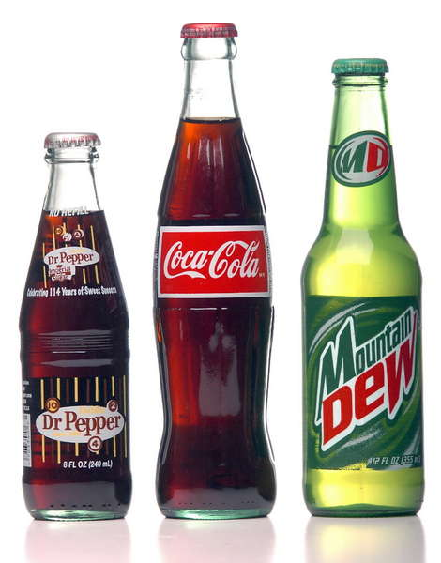

WHO CARES?
blogs.seattleweekly.com
bp.blogspot.com
greenlivingearth.net
.bp.blogspot.com
bp.blogspot.com
img.dailymail.co.uk
nateliston.files.wordpress.com
medicine.com
Notes:
Here we see a variety of images showing the benefits of biodiversity.
Activity: Explain to students what we get from biodiversity.
Notes: Corn – crops can grow due to diversity in pollinators, soil, etc.
Hamburger – all the meat and vegetables can be linked back to a variety of plants used for animal feed and crops.
Soda – sodas flavor comes from various sugar sources (corn, cane, beet).
Fuel/Natural Gas – comes from the decomposition of various organic material
Medicines – many come directly and indirectly from wild plants and animals.
Terrestrial/Ocean – diversity in the environment provides natural wonders and a stable system.

Slide 9
SOME FACTS…
“There are over 20,000 species of edible plants in the world yet fewer than 20 species now provide 90% of our food.”
- US Department of Agriculture
“Of the more than 250,000 known plant species, less than 1 percent have been thoroughly tested for medical applications. Surprisingly, 25 percent of our prescription medicines come from this tiny portion of tested plants.”
- National Parks Service
There can be as many as 10,000 species of plant per hectare, making rainforest the most diverse and productive global biome. - Ohio State University
Over 85% of our energy demands are met by the combustion of fossil fuels. - University of Michigan
Notes:
Here are a few facts gathered from various agencies and academic institutions showing the importance of biodiversity.
Activity: Discuss with students some facts about what biodiversity can provide.

Slide 10
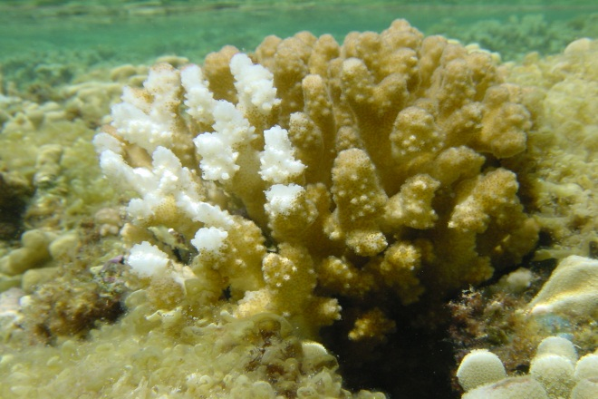
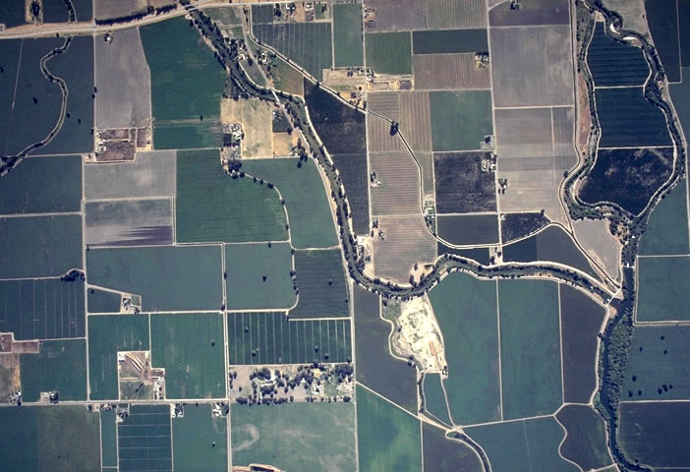
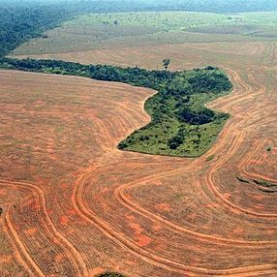
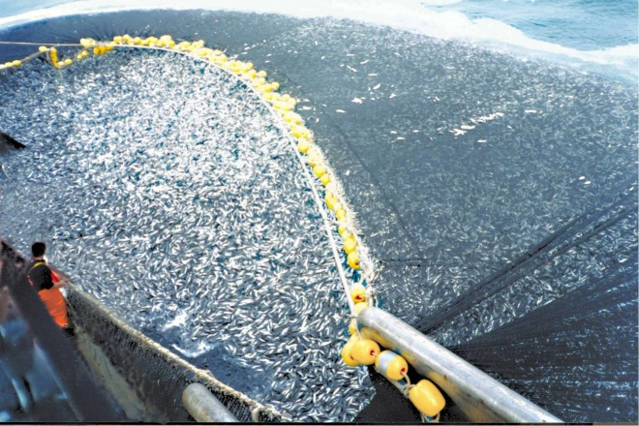
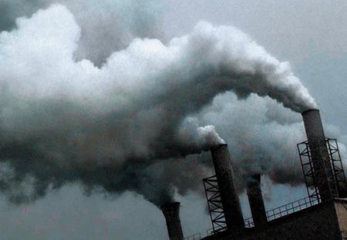
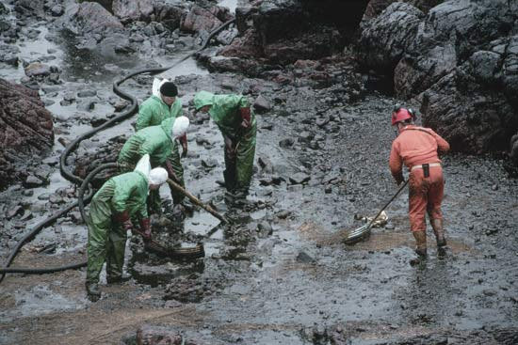
THREATS TO BIODIVERSITY
.globalwarmingart.com
fs.fed.us
.elrst.com
Bleaching
Fragmentation
Deforestation
bp.blogspot.com
bp.blogspot.com
sea-turtles.net
Overfishing
Air Pollution
Water Pollution
…and many more!
Notes:
Here are 6 images showing the potential threats to biodiversity.
Activity: Ask students if they can explain what these are. Clarify if needed.
Notes: Bleaching – occurs when ocean pH levels change to changes in acidification, which is believed to be caused by warming of the atmosphere. This can damage entire coral ecosystems, which in turn can affect adjacent ecosystems and organisms that rely on them.
Fragmentation – dividing of land into parcels for housing, farming, etc. This may limit native animal and plant habitats by breaking apart their natural borders causing them to 1) limit their range which may effect their ability to obtain food and reproduce, and/or 2) venture out over the fragmented areas increasing the possibility of danger.
Deforestation – removal of trees primarily for timber. This can lead to the issues surrounding fragmentation but at a much larger scale. In some cases causing entire species to be threatened or go extinct.
Overfishing – removal of fishery species above and beyond their reproductive capacity. Reduces overall fish populations beyond sustainability.
Air Pollution – can effect global air quality changing atmospheric conditions. This can effect all living organisms on the planet from humans to microscopic bacteria.
Water Pollution – can effect global water quality and effect fisheries, coastal environments, etc.

Slide 11
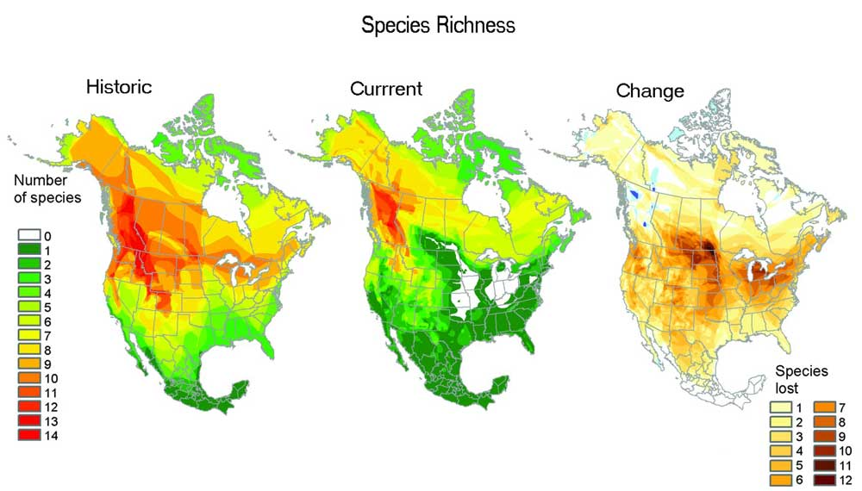
CHANGES IN BIODIVERSITY
Specieslist.com
cof.orst.edu
Notes:
The graph depicted above shows the changes in biodiversity over time. The right 2 images of North America shows the reduction in biodiversity as you go from green (high biodiversity) to red (low biodiversity) on the color key. The image of North America on the right shows the loss in species as you go from white (very little species lost) to dark brown (lots of species lost).
Activity: Ask students why they think this happened…natural effects? human effects? mixed effects?
Notes: You can easily see that much of the changes in biodiversity occur throughout North America, with very little changes occurring in northern Canada and Alaska.
Activity: Ask the students why they think this is the case?
Notes: Less people live and work in the northern regions of North America, possibly due to the weather, and are in less need of things such as cities and farmlands. This reduces the potential threats of deforestation, air and water pollution, overfishing, and fragmentation which can all reduce overall biodiversity. Unfortunately, this is not the case for the United States which is home to nearly 500,000,000 people, all in need of natural resources. This again puts strain on our environment reducing biodiversity.

Slide 12
BIODIVERSITY COMES IN ALL SHAPES AND SIZES…LETS TEST YOUR SKILLS

Slide 13
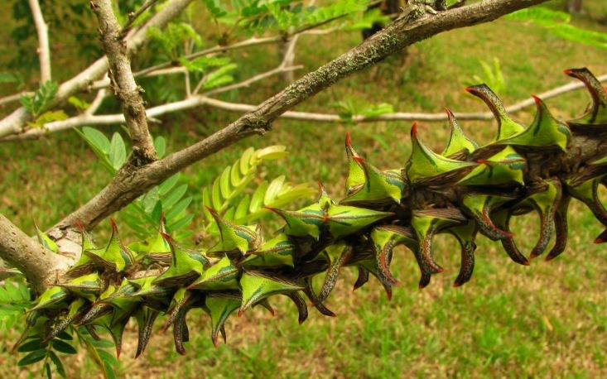
VARIATIONS IN BIODIVERSITY?
ntsavanna.com
Notes:
The image above shows how diverse organisms can truly be. Can anyone locate the bugs?
Activity: Have the students try and locate the bug(s).
Notes: All of the thorns are thorn bugs.

Slide 14
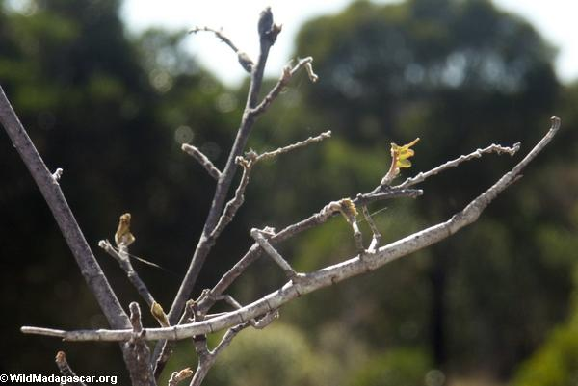
VARIATIONS IN BIODIVERSITY
wildmadagascar.org
Notes:
Similar to the previous slide, this image also shows how diverse organisms can be. Can you once again locate the bug?
Activity: Have the students try and locate the bug.
Notes: Stick bug.

Slide 15
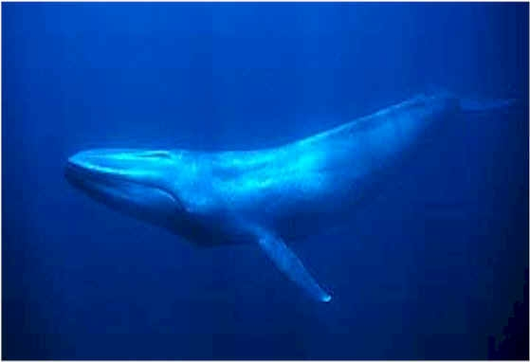
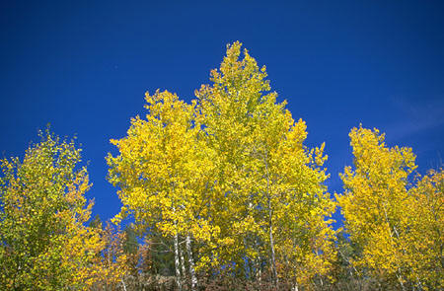
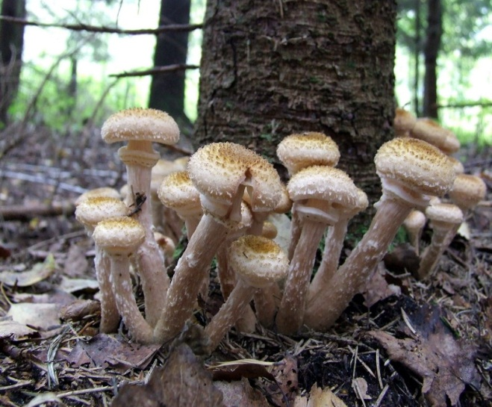
VARIATIONS IN BIODIVERSITY
truewildlife.com
yourworkforce.com
wikipedia.com
All of them!!!!!!!!
Notes:
The above images show 3 different living organisms all of which have unique physical traits. Can anyone guess which of these organisms is the largest?
Blue Whale - The largest known animal whose official record length is 33.58 m (110 ft 2 in), and weight 190 short tons (172 metric tons)
Aspen Tree - large stands of genetically identical trees (technically, stems) connected by a single underground root system. Aspen grove in Utah nicknamed Pando, and some experts call it the largest organism in the world, by mass or volume. It covers 0.43 km² (106 acres) and is estimated to weigh 6,600 short tons (6,000 t)
Honey Mushroom - in the Malheur National Forest in Oregon was found to span 8.9 km² (2,200 acres), which would make it the largest organism by area.
As you can see biodiversity can be defined in various ways from genetic similarities, to specific classifications, to global habitats. It can include organisms from the largest baleen whales to the smallest microbes. We have learned that biodiversity can bring a wealth of things from medicines to foods to things we use everyday from fuels to recyclables. We have also come to realize that biodiversity can be easily affected by the things we do. Simple activities such as driving our vehicles emit large amounts of air pollution, building our homes removes precious timber from forest, and fertilizing our lawns contaminates ground water which runs into the oceans. In our next lesson we will take a look into the different global habitats, known as biomes, and see what unique characteristics sets them apart from one another.

