Slide 1
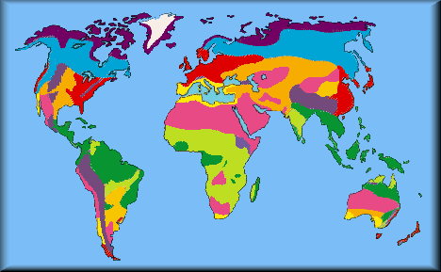
Biomes of the World
AP Environmental Science
blueplanetbiomes.org
Damien Cie – UCSD/SIO
Jennifer Ogo – Lincoln HS
Notes:
In this lecture you will learn about biomes, what they are, where they are located, and what organisms live within them.
Biomes are simply large geographic areas containing similar plants and animals. Most scientists agree that the Earth is composed of 8 major biomes, however, this is still highly debated. Depending on the scale you are considering biomes may consist of tropical rainforest filled with hundreds of micro and macro organisms or hydrothermal vents on the ocean floor composed mainly of microscopic organisms. For the purpose of this lecture we will focus on the larger 8 major biomes.
As you flip through the slides you will notice the 8 major biomes with key points bulleted. This is of course not an exhaustive list and additional information can easily be found on the internet. Before continuing on feel free to follow the activity below.
Activity: Ask the students: Can anyone explain what they think a biome is?
Notes: A biome is a large geographic area containing similar plants and animals. The different colors on the map represent various global biomes.

Slide 2
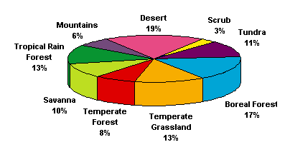
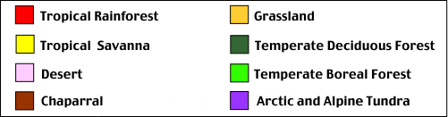
What is a biome?
A BIOME is the largest geographic biotic unit, a major community of plants and animals with similar life forms and environmental conditions.
blueplanetbiomes.org
blueplanetbiomes.org
ICE & OCEANS!
Notes:
Notes: Each biome can have distinguishing characteristics based on local factors. For example, within the desert biome, there may be hot, cold, and coastal deserts, each with slightly different climates.
It is possible to divide the biomes into smaller units that we call biotic communities, ecosystems, or habitats.
Activity: Ask students: Can anyone name a biome that is not represented here?
Notes: Ice and oceans is one of the largest biomes; however, it to can be broken down into even smaller units and “sub biomes” (e.g. tropical ocean, polar oceans, hydrothermal vents, etc.). Most people tend to characterize biomes by what they can visually see, however, there are numerous biomes that exist within the ocean that have rarely been seen. Take for example hydrothermal vents, which was briefly introduced in the first slide, exists miles below the surface under extreme pressures and absent of light providing a refuge for numerous tube worms, crustaceans, and microscopic organisms.
Activity: Show graph and explain the estimated breakdown of global biomes. Have the students recognize the largest biome and discuss.

Slide 3
How are biomes formed?
Biomes are distributed across the Earth based primarily on climate. Therefore, in areas that are far apart, you will sometimes find similar plants and animals because the climate is similar.
One factor affecting climate is latitude. Typically, the farther you move north or south of the equator, the colder the temperature gets. Another factor affecting climate is elevation. The higher you go in elevation, the colder the temperature gets.
Biomes usually found at cold latitudes far from the equator are sometimes also found on high mountains at low latitudes. Typically, a climb of 100 feet in elevation is equivalent to traveling 600 miles northward.
Notes:
Activity: Ask students: Can anyone guess how biomes are formed, what characterizes them?
Notes: Discuss with students how biomes are formed. Allow the students to provide their own personal insight.

Slide 4
Lets take a look at a few types of biomes!

Slide 5
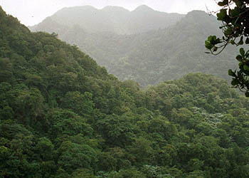
Tropical
Typically found near the equator
Receives more than 200 cm of rain annually
Temperatures typically fall between 20ºC and 25ºC for the entire year
As many as 50% of all the world’s animal species may be found here
Notes:
Activity: Ask students: What characteristics do they think represent a tropical biome?
Notes: Discuss characteristics and allow the students to elaborate.

Slide 6
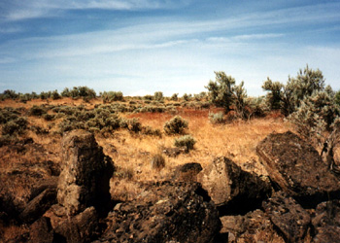
Desert
Typically found between 25º and 40º latitude
Receives less than 25 cm of rain each year
Temperatures typically range between 20ºC and 25ºC but some extreme deserts can reach temperatures higher than 38ºC and lower than –15ºC
Notes:
Activity: Ask students: What characteristics do they think represent a desert biome?
Notes: Discuss characteristics and allow the students to elaborate.

Slide 7
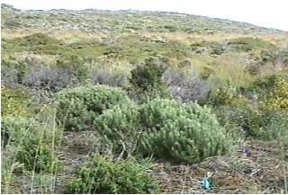
Chaparral
Found between 32º and 40º latitude on the west coast of continents
Receives between 35 and 70 cm of rain, usually in the winter
Extremely resistant to drought and weather events
Notes:
Activity: Ask students: What characteristics do they think represent a chaparral biome?
Notes: Discuss characteristics and allow the students to elaborate.

Slide 8
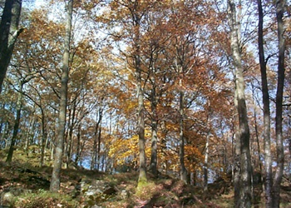
Temperate
Moderate climate
Most trees will lose their leaves in the winter
Temperatures range between –30ºC and 30ºC
Averages from 75 to 150 cm of precipitation
Well developed understory
Notes:
Activity: Ask students: What characteristics do they think represent a temperate biome?
Notes: Discuss characteristics and allow the students to elaborate.

Slide 9
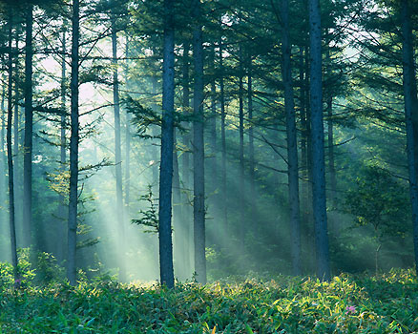
Boreal
Also known as Taiga
Typically found between 45º and 60º North latitude
Cold climate with summer rains
Very few reptiles
Limited understory
Snow is primary form of precipitation (40 – 100 cm annually)
Notes:
Activity: Ask students: What characteristics do they think represent a boreal biome?
Notes: Discuss characteristics and allow the students to elaborate.

Slide 10
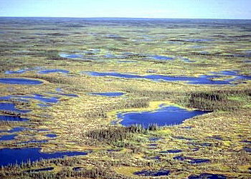
Tundra
Means treeless or marshy plain
Characterized by permafrost – permanently frozen soil starting as high as a few centimeters below the surface
Winter average –34ºC summer average < 10ºC
Low precipitation (15–25 cm per year) but ground is usually wet because of low evaporation
Notes:
Activity: Ask students: What characteristics do they think represent a tundra biome?
Notes: Discuss characteristics and allow the students to elaborate.

Slide 11
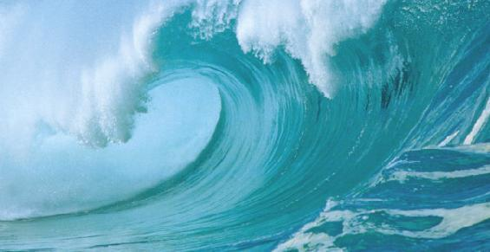
Ocean
Covers 71% of the Earth’s surface
Salinity and temperature varies globally
Light varies by depth and turbidity
Composed of many biodiversity hotspots (e.g. coral reefs)
More is known about the moon than the world’s oceans.
Notes:
Activity: Ask students: What characteristics do they think represent an ocean biome?
Notes: Discuss characteristics and allow the students to elaborate.

Slide 12
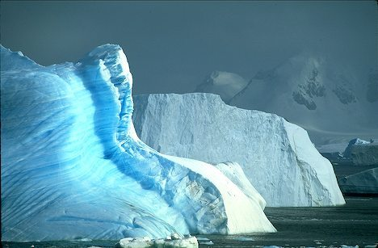
Ice
Largest continent on Earth - Antarctica
Coldest, driest, and windiest continent
Coldest recorded temperature: -89C
Physical size changes seasonally
  Winter - 18M km2
  Summer - 3M km2
Notes:
Activity: Ask students: What characteristics do they think represent an ice biome?
Notes: Discuss characteristics and allow the students to elaborate.
As you can see biomes can exist all over the world from our tallest peaks to the deepest trenches of our oceans. In fact, you can easily find small areas in your backyard that you can consider a sub-biome. For example, a shaded corner in your backyard vs. an area that is always exposed to the sunlight; A large bush vs. the grass on your lawn. In each you may find different organisms living under different conditions.
In the next lecture we will focus on a specific ocean biome known as a kelp forest. Kelp forest are unique in that they exist only in certain parts of the world and provide refuge and food to hundreds of organisms from the smallest phytoplankton to the largest whales.

