Slide 1
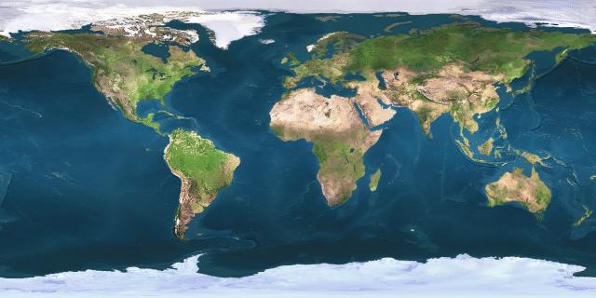
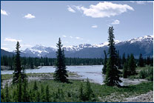
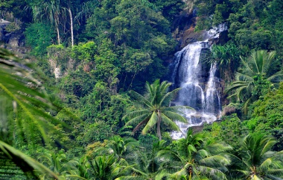
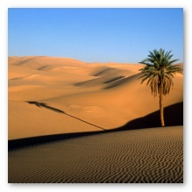
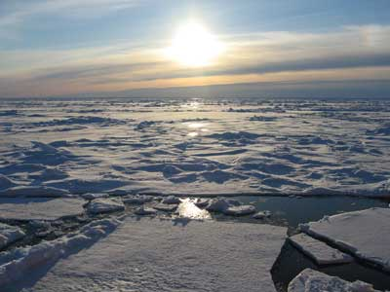
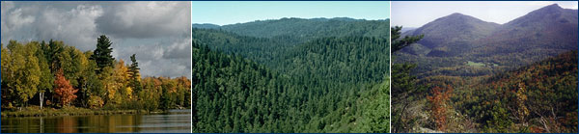
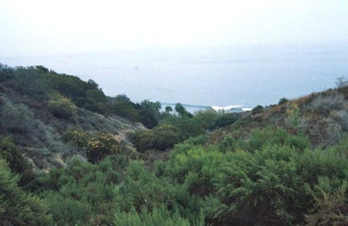
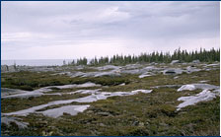
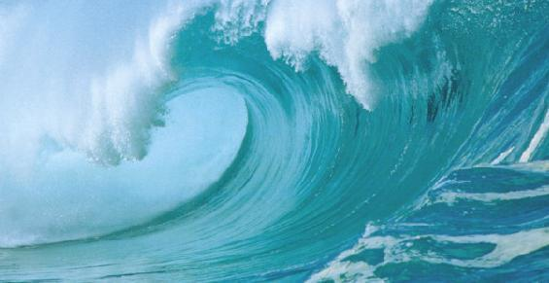
Global Biomes
Boreal
Tropical
Desert
Ice
Temperate
Chaparral
Tundra
Ocean

Slide 2
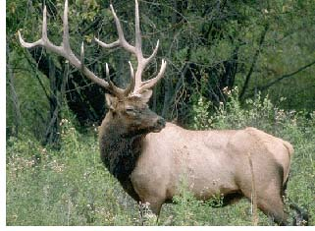
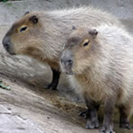
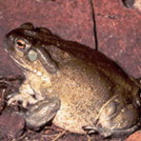
Score________
APES: Global Biomes Lab
Name__________________________________
Organisms Biome Common Name Diet Competition Predators
Cervus elaphus
Hydrochoerus hydrochaeris
Bufo alvarius

Slide 3
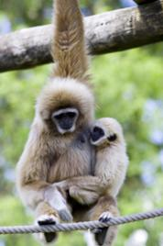
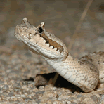
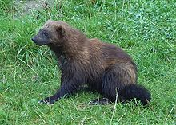
Score________
APES: Global Biomes Lab
Name__________________________________
Organisms Biome Common Name Diet Competition Predators
Hylobates lar
Crotales cerastes
Gulo gulo

Slide 4
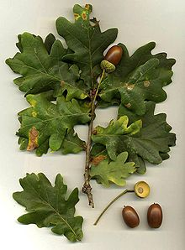
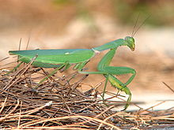
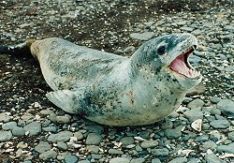
Score________
APES: Global Biomes Lab
Name__________________________________
Organisms Biome Common Name Diet Competition Predators
Quercus robur
Sphodromantis viridis
Hydrurga leptonyx

Slide 5
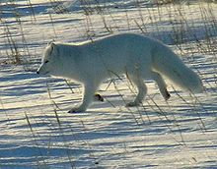
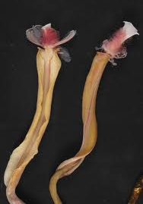
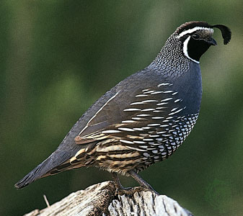
Score________
APES: Global Biomes Lab
Name__________________________________
Organisms Biome Common Name Diet Competition Predators
Alopex lagopus
Riftia pachyptila
Callipepla californica

Slide 6
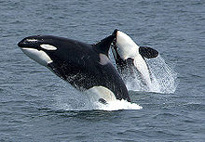
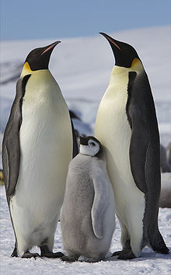
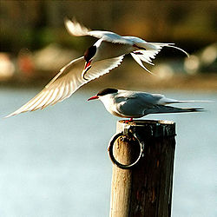
Score________
APES: Global Biomes Lab
Name__________________________________
Organisms Biome Common Name Diet Competition Predators
Orcinus orca
Aptenodytes forsteri
Sterna paradisaea

