Slide 1
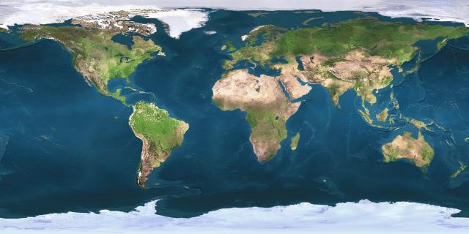
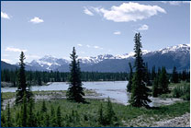
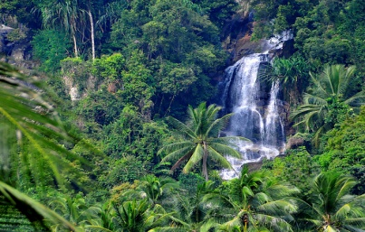
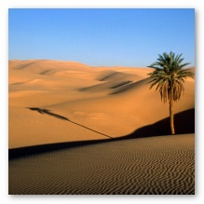
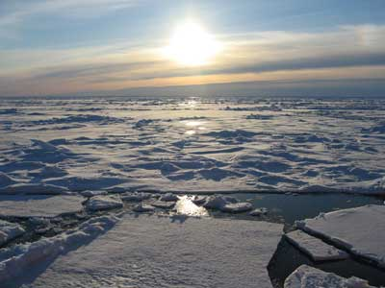
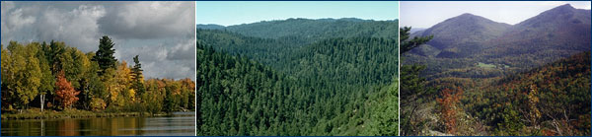
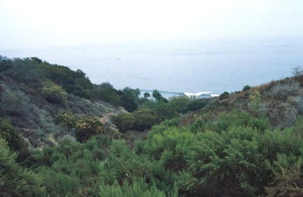
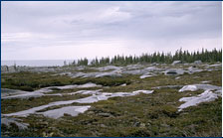
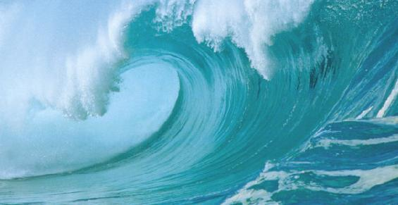
Global Biomes
Boreal
Tropical
Desert
Ice
Temperate
Chaparral
Tundra
Ocean

Slide 2
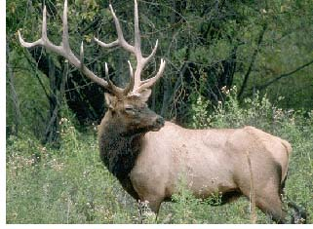
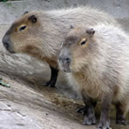
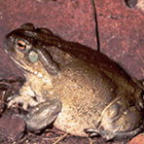
Score________
APES: Global Biomes Lab
Name__________________________________
Organisms Biome Common Name Diet Competition Predators
Other herbivores, deer, moose
Bears, Mountain Lions
Elk
Leaves
Boreal
Cervus elaphus
Capybara
Leaves
Other herbivores
Large cats. Jaguars, etc
Hydrochoerus hydrochaeris
Rainforest
Insects, small rodents
X
X
Toad
Bufo alvarius
Desert

Slide 3
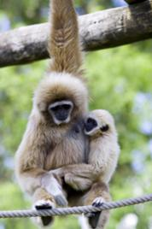
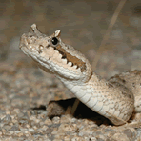
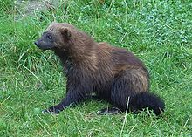
Score________
APES: Global Biomes Lab
Name__________________________________
Organisms Biome Common Name Diet Competition Predators
X
X
Fruit
Other
Rainforest
Hylobates lar
Birds of prey, Hawks, Falcons, etc.
Birds of prey, Hawks, Falcons, etc.
Rattlesnake
Rodents
Desert
Crotales cerastes
Wolverine
Carrion
Bears, Wolves, etc.
Humans
Gulo gulo
Temperate

Slide 4
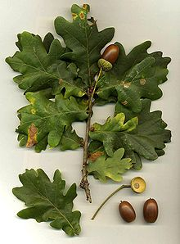
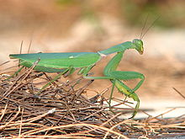
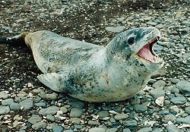
Score________
APES: Global Biomes Lab
Name__________________________________
Organisms Biome Common Name Diet Competition Predators
Other trees (shade = less sunlight)
Oak
Photosyn-thesis
Insects, disease
Oak
X
Quercus robur
Other insects, spiders
Praying Mantis
Other insects
Birds
Sphodromantis viridis
X
Penguins, fish
Polar Bears, Walruses
Killer Whales
Leopard Seal
Hydrurga leptonyx
Ice

Slide 5
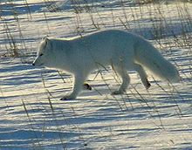
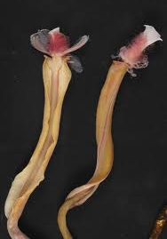
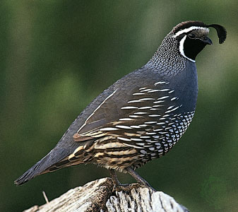
Score________
APES: Global Biomes Lab
Name__________________________________
Organisms Biome Common Name Diet Competition Predators
Birds of prey, Eagles, Hawks
Rodents, birds
Wolverine, Wolves, etc.
Arctic Fox
Alopex lagopus
Tundra
Tube worm
Plankton
Other filter feeders
X
Ocean
Riftia pachyptila
California Quail
Seeds, Insects
Other birds
Snakes, Coyotes
Callipepla californica
X

Slide 6
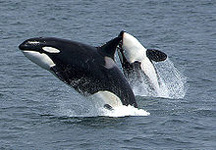
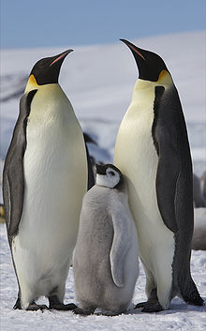
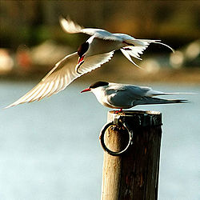
Score________
APES: Global Biomes Lab
Name__________________________________
Organisms Biome Common Name Diet Competition Predators
Killer Whale
Fish, seals, whales
Sharks
Human
Orcinus orca
Ocean
Other penguins and sea birds
Emperor Penguin
Fish, crabs
Leopard seal
Aptenodytes forsteri
Ice
Arctic Tern
Other sea birds
Large cats, gulls , skuas
Fish
Sterna paradisaea
Tundra

