Slide 1
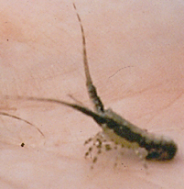
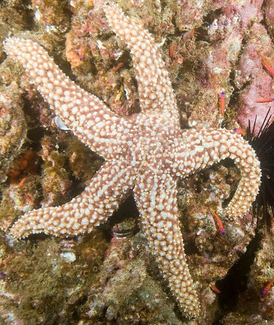
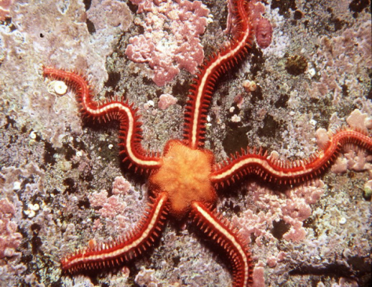
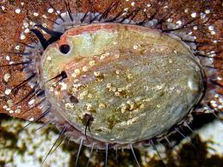
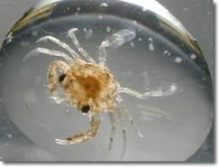
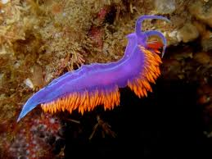
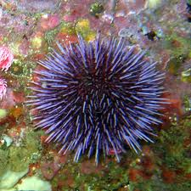
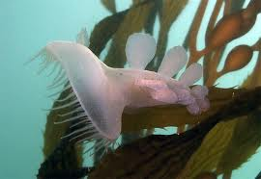
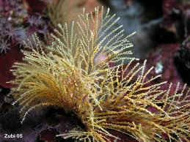
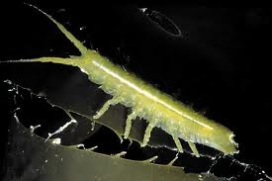
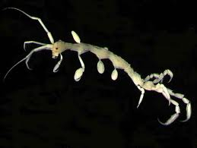
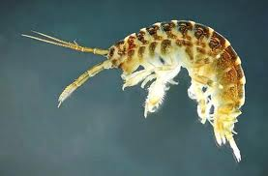
nku.edu
phtotshelter.com
Itsnature.org
outdoorcentral.com
California Spiny Lobster (juvenile)
Seastar
Brittlestar
Abalone
scubetube.org
coldwaterimages.com
fishjournal.com
Crab (juvenile)
Nudibranch (various colors)
Melibe
Sea urchin
starfish.ch
seaotter.com
calacademy.org
mirror.co.uk
Bryozoan
Isopod
Caprellid
Gammarid

