Slide 1
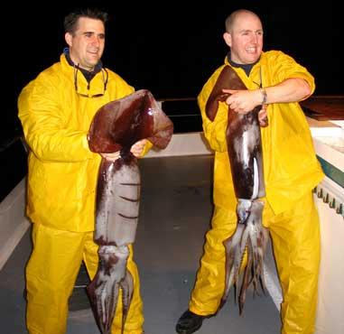
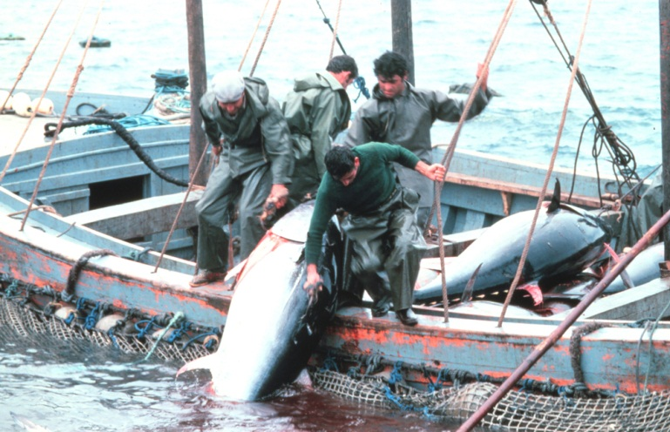
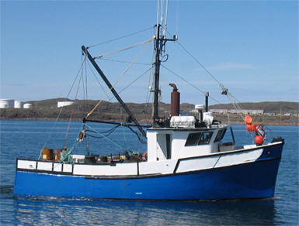
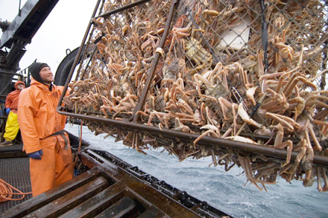
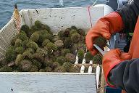
FISHERIES
fieldandstream.com
fao.org
tc.gc.ca
tc.gc.ca
eujacksonville.com
maine.gov
Notes:
Fisheries are found throughout the world from large commercial fisheries (e.g. tuna) to small artisanal fisheries (e.g. Aleutian Eskimos). Fisheries have provided a source of sustenance for millions of people for over thousands of years, however, it is not an inexhaustible resource. They are limited by a variety of factors from predation to reproduction to food availability, and can become easily unstable if not managed in a sustainable way. In fact, over the past few decades we have seen a dramatic decrease in fisheries. Some speculate this is due to overfishing while others say that it may be a normal cyclical pattern that occurs randomly over thousands of years. In either case, mismanagement of these resources can severely effect the present populations, which will certainly have ramifications for the future.
This lecture is intended to provide the students with a summary of global fisheries; using specific examples of methods and techniques used.

Slide 2
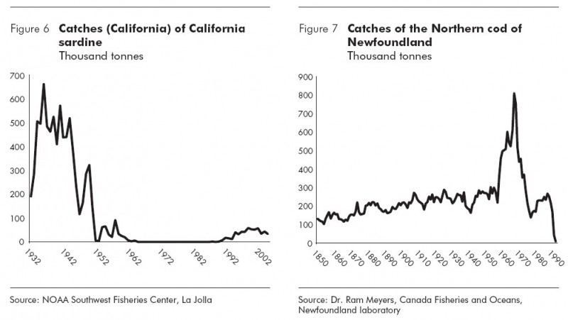
COLLAPSE
?
?
Notes:
Activity: Graphical analysis of 2 fisheries.
Note: This is a great opportunity to engage the students by having them guess why the fisheries have declined. Elaborate on each of their answers.
Reasons for the decline:
Fig 1. The fishery collapse was due to additive effects from both depressed cold-water upwellings (cold = nutrients/food) associated with ENSO events and increased fishing pressure due to an advancement in fishing gear and vessels.
Fig 2. The fishery collapse was due to additive effects from both increased fishing pressure due to the advancements in fishing gear/vessels specifically targeting larger more reproductive individuals, and improper management of the fishery.

Slide 3
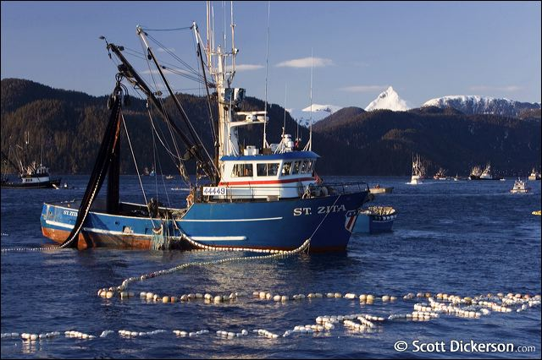
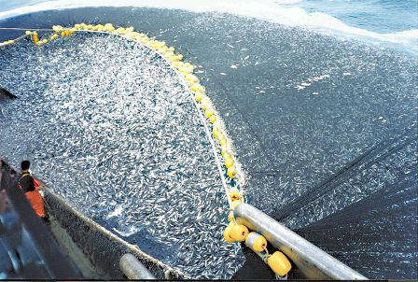
COMMERCIAL
500 species regularly caught
  Employs 15 million people worldwide
scottdickerson.com
In 2010:
  145 million tons taken
  $107 billion
oceana.org
Notes:
Commercial fisheries can have a significant effect on global communities, providing both economic and social impacts. These fisheries catch an estimated 500 species worldwide, and employ nearly 15 million people. Many of these people live and work in communities that have developed strictly for or indirectly from these commercial fisheries.
In 2010 an estimated 145 million tons of fish were caught with a value of nearly $107 billion, making it one of the largest global industries based on revenue. Over the past decade there has been very little change in global fisheries revenue causing many to believe that fish stocks are rebounding or able to withstand the effects of overfishing. However, before we can come to such a conclusion we must also consider other external factors such as improvements in fishing equipment (e.g. gear, boats, bait, etc.). These effects were clearly seen during the Atlantic Cod fishery collapse when improvements in fishing gear increased the overall catch rate while reducing the effort needed. This of course skewed the fishery stock numbers until it was too late and the fishery collapsed.

Slide 4

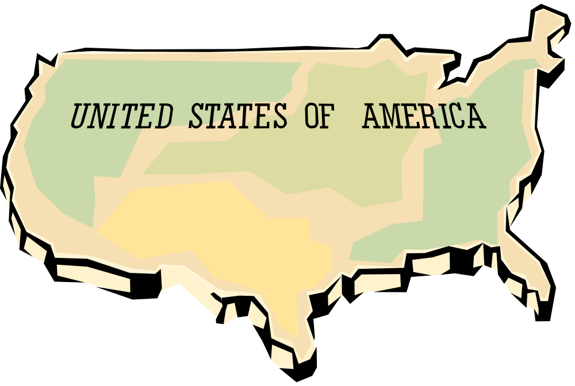
PROBLEM?
World per capita consumption of seafood in 2009 = 17.5 kg/yr
U.S. per capita consumption of seafood in 2009 = 7.5 kg/yr
Notes:
According to the Food and Agriculture Organization (FAO) it is estimated that in 2007 the United States consumed nearly 24.05 kg of seafood per capita, while the global per capita was approximately16.69 kg. Although the United States has only 5% of the world’s population it consumes nearly twice as much seafood.
Activity: Does anyone see a problem with these numbers?

Slide 5
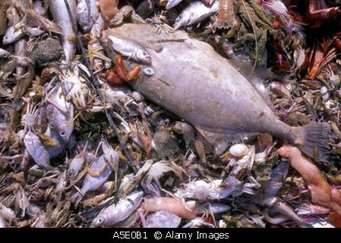
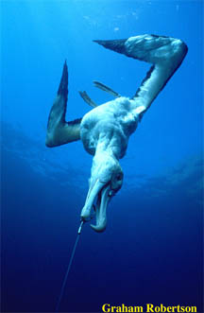
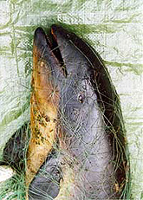
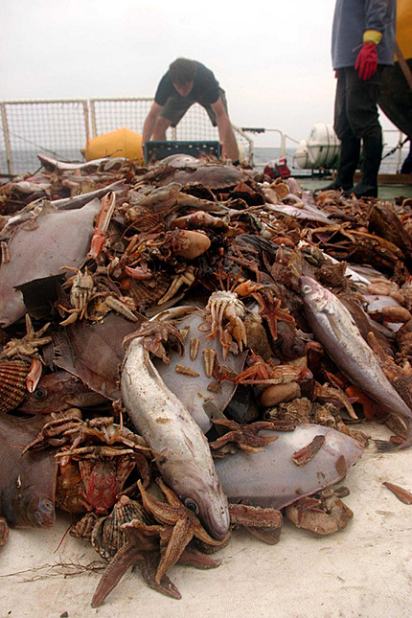
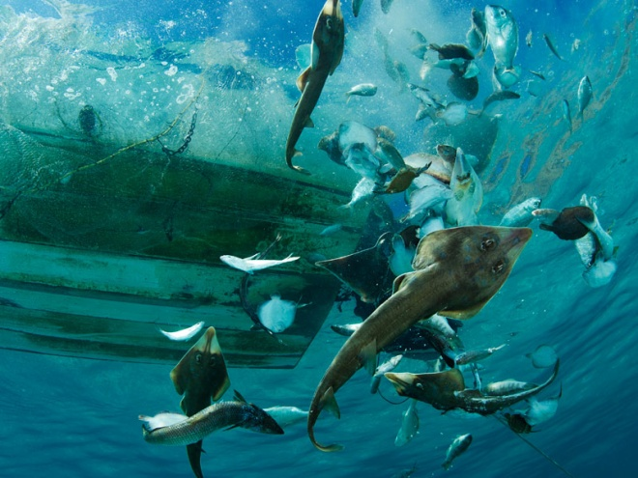
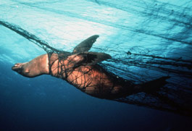
MISMANAGEMENT
Overfishing
Commercial extinction
Bycatch (27 million metric tons annually)
Targeting smaller species on the low end of the food chain
ambergriscaye.com
oikonos.org
duke.edu
trendyink.net
isiria.files.wordpress.com
motherjones.com
Notes:
Activity: This slide is to show the effects of fisheries mismanagement on both fish and marine mammals.
Note:
Group 1 –Many types of fishing techniques (e.g. bottom trawl, drift nets) do not discriminate between species caught causing numerous amounts of bycatch to be thrown overboard. It is estimated that roughly 60-70% of the species caught in bottom trawls are considered bycatch and disposed of. This can have a dramatic effect on the local area removing important grazers and predators that maintain the ecosystem. Many have wondered why don’t the fisherman keep everything to sell or consume. In most cases it is because fisherman are allotted a certain amount of seafood per fishing season. Since many fisherman specialize and/or have connections for specific species they maximize their space, profit, and time by only focusing on those species. Therefore, any additional seafood caught is not considered economically valuable causing much of it to be thrown overboard.
Group 2 –Many types of nets are used in fishing (e.g. drift, trawl, seine, etc.) all of which can cause severe harm to marine mammals. In addition to bodily harm, many marine animals die from their injuries or drown. This occurs when marine mammals get caught in the nets while submerged and are unable to surface for air. Although this happens in nets that are actively used throughout the fishing community, it is the derelict nets or the ones that are left on the bottom of the ocean floor that cause the most harm. Without the possibility of human intervention marine mammals that are caught in these nets will most likely die.

Slide 6
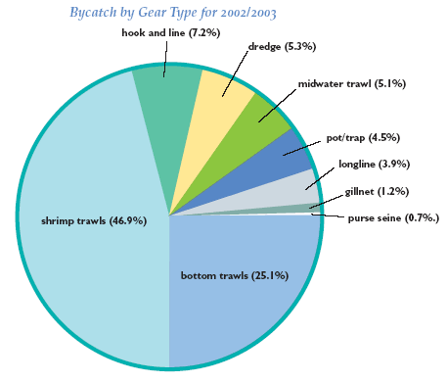
FISHING GEAR USAGE
fao.org
Notes:
Pie chart displays the percentage of bycatch reported within the United States in 2004 for each type of fishing gear used.
Activity: What 2 methods are used the most often?
Note: Shrimp and bottom trawls.
Activity: Emphasize that trawling makes up for nearly 72% of fishing methods/gear used.

Slide 7
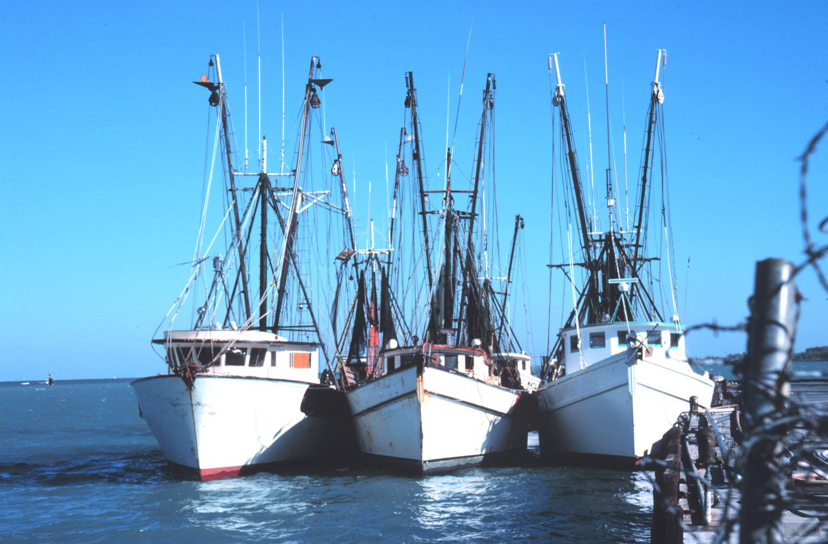
FISHING TECHNIQUES
lenfestocean.org
Notes:
Activity: Now lets take a look at what exactly a few of these methods are.

Slide 8
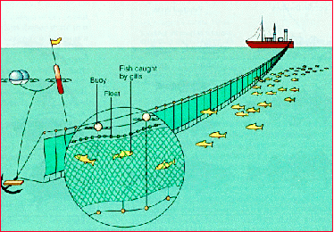
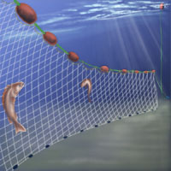
GILL/DRIFT NET
montereybayaquarium.org
Notes:
Activity: Image shows a cartoon rendition of what a gill net looks like when deployed.
Note: Using high tech devices fish are located and targeted. Small catcher boats pull the lead line of the drift net away from the main vessel, which can reach hundreds of miles in length and be weighted to stay at desired depths. The net is then allowed to drift overnight and hauled in by factory ships to be processed on board by canning or freezing. Nets that are lost or abandoned at sea due to storms or purposely cut loose can become ghost nets, entangling marine animals. In addition, the remaining netting material (e.g. floats, top lines) can washed ashore damaging coastal habitat and/or get caught on boat screws causing damage and safety concerns. With the growing concerns regarding drift nets, the United Nations enacted the “1991 Drift Net Moratorium”, which required the President to impose economic sanctions against countries that fail to eliminate large-scale driftnet fishing.

Slide 9
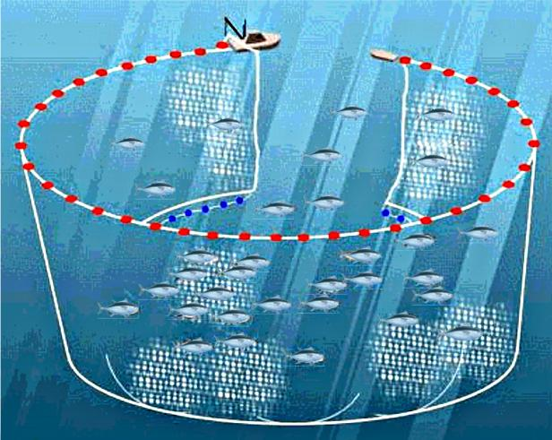
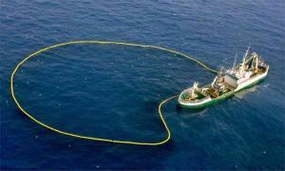
PURSE SEINE
svn.vefir.net
Notes:
Activity: Image shows a cartoon rendition of what a purse seine looks like when deployed. Inset image is an actual purse seine when deployed.
Note: Purse seines are used to target fish who tend to school or aggregate. They are similar to drift nets in that a small catcher boat is used; however, they are much smaller and are hauled in using a drawstring method similar to a purse.

Slide 10
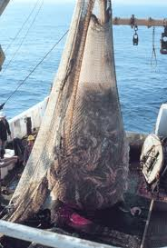
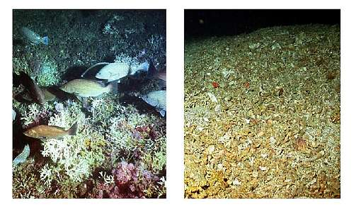
TRAWLING
Video
t0.gstatic.com
vinniesblog.com
Notes:
Activity: Trawling is one of the most controversial and highly damaging fishing methods employed. Trawling nets are deployed overboard with large weighted wheels and support beams that allow the net to stay on the bottom during deployment. These wheels and beams indiscriminately travel over anything that they encounter damaging the area in the process.
Note: Image on left shows the catch hauled in after a trawl. Bottom right images shows a reef before and after a trawl. *Video hyperlink goes to a YouTube video showing an actual trawl being used. During the video notice the school of fish trying to escape in the beginning and the amount of physical damage that is done on the reef.
Video link: http://www.youtube.com/watch?v=zikSzUhUGtA

Slide 11
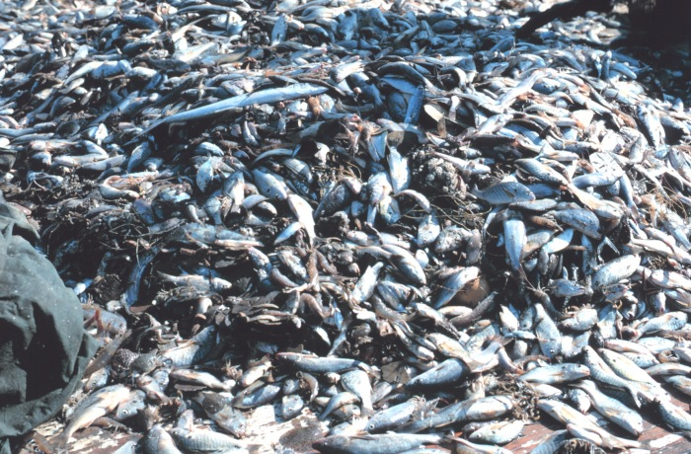
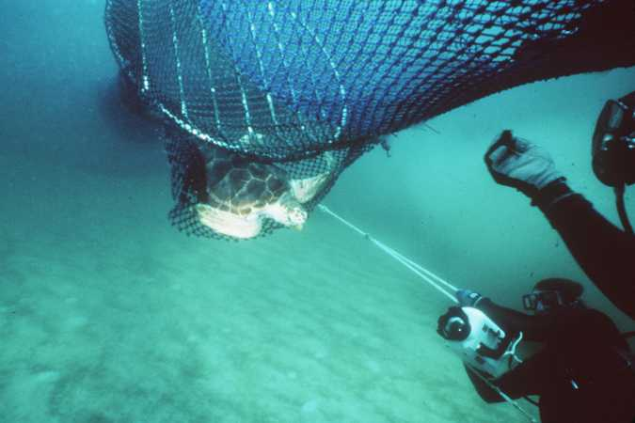
POSSIBLE SOLUTIONS?
Trawling: Bycatch in shrimp trawling is very high (25 to 83% of the catch is discarded), turtles often caught in trawls.
SOLUTION: trawls with trap doors to let turtles escape
nmfs.noaa.gov
Notes:
Activity: Ask the audience what they would suggest as a possible solution to the problem.
Note: Point out that this solution is only one of the many choices available.
Note: Left image shows the large of amount of bycatch collected during a shrimp trawl. Right image is one of a turtle exclusion device or TED. Click on the image to open up a video on You Tube showing a TED in action.
Video Link: http://www.youtube.com/watch?v=j9olIycYg0c

Slide 12
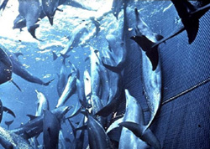
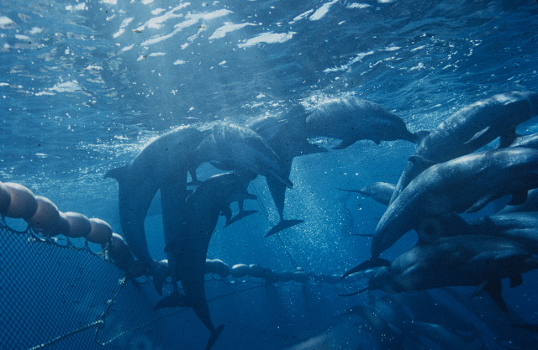
POSSIBLE SOLUTIONS?
Purse seine: Tunas are known to hang out under pods of dolphins, nets set around pods of dolphins result in many drowning.
SOLUTIONS: Nets not set around dolphin pods and/or employ — “backing down”, a technique that lowers upper edge of net letting dolphins escape
greenpeacefoundation.org
swfsc.noaa.gov
Notes:
Activity: Ask the audience what they would suggest as a possible solution to the problem.
Note: Point out that this solution is only one of the many choices available.
Note: Left image shows the large of amount of dolphins trapped in the net. Right image shows the dolphins escaping after the “backing down” method was employed.

Slide 13
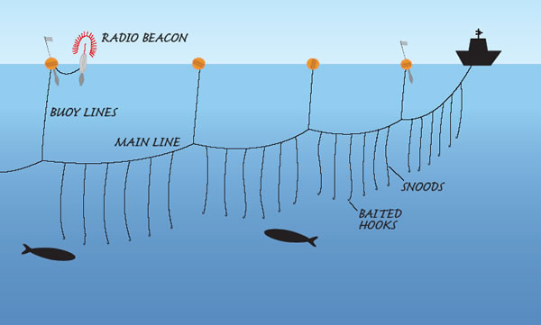
POSSIBLE SOLUTIONS?
Driftnets: indiscriminate entangling of many sorts of marine animals
SOLUTION: banned in oceanic fisheries (but some countries still using them)
Long lining: Many albatross drown trying to snatch bait from long lines being deployed. snagged on hooks and pulled under.
SOLUTION: deploy in the dark or with special rig to let line out under water.
afma.gov.au
Notes:
Activity: Ask the audience what they would suggest as a possible solution to the problems.
Note: Point out that these solutions is only a couple of the many choices available.
Note: Image shows a cartoon rendition of a long line.
In order to address these issue we must practice sustainability, or the act of using only what is necessary. For example, sustainable fisheries can include things such as:
- Limiting the amount of harvest thereby allowing enough remaining fish stocks to reproduce.
- Creating alternatives to wild caught fish, such as fish farms and/or aquaculture.
- Creating laws and abiding by them for specific fishing seasons as to allow for fish stocks to repopulate.
- Creating literature and/or informing the general public about sustainable fishing practices, which could include what fish to eat and when to eat them.
It is estimated that over 1 billion people globally rely directly on the ocean for their livelihood. This includes commercial fisherman who sell the product to foreign nations to individual families that fish for sustenance. Although the world is divided into nations we all share a common resource which is the oceans. Just recently trash and debris that was pulled out into the ocean from the tsunami that occurred in Japan is now reaching coastlines along parts of the Western United States. This is just one example of how damage caused by or to one nation can effect others on a global scale. The issue concerning a common resource is better known as the “Tragedy of the Commons”. Simply put, the situation arises when multiple individuals and/or parties share a common “limited” resource but act in self-interest to maximize their own gain, regardless of the effects to the other parties involved. This can occur in such things as fish stocks, grazing lands, water, etc.
We will look into this topic further in the next lesson plan, providing a lab activity and video as supportive material.

