Slide 1
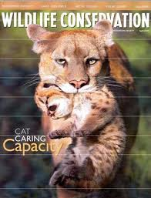



What is CONSERVATION???
clipartof.com
unm,.edu
marketwire.com
nationalschoolsupply.com
Notes:
Conservation is the scientific study of nature with the aim of protecting species and ecosystems from overexploitation and/or extinction. In many cases this involves an interdisciplinary approach to research combining subjects such as social and biological sciences, economics, and natural resource management. Conservation can range from protecting large regions such as watersheds and rainforest to specific animals like the African elephant and Great White shark to preserving some of our natural resources such as freshwater and clean air.
To strengthen the understanding of conservation students will be placed into groups to participate in an interactive laboratory exercise. Instructions are provided in the activity handout sheet.
What is CONSERVATION???

Slide 2
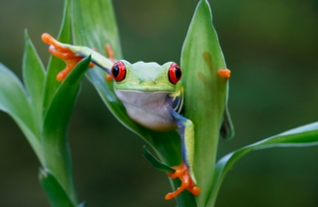
Why do we care?
uimages.org
Delicate skin – sensitive to environmental change
Feed on insects (mosquitoes) – carriers of disease
Poison glands – possible medicinal use
Scientific research, culture, and food
Notes:
Organisms can provide a wealth of benefits, from possible medicinal uses to environmental indicators. Examples like the South American Tree Frog, which is threatened by the destruction of the Amazon Rainforest, consumes numerous insects reducing vectors for disease, provides possible medicinal uses from poison glands, and acts as an environmental indicator through its sensitive skin by detecting trace amounts of impurities in the air and water.
What other organisms have such benefits? Are some more important than others, or do they simply address different issues and concerns? During the lab activity students will be given the opportunity to research an individual organism noting any significant social, biological, and economic benefits. Once completed students will have a chance to share their information with the class in an attempt to convince others why their organism is important. This activity will teach the importance of organisms and the interconnectedness between causes and effects in our environment. It will also introduce resource management and the difficulties in addressing environmental issues.
Activity – Have the students look at the slide for a couple of minutes and then ask them why is this frog important to conservation?
Notes: Let them elaborate on the answers. It may help to have students put their suggestions on the board for discussion.
Sensitive skin – can act as an indicator for environmental change (toxicity, pollution, etc.). Skin may possess a gene that can later be used for pollution analysis.
Feeds on mosquitoes which are one of the leading global vectors for disease.
Poison glands – may provide pharmaceutical and medicinal properties/applications.
Research – much more can be learned about the organisms life history, ecosystem role, and possible benefits for humans.
Emphasize to the class that this is only a single organism and that there may be many that have yet to be discovered.

