Slide 1
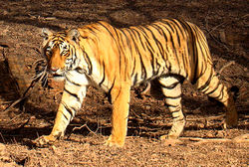
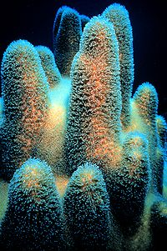
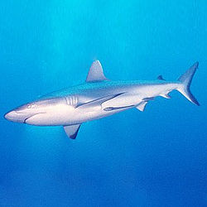
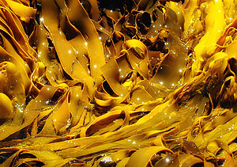
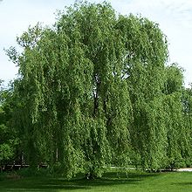
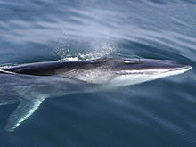
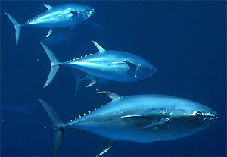
TIGER
SHARK
CORAL
KELP
WILLOW
Fin Whale
TUNA
Notes:
*All photos are credited to wikimedia.com. The credits were omitted from the handouts and lecture so that students were not provided with a specific source of online information.

Slide 2
wikimedia.org
Thunnus albacares
TUNA

Slide 3
Salix alba
WILLOW

Slide 4
Macrocystis pyrifera
KELP

Slide 5
Carcharhinus amblyrhynchos
SHARK

Slide 6
Dendrogyra cylindricus
CORAL

Slide 7
Panthera tigris
TIGER

Slide 8
Balaenoptera physalus
FIN WHALE

