Slide 1
Atoms – Building Blocks of Life
This presentation is for the instructor, not to be used in the classroom.
This lesson will teach the students that everything is made of matter, and all matter is made up of atoms, which can undergo infinite rearrangements.
Notes:
AUTHORS: Maryann Tekverk, PhD student, Scripps Institution of Oceanography and Jerry Ruiz, teacher, Dana Middle School, San Diego, CA
WHY: This lesson is used to teach students that everything is made of matter, all matter is made of atoms, and that matter can be rearranged into infinite arrangements. Understanding these things is key to learning atomic theory.
SUMMARY: This lesson plan assumes that students have heard that matter is made of atoms, but that their understanding is very basic and that they have not explored the concept of conservation of mass. These activities are meant to be the beginning of a unit that will continue expanding students’ understanding of atomic structure using tangible and relatable examples. The objective is to give students a fun and memorable hands-on appreciation for the permanence of individual atoms along with the understanding that they can undergo infinite rearrangements. The unit will provide a concrete example to refer back to as more advanced concepts of sub-atomic particles and stable isotopes are introduced and explored. It will also provide an introduction to trends on the Periodic Table.
WEBSITES USED IN THIS PRESENTATION: No websites are used in this presentation.
ADDITIONAL READING: n/a
CONTEXT FOR USE: This is the first one-day section a two-week unit focusing on atoms and trends on the periodic table. The following lecture is a lesson on elements and atomic particles. This lesson plan is designed for fifth and sixth graders. It assumes the students start with little or no knowledge of atomic theory and properties of matter.
MISCONCEPTIONS:
- Particles are viewed as mini versions of the substance they comprise – Be sure to clarify that Legos are like atoms conceptually, but not in shape and structure. Also be sure to clarify that students are NOT made of tiny Legos.
- No differentiation is made between atoms and molecules – This will be addressed in later lessons but may come up.
EVALUATION TIPS: Post-Evaluation is in the form of a class discussion.
TEACHING NOTES: The concepts in this lesson will be initially hard to grasp and may take a few reinforcing lessons before they are concrete to all students.

Slide 2
Reasoning and Context
The lesson assumes that students understanding of matter is very basic and that they have not explored the concept of conservation of mass.
It is important to have a fundamental knowledge of atoms to build upon before discussing bonding, energy exchange, and eventually chemistry.
Notes:
All of the slides in this presentation are meant to walk the instructor through the lesson.

Slide 3
Materials
6 boxes of at least 30 assorted Legos each
  You may need a few more boxes depending on how large the class size is. Its good to have 2-4 students per box of Legoes.
Notecards with a simple object written on both sides, e.g: tree, flower, bird, town, planet, bridge
  Students will be building objects written on the cards.
Science journals (one per student)
  These will be used throughout the 2 week lesson to record students’ thoughts and observations.
Notes:
All of the slides in this presentation are meant to walk the instructor through the lesson.
Its best to have the standard small square and rectangular Legos so that kids have to think to create the proper shapes for their objects. If they have doors and flowers and people already than the analogy to atoms is weaker. Also, it is best to have a plate in each box as a foundation.

Slide 4
Opening Question
What are you made of?
Write this question on the board/overhead
Students’ preliminary answers will be written individually in student daily science journals.
After students are given 5-10 minutes to think and write, each table can give one or 2 answers.
Notes:
All of the slides in this presentation are meant to walk the instructor through the lesson.
Opening questions such as this are used to begin each day of instruction. Have students copy down the question and then do their best to write something down. It is good to pick questions which make students think, but are not inaccessible to those who have not been exposed to the material yet. For example “What are atoms?” might discourage students who cannot formulate an answer. By the second week these questions can also be used to reinforce all the concepts already taught.
Discussion does not need to be very long and detailed, it is more important that students think of answers on their own so they are in a thoughtful mood when they begin building with and thinking about the Legos.

Slide 5
Activity
Students will be told to complete a quick Lego building challenge. Each group of two will be given a box of Legos with an included index card with a common object written on side one and another on side two. The teams will be asked to build their first object in a five minute time period.
At the end of this time, student groups will be asked to share their creations (a few seconds per group), then told to take their creations apart and return the Legos to the boxes as quickly as possible.
Each group will pass their box to the next group and repeat the exercise, building the object written on side two of the card.
After a second quick sharing of the creations, the Legos will be put away
Notes:
All of the slides in this presentation are meant to walk the instructor through the lesson.

Slide 6
Guided Discussion
Introduce the concept that atoms are the building blocks of the universe
Explain and expand upon the responses that the students wrote in their journals and observations they made while building and deconstructing their objects.
  Ask, “How are you like Legos?”
After some discussion, share the following passage from Chapter Five of “Sophie’s World” by Jostein Gaarder with the students.
Notes:
All of the slides in this presentation are meant to walk the instructor through the lesson.
While students will make many valuable observations, the most important to emphasize is that atoms come in a limited number of types, but can be rearranged in an infinite number of ways without any change in the individual atom, like Legos.
At this point students generally bring up atoms. Keep this discussion short until after the section of Sophie’s World is read. Students may bring up molecules or examples of molecules as well, if they do, tell them that a discussion of these will continue after the reading activity and then afterwards, ask them to make a comparison between a molecule and their Legos, and ask if they know how an atom is different than a molecule.
Gaarder, Jostein. "The Atom Theory." Sophie's World: A Novel about the History of Philosophy. New York: Farrar, Straus and Giroux, 1994. 43-45. Print.

Slide 7
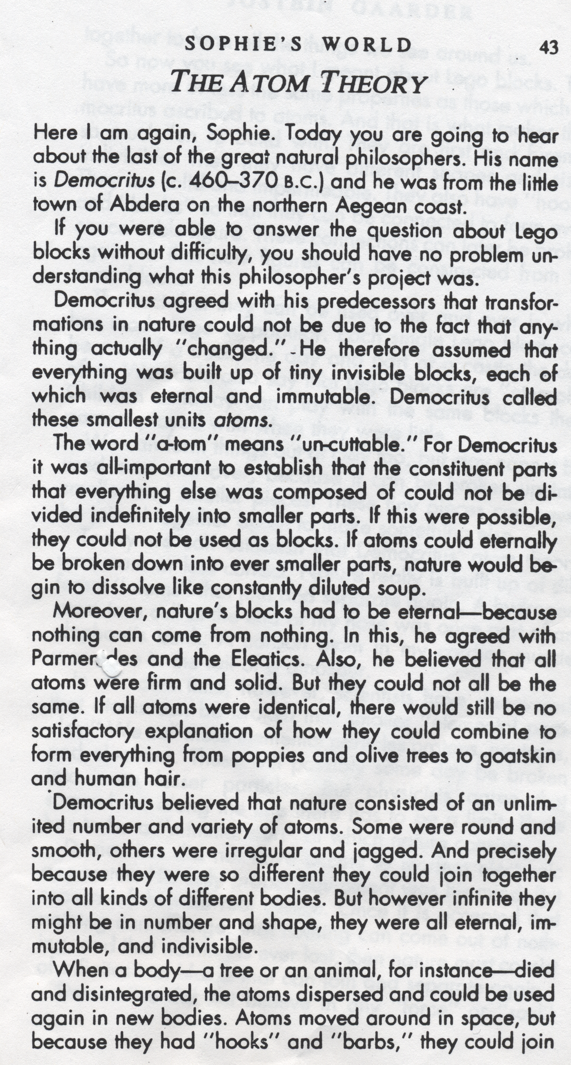
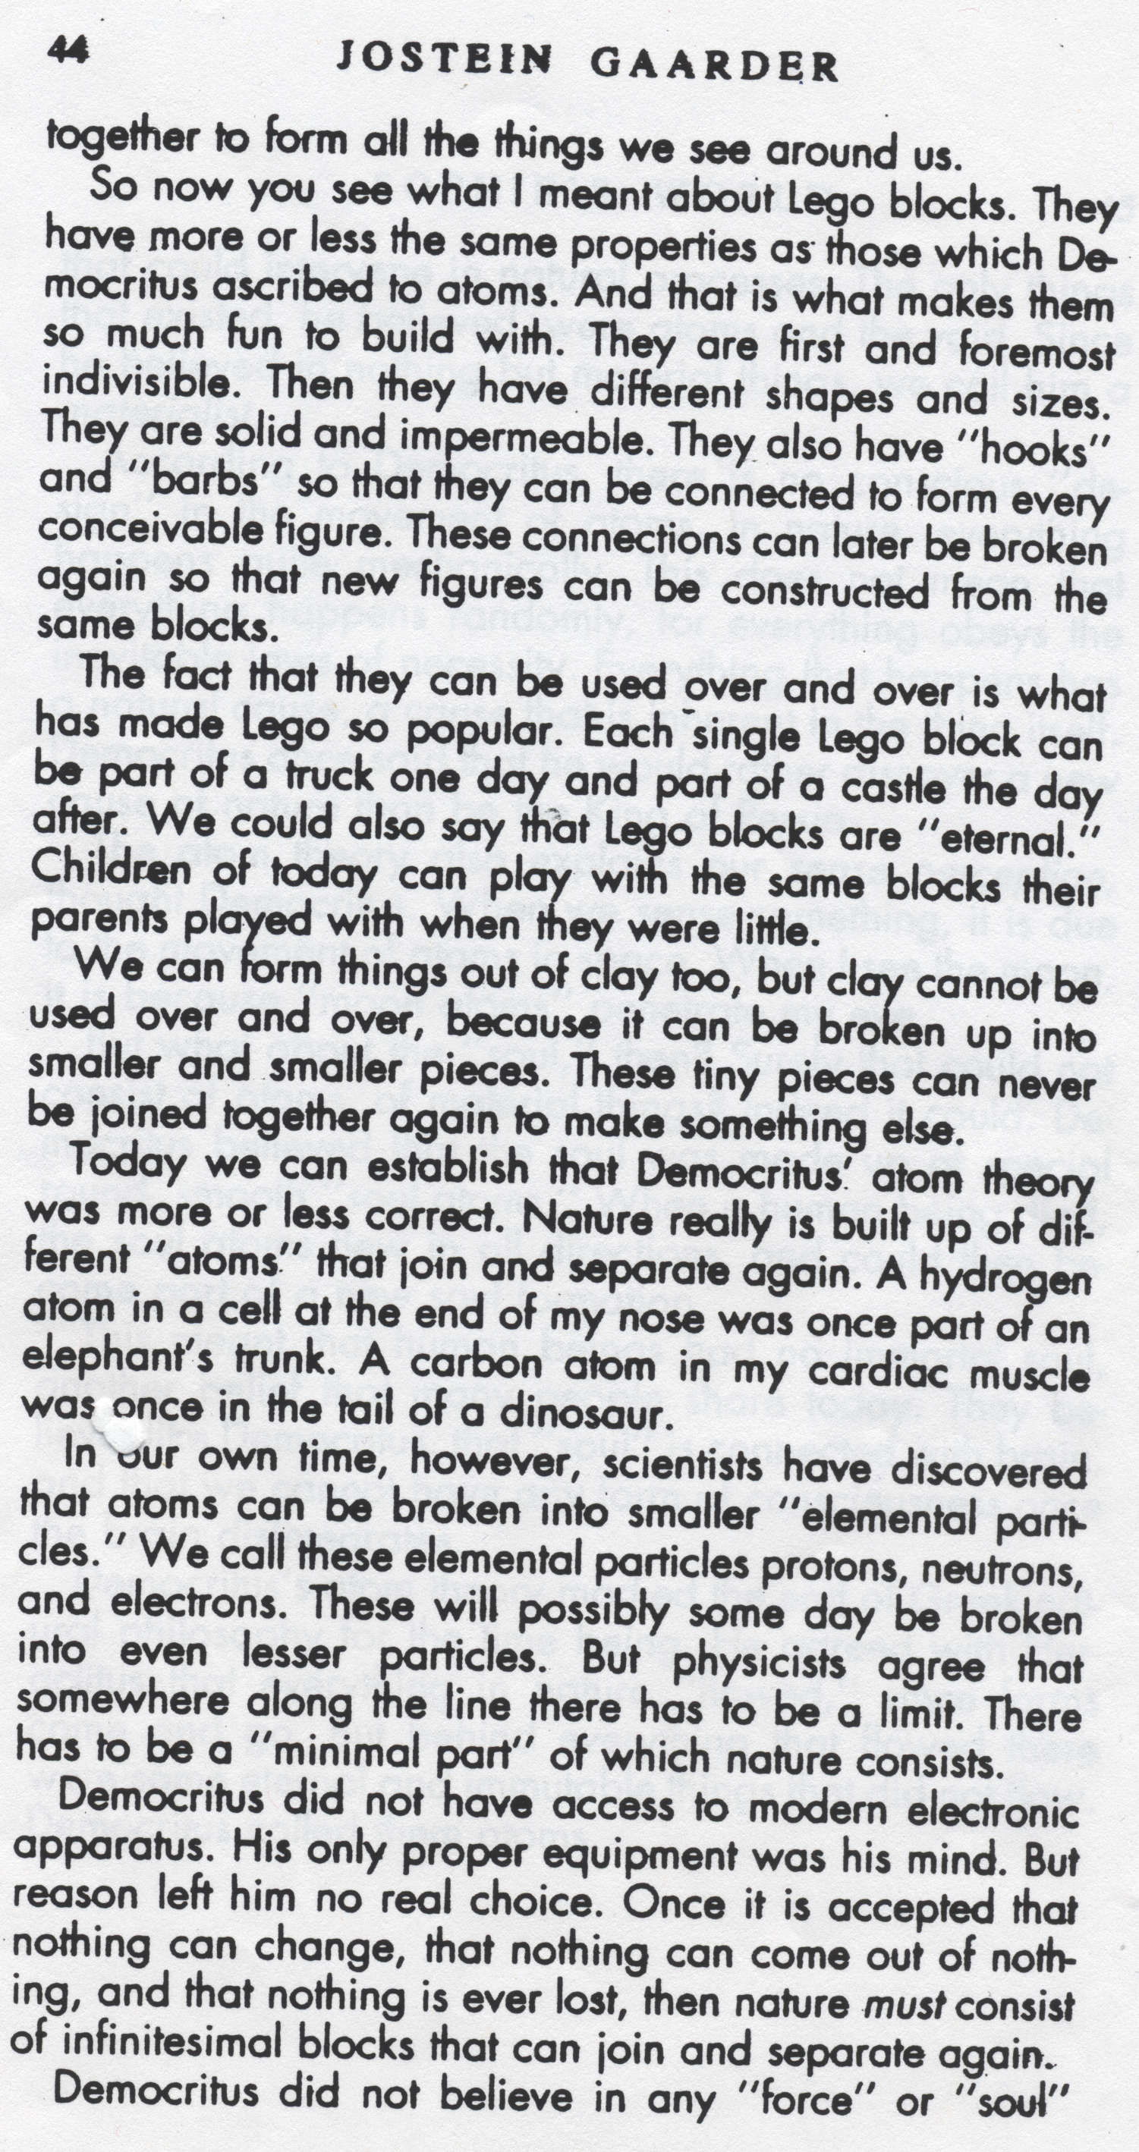
In this passage, a discussion takes place detailing how the first descriptions of atoms by Democritus were, in many ways, a design description for Legos of the future.
Notes:
All of the slides in this presentation are meant to walk the instructor through the lesson.
This may be read by students or by the teacher, depending on the reading level of the class. Even without students having a background in atomic history, this passage is entertaining and reaffirms the basic fundamental properties of atoms and atomic behavior.
This piece is a bit lengthy, so it is good to have students share the reading of it. You can choose to end it at any point you see fit on page 44-45. I ended the passage at the “nothing can come from nothing” paragraph on page 44 (where the red line is) and then we discussed the passage, because with younger students the additional material may further misconceptions. Also, there are a few phrases which are difficult for younger kids to understand, and it is good to define them as you go through. Make sure to tell students to ask for the definition of any phrase they do not understand.
Gaarder, Jostein. "The Atom Theory." Sophie's World: A Novel about the History of Philosophy. New York: Farrar, Straus and Giroux, 1994. 43-45. Print.

Slide 8
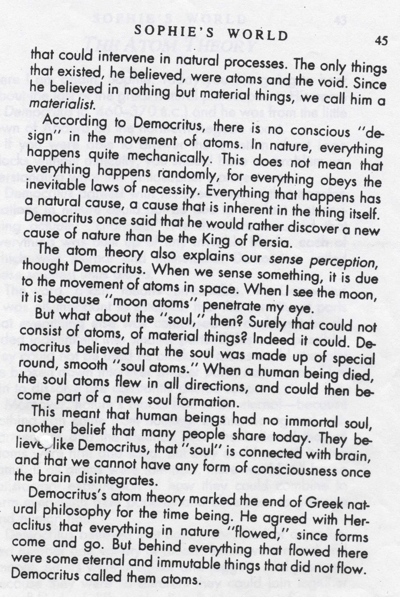
In this passage, a discussion takes place detailing how the first descriptions of atoms by Democritus were, in many ways, a design description for Legos of the future.
Notes:
All of the slides in this presentation are meant to walk the instructor through the lesson.
Gaarder, Jostein. "The Atom Theory." Sophie's World: A Novel about the History of Philosophy. New York: Farrar, Straus and Giroux, 1994. 43-45. Print.

Slide 9
Discussion
Ask the students what their thoughts were when hearing the piece, and specifically ask one student to now clarify how Legos are like atoms. Have others help them if necessary.
Notes:
All of the slides in this presentation are meant to walk the instructor through the lesson.
While this may seem unnecessarily repetitive, these concepts are fundamental to the following two weeks of instruction.
Note: The section on Sophie’s World is above the level of the average sixth grade reader, but I was pleasantly surprised by the thoughtfulness of students’ responses. My recommendation is to take the risk of reading it, as some students may be inspired by it and it can foster interesting discussion.

Slide 10
Conclusions
Ask students to consider real-life examples of atoms moving from one object to another.
Ex: Photosynthesis and respiration (a good example to conclude with is the fact that a plant in the room has exchanged atoms with all of the students in the room, and vice versa)
Some students may bring up more disgusting exchanges, but these are valid and memorable examples as well, and will reinforce the basic principles learned.
Continue to emphasize that all life is made of atoms
Notes:
All of the slides in this presentation are meant to walk the instructor through the lesson.
Students may ask questions such as “Is this apple made of atoms?”, “Am I made of atoms”, “Is this water made of atoms”. A good way to get them thinking about atomic exchange is to get students thinking about a process, such as eating an apple, or photosynthesis and respiration of a plant.
Gaarder, Jostein. "The Atom Theory." Sophie's World: A Novel about the History of Philosophy. New York: Farrar, Straus and Giroux, 1994. 43-45. Print.

