Slide 1
Atoms, Elements, and Properties of the Periodic Table
This presentation is for the instructor and the students.
Only the “What is an Element?” section (orange) is for use with students.
The lesson will walk the students through constructing a model of Bohr’s Atom.
Notes:
AUTHORS: Maryann Tekverk, PhD student, Scripps Institution of Oceanography and Jerry Ruiz, teacher, Dana Middle School, San Diego, CA
WHY: This lesson will introduce students to atomic particles (protons, neutrons, electrons) which will allow for later discussion of atomic bonding.
SUMMARY: This is part 2 of a two-week unit focusing on atoms and trends on the periodic table. This lesson plan assumes that students know that matter is made of atoms, but that their understanding is very basic and that they have not explored atomic structure or learned about atomic particles.
WEBSITES USED IN THIS PRESENTATION: No websites are used in this presentation.
ADDITIONAL READING: http://www.webelements.com is a useful website for exploring the Periodic Table.
CONTEXT FOR USE: This lesson plan is part 2 of a two-week section designed for fifth and sixth graders. The lesson assumes the students start with little knowledge of atomic theory and properties of matter, but have been introduced to the concept of atoms and conservation of mass. The previous lesson uses Legos to teach that atoms are the building blocks of life, and the following lesson involves reporting on an elements physical and chemical properties
MISCONCEPTIONS:
Gases are not matter
Particles are viewed as mini versions of the substance they comprise
No differentiation is made between atoms and molecules
Air and Oxygen are the same
EVALUATION TIPS: Post-evaluation will involve discussion, and students ability to understand further examples of atomic theory. In addition, student’s Bohr Models can be evaluated for fundamental understanding.
TEACHING NOTES. It is best to start with the carbon atom as an example and walk students through making their own, and then explain the parts, if you do it in the other order it is too much information at once and students become confused about which atomic particles are which.

Slide 2
Opening Question
Can you think of some examples of atoms?
Have students write this question down and answer it in their journals.
If time allows, a short discussion can follow.
Notes:
This slide is for the instructor.

Slide 3
Materials
One large paper plate per student
Painter’s dots in three colors
  I used red, yellow, and green
  These are available at hardware stores and office supply stores
Pencils, markers, or pens
Notes:
This slide is for the instructor.

Slide 4
What is an Element?
Consists of only one kind of atom
Cannot be broken down into a simpler type of matter by chemical means
Can exist as either atoms or components of a molecule
Notes:
This slide is for use with students
Ask students the question and see if they have an answer before introducing this concept
Clarify each bullet by giving examples, asking students for examples and then confirming or denying whether they are true, and discussing why.

Slide 5
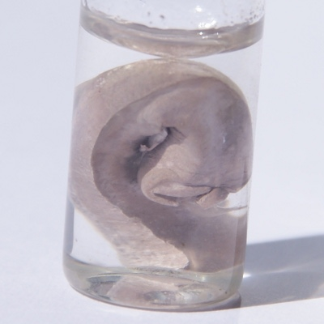
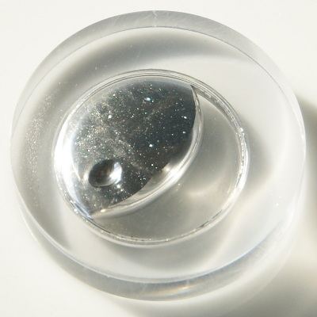
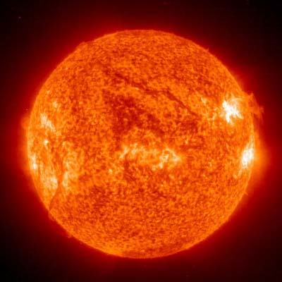
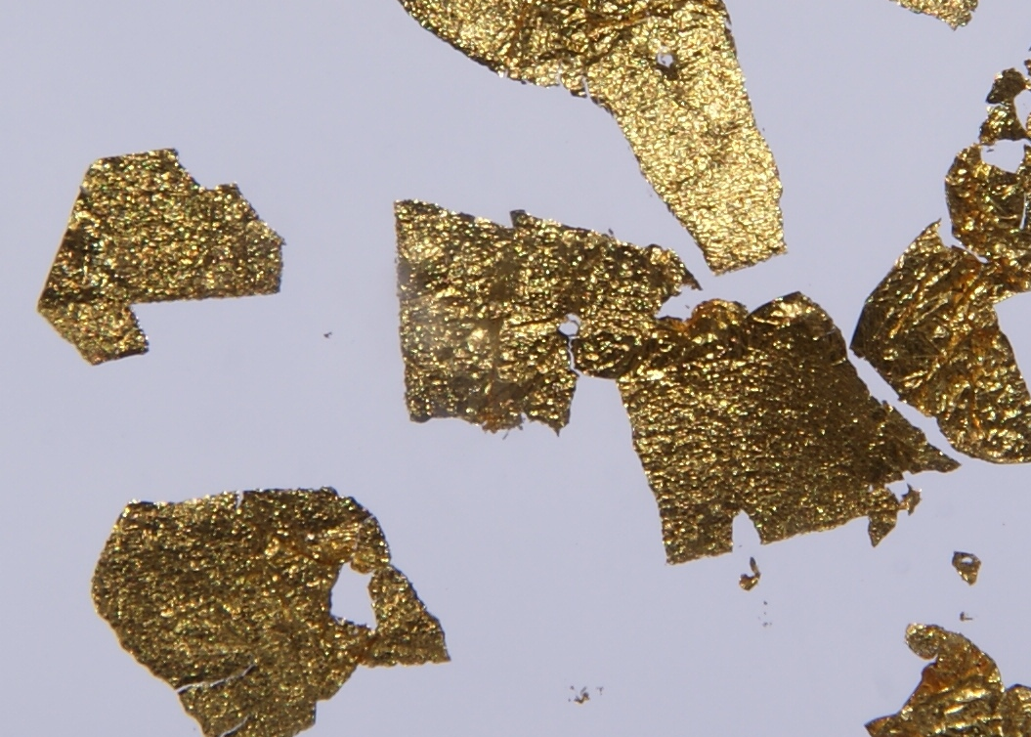
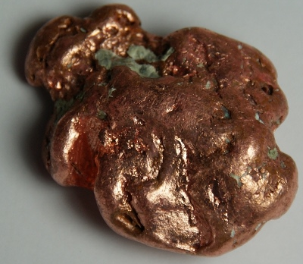
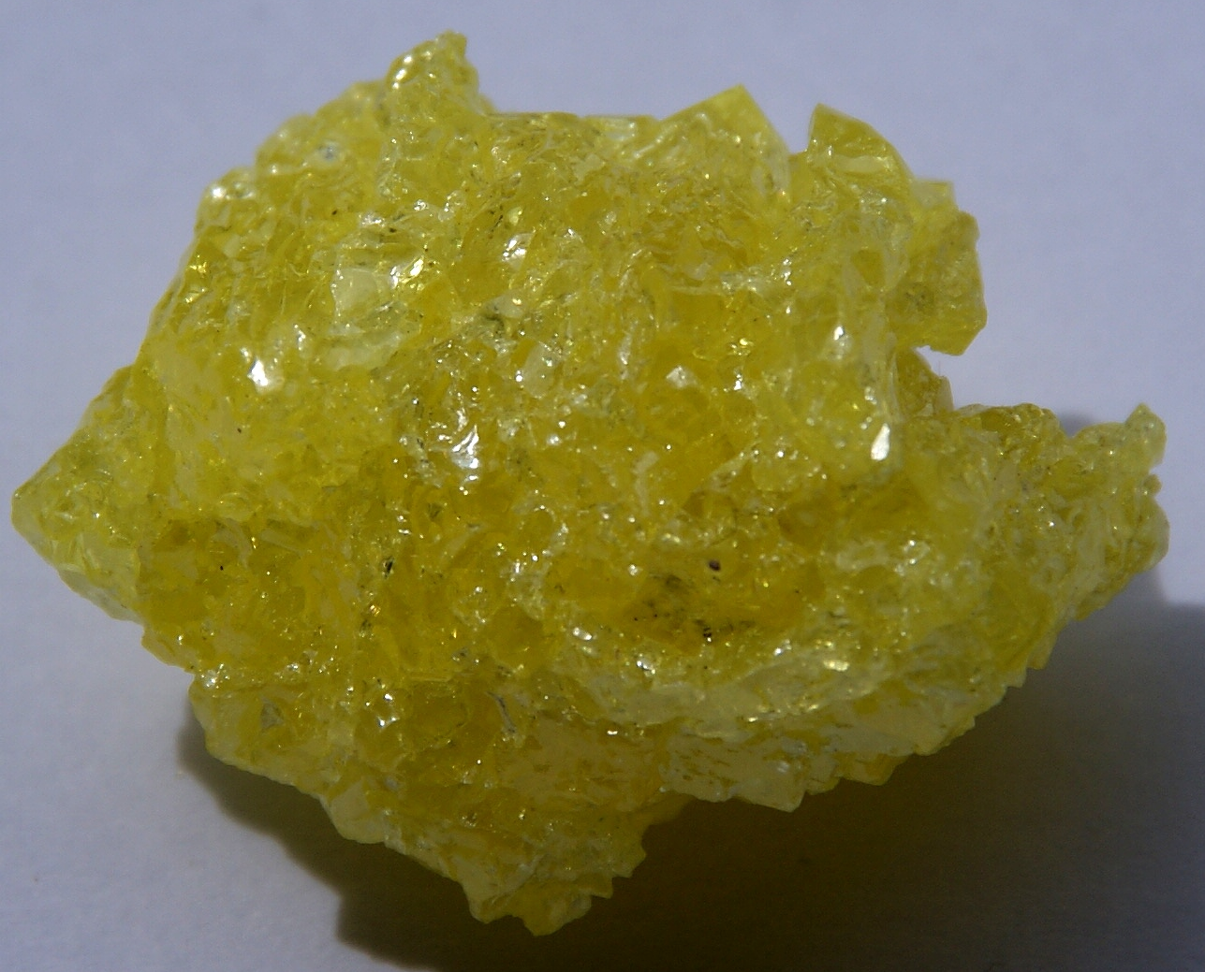
Examples of Elements
Sodium (Na)
Helium (He)
Mercury (Hg)
Gold (Au)
Copper (Cu)
Sulfur (S)
Notes:
Go through each example, pointing it out on the Periodic Table, and mentioning where it is found, and what state the element is at room temperature. Be sure to mention that the Periodic Table includes solids, liquids, and gases. Ask students if they know of any other examples.
Images are from http://images-of-elements.com – Images are public domain and can be shared and copied.

Slide 6
What distinguishes one element from another?
Notes:
For this slide, ask students for their ideas, before moving on to explain atomic particles. Students may say that elements are different shapes and sizes like the Legoes they used. Be sure to clarify that they “act like” Legos, but are not shaped like Legos.

Slide 7
Atomic Particles
Protons – positive charge (+)
  Defines what type of atom it is
Neutrons – neutral charge (0)
Electrons – negative charge (-)
Notes:
Have students copy this slide into their science journals, labeling the protons, neutrons, and electrons, and recording their charges.
Be sure to emphasize that protons define which atom is which, and point out that this is how they are listed on the Periodic Table.

Slide 8
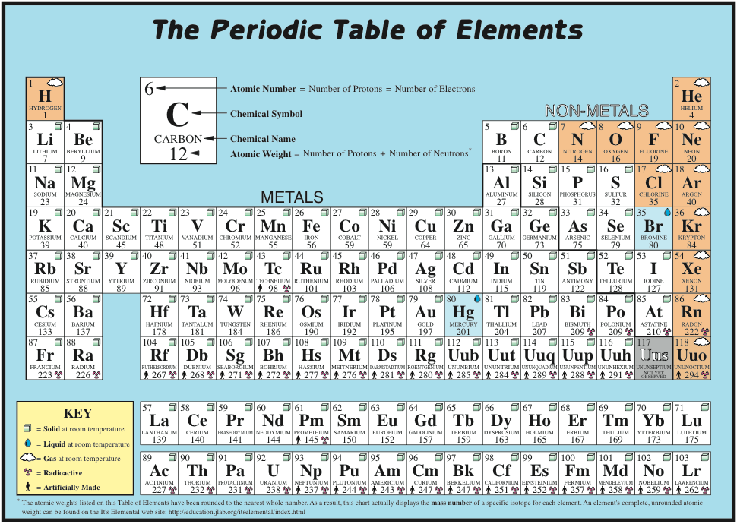
Notes:
Introduce the Periodic Table, and explain that it is arranged into rows and columns based on the properties of each of the elements.
After this is done, assign each student an element (starting with one and going up to ~30). Avoid elements with atomic numbers higher than 36 because orbitals will become extremely complicated and students will have trouble relating these elements to their lives as they are rare. The instructor can take carbon, and work through the activity with the students, using carbon as the example.
Instruct students to copy the square for their element down from this periodic table, drawing it in their science journals and labeling it similarly to the C example at the top of the slide. Go through this with them, using carbon as an example.
Periodic Table images are from ttp://education.jlab.org
Author: Steve Gagnon
Last accessed: February 28, 2012
Images are public domain and can be shared.
Periodic table image is found at: http://education.jlab.org/itselemental/tableofelements5dc.pdf

Slide 9
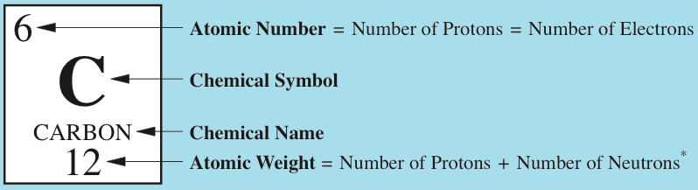
The Periodic Table of the Elements
Number of Protons = Atomic Number = 6
Number of Electrons = Atomic Number = 6
Atomic weight – Atomic Number = Number of Neutrons
12 – 6 = 6
Notes:
Now ask students to calculate the number of protons, neutrons, and electrons in their individual elements, going through the example of carbon with them. Tell students to ask a neighbor for help. This part will require going around the classroom to make sure every student is understanding.
Some students may copy the carbon example directly, thinking they should record 6,6, and 6. Be sure to specify that these numbers are specific to carbon, and that everyone’s answers will be different because every element is different.
Periodic Table images are from ttp://education.jlab.org
Author: Steve Gagnon
Last accessed: February 28, 2012
Images are public domain and can be shared.
Periodic table image is found at: http://education.jlab.org/itselemental/tableofelements5dc.pdf

Slide 10
Check your work:
Find your element on the periodic table.
Copy the Element Square into your notebook.
Determine the number of protons, neutrons and electrons and record the number of each in your notebook
= Protons – positive charge
= Neutrons – neutral charge
= Electrons – negative charge
Notes:
Make sure that each student has all of this information recorded before starting the exercise. Once this is complete, pass to each student:
One large plate
Markers, pens or pencils
Red, yellow, and green painting stickers (or other circular stickers). These can be found at hardware or office supply stores.
Tell students that they will be making models of their atom, using the stickers at atomic particles. Then specify which color is which atomic particle. An example is written on the slide, but change it if necessary for classroom use.

Slide 11
Notes:
Now tell students that you will be looking at individual blocks on the periodic table to go through examples of how many protons, neutrons, and electrons are in each element.
Periodic Table images are from ttp://education.jlab.org
Author: Steve Gagnon
Last accessed: February 28, 2012
Images are public domain and can be shared.
Periodic table image is found at: http://education.jlab.org/itselemental/tableofelements5dc.pdf

Slide 12
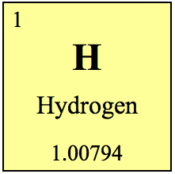
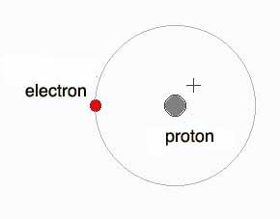
Hydrogen
1
1 proton
0 neutrons
1 electron
Notes:
Now Explain that all elements are different by showing a few examples, on the whiteboard, go through the calculations of the number of protons, neutrons, and electrons, if it is still unclear. If not, have students shout the answers out.
Periodic Table images are from ttp://education.jlab.org
Author: Steve Gagnon
Last accessed: February 28, 2012
Images are public domain and can be shared.
Periodic table image is found at: http://education.jlab.org/itselemental/tableofelements5dc.pdf

Slide 13
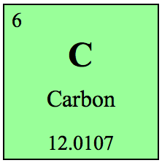
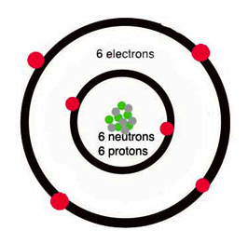
Carbon
12
6 protons
6 neutrons
6 electrons
Notes:
Again have students call out the answers, pointing out how this atom looks different from the last one.
Periodic Table images are from ttp://education.jlab.org
Author: Steve Gagnon
Last accessed: February 28, 2012
Images are public domain and can be shared.
Periodic table image is found at: http://education.jlab.org/itselemental/tableofelements5dc.pdf

Slide 14
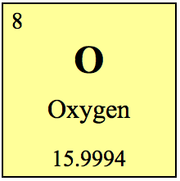
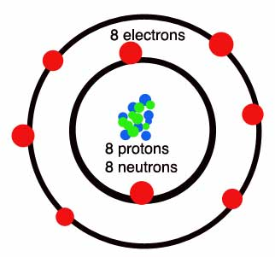
Oxygen
16
8 protons
8 neutrons
8 electrons
Notes:
Again have students call out the answers, pointing out how this atom looks different from the last one.
Periodic Table images are from ttp://education.jlab.org
Author: Steve Gagnon
Last accessed: February 28, 2012
Images are public domain and can be shared.
Periodic table image is found at: http://education.jlab.org/itselemental/tableofelements5dc.pdf

Slide 15
Orbitals
Nucleus – Protons and Neutrons
Notes:
Now tell students that they will be drawing their atoms, using the stickers. Have students draw the nucleus in the center of their plate. Show your carbon example, and have them place in the number of protons and neutrons that belong in the nucleus. This will likely require a walk around the classroom to assure that everyone is on the same page.

Slide 16
Orbitals
First orbital – 2 valence electrons
Notes:
Once the students have filled in their nuclei with protons and neutrons, tell them that each of them will have to add electrons to their atoms to balance the charges. Explain that electrons are found in orbitals, and ask students to wait a few slides before adding electrons to their models.

Slide 17
Orbitals
Second orbital – 8 valence electrons
Notes:
Explain that orbital one has 2 spots for electrons, and orbital 2 has eight places for electrons. Explain that each orbital must be filled before moving on to the next orbital.

Slide 18
Orbitals
Third orbital – 8 valence electrons
Notes:
Now explain that orbital 3 again has eight places for electrons, reminding students that orbital one has 2 spots for electrons, and orbital 2 has eight places for electrons. Again state that each orbital must be filled before moving on to the next orbital.

Slide 19
Activity
Find your element on the periodic table.
Copy the Element Square into your notebook.
Determine the number of protons, neutrons and electrons
  If your element is in the 1st row it has 1 orbital shell
  If your element is in the 2nd row it has 2 orbital shell
  If your element is in the ^{3rd} row it has 3 orbital shell
Place protons and neutrons in the nucleus, and organize electrons around the nucleus in valence shells
Notes:
Now have students complete the activity by adding electrons to their atoms. Go back to the image of an atom (next slide) so that students may refer to it while making orbitals.

Slide 20
Electron shells
Nucleus Contains protons and neutrons
Notes:
As students are finishing their models, ask them to quietly compare with their neighbors the similarities and differences they find between their models.

Slide 21
Conclusions
Reinforce the learning goals
Know that atoms are made up of protons, neutrons, and electrons
Understand that the number of protons specifies one element from another
Ask Students:
How are students’ models the same?
How are they different?
How is the Periodic Table useful?
Notes:
This slide is for the instructor.
By the time models are constructed the period is probably over, so save discussion for next time. Tell students to go home and think about their element because in the next lesson they will be learning about this element’s physical and chemical properties.
If there is extra time discuss the questions above.

