Slide 1
Molecules and Bonding
This presentation is for the instructor and the students.
Only the “Molecular Structure” section (orange) is for use with students.
  This will be used to introduce molecular structures to students as well as walking them through making a gumdrop and toothpick salt molecule.
Notes:
AUTHORS: Maryann Tekverk, PhD student, Scripps Institution of Oceanography and Jerry Ruiz, teacher, Dana Middle School, San Diego, CA
WHY: This lesson is used to show students that there is order in nature. It will also show them how atoms undergo the infinite rearrangements previously discussed.
SUMMARY: This is part 4 of a two-week unit focusing on atoms and trends on the periodic table. This lesson plan assumes that students know that matter is made of atoms, know the atomic particles, and have learned about elements on the Periodic Table. The objective is to give students a fun and memorable hands-on appreciation of ordered arrangements of atoms. The unit will provide a concrete example to refer back to as more advanced examples of bonding, minerals, and molecular structures are discussed.
WEBSITES USED IN THIS PRESENTATION: These websites can be used to show 3-D molecules. They may require Flash or Java. The molecules shown are complex and it may be best to show them at the end, as an example of the complex possibilities of molecular structure, rather than at the beginning, where they may confuse students.
http://www.umass.edu/molvis/tutorials/dna/dnapairs.htm
http://www.umass.edu/microbio/chime/
CONTEXT FOR USE: This lesson plan is part of a two-week section designed for fifth and sixth graders. The lesson requires knowledge of atoms, atomic theory, and the periodic table, and is used as a pre-cursor to a discussion of crystals.
MISCONCEPTIONS:
No differentiation is made between atoms and molecules
EVALUATION TIPS: Successful construction of an element cube will indicate understanding.
TEACHING NOTES:

Slide 2
Materials
White and green gumdrops. If possible when planning ahead, it is best to buy these at a bulk candy store or at Christmastime, so single colors may be purchased (any 2 colors will work)
At least 8 gumdrops per student (4 of each color) are needed
Hundreds of toothpicks (a few boxes)

Slide 3
Opening Question
What are some examples of crystals that you have seen?
  Write this on the board and have students record answers in journals. Discussion should be kept short because the lesson takes the full hour.
    As students are writing ask them to think about all the crystal shapes they have seen, and to describe or draw one or two.
Notes:
Students may mention sugar, or rocks from a collection, or jewelry. You can also remind them that salt is a common mineral, and depending on what you can find in your classroom, give some examples from there.
Do not spend too long on this question because the lesson takes a surprisingly long amount of time.

Slide 4
Valence Electrons
Nucleus
Contains Protons and Neutrons
2
8
8
Notes:
This slide is for use with students
This slide can be used to remind students of the structure of atoms from the previous lesson.
Have students point out what each part of the atom is called, and what its charge is. Ask students for the charge of each sub-atomic particle.
Specifically, mention that in the center is a Nucleus which contains Protons and Neutrons, surrounded by Electron Shells arranged in a particular pattern.

Slide 5
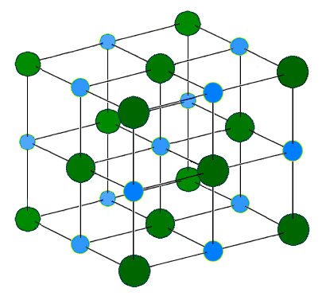
Molecular Structure
Defines crystal shape
Determined by bonds between atoms
Notes:
Introduce students to the concept that the atoms from the previous slide must be “held together” somehow. Show this picture of an NaCl molecule and point out where there are atoms (balls) and where there are bonds connecting these atoms (sticks). Mention that each ball represents an atom which contains protons, neutrons, and electrons. Students will have questions, but they will be addressed as the slide show continues so don’t get too far ahead.
Point out that the balls and sticks form a repeating pattern by showing the next slide.
Image is from http://en.wikipedia.org/wiki/File:Sodium_chloride_crystal.png
The author is H Padleckas and the image is public domain.

Slide 6
Molecular Structure
Defines crystal shape
Determined by bonds between atoms
Often has a repeating pattern
Notes:
Point out that the balls and sticks form a repeating pattern of atoms. Mention that each color represents one type of atom. Show students that there is one “unit cell” highlighted in red, and ask students how many times the pattern is repeated in this structure (8).
Image is from http://en.wikipedia.org/wiki/File:Sodium_chloride_crystal.png
The author is H Padleckas and the image is public domain.

Slide 7
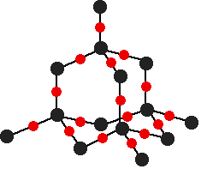
Molecule
A group of at least two atoms held together by chemical bonds
Chemical bonds are
strong attractive
forces between
atoms
Notes:
Define a molecule for students and have them record the definition in their journals. Then have students do the same for chemical bonds. See if students can think of any examples of molecules, but keep discussion brief.
Explain to students that this is also a molecule (SiO₂) with a repeating structure, and that molecules occur in different patterned structures.
Image: http://www.chemguide.co.uk/inorganic/group4/oxides.html
Author: Jim Clark
Last Accessed: February 28 2012
Information from this site may be shared as long as it is cited and not for profit

Slide 8
Chemical Bonds
A bond is formed when electrons from two atoms interact with each other and their atoms become joined
There are 2 types of strong bonds:
  Ionic – Atoms steal valence electrons from other atoms
  Covalent - Two atoms "share" valence electrons between them
Notes:
Now explain that the forces holding atoms together in these molecular structures are called “chemical bonds”. Go through the bullet points and explain that these bonds are based on valence (outer orbital) electrons.
This concept will initially be very difficult, so it is important to go through examples (next slides). Go through each definition with the students and then explain to students that they will be focusing on ionic bonding in this lesson.
Explain that students will be focusing on ionic bonds today and than as an example, explain that if one ion has an extra electron and one has one too few, than the ion with two few electrons can “steal” from the ion with too many, to form a bond.

Slide 9
Ionic Bonding
An Ion is an atom or group of atoms that has become electrically charged.
A When an atom loses an electron it loses a negative charge and becomes a positive ion.
When an atom gains an electron, it gains a negative charge and becomes a negative ion.
Notes:
Go through each bullet point. Explain that ionic bonding involves electrically charged molecules. Explain that positive and negative charges have to cancel out, so that the “net charge” of any molecule is zero. For each example (next) write out the math on the board so students can see how it works.

Slide 10
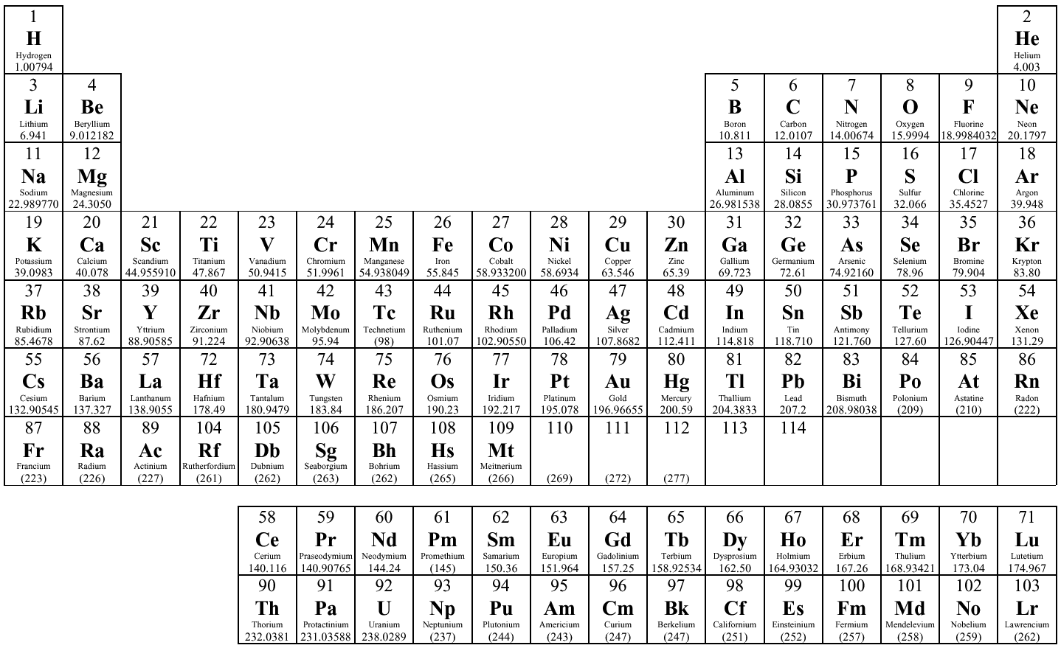
Forming an Ionic Bond
+1
0
+2
+3
+4
-3
-2
-1
Transition metals – charge varies
Notes:
Explain that atoms have different charges based on their position (column) on the Periodic table. Ask students for examples to make sure they understand. Also, remind students that the Periodic Table is organized in trends and that charge is one of them.
Questions may include:
“which side of the Periodic table has negatively charged ions?”
“What’s an example of an atom with a plus one charge?” “How about a charge of minus two?”
Periodic table image can be used and posted and is available at:
<http://www.lhup.edu/bmay/tables/>
Brent May, Ph.D.
Chair, Department of Chemistry
Lock Haven University

Slide 11
Ionic Bonding
Elements form compounds to maintain a neutral charge
  Positively charged ions combine with negatively charged ions so their total charge is zero
An atom with a neutral charge is chemically stable. An atom will lose, share, or gain electrons to become chemically stable.
Notes:
Again go through each bullet point. Mention that the positive and negative charges act like a magnet, holding positive and negative ions together in a molecule.

Slide 12
Forming an Ionic Bond
+1
0
+2
+3
+4
-3
-2
-1
Transition metals – charge varies
Notes:
Go through each example by asking students for examples of what the element in the box can bond with.
For the first one say “this is Hydrogen, what charge does it have?”
Then ask “because it has a charge of plus one, which elements can it bond with?”
You may not get an answer. If not, ask, “what charge will balance a charge of plus one?”
Then ask, “Where do we find elements with a minus one charge?”
write out the equation (+1 -1=0)
Ponit out that any element from the “-1” column will bond with H+1
In the next slides write out the equations as needed, asking similar leading questions, but as students begin to understand let them figure out more for themselves, eventually only asking for an element that will bond with each example.
Periodic table image can be used and posted and is available at:
<http://www.lhup.edu/bmay/tables/>
Brent May, Ph.D.
Chair, Department of Chemistry
Lock Haven University

Slide 13
Forming an Ionic Bond
+1
0
+2
+3
+4
-3
-2
-1
Transition metals – charge varies
Notes:
Say “this is Magnesium, what charge does it have?”
Then ask “because it has a charge of plus two, which elements can it bond with?”
If you don’t get an answer, ask, “what charge will balance a charge of plus two?”
Then ask, “Where do we find elements with a minus two charge?”
write out the equation (+2 -2=0)
Periodic table image can be used and posted and is available at:
<http://www.lhup.edu/bmay/tables/>
Brent May, Ph.D.
Chair, Department of Chemistry
Lock Haven University

Slide 14
Forming an Ionic Bond
+1
0
+2
+3
+4
-3
-2
-1
Transition metals – charge varies
Notes:
Say “this is Boron, what charge does it have?”
Then ask “because it has a charge of plus three, which elements can it bond with?”
Periodic table image can be used and posted and is available at:
<http://www.lhup.edu/bmay/tables/>
Brent May, Ph.D.
Chair, Department of Chemistry
Lock Haven University

Slide 15
Forming an Ionic Bond
+1
0
+2
+3
+4
-3
-2
-1
Transition metals – charge varies
Notes:
This example is tricky, showing that in order to get a neutral charge, one Ca2+ can combine with 2 Cl-. Explain this concept to students, going through the same questions and writing out (+2 -1-1=0)
Periodic table image can be used and posted and is available at:
<http://www.lhup.edu/bmay/tables/>
Brent May, Ph.D.
Chair, Department of Chemistry
Lock Haven University

Slide 16
Forming an Ionic Bond
+1
0
+2
+3
+4
-3
-2
-1
Transition metals – charge varies
Notes:
Now tell students that the molecule they will be creating is salt NaCl. Ask students if the charges are balanced and have one student explain why it IS possible to form this molecule.
Periodic table image can be used and posted and is available at:
<http://www.lhup.edu/bmay/tables/>
Brent May, Ph.D.
Chair, Department of Chemistry
Lock Haven University

Slide 17
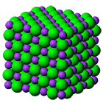
Forming an Ionic Bond
NaCl
Sodium has one valence electron and transfers that electron to chlorine
Na⁺¹Cl⁻¹ the negative and positive electrical charges attract each other so the oppositely charged ions come together and form sodium chloride (salt).
Notes:
Confirm what students explained in the last side by quickly going through each bullet point.
Explain to students that the image is a conceptual picture of a salt molecule, which they will be building.
Image: http://www.standardsed.com/html/products.html PERMISSION IS GRANTED TO COPY AND USE INFORMATION FROM THIS SITE WITH STUDENTS FOR EDUCATIONAL PURPOSES IN A CLASSROOM SETTING ONLY

Slide 18
Activity – Building Salt Molecules
Salt is Sodium(Na) Chloride(Cl)
Chemical Formula: NaCl
Every Sodium(Na) atom bonds with Chloride(Cl) atoms
Start with 8 gumdrops and 12 toothpicks
White gumdrops represent Sodium (Na) atoms
Green gumdrops represent Chlorine (Cl) atoms
Each Sodium atom can only connect with Chlorine atoms
Notes:
For this slide, explain that students will be building molecules and that the atoms in their molecules must follow all of the “rules” discussed in the previous slides.
Explain that toothpicks will represent bonds, and that each green gumdrop is Cl- and each white gumdrop is Na+, and that the molecule must have a neutral charge. In addition it is useful to tell students that bonds must be at right angles. Go through each bullet on the slide.
Write up on the board than Na=+1 and Cl=-1 and that Na+Cl=0=neutral charge, so that students clearly understand that for balanced charge, they must have one Na for every one Cl in their molecules.
Now have students construct gumdrop salt molecules, and walk around the classroom helping them out as necessary. Leave this slide up as they construct their molecules.
Image: http://www.standardsed.com/html/products.html PERMISSION IS GRANTED TO COPY AND USE INFORMATION FROM THIS SITE WITH STUDENTS FOR EDUCATIONAL PURPOSES IN A CLASSROOM SETTING ONLY

Slide 19
Additional websites with 3-D molecule Demos
http://www.umass.edu/molvis/tutorials/dna/dnapairs.htm
http://www.umass.edu/microbio/chime/
Notes:
These websites can be used if there is extra time, to show examples of other molecules. Images are 3-D so molecules can be rotated. These websites may require Flash or Java.
These websites allow students to look at a crystal structure in 3D.
Note: The molecule shown is DNA and it is very complex. Tell students it is a very complex example, and that not all structures are this complicated. Also, look at the molecule in 3D and rotate it to get a better view of what it really looks like.

Slide 20
Conclusions
Students should end the lesson with their individual salt molecule complete and an understanding that this is how crystal structures form.
End the lesson by reminding students that next class they will be observing their crystals and looking at more examples of crystal structure.
Save the gumdrop molecules, as they will be combined in the next lesson to form larger salt molecules.
Notes:
Save the gumdrop molecules. They will be combined in the next lesson in groups of 8 to form one larger cube per group of 8 students.
Learning Goals of the lesson:
Know that atoms are made up of protons, neutrons, and electrons
Understand that the number of protons specifies one element from another
Understand how the Periodic Table is organized by trends in chemical properties
Understand how atoms form well-ordered molecular structures based on their properties as well as the common properties of salts and sugars

