Slide 1
Crystals and Mineral Structures
The presentation is for the instructor and the students.
Only the “Crystal Structures” section (orange) is for use with students, and this is mainly a visual aid.
Notes:
AUTHORS: Maryann Tekverk, PhD student, Scripps Institution of Oceanography and Jerry Ruiz, teacher, Dana Middle School, San Diego, CA
WHY: This lesson reinforces the concept that ordered arrays exist in nature, by example. It also gives students a visual example of how minerals form from atoms.
SUMMARY: This is part five of a two-week unit focusing on atoms and trends on the periodic table. The lesson will give students examples of crystals and show them how principles of bonding affect molecular structure and in turn affect how substances look. In this part of the lesson students use molecular models from the previous lesson and connect them, reinforcing the same principles as well as teaching them how molecular structures form and then grow to the shapes we see at the observable size scale.
ADDITIONAL READING: If your teaching background doesn’t include rocks and minerals it is useful to check out <http://en.wikipedia.org/wiki/Mineral> as a quick refresher on mineral properties.
CONTEXT FOR USE: This lesson plan is part of a two-week section designed for fifth and sixth graders. This is lesson 5, a one-day lesson on crystals and mineral structures. It comes after a lesson where students construct salt molecules using gumdrops and toothpicks to represent atoms and bonds. The lesson does not make sense without first completing the previous lesson.
MISCONCEPTIONS
No differentiation is made between atoms and molecules
EVALUATION TIPS: Evaluation for this lesson is in the form of class discussion, as well as completion of larger gumdrop molecules. In addition, their experimental set-ups, hypotheses, and results regarding their growing sugar crystals should be evaluated.
TEACHING NOTES: This lesson varies depending on classroom style and supplies available. Don’t be afraid to put a larger emphasis on either the growing crystals experimental results or the mineral lesson, depending on your expertise and timing.

Slide 2
Materials
Salt molecules from previous week
More toothpicks
A mineral kit
  Mineral kits or individual minerals can be purchased or borrowed from colleagues. Minerals do not need to be expensive. Good examples of organized crystal structure can be found in low cost specimen of quartz, pyrite, halite, calcite, amethyst (a form of quartz), mica, galena, fluorite, gypsum, beryl, feldspar, or others.
  Its good to bring in a magnifying glass if a hand lens is not available or provided with a mineral kit.

Slide 3
Opening Question
Make observations of your growing sugar crystal.
Have students observe their growing sugar crystals and make drawings in their journals of changes. Ask them to record whether any of their hypotheses have been confirmed or disproven yet.
Put the sugar crystals away for next time.
Notes:
Have each student record observations in their journal. It is useful to have a discussion of experimental design and scientific observation if time allows here.
Ask students what they observed, then whether this agreed with their hypothesis. Some students may want to change their hypothesis or they may be upset that is it wrong. Be sure to state that this is not only okay, but very common in experimental science.

Slide 4
Activity: Expanding Gumdrop Molecules
Divide students into groups of 8, or give each smaller group 8 cubes to work with (you may have to build a few extras depending on how many students you have).
  All cubes within a group MUST BE of the same two colors.
Give each group extra toothpicks and tell them that they will be constructing a larger salt cube, following the same “rules” as in the previous lesson.
Post the slide (next) from the previous lesson as a reminder of the rules of ionic bonding.
Notes:
Now have students collect their molecules from last week and either get in groups of eight or smaller groups where each group has eight small gumdrop models.

Slide 5
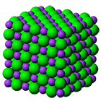
Activity – Building Salt Molecules
Salt is Sodium(Na) Chloride(Cl)
Chemical Formula: NaCl
Every Sodium(Na) atom bonds with Chloride(Cl) atoms
Start with 8 gumdrops and 12 toothpicks
White gumdrops represent Sodium (Na) atoms
Green gumdrops represent Chlorine (Cl) atoms
Each Sodium atom can only connect with Chlorine atoms
Notes:
Have students construct their larger gumdrop salt molecules, and walk around the classroom helping them out as necessary. Leave this slide up as they construct their molecules.
Depending on classroom structure and atmosphere, it is good to do this as a race.
Once students are done, have them attempt to draw their larger salt molecule in their journals. It is a challenging task, but will help them to make observations about the 3-D structure.
NOTE: Colors in the cube shown and in the gumdrop cubes will not match, be sure to point this out to students so they do not become confused.
Image: http://www.standardsed.com/html/products.html PERMISSION IS GRANTED TO COPY AND USE INFORMATION FROM THIS SITE WITH STUDENTS FOR EDUCATIONAL PURPOSES IN A CLASSROOM SETTING ONLY

Slide 6
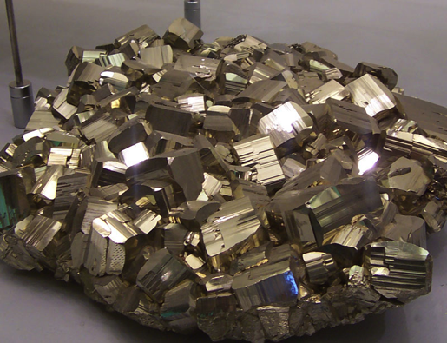
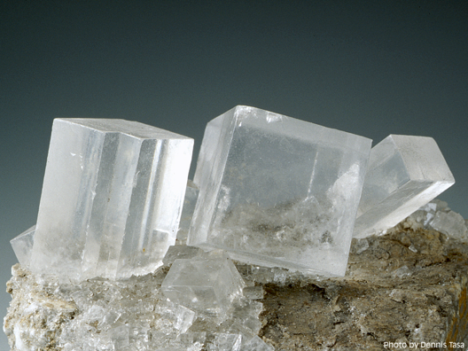
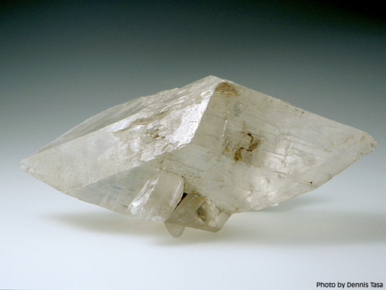
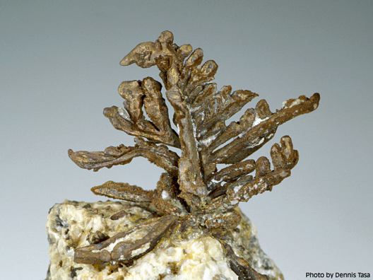
Examples of Crystal Structure
Notes:
Once students are done constructing there molecules a discussion of crystals will follow. Explain that the process by which the students made these larger salt molecules is the same process that allows all crystals to form in their organized structures. Pass around crystals from a mineral kit or have students make observations in groups, depending on available supplies.
Images above are of pyrite (top left), halite (top right), calcite (bottom left), and gold (bottom right).
Explain that different shapes can form from different bod angles, and that not all molecules (use the example of gold) form such ordered arrays. Ask students which shape above they think their model represents. (The answer is halite – top right). Discuss why they think so, and then tell them that the chemical formula of halite (salt crystals) is NaCl, just like they’re gumdrop molecules.
Images: - http://tasaclips.com/photos.html These images may be used only for personal use and/or for live, classroom presentations.

Slide 7
Conclusions
Atoms combine to form molecules, often in ordered arrays.
These molecular structures may determine the larger structure of a mineral.
Notes:
Through discussion try to introduce and reinforce these ideas.

