Slide 1
States of Matter Demo
This presentation is for the instructor, only the Phases of Matter section (orange) is for use with students.
Notes:
AUTHORS: Maryann Tekverk, PhD student, Scripps Institution of Oceanography and Jerry Ruiz, teacher, Dana Middle School, San Diego, CA
WHY: This lesson will teach students the states of matter and give them lots of fun examples to think back on.
SUMMARY: This is the last lesson in a two-week set of lessons on atoms, molecules, bonding, and phases of matter. The lesson is 2 days but may be expanded to be longer. This lesson plan assumes that students know that matter is made of atoms, mass is conserved, and students have a basic understanding of atoms and molecules. It is important to have a fundamental knowledge of atoms to build upon so students can discuss states of matter without furthering any misconceptions. These activities include many demos as well as a few hands-on and observation-based activities.
WEBSITES USED IN THIS PRESENTATION: This website provides a useful visual aid for the changing arrangement of atoms as they change from one phase of matter to the next <http://www.harcourtschool.com/activity/states_of_matter/index.html>
ADDITIONAL READING: Be sure to read and follow all safety instructions for dry ice and liquid nitrogen.
CONTEXT FOR USE: This lesson plan is part of a two-week section designed for fifth and sixth graders. This is the last lesson but can be used on its own as a lesson about the phases of matter.
MISCONCEPTIONS:
- Elements only exist as one state of matter
Ice cannot change temperature
Air and Oxygen are the same
EVALUATION TIPS: Evaluation of this lesson is in the form of observation in student science journals and discussion. In addition, students will complete a final worksheet which synthesizes ideas learned in all of the lessons.
TEACHING NOTES. These activities include the use of liquid nitrogen and dry ice. Dry ice can be purchased at some grocery stores and gas stations. To find a location where you can purchase it, use this website: <http://dryiceideas.com/wheretopurchase/>
Liquid nitrogen can be obtained from industrial gas suppliers or local welding supply companies. It may take a little digging to find out where to purchase some. Liquid Nitrogen is HAZARDOUS so follow safety instructions.

Slide 2
Opening Question: Day 1
Can you name the 4 phases of matter?
Give an example of each one.
Use the question as an intro to the following PowerPoint. No discussion is necessary as this will be part of the PowerPoint presentation.
Notes:
Introduce the question to students by letting them know that today they will be learning about and observing the 4 phases of matter. The goal of this day is to familiarize students with the four phases (especially solid, liquid, and gas) and to give them examples and a mental picture to refer back to as they continue to talk about the phases.
If students do not understand the term “phase of matter” it may be necessary to give them a clue, for instance, by asking what the difference is between water and ice, if they are chemically the same.
Additionally, use your discretion when deciding whether to discuss plasma. The fifth grade class I taught had heard of it before, but it is not necessary in order to teach the principles of phase changes laid out in the later slides.

Slide 3
Materials: Day 1
Day 1
Liquid Nitrogen
Safety goggles
Thermal gloves (for handling LN2)
Balloons (~5)
Banana (apple works too, but not oranges, the peel insulates too well)
A few flowers
Racketball
Cup of water
Ice
Dewar (4-5liters) see notes
Notes:
The instructor will be dipping these objects in LN2 and observing the changing properties as this occurs.
A Dewar can be purchased from a lab equipment catalogue through companies such as Fischer and Thermo Scientific. You will need a Dewar to transport the N2 and an additional, smaller, open-topped one for the demos, which is large enough to dip objects into.
SAFETY: Safety goggles and gloves must be worn at ALL TIMES when handling liquid nitrogen (LN2). Use tongs (NOT HANDS) to remove objects from LN2. Objects will spatter when placed in LN2. Wear a lab coat or full coverage clothing and CLOSED-TOED SHOES. Keep students away from LN2. Do this as a demo, not as a student-involved activity.
It is best to practice these activities before doing the lesson in front of the classroom, as some objects will provide better examples than others, and results may be unexpected if you have not practiced.

Slide 4
Phases of Matter
Solid, Liquid, Gas & Plasma
Notes:
This slide just provides a framework, but examples will be given in the 2 following slides.

Slide 5
What is Matter?
Matter is anything that has mass and takes up space
Notes:
Ask students what matter is (reminding them of the Legos lesson if necessary) and discuss the concept before defining it for them.

Slide 6
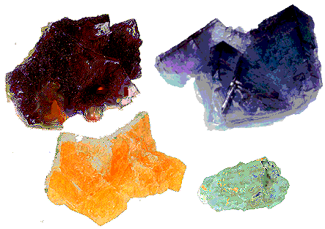


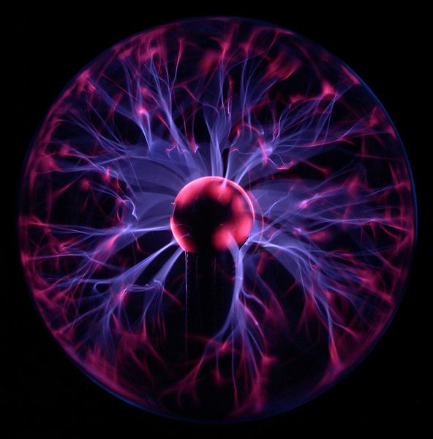
Phases Of Matter
Solid
Liquid
Gas
Plasma
http://www.harcourtschool.com/activity/states_of_matter/index.html
Notes:
In this slide, give the students the answer to the journal question and have them give examples of each:
For Plasma, examples include the sun and stars, lightning, plasma TVs, plasma ball (pictured), tesla coil.

Slide 7
Phase | Solid | Liquid | Gas | Plasma
Shape
Volume
Compressibility
Motion
Notes:
Explain to students that each phase of matter is defined by its shape, volume, compressibility, and motion.
Explain what each term really means:
Shape refers to whether the substance holds its form if it is not in a container.
Volume refers to whether the substance has a fixed volume that does not change.
Compressibility is the ability to squish something into a container where the atoms will be more closely packed.
Motion is the flow of the substance when released from a container
If you want, print this blank version of the table and have students fill it out as you go.
Go through “Solid” as an example, discussing each box, and then show the answers in the next slide.

Slide 8
Phase | Solid | Liquid | Gas | Plasma
Shape | Definite Shape
Volume | Definite Volume
Compressibility | Incompressible
Motion | Does not flow
Notes:
For “Liquid” go through it with the students, but ask them to provide the answers.

Slide 9
Phase | Solid | Liquid | Gas | Plasma
Shape | Definite Shape | Indefinite Shape
Volume | Definite Volume | Definite Volume
Compressibility | Incompressible | Not Easily Compressed
Motion | Does not flow | Flows easily
Notes:
For “Gas” go through it with the students, but ask them to provide the answers.

Slide 10
Phase | Solid | Liquid | Gas | Plasma
Shape | Definite Shape | Indefinite Shape | Indefinite Shape
Volume | Definite Volume | Definite Volume | Indefinite Volume
Compressibility | Incompressible | Not Easily Compressed | Easily Compressed
Motion | Does not flow | Flows easily | Flows very easily – expands to fill its space
Notes:
Go through “Plasma” by discussing each box, as students are unlikely to know the properties of this phase. Then show the answers in the next slide.

Slide 11
Phase | Solid | Liquid | Gas | Plasma
Shape | Definite Shape | Indefinite Shape | Indefinite Shape | Indefinite Shape
Volume | Definite Volume | Definite Volume | Indefinite Volume | Indefinite Volume
Compressibility | Incompressible | Not Easily Compressed | Easily Compressed | ?
Motion | Does not flow | Flows easily | Flows very easily – expands to fill its space | ?
Notes:
Now point out that each phase is unique and can be identified by observing these properties
For reference, plasma motion is affected by the electric field of other particles. This can be seen in a demo with a plasma ball, but is hard to explain to this age group.

Slide 12
Phase changes
Boiling/
Vaporization
WARMING
(energy is gained)
GAS
LIQUID
Sublimation
Melting
SOLID
Notes:
Explain to students that each material goes through phase changes, either by warming or cooling, and then go through each type of phase change. Make a note that in sublimation there is no liquid phase step.

Slide 13
Phase changes
Condensation
COOLING
(energy is lost)
GAS
LIQUID
Deposition/
De-sublimation
Freezing
SOLID
Notes:
Go through each type of phase change. Make a note that in Deposition there is no liquid phase step.

Slide 14
Demo: Liquid Nitrogen and Phase Changes
For each object, have students record the object in their journal, and record how it changes when it is exposed to liquid nitrogen. Then discuss why the change occurs
Example:
Balloon
  When dipped in LN2, the balloon contracts (gets smaller) and when it is taken out again it expands.
Discuss: Why does the balloon contract and expand. Which phase of matter is inside the balloon.
Notes:
While wearing safety goggles, thermal gloves (for handling LN2), and a lab coat or full-coverage clothing, dip each of the objects from the materials list into LN2.
For each object use forceps, NOT YOUR HANDS
Balloons – blow up the balloon and watch how it contracts and expands
Cup of water – water changes to ice
Ice – Point out that ice does NOT change in state, but does change temperature. The extra cold ice cube can be used to freeze water and compared to a regular ice cube to show that they are different temperatures.
A few flowers – The flowers will shatter easily once frozen
Racketball – Leave the ball in for a few minutes so it gets really brittle, than throw it on the ground so it shatters
Banana (apple works too, but not oranges, the peel insulates too well) – Do the same with the banana
Tip: Students will want to run up and take the pieces, make sure they do not, as they will be extremely cold.
SAFETY: Safety goggles and gloves must be worn at ALL TIMES when handling liquid nitrogen (LN2). Use tongs (NOT HANDS) to remove objects from LN2. Objects will spatter when placed in LN2. Wear a lab coat or full coverage clothing and CLOSED-TOED SHOES. Keep students away from LN2. Do this as a demo, not as a student-involved activity.

Slide 15
Conclusions: Day 1
Matter goes through phase changes based on adding heat to the system or taking heat away.

Slide 16
Materials: Day 2
Dry ice opener
Dry Ice
Ice
Clear plastic containers
LN2 Ice Cream
Liquid Nitrogen
Thick plastic bowl (NOT glass or ceramic)
Wooden spoons
Safety Goggles
Thermal gloves (for handling LN2)
Ice cream ingredients – listed in notes
Notes:
Ice cream:
4 cups heavy cream
1-1/2 cups half-and-half
1-3/4 cups sugar
1 quart mashed fresh strawberries or thawed frozen berries, or 1 tbsp vanilla, or 1/4 cup cocao powder (optional)
SAFETY: Safety goggles and gloves must be worn at ALL TIMES when handling liquid nitrogen (LN2). Use tongs (NOT HANDS) to remove objects from LN2. Objects will spatter when placed in LN2. Wear a lab coat or full coverage clothing and CLOSED-TOED SHOES. Keep students away from LN2. Do this as a demo, not as a student-involved activity.

Slide 17
Opening Question: Day 2
Which of these cups contains ice (frozen H₂O)? How can you tell?
On the desk in front of the room put a beaker or other clear container of ice, and another of dry ice. Label the beakers A and B. Allow students to com up and observe each one.
Students may or may not notice that the ice melts to liquid, whereas the dry ice sublimates.
After 5-10 minutes, discuss students’ answers and ask them what makes the 2 substances different
Notes:
This slide is for instructor use.
The goal of this lesson is to introduce students to the idea that observable properties of matter can help to distinguish one material from another. The two types of ice illustrate two different phase changes while establishing this concept.
After students initial answers are down and you have discussed them, ask students if they know what is in the other cup. Generally a student will know that in the other cup is dry ice. Ask how it is different and then have students write down that water is frozen H2O and that dry ice is frozen CO2.

Slide 18
Final Asseessment Worksheet
Have students fill out the final assessment worksheet in groups or pairs and then go through it as a class once everyone has completed it. By walking around the room as students ask questions and work on it, you will be able to tell what areas they are strong and weak in.

Slide 19
Demo: Liquid Nitrogen ice cream
Have the ice cream ingredients combined in a LARGE plastic bowl with lots of extra space. If you want, measure the ingredients with the class, as an exercise.
Ask the students what they think will happen when LN2 is added to the ice cream ingredients
Ask students why they think the phase change will occur
Make ice cream and then have students record their observations of the process in their journals.
Last, have students come up and taste the ice cream.
Notes:
Making the ice cream may require 4-5 L LN2. When making the ice cream it is important to have on all safety gear, use wooden or plastic spoons, and STIR EXTREMELY FAST. Otherwise you will get an ice block floating in milk.
SAFETY: Safety goggles and gloves must be worn at ALL TIMES when handling liquid nitrogen (LN2). Use tongs (NOT HANDS) to remove objects from LN2. Objects will spatter when placed in LN2. Wear a lab coat or full coverage clothing and CLOSED-TOED SHOES. Keep students away from LN2. Do this as a demo, not as a student-involved activity.

Slide 20
Conclusions: Day 2
Remind students that phase changes take place all the time in their daily lives, and ask for examples like the ice cream.

