Slide 1
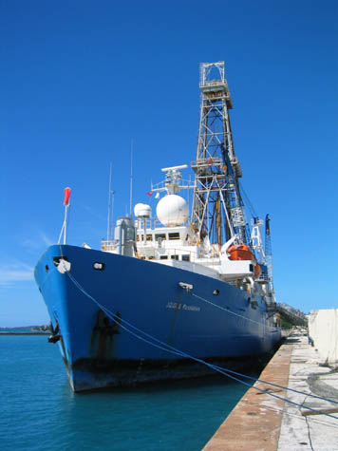
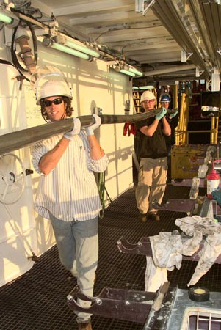
Core Lab
Unraveling the history of Earth’s climate and chemistry with sediment cores
Notes:
SCC Powerpoint Presenter Notes Instructions (Version 1.0)
AUTHORS: Sandra Kirtland Turner, Scripps Institution of Oceanography and Jason Moore, San Diego High School
WHY: We’ve all heard various stories about Earth’s past, but we hardly ever hear about how scientists actually know these things happened. Today, when scientists talk about climate change, how do they actually know climate was different in the past? This activity is all about learning some key detective methods scientists use to peer into Earth’s history.
SUMMARY (< 100 words): This presentation will introduce the important concepts that you need to know to do the Core Lab activity. The purpose of the Core Lab is to introduce students to the idea that we can use sediment cores as recorders of the history of Earth’s climate and chemistry. In particular, we focus on sediment cores from the deep sea, since this represents the best archive for scientists studying Earth’s climate. We introduce some basic concepts in Earth History and provide examples of the types of questions scientists might ask about Earth’s past. A good analogy for using sediment cores as recorders of Earth History is to explain that proxy data are like the words on a page, sediment layers are the pages in a book, and columns of sediment are chapters in the book of Earth’s history. The key concepts for students to understand are that columns of sediment represent time and that properties preserved in the sediment can provide indirect evidence for some variable we want to measure. These ideas are important for understanding core lab activities as a metaphor for changing environmental conditions through time. It is also important for students to review the carbon cycle because this is an important example of how changes in Earth’s chemistry through time (including differences in the size of reservoirs and fluxes) can alter Earth’s climate as well.
PICTURE/GRAPHICS CREDITS: Pictures are the property of the Integrated Ocean Drilling Program and are in the public domain. Photo on the right is from IODP Leg 204 and can be found at http://www-odp.tamu.edu/public/life/leg204.html. Photo on the left is from IODP Leg 210 and can be found at http://www-odp.tamu.edu/public/life/leg210.html. Core photos are available from the Janus IODP database at http://www-odp.tamu.edu/public/life/leg210.html. The core shown is from Leg 207, Site 1258.
WEBSITES USED IN THIS PRESENTATION: An excellent website for all things ocean drilling is http://www.oceanleadership.org/education/deep-earth-academy/. We also recommend using the Youtube channel for the Ocean Leadership consortium at http://www.youtube.com/user/OceanLeadership?ob=0&feature=results_main for many videos about drilling cruises and scientific objectives and methods.
ADDITIONAL READING:
CONTEXT FOR USE: We designed this activity for 11th and 12th grade Chemistry students. All students have previously had Earth Science, but we do not assume extensive prior knowledge about Earth Science during the lesson. We recommend teaching this activity mid-year, since students need to know basics of stoichiometry, acids/bases, and oxidation/reduction reactions to complete the different activities that make up the full lab. We have also previously introduced the carbon cycle to students--we recommend using Danny Richter’s Carbon Cycle game activity before beginning this lab. The total lab will take at least 3 weeks (we did it over 6). A few of the reactions will take more than one class period to finish. Please see teacher instructions for more detailed instructions.
MISCONCEPTIONS: Some students may have misconceptions about how we generate temperature records--for instance they may believe we have records from thermometers extending back hundreds of years, or they may think that tree rings and ice cores are the only sources of paleoclimate data. Try to ask students the ‘how’ question upfront: how do they believe we generate temperature records from deep in Earth’s past? Also, make sure that you fully clear up the meaning of the word ‘core.’ We are talking about cores of sediment--not the center of the Earth and not a processor on a computer!
EVALUATION TIPS: We include a final evaluation activity with the lab materials. This activity will require students to interpret another student’s core. Emphasize this upfront! We encouraged students to take extensive observational notes throughout the activity so that they could use this information when trying to reconstruct the history represented in the core.
TEACHING NOTES. This powerpoint is NOT meant to be a stand alone lecture. It is specifically created as an introduction to the core lab.

Slide 2
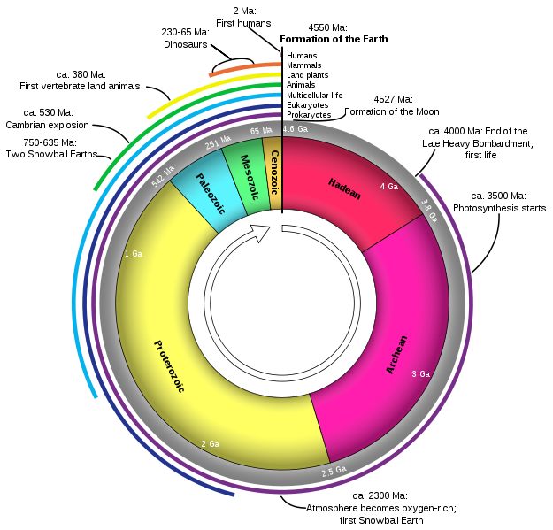
Geologic Timeline
Time periods identified by types of fossils found in bodies of rock
Time scale developed before actual ages were known
How do we look into Earth’s past?
Notes:
Notes: This slide shows a timeline of Earth’s history and gives students a perspective of how our knowledge is bunched up at the end (tip: ask students why they think this is the case). The purpose is to get students thinking about how we know that all these events took place (specifically, ask students where we would look). Also, now is a good time to reiterate the vastness of Earth’s history and use a favorite analogy. Our classes had previously done an activity where we made a string of major Earth History events to scale with ~1 in to 10 million years, so we could reference this activity here.
Bulleted Lists: Point out that the original geologic time scale (those names in the circle, plus more subdivisions that are not shown here) was developed by identifying types of fossils in rocks and naming a time period based on the presence of specific fossil types. All of this happened by mostly amateur geologists who had no way of knowing the actual ages of the fossils/rocks. Try to get students to brainstorm where they would actually find these rocks. As a sidenote, this may be more obvious to students living in areas where cliffs or other outcrops are present, but not so obvious to students on the East coast or Midwest.
Flow charts, maps, geochemical cycles, models etc: This timeline of Earth History represents the relative size of the different eras and marks a few major events. Point out a few of these to give students a perspective of scale (I.e. dinosaurs existed for almost 200 Myr compared to a total of only 2 Myr for humans so far). The colored lines on the outside of the circle represent the total amount of time various groups of organisms have existed, with the purple line indicating the total time life has existed on Earth. You might want to point out the fact that the circle is just to give the perspective of scale--obviously time isn’t about to end and loop back to the beginning now.
Conclusion: The main point is not so much to do a complete overview of Earth history as to get students thinking about how we know that this history actually occurred.
Credits: Image is from Wikimedia Commons, author Woudloper. Available at http://en.wikipedia.org/wiki/File:Geologic_Clock_with_events_and_periods.svg

Slide 3
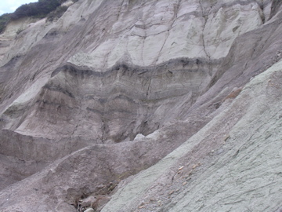
Sedimentary Rocks
Bits of rock (called sediment) formed from weathering and erosion of igneous, metamorphic, or other sedimentary rocks
Weathering includes processes that break down rock
Erosion is the transport of those sediments
Sediments settle in layers at the bottom of rivers, lakes, and oceans
http://earthref.org/SCC
Scripps Classroom Connection
Notes:
Notes: This slide shows a photo of what sedimentary rock layers look like in the field. The purpose of this slide is to build on guesses your students made on the previous slide about where we look to find Earth’s history (hopefully some students suggested rock layers). The point here is to emphasize what types of rock layers will yield useful information about Earth’s past environments.
Photographs: This photo is looking up (sorry I couldn’t get a reference point in it for scale!) It shows the Cretaceous-Paleogene boundary (known as K/T or K/Pg boundary) when the dinosaurs went extinct from a section on the South Island, New Zealand. The dark sediments are the K/T. The total thickness of this outcrop is probably around 20 meters.
Bulleted Lists: First describe the photo and point out that these layers are examples of sedimentary rocks. Define sedimentary rocks. Emphasize the difference between sedimentary rocks and igneous and metamorphic. Try to get students to think about whether igneous and metamorphic rocks could preserve fossils (would they survive a trip into the mantle or high temperatures/pressures after burial?) Point out that sedimentary rocks are the results of two distinct processes: weathering and erosion. Define each process. Point out that many people use these two terms interchangeably but they are not the same thing. We will talk about weathering again in the carbon cycle review. Finally describe how sediments form layers by settling through water. Ask where the sediments in this graph formed, and ask how they got on land now.
Conclusion: Sedimentary rocks provide our archive of Earth’s History because they contain fossils and elements that reflect the environment that existed when they formed. Sediments are simply pieces of other rocks.
Credits: This photo is by Sandra Kirtland Turner and available for use.
3

Slide 4
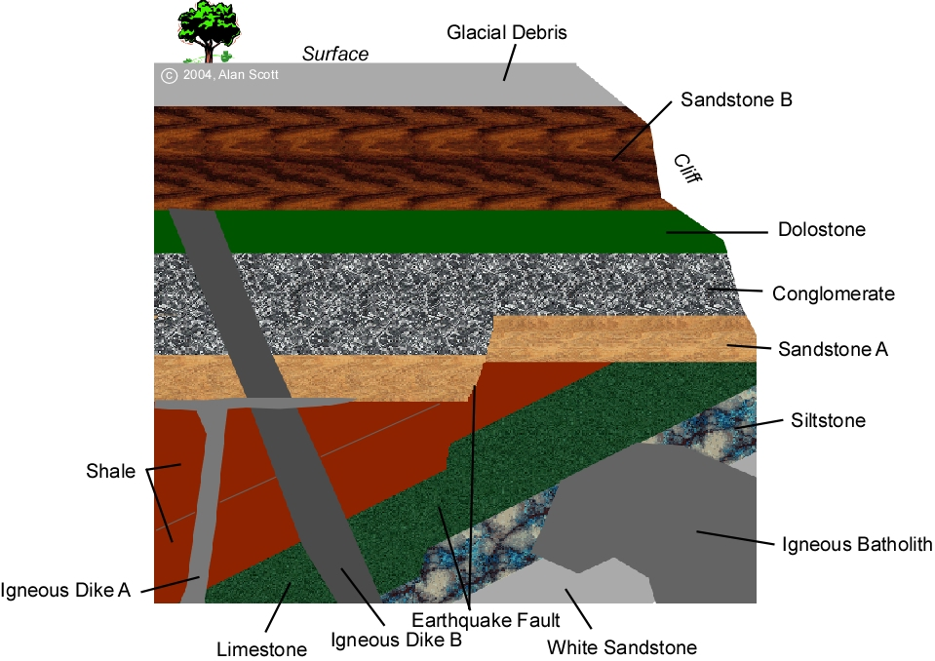
Relative Age
Law of superposition: layers of sediment deposited with the oldest on the bottom and the youngest on the top
Layers exposed in cross-section OR identified by drilling cores
http://earthref.org/SCC
Scripps Classroom Connection
Notes:
Notes: This slide gives an example of relative age. Students should learn that the oldest sediments are on the bottom and youngest are on the top. These ages are not absolute (I.e. we cannot assign a number), but are relative to each other. If the instructor wishes, he/she may go into many more details about superposition using this figure and by going to the website below to find answers about ages and types of unconformities represented in the diagram. However, for the purposes of this activity, a simple understanding of the law of superposition and relative dating will suffice.
Bulleted Lists: First define the law of superposition. Explain how this relates to relative age: this law allows us to develop a relative age scale (oldest on the bottom, youngest on the top). Point out how we actually see these layers--outcrops or by drilling cores. This is where you introduce the idea of a drill core--a way to see what is below the surface.
Conclusion: By using sediment cores, combined with an understanding of the law of superposition and relative age, we can gain access to Earth’s archives.
Credits: Image from Alan Scott, 2004. Available at http://www.uwstout.edu/faculty/scotta/sect1.cfm
4

Slide 5
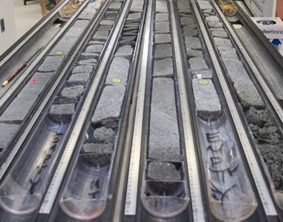
Sediments in the Ocean
From Ocean Floor to Climate Reconstruction
Biogenic sediments-come from the remains of organisms
Terrigenous sediment-eroded from land
Evaporites-formed from the leftover precipitates when seawater evaporates
How can we see these?
http://earthref.org/SCC
Scripps Classroom Connection
Notes:
Notes: This slide moves from sediments in general to sediments on the ocean floor. Point out that erosion is not as much of an issue for sediments in the deep ocean, so we can typically get much better preserved and longer sedimentary records from the ocean floor. The link “from ocean floor to climate reconstruction” will show a video from the Consortium for Ocean Leadership explaining how the Integrated Ocean Drilling Program accesses these deep-sea sediment records.
Photographs: This is a photo of deep sea cores acquired by IODP. Cores are obtained as cylinders but split in half--you are looking at these split core surfaces. Each core is cut into a 1.5 m long section (even though the cores themselves will be tens of meters long).
Bulleted Lists: Point out the types of sediment that you will find in deep-sea sediment cores. There are three main categories listed above. Ask students how each of these might get to the bottom of the ocean. Our classes had previously done an activity learning about the microscopic organisms found in the ocean--they learned about foraminifera, diatoms, and radiolarians. We showed photographs of all these organisms and did a series of unit conversion worksheets to understand their size (I.e. a typical coccolithophore or diatoms is just 2-5 microns, or millionth of a meter, in size). This is a good time to explain that chalk is made out of the remains (shells) of tiny organisms that build their shells from seawater--more on this later.
Conclusion: The deep ocean is a particularly good place to look for long-term records of Earth History. We can get information about the sea-surface and atmosphere from deep sea cores because organisms living in the surface ocean sink to the bottom after they die and can be preserved as sediments.
Credits: Photo from the Consortium for Ocean Leadership. Available at http://www.oceanleadership.org/wp-content/uploads/2009/10/IODPPrimerShortCourse.jpg
5

Slide 6
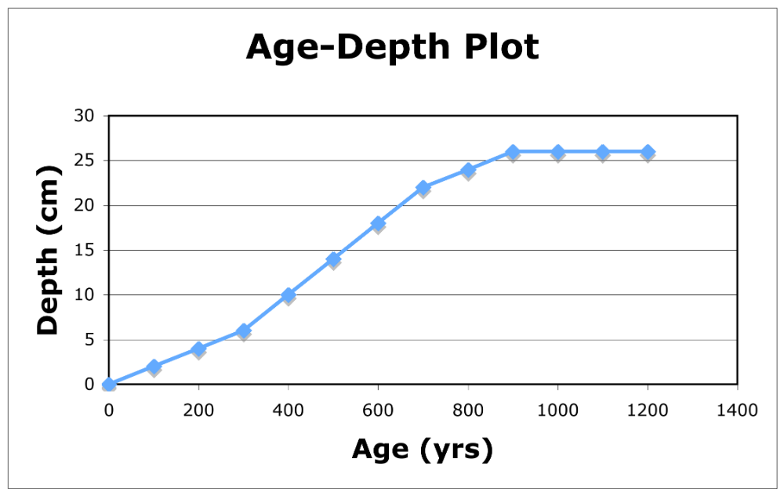
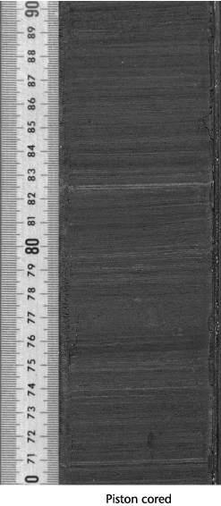
Sediment Cores
Sedimentation rate = ∆ depth
∆ time
Layers accumulate over time
Depth is proportional to time
Sedimentation rate equals the change in depth divided by the change in time
Depth
(or Time)
http://earthref.org/SCC
Scripps Classroom Connection
Notes:
Notes: This slide explains how we get information from sediment cores. In particular, students need to understand the link between depth and time. Point out that they will use this knowledge during the activity to generate age models for their own cores.
Bulleted Lists: Relate layers in the sediment core to intervals of time. Explain how the build-up of these sediments can happen at different rates, and that dictates how much sediment will represent a given interval of time. If sediments build up rapidly, then you have a high sedimentation rate and a thick section of sediment represnts a short amount of time. If sediments accumulate slowly, then sedimentation rate is low, and you have a thin layer of sediments representing a long interval of time. Point out that typical sedimentation rates in the open ocean are around 1-3 cm/kyr.The formula for sedimentation rate is the change in depth (or thickness of the sediment column) divided by change in time (or the difference in ages of the sediments at the top and bottom of the column).
Plotting Graphs: This is an Age-Depth plot for a made-up sediment core. Depth in centimeters is on the y-axis and Age in years is on the x-axis. Point out that the ‘0’ depth is usually considered the sediment surface and depth increases the further you go below the surface. (This is why age is also increasing as you move to greater depths). The slope of this graph is equivalent to the sedimentation rate. Areas where the slope is steepest indicate high sedimentation rate, point out how this means that you have a very wide range in y for a small range in x. In contrast, the flatter portions of the graph represent low sedimentation rates where a wide range of x corresponds to a small range in y. Point out that a slope of 0 (flat line) effectively indicates an unconformity, or a gap in time. Ask students if this graph could ever have a negative slope. Explain why this would not make any sense (you can’t have sediments accumulating and representing negative time).
Conclusion: This relationship between age and depth in a sediment cores allows researchers to build an age model so they can relate different events in Earth history to different intervals of time. When combined with absolute dating methods (something that can give you a precise date, basically radiometric dating methods, which we did not discuss in detail, combined with other dating methods), you can get very detailed information about the age of sediment in the core.
Credits: Core photo is from ODP. Available at http://www-odp.tamu.edu/publications/tnotes/tn31/apc/fig_02.htm
6

Slide 7
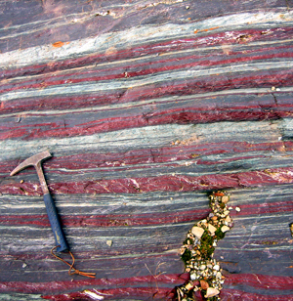
Proxy Measurements
When you can’t directly measure a variable of interest
Measure proxy variables in sediment cores
Tells us what the environment was like in the past
Example: What do the colors tell us?
http://earthref.org/SCC
Scripps Classroom Connection
Notes:
Notes: Now that we know we can obtain sediment cores and relate sediments at different depths to different ages, how do we use these sediments to learn about the past? Ask students to brainstorm things they might look for in their sediment cores--most will probably guess fossils.
Photographs: This is a photo of a banded iron formation, which we will learn a lot more about in one of the labs. Ask students to think about the colors. Do they think sediments of such different colors would have accumulated under the same environmental conditions?
Bulleted Lists: Explain that the sediment color is an example of a proxy measurement. To explain this concept further, ask the students to look around the room at what everyone is wearing. Ask them, if they hadn’t been outside, could they use their observations of fellow students clothing to guess what the temperature is like? That means the clothing is a proxy for temperature outside. We can measure all sorts of proxy variables in sediments. Some are much more quantitative than others. We can actually get numerical temperature data from some types of proxies, whereas our clothing example is more qualitative (i.e. relatively warm or cold).
Conclusion: Refer back to analogy: proxies are the words on the page in our Earth History book. They provide us detailed information about what the environment was like when we can’t go back and measure directly.
Credits: photo by Stefan Lalonde showing BIFs in Ontario, Canada. Photo available through Cosmos at http://www.cosmosmagazine.com/news/2675/did-nickel-kick-start-evolution?page=0%2C1
7

Slide 8
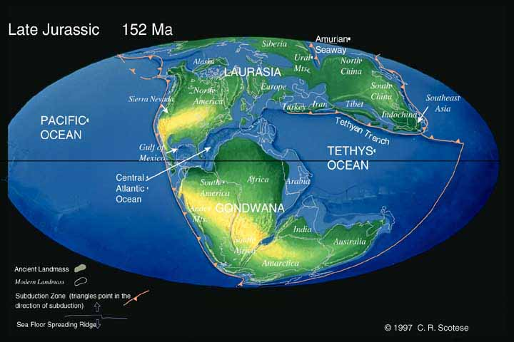
What was the Earth like in the past?
What was the atmosphere made of?
How salty were the oceans?
How warm/cold was it?
What life existed?
… can learn all this (and much, much more) from sediment cores!
http://earthref.org/SCC
Scripps Classroom Connection
Notes:
Notes: The purpose of this slide is to reiterate to motivation behind obtaining sediment cores and developing proxy records from them: we are curious about our past! Point out that the world has gone through many iterations--completely different continents, different life, different weather. This is part of a broader question of how we got here today.
Image: This is a paleogeographic reconstruction of what the Earth looked like in the late Jurassic Period about 152 Myr ago. Try to get students to point out the different continents. Point out Gondwana--as a supercontinent that is breaking up at this time. Many students think there was a single supercontinent (Pangea) in Earth’s past, but have no idea that supercontinents have come and gone.
Bulleted Lists: This is just a list of things you might want to learn about. Feel free to add others or encourage the students to brainstorm more things they might want to know about (perhaps asteroid impacts?)
Conclusion: Sediment cores provide a really endless source of information for learning about Earth’s past--it’s really cool!
Credits: Image is from the paleomap project by Christopher R. Scotese. Scotese, C. R., 2001. Atlas of Earth History, Volume 1, Paleogeography,PALEOMAP Project, Arlington, Texas, 52 pp.ﾊScotese, C. R., 2001. Atlas of Earth History, Volume 1, Paleogeography,PALEOMAP Project, Arlington, Texas, 52 pp. Images are free for teaching. You can obtain maps from other geological intervals from the website: www.scotese.com
8

Slide 9
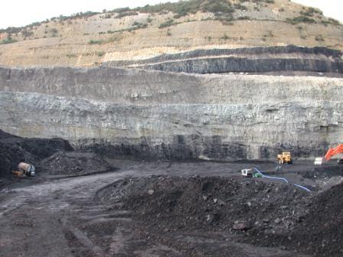
Changes in Earth’s Carbon Cycle?
Coal formed from plant remains
Plants remove carbon dioxide from atmosphere by photosynthesis
How did carbon dioxide levels in the atmosphere change when all this coal was buried?
http://earthref.org/SCC
Scripps Classroom Connection
Notes:
Notes: Now we focus on changes in the carbon cycle as an important example of how Earth’s chemistry has changed in the past. We discuss how this has implications for Earth’s climate. Our students had previously done activities on the carbon cycle, and we’d briefly discussed global warming and how increasing atmopsheric CO2 concentrations increase global temperature through the greenhouse effect.
Photographs: This is a picture of an exposed coal seam in a coal mine from New Zealand. See the yellow truck for scale. Point out that there are huge coal seams in North America too. Ask students where this coal comes from.
Bulleted Lists: Point out that coal is the remains of dead plants. Explain that a large proportion of the coal we mine comes from a geologic time period called the Carboniferous that extends ~360 to 300 Myr ago. This is when bark-bearing trees first evolved, and all this terrestrial organic matter, combined with widespread swamps, led to the formation of huge coal beds because when the plants died, the plant matter didn’t decay. Ask students to think about the steps through which this could trap excess carbon dioxide and remove it from the atmosphere. Go a step further and ask students if this would affect global temperatures, and in what direction (global temperatures cooled markedly through the late Carboniferous).
Conclusion: We know a lot of information about Carboniferous climate as a result of information that coal beds give us about major changes in the carbon cycle at that time.
Credits: Image from Wikimedia Commons, author Kai Point Coal Mine. Available at http://en.wikipedia.org/wiki/File:Uncovered_Coal_Seams.jpg
9

Slide 10
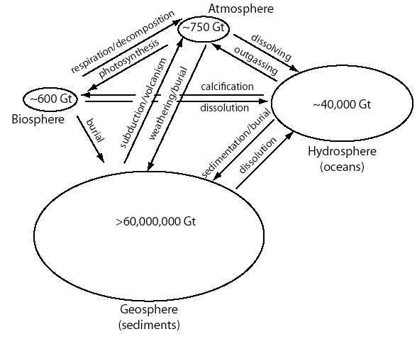
Carbon Cycle
Reservoirs-where carbon is stored
Fluxes-movement of carbon from one reservoir to another
The total amounts of carbon in each reservoir have NOT always been the same
http://earthref.org/SCC
Scripps Classroom Connection
Notes:
Notes: Time to review the carbon cycle! Our students also played the Carbon Cycle game (by D. Richter, mentioned earlier), to learn about reservoirs and fluxes.
Bulleted Lists: After giving definitions and identifying the different reservoirs, point out that the exact amount of carbon in each reservoir is not fixed. What reservoirs are we changing through human activity (hint: all of them), and in what direction (decreasing carbon in the geosphere and biosphere, adding carbon to the atmopshere and oceans). What we want to know is whether similar changes happened in the past through mechanisms other than human activity (yes).
Flow charts, maps, geochemical cycles, models etc: There are many versions of the carbon cycle diagram available online. This one is my creation and emphasizes the processes I think are most important for this lesson. I’ve drawn each of the reservoirs based on relative size (although obviously not nearly to scale). Quantities are in Gt, which is billions of tons of carbon (one billion tons of carbon is equal to 10^15 grams of carbon, abbreviated Pg). To give students some perspective on this unit, explain that humans currently emit about 9 Gt of carbon per year by burning fossil fuels and deforestation. Since we just talked about carbon moving between the atmosphere, biosphere, and geosphere on the previous slide, I’d start with this here. Especially for a chemistry class, try to emphasize that some of these fluxes involve chemical reactions, like photosynthesis and respiration (6CO2 + 6H2O = C6H12O6 + 6O2) while others are physical processes (CO2 dissolving in the ocean or outgassing from the ocean). We emphasize that the hydrosphere mainly refers to the oceans. For geosphere, the estimated amount of carbon just includes the lithosphere and we do not go into deeper carbon cycling in this lecture. Specifically, the estimate of >60 million Gt includes sedimentary rocks (shales and carbonates) as well as fossil fuels. Surface sediments would be a much smaller quantity (closer to 150 Gt). Carbon in soils (if you want to include this in the geosphere, though some would argue it is a biosphere component) is another ~1500 Gt. The ‘geosphere’ estimate is then somewhere between 60-100 million Gt. If you want to discuss deep Earth carbon (lower lithosphere, mantle, etc), I suggest the Deep Carbon Observatory website https://dco.gl.ciw.edu/ for more information. Estimates of the quantity of carbon in the mantle are on the order of 100 million-1 trillion Gt C (Dasgupta and Hirschmann, 2002). Students can think of carbon from the sediments moving into the mantle to be liberated through volcanic CO2 emissions. A few processes I think it might help to clarify (non-obvious terminology to students):
Weathering - chemical breakdown of rocks; refers to chemical reactions that use CO2 as a product, formed new sediments that ultimately get buried (simplified version)
Calcification - organisms use dissolve inorganic carbon in seawater to build shells
Dissolution - literally the dissolving of shells--this can happen either in the water column, or from the sediments
Conclusion: We want to be able to trace changes in the carbon cycle in order to see 1) how variable this is through time and 2) how changes in the carbon cycle are linked to changes in climate. We can also trace other chemical cycles in the past, but this my primary research focus and the most obviously linked to changing climate.
Credits: Diagram by Sandra Kirtland Turner.
References: Dasgupta, R. and M. M. Hirschmann, 2002, The deep carbon cycle and melting in Earth’s interior, Earth and Planetary Science Letters, Vol. 298, pp 1-13, doi:10.1016/j.epsl.2010.06.039.
10

Slide 11
Conclusions
Sediment cores give us a window into the past
Depth in sediment cores represents time: older materials are on the bottom, younger on top
Proxy measurements from sediment cores let us reconstruct past environments including variables like temperature, the composition of the atmosphere, and existing forms of life
Notes:
Notes:
Hopefully this presentation will have convinced you that sediment cores are very important archives for understanding Earth’s past and made you realize that there’s a lot of complexity to discover in sediment layers. They are extremely useful for creating timelines of Earth History, and we can learn a lot about how Earth’s chemistry has changed through time as well. Sediments are so much more than simply bits of rock! Now, we will begin making our own sediment cores to get an idea of how different environmental changes end up getting recorded in sediments through time.

Slide 12
Lab Instructions:
Overview
Purpose: To understand how sediments record major changes in Earth’s chemistry through time by making a ocean sediment ‘core.’
Materials: 1L plastic bottle, sand, carbonate, clay, water, acid, salt, gravel, Fe powder
http://earthref.org/SCC
Scripps Classroom Connection
Notes:
The following slides are instructions for the students. Where we have separate lab worksheets, we will include directions on these worksheets. However, for the first two days’ worth of activities, students simply need to record the directions and their observations in their notebooks. We encourage students to keep a designated journal for core lab notes. Emphasize that these observations will be extremely useful during the final activity (and important for their grade). We want students to learn that observation and note-keeping are very important parts of being a scientist. You need to have a record of what you’ve done/seen. Notes should be complete. This is also an opportunity to work on students’ writing skills and use of new vocabulary.
12

Slide 13
Lab Instructions:
Directions
Work in groups to create and observe a series of chemical reactions and physical processes that represent major events in Earth History.
Make a core that represents the series of reactions.
Interpret another group’s core to tell a story about the history represented.
http://earthref.org/SCC
Scripps Classroom Connection
Notes:
13

Slide 14
Lab Instructions:
Day 1
Form your group.
Get one plastic bottle per group.
Measure and mark 1 inch intervals along the bottle from bottom to top (each inch=100 mL)
Add to beaker: SiO₂ - 100 mL, H₂O - 300 mL
Record observations: what are the depths of the sand? Water? What does the sand look like (color, texture)?
http://earthref.org/SCC
Scripps Classroom Connection
Notes:
14

Slide 15
Lab Instructions:
Settling Rates
Bring your core to your desk - try not to shake it up or disturb the sand.
Record the level of sand and the level of water using the scale on your core liner.
Pick up the following: 50 mL SiO₂, 100 mL Al₂Si₂O₅ + H₂O, 50 mL CaCO₃
http://earthref.org/SCC
Scripps Classroom Connection
Notes:
Notes: Explain to students that the purpose of the day’s activity is to think about how sediments physically form layers on the bottom of the ocean. We can think about the water in our bottles as the water column above a specific area of sediment in the ocean. How do sediments derived from dead organisms and terrestrial sediments actually get into our sediment layers?
Next, since this is a chemistry class, try to get the students to guess what the different chemical formulas represent: SiO2 is sand, Al2Si2O5 + H2O is clay slurry and CaCO3 is carbonate. As students which ones they think are biologically-derived and why? (Hint: it’s the one with carbon in the chemical formula!)
15

Slide 16
Lab Instructions:
Settling Rates
Describe each of the materials you’ve collected. Can you see individual particles? What is the texture? Color?
Record your predictions: what do you think will happen when you pour a mixture of all these materials into the core? Will layers form? What material will be on the bottom? Why?
http://earthref.org/SCC
Scripps Classroom Connection
Notes:
16

Slide 17
Lab Instructions:
Settling Rates
Mix all your materials together - stir well!
Pour the mixture into your core and observe what happens.
Were your predictions correct? Can you tell? Why or why not?
What factors would cause layers to form?
Did all the materials sink at the same speed?
http://earthref.org/SCC
Scripps Classroom Connection
Notes:
Note: If available, use a wide-mouth funnel for pouring the sediments into the bottle. If the neck is too thin, the sand will clog up the funnel and make a big mess. Otherwise, just instruct students to carefully pour sediments into the bottle using the lip on their beaker or graduated cylinder (whichever you used when mixing your materials).
17

Slide 18
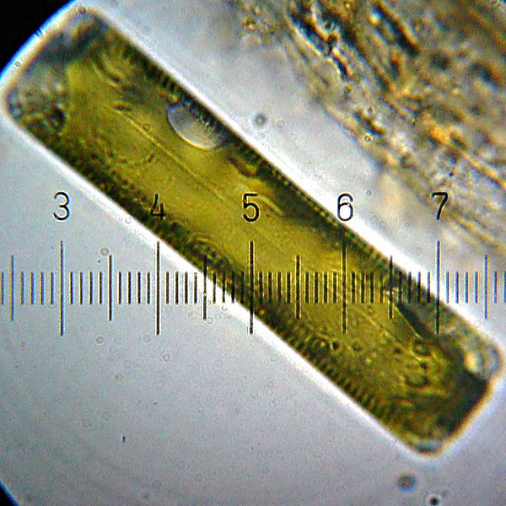
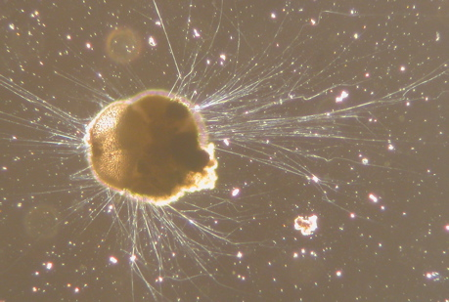
Critical Thinking:
Settling Rates
What do you think determines how fast particles sink in the ocean?
Put the following in order of sinking speed (from fastest to slowest): sand, dead diatoms, dead foraminifera, fish bones, wind-blown dust.
10 microns
100 microns
Foraminifer
Diatom
http://earthref.org/SCC
Scripps Classroom Connection
Notes:
Notes: Here we discuss density with students. It is not just the mass or absolute size of the item that is important with sinking speed, but the volume this mass is spread over. The order is fish bones, sand, forams, diatoms, dust. (You could make an argument about very tiny fish bones, but we’ll think of larger bones here).
Photographs: Living foraminifera; photo by Scott Fay, UC Berkeley, 2005. Available for use through Wikimedia Commons at http://en.wikipedia.org/wiki/Foraminifera
Diatom; photo by Bob Blaylock. Available for use through Wikimedia Commons at http://en.wikipedia.org/wiki/Diatom
18

Slide 19
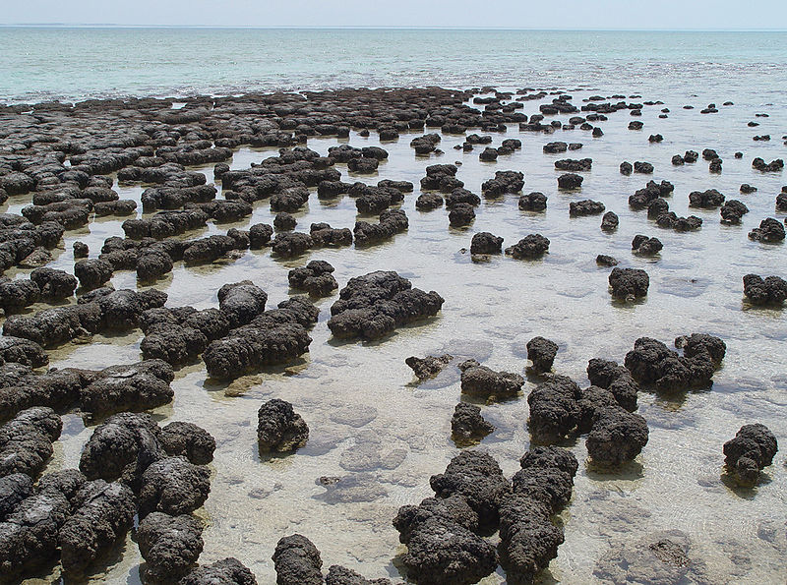
Rise of Oxygen
(and Redox Lab)
Stromatolites: earliest photosynethesizing organisms
Banded Iron Formations: layers of sediment the show the repeated oxygenation and oxygen-depletion of the oceans through the periodic oxidation and precipitation of iron.
http://earthref.org/SCC
Scripps Classroom Connection
Notes:
Notes: After showing students video about the rise of oxygen and banded iron formations, we reviewed these two key terms.
Photograhs: Stromatolite photo by Paul Harrison and available through Wikimedia Commons at http://en.wikipedia.org/wiki/File:Stromatolites_in_Sharkbay.jpg. BIF photo by Stefan Lalonde showing BIFs in Ontario, Canada. Photo available through Cosmos at http://www.cosmosmagazine.com/news/2675/did-nickel-kick-start-evolution?page=0%2C1
19

Slide 20
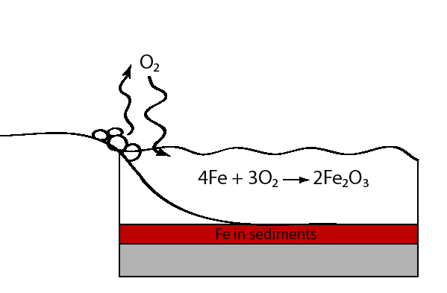
Rise of Oxygen
(and Redox Lab)
http://earthref.org/SCC
Scripps Classroom Connection
Notes:
Notes: I drew this diagram on the board. I do not recommend using this slides for your classroom presentation; rather, you should draw the diagram yourself for the students and have them draw their own version too.
Diagram: This diagram shows stromatolites (circles) releasing O2 as a waste product during photosynthesis. This O2 enters the atmosphere and dissolves into the ocean (arrows). Dissolved oxygen reacts with soluble iron (we will go over the details of this equation much more on the lab worksheet). This forms a layer of iron precipitate on the seafloor that is red (the color of rust).
20

Slide 21
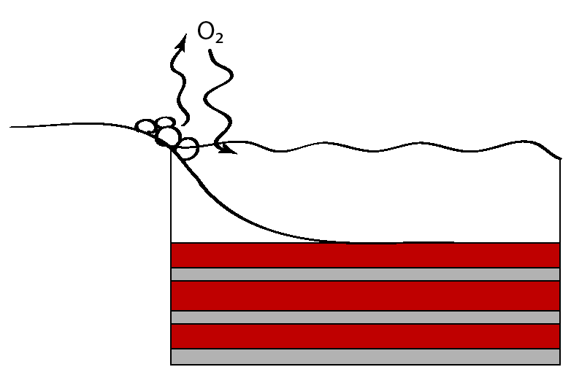
Rise of Oxygen
(and Redox Lab)
http://earthref.org/SCC
Scripps Classroom Connection
Notes:
Notes: I drew this diagram on the board. I do not recommend using this slides for your classroom presentation; rather, you should draw the diagram yourself for the students and have them draw their own version too.
Diagram: As this process of O2 release and reaction with Fe continues, all oxygen will be used up, and once again Fe-free sediments (grey layers) precipitate. However, O2 is continuing to build up in the atmosphere, and eventually formation of insoluble Fe-rich sediments continues and another red layer develops. Hence the name Banded Iron Formation.
21

Slide 22
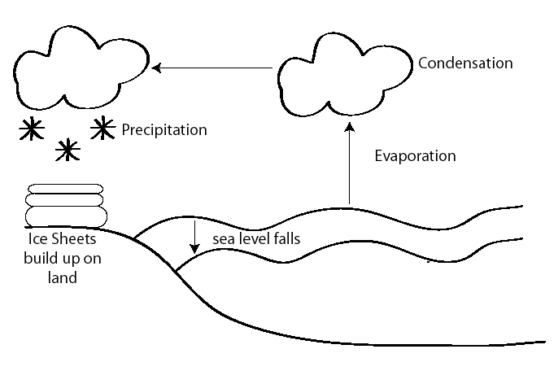
Glaciations
(and Salinity Lab)
http://earthref.org/SCC
Scripps Classroom Connection
Notes:
Notes: I drew this diagram on the board. I do not recommend using this slides for your classroom presentation; rather, you should draw the diagram yourself for the students and have them draw their own version too.
Diagram: This diagram shows how ice sheets form as snow falls and builds up layers without melting during the spring and summer. Emphasize that this water ultimately comes from evaporation from the oceans. Because the ice doesn’t melt and return the water as runoff to the oceans, sea level will fall. Ask students how this affects salinity. Do they think the salt evaporates along with the water? Ask them to make the connection: how does the formation of massive ice sheets affect the salinity of the oceans?
22

Slide 23
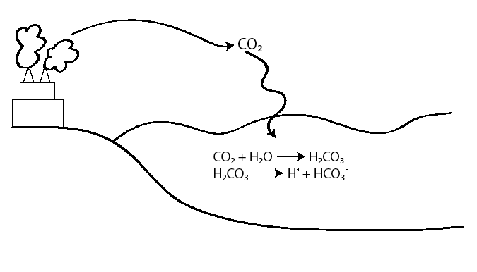
Ocean Acidification Lab
http://earthref.org/SCC
Scripps Classroom Connection
Notes:
Notes: I drew this diagram on the board. I do not recommend using this slides for your classroom presentation; rather, you should draw the diagram yourself for the students and have them draw their own version too.
Diagram: This diagram shows that when CO2 enters the atmosphere, some also dissolves into the oceans. This is a physical process. Once the CO2 has dissolved into the oceans, a chemical reaction between CO2 and H2O forms H2CO3, or carbonic acid. Carbonic acid rapidly dissociates into a proton and bicarbonate (HCO3). It is the release of these excess protons that changes pH (pH is a measure of proton concentration). Note the charges of the different carbon species and ask students what these charges mean. Also, try to get them to figure out why H+ is a proton.
23

Slide 24
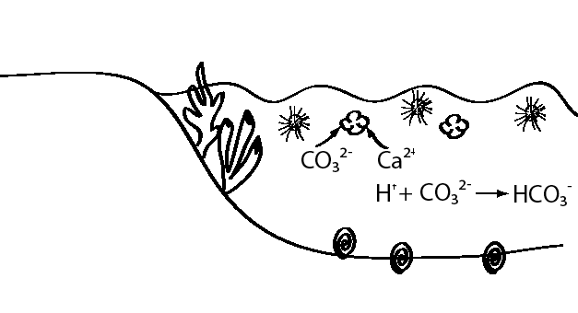
Ocean Acidification Lab
coral
forams
http://earthref.org/SCC
Scripps Classroom Connection
Notes:
Notes: I drew this diagram on the board. I do not recommend using this slides for your classroom presentation; rather, you should draw the diagram yourself for the students and have them draw their own version too.
Diagram: This diagram shows some examples of carbonate organisms living in the ocean. All these organisms use the carbonate ion to build their shells--ask students to identify the chemical formula for the shells (CaCO3). However, carbonate reacts readily with free protons to form bicarbonate. Adding more protons increases the competition for these organisms to get carbonate ions, and it becomes more difficult for them to build their shells.
24

