Slide 1
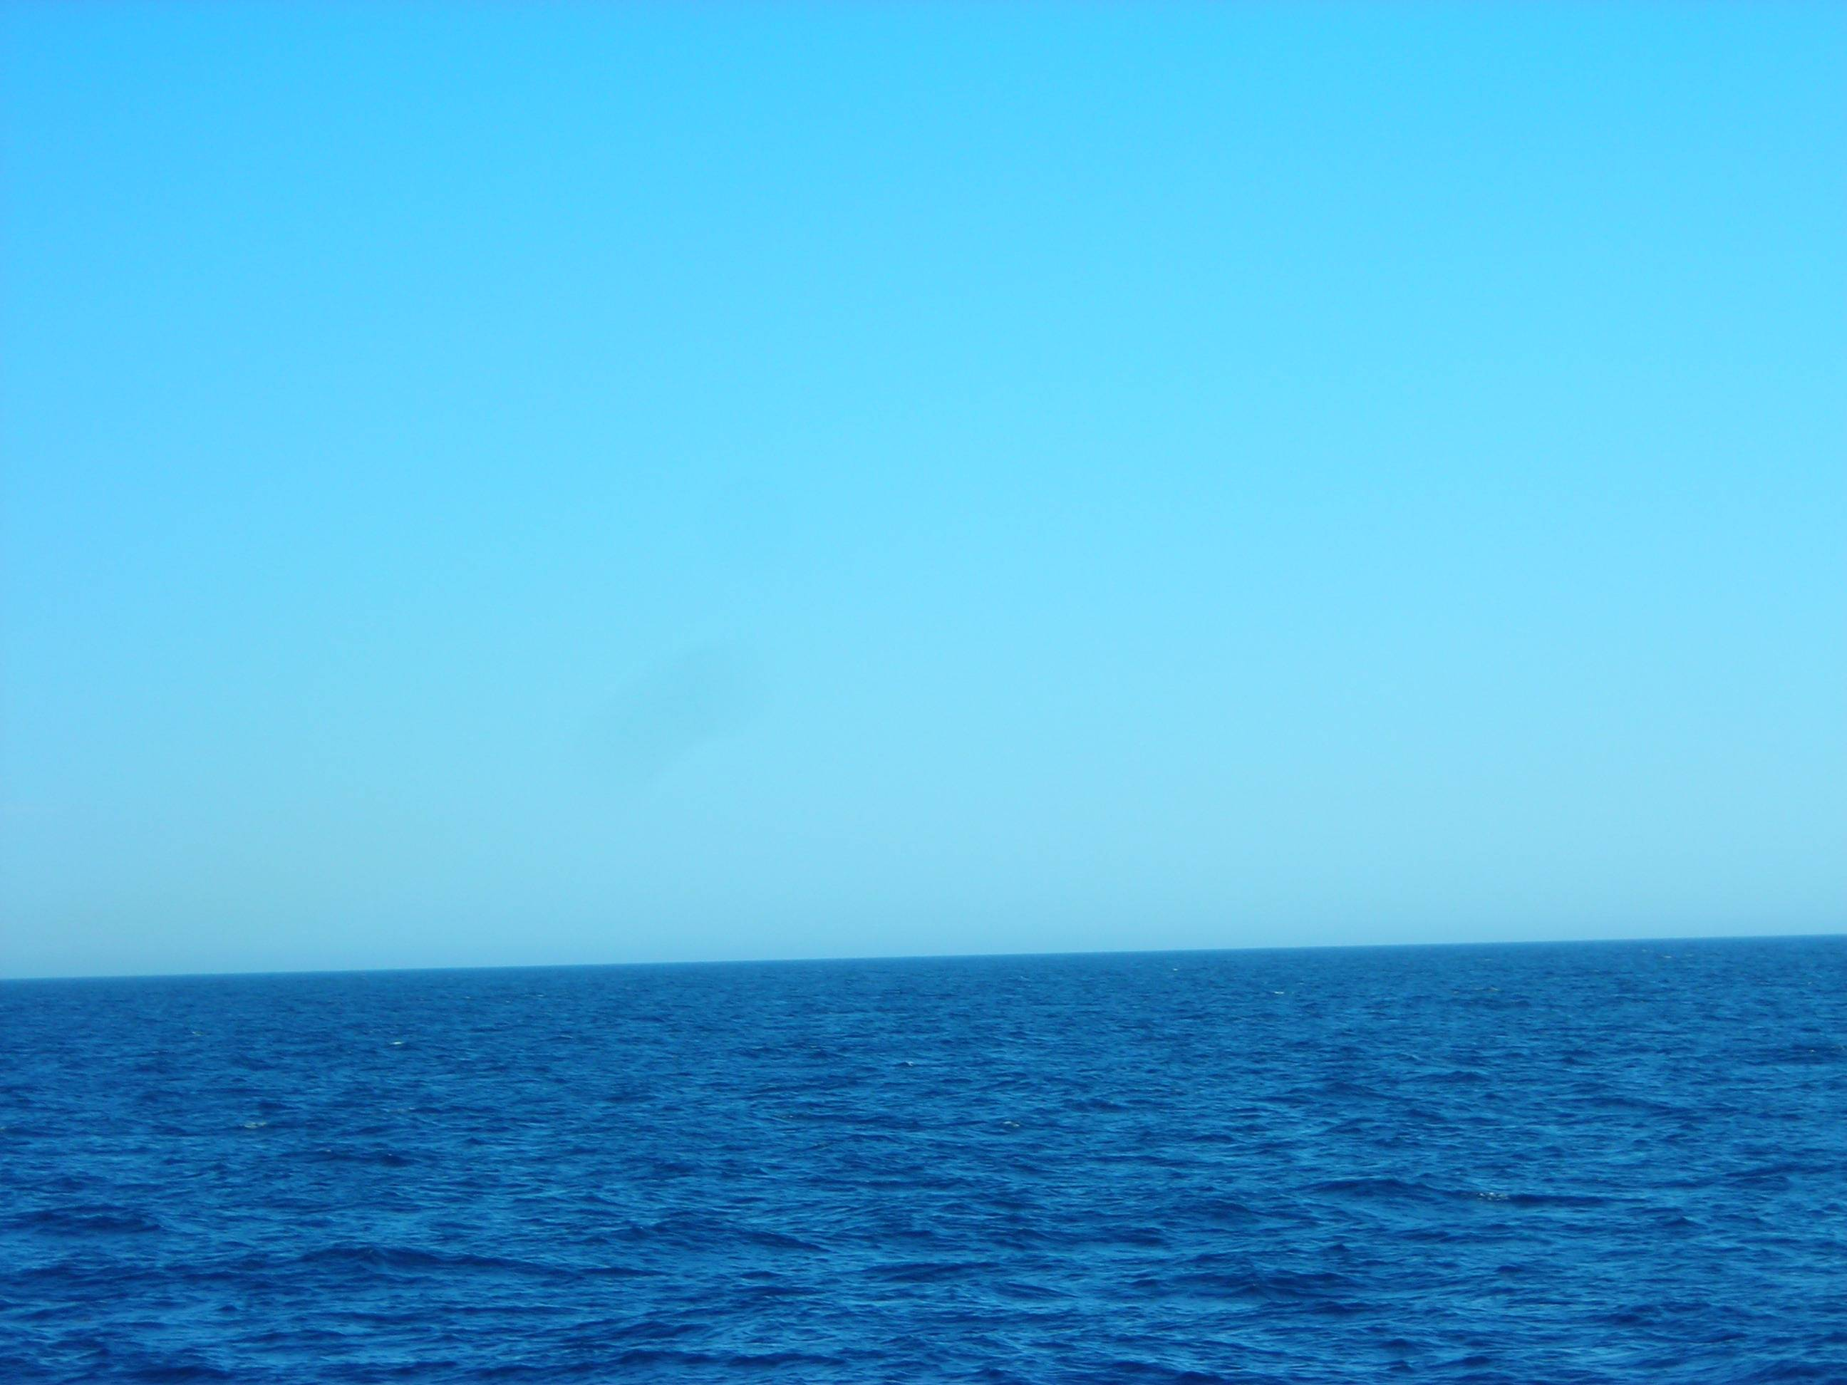
Graphing Oceanographic Data
Notes:
Photo Credit: Darcy Taniguchi

Slide 2
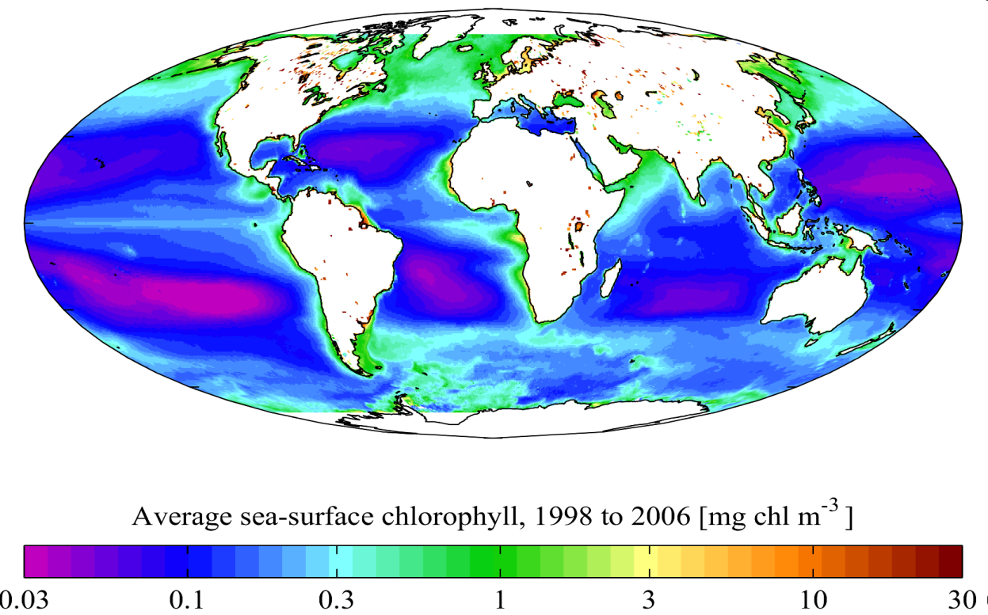
The Ocean is a Variable Ecosystem
The ocean is a huge and highly variable environment
  Changes with time (daily, seasonally, annually)
  Changes horizontally (from onshore to offshore)
  Changes vertically (with depth)
Notes:
Photo credit: http://upload.wikimedia.org/wikipedia/commons/6/68/AYool_SEAWIFS_annual.png
The ocean covers approximately 70% of the surface of the Earth and it is a highly variable environment (lots of variability). This variability exists in space (from on shore to offshore, vertically, latitude, longitude) and time (daily, seasonally, annually, long time scales (El Niño, climate change, ice ages). This variability exists in the kinds of organisms found in a given place and in the physical and chemical characteristics of a given place (and these changes relate to and influence one another).

Slide 3
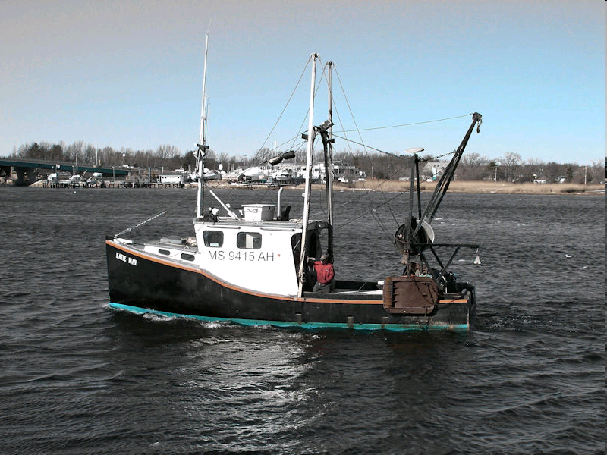
Why Does Variability Matter?
Variability plays a huge role in where oceanic organisms can live
  Impacts fisheries
  Impacts tourism
The animals that live in a certain place influence the chemistry of that place
  Impacts for nutrient cycles
Notes:
Photo Credit: http://www.fotoblography.com/wp-content/uploads/2008/07/fishing-boat-small.jpg
A variable is something that you can measure.
Physical variables play a huge role in the distribution of organisms. Variables such as temperature, salinity, and oxygen levels will mean that some organisms can (or have to) live a certain area. Knowing where to find fish (or other commercially important species like shrimp) and the things that they eat is really important in order for fishermen to find fish (which is in turn important for all of the people who eat fish). Also, in many coastal areas, recreational fishing contributes a large amount to tourism revenue. If the people who run the fishing tours cannot find fish on a regular basis, this portion of the local economy will not be reliable. Also, variability in physical factors that is related to long term cycles, such as El Niño, mean that there are good years (when lots of new organisms are produced) and bad years (in which few organisms are produced). Further, organisms that are different from the organisms of interest may thrive, while the organisms of interest are difficult to find. Because some fish are very long lived, a bad year may not have impacts on the fish population until many years in the future.
The location of biological organisms can play a large role in nutrient cycling. If there are lots of large phytoplankton in an area, they are more likely to sink quickly and export carbon to the deep ocean. The organisms that eat the phytoplankton play a role too. Organisms like salps, which produce large fecal pellets, can export more carbon than organisms which produce small fecal pellets, such as copepods. These sorts of dynamics may have large impacts on the way that carbon and nitrogen are cycled through the environment (this is a very active area of study at Scripps Institution of Oceanography).

Slide 4
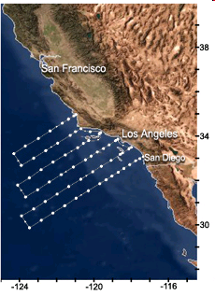
How do scientists study variability?
Scientists study variability by taking lots of samples in time and space
One program that does this is the CalCOFI
  Samples the California current along a grid
  Samples taken from 1949 through the present
Notes:
Photo Credit: http://www.calcofi.org/downloads/media/graphics/station_maps/66StationPositions72.png
In order to see and understand patterns in variability, scientists have to take lots of samples through time and space. These programs have to exist on large scales because lots of samples are needed in order to see what variability is random and what is related to some pattern in time and/or space. Because this requires lots of time and manpower, special programs are established to collect, organize, and maintain all of the data that are collected. One of the longest-running programs is CalCOFI (calcofi.org), which collects data from the southern part of the California current. Other programs include HOT in Hawaii (http://hahana.soest.hawaii.edu/hot/hot_jgofs.html) and BATS in Bermuda (http://bats.bios.edu/).
The CalCOFI program was established in 1949 to explain the crash of the sardine fishery. Samples have been taken from then to the present. Currently, CalCOFI samples are taken along a grid of stations along six lines that stretch from north of Point Conception, CA to San Diego, CA, from the coast to approximately 700 km offshore, and from the surface to approximately 500 meters depth. These samples are taken four times per year (one cruise in each season). All of the data are publically available and the actual samples are stored at Scripps Institution of Oceanography.

Slide 5
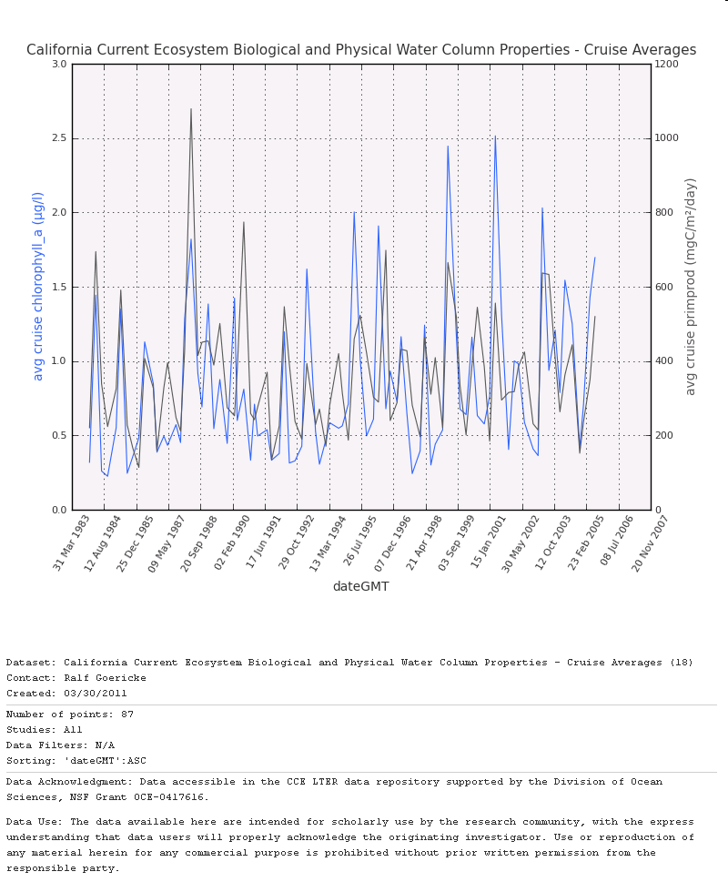
How do scientists look at variability?
Looking at large amounts of data can be challenging
Scientists often deal with this by examining graphs.
  Allow them to see differences in time and space
  Oceanographers often look at changes in variables with depth
Notes:
Photo Credit: http://oceaninformatics.ucsd.edu/datazoo/data/all/views?action=view&id=24
Graphs provide a method for visually representing data. Most data exist as numbers (counts, lengths, mass, abundance, temperature, concentration, etc.). Long lists and groups of numbers are very difficult to interpret or make sense of, so instead of looking at them as lists and numbers, scientists tend to view them as graphs. They make it much easier to look at the data and to share results with others.

Slide 6
Graphing Oceanographic Data
Oxygen Saturation (%)
1000
100
0
0
Most data are plotted like this. If you were plotting oxygen concentration up a mountain, your axes would be like this.
Oceanographic data are generally plotted like this - with the X axis at the top and the Y axis going down with depth.
Height Above Sea Level (m)
Height Above Sea Level (m)
0
0
100
1000
Oxygen Saturation (%)
Notes:
The kind of graph (line graph, bar graph, pie chart) depends on the type of data that you are trying to present. The sort of data that we will be using in this activity are best represented by line graphs because you will be using two continuous variables (there are not discrete depths in the ocean - it goes continuously from the top to the bottom). Bar graphs are more appropriate when one of the variables is discrete (there are only a few possible things that the answer could be (e.g. yes or no)). Pie charts are used to represent percentages of a whole.
Most simple graphs start with an X axis and a Y axis. The independent variable is plotted on the X axis and the dependent variable is plotted on the Y axis. The X axis is horizontal and the Y axis is vertical. Each axis is actually a number line, so the numbers go from zero at the origin to the end of the number line (positive or negative). Generally, the X axis is at the bottom of the chart and the Y axis goes up. This would be the case if you were looking at how oxygen saturation changes with elevation. However, the ocean goes the other direction (down with depth). This can be written using negative numbers, but generally, the negative signs are not used (sea level is the surface (0) and depth increases as you move away from the origin).

Slide 7
Graphing Steps
Draw the X axis at the top of the paper. Put zero at the upper left corner. This is the origin.
2. Draw the Y axis on the left side of the paper from the origin down towards the bottom of the page.
3. Determine the maximum values of your dependent and independent variables.

Slide 8
Graphing Steps, cont.
4. Decide what size step you are going to use to get from zero to the maximum number (for both the x and y axes).
    If the largest number is 1000, you do not want to count from 0 to 1000 by ones. Similarly, if your largest value is 1, you don’t want to count by ones.
    If you have to get from 0 to 1000, you might want to count by 100. If you have to get from 0 to 1, you might want to count by 0.1.
    In a line graph, you do not only use the numbers that are present in your data. You use the entire range over which your numbers fall.
Notes:
The range is the distance between the highest and the lowest value in your data set.
The count step will probably be different for the X-axis and the Y-axis.

Slide 9
Graphing Steps, cont.
Determine how many numbers there are between 0 and the value one step beyond your maximum value using your count step for the X and Y variables.
    If your data range from 0 to 1.34 and you decided to count by 0.25, you will have want to go to 1.5 (one step beyond your maximum value).
    There would be 6 values (0.25, 0.5, 0.75, 1.0, 1.25, and 1.5) using the range of 0 to 1.5 with a count step of 0.25.

Slide 10
Graphing Steps, cont.
Draw dashes along the X-axis so that the dashes are evenly distributed. The number of dashes will depend on the number that you determined in Step 5.
Write the values represented by each dash (0.25, etc. in the previous example) above each dash.
8. Draw the dashes along the Y-axis so that the dashes are evenly distributed. The number of dashes will depend on the number that you determined in Step 5.

Slide 11
Graphing Steps, cont.
Write the values that each dash represents to the left of the dashes on the Y-axis.
10. Write a label for the X-axis (this will be whatever you are graphing) and the units that the values are in (e.g., °C for temperature).
11. Write a label for the Y-axis (this will be depth) and the units for the values (m).

Slide 12
Graphing Steps, cont.
Draw a dot at the position indicated by your first (lowest depth) data point. For example, if the temperature is 25°C at 10 meters depth, you will put a dot at the lines where 25 on the X axis and 10 on the Y axis intersect.
13. Draw a dot at the position indicated by the second data point. Draw a straight line between the two data points.
14. Repeat step 13 until you have plotted all of the data points. Don’t wait until the end to connect your points! Do them as you go along. Oceanographic data sometimes change direction and have peaks within the data.

