Slide 1
Ocean Waves
Scripps GK-12 Classroom Connection
Notes:
AUTHORS: Brianne Moskovitz – Scripps Institution of Oceanography
WHY: The ocean makes up 70% of planet earth. As wind travels across our oceans, the friction with the sea surface creates ocean waves. The energy from ocean waves has begun to be harnessed to use as a source of power. Other water waves encountered in the ocean are tsunamis, but they are not created by wind, but a displacement of the ground underwater. Students will learn the differences in structure of these waves in this PowerPoint.
PICTURE/GRAPHICS CREDITS: n/a
WEBSITES USED IN THIS PRESENTATION: Some have commercials before them. Go past commercials before showing to your class.
http://dsc.discovery.com/videos/assignment-discovery-shorts-waves-of-destruction-tsunamis.html
http://youtu.be/N-M0Q1P_EKs
http://www.nationalgeographic.com/volvooceanrace/interactives/waves/index.html
http://oceanexplorer.noaa.gov/edu/learning/9_ocean_waves/activities/breaking_waves.html
ADDITIONAL READING: http://oceanexplorer.noaa.gov/edu/learning/#lesson9 – Lesson 9 is about Ocean Waves distinguishing between wind driven waves and tsunami.
http://oceana.org/en/explore/marine-science/ocean-waves gives a cursory background.
CONTEXT FOR USE: High School physics or marine science. This presentation should be given after Waves_1 (Introduction to Waves) and before Waves_3 (Ocean Acoustics). Seismogram basics may fit well before this lesson.
MISCONCEPTIONS: Ocean waves are created by the moon’s gravity.
A tsunami occurs when there is a big storm at sea.
EVALUATION TIPS:n/a
TEACHING NOTES: This powerpoint is a lesson on ocean waves to share with your class. With a basic understanding of the anatomy of waves, students will be able to learn more about the waves we see at the beach. If you have surfers in your class, they may find the discussion of the sea slope particularly interesting.

Slide 2
Ocean Waves
Where do you think the energy comes from to create ocean waves?
Classify the following waves as transverse and longitudinal:
  Sound Waves
  Ocean Waves
  Light Waves
Distinguish between a tsunami and a typical ocean wave.
Draw the slope of a beach that would create waves you would like to surf.
Notes:
Notes: These questions should be used as a warm-up. Give students a few minutes to consider (or write down the answers) these questions, then a minute to discuss with a partner, and finally discuss with the class (maybe have students present what their partner thought).
Once students have given their thoughts, you may clarify some of the answers:
Wind energy creates typical ocean waves.
Sound Waves are longitudinal (I like to remember this by thinking of longitudinal lines compressing and expanding). Ocean waves (on the surface) are transverse. Light waves are transverse.
A tsunami is generated by a displacement of the seafloor. Typical ocean waves are created by wind.
Any slope less than 15* would generate mild, surfable waves. Some daredevils may prefer a steeper slope.

Slide 3
Outline
Warm up
Objectives
Wave tank demonstration
    Video clips
    Notes
    Worksheet
    Discuss answers
    Build a surfboard!
Notes:
Notes: Students have already done the warm up
You will go over the objectives
With a wave tank, you will demonstrate the difference between wind driven waves and tsunami.
There will be a few short video clips elaborating on tsunami.
Students will take notes on the differences (source, wave height, wave length, wave speed) of typical ocean waves and tsunami on the worksheet (OceanWavesWksht.doc).
Students will continue to answer questions on the worksheet using the wave simulator and breaking waves simulator.
Discuss answers.
With the knowledge they now have, students will build surfboards out of cardboard, scissors, and aluminum foil. Students will determine the slope of the beach, and use the paddle to create waves that their surfboard will catch.

Slide 4
Objectives
Where does wave energy come from?
Wavelength, Frequency and Wave speed of various wave forms.
Distinguish between tsunami waves and standard ocean waves.
Understand how bathymetry impacts waves.
Notes:
Notes: These are the objectives being taught in this lesson.
Students will learn that surface ocean wave energy comes from wind, distinguish between the wavelength, frequency, and wave speed of tsunamis and surface ocean waves, and understand how the seafloor creates breaking waves.

Slide 5
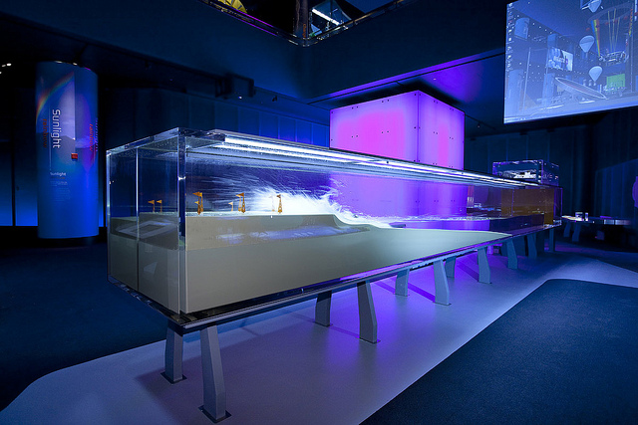
Breaking Waves Demonstration
http://oceanexplorer.noaa.gov/edu/learning/9_ocean_waves/activities/breaking_waves.html
Museum of Science and Industry Chicago
Photo Credit: Lexington Design + Fabrication
Notes:
Notes: A wave tank will be used to demonstrate the differences between a tsunami and typical ocean wave.
With a flat paddle pivoting from the base, create waves by moving your hand back and forth. This simulates a typical ocean wave.
With a paddle resting on the “seafloor” attach string to jerk the paddle up quickly to simulate an earthquake. Students should notice that the resulting wave is much larger than the wind waves. This is a tsunami. Have students note the wavelength differences, frequency differences, and wave height differences.
Go to the following website: http://oceanexplorer.noaa.gov/edu/learning/9_ocean_waves/activities/breaking_waves.html and do the Breaking Waves demonstration. This animation shows that as the slope of the beach becomes steeper, the size of the waves become larger. Ideal surfing is done on a moderately sloped beach. The materials of the seafloor, and slope of the beach determine the size of the breaking waves.

Slide 6
Tsunami
http://dsc.discovery.com/videos/assignment-discovery-shorts-waves-of-destruction-tsunamis.html
http://youtu.be/N-M0Q1P_EKs
Wave Simulator
http://www.nationalgeographic.com/volvooceanrace/interactives/waves/index.html
The energy of a tsunami reaches from the ocean surface to the seafloor. In contrast, energy from a wind driven wave may only reach 10-100m. Because the energy reaches the seafloor, a tsunami is considered a “shallow water” wave. An approximation of the wave speed of a tsunami is as follows:
v=√(g*d)
v is wave velocity, g is the gravitational constant (9.8m/s²), d is depth in m
Notes:
Notes: the short clip “Waves of Destruction” reinforces what students have learned about tsunamis with the wave tank demonstration. Reinforce that out in the middle of the ocean, the wave height of a tsunami may only be 1 m. If you are on a boat in the middle of the ocean, you will not be able to feel a tsunami, and it may be the best place to be in the case of a tsunami.
The second clip is an animation of the path of the Japan Tsunami from March 11 2011. Note that the wave reaches the Hawaiian Islands around the 7 hour mark, and the San Diego area around 10 hours. This time difference gave enough warning for people to get to safety (high and inland). With a tsunami warning, many ships and boats are brought out to sea to prevent damage to the ships.
Continue to slide 7 before beginning the wave simulator.

Slide 7
Properties of Ocean Waves
Kind of Wave | Mode of Generation | Range of Wavelength | Wave Frequency (Period) | Wave Speed
wind-driven | local or distant winds that blow across the ocean's surface | about 100 m to 200 m | 5 s to 20 s | about 40 to 90 km/h (40 km/h, the speed of a moped, is most common)
seismic-sea wave (tsunami) | displacement of the seafloor due to sub-marine earthquakes (most tsunamis), volcanic eruptions, landslides, underwater explosions, and meteor impacts | from 100 m to >500 km; are at least three times the ocean depth at which the wave was generated | 10 min to 2 h | variable, up to 1,000 km/h (the speed of a jet plane)
http://www.pbs.org/wgbh/nova/teachers/activities/3208_tsunami.html#materials
Notes:
Notes: Hand out OceanWavesWksht.doc. Open the wave simulator as students fill out the chart on OceanWavesWksht.doc.
Point out the mode of generation for both wind-driven and seismic-sea waves. The wavelength of a typical ocean wave is about the length of a football field. The wavelength of a tsunami is about the distance from San Diego, to Los Angeles and back! This is why a second wave usually doesn’t hit from 10 minutes to 2 hours after the first wave.
As you describe each wave, ask students what to change (amplitude, wavelength, frequency) to get the wave to fit a typical ocean wave and tsunami.
Have students describe how to make the bumpiest wave (that will get any sailor sick), and the flattest wave. The flattest wave should look similar to your description of the tsunami!
Credits: http://www.pbs.org/wgbh/nova/teachers/activities/3208_tsunami.html#materials

Slide 8
Surfboard Instructions
Materials: One piece of cardboard, scissors, aluminum foil
Use the materials to build a surfboard that you think will be fast.
Ask a partner to set the slope of the beach. You will set the frequency of the wave, and see how long it takes to get your board from one side of the tank to the other.
Notes:
Notes: Students will build their own surfboards using scissors, cardboard and aluminum foil. It may help having pictures of surfboards as examples. (One or more fins may help stabilize the board.)
This can be a competition. Have students create waves, and see how long it takes for the board to get from one side to the other.
Have fun with this.

Slide 9
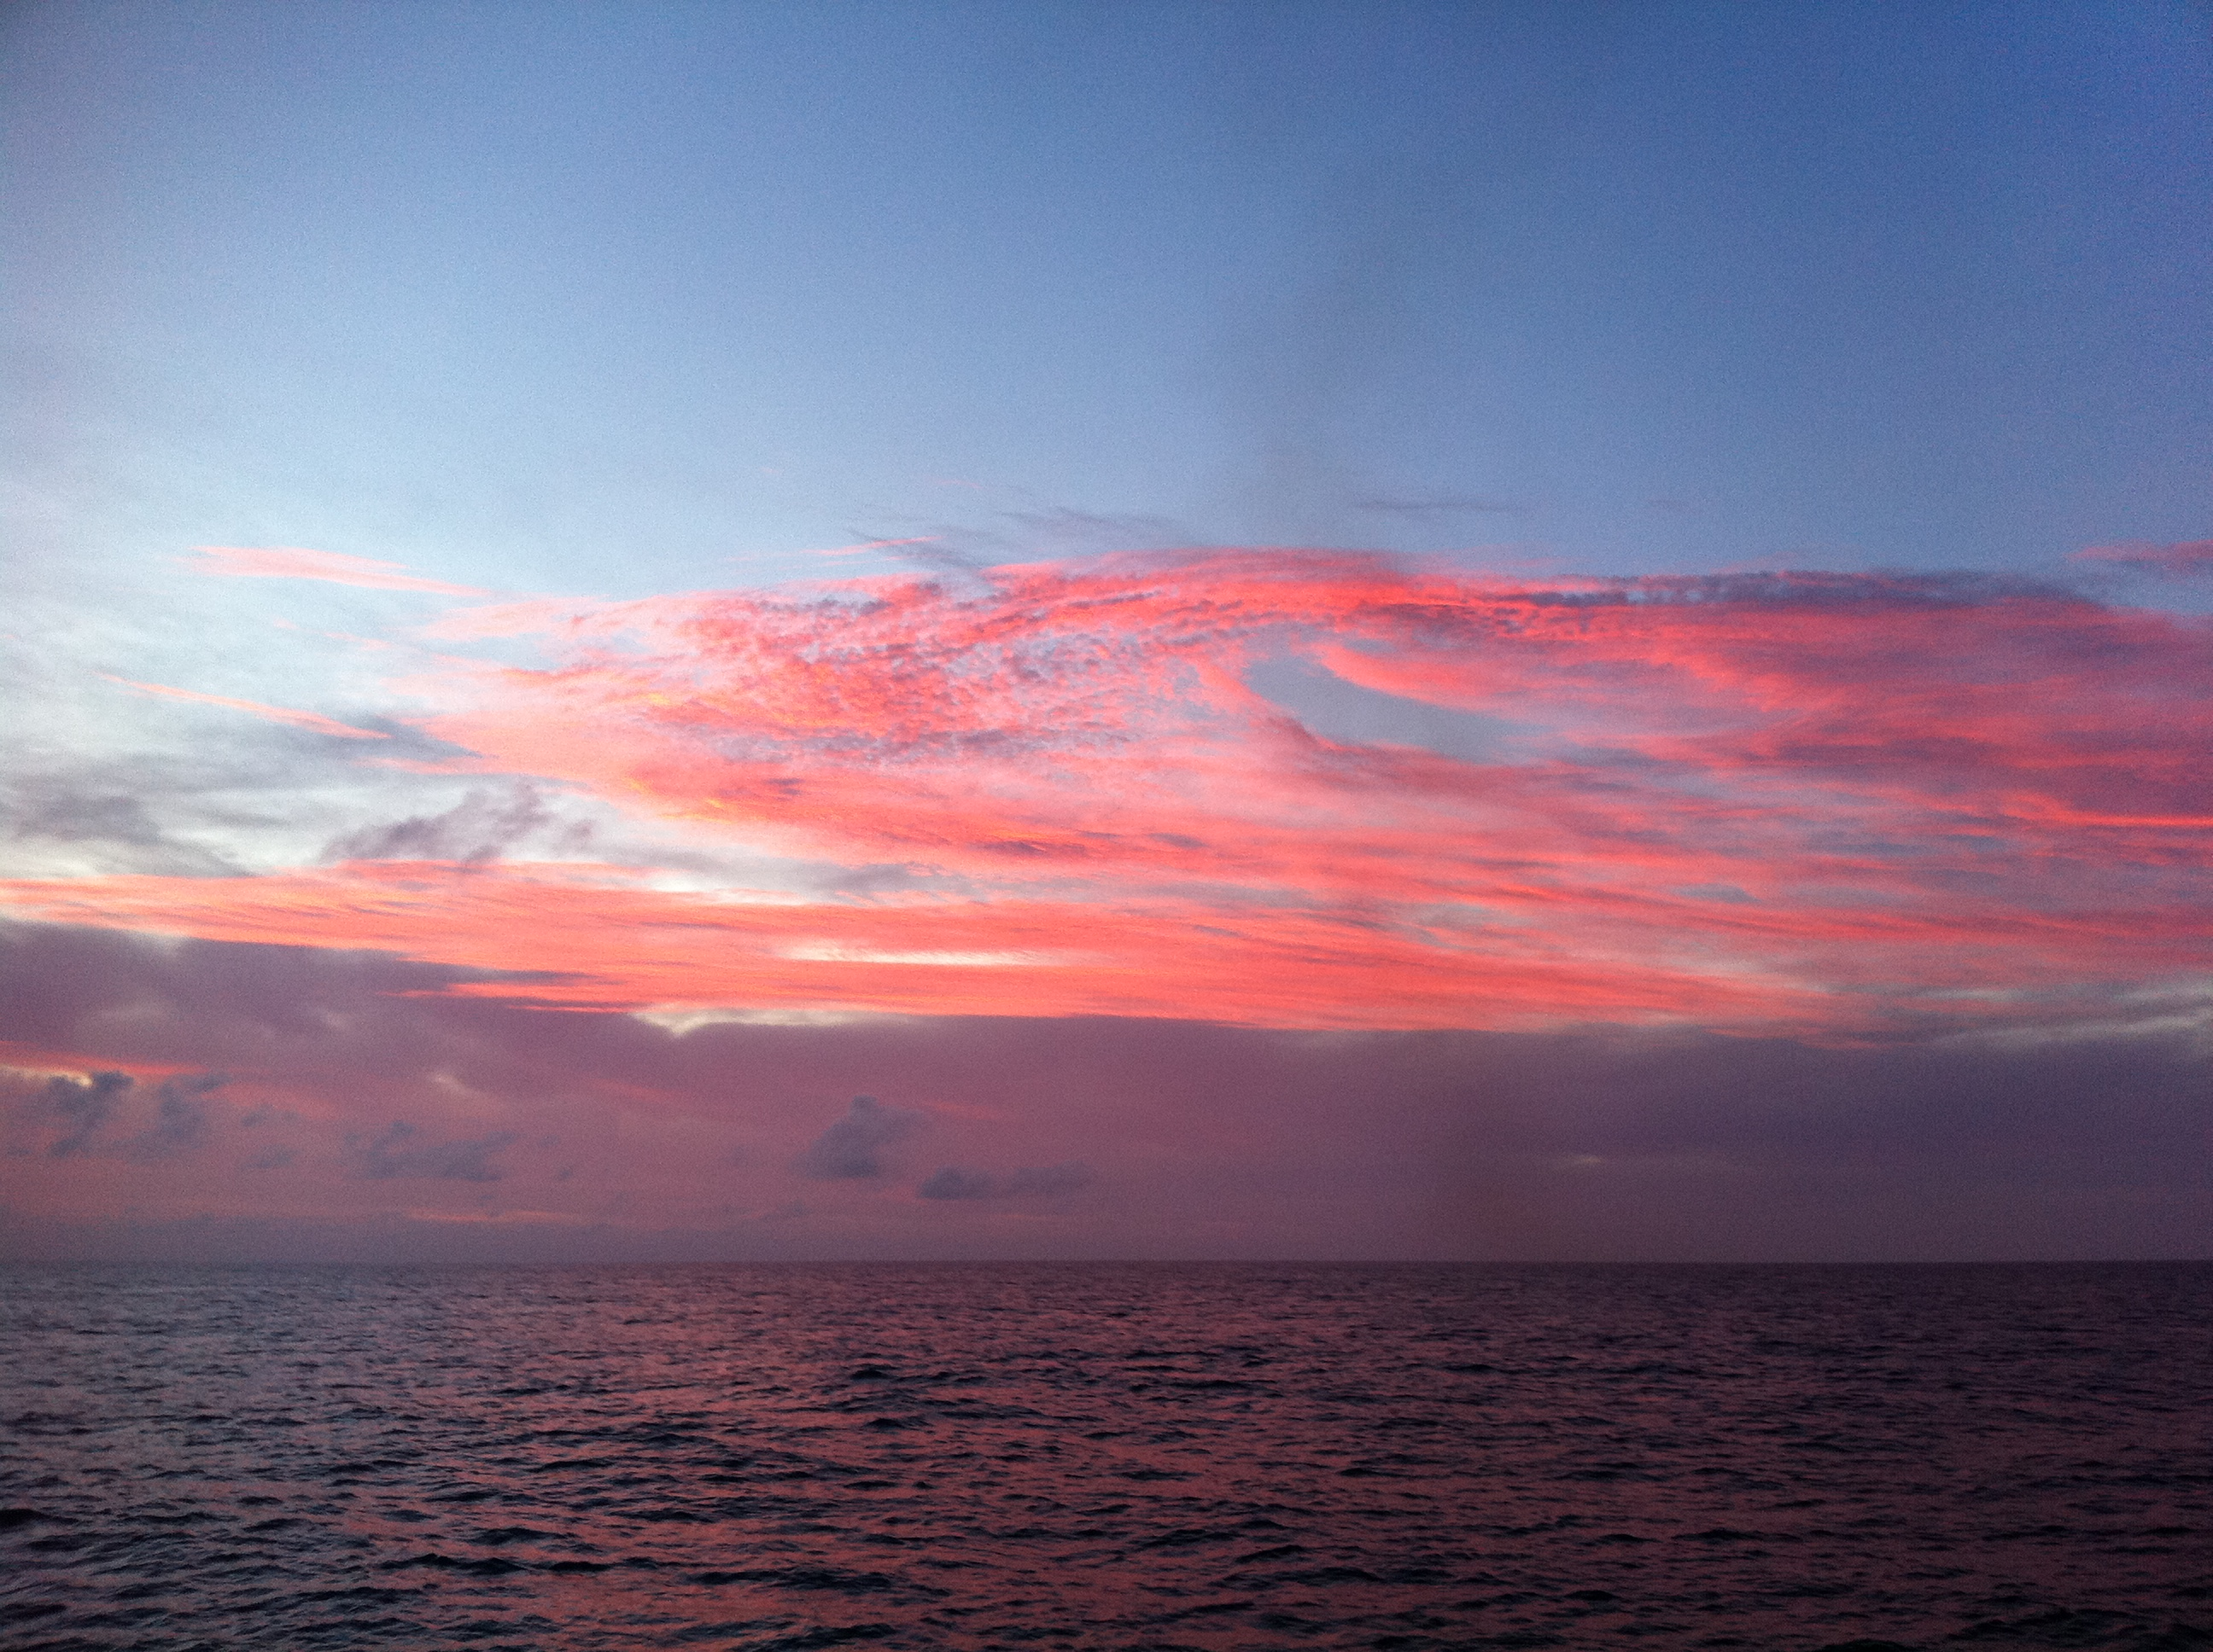
Conclusion
  Ocean waves are primarily generated by wind energy
  Tsunamis are “shallow water” waves driven by geological forces
  Breaking waves are caused by shoaling
Photo Credit: Brianne Moskovitz
Notes:
Notes: This page reinforces what students have learned.
The definition of a “shallow water” wave is a wave that feels the bottom of the sea floor. A typical ocean wave will only affect particles a few meters deep. A tsunami will affect particles on the seafloor. The tsunami warning system has sensors on the seafloor. This is how they interpret tsunami from typical ocean waves.
Breaking waves are caused by the slope of the seafloor, know as shoaling of the beach.
Photo Credit: Brianne Moskovitz

