Slide 1
Ocean Acoustics
Scripps GK-12 Classroom Connection
Notes:
AUTHORS: Brianne Moskovitz – Scripps Institution of Oceanography
WHY: Light waves (transverse waves) are readily absorbed by water and do not travel great distances in the ocean. Underwater, most sunlight is gone at a depth of only 50m and, hence, we cannot see the bottom of the ocean. To learn about the ocean floor, we need to use senses other than sight. Sound travels faster in water than in air, which give it the ability to travel great distances in the ocean. Ocean acoustics is very important for the navy, and scientists, but is even used by the everyday fisherman.
PICTURE/GRAPHICS CREDITS: n/a
WEBSITES USED IN THIS PRESENTATION: www.dosits.org
ADDITIONAL READING: www.dosits.org This website has an in-depth explanation of sound in the ocean environment.
CONTEXT FOR USE: High School physics or marine science. This presentation should be given after Waves_1 (Introduction to Waves) and Waves_2 (Ocean Acoustics).
MISCONCEPTIONS: Whales make most of the sound in the ocean.
EVALUATION TIPS:n/a
TEACHING NOTES: Depending on the level of your class, you may or may not choose to do the group activity and presentations.

Slide 2
Ocean Acoustics
Why do you think we use sound in the ocean?
What do you think makes the most sound in the ocean?
What is echolocation?
Notes:
Notes: These questions should be used as a warm-up. Give students a few minutes to consider (or write down the answers) these questions, then a minute to discuss with a partner, and finally discuss with the class (maybe have students present what their partner thought).
Why do you use sound in the ocean? – will be elaborated on later in the ppt.
The most sound in the ocean is caused by bubbles (wind counts). As wind blows across the surface, air is trapped below the surface. The bubble vibrates as it expands and contracts finding equilibrium. This expansion and contraction creates pressure waves which generate sound.
From Dosits.org: Echolocation: a process for locating distant or hard-to-see objects using the reflection of sound waves. The distance of objects or depth of the seafloor can be determined by measuring the time it takes for reflected sound waves (echoes) to return to the sound source. Some whales and dolphins use echolocation to identify underwater objects and to help find food.
Outside of the ocean environment, bats use echolocation.

Slide 3
Outline
Warm up
Objectives
Power Point and Discussion
Demonstrations
Group Activity
Group Presentations
Waves Jeopardy
Notes:
Notes: This is an outline for the upcoming lesson.

Slide 4
Objectives
Learning Goals
  Many marine animals are adapted to use sound
  Acoustic technologies are used for many purposes
  Sound waves travel at different speeds in different medium
  Temperature, pressure and salinity are variables of sound speed in seawater
Notes:
Notes: Students tend to find that the most exciting application of sound in the ocean is whale and other marine mammal communication. Play it up. Who doesn’t love whales? In Finding Nemo – “Do you speak whale?”
From our discussion of waves on day 1, we know sound needs a medium to travel through. In air it is much slower than in the water. This is because particles are closer together in water.

Slide 5
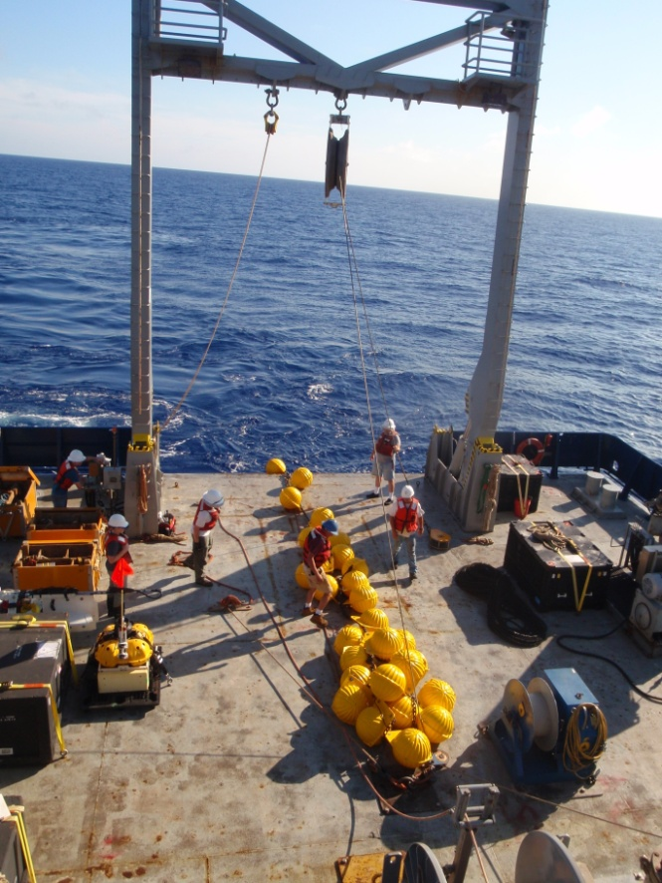
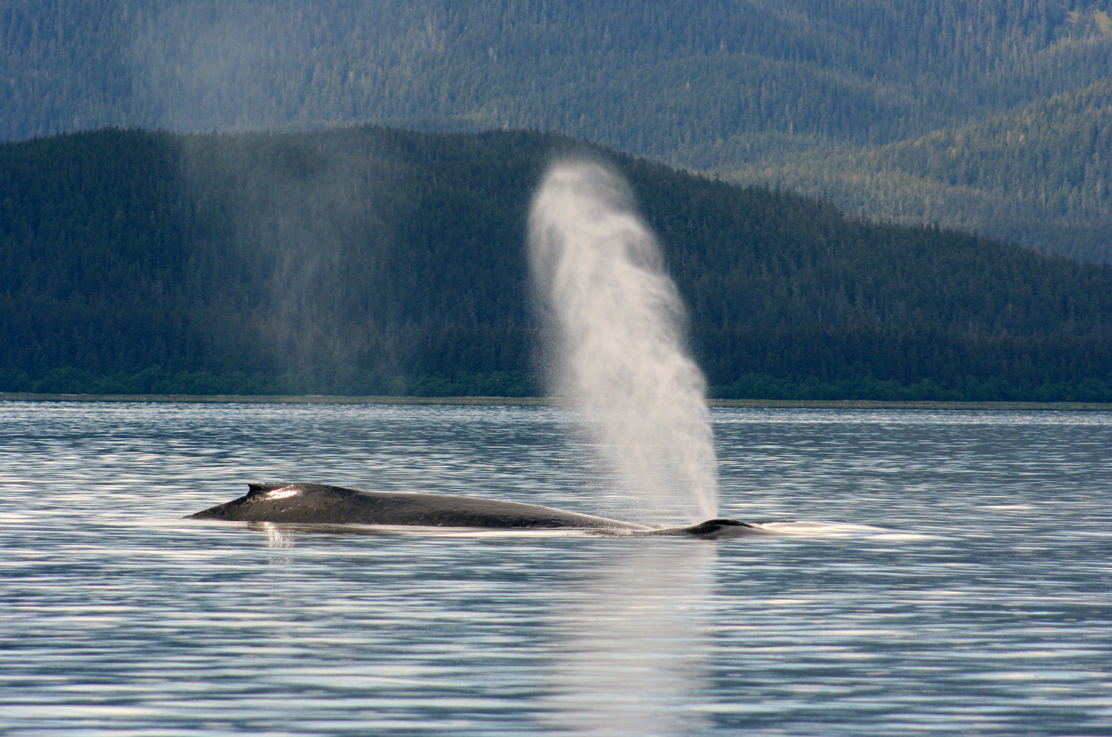
Applications of Ocean Acoustics
Navigation
Fishing
Communications
Temperature & Weather
Marine Mammals
Seismology
Defense
Photo Credit: Brianne Moskovitz
Photo Credit: Brianne Moskovitz
Notes:
Notes: All applications of ocean acoustics.
Navigation – Any navigator needs to know the depth of the seafloor so the ship does not run aground. A ping is sent from ships, bounces on the seafloor, and returns to the ship. Computerized echolocation systems measure the time it takes for the sound to return to the ship, and determines the depth of the water knowing the speed of sound in the ocean.
Fishing – if anyone has ever been on a fishing boat, they may have noticed a “fish finder.” This is a screen that shows blobs where it thinks fish are. This is done with sound, in a process similar to echosounding in navigation. If the ping hits a fish, it appears closer than the seafloor. You may even be able to learn about the size and depth of the fish.
Communications – Scientists use underwater robots to study the ocean. To communicate with these robots, they often use sound.
Marine Mammals – use echolocation to find food, trap their prey, and communicate with each other using sound.
Seismology – Earthquakes in the ocean generate sounds that may travel through the water column and can be detected by hydrophones. Seismologists use airguns to send acoustic signals to the seafloor and study the structure of the seafloor.
Defense – The navy uses acoustics to look for submarines, and learn about the depth of the seafloor.
Photographs – The image on the right is a hydrophone array on the RV Revelle. A hydrophone is an underwater microphone, and records sounds in the ocean. The yellow spheres are glass balls that provide buoyancy to keep the array straight in
the ocean. They also allow scientists to retrieve the array and carry the array to the surface after an acoustically releasing a weight. This array was mounted to the seafloor, and was released with an acoustic command. The middle image is of a humpback whale off the coast of Alaska.

Slide 6
Why acoustics in the ocean?
Acoustics is study of pressure and vibrations
Speed of sound in air?
340 m/s
Speed of sound in water?
1500 m/s
Sound, and especially low-frequency sound, can travel thousands of meters with very little loss of signal.
Ocean sounds can be “trapped” and effectively carried very long distances by the “deep sound channel ” that exists in the ocean.
Called SOFAR or SOund Fixing And Ranging channel
Notes:
Notes: The speed of sound in water is almost 5 times as fast! On land, it would be difficult to hear someone shouting from the other side of a football field. In the ocean, sound energy doesn’t disappear quickly, and low frequency sounds may be heard on the other side of the world.
More information on the SOFAR channel is on slide 9.

Slide 7
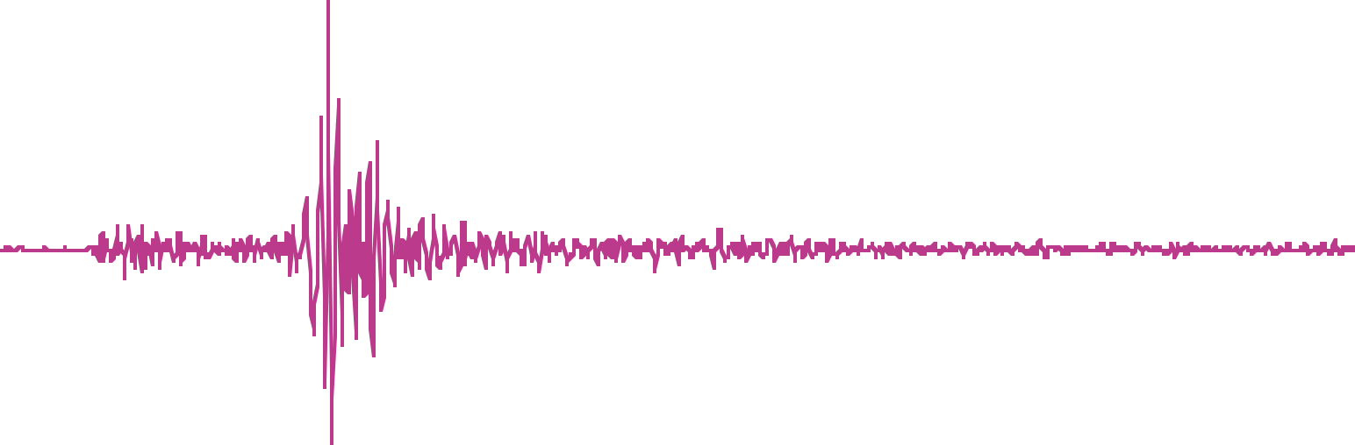

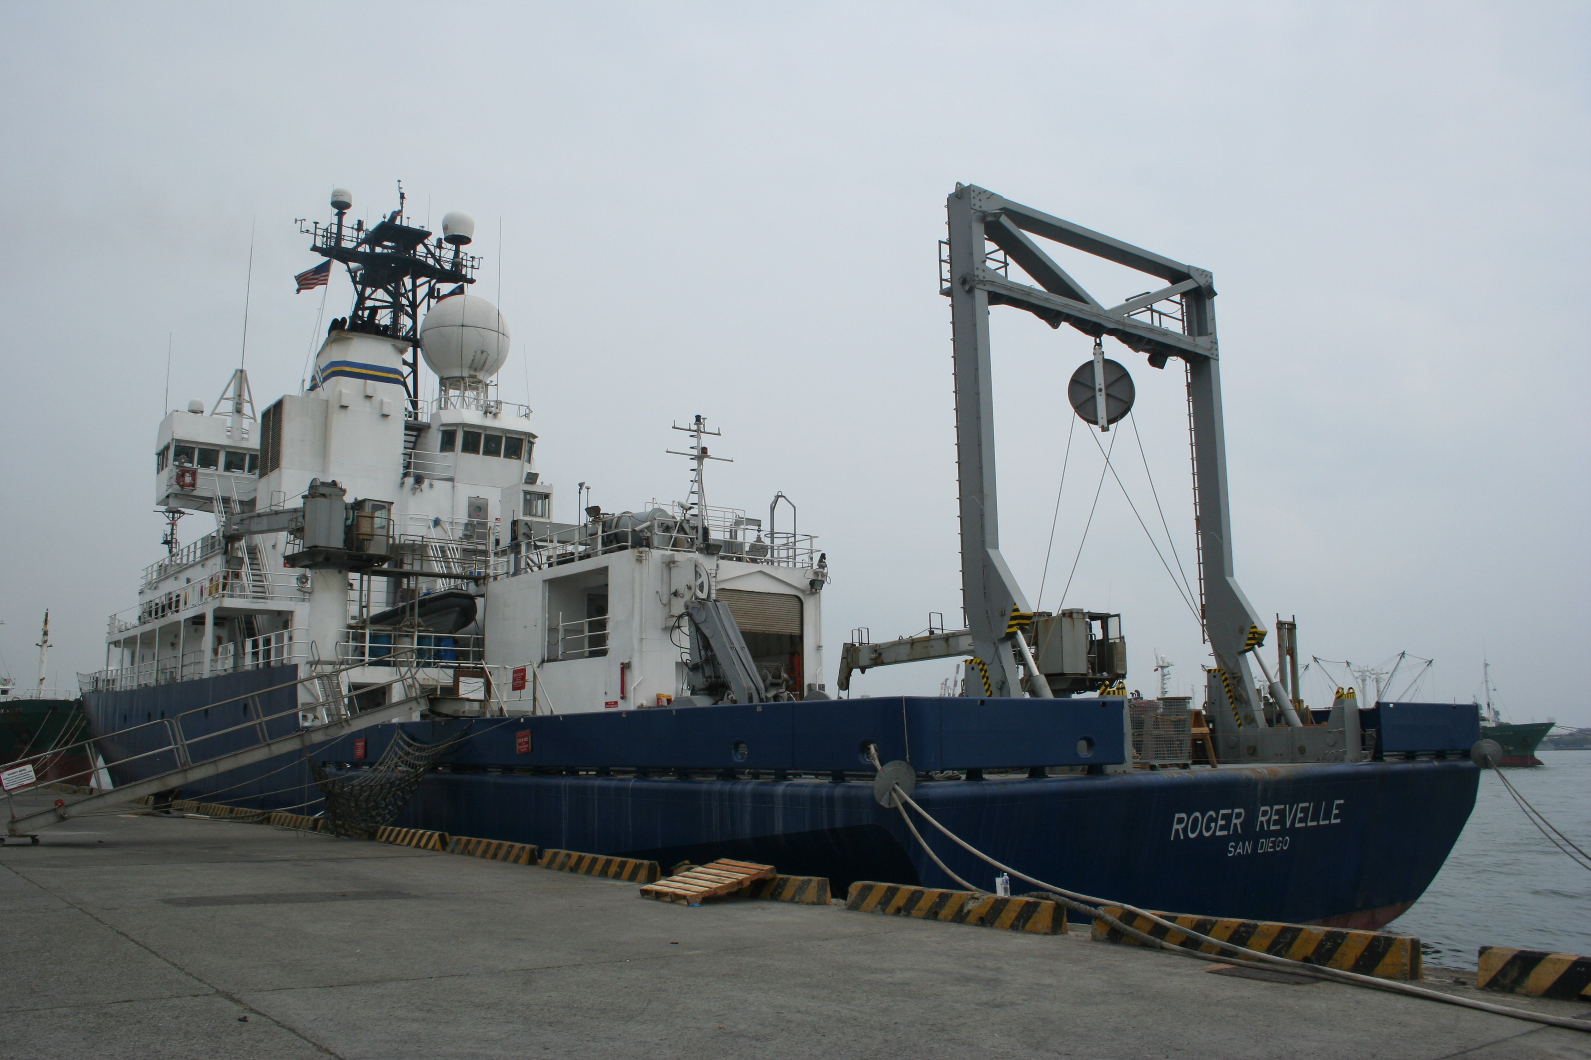
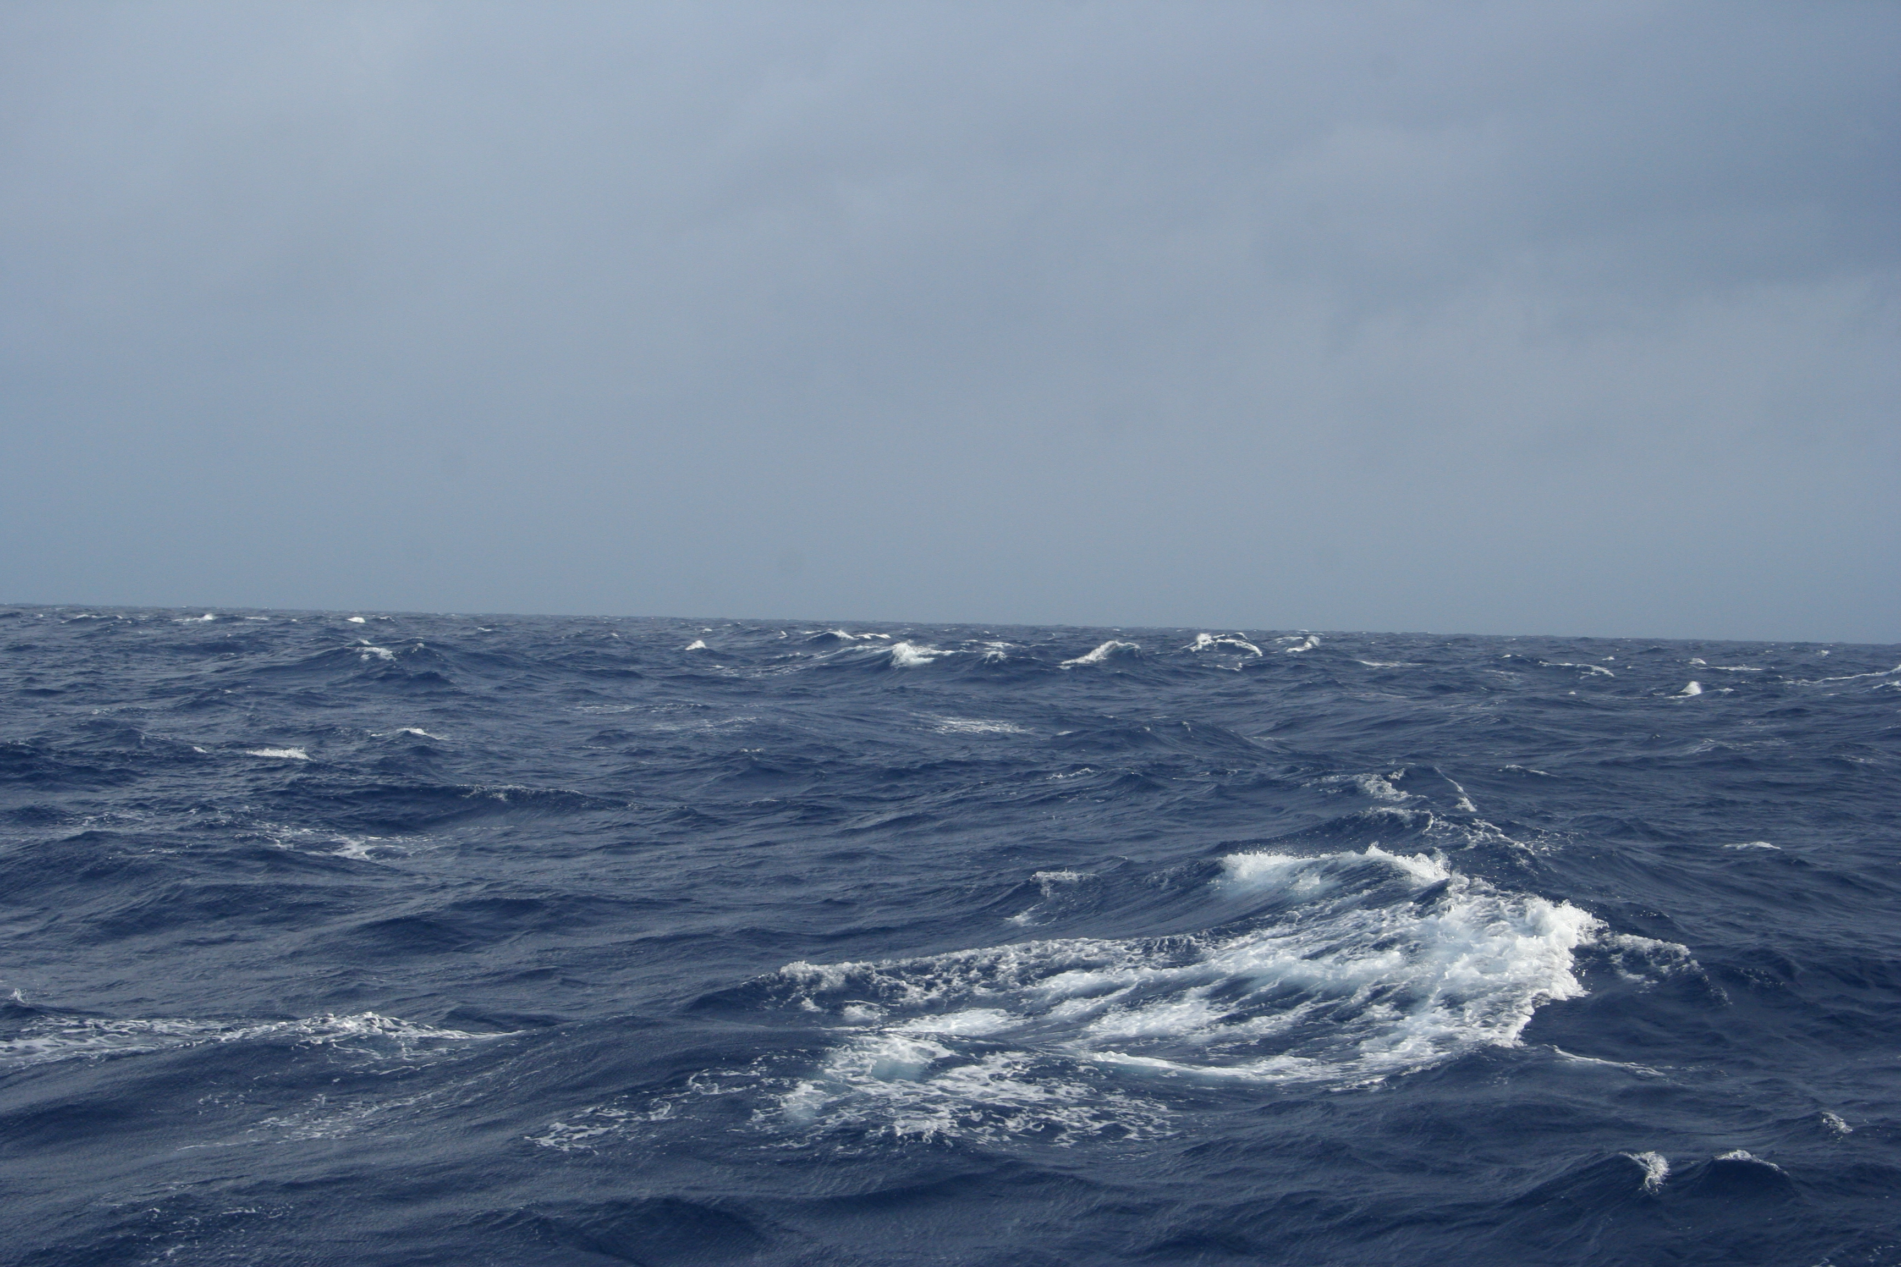
Ocean Sounds
Earthquake Signal
Ship Noise and Airgun Signal
Wind Noise
Notes:
Notes: Play these sounds to give students an idea of what they are hearing.
The wind noise sounds similar to pouring a glass of water into a larger body of water. It’s all bubbles!
The first image shows the RV Revelle at port in Kaohsiung, Taiwan.
The second image shows white caps created by wind. These white caps are lots of little bubbles.

Slide 8
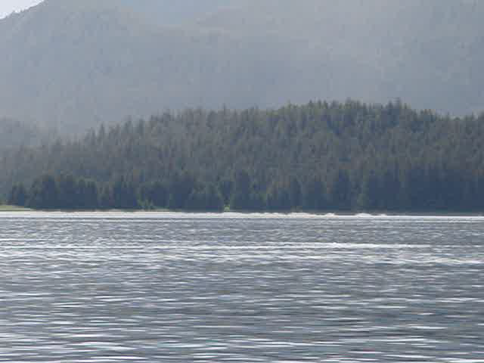
Ocean Sounds
Whales
http://youtu.be/vJvfjiCTvq4
Video credit: Philip Baxa
Notes:
Notes: This video was taken off the coast of Alaska and demonstrates humpback whales bubble net feeding. A hydrophone was placed in the water to hear what sounds the humpbacks were making. Please excuse the other tourists comments, and enjoy the sound of the whales.
http://youtu.be/vJvfjiCTvq4 is another good video that explains bubble net feeding.

Slide 9
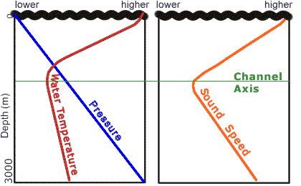
Sound Speed Profile
Thermocline
Turning Point
SOFAR Channel
Conjugate Depth
image from http://www.pmel.noaa.gov/vents/acoustics/tutorial/11-sofar.html
Notes:
Notes: As in slide 6 Salinity (how salty the water is), Temperature and Pressure create the sound speed profile. In the ocean, pressure is linearly dependent on depth (it increases with increasing depth). The average ocean environment has a warm surface, that decreases in temperature until a certain depth (between 500m and 1km). At this point, the water doesn’t get any colder as you get deeper. Temperature is most important in creating the sound speed profile, and that is why, as temperature decreases, so does sound speed. When the temperature levels off to the coldest point, pressure takes over. Sound speed increases with increasing pressure. This C shape in the sound speed profile traps sound in it, and is know as the deep sound channel, or SOFAR channel.
The turning point is the sound speed minimum.
The conjugate depth is the point at which the sound speed is the same as it is at the top of the SOFAR Channel (below the mixing layer by the surface).
DEMONSTRATION: Use two similar glasses, that when tapped with a knife make the same sound. Using a hot pot, heat some water. If you have ice, cool another body of water. Measure out an amount of hot water, and pour it into glass 1. Measure out the same amount of cold water, and pour it into glass 2. Tap on each glass. The glass with the hot water, should make a higher pitch than the glass with cold water. (Make sure you have the same volume of water in each and make sure they sound the same with the same temperature of water.) This is a cool way to demonstrate that sound speed is higher in hot water, and lower in cold water.
For more information, see http://dosits.org/resources/all/classroom/stirringupsound/

Slide 10
Group Activity
Follow the instructions on the handout.
Prepare a poster on your findings.
Prepare to present what you learned.
Notes:
Notes: Break students into groups of 3-4. Give each group one of the pages of SoundSpeedGroupActivity.doc.
Students will use the sound speed data given to plot the sound speed profile. They will then use the information about longitude and latitude, and temperature and salinity profile to answer the questions about the profile. Answers are in SoundSpeedGroupActivityAnswers.doc.
Students should prepare a poster with their findings, and present to the class.
Each region creates a different sound speed profile. The Mediterranean has warm salty water, and has a different profile than the cold Arctic, and the sub-tropical San Diego and Taiwan regions. The Arctic region will not see a SOFAR channel. The temperature differences aren’t great enough in that region.

Slide 11
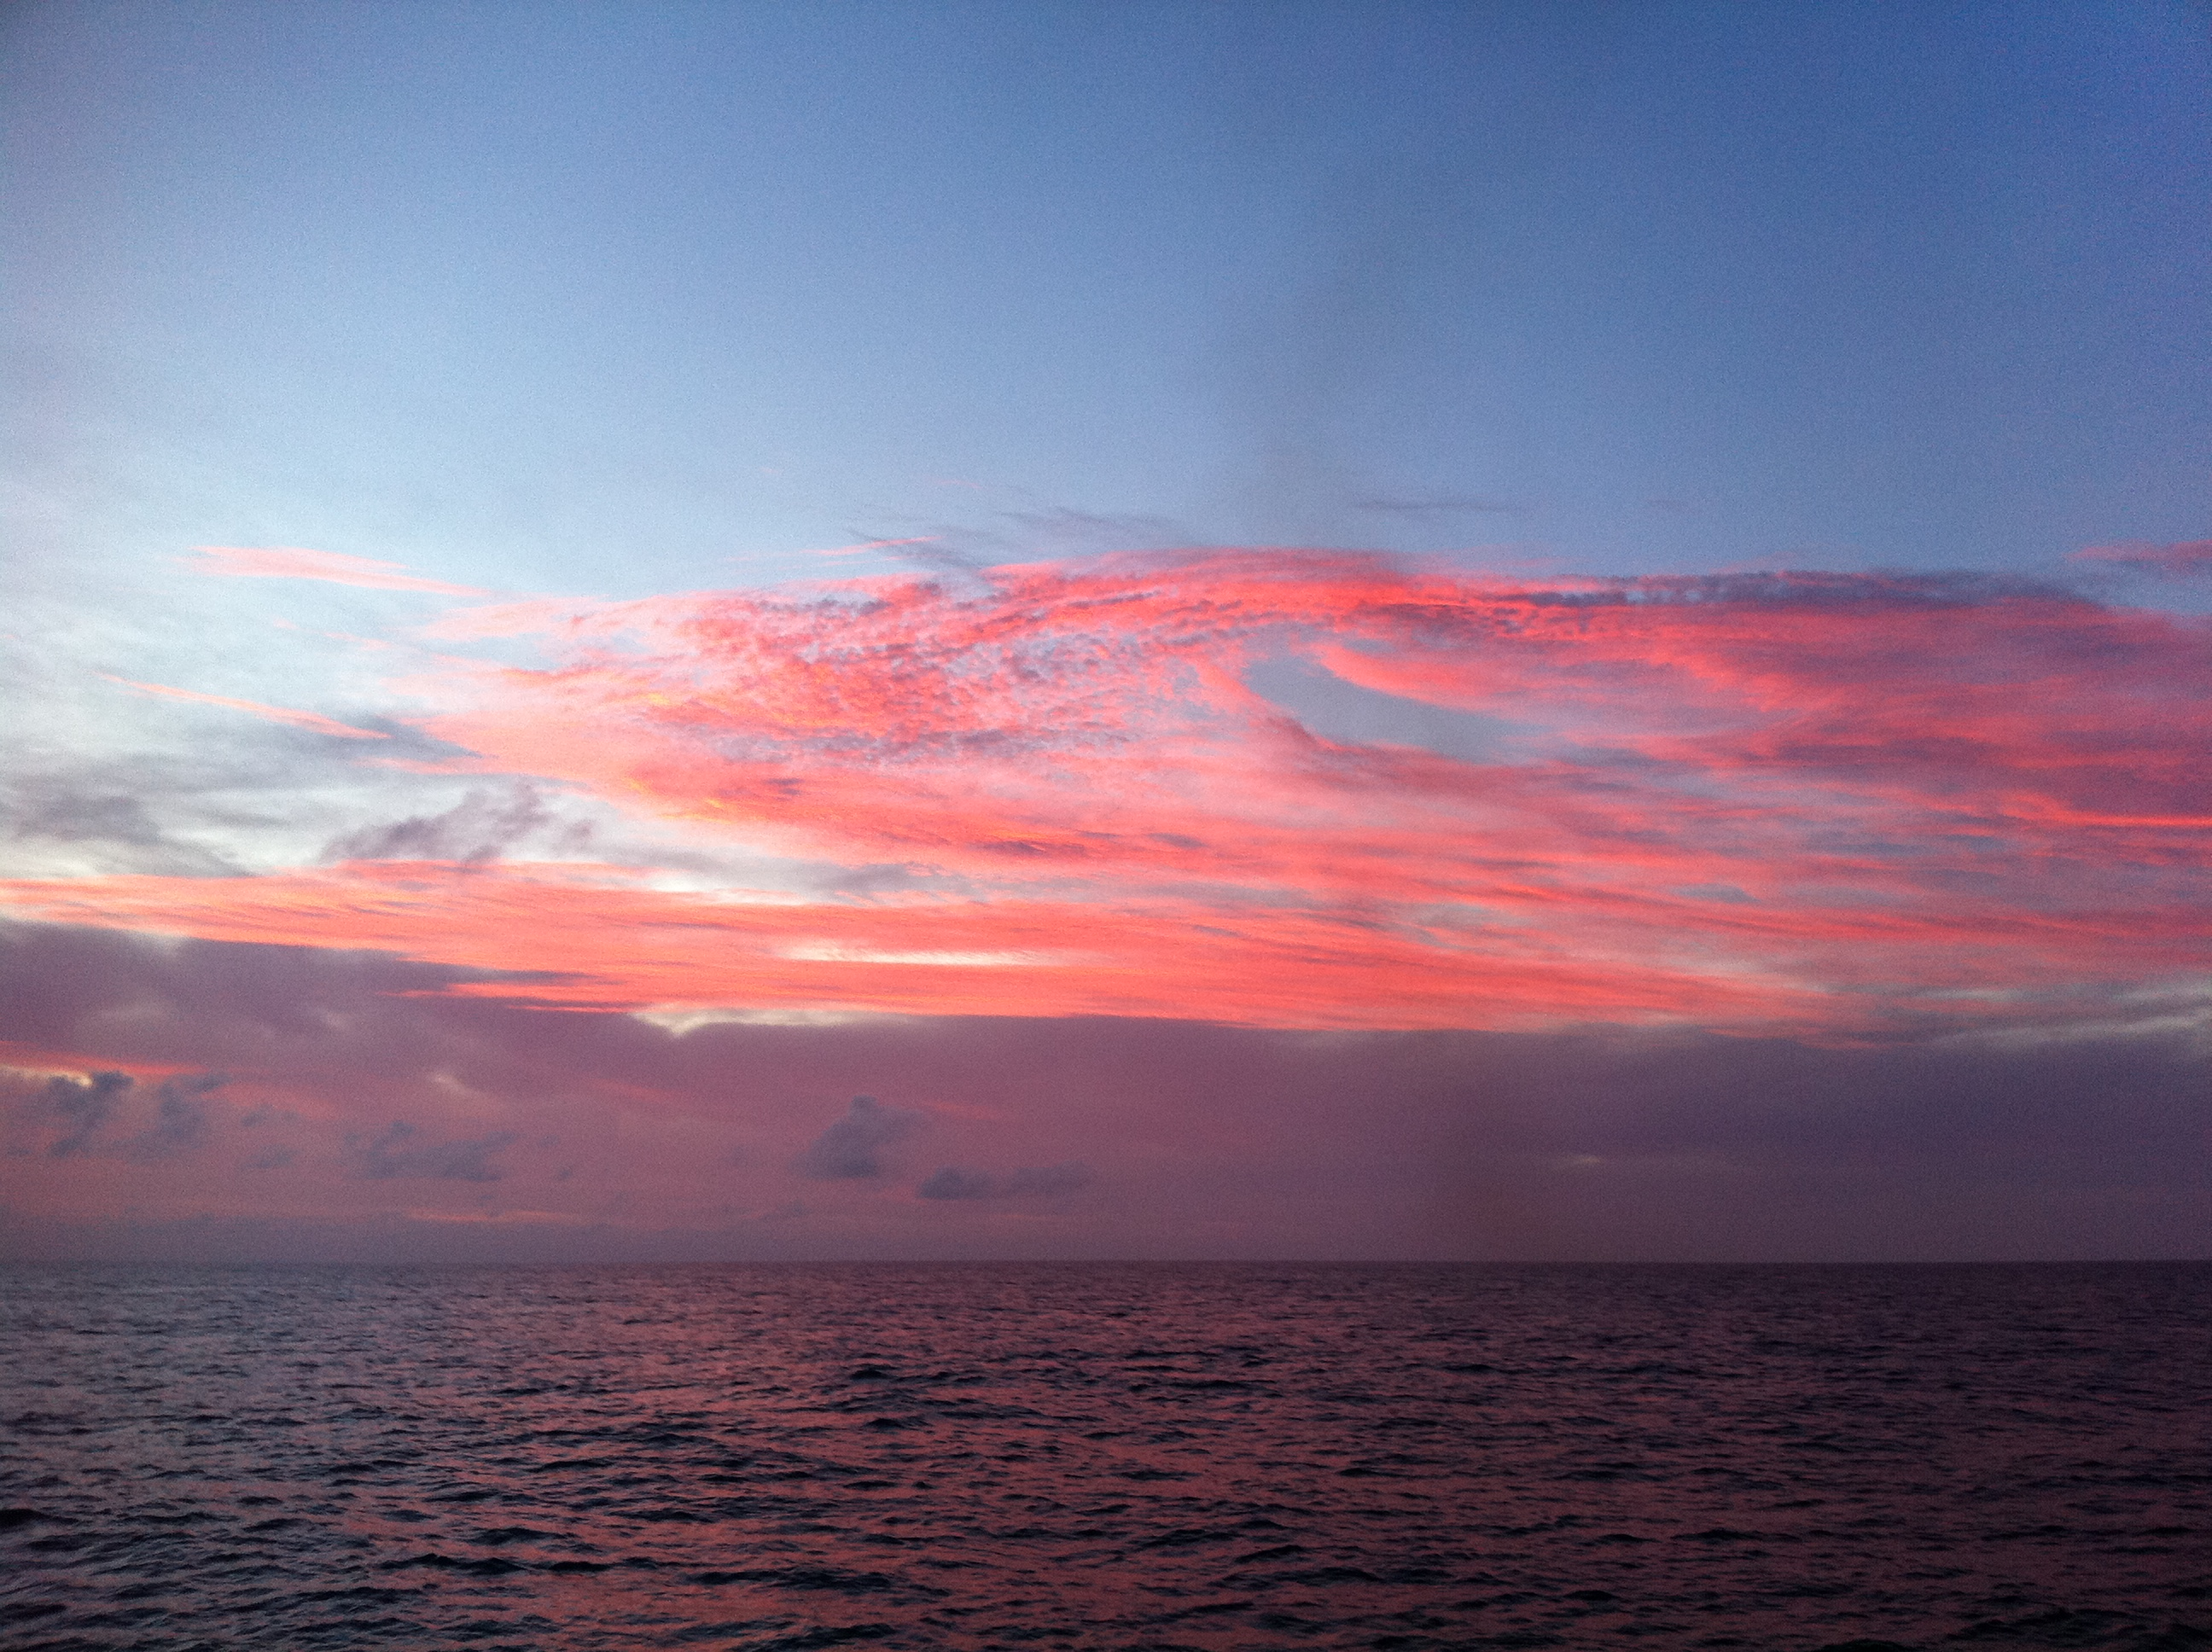
Conclusion
  Many marine animals are adapted to use sound
  Sound waves travel at different speeds in different medium
  Temperature, pressure and salinity are variables of sound speed in seawater
Photo Credit: Brianne Moskovitz
Notes:
Notes: This page reinforces what students have learned.
After group presentations, a fun follow up activity is Waves Jeopardy (WaveJeopardy.xls) This is an adaptation of a jeopardy game created specifically for this week long lesson on waves.
Before you begin, make sure the questions are blacked out. As a section is chosen, highlight the cell, and change the background to white. You may use your own rules, but two teams, one student at a time has worked well for me. If neither student gets the question correct, it goes out to the rest of the class (first hand up).
Photo Credit: Brianne Moskovitz

