Slide 1


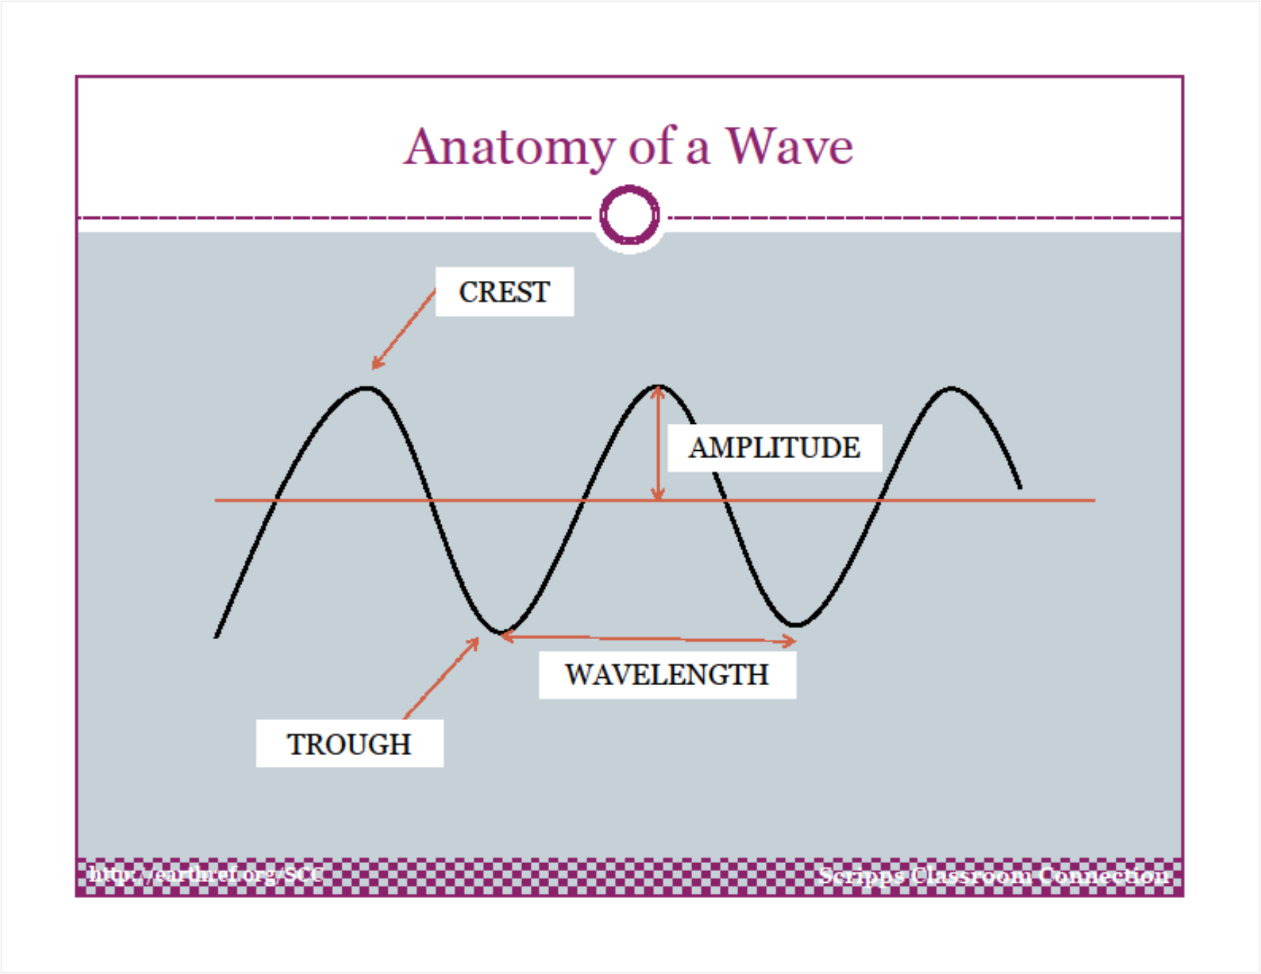
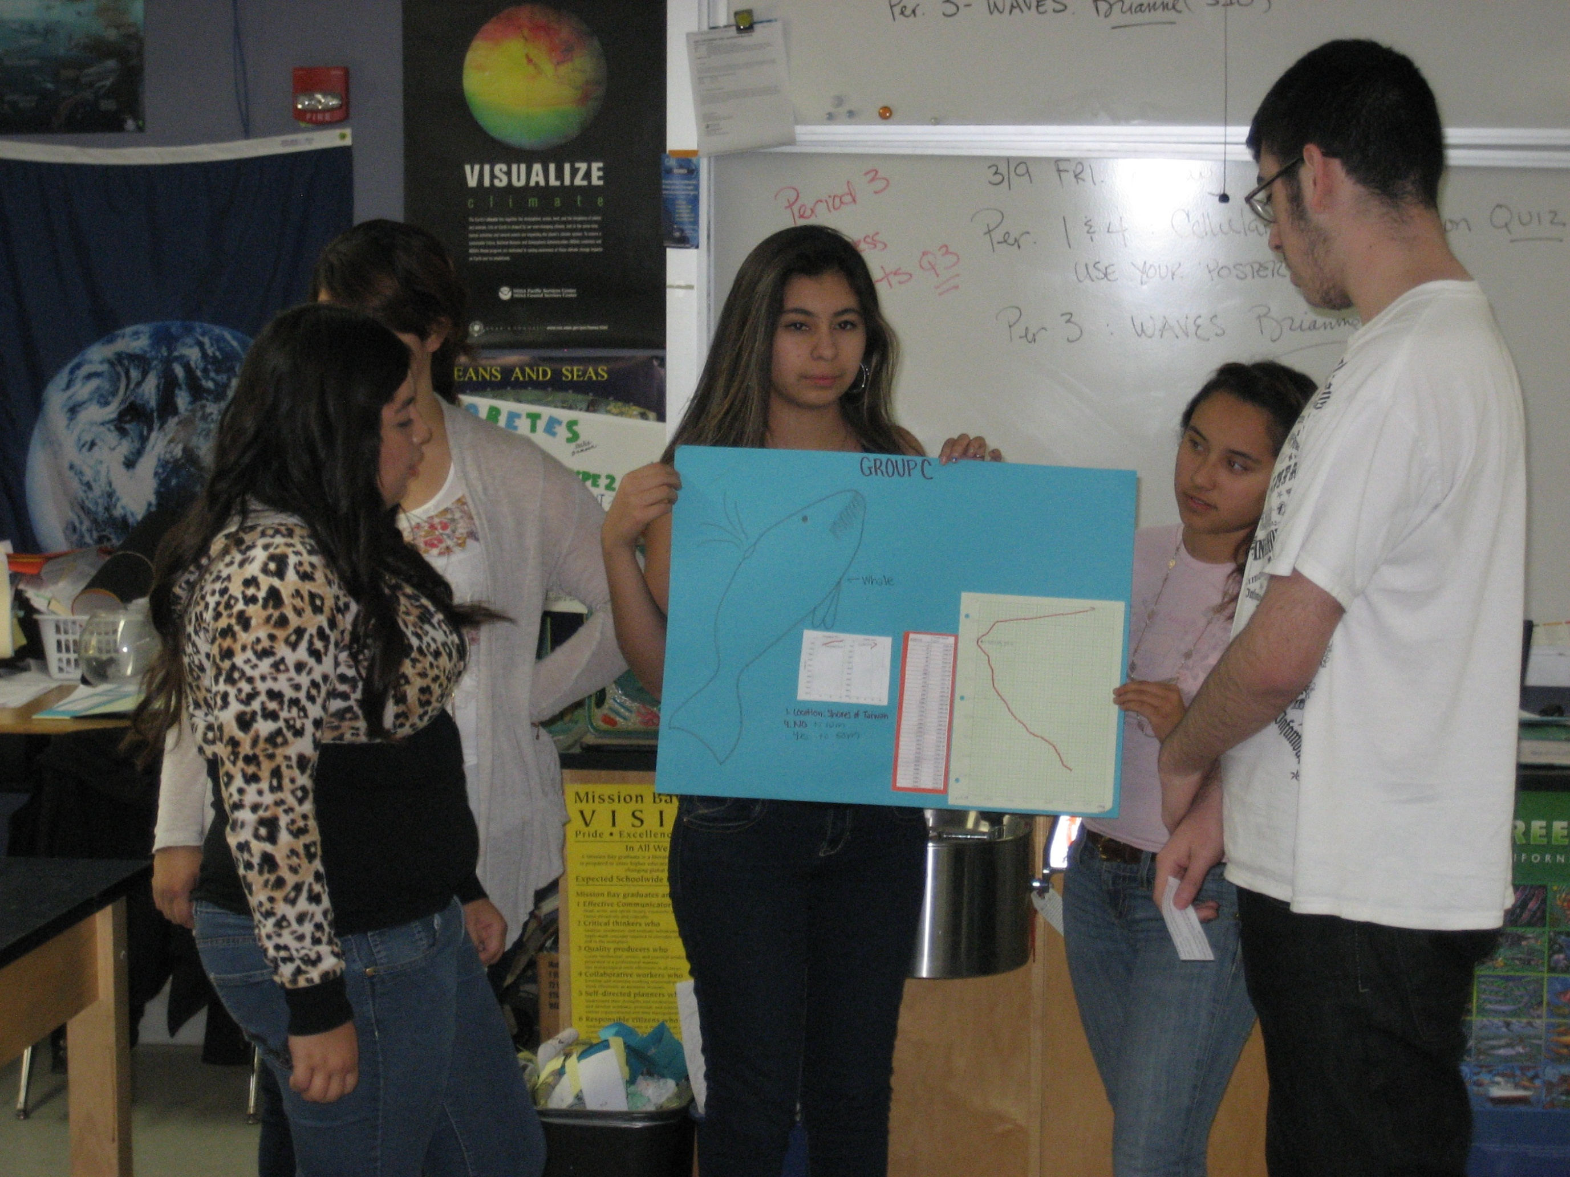
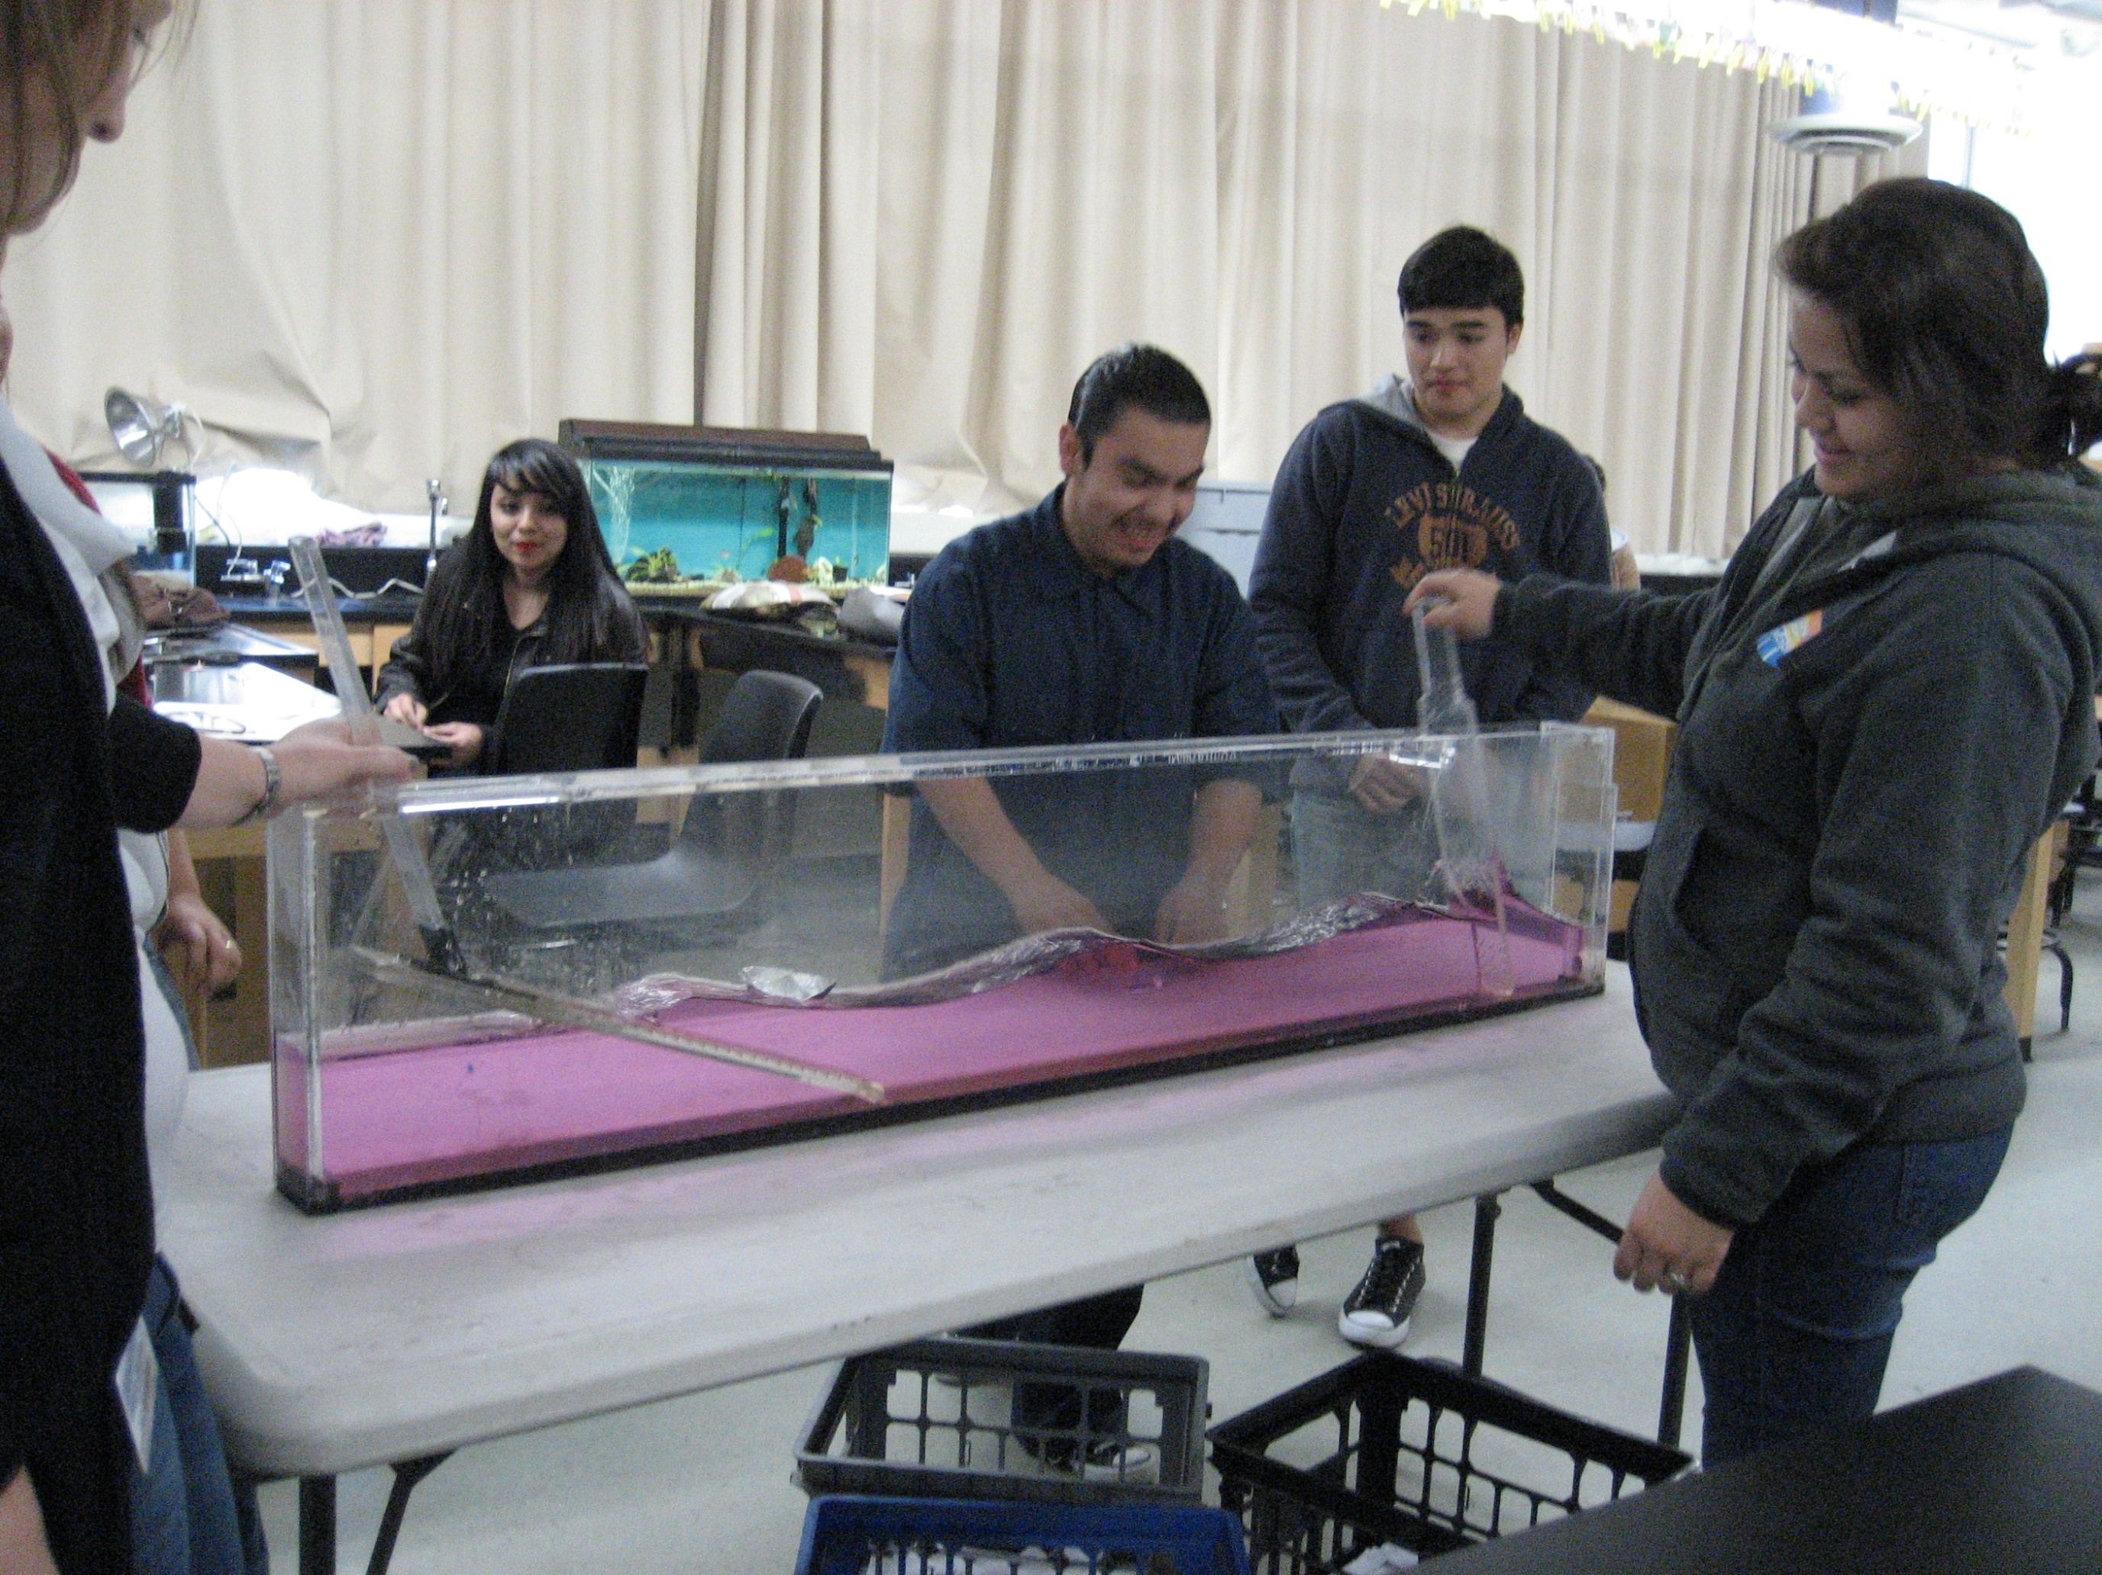
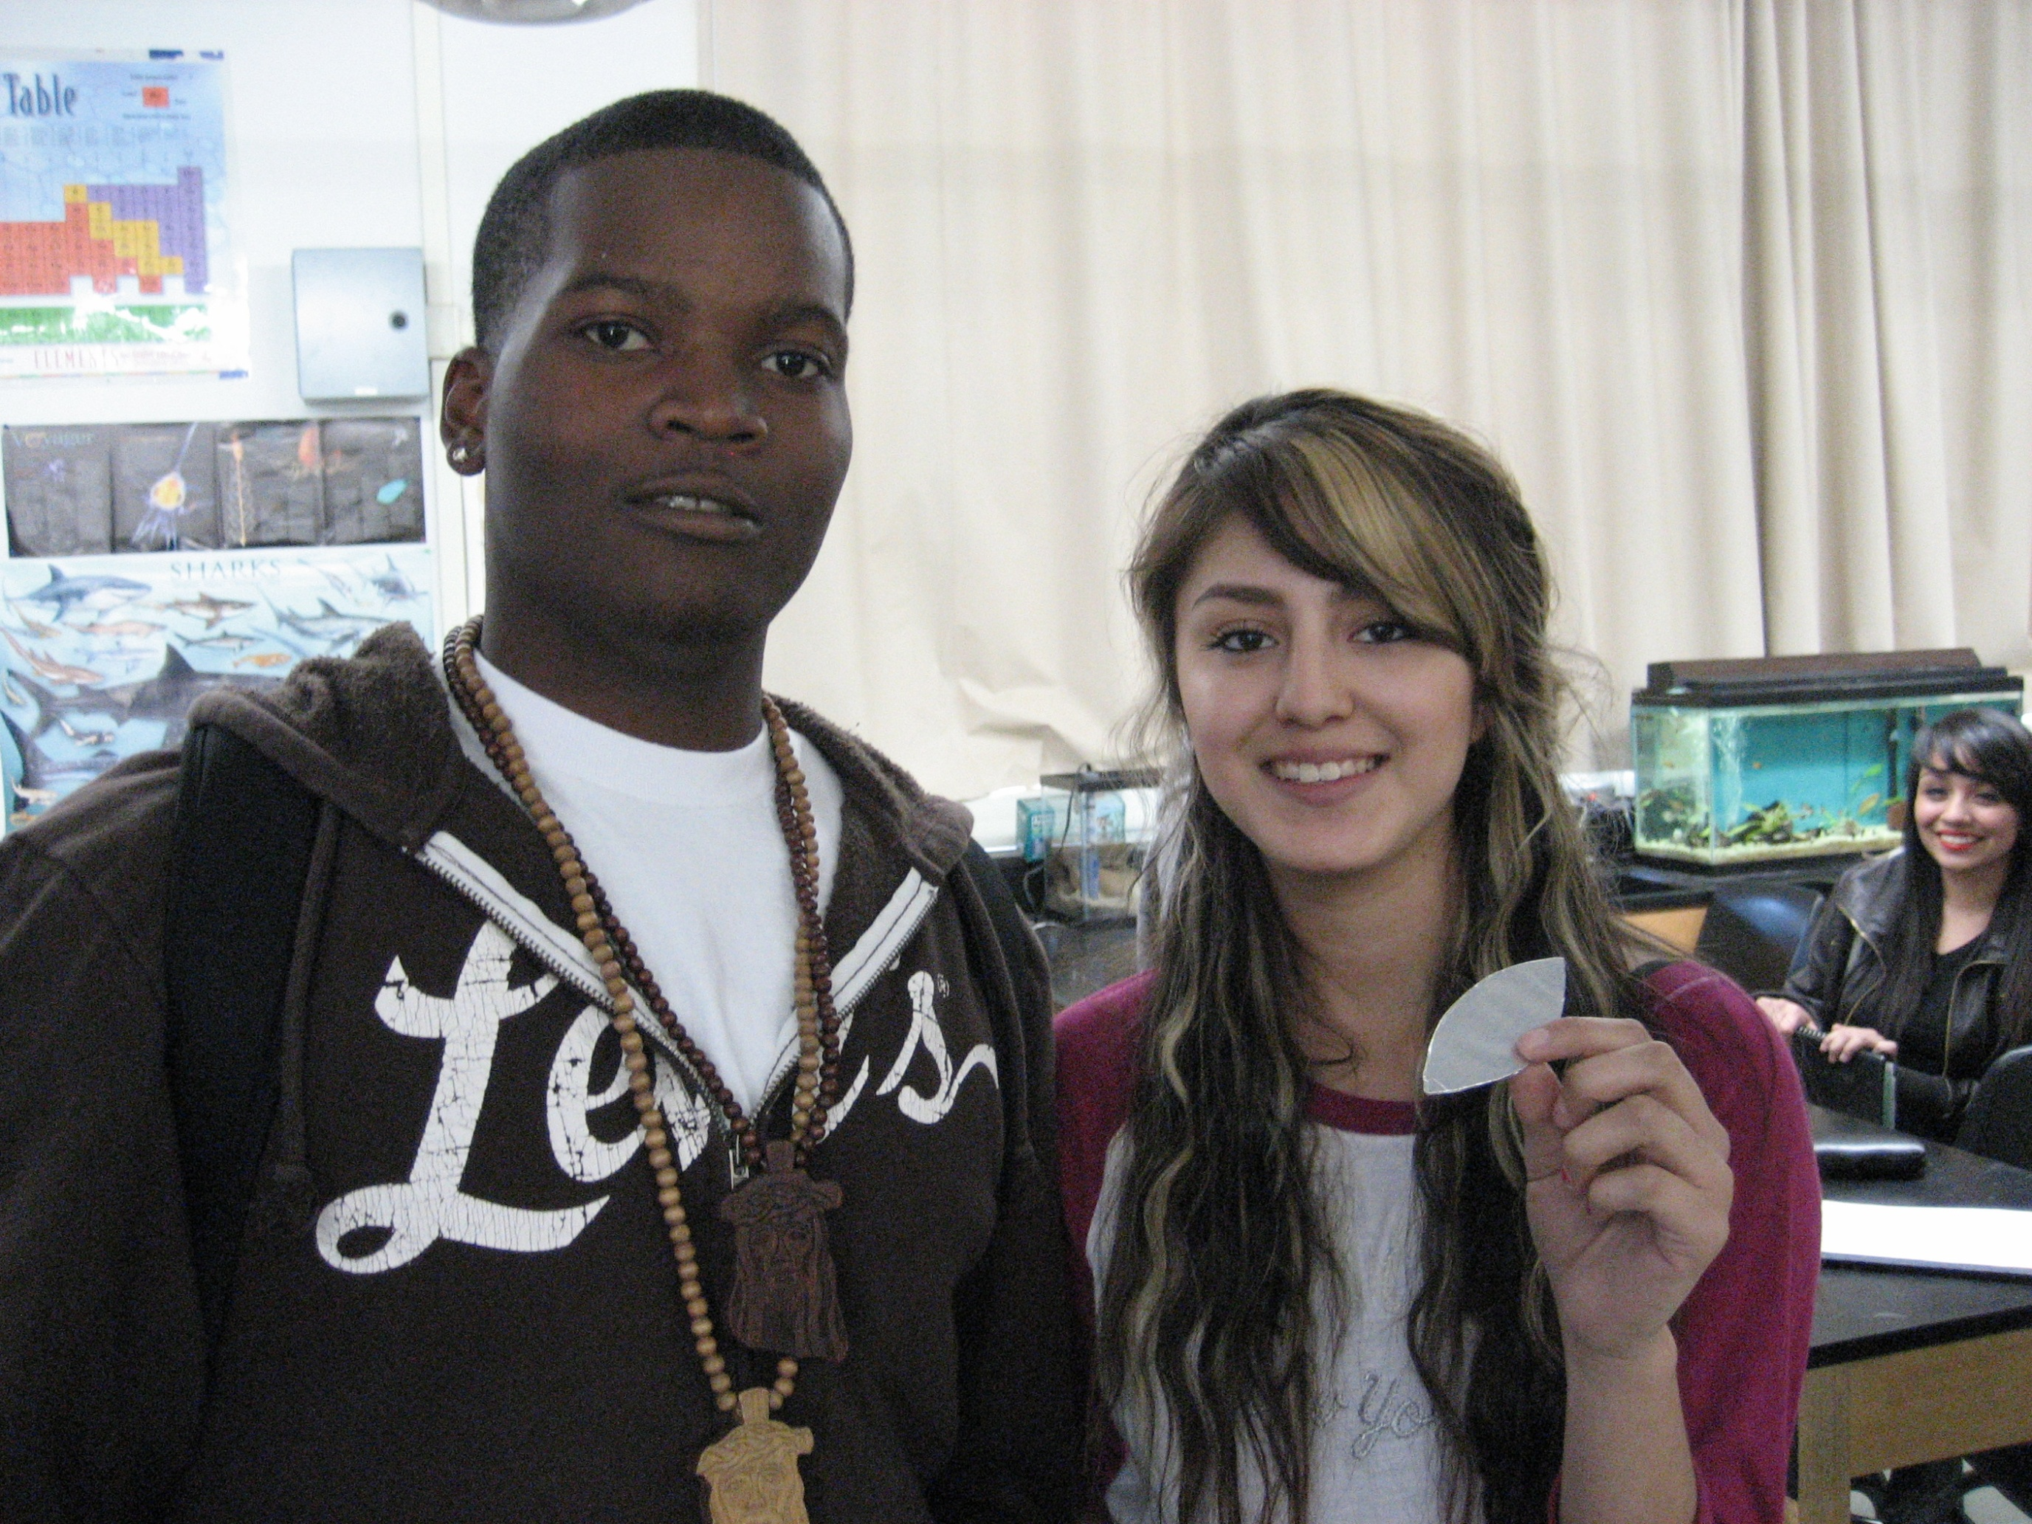
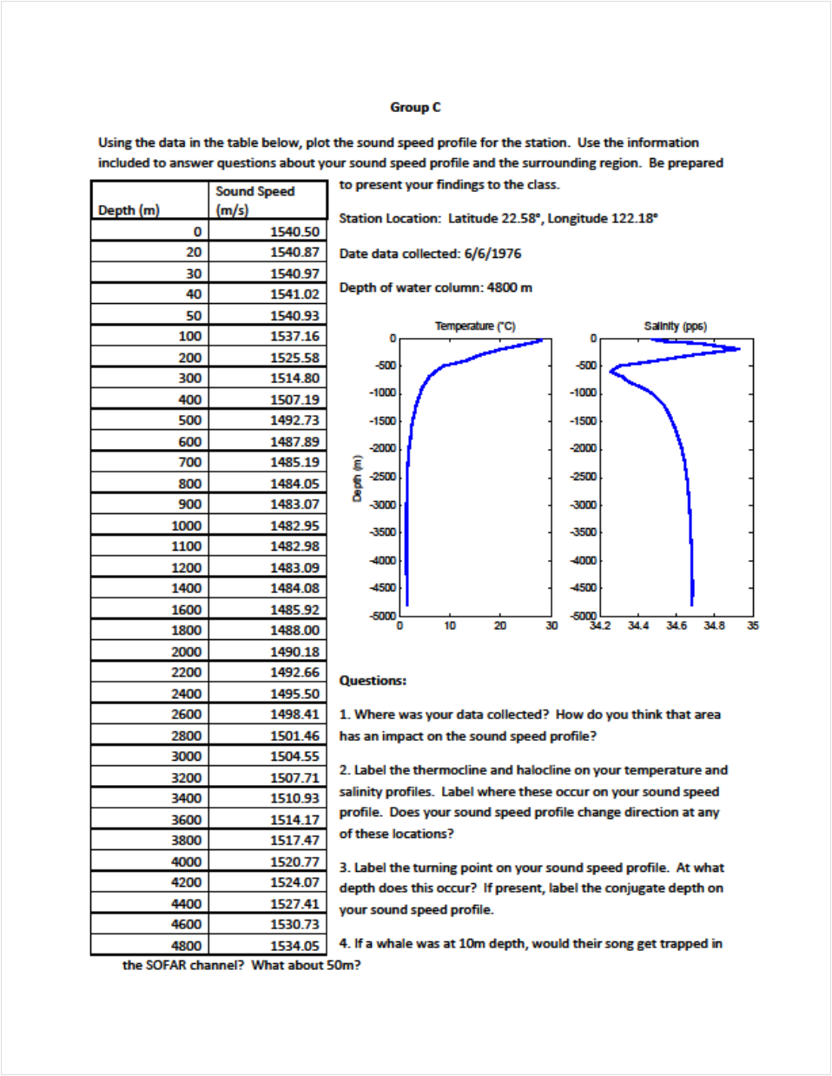
Waves in the Marine Environment
Brianne Moskovitz¹, David Escamilla², Steve Walters², and Jon Corbin²
1) Scripps Institution of Oceanography 2) Mission Bay High School
Day 1: What are waves?
10-15 min PPT, activity with slinkys and springs, reinforcement worksheet
TRANSVERSE LONGITUDINAL
Features (amplitude, crest, trough, wavelength, wave speed, longitudinal, transverse)
Learning Goals
Students know waves carry energy from one place to another.
Students know how to identify transverse and longitudinal waves in mechanical media, such as springs and ropes, and on the earth (seismic waves).
Students know how to solve problems involving wavelength, frequency, and wave speed.
Students know sound is a longitudinal wave whose speed depends on the properties of the medium in which it propagates.
Students will be able to distinguish between a wind driven wave and a tsunami with regards to mode of generation, wave speed, frequency, and wavelength.
Students will be able to describe the uses of sound in the ocean environment.
Students will be able to understand the driving forces of a sound speed curve in the ocean, and the impacts of the shape of the curve.
Science Standards
California Science Standards
Grades 9-12 Physics
4 a,b,c,d
Day 3 and 4: Acoustic Waves
PPT on applications of ocean acoustics, common ocean sounds, and structure of sound speed profile
Stirring up Sound demonstration
Group activity with presentations of regional sound speed data.
Review Jeopardy
Day 2: Ocean Waves
Wave tank demonstration,
Video clips on tsunami and worksheet
Make your own surfboard competition
  Students used cardboard and aluminum foil to build surfboards
  Using their knowledge of wave frequency and the slope of the seafloor, they created waves to push their board from one end of a wave tank to the other.
  The winning board traveled the length of the tank in 4 seconds!
Scripps Classroom Connection

