Slide 1
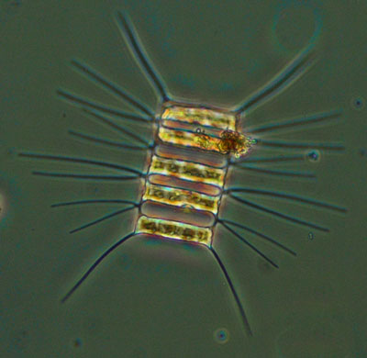
Phytoplankton Diversity and Cell Model Building
earthref.org/SCC
Scripps Classroom Connection
Notes:
1. AUTHORS: Darcy Taniguchi, Scripps Institution of Oceanography, Ph.D. Candidate
Steve Walters, Mission Bay High, Science Teacher
2. WHY: Whenever you go swimming in the ocean, you swallow thousands of phytoplankton. Aren’t you curious what you are consuming?
Also, a lot of the oxygen you breathe comes from phytoplankton. Without these organisms, you wouldn’t be able to survive.
Furthermore, have you ever eaten fish? At the bottom of the food web that produced that fish were these phytoplankton.
Phytoplankton are also major players in chemical cycles, such as those of carbon and nitrogen.
3. SUMMARY: This presentation goes over major types of phytoplankton in the ocean. Specifically, prokaryotic cyanobacteria are contrasted with other eukaryotic phytoplankton. Then distinct types of eukaryotes, including diatoms, dinoflagellates, and coccolithophores, are covered.
4. PICTURE/GRAPHICS CREDITS:
The picture is of the diatom Chaetocerous decipiens. It is 16 μm wide and 42 μm long. It is a phytoplankton found in the Rhode River. Image taken from the website http://serc.si.edu/labs/phytoplankton/guide/diatoms/chatdec.aspx. The photo was taken by Sharyn Hedrick of the Smithsonian Environmental Research Center.
5. WEBSITES USED IN THIS PRESENTATION: The Smithsonian Research Center, http://serc.si.edu/index.aspx, for images.
For information and images, I also used http://www.botany.hawaii.edu/faculty/webb/bot311/cyanobacteria/cyanobacteria.htm
http://www.mbari.org/staff/conn/botany/phytoplankton/phytoplankton_cyanobacteria.htm was also used.
6. ADDITIONAL READING:
A brief, non-technical overview of phytoplankton can be found at http://nerrs.noaa.gov/Doc/SiteProfile/ACEBasin/html/biores/phyto/pytext.htm#marine
7. CONTEXT FOR USE: This presentation was used for a 10th grade biology class, particularly a class with a marine emphasis (however, the emphasis is not necessary). This powerpoint and its associated activity were conducted during a 90 minute period. Prerequisites include knowledge of cell organelle functions. This activity was taught as the first of three parts that make up the unit Community Structure and Dynamics of Marine Plankton. The remaining two lessons include Microzooplankton and Feeding Strategies and Plankton Population Dynamics.
8. MISCONCEPTIONS:
The main photosynthesizers of the sea are multicellular and large, like plants on land. This misconception will be dealt with by building single-celled phytoplankton and explaining that they are the photosynthesizers of the ocean.
All phytoplankton are the same. This misconception will be dealt with by building distinct types of phytoplankton.
At the very least, phytoplankton are all the same size. This misconception will be dealt with by looking at real phytoplankton and comparing cell models of different sizes.
Phytoplankton are not found everywhere in the surface of the ocean. This misconception will be dealt with during the brief introduction to phytoplankton at the beginning of the lesson.
There is nothing common to a land plant cell and a marine phytoplankton cell. This will also be dealt with during the brief introduction to phytoplankton at the beginning of the lesson.
9. EVALUATION TIPS: The Cell Labeling Worksheet is intended to review the students’ knowledge of cell parts. The Cell Questions Worksheet is intended to reinforced concepts dealing with prokaryotic and eukaryotic cells learning in this activity.
10. TEACHING NOTES: See the Phytoplankton Cell Model Building Expanded Teacher Notes and How to Build a Cyanobacterium Cell Model for more detailed instruction.

Slide 2
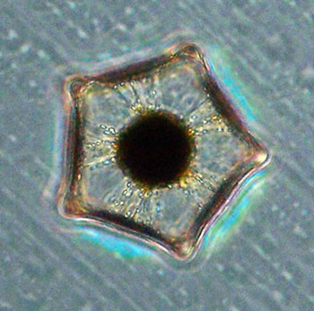
Why should you care about phytoplankton?
If you’ve been in the ocean, you have swallowed thousands of phytoplankton.
Much of the oxygen that keeps you alive was produced by phytoplankton
They form the base of the food web in the ocean
earthref.org/SCC
Scripps Classroom Connection
Notes:
POINT OF SLIDE:
This slide explains why students should care about phytoplankton.
BULLETED POINTS:
Phytoplankton range in size from about 1 um to 300 um. They are single cells, although they can live in colonies or chains
Just like plants, phytoplankton are photosynthesizers. That means they use the sun’s energy to create chemical energy. Usually, they produce carbohydrates from carbon dioxide and water, with oxygen as a byproduct.
These cells can be either prokaryotic (which are less evolved, usually smaller, and don’t have membrane-bound organelles) or eukaryotic (more complex, usually bigger, with membrane-bound organelles)
PICTURE/GRAPHICS CREDITS:
The image is of the phytoplankton Lithodesmoides polymorphum. It was collected near the Southwater Island near Belize. The phytoplankton size is on the order of 10-6 m. The photo was taken by Sharyn Hedrick of the Smithsonian Environmental Research Center.
The image was taken from the website http://serc.si.edu/labs/phytoplankton/guide/addtl_collections/Belize%202/lithodespoly.aspx.

Slide 3
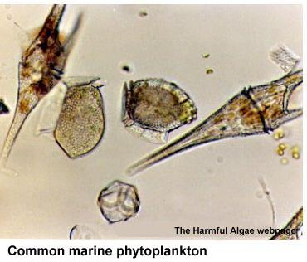
What are phytoplankton?
They are tiny, single-cell organisms
Just like plants, they photosynthesize
They can be either eukaryotic or prokaryotic
earthref.org/SCC
Scripps Classroom Connection
Notes:
POINT OF SLIDE:
This slide covers some very basic defining characteristics of phytoplankton
BULLETED POINTS:
Phytoplankton are small organisms, ranging in size from <0.5 um to ~500 um. They are also made up of just one cell
They are photosynthesizers, meaning they get their energy from the sun
Phytoplankton can be either prokaryotic (meaning they have membrane-bound organelles, are smaller, less complex, etc.) or eukaryotic (meaning they have organelles, like a nucleus, are larger, more complex, etc.)
PICTURE/GRAPHICS CREDITS:
The picture of these phytoplankton was taken from http://nerrs.noaa.gov/Doc/SiteProfile/ACEBasin/html/biores/phyto/pytext.htm#marine

Slide 4
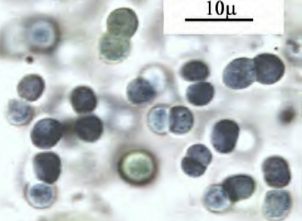
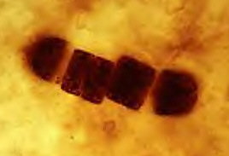
Phytoplankton diversity
Prokaryotic phytoplankton are called cyanobacteria
  They do not have any membrane-bound organelles
  They are small and abundant
  They make up some of the oldest fossils on earth (3.5 billion years old)
earthref.org/SCC
Scripps Classroom Connection
Notes:
POINT OF SLIDE:
This slide shows pictures and text to help describe the prokaryotic types of phytoplankton
BULLETED POINTS:
Prokaryotic phytoplankton are given a special name—cyanobacteria
A distinguishing characteristic of cyanobacteria is that do not have membrane-bound organelles, hence why they are prokaryotes
Cyanobacteria are also small (0.5 to 3.0 um) and very abundant (~10⁵ to 10⁶/ml)
A neat fact about cyanobacteria is that they are some of the oldest fossils of living organisms that have ever been found. The date back 3.5 billion years.
PICTURE/GRAPHICS CREDITS:
The fossilized cyanobacteria on the left is from the website http://www.botany.hawaii.edu/faculty/webb/bot311/Cyanobacteria/CyanoFossil.jpg.
The living Synechococcus on the right is from the website http://www.botany.hawaii.edu/faculty/webb/bot311/cyanobacteria/Synechococcus.jpg

Slide 5
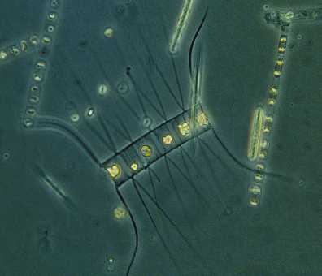
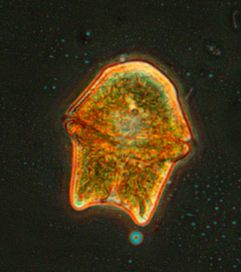
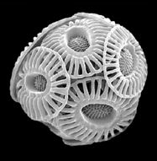
Phytoplankton diversity
Phytoplankton can also be eukaryotic
  They have membrane-bound organelles, are larger, more complex
There are three main types that we will be focusing on today:
Diatoms
Dinoflagellates
Coccolithophores
earthref.org/SCC
Scripps Classroom Connection
Notes:
POINT OF SLIDE:
This slide shows images and introduces the concept of of eukaryotic phytoplankton
BULLETED POINTS:
In contrast to prokaryotic cyanobacteria, some phytoplankton are eukaryotic
A distinguishing characteristic of eukaryotic cells is that they have membrane-bound organelles. They are also larger than eukaryotes as well as more complex in other ways as well.
There are three types of eukaryotic cells that will be discussed in this lecture—diatoms, dinoflagellates, and coccolithophores
PICTURE/GRAPHICS CREDIT:
The diatom picture on the left is from the website http://www.serc.si.edu/labs/phytoplankton/guide/diatoms/chataff.aspx. The photo was taken by Sharyn Hedrick of the Smithsonian Environmental Research Center. It is the diatom Chaetoceros affinis. It is 11 um wide and 18 um long. It was collected from the Rhode River and the Chesapeake Bay.
The dinoflagellate picture in the middle is Gymnodinium sanguineum. It is 49 um wide and 63 um long. It was collected in the Rhode River. The photo was taken by Sharyn Hedrick of the Smithsonian Environmental Research Center. It was taken from the website http://www.serc.si.edu/labs/phytoplankton/guide/dinoflagellates/gsang.aspx
The picture of the coccolithophore was taken from the website http://www.co2.ulg.ac.be/peace/summary.htm. The cell size is on the order of micrometers. The image provides a visual of this type of cell.

Slide 6
Diatoms
They can form a toxin that harms seabirds and sea mammals
They live alone or in chains
Have a cell wall made of silica, like glass
earthref.org/SCC
Scripps Classroom Connection
Notes:
POINT OF SLIDE:
This slide shows a picture of a diatom and describes some of its characteristics.
BULLETED POINTS:
An interesting fact about diatoms is that they can produce a toxin, called domoic acid, that can be harmful to large animals, like seabirds and marine mammals
Diatoms can be found living as solitary cells or linked together in chains
The outer portion of the diatom is made of silica, which is like glass
PICTURE/GRAPHICS CREDIT:
The diatom picture on the left is from the website http://www.serc.si.edu/labs/phytoplankton/guide/diatoms/chataff.aspx. The photo was taken by Sharyn Hedrick of the Smithsonian Environmental Research Center. It is the diatom Chaetoceros affinis. It is 11 um wide and 18 um long. It was collected from the Rhode River and the Chesapeake Bay.

Slide 7
Dinoflagellates
They glow in the water
They cause shellfish poisoning
They move around using flagella
They have a cell wall made of cellulose, like wood
earthref.org/SCC
Scripps Classroom Connection
Notes:
POINT OF SLIDE:
This slide shows an image of a dinoflagellate and also introduces some of its characteristics.
BULLETED POINTS:
Some types of dinoflagellates can give off a glow, called bioluminescence, which can cause the water to look like it’s glowing if agitated, such as by crashing waves
Some kinds of dinflagellates also produce toxins, some of which can get into shellfish and cause harm to humans if they eat the affected shellfish
Dinoflagellates move around in the water using two arm-like appendages called flagella
These cells have a cell wall made of cellulose, similar to what is found in wood
PICTURE/GRAPHICS CREDIT:
The dinoflagellate picture in the middle is Gymnodinium sanguineum. It is 49 um wide and 63 um long. It was collected in the Rhode River. The photo was taken by Sharyn Hedrick of the Smithsonian Environmental Research Center. It was taken from the website http://www.serc.si.edu/labs/phytoplankton/guide/dinoflagellates/gsang.aspx

Slide 8
Coccolithophores
These single-celled organisms can be seen from space
They are affected when the ocean becomes more acidic
Their cell is surrounded by calcium carbonate, like chalk
earthref.org/SCC
Scripps Classroom Connection
Notes:
POINT OF SLIDE:
This slide shows an image of a coccolithophore and describes some of its characteristics
BULLETED POINTS:
Coccolithophores live as single cells (which are a coupled of micrometers—10⁻⁶—in diameter), but when their abundances get large enough, they can be seen from outer space due to their distinct color
Coccolithophores are being affected by the phenomenon known as ocean acidification, a process which causes the pH of the ocean to lower
Coccolithophores are surrounded by coccoliths, which are made of calcium carbonate, which is like chalk
PICTURE/GRAPHICS CREDIT:
The picture of the coccolithophore was taken from the website http://www.co2.ulg.ac.be/peace/summary.htm. The cell size is on the order of micrometers. The image provides a visual of this type of cell.
WEBSITES:
http://www.nhm.ac.uk/nature-online/virtual-wonders/vrcocco_ehux.html provides a 3-d image of a fossil coccolithophore.
For form information about coccolithophores, see http://www.noc.soton.ac.uk/soes/staff/tt/eh/

Slide 9
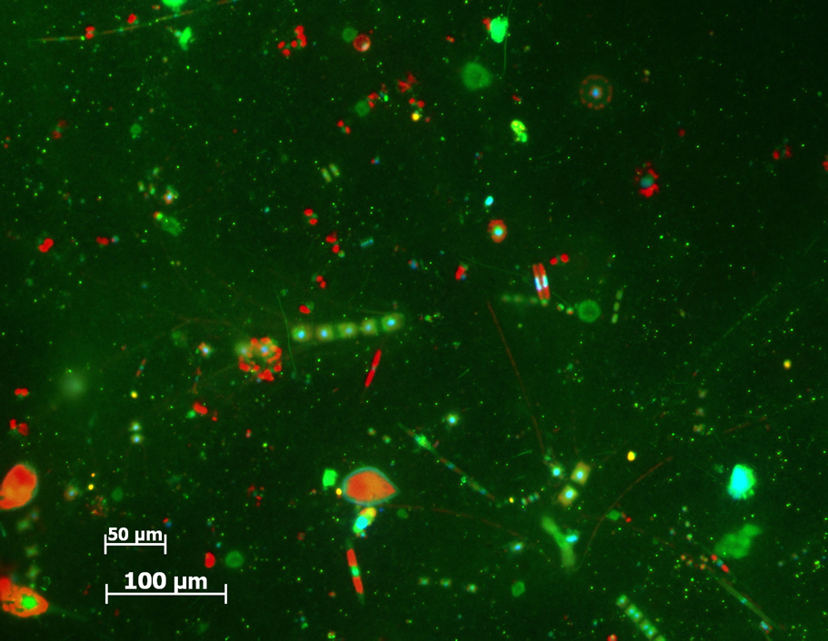
Conclusions
Phytoplankton are single-celled organisms
They are the main photosynthesizers of the ocean
They are diverse
They can be either prokaryotic or eukaryotic
earthref.org/SCC
Scripps Classroom Connection
Notes:
POINT OF SLIDE:
This slide provides some take-home messages from the presentation
BULLETED POINTS:
Phytoplankton are made up of one cell
Phytoplankton photosynthesize
There are many types of phytoplankton
Phytoplankton can be either prokaryotic or eukaryotic
PICTURE/GRAPHICS CREDIT:
This image is an epifluorescence microscopy image taken by Andrew Taylor, Univeristy of California, San Diego. The scale bars are in the lower left corner. The cells are a variety of phytoplankton found in the California Current.

