Slide 1
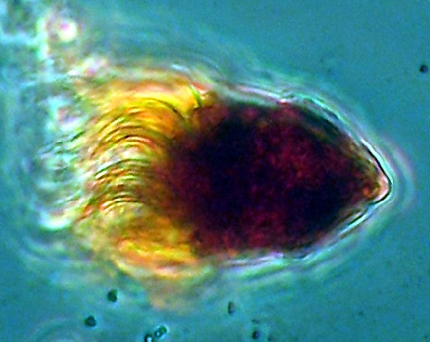
Microzooplankton, Feeding Strategies, and the Energy Pyramid
Notes:
AUTHORS:Darcy Taniguchi from Scripps Institution of Oceanography, Steve Walters from Mission Bay High School
WHY: If you have ever been in the ocean, you have swallowed the organisms discussed in this presentation. This presentation and lesson also describes the variety of ways that single celled organisms eat. It also discusses how to produce an energy pyramid, similar to the food pyramid that used to describe how humans should eat.
SUMMARY (< 100 words): In this learning activity, students will be introduced to the diversity of microzooplankton. Specifically, they will explore the variety of feeding strategies microzooplankton exhibit and reinforce the idea that they are consumers in a marine food web. To learn the difference between pallium feeding, peduncle feeding, and phagocytosis, the students will enact these feeding types and “consume” specific prey items. Some students will also be assigned the role of secondary consumer to elongate the food web. Students will also calculate the energy value in each trophic level and combine results to construct an energy pyramid.
PICTURE/GRAPHICS CREDITS: Image of a an oligotrich ciliate called Strombidium Claparede and Lachmann, 1859. Size is 50 micrometers. Image taken by John Dolan. http://www.marinespecies.org/photogallery.php?album=769&pic=643
WEBSITES USED IN THIS PRESENTATION: Give URLs to websites that you consulted, borrowed from or or that will offer interesting additional information. Say, for example, this activity is adapted from URL “http//:etc” or say that additional information can be fount at URL etc.
ADDITIONAL READING: Hansen, 1991. Marine Ecology Progress Series 69:201-204.
CONTEXT FOR USE: This activity was created for a 10th grade biology class. It can be used for class sizes ranging from 15 to 40 students. The activity can be adapted to class periods between 50 minutes and 90 minutes. Previous knowledge relating to this activity is the concepts of trophic levels and primary producers. This activity is the second of three lessons in a unit called Community Structure and Dynamics of Marine Plankton. The first activity is called Phytoplankton Cell Model Building, and the third activity is Plankton Population Dynamics.
MISCONCEPTIONS:
There is only one way to consume food to gain energy
Unicellular organisms cannot eat
Primary consumers in the ocean are not important, especially to humans
EVALUATION TIPS: Students will be asked to calculate the caloric intake from the feeding game. They can fill out this information in the worksheet Microzooplankton and Feeding Strategies Worksheet. The values from the class will be combined to calculate an energy pyramid.
(See the Expanded Teaching Notes document for more information.)
TEACHING NOTES. Describe the information in the powerpoint. Assign students to different marine organisms and have them act out these feeding strategies. From what they consume, have the students calculate their caloric intake and use that to create an energy pyramid. For more information, see the Expanded Teaching Notes document.

Slide 2
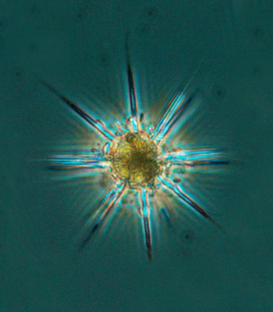
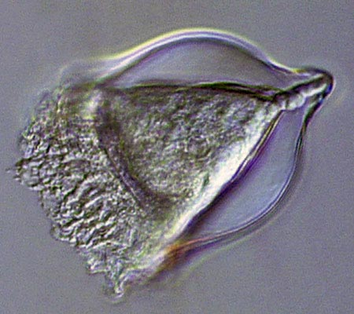
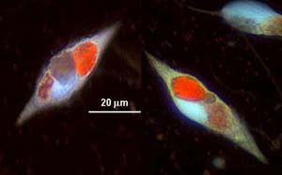
What are microzooplankton?
Tiny, single-celled organisms
They eat phytoplankton, which are primary producers
So, microzooplankton are called primary consumers
Microzooplankton, in turn, are eaten by larger zooplankton, called secondary consumers
Notes:
POINT OF SLIDE:This slide shows a diversity of microzooplankton and briefly explains what they are
BULLETED POINTS:
Microzooplankton are made up of one cell
They eat photosynthesizers (aka primary producers)
Because microzooplankton eat primary producers, microzooplankton are called primary consumers
They are in turn eaten by larger zooplankton, making zooplankton secondary consumers
IMAGES:
Grey background image is of a tintinnid, micrometers in scale, taken by Rebecca Gast of WHOI, http://www.divediscover.whoi.edu/expedition10/daily/critter/tintinnid-en.html
Black background image is of dinoflagellates with full food vacuoles, taken from Sherr and Sherr, http://bioloc.coas.oregonstate.edu/SherrLab/GLOBEC.html
The greenish blue background image is of a radiolarian called Acanthometrol pellucidum. It is micrometers in length. It was taken from http://www.serc.si.edu/labs/phytoplankton/guide/addtl_collections/microzoops/acantho.aspx
USEFUL LINKS: http://bioloc.coas.oregonstate.edu/SherrLab/GLOBEC.html

Slide 3
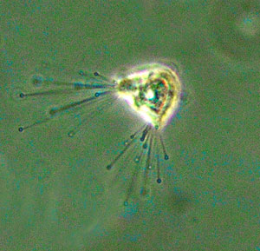
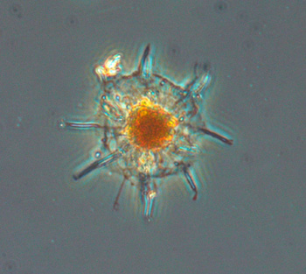
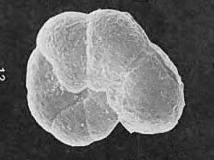
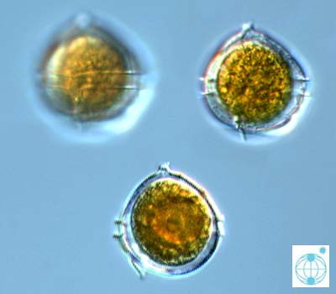
Examples of Microzooplankton
ciliate
radiolarian
foraminiferan
dinoflagellate
Notes:
POINT OF SLIDE:
This slide shows examples of microzooplankton. These include ciliates, radiolarians, foraminifera, and dinoflagellates.
IMAGES:
The ciliate is Acineta tuberosa. Image taken from http://www.serc.si.edu/labs/phytoplankton/guide/addtl_collections/microzoops/acintub.aspx
The radiolarian is Arachnophaerea spp. Image courtesy of http://www.serc.si.edu/labs/phytoplankton/guide/addtl_collections/microzoops/arachnosph.aspx
Foraminifera is Cribrostomoides jeffreysi. Image courtesy of http://www.marinespecies.org/aphia.php?p=image&pic=41411
Dinoflagellate is Oblea rotunda. Image taken by T. Monrozova from http://planktonnet.awi.de/index.php?contenttype=image_details&itemid=14265#content

Slide 4
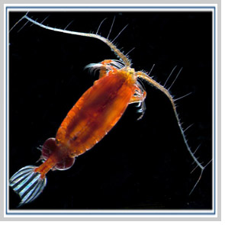
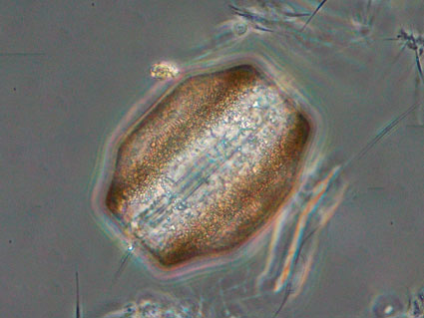

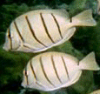
Why should you care about microzooplankton?
They are part of the food chain that leads to the fish you eat
secondary consumers
microzooplankton,
primary consumers
primary producers
quaternary consumer
tertiary consumers
Notes:
POINT OF SLIDE:
This slide shows a simplified food chain, showing how microzooplankton fit in and thus are relevant to people.
NOTES:
At the bottom of the food chain are the primary producers, in this case phytoplankton
The primary producers are eaten by the primary consumers, in this case the organism of interest, microzooplankton
The primary consumers are in turn eaten by secondary consumers, represented here by a copepod
The secondary consumers are eaten by tertiary consumers, in this case fish
Finally, the tertiary consumers are eaten by the quaternary consumer, a human
IMAGES:
The phytoplankton primary producer is an image of the diatom Conscinodiscus, taken from http://www.serc.si.edu/labs/phytoplankton/guide/addtl_collections/Antarctica/cocsinbuvet.aspx
As in the previous slide, the microzooplankton primary consumer is the radiolarian Arachnophaerea spp. Image courtesy of http://www.serc.si.edu/labs/phytoplankton/guide/addtl_collections/microzoops/arachnosph.aspx
The zooplankton secondary consumer is a copepod, image taken from http://www.foundation.uconn.edu/stories-of-giving/2007-02-zooplankton.html
The fish image is taken from http://science.nature.nps.gov/im/units/pacn/monitoring/vs_fish_marine.cfm
The server image is from clip art

Slide 5
What we are focusing on today: How microzooplankton get their food
microzooplankton,
primary consumers
primary producers
Notes:
POINT OF SLIDE:
This slide circles the part of the food chain we will be focusing on next. That is, we will be examining how primary producers consume primary producers
IMAGES:
The phytoplankton primary producer is an image of the diatom Conscinodiscus, taken from http://www.serc.si.edu/labs/phytoplankton/guide/addtl_collections/Antarctica/cocsinbuvet.aspx
As in the previous slide, the microzooplankton primary consumer is the radiolarian Arachnophaerea spp. Image courtesy of http://www.serc.si.edu/labs/phytoplankton/guide/addtl_collections/microzoops/arachnosph.aspx
The zooplankton secondary consumer is a copepod, image taken from http://www.foundation.uconn.edu/stories-of-giving/2007-02-zooplankton.html
The fish image is taken from http://science.nature.nps.gov/im/units/pacn/monitoring/vs_fish_marine.cfm
The server image is from clip art

Slide 6
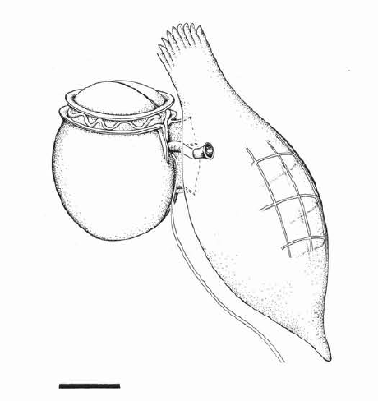
Feeding Strategies: Peduncle Feeding
Primary producer
Primary consumer
Peduncle
Notes:
POINT OF SLIDE:
This slide shows an illustration of peduncle feeding.
NOTES:
For this feeding strategy, the microzooplankton uses its peduncle like a straw to suck out the insides of its prey item. Because it is sucking out the insides, the prey can be much larger than the predator.
IMAGES:
Hansen, 1991. Dinophysis—a planktonic dinoflagellate genus which can act both as a prey and a predator of a ciliate. Marine Ecology Progress Series 69:201-204.
USEFUL INFORMATION:
Hansen, 1991. Marine Ecology Progress Series 69:201-204.

Slide 7
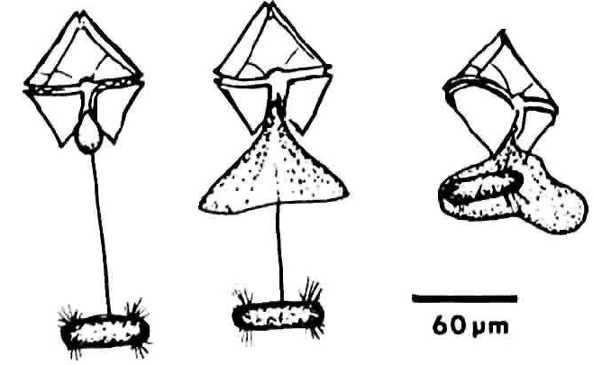
Feeding Strategies: Pallium Feeding
Primary consumer
Primary producer
Pallium
Notes:
POINT OF SLIDE:
This slide shows an example of pallium feeding.
NOTES:
For this feeding strategy, the predator extends a filament that attaches to the prey. Then the pallium (a net-like, membranous psuedopod) extends outward to engulf the prey. The prey item is liquefied in and set upward through the pallium to the predator.
IMAGES:
The drawing is taken from p. 252, Fig. 2 of Jacobson and Anderson, 1986. Journal of Phycology.
FURTHER INFORMATION:
Jacobson and Anderson, 1986. Journal of Phycology 22:249-258.

Slide 8
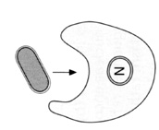
Feeding Strategies: Phagocytosis
Primary producer
Primary consumer
Notes:
POINT OF SLIDE:
This slide shows an example of the feeding strategy phagocytosis.
NOTES:
In this mode of feeding, the primary consumer changes its shape to extend portions of its cell called pseudopodia. These pseudopodia surround the prey item (the primary producer) and engulf it.
IMAGES:
Schematic drawing of phagocytosis taken from http://www.jochemnet.de/fiu/bot4404/BOT4404_13.html
FURTHER INFORMATION:
http://academic.brooklyn.cuny.edu/biology/bio4fv/page/phago.htm

Slide 9
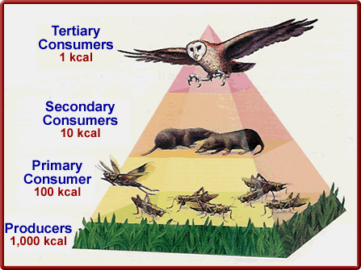
An Energy Pyramid
An energy pyramid shows the amount of energy in different parts of the food chain
Because energy is lost moving up the food chain, higher levels in the food chain have less energy
Notes:
POINT OF SLIDE:
This slide shows an energy pyramid with more recognizable organisms than before.
NOTES:
Only 10% of energy is transferred from one level to another because of loss due to heat and energy use by the organisms in that level.
You may want to point out that a kcal is a unit of energy, in case your students are not familiar with that unit.
IMAGES:
Energy pyramid taken from http://schoolworkhelper.net/2011/01/energy-movement-in-ecosystems-trophic-energy-pyramid/
FURTHER INFORMATION:
Further information on energy pyramids can be found from http://www.etap.org/demo/biology_files/lesson6/instruction6tutor.html

Slide 10
Our food chain with microzooplankton can be put into an energy pyramid as well
Food Chain
Energy Pyramid
Notes:
POINT OF SLIDE:
This slide shows how the simplified food chain from the previous slide can be put into the shape of an energy pyramid.
NOTES:
This slide is meant to show how the unfamiliar organisms in the marine food web can still be put into an energy pyramid, just as was shown on the previous slide.
This slide can also highlight how to move between a food chain and an energy pyramid; they use the same organisms but highlight different pieces of information.
That is, the food chain highlights what different organisms consume
The energy pyramid emphasizes how energy moves through these different groups in the food chaing
IMAGES:
The phytoplankton primary producer is an image of the diatom Conscinodiscus, taken from http://www.serc.si.edu/labs/phytoplankton/guide/addtl_collections/Antarctica/cocsinbuvet.aspx
As in the previous slide, the microzooplankton primary consumer is the radiolarian Arachnophaerea spp. Image courtesy of http://www.serc.si.edu/labs/phytoplankton/guide/addtl_collections/microzoops/arachnosph.aspx
The zooplankton secondary consumer is a copepod, image taken from http://www.foundation.uconn.edu/stories-of-giving/2007-02-zooplankton.html
The fish image is taken from http://science.nature.nps.gov/im/units/pacn/monitoring/vs_fish_marine.cfm
The server image is from clip art

Slide 11
The energy in an energy pyramid
1 kcal
10 kcal
100 kcal
Remember, 10% of the energy is lost moving up each level
1,000 kcal
10,000 kcal
Notes:
POINT OF SLIDE:
This slide uses the energy pyramid from the previous slide and shows how energy moves through each level.
NOTES:
As in the more familiar pyramid from before, this energy pyramid also has a transfer of only 10% of the energy from one level to the next higher one.
IMAGES:
The phytoplankton primary producer is an image of the diatom Conscinodiscus, taken from http://www.serc.si.edu/labs/phytoplankton/guide/addtl_collections/Antarctica/cocsinbuvet.aspx
As in the previous slide, the microzooplankton primary consumer is the radiolarian Arachnophaerea spp. Image courtesy of http://www.serc.si.edu/labs/phytoplankton/guide/addtl_collections/microzoops/arachnosph.aspx
The zooplankton secondary consumer is a copepod, image taken from http://www.foundation.uconn.edu/stories-of-giving/2007-02-zooplankton.html
The fish image is taken from http://science.nature.nps.gov/im/units/pacn/monitoring/vs_fish_marine.cfm
The server image is from clip art

