Slide 1
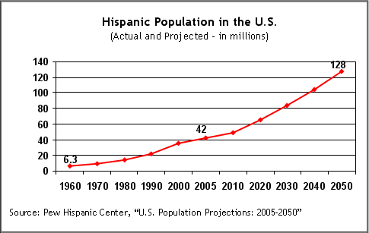
Population Dynamics
and Diversity
Notes:
AUTHORS:
Darcy Taniguchi of Scripps Institution of Oceanography and Steve Walters of Mission Bay High School
WHY:
It is important to know about population dynamics because a basic understanding will help people know how the size of a population—from humans to polar bears to insects—will change with time. This information, in turn, can help people predict how a population will change in the future and how we should act now to take those future considerations into account. It is also important to understand the concept of diversity because it can be seen in our own human communities and affects human interactions and social constructs as well as the health and stability of the natural world on which we depend.
SUMMARY:
This presentation covers the general concept of population dynamics--specifically immigration, emigration, birth, and death--and how those affect the diversity of a population.
PICTURE/GRAPHICS CREDITS:
This graph of the Hispanic population in the US is taken from http://pewforum.org/Christian/Catholic/A-Portrait-of-American-Catholics-on-the-Eve-of-Pope-Benedicts-Visit-to-the-US.aspx
WEBSITES USED IN THIS PRESENTATION:
http://www.nhptv.org/natureworks/nwep12.htm for general information and examples on population dynamics
http://www.stanford.edu/group/stanfordbirds/text/essays/Population_Dynamics.html for information specifically on bird population dynamics
ADDITIONAL READING:
Additional information on this topic can be found at http://www.thomas-brey.de/science/virtualhandbook/navlog/index.html
Interactive, mathematically based activities can be found at http://ats.doit.wisc.edu/biology/ec/pd/pd.htm
For information, examples, and an activity, you can go to http://www.nhptv.org/natureworks/nwep12.htm
CONTEXT FOR USE:
This activity is meant for 10th grade biology students. The powerpoint and associated activity are meant to last for a 90 minute period. The activity does not require any prerequisites. It is the third activity in a series called Community Structure and Dynamics of Marine Plankton. However, these other activities are not necessary to understand and complete this activity.
MISCONCEPTIONS:
Populations do not change at all through time
Populations may change in size or diversity, but not both
Immigration and emigration are the same thing
EVALUATION TIPS:
The worksheet associated with the activity that comes after this powerpoint is call the Plankton Population Dynamics Worksheet.
TEACHING NOTES.
Teaching notes are found in the document Plankton Population Dynamics, and more detailed teaching notes can be found in Plankton Population Dynamics: Expanded Teacher Notes

Slide 2
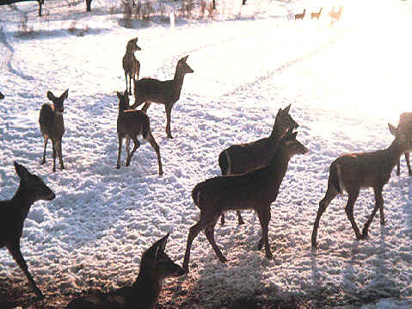
What is a population?
The number of individuals of a particular species in a specific area
Notes:
POINT OF SLIDE:
This slide explains what a population is.
NOTES:
The area covered in this photograph includes images of ten deer and hence the population is ten. Typically one uses more meaningful areas for population counts (like a square mile).
IMAGES:
The white-tailed deer image is taken from http://wildlifecontrol.info/deer/pages/deerpopulationfacts.aspx

Slide 3
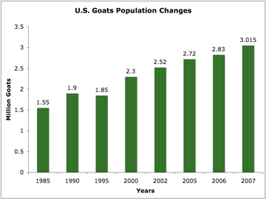
What is population dynamics?
The change in the number of individuals of a population over time
Notes:
POINT OF SLIDE:
This slide describes how a population changes over time, which is commonly called population dynamics.
GRAPH DESCRIPTION:
The graph shows how the US goat population has changed between 1985 and 2007.
On the x-axis is time, in years
On the y-axis is the number of goats, in millions
The numbers at the top of each green bar is the exact number of goats, in millions, in that year.
The point of the graph is that is shows that the number of goats in the US has increased between 1985 and 2007.
The increase in the goat population means there have been more inputs of individuals (i.e. births and immigration) into the goat population than outputs (i.e. death and emigration).
Note that the population has a steady increase over time, but there is a slight decline between 1990 and 1995. Such declines often reflect events such as an economic crisis, the toll of disease etc.,, It is not clear what causes this decline but people studying population dynamics, explore these type of things.
GRAPH CREDITS:
The bar graph of the goat population was taken from http://www.extension.org/pages/26214/goat-industry-profile

Slide 4
What should we care about population dynamics?
It tells us how many people there will be
It affects what people will build and where
It tells us if a species will go extinct or grow out of control
Notes:
POINT OF SLIDE:
This slide describes why we should care about population dynamics.
NOTES:
Population dynamics provides information on how many people there will be in a specific area, be it the world, the United States, or a city. For example, the graph (described more thoroughly below) describes how the Hispanic population in the US is expected to grow between 1960 and 2050.
Population dynamics also affects what people build and where. For example, if there is an increase in the number of people in a city, maybe more schools will need to be built
Population dynamics also provides information on whether or not a population will go extinct (i.e. never to be seen again in a specific area or on the face of the Earth) or if it will grow out of control (i.e. increases so rapidly and by such a great amount that other populations cannot keep it in check).
Population dynamics does NOT tell us how many people or organisms there will be. Instead, it helps us make predictions, and those predictions are important for things like city planning (roads, schools, water supply...)
GRAPH DESCRIPTION:
The point of this graph is just to show how the US Hispanic population has changed and will change with time.
On the x-axis is the year, going from 1960 to 2050.
The y-axis has the number of individuals, in millions
The numbers in the graphing area (names 6.3, 42, and 128) indicate the millions of Hispanics that were in the US during the associated year. It aims to highlight that the population is increasing.
The red line on the graph follows the change in population, also indicating that the Hispanic population in the US is increasing with time and is expected to increase.
GRAPH CREDITS:
This graph of the Hispanic population in the US is taken from http://pewforum.org/Christian/Catholic/A-Portrait-of-American-Catholics-on-the-Eve-of-Pope-Benedicts-Visit-to-the-US.aspx

Slide 5
Factors that increase the size of a population
Birth—the start of life of a new individual
Immigration—the addition of individuals from an outside area
population
size
time
Notes:
POINT OF SLIDE:
This slide describes two factors that can increase the size of a population, namely birth and immigration.
NOTES:
Birth is one method by which a population may increase. Birth is the beginning of life of a new organisms. The population increases because more individuals are created and added to the population.
Immigration is another method by which a population will increase. Immigration involves the movement of a group or individual from an outside area to the area of interest. Therefore, the population increases from the influx of new individuals.
GRAPH DESCRIPTION:
On the x-axis is time, in arbitrary units (i.e it could be days, weeks, seconds—it doesn’t matter)
On the y-axis is the size of the population, also in arbitrary units
The light green line ending in an arrow shows how the population size changed with the passage of time.
The main point of the schematic graph is that, because the line curves upward and ends in an upward turned arrow, the population is increasing—due either to birth or immigration or both—with time.

Slide 6
Factors that decrease the size of a population
Death—the end of life of an individual
Emigration—the movement of individuals to another area
population
size
time
Notes:
POINT OF SLIDE:
This slide describes two ways in which the size of a population can decrease, namely death and emigration.
NOTES:
This slide describes two ways in which a population can decrease—through death and emigration.
Death when the life of an organism ends. Once an organism is dead, it is no longer included in the population, leading to a decrease in the size of the population.
Emigration is the process in which individuals leave the area of interest to another, foreign area. Because they left the area of interest, the population decreases.
GRAPH DESCRIPTION:
On the x-axis is time, in arbitrary units.
On the y-axis is the size of the population, also in arbitrary units.
The red curve ending in an arrow indicates the direction in which the population size is changing with time.
The main point of the schematic graph is to show that the population is decreasing—due to death or emigration or both—with time.

Slide 7

Diversity
What is diversity?
Notes:
POINT OF SLIDE:
This slide just poses the question of what diversity is.
NOTES:
Ask the students for their input on what diversity means to them.
IMAGE DESCRIPTION:
The image shows cartoons of people of different genders and from different countries, as represented by the flag designs on their bodies. The image is meant to give a visual representation of global human diversity, a concept to which the students can hopefully relate and will prompt them to describe what diversity it.
IMAGE CREDITS:
http://diversity.uno.edu/

Slide 8
Diversity
Diversity is the amount of different types of individuals or groups in a population
Notes:
POINT OF SLIDE:
This slide provides a general answer to what diversity can mean. It is only general, however, and there are many, more technical definitions as well.
NOTES:
This slide answers the question posed on the previous slide—what is diversity?
In it’s most general sense, diversity is the number of different kinds of organisms or types in a population.
IMAGE DESCRIPTION:
The image is the same as on the previous slide. The image shows cartoons of people of different genders and from different countries, as represented by the flag designs on their bodies. The image is meant to give a visual representation of global human diversity, a concept to which the students can hopefully relate.
IMAGE CREDITS:
http://diversity.uno.edu/

Slide 9
How does population dynamics affect diversity?
Initially, there are:
4 yellow smiles
3 orange smiles
8 blue smiles
Notes:
POINT OF SLIDE:
This slide is the beginning of a simple example of how population dynamics affects the diversity of a population.
NOTES:
This slide shows the initial state of a population of smiley faces. During this initial state, there are 4 yellow, 3 orange, and 8 blue smiley faces.
IMAGE DESCRIPTION:
The smiley faces are a visual representation of the initial population.

Slide 10
How does population dynamics affect diversity?
Later, there are:
3 births of new yellow smiles
1 death of an orange smile
5 blue smiles emigrated away
Notes:
POINT OF SLIDE:
This slide shows how the population of smiles changed with time.
NOTES:
This slide shows the final state of a population of smiley faces. Because of the processes of birth, death, and emigration, there are now 7 yellow, 2 orange, and 3 blue smiley faces.
The population changed compared to the previous slide because 3 yellow smiles were born, 1 orange smile died, and 5 blue smiles emigrated to another area.
IMAGE DESCRIPTION:
The smiley faces are a visual representation of the smiley face population at a later time.

Slide 11
How does population dynamics affect diversity?
Initial population
Final population
http://earthref.org/SCC
Scripps Classroom Connection
Notes:
POINT OF SLIDE:
This slide is the summary of how population dynamics changed the diversity of the smiley face population.
NOTES:
On the left is the initial population of smiley faces, with 4 yellow, 3 orange, and 8 blue smiles.
On the right is the final population, with 7 yellow, 2 orange, and 3 blue smiles.
The changes in the population lead to a change in both the size and diversity of the population.
IMAGE DESCRIPTION:
The smiley faces are a visual representation of the initial population and the final population.

Slide 12
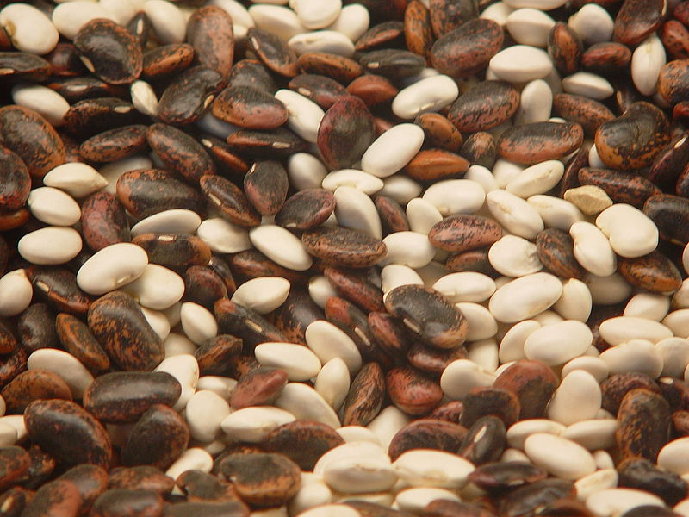
Today’s Activity:
Population Dynamics Game
You will be put in groups of 4
Everyone gets an initial population of plankton (beans)
Notes:
POINT OF SLIDE:
This slide begins the instructions for the lesson’s associated activity—Plankton population dynamics game.
NOTES:
First, students will be split up into groups of 4 students.
Each student will get a handful of beans, each of which represents a plankton cell. There will be different kinds of beans in the handful, representing the diversity of plankton types.
IMAGE CREDITS:
http://www.neatorama.com/2009/07/05/7-things-that-make-beans-magical/

Slide 13
Today’s Activity:
Population Dynamics Game
Each group will have two dice—one white and one colored
Each group will also get 6 bowls, labeled as follows:
reproduction
consumption
wave
sinking
food influx
seafloor
Notes:
POINT OF SLIDE:
This slide describes what each group will need to play the game.
NOTES:
Each group will get two dice—one white and one red
Each group also gets 6 bowls, each labeled with a specific process.

Slide 14
Today’s Activity:
Population Dynamics Game
Each student will take turns rolling the dice
The white die will tell you by how much your population will change
The red die will tell you which process occurred in your population
1.
reproduction
2.
consumption
3.
wave
4.
sinking
5.
food influx
6.
seafloor
Notes:
POINT OF SLIDE:
This slide describes what each die does.
NOTES:
Students take turns rolling both dice.
The number rolled on the white die represents the amount by which a student’s plankton population changes.
The number rolled on the red die represents the process that acts on the student’s plankton population.

Slide 15
Today’s Activity:
Population Dynamics Game
Odd numbers on the red die correspond to processes that increase the size of your population
If you roll an odd number on the red die, then you will take beans from the correspondingly numbered bowl and put them in your own population
double the white die number
1.
reproduction
3.
wave
5.
food influx
Notes:
POINT OF SLIDE:
This slide describes more of the rules of the population dynamics game.
NOTES:
When an odd number is rolled on red die, it means that a process that increases the size of a population—reproduction (birth), a wave (immigration), or food influx (which leads to lots and lots of births in the plankton)—has occurred.
If an odd number is thus rolled, then the student takes plankton (beans) from the bowl with the corresponding number as was rolled on the red die. The exact number to take depends on what was rolled on the white die.
If a 5 was rolled on the red die, then the student should double the number on the white die and take that many beans from the 5. food influx (the process which leads to lots and lots of births) bowl and put them in their own population.

Slide 16
Today’s Activity:
Population Dynamics Game
        Even numbers on the red die correspond to processes that decrease the size of your population
        If you roll and even number on the red die, you will take beans from your own population and put them in the correspondingly numbered bowl
double the white die number
2.
consumption
4.
sinking
6.
seafloor
Notes:
POINT OF SLIDE:
This slide describes more of the rules of the population dynamics game.
NOTES:
When an even number is rolled on red die, it means that a process that decreases the size of a population—consumption (death), sinking (emigration) or sea floor (massive death and emigration)—has occurred.
If an even number is thus rolled, then the student takes plankton (beans) from their own bowl and puts them in the bowl with the corresponding number as was rolled on the red die. The exact number to take depends on what was rolled on the white die.
If a 6 was rolled on the red die, then the student should double the number on the white die and take that many beans their own population and put them in the bowl labeled 6. seafloor, because rolling a 6 on the red die means there has been a massive die off and emigration from the student’s population, leading to a decrease in their population size.

Slide 17
Example
how much you change your population
what processes occurred in your population
your own population
1.
reproduction
2.
consumption
3.
wave
4.
sinking
5.
food influx
6.
seafloor
Notes:
POINT OF SLIDE:
This slide provides an example of a hypothetical roll in the population dynamics game.
NOTES:
If a student rolls a 3 on the white die and a 3 on the red die, then that student will take 3 plankton (beans) from the bowl labeled with a 3 and put it in his/her own bowl

Slide 18
Example
how much you change your population
what processes occurred in your population
double the white die number
your own population
1.
reproduction
2.
consumption
3.
wave
4.
sinking
5.
food influx
6.
seafloor
Notes:
POINT OF SLIDE:
This slide provides another example of a hypothetical roll in the population dynamics game.
NOTES:
If a student rolls a 2 on the white die and a 6 on the red die, then that student will take 2x2=4 plankton (beans) his/her own bowl and put them in the bowl labeled with a 6

Slide 19
Questions?
Notes:
COMMENTS ABOUT THE GAME:
Before the game begins, students are meant to count the number of beans in their own, individual populations, NOT in the bowls in the middle of each group.
If the game proves a little complicated, students do not need to double the number by which their population changed (the number on the white die) when they roll a 5 (food influx) or 6 (sea floor) on the red die.
After the game is over, students have time to reflect how their populations changed after all of these population events. By looking over the worksheet (Plankton Population Dynamics Worksheet) they filled out as well as a briefly surveying the bowls in the middle of each group, students can see how much their population changed. The bonus question on their worksheet provides a graphical way for students to see how their populations changed.

