Slide 1
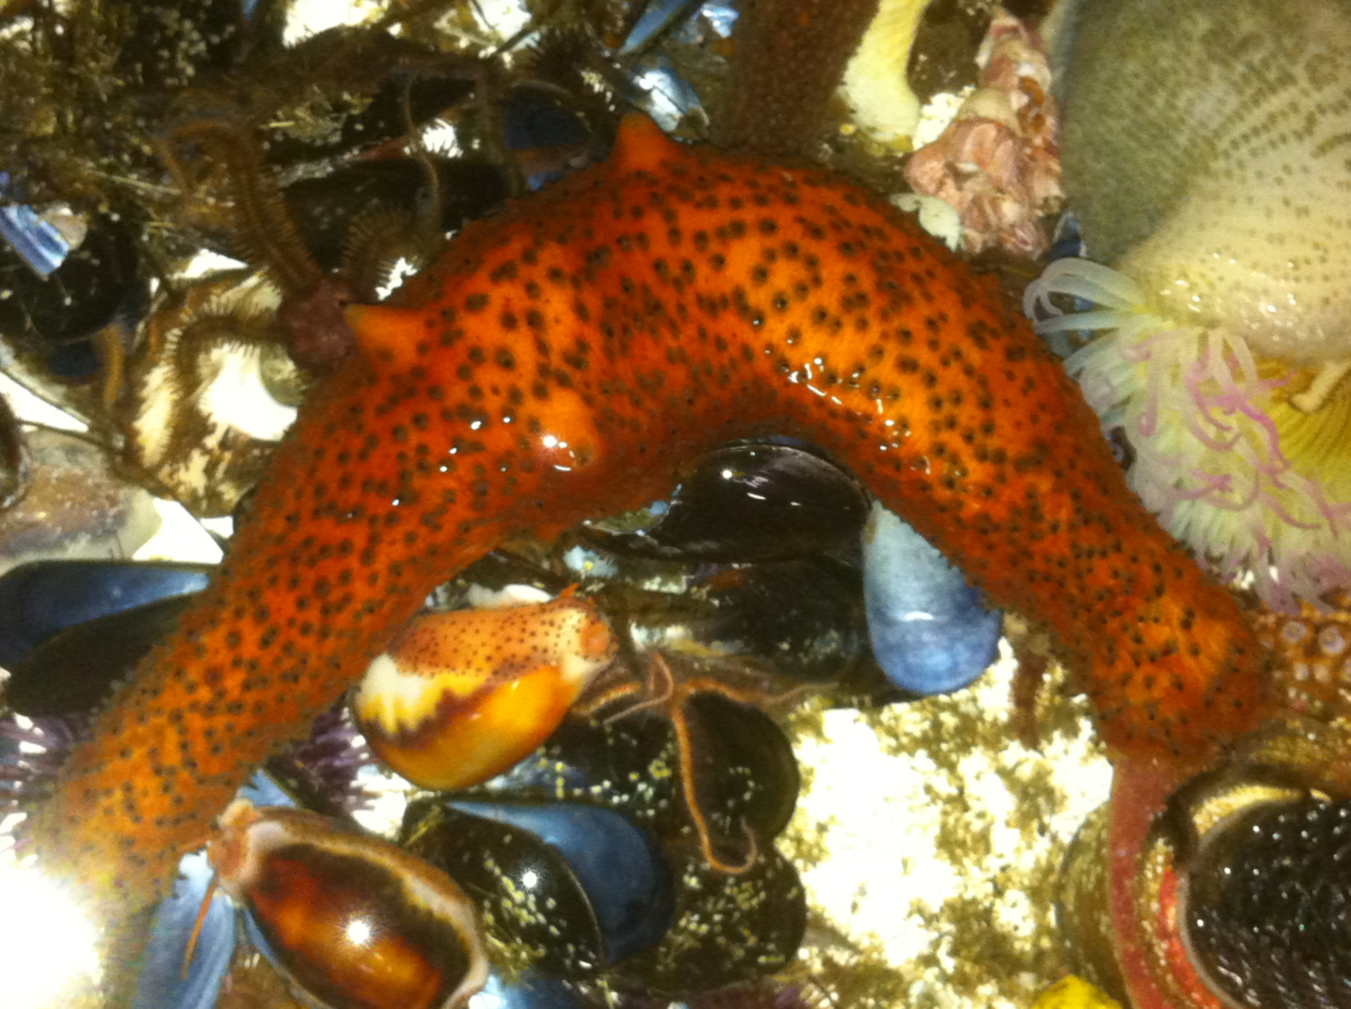
Ecology
Lesson 1: What does it mean to be alive?
Notes:
The picture on this slide is a sea cucumber from a tidal pool in San Diego. In a later activity the students were unsure if it was a alive or not!

Slide 2
What is Ecology?
Biology = the study of living things
Ecology = the study of the relationships of living things with each other and their environment
So…what is a living thing??
Notes:
This unit of biology is on ecology. Biology in general is the study of living things, and ecology is the study of how these living things interact with each other and their environment. But before we can study their interactions, we must learn what exactly a living thing is.

Slide 3
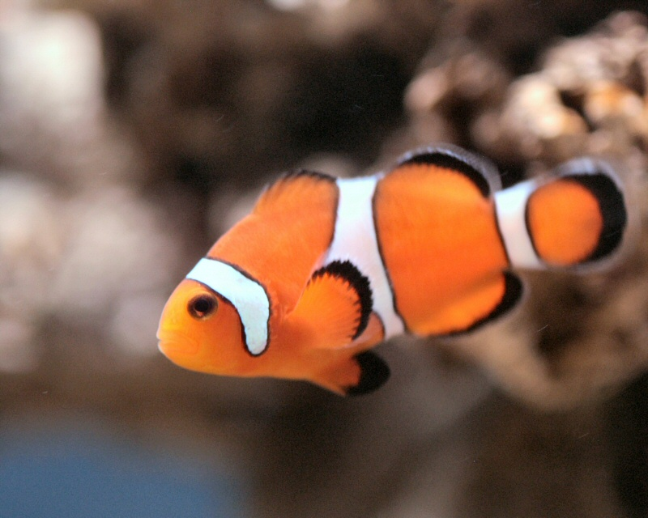
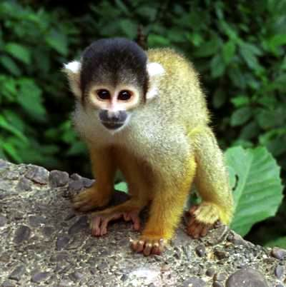
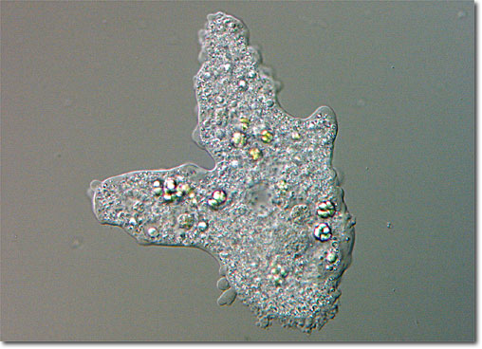
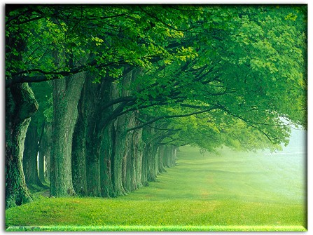
Notes:
Here are pictures of a clownfish, a monkey, an amoeba, and trees. What do all the things in these pictures have in common? They are all alive! So what are some different characteristics that they have in common with each other? First, they all have (or are) cells. The smallest living things are single cells. Larger organisms, such as the fish, monkey and tree, are made up of many millions of cells. Second, all these things have the means to reproduce, or to make more living things. All these things reproduce in different ways. Fish lay eggs. Monkeys have babies like humans. Trees release seeds. Amoeba simply divide in half into two new cells. Third, all of these things have the ability to grow, develop and adapt to their surroundings. Fish eggs, baby monkeys, and tree seeds all have to grow from their small beginnings into adults. Even newly budded amoeba change over time as they get older. Trees change color with the seasons, monkeys actively search out food in the trees, fish swim away from predators, and even amoeba can take cues from its environment. Fourth, all of these things have moving parts. Fish and monkeys can obviously move. But did you know plants like trees and single-celled organisms like amoeba have moving parts too? Trees have cells within them that move, and amoeba have tiny parts within their single cells that move. Fifth, all of these things use energy. Fish and monkeys eat food in order to get energy for their bodies. Trees use their roots to soak up nutrients and use the sunlight to make food in their cells. Amoeba eat even smaller living things from their environment. Finally, all these things contain DNA. DNA is the blueprint of life that is passed on when things reproduce. It is what gives you your hair color, your eye color, your height. It makes a clownfish orange and a tree green!
Image references:
http://rjfisherjoanides.pbworks.com/w/page/36530179/Fish-5
http://www.fcps.edu/islandcreekes/ecology/amoeba.htm
http://www.hdpicturesofanimals.com/monkey/monkey-2.html
http://thundafunda.com

Slide 4
Look around the room…
What’s alive?
What’s not alive?
What used to be alive?

