Slide 1
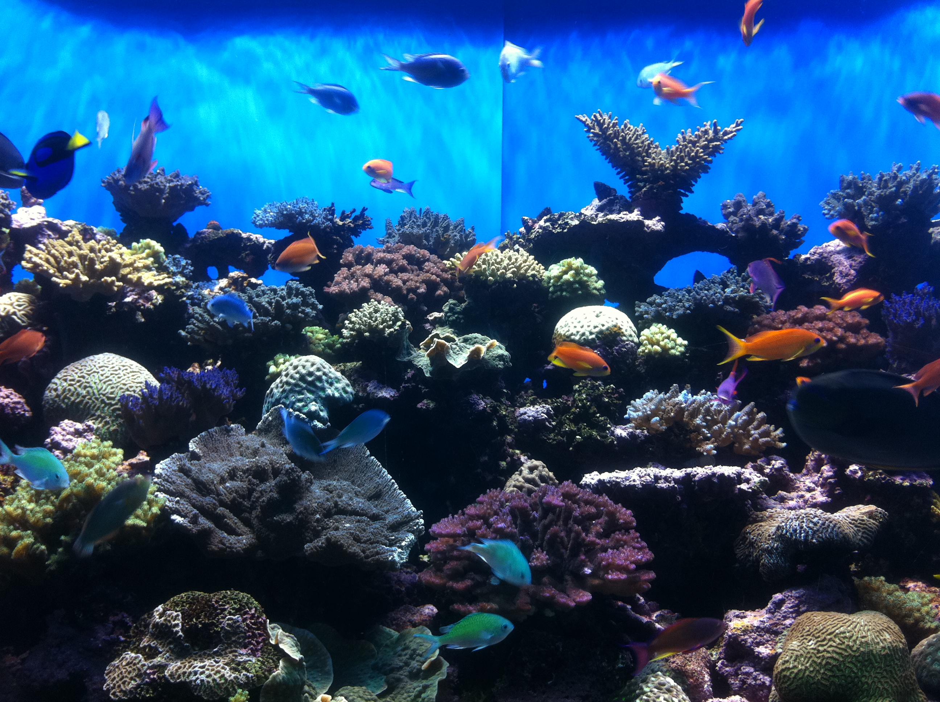
Ecology
Lesson 2: Organisms and their environments

Slide 2
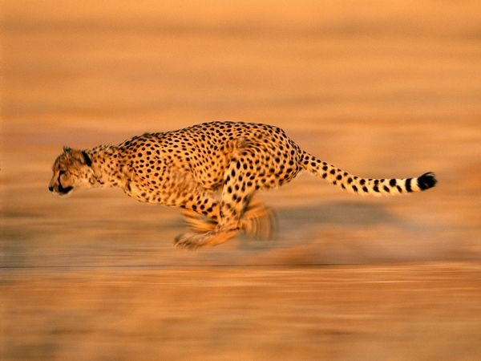
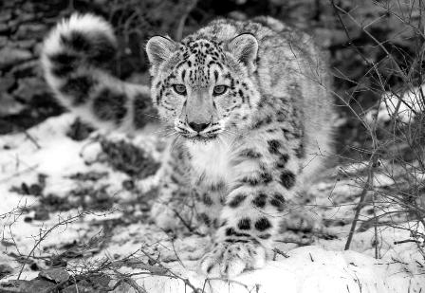
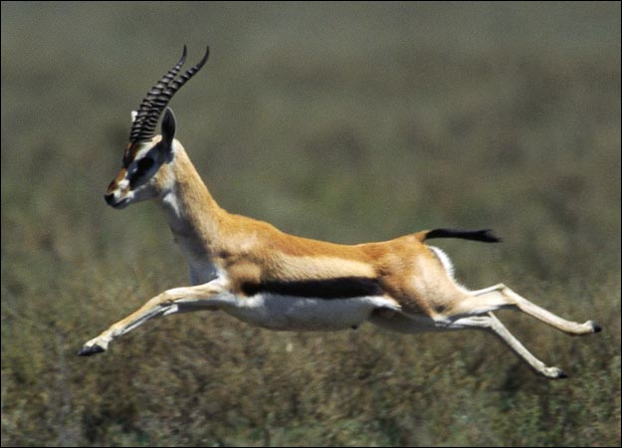
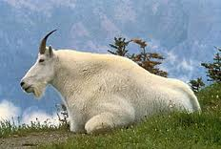
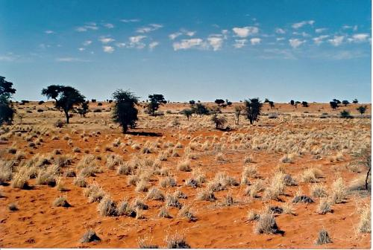
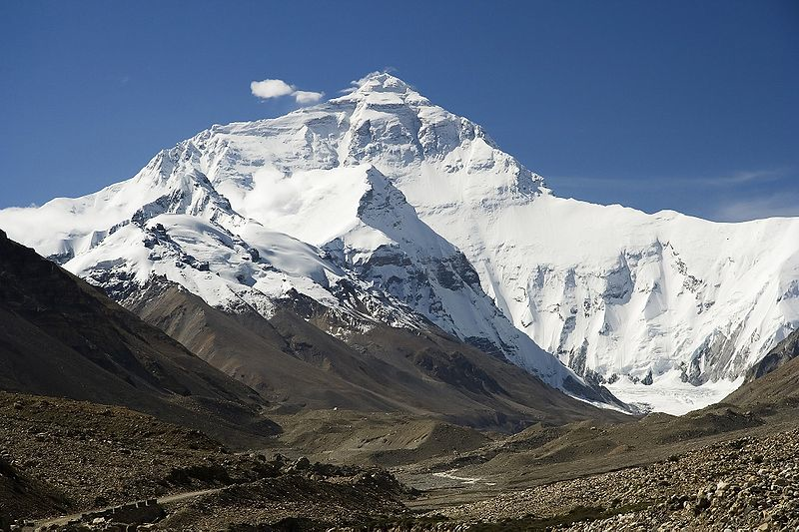
What sorts of things affect living organisms?
Other living things
Biotic factors
Prey/food source
Plants
Other predators
Notes:
Ecology is the study of how living things interact with each other and with their environments. Let’s look at 2 different animals in 2 different places in the world. Cheetahs in the desert and snow leopards in the mountains. First, what are some other living things that interact with cheetahs? Cheetahs are predators that eat other animals, mostly antelope. If the number of antelope drops, then the cheetahs won’t have as much to eat. The same is true of snow leopards with mountain goats. Mountain goats are the main food for snow leopards. If the amount of mountain goats goes down, the amount of snow leopards will too. The antelope in the desert is a biotic factor in the cheetah’s ecosystem and the mountain goat is a biotic factor in the snow leopard’s ecosystem. Biotic factors are living things in an ecosystem that affect an organism. What are some other biotic factors in these cats’ ecosystems? Last lesson we learned that plants are living things. How would plants affect cheetahs or snow leopards? Antelope and mountain goats are both herbivores, meaning they only eat plants. The more plants available, the more antelope and goats there can be, and we just learned that the number of antelope or mountain goats affects the number of cats. Because plants can affect the cats by affecting their main food source, the plants in the desert and the mountains are also biotic factors. What other living things interact with these cats? How about other predators? Cheetahs interact with other cheetahs, and snow leopards interact with other snow leopards. So, other cheetahs and other snow leopards are also biotic factors.
Image references:
Animals.nationalgeographic.com
Animal.discovery.com
Gardenofeden.blogspot.com
Wikipedia.org

Slide 3
What sorts of things affect living organisms?
Other living things
Abiotic factors
Sun/weather
Rains/snow
Temperature
Water source
Notes:
Ecology is the study of how living things interact with each other and with their environments. Let’s look at 2 different animals in 2 different places in the world. Cheetahs in the desert and snow leopards in the mountains. First, what are some other living things that interact with cheetahs? Cheetahs are predators that eat other animals, mostly antelope. If the number of antelope drops, then the cheetahs won’t have as much to eat. The same is true of snow leopards with mountain goats. Mountain goats are the main food for snow leopards. If the amount of mountain goats goes down, the amount of snow leopards will too. The antelope in the desert is a biotic factor in the cheetah’s ecosystem and the mountain goat is a biotic factor in the snow leopard’s ecosystem. Biotic factors are living things in an ecosystem that affect an organism. What are some other biotic factors in these cats’ ecosystems? Last lesson we learned that plants are living things. How would plants affect cheetahs or snow leopards? Antelope and mountain goats are both herbivores, meaning they only eat plants. The more plants available, the more antelope and goats there can be, and we just learned that the number of antelope or mountain goats affects the number of cats. Because plants can affect the cats by affecting their main food source, the plants in the desert and the mountains are also biotic factors. What other living things interact with these cats? How about other predators? Cheetahs interact with other cheetahs, and snow leopards interact with other snow leopards. So, other cheetahs and other snow leopards are also biotic factors.
So far we’ve only talked about how living things can affect the cheetahs and snow leopards. What about non-living things? The cheetah lives in the desert where the ground is mostly sand. The snow leopard lives in the mountains where there is snow most of the year. How does sand vs snow affect these cats? Well, first look at the color of the cats. Cheetahs are tan, just like the sand in their surroundings. Snow leopards are white, just like the snow in their surroundings. The sand and the snow both affect the cats and ae calld abiotic factors. What other nonliving things affect the animals? How about the temperature of the ecosystem? Cheetahs live in very hot area and snow leopards live in very cold areas, so snow leopards have much thicker fur than cheetahs do. There is much less water available in the desert for cheetahs, so cheetahs need less water than snow leopards. The temperature, the water, the precipitation are all abiotic factors in ecosystems.

Slide 4
Food chains
Notes:
We just talked about biotic factors in an ecosystem and how something as small as plants can affect a cheetah. The reason plants can affect a cheetah is because they are part of something called a food chain. Food chains are chains of living things in which each new link eats the link before. Cheetahs eat antelope, and antelope eat grass. The grass, antelope and cheetah make up a food chain. Food chains always start with an organism that eats no other organism. Grass doesn’t eat any living thing. It gets its energy from the sun. In fact, most food chains begin with plants. Food chains end with organisms that are not eaten by any other organism in the ecosystem. Nothing eats a cheetah, so it is the end of the food chain. Most food chains end with large animals such as cheetahs, humans, or sharks.

Slide 5
Energy pyramids
Notes:
The grass, antelope and cheetah that make up the food chain also make up a trophic pyramid. The trophic pyramid shows that organisms that are lower on the food chain tend to be more numerous in ecosystems. For example, the grass is on the bottom of the pyramid because it is the lowest level on the food chain. There has to be a lot more grass than antelope in order to support the antelope. Similarly, there has to be a lot more antelope than cheetahs in order to support the cheetahs. Because the cheetahs are the end of the food chain they go on the top of the pyramid. Why does there have to be more grass than antelopes and more antelopes than cheetahs? Every time an antelope runs it loses energy as heat. This means that only some of the energy from the grass is available to the antelope to make up its body– the rest is lost as heat. So, not all of the grass eaten is turned into antelope. This means there is less antelope in the end than grass. The same happens when the cheetah eats the antelope. A lot of the energy from the food gets lost as heat, so an equal amount of cheetah is not made from the antelope and there are less cheetahs in the end.

Slide 6
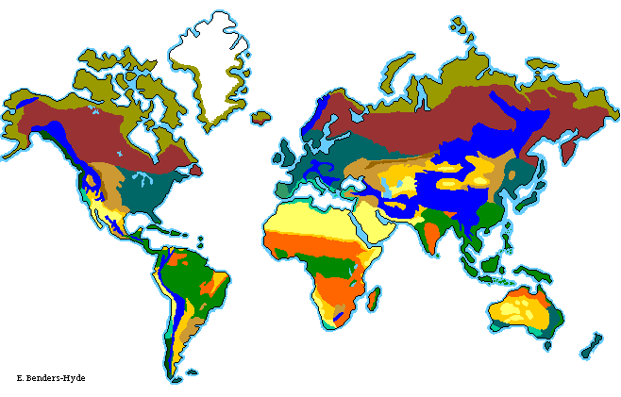
Biomes
Notes:
Ecosystems are made up of their biotic and abiotic factors. There are hundreds of ecosystems in the world, and these are organized into biomes. Biomes are geographic regions of the world that have specific abiotic factors that define the types of ecocsystems that can exist there. The climate defines the plants that can grow in the region, and the plants define what food chain can be supported in the region. Each color here represents a different biome. Each of these biomes have plants and animals that are adapted to the abiotic factors of those biomes.
Image reference: blueplanetbiomes.org

Slide 7
Biomes
Savanna Biome
Notes:
For example, the cheetah we’ve been talking about lives in the savanna biome. The savanna biome is mostly in Africa and is characterized by a hot, dry climate and long periods of drought. The plants and animals in the savanna are specially adapted to this hot, dry climate. Most of the plants in the savanna are short grasses that don’t require a lot of water, or short trees that don’t require much water. Because of this plant life, most of the animals that live in this biome eat grass, and can migrate very long distances as an adaptation to the need to find water. These include zebras and antelope. These animals are frequently sand or grey-colored so they blend in with the sand. They have to be able to run fast or blend in to get away from their predators. The predators, such as lions and cheetahs, are also sand-colored so they can blend in and not be seen by their prey. They are mostly large and also very fast so the can catch the fast prey.

Slide 8
Biomes
Tundra
Taiga
Grasslands
Deciduous Forest
Alpine
Chaparral
Desert
Desert-scrub
Savanna
Rainforest
Notes:
These are the locations of the biomes throughout the world. North America is mostly deciduous forest with some desert and desert-scrub. California is mostly a chaparral biome. The climate of a certain region of the world will determine what sorts of plants the ecosystems can sustain. The plants in turn will determine what sort of food chains and energy pyramids can be supported in that biome.

Slide 9
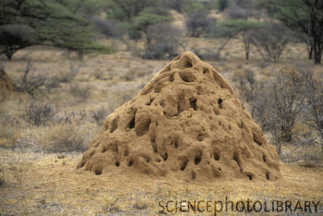
Roles in the ecosystem
Grasses: Producer
Make their own food
Antelope: Consumer
Eat plants
Cheetah: Consumer
Eat animals
Termites: Decomposer
Recycle dead plants animals into useful energy for plants
Notes:
Earlier we talked about how even plants can affect larger animals through their food chains. In order for animals like cheetahs to survive, an ecosystem must have a sufficient amount of lower animals in the food chains like antelope and grasses. This is called being in balance. The lowest organisms on food chains and in energy pyramids are always producers. Producers are almost always some form of plant, and they are called producers because they make energy using sunlight rather than having to eat another organism. Anything above this first level on the food chain is called a consumer. Both antelope and cheetahs are consumers. Antelope are herbivores because they only eat plants, and cheetahs are carnivores because they only eat meat. Antelope are also called prey and cheetahs are the predators. Predators eat prey. However, there is a third type of organism that must exist in an ecosystem in order to maintain balance. This is a decomposer. Decomposers eat dead plants and animals or waste from animals. Some common decomposers are mushrooms, bacteria, and worms. In the savanna biome where cheetahs live, termites are a common decomposer as well.

