Slide 1
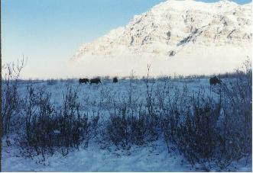
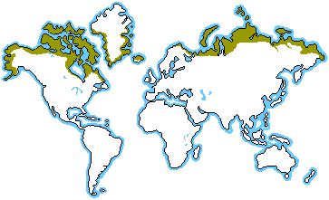
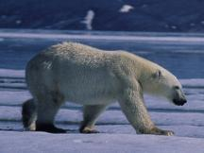
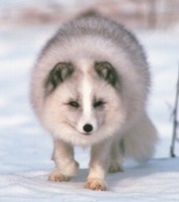
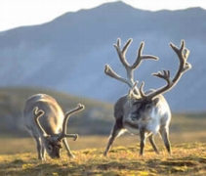
Tundra
Climate: Very windy, very cold, soggy and swampy
Plants: Very little vegetation, mosses, grasses, lichens, shrubs
Animals: Arctic fox, caribou, polar bear
Notes:
References:
Blueplanetbiomes.org

Slide 2
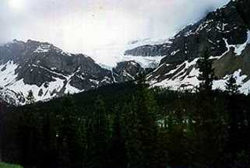
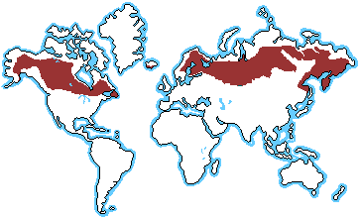
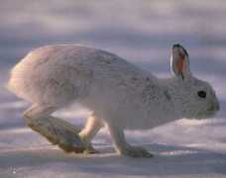
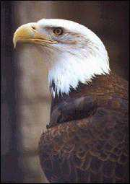
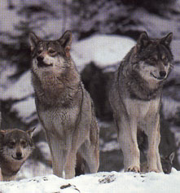
Taiga
Climate: cold, snowy winters and warm, rainy and humid summers
Plants: mostly evergreen trees
Animals: black bears, bald eagles, wolves, rabbits

Slide 3
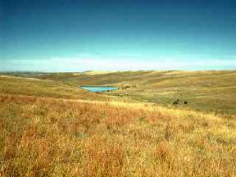
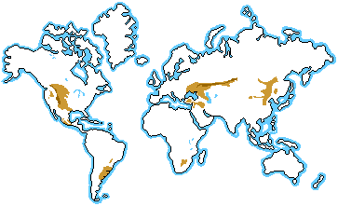
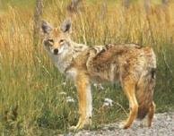
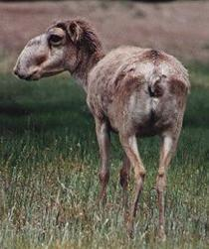
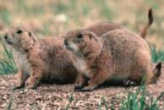
Grasslands
Climate: variable rain, wildfires, not much snow, cold winters, hot summers
Plants: almost no trees, mostly grasses
Animals: foxes, coyotes, antelope, bison, prairie dogs

Slide 4
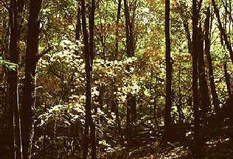
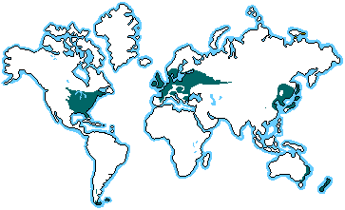
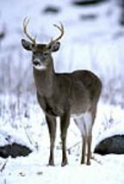
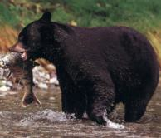
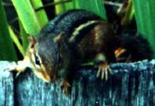
Deciduous Forest
Climate: lots of rainfall, 4 distinct seasons
Plants: lots of tall trees, maple trees, oak trees
Animals: chipmunk, deer, black bear

Slide 5
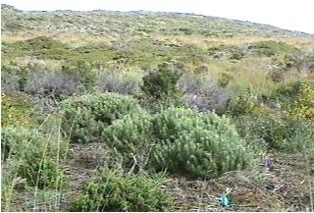
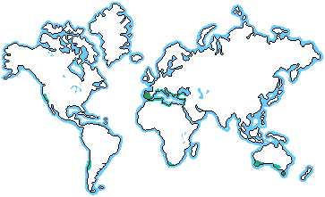
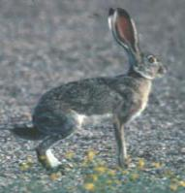
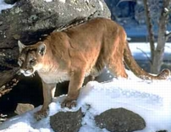
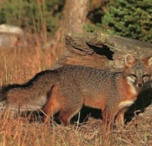
Chaparral
Climate: very hot and dry, wildfires, droughts
Plants: short bushes, grasses, some trees
Animals: jack-rabbit, fox, puma, skunk

Slide 6
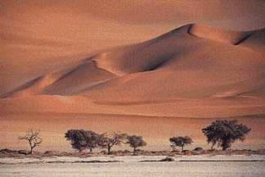
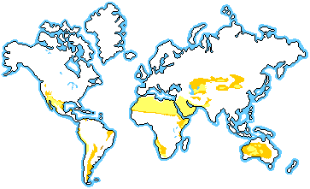
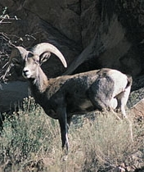
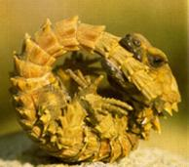
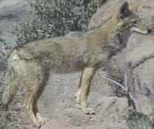
Desert
Climate: extremely dry, extreme heat,
Plants: cactus, very short grasses, short woody trees
Animals: lizards, bighorn sheep, antelope, coyote

Slide 7
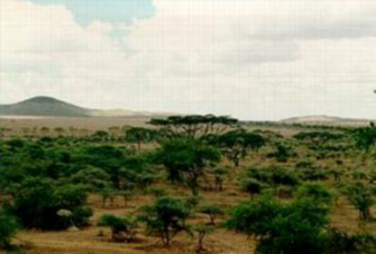
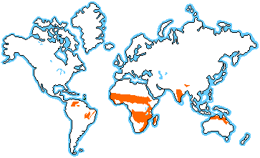
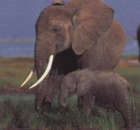
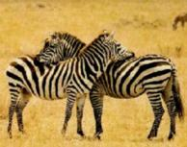
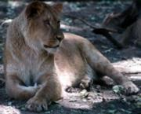
Savanna
Climate: hot and humid, droughts and monsoons
Plants: long grasses, eucalyptus
Animals: zebras, giraffes, lions, cheetahs, elephants

Slide 8
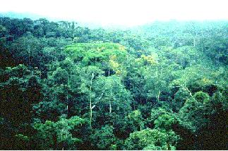
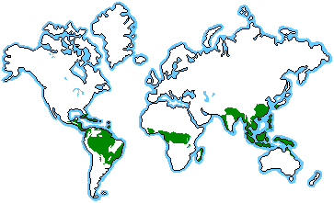
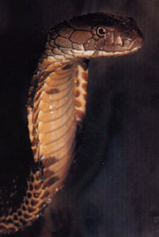
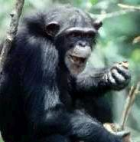
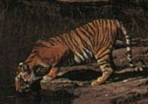
Rainforest
Climate: extremely humid, most rain of anywhere, very hot, lots of sun
Plants: more trees than anywhere, very tall trees
Animals: tigers, monkeys, snakes

Slide 9
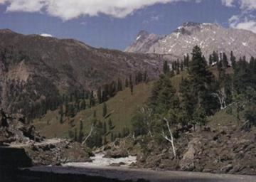
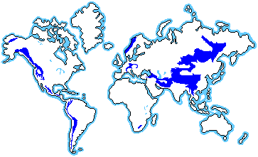
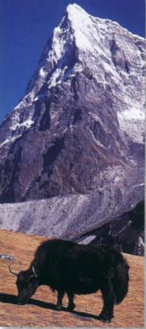
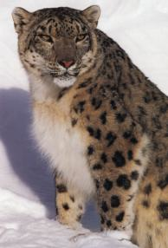
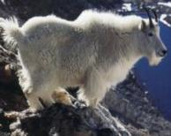
Alpine
Climate: very cold, tons of snow, very windy
Plants: only small bushes and some evergreen trees
Animals: snow leopard, mountain goat, yak

