Slide 1
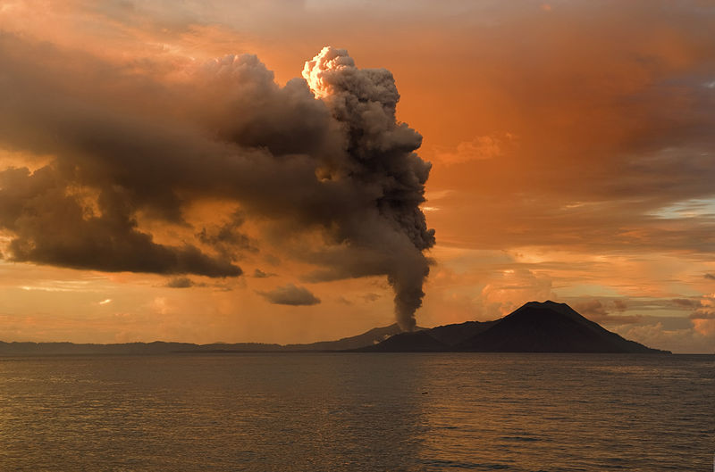
Volcanic Eruptions
Notes:
AUTHORS: Geoffrey Cromwell (Scripps Institution of Oceanography, UC San Diego) and Danny Blas (Abraham Lincoln High School, San Diego)
WHY: Volcanic eruptions can be some of the most violent, chaotic natural disasters, but their extreme power makes them all the more interesting to geologists. Some of the best ways to learn about volcanic explosions are to make simple models. In this lesson we’ll learn some simple ways to mirror volcanic eruptions, bringing the power of volcanoes into our hands.
SUMMARY (< 100 words): This lesson explores how and why some volcanic eruptions are explosive and some are more gentle and effusive. Explosivity of a volcano is determined by the composition of the magma that supplies the volcano, and interaction of the magma with external water sources that can turn to steam. Major factors of magma composition controlling explosivity are gas content, viscosity and interaction with external water. Mid-way through the presentation there will be a demonstration with bottled soda, highlighting the effects of gas content and pressure on volcanic eruptions. Following the presentation will be a hands-on activity exploring the viscosity of different liquids. The take-home messages of this presentation are: 1) Explosivity is controlled by magma composition and interaction with water 2) Explosive eruptions have magma with high gas content and high viscosity 3) Effusive eruptions have magma with low gas content and lower viscosity.
PICTURE/GRAPHICS CREDITS: Tavurvur volcano erupting, Papua New Guinea. Image from Wikipedia, http://en.wikipedia.org/wiki/File:Tavurvur_volcano_edit.jpg
ADDITIONAL READING: See TEACHING NOTES
CONTEXT FOR USE: This lesson is designed for a 9th grade Earth Science class. This presentation, and accompanying activity, is the third lesson in comprehensive, 5 day Volcano Unit. The preceding lesson is titled “Global Volcanoes”, the following lesson in the Volcano unit is titled “Volcanic Hazards”.
MISCONCEPTIONS: Explosive eruptions are only caused by pressure within a volcano; All magmas are the same density; All lavas flow at the same speed
TEACHING NOTES: This lesson contains this presentation, a soda bottle demonstration on gases in liquid (“Soda Bottle Demonstration”) and a hands-on viscosity activity (“Viscosity Activity”). Teaching materials for the viscosity activity are also available (“Viscosity Activity Teachers” and “Viscosity Labels”). Unless otherwise noted, all information in this lesson was derived from Wikipedia.com or a college level Earth science textbook titled:
Earth, Portrait of a Planet - Third Edition
Stephen Marshak
Copyright 2008 by W. W. Norton & Company, Inc.

Slide 2
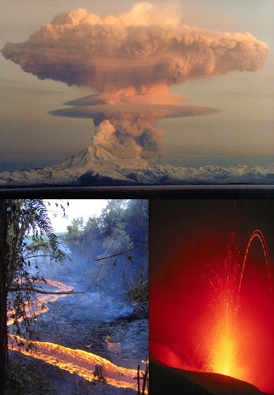
Explosive and Non-explosive Eruptions
Types of Eruption
Explosive or non-explosive?
Magma composition:
  Amount of gas
  Magma viscosity
Interaction with water
  Water explosively turns into steam
Notes:
Notes:
This slide introduces the main concepts of the presentation. The explosivity of volcanic eruptions is mostly controlled by the amount of gas dissolved in the magma supply and the viscosity of the magma.
The image on this slide is a composite of volcanic eruptions with varying degrees of explosivity. The top eruption is a stratovolcano with a large ash cloud, this is highly explosive. The bottom left image is an effusive lava flow, likely from a shield volcano. The bottom right image is a lava fountain which could also be from a shield volcano, potentially feeding the lava flow to the left.
The bulleted list explains that a volcanic eruption is explosive or non-explosive depending on the magma composition, specifically the gas content and the viscosity of the magma, and interaction with external water sources (groundwater or seawater)
Students are not advised to take notes on this slide, it is meant to outline the major concepts of this presentation.
The above image is from Wikipedia, http://en.wikipedia.org/wiki/File:Lava_forms.jpg

Slide 3
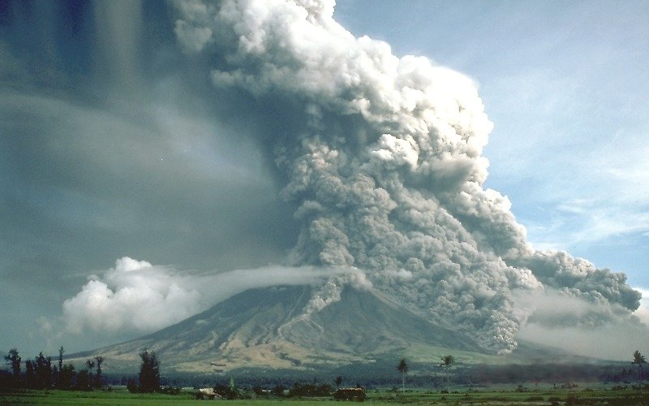
Explosive Volcanoes
Explosive Eruptions
Magma composition
  High gas content
  High magma viscosity
Water
http://earthref.org/SCC
Scripps Classroom Connection
Notes:
Notes:
This slide introduces the magma characteristics of explosive volcanic eruptions. Students should take note of these characteristics. More detail is provided in following slides.
The picture is of the Mayon volcano in the Philippines erupting. There is a buoyant eruption column rising above the volcano, in addition to pyroclastic flows on the flanks.
The above image is from Wikipedia, http://en.wikipedia.org/wiki/File:Pyroclastic_flows_at_Mayon_Volcano.jpg
3

Slide 4
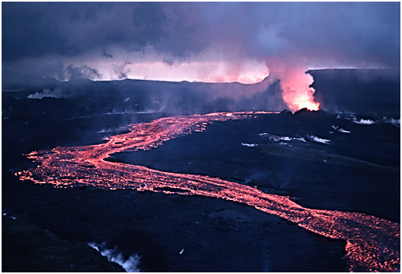
Non-explosive Volcanoes
Non-explosive Eruptions
Magma composition
- Low gas content
- Low magma viscosity
http://earthref.org/SCC
Scripps Classroom Connection
Notes:
Notes:
This slide introduces the magma characteristics of non-explosive volcanic eruptions. Students should take note of these characteristics. More detail is provided in following slides.
This image is of the 1984 Krafla eruption in Iceland. This is a non-explosive eruption with effusive lava flows.
Non-explosive eruptions are the result of magma with low gas content and low viscosity.
Note how the lava appears to flow like a river, this implies that there is faster flow which indicates lower viscosity (like milk)
A slower moving lava flow would have a higher viscosity (like honey)
The above image is from Wikipedia, http://en.wikipedia.org/wiki/File:Lava_flow_at_Krafla,_1984.jpg
4

Slide 5

Viscosity
Viscosity
Measures the “thickness” of a fluid
High Viscosity = thick
Slow Moving
- Syrup, motor oil, shampoo, honey
Low Viscosity = thin
Fast moving
- Water, juice, milk
http://earthref.org/SCC
Scripps Classroom Connection
Notes:
Notes:
This slide introduces viscosity and provides examples of high and low viscosity fluids.
The image shows an example of honey being poured on some biscuits. Honey is a highly viscous fluid.
Viscosity is a measure of the “thickness” of a fluid, or it’s ability to flow.
A high viscosity fluid flows slowly and is thicker, or more “sticky”
A low viscosity fluid flows more easily and is thinner, or less “sticky”.
Syrup, motor oil, shampoo, honey are examples of highly viscous fluids
Water, juice, and milk are examples of lower viscosity fluids
Temperature also plays a roll in viscosity. At higher temperatures, fluids will be less viscous.
To be sure that students understand the concept of viscosity, ask them to name other fluids that are low, or high viscosity. Then ask the class whether Fluid A is more or less viscous than Fluid B. For example: “Is milk more or less viscous than water?”. Also, ask the class which is more viscous, syrup that just came from the refrigerator, or honey that has been sitting in the cupboard?
The above image is from Wikipedia, http://en.wikipedia.org/wiki/File:Runny_hunny.jpg
5

Slide 6

Gas in Magma
Gas Content
Magma contains dissolved gasses
More gas = more pressure
If too much pressure, volcano will erupt violently
-Like shaking a soda bottle
http://earthref.org/SCC
Scripps Classroom Connection
Notes:
Notes:
This slide goes into detail about the properties of dissolved gasses in magma that cause volcanic explosions.
The picture is of carbonated gas in water, but designed to represent gas in any fluid.
Most magmas contain dissolved gases (water, carbon dioxide, sulfur dioxide and hydrogen sulfide). In some cases, gases can make up 9% of magma composition.
Pressures on the magma while within the Earth cause more gas to dissolve into the melt. This increasing pressure, and subsequent addition of gasses to the melt is why magmas want to rise to the surface
The more gas present in the magma, the higher the pressure the magma can generate in its confined space (i.e. magma chamber). With greater pressure, the more likely the volcano is to erupt violently.
This is similar to shaking a soda bottle and twisting off the cap. The more you shake the soda bottle, the greater the pressure inside is and the more the gas wants to escape. Taking off the soda cap can be equated to a volcano erupting.
Magmas with high silica content generally have a higher proportion of dissolved gas (due to the increased viscosity of those magmas)
The higher the viscosity of magma (silica content), the harder it is for gases to escape the fluid and go into the atmosphere. When magma rises closer to the surface, the decreasing pressure from the overlying crust causes the gases to expand, thereby causing the pressure within the magma chamber to increase.
In a magma with lower viscosity, gasses can escape to the Earth’s surface in small eruptions. In more viscous magmas, the pressure will build and release in a massive, violent eruption.
The above image is from Wikipedia, http://en.wikipedia.org/wiki/File:Soda_bubbles_macro.jpg
6

Slide 7
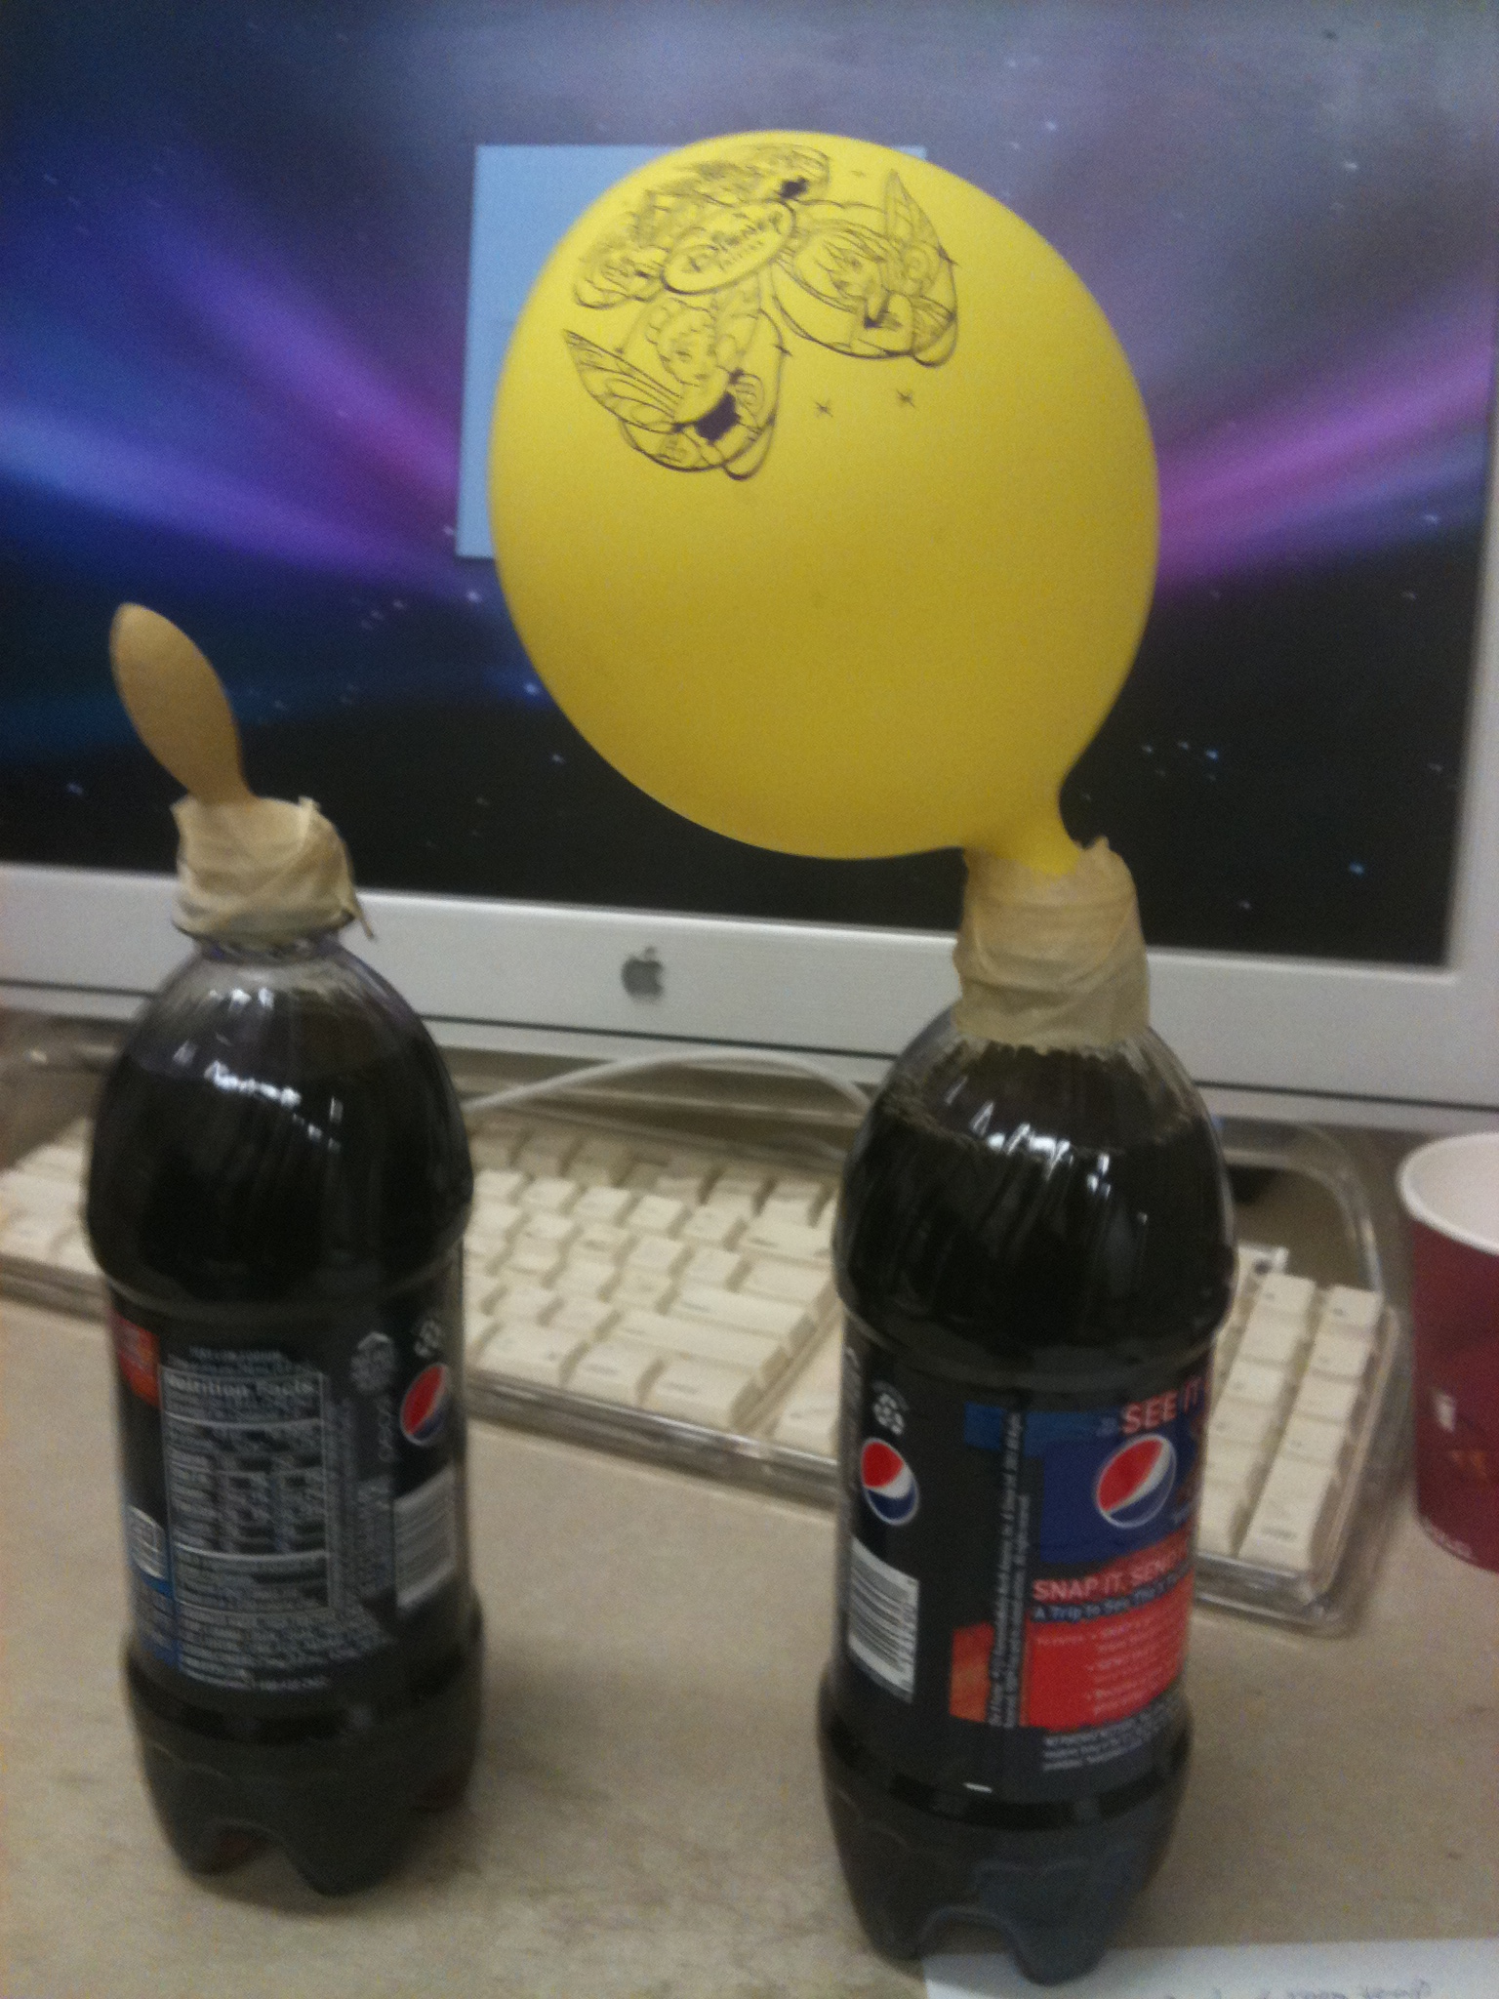
Soda Bottle Demonstration
Soda and gasses
Soda contains dissolved CO₂ gas
When under pressure, can’t see gas in the liquid
Same as magma, dissolved gasses under pressure
More gas equals more pressure
Explosive response when pressure finally released.
http://earthref.org/SCC
Scripps Classroom Connection
Notes:
Notes:
This slide is designed to guide the instructor’s demonstration using a two-liter bottle of carbonated soda, however it can also be presented to the class as another slide in the presentation. The slide describes the dissolved gasses in soda (carbon dioxide) and how it can simulate the conditions of dissolved gases in magmas.
The image is an experiment testing how much carbon dioxide is in a 20 oz. bottle of soda. The balloons are taped to the top of the soda bottle immediately after opening, the balloons will slowly fill with carbon dioxide gas. The image was taken after the soda bottle on the right had been opened for about an hour.
Instructions for the demonstration can be found in an attached document titled “Soda_Bottle_Demonstration”.
The above image is by Geoffrey Cromwell and is free to use.
7

Slide 8
High Viscosity Magma
High Viscosity
Gas can’t escape “sticky” magma
  Bubbles are slow to form
  Bubbles take longer to rise to surface
Higher pressure
  Bubbles can’t escape, gas pressure increases
Explosive Eruptions
http://earthref.org/SCC
Scripps Classroom Connection
Notes:
Notes:
This slide reinforces how gas content and viscosity of magma causes explosive volcanic eruptions.
The two images are from previous slides, emphasizing that highly viscous magma is more likely to lead to explosive eruptions.
Highly viscous magmas are more “sticky” and trap dissolved gases in the fluid when they would prefer to escape.
Dissolved gases need to nucleate into gas bubbles before escaping a fluid. In more viscous fluids, this process takes longer. Once bubbles form, the high viscosity also slows the escape of those bubbles, essentially trapping them.
By trapping the gases in the magma, pressure builds as the gases expand, leading up to an explosive release of energy. With very high pressures, a single explosive eruptive event is likely.
High viscosity magmas result in slow moving lavas that have a high silica content. An example of such a lava is called rhyolite.
The two images are from Wikipedia, http://en.wikipedia.org/wiki/File:Runny_hunny.jpg and http://en.wikipedia.org/wiki/File:Pyroclastic_flows_at_Mayon_Volcano.jpg
8

Slide 9
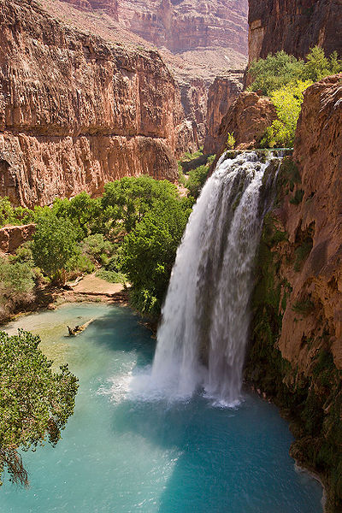
Low Viscosity Magma
Low Viscosity
Gas can escape magma
  Fluid not as “sticky”
  Bubbles form more quickly
  Bubbles can rise to the surface and escape
Lower pressure
  Bubbles can escape, gas pressure doesn’t build as much
Non-explosive Eruptions
http://earthref.org/SCC
Scripps Classroom Connection
Notes:
Notes:
This slide reinforces how gas content and viscosity of magma causes non-explosive, effusive volcanic eruptions.
The image of a lava flow is from a previous slide. The other image shows a waterfall, representing low viscosity fluids. These pictures show that less viscous magma is associated with effusive eruptions.
Low viscosity magmas are generally associated with non-explosive volcanic eruptions
Lower viscousity magmas aren’t as “sticky” and dissolved gases are usually able to escape as the magma rises to closer to the surface.
The nucleation process of dissolved gases can occur more quickly since the magma is less sticky. Once the bubbles form, they can escape the fluid, preventing the build-up of explosive pressures.
Lower viscosity magmas generally produce fast flowing lavas from effusive volcanoes. These lavas are more likely to cover large areas. They generally have a lower silica content. One example of such a lava is basalt.
The two images are from Wikipedia, http://en.wikipedia.org/wiki/File:Havasu_Falls_1a_md.jpg and http://en.wikipedia.org/wiki/File:Lava_flow_at_Krafla,_1984.jpg
9

Slide 10
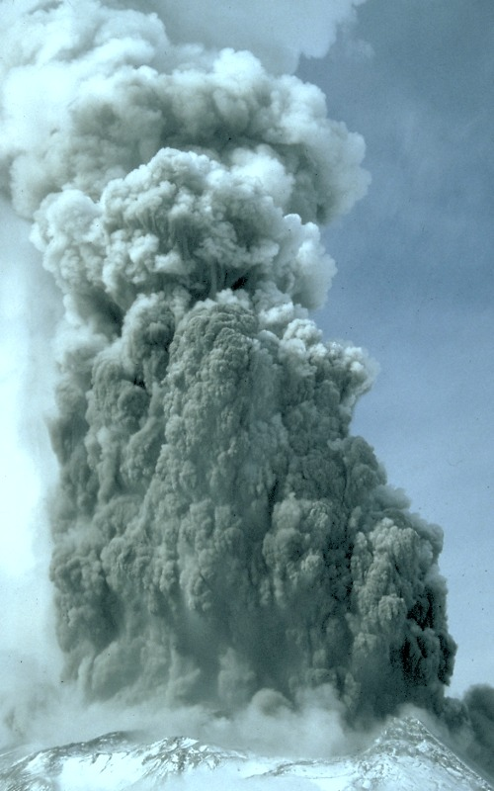
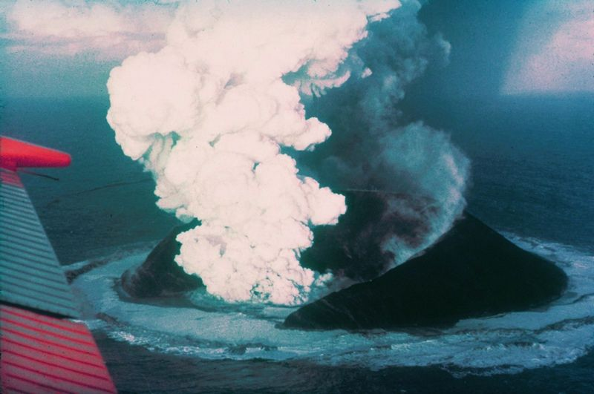
Interactions with Water
Explosive Eruptions
Underground contact with groundwater or seawater
  Water instantly turns to steam, explosive
Contact with seawater, lakes after eruption
  Steam, ash, fragmentation of lava
  Once above water level, normal eruption type
Notes:
Notes:
This slide discusses hydromagmatic interactions that cause explosive volcanism. There are two types of interactions.
The first is contact of groundwater or seawater with the magma conduit. This occurs underground, prior to an actual eruption. The water explosively turns into steam, causing an explosive eruption (called a phreatic eruption)
This type of eruption is illustrated in the lefthand image from the 1980 Mt. St. Helens eruption.
The second type of interaction is post-eruption contact with standing water (e.g. ocean, lakes, glaciers) (phreatomagmatic eruptions)
Eruptions of this kind produce steam, ash and fragmented lava and are explosive, although not to the degree of phreatic eruptions.
An example of this is in the top right photograph of the Surtsey eruption in Iceland in 1963, the submarine eruption produces a large steam column.
The volcano at Surtsey eventually rose above sea level, after that the eruption was similar to the image in the bottom right, a normal effusive eruption.
Left Image from Wikipedia, http://en.wikipedia.org/wiki/File:Phreatic_St._Helens.jpg
Top right image from Wikipedia, http://en.wikipedia.org/wiki/File:Surtsey_eruption_1963.jpg
Bottom right image from previous slide

Slide 11
Conclusions
Type of volcanic eruption controlled by magma composition
Gas content and viscosity
Explosive eruptions have high gas content and high viscosity
Effusive eruptions have low gas content and low viscosity
Magma contact with water can also cause explosive eruptions
Notes:
The main take home message for students should be that explosive volcanic eruptions are controlled by the composition of the magma. Gas content and viscosity are the two major components that dictate explosivity.
In general, more viscous magmas trap more gasses, which in turn leads to a greater build-up of pressure as the magma moves closer to the Earth’s surface. More pressure, like in a soda bottle, leads to more violent eruptions when the pressure is finally released (by the rupturing of the volcano or by opening the cap on a soda bottle).
More viscous magmas generally have more silica content, and form rocks such as rhyolite. This type of lava could be represented by honey or syrup. Less viscous lavas form rocks such as basalt, which has a lower silica content. Lower viscosity lavas could be represented by juice or milk.
An activity on viscosity follows this presentation. Students will explore the viscosity of different household fluids in order to gain a physical understanding of viscosity and relate their findings to different magma types. The handout and student instructions are in the document titled, “Viscosity Activity”. Teacher instructions are in the document titled, “Viscosity Activity Instructions” and “Viscosity Labels”.

