Slide 1
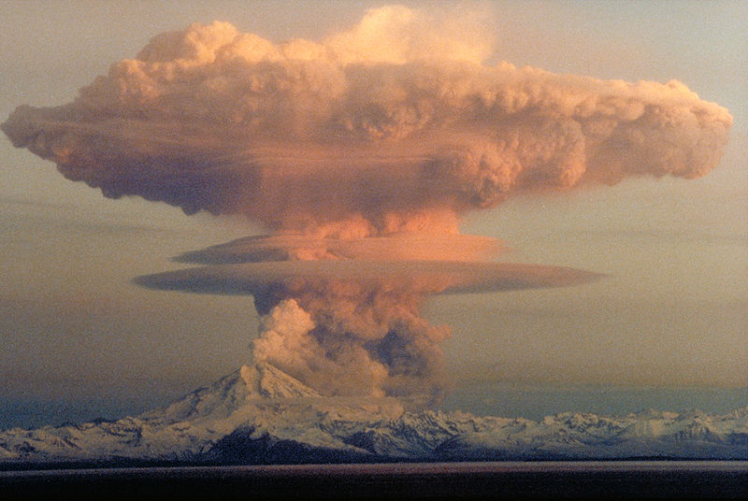
Volcanic Hazards
Notes:
AUTHORS: Geoffrey Cromwell (Scripps Institution of Oceanography), Danny Blas (Abraham Lincoln High School)
WHY: Volcanoes are some of the most powerful things in nature which makes them both beautiful and dangerous. Although the hazards associated with volcanic eruptions vary depending on the type of volcano, the dangers of volcanic eruptions are diverse and can destroy man-made objects or natural landscapes in many different ways. This lesson highlights the most deadly and powerful volcanic hazards and how they affect human populations and natural resources.
SUMMARY (< 100 words): In this lesson we will learn about the major volcanic hazards associated with shield and stratovolcanoes. Shield and stratovolcanoes are generally effusive and explosive, respectively, and therefore have different associated hazards as well as some in common. We will take notes on a powerpoint and learn about six volcanic hazards. For each hazard we will discuss which volcano type they are associated with, the physical attributes of each hazard, and the effects and damage each hazard can cause. Take home messages: 1) Stratovolcanoes have explosive eruptions, their associated hazards are more violent and devastating 2) Shield volcanoes are effusive and have more predictable dangers with generally fewer lives lost (although they can still be explosive and very dangerous, especially when water is present)
PICTURE/GRAPHICS CREDITS: This image is of the Redoubt Volcano in Alaska, from Wikipedia http://en.wikipedia.org/wiki/File:MtRedoubtedit1.jpg
WEBSITES USED IN THIS PRESENTATION: Give URLs to websites that you consulted, borrowed from or or that will offer interesting additional information. Say, for example, this activity is adapted from URL “http//:etc” or say that additional information can be fount at URL etc.
ADDITIONAL READING: http://volcanoes.usgs.gov/ This is a very complete and comprehensive website. Much of the material and pictures came while exploring this site. In addition, see TEACHING Notes
CONTEXT FOR USE: This lesson is designed for a 9th grade Earth Science class and is meant for a 55 minute class period. This lesson is accompanied by an activity titled “Hazards_House_Activity”. This lesson is the second of five lessons in a comprehensive Volcano Unit. The preceeding lesson is titled “Introduction to Volcanoes: Shield vs. Stratovolcanoes”, the following lesson is titled “Global Volcanoes”.
MISCONCEPTIONS: Lava flows are the most dangerous volcanic hazard; All volcanoes have the same dangers; It is never possible to evacuate people from a volcano; Volcanic eruptions only affect local areas
EVALUATION TIPS: You may give an example for a pre/post evaluation that you provided, with a link to the file provided with your lesson materials
TEACHING NOTES: This lesson includes this presentation as well as a creative group activity. The worksheet for the activity is titled “Hazards_House_Activity”. Teaching instructions for the activity are found in the document “Hazards_Activity_Instructions”. Unless otherwise noted, all information in this lesson was derived from Wikipedia.com or a college level Earth science textbook titled:
Earth, Portrait of a Planet - Third Edition
Stephen Marshak
Copyright 2008 by W. W. Norton & Company, Inc.

Slide 2
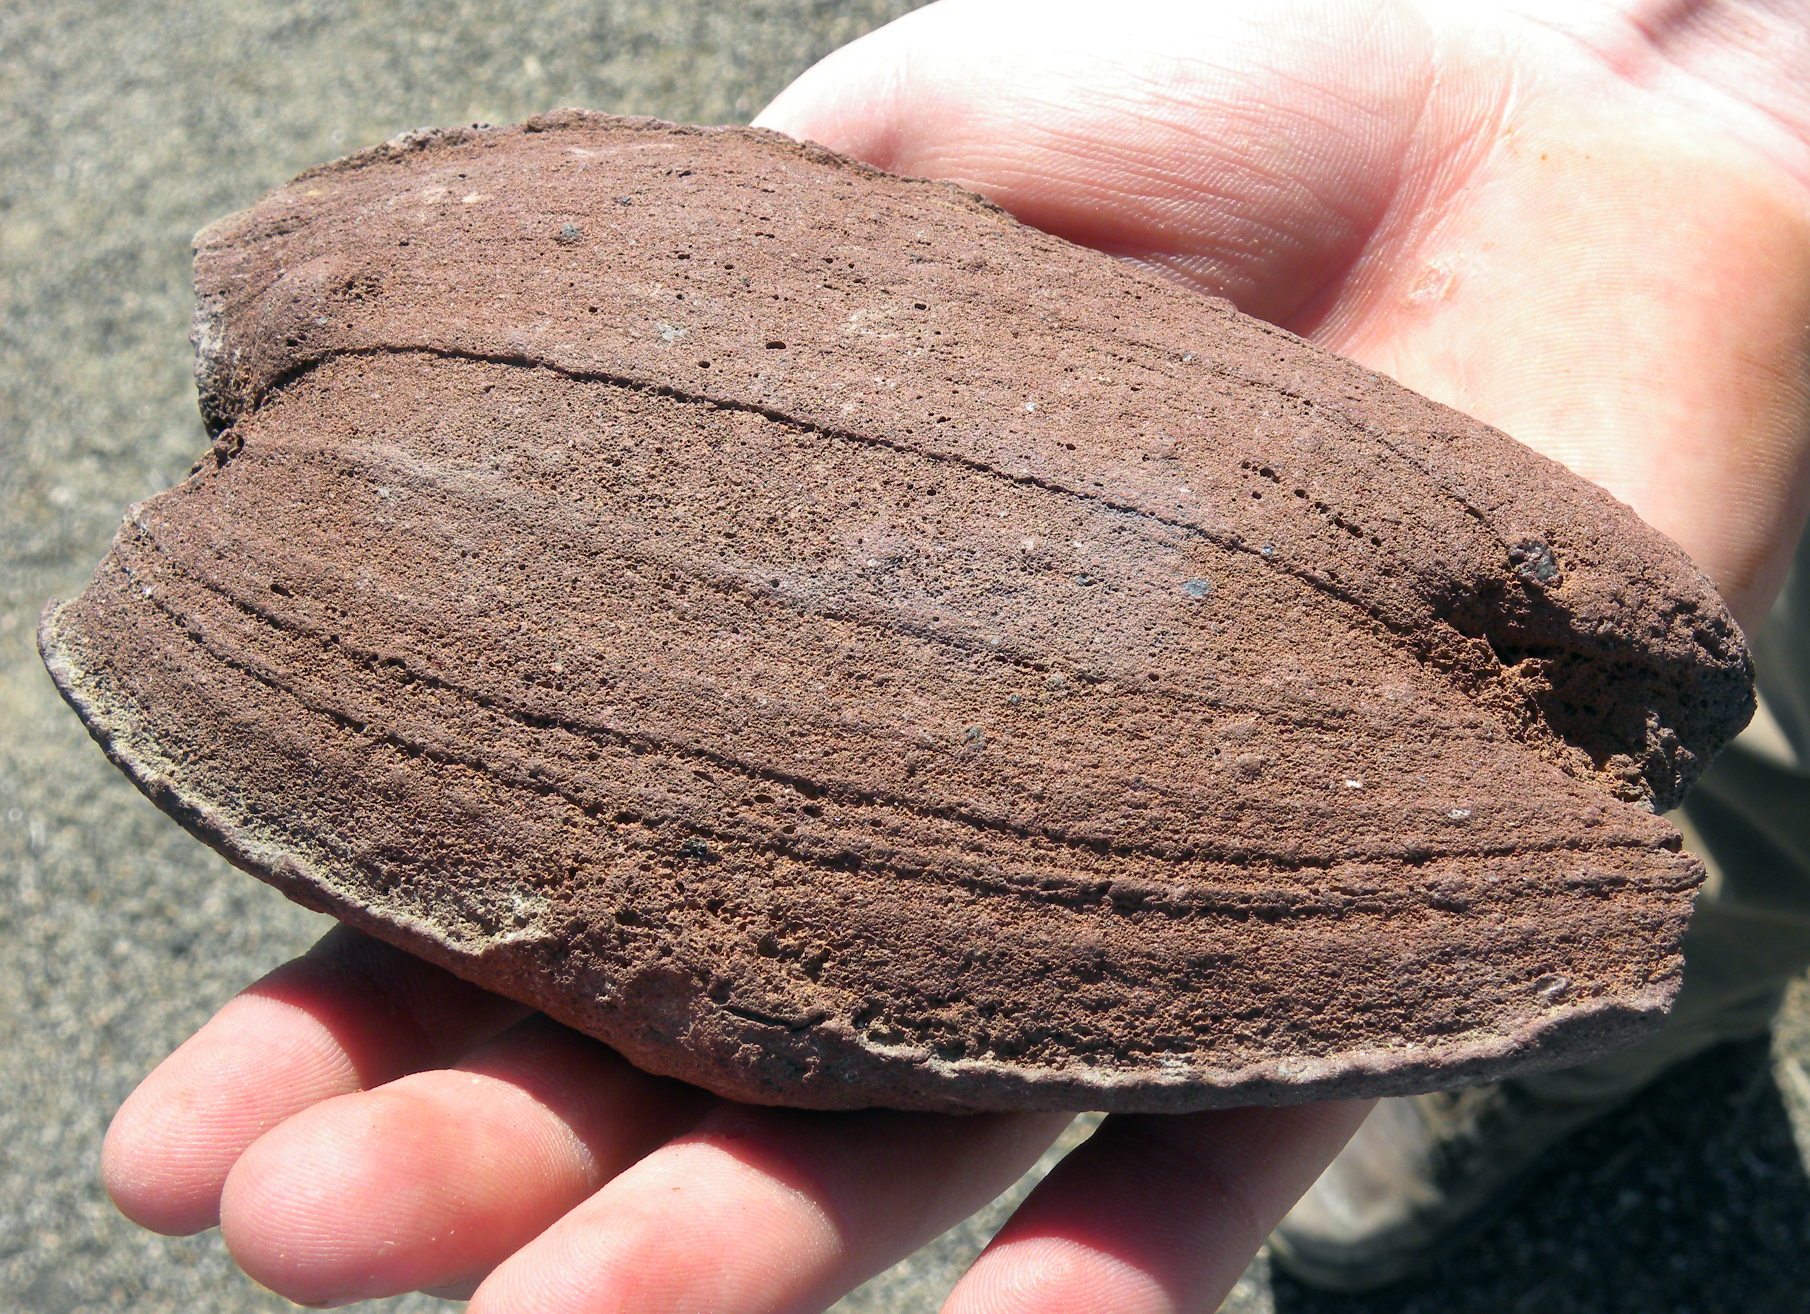
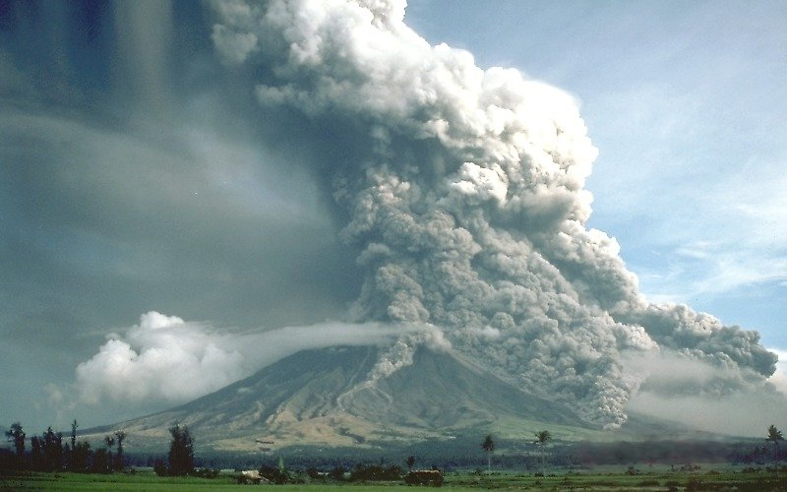
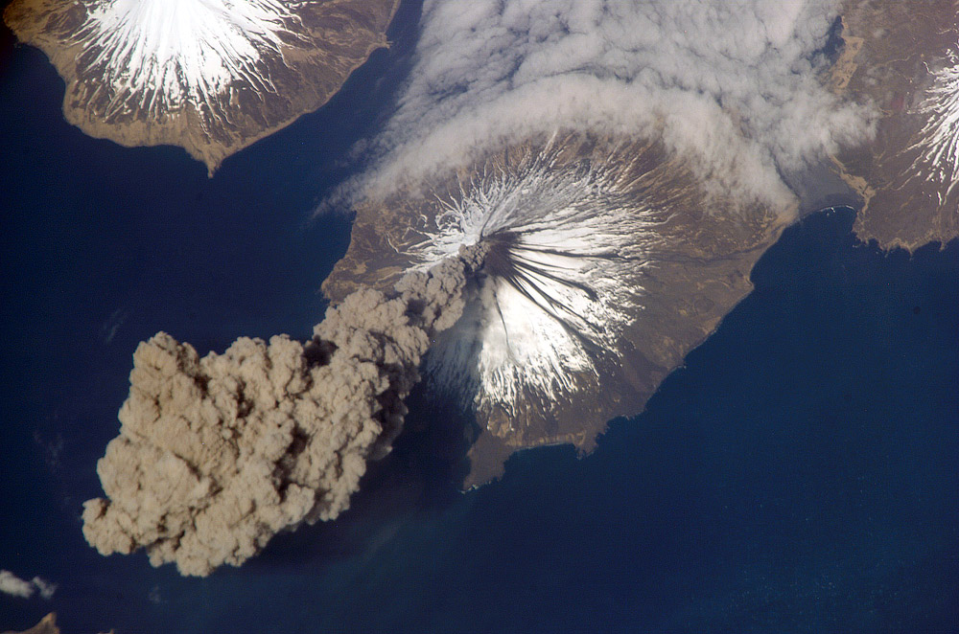
Stratovolcano Hazards
Stratovolcano Hazards
Pyroclastic flows and lahars
Volcanic ash
Volcanic debris
Hydrovolcanic explosion
Gasses
Earthquakes
http://earthref.org/SCC
Scripps Classroom Connection
Notes:
Notes:
This slide lists the major volcanic hazards associated with stratovolcanoes. These bullets serve as an introduction to stratovolcanoes. It is important to note that Gasses and Earthquakes also accompany shield volcanoes.
The images clockwise from the top show examples of: Volcanic bomb (large volcanic rocks, shaped by the eruption while still soft and then thrown from the volcano), pyroclastic flow, ash cloud from Mt. Cleveland volcano.
Image credits-
Volcanic debris: http://en.wikipedia.org/wiki/File:VolcanicBombMojaveDesert.JPG
Pyroclastic Flow: http://en.wikipedia.org/wiki/File:Pyroclastic_flows_at_Mayon_Volcano.jpg
Ash cloud: http://en.wikipedia.org/wiki/File:MtCleveland_ISS013-E-24184.jpg
2

Slide 3
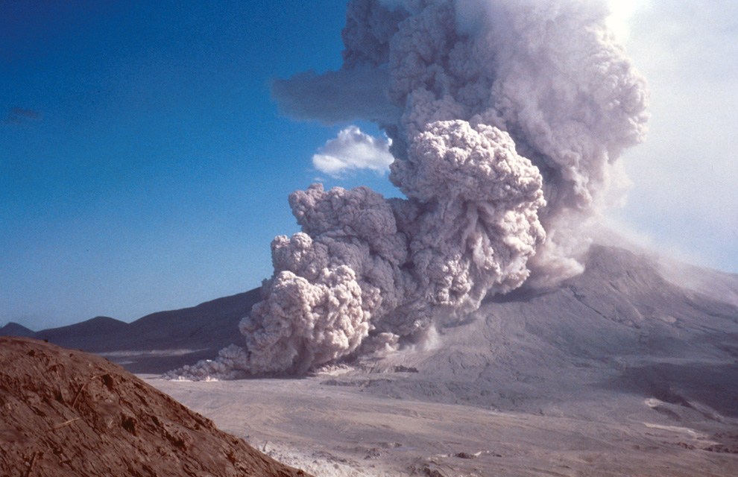
Pyroclastic flows and Lahars
Pyroclastic Flows
Fast: 200 mph
Can travel 10-100 miles
Flatten anything in its path
Can Reach 450°C
Lahars
Mix of water with volcanic ash/debris
Denser than water, flow like a more powerful river
Carry everything in their path
http://earthref.org/SCC
Scripps Classroom Connection
Notes:
Notes:
The image is of a pyroclastic flow running down the side of Mt. St. Helens, August 7, 1980 (three months after the initial eruption). The bulleted list give relevant information about pyroclastic flows, highlighting physical properties of most pyroclastic flows as well as the extent of damage likely to be caused.
Pyroclastic flows are the result of explosive eruptions, a hot mixture of lava, solid volcanic rock, ash, and poisonous gas
Pyroclastic flows race down the sides of volcanoes at speeds up to 200 mph. Flows reach these speeds after the initial eruption (like a gun blast) then are aided by gravity as they move down the volcano
Lahars are a different type of flow that occur when volcanic ash and other debris mix with water.
Travel up to 35 mph, and act as a more powerful river/flood (since the mixture is denser than water)
Common in places where snow and ice cover volcanoes, since there is an immediate supply of water
The speed of flows, and the massive amount of material allows flows to travel long distances. Local topography play a role in how far a flow, and fast, a flow travels. All flows are likely to follow local topography (down valleys), but they can also jump ridges.
The power of these flows can level most anything in their path (i.e. trees, buildings). The path of the flow can be traced years after the eruption due by looking at the flattened and dead vegetation around a volcano.
Although not as hot as molten lava, pyroclastic flows can reach temperatures up to 450° C. Superheated air at this temperature can kill a person, and pretty much anything else, almost instantly. Lahars are much colder mixtures
The image was taken by the U.S. Geologic Survey, from the website: http://www.boston.com/bigpicture/2010/05/mount_st_helens_30_years_ago.html
3

Slide 4
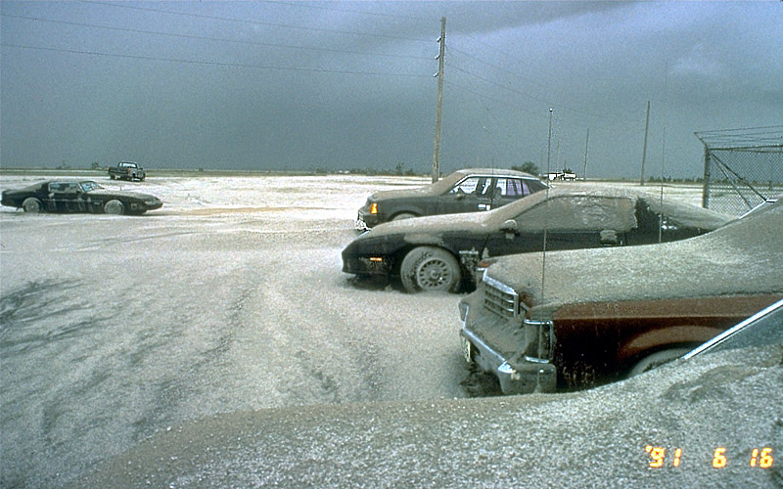
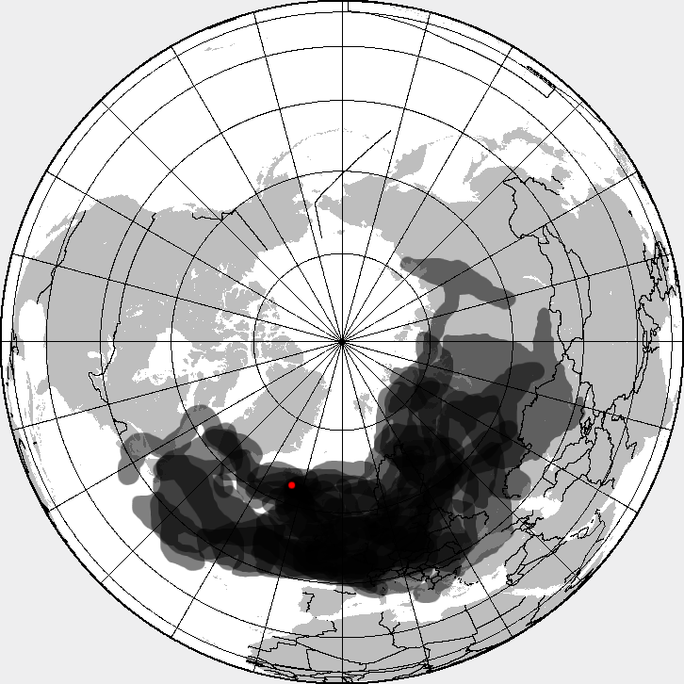
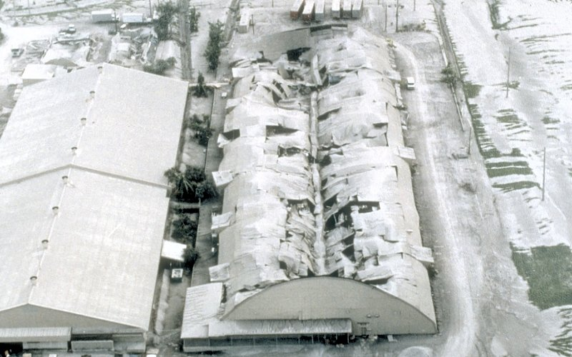
Volcanic Ash
Volcanic Ash
Cause roofs to collapse
Get in people’s lungs
Damage crops, cars and machinery
Cause airplanes engines to stop working
Blown by the wind
Can spread across the globe!
http://earthref.org/SCC
Scripps Classroom Connection
Notes:
Notes:
The top two pictures are the results of volcanic eruptions with ash causing a roof to collapse and ash covering cars in a parking lot. The bottom picture is an image of Europe in 2010 and the spread of volcanic ash from the April 2010 Eyjafjallajokull volcanic eruption. The red dot in the picture is the location of the volcano, the black areas show the dispersion of volcanic ash after the eruption.
The bulleted list highlights the negative effects of ash from volcanic eruptions including some global implications.
Volcanic ash is made of rock dust which is denser than the ash from burnt wood or paper, as a result, when it is wet it is particularly dangerous and the weight can damage roofs. If there is enough ash material, roofs can collapse.
The fine particles from volcanic ash can cause breathing problems if inhaled. This is an issue both during an eruption, and afterwards when ash is lying on the ground. Wind and clean-up efforts may also kick ash into the air, so it is possible for volcanic ash to affect human health long after an eruption.
Ash can bury crops and cover the leaves, preventing sunlight from reaching the plants.
Fine ash particles can infiltrate mechanical parts, causing problems for cars and other machinery
Volcanic ash particles are sharp, angular grit made of cooled lava. When airplanes fly through an ash cloud the fine particles act like a sandblaster, wearing down turbine blades, windows and the fuselage. When ash is heated inside an airplane engine, the ash melts and recools inside the engine, restricting airflow and causing the engine to stall. The Eyjafjallajokull eruption in Iceland in April 2010 caused an 8 day uninterrupted shutdown of European airspace, and affected air travel for several weeks afterwards. The cloud of ash lifted high into the atmosphere and was spread over Europe by the jet stream. Reference the lower picture on this slide showing the extent of volcanic ash spread.
If an eruption is large enough, volcanic ash will reach the upper atmosphere and can be carried for thousands of miles, possible causing respiratory issues and affecting air travel. Large amounts of ash in the atmosphere can also cause cooler weather. In these instances, the high volume of ash particles act as a sun shade, blocking the Sun’s rays and preventing them from reaching the Earth’s surface.
Image credits from the U.S. Geologic Survey-
Cars in Ash: http://volcanoes.usgs.gov/hazards/tephra/index.php
Collapsed Roof: http://volcanoes.usgs.gov/ash/build/index.html
Other image:
Ash Map, from wikipedia, http://upload.wikimedia.org/wikipedia/commons/b/b1/Eyjafjallajökull_volcanic_ash_composite.pn
4

Slide 5
Volcaniclastic Rocks
Volcaniclastic Rocks
Ash
Lapilli-pea sized
Blocks and bombs-anything larger than lapilli
Fall violently to the ground
Hurt people
Damage buildings and roads
Affected by wind direction
http://earthref.org/SCC
Scripps Classroom Connection
Notes:
Notes:
This slide has a picture of volcanic bombs. The bulleted list illustrates the hazards associated with volcaniclastic rocks ejected into the air during eruptions and then falling to the ground.
Volcaniclastic rocks fragments are called different names depending on the size of the material. Ash, is the smallest size material, < 2mm. Lapilli is anything 2-64 mm in diameter, roughly pea to baseball sized chunks. Anything larger than lapilli is referred to as volcanic bombs.
The major hazards are impacts from the falling material. Volcanic bombs can hurt people, damage building and cars, as well as infrastructure. In some Japanese cities, people keep hard hats in their safety kits to protect against falling debris
The distribution of volcanic fall-out is greatly affected by wind direction. Volcanic ash and lapilli are more affected and are more likely to be blown in the primary wind direction. These smaller fragments will also travel the furthest distance from the volcanic center
Image from Wikipedia, http://en.wikipedia.org/wiki/File:VolcanicBombMojaveDesert.JPG
5

Slide 6
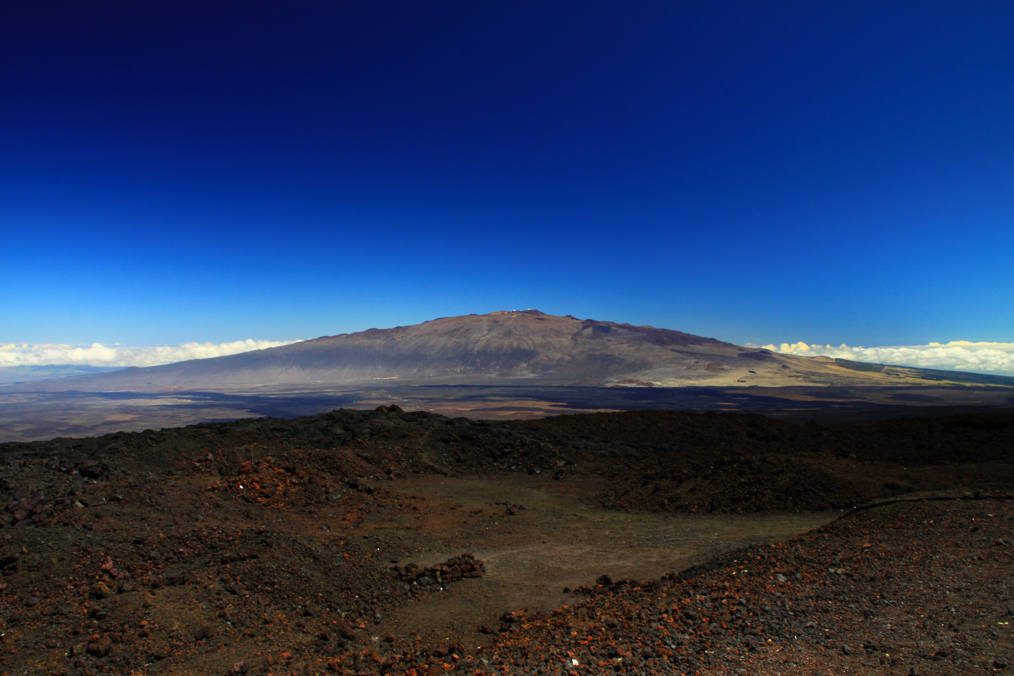
Shield Volcano Hazards
Shield Volcano Hazards
Lava flows
Hydrovolcanic explosions
Gasses
Earthquakes
http://earthref.org/SCC
Scripps Classroom Connection
Notes:
Notes:
This slide is an outline of the volcanic hazards associated with Shield volcanoes. Lava flows are the only hazards unique to shield volcanoes. Volcanic gasses and earthquakes are common to both shield volcanoes and stratovolcanoes.
Image is of the Mauna Kea shield volcano on Hawaii.
Image from Wikipedia, http://en.wikipedia.org/wiki/File:Mauna_Kea_from_Mauna_Loa_Observatory,_Hawaii_-_20100913.jpg
6

Slide 7
Kilauea Lava Flow, 2010
Lava Flows
Hot! > 1000° C
Burns roads, buildings, farms
Can travel more than 30 miles
Can bury towns in 6 ft. of lava
Cause forest fires
Don’t flow very fast, people usually get out of the way
http://www.youtube.com/watch?v=xiYzYaLM-hQ
http://earthref.org/SCC
Scripps Classroom Connection
Notes:
Notes:
This slide shows a video of a lava flow riding passing over a road in Hawaii and provides details about lava flows as a volcanic hazard.
The youtube video is 2:30 minutes long and shows a slow moving lava flow crossing over a rural Hawaiian road (lava flows can be much faster than this). The lava is moving slowly in the video because it is likely some distance from the volcanic center and has cooled. The vegetation around the road catches fire due to the still intense heat of the lava flow. Note the smoke and gas from the burning vegetation, the dry sections of the road where the heat from the lava has evaporated water from a recent rainstorm. The sounds you can hear are all natural from the lava flow moving. Important to note how the lava flow covers the road, blocking any access, including emergency vehicles. The second half of the video is from another section of the lava flow, showing faster moving, hotter portions of the flow. The ropey texture of the flowing lava is typical of pahoehoe lava flows which have low viscosity.
Lava flows erupt from volcanoes at temperatures in excess of 1000 C. These temperatures decrease with time and distance from the volcanic center but remain dangerous to people, vegetation and buildings. Lava flows generally take several weeks to cool completely.
Lava flows burn plants, buildings and infrastructure. Flows can cover roads, destroy power lines and other means of communication, limiting access for residents and emergency vehicles. Crews will need to wait for the lava flows to cool before repairing roads.
Highly effusive volcanoes with a large magma supply and low viscosity, can have lava flows that extend for 10s of miles. This can cause problems for population centers that might seem safe from effusive eruptions.
Lava flows can be several meters high, and once they reach cities and towns can cover entire areas in several feet of lava. This renders buildings, and roads useless.
In densely wooded areas, lava flows can ignite forest fires which presents a whole new set of hazards to infrastructure and people.
Although lava flows from shield volcanoes can affect population centers tens of miles away, lava flows are generally slow enough that their paths can be predicted and people will be able to evacuate in time. Earthquakes also provide an early indication of volcanic activity, alerting scientists and authorities to the probability of a volcanic eruption.
Video from, http://www.youtube.com/watch?v=xiYzYaLM-hQ
7

Slide 8
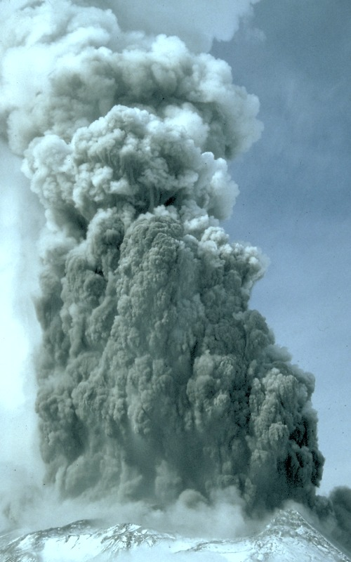
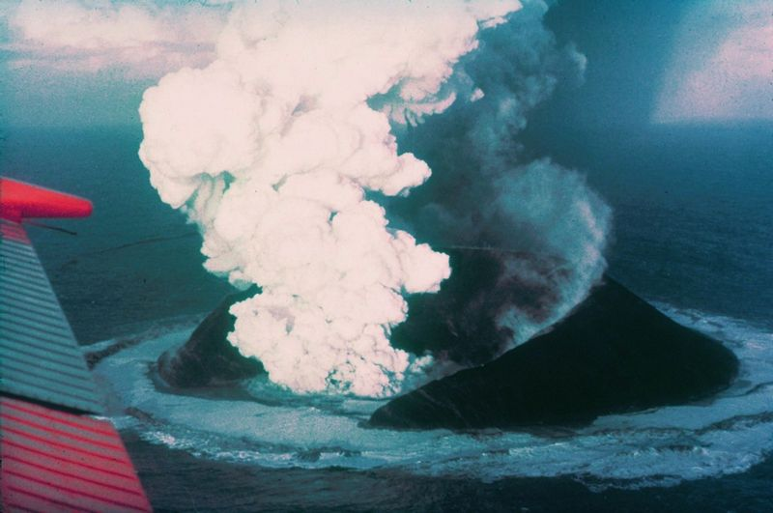
Hydrovolcanic Explosions
Hydrovolcanic Explosions
Water turns into steam
Steam pressure blasts volcano apart
Volcaniclastic rocks are thrown
Hot water and steam can burn
Notes:
Notes:
This slide shows an image of hydrovolcanic eruptions from Mt. St. Helens, left, and Surtsey, right. The bulleted list covers some of the hazards associated with hydrovolcanic eruptions.
Blast from steam pressure explosion is dangerous in itself, flattening trees, infrastructure and causing death to anyone nearby
The threat from volcaniclastic rocks is the same as in stratovolcanoes
The additional steam and hot water from the eruption (like in the Surtsey image) can cause burns and death.
Left Image from Wikipedia, http://en.wikipedia.org/wiki/File:Phreatic_St._Helens.jpg
Right image from Wikipedia, http://en.wikipedia.org/wiki/File:Surtsey_eruption_1963.jpg

Slide 9
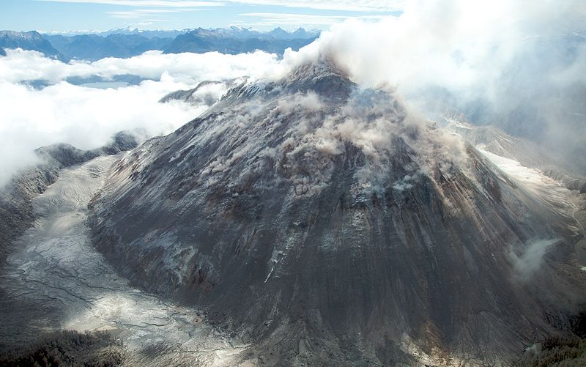
Volcanic Gasses
Gasses
Sulfur dioxide, carbon dioxide, hydrogen sulfide, water vapor
Asphyxiation from lack of oxygen (CO₂)
Rotten egg smell (SO₂)
Other poisonous gasses
Dangerous if inhaled
http://earthref.org/SCC
Scripps Classroom Connection
Notes:
Notes:
This slide shows an image of volcanic gasses escaping from the Chaiten Volcano . The bulleted list names several gasses that can be harmful to humans and their effects.
Sulfer dioxide, carbon dioxide and hydrogen sulfide and water vapor are four of the most common gasses exuded during volcanic eruptions. Gas often accompanies lava and ash, but can also erupt alone.
Carbon dioxide can cause asphyxiation by physically taking the place of breathable oxygen. This is most dangerous when CO₂ is erupted with no accompanying ash or lava. There may be no indication of an eruption, and the gas can travel and asphyxiate entire villages.
Sulfur dioxide is very poisonous and gives off a smell of rotten eggs
Other gasses can be poisonous if inhaled, in addition to the often extremely high temperatures at which they are extruded. Volcanologists often wear gas masks, among other safety equipment, when working near volcanic vents and craters.
Image from Wikipedia, http://en.wikipedia.org/wiki/File:Volcán_Chaitén-Sam_Beebe-Ecotrust.jpg
9

Slide 10
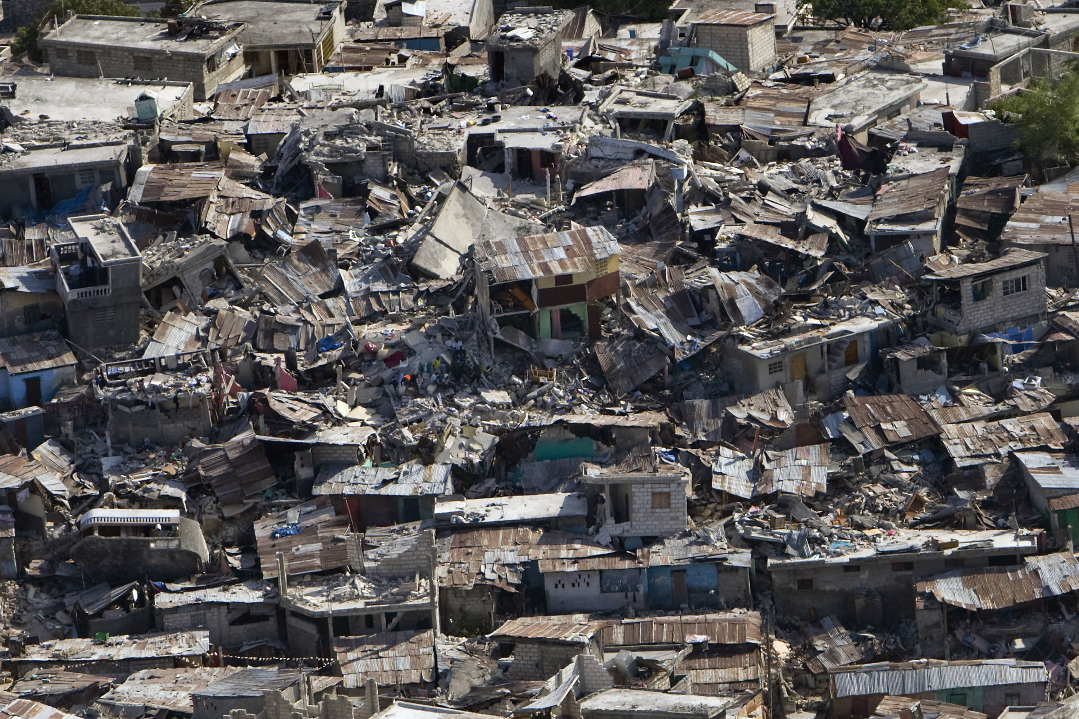
Earthquakes
Earthquakes
Most eruptions accompanied by earthquakes
Used to predict when an eruption might happen
Can trigger landslides and tsunamis
Destroy buildings, dams, roads
http://earthref.org/SCC
Scripps Classroom Connection
Notes:
Notes:
This slide details some of the hazards associated with earthquakes that may coincide with volcanic activity.
The image on this slide shows damage from the 2010 Haiti earthquake (which was not from a volcanic eruption, the image is simply an example)
Active volcanoes generally trigger small earthquakes as a result of the movement of magma underground that breaks the surrounding rock.
An increase in seismic activity near a volcano is one sign that geologists use to predict volcanic eruptions
Although the volcanic eruption itself is likely to be more of a concern to public safety, earthquakes can still pose a risk. Earthquakes can trigger landslides and tsunamis as well as possibly damaging roads, dams, buildings and other infrastructure.
Earthquakes associated with volcanism are generally small, all major earthquakes are due to interactions between tectonic plates and the breakage of rocks
Image from Wikipedia, http://en.wikipedia.org/wiki/File:Haiti_earthquake_damage.jpg
10

Slide 11
Conclusions
Volcanic hazards vary depending on volcano type
Stratovolcanoes
-Pyroclastic Flows and Lahars
-Volcaniclastic rocks
-Volcanic Ash
Shield Volcanoes
-Lava Flows
Both
- Hydrovolcanic explosions
- Volcanic Gases
- Earthquakes
Notes:
Notes:
The take away message is that volcanic hazards depend on the specific volcano type. The bulleted list above highlights the major hazards associated with stratovolcanoes and shield volcanoes. Keep in mind that these are the hazards that are GENERALLY seen at these volcanoes, there is always variation in natural disasters.
Pyroclastic flows and lahars flatten almost everything in their path and can travel great distances from the volcano (up to 100 miles). Pyroclastic flows have the additional threat of being superheated
Volcaniclastic rocks are erupted into the air and will crash down to Earth, sometimes several miles away. Volcanic bombs and lapilli are likely to cause injury and damage buildings
Volcanic ash poses a health hazard to humans, can damage crops, cause airplanes and machinery to malfunction. The size of volcanic ash allows it to spread large distances, in 2010 ash from a volcano in Iceland shut down air travel over Europe for several weeks.
Lava flows can destroy homes, infrastructure, cause wildfires and death
Hydrovolcanic explosions are violent eruptions and the blast can flatten and destroy anything nearby
Volcanic gasses are poisonous to humans and can be superheated
Earthquakes, although small when associated with volcanoes, can cause landslides and tsunamis
Volcanoes pose a real danger to human populations. The majority of the volcanoes above ground are stratovolcanoes, explosive, and are often near population centers. It is important to study and monitor all active volcanoes and warn the public of the potential hazards they may face if an eruption is imminent.
An activity is designed to follow this presentation. Student handout for this activity is titled “Hazards_House_Activity”. Instructions for the lesson are found in the document titled “Hazards_Activity_Instructions”.

