Slide 1
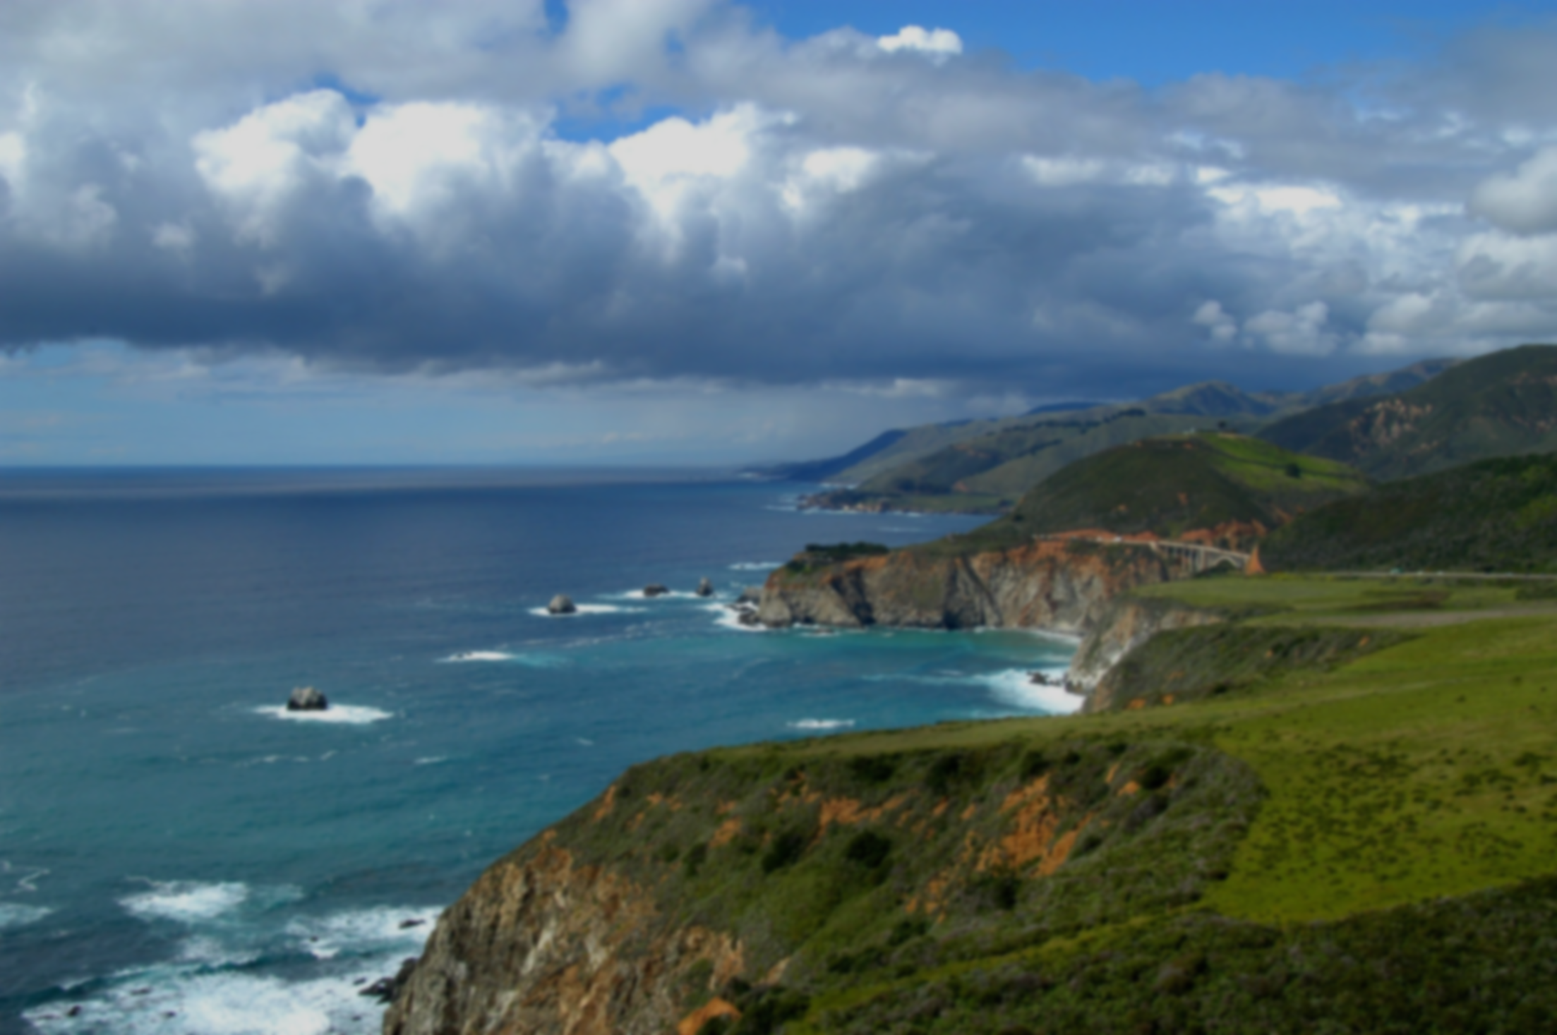
Global Carbon Cycle &
Computer Activity
Notes:
Authors: Sean Walstead, Scripps Institution of Oceanography; Alison Dickens, Lincoln High School, San Diego Unified District.
WHY : The carbon cycle is the biogeochemical cycle by which carbon is transferred between the biosphere, geosphere, hydrosphere, and atmosphere. A place where carbon is stored is known as a reservoir or pool while the exchange of carbon between reservoirs is known as a flux. The pathways by which carbon is transferred are specific to which reservoirs are exchanging carbon. Carbon-based molecules are the main component of biological compounds. Carbon dioxide in the atmosphere is a greenhouse gas and is the most important human-contributed greenhouse gas.
SUMMARY: In this activity students will be given a brief introduction to the carbon cycle and then will individually (or in pairs) play “The Carbon Cycle Game” on computers. While they are playing the game, they will be completing an associated worksheet. Most answers to the worksheet questions are found in the descriptive text provided while playing the computer game. The goal here is to understand that carbon exists in many forms and in many places. Students should be able to recognize pathways in the carbon cycle and be able to identify the pathways that humans play a direct role in.
PICTURE CREDIT: http://www.earthgauge.net/wp-content/uploads/2012/05/ocean2.jpg
WEBSITES USED IN THIS PRESENTATION: Worksheet adapted from Biogeochemistry Unit by K. Row and M. Quessenbery on SCC Classroom Connection website http://earthref.org/SCC/lessons/2010/biogeochemistry/, computer game activity by Lisa Gardiner and Julia Genyuk http://www.windows2universe.org/earth/climate/carbon_cycle.html distributed by the National Earth Science Teacher Association (NESTA http://www.nestanet.org/cms/content/welcome )
ADDITIONAL READING: Carbon Cycle Interactive Game additional information http://www.windows2universe.org/teacher_resources/teach_carbongame.html, General carbon cycle info http://en.wikipedia.org/wiki/Carbon_cycle, Detailed role of biology in carbon cycle http://dilu.bol.ucla.edu/home.html
CONTEXT FOR USE: This lesson is designed for a high school chemistry class. It is the first in a sequence of 5 lessons aimed at covering interactions between the ocean and atmosphere. Although students have most likely encountered the material in this lesson in another science class, the idea is to get students thinking about chemistry in a broad Earth system context.
MISCONCEPTIONS:
Fossil fuels are formed from the fossils of dead organisms.
The only form of carbon in the carbon cycle is carbon dioxide.
8.EVALUATION TIPS: Students will be completing and turning in the associated worksheet with the computer activity.
9.TEACHING NOTES:
Present PowerPoint lesson on the global carbon cycle.
Pass out worksheets to students and assign students to a computer.
Instruct students to complete their worksheets while playing the computer game.
If time permits, review answers to the students worksheet.

Slide 2
What is the carbon cycle?
The carbon cycle is the biogeochemical cycle by which carbon is transferred between the biosphere, geosphere, hydrosphere, and atmosphere.
Notes:
The goal here is to introduce the definition of carbon cycle.
1.) Ask students to volunteer their definition of the carbon cycle.
2.) Once several students have answered, reveal the definition box in the slide. Answer: The carbon cycle is the biogeochemical cycle by which carbon is transferred between the biosphere, geosphere, hydrosphere, and atmosphere.
3.) Ask students to come to the projection and point out in turn, the biosphere, the geosphere, the hydrosphere, and the atmosphere. Discuss the root-words in each of those terms.
Bio- relates to life. The carbon in the biosphere makes up plants and animals. Geo- relates to Earth. Only the very outermost portion of the geosphere is exposed in this picture. It is the edge of the cliffs. Most of the geosphere exists below ground. Top soil is included in the biosphere because it typically contains bacteria and other living things. Hydro- relates to water. This includes the ocean and water vapor in the atmosphere. Atmosphere relates to the sky. Although not visible to the human eye, the atmosphere is composed of many gaseous molecules, many of which contain carbon.
Additional information: the biosphere is the sum of all ecosystems, the portion of the biosphere depicted here are trees and grass. However there are also organisms too small to see in this photo that belong to the biosphere such as plankton, fish, insects, birds, and small animals.
The geosphere refers to the densest parts of Earth, which consist mostly of rock and regolith. The geosphere consists of the inside of the Earth. Technically the geosphere is not visible in this photo, although the materials that make up the rocks and exposed dirt in the picture are the same materials that constitute the geosphere.
The hydrosphere is the combined mass of water found on, under, and over the surface of the planet. Both the ocean water and the clouds in the atmosphere are part of the hydrosphere. The total mass of the Earth’s hydrosphere is about 0.023% of the Earth’s total mass. The fraction of the hydrosphere that is in the Earth’s atmosphere is about 1.4 x 10^(-5).
The atmosphere is the layer of gases surrounding the plant that is retained by Earth’s gravity. The atmosphere is composed primarily of nitrogen (78%), oxygen (20%), and argon (1%). Carbon dioxide presently makes up 0.035% of the atmosphere.

Slide 3
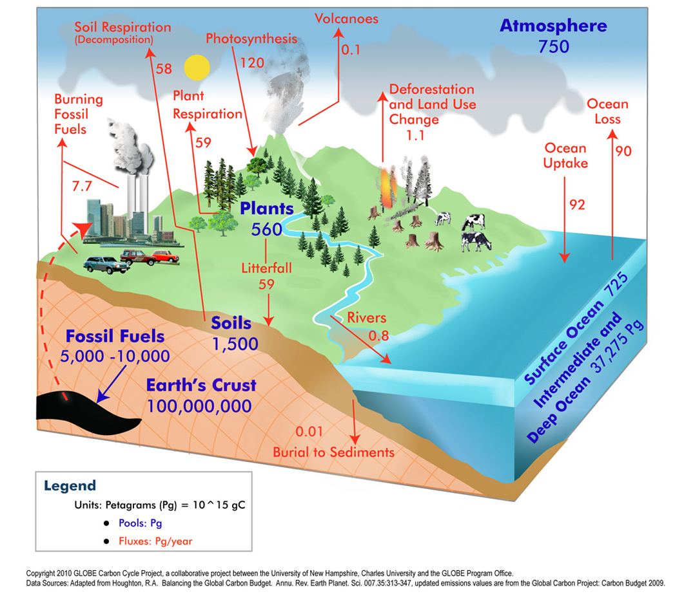
Global Carbon Cycle
Notes:
Although students have probably seen the carbon cycle before, this slide details some of the processes involved in the carbon cycle more specifically. The goal here is to show that there are discrete pathways through which carbon flows. The computer activity following this presentation will ask them to follow a carbon atom through various reservoirs of the carbon cycle. First identify that the text in blue refers to carbon reservoirs. This is where carbon is stored. Amounts of carbon in each reservoir are given in petagrams.
Highlight the carbon flux between the ocean and atmosphere as that flux will be the topic of Lesson 4.
Some sample topics to address with students are listed below.
Questions to ask students w/ answers:
What are some reservoirs of carbon? Atmosphere, plants, soils, fossil fuels, Earth’s crust, surface ocean, deep ocean.
What are some common forms of carbon on Earth? Carbon dioxide (CO2), graphite/coal/diamond (pure C), methane (CH4), sugar (C6H12O6), CO3 (carbonate ion)
Are fossil fuels derived from the fossils of ancient dinosaurs? No, fossil fuels are deposits of carbon that has not been in contact with the atmosphere in more than 150 years.
What are some examples of fossil fuels? Coal, natural gas, oil. Coal is made up of pure carbon, the same as diamond, however it has not been compressed and heated enough to form diamond.
By what process does the ocean uptake and lose carbon? Carbon in the form of gaseous carbon dioxide diffuses in and out of the ocean (due to the direct contact of ocean and atmosphere). This is possible because carbon dioxide gas is soluble in sea water.
What is the process by which plants uptake carbon from the atmosphere? Photosynthesis
What is the balanced chemical equation for photosynthesis? 6CO2 + 6H2O -> C6H12O6 + 6O2
If plants remove carbon from the atmosphere during photosynthesis, what is meant by the flux depicted as Plant Respiration which delivers carbon to the atmosphere? Plants make sugar from sunlight, carbon dioxide, and water, however they also respire some of that sugar as the plants grow.
Why is the surface ocean considered a separate reservoir of carbon from the deep ocean? The surface ocean receives sunlight (photic zone) and can support populations of photosynthetic phytoplankton. As they organisms perform photosynthesis, carbon is taken out of the surrounding water and subsequently replaced by more atmospheric CO2 dissolving into the water. As the photosynthetic phytoplankton die, they are either respired by other organisms or fall to the bottom of the ocean (marine snow) and are buried to the sediment layer below.
Which of the fluxes in red can humans influence in order to reduce the amount of greenhouse gases in the atmosphere? Burning fossil fuels and deforestation are two carbon fluxes that humans can hope to manipulate in order to control carbon dioxide levels in the atmosphere.
Photo credit: http://www.nasa.gov/topics/nasalife/features/globe-workshop.html

Slide 4
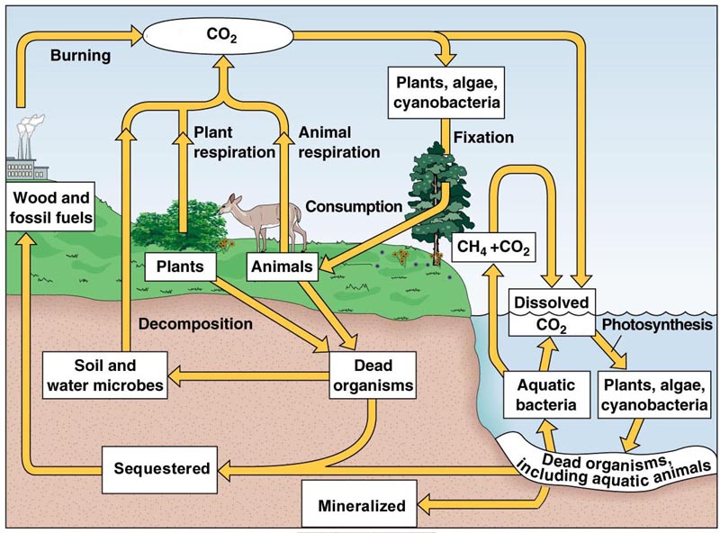
Global Carbon Cycle
Notes:
The purpose of this slide is to highlight some of the marine processes that are part of the carbon cycle. You should highlight the difference between surface ocean processes and deep ocean processes.
At the ocean surface CO2 enters from the atmosphere by direct dissolving or by becoming trapped as gas bubbles in breaking waves. Once dissolved in the upper ocean, phytoplankton (listed as “plants” in the diagram) perform photosynthesis which takes carbon out of the water column and into the phytoplankton cells. Other zooplankton (heterotrophs) eat the phytoplankton. Larger zooplankton eat the smaller zooplankton and so forth up the food chain. Eventually those organisms die and may sink to the deep ocean before being totally respired by aquatic bacteria. Once at the seafloor, those dead organisms may be buried and mineralized into sediment (part of the geosphere).
In relation to the previous diagram which separated the carbon reservoirs of surface ocean and deep ocean, highlight the fact that photosynthesis can only occur in the photic zone (where light exists) of the ocean (approx. upper 100 m).
Allude to the fact that in later lessons, the exact mechanisms by which carbon is transferred from the atmosphere to the ocean will be discussed in detail. This is the reason for introducing that carbon flux here as part of a larger picture on the carbon cycle.
A side note that may be interesting to students is that plants not only fix carbon dioxide from the atmosphere, but they release it during respiration when plants grow.
Photo credit: http://www.smccd.edu/accounts/case/BIOL675_energy/carboncycle.html

Slide 5
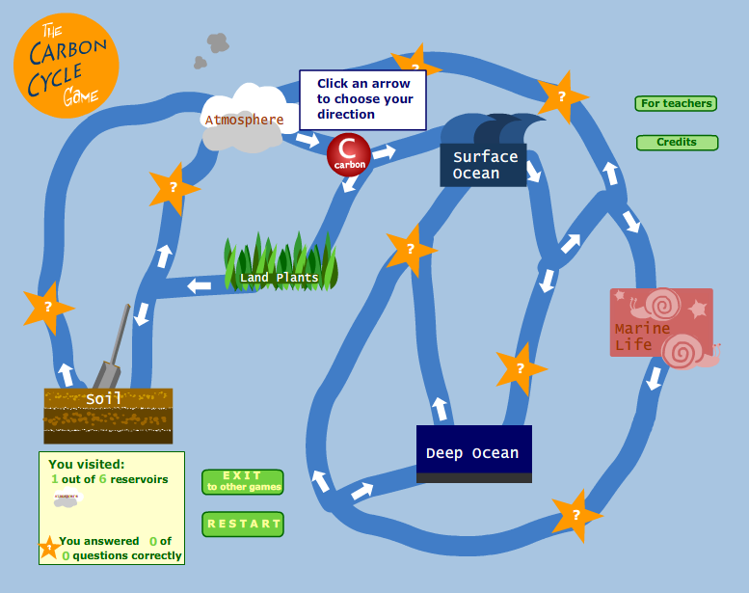
Carbon Cycle Game
Go to this URL in your web browser to start the Carbon Cycle Game
http://www.windows2universe.org/earth/climate/carbon_cycle.html
Notes:
Directions: The web address leads to the Carbon Cycle Game. Instruct students to complete the associated worksheet as they play The Carbon Cycle Game.

Slide 6
Conclusions
Carbon exists on earth in major reservoirs
Carbon is transferred in discrete pathways
Surface ocean vs. deep ocean
Ocean-atmosphere carbon transfer
Notes:
This lesson is meant to reintroduce the global carbon cycle. Students up at this point in their chemistry class have probably been focusing on atomic structure and chemical bonding. However the next few lessons will focus on chemistry in an Earth systems context, so a review of the global carbon cycle is appropriate.
Carbon can be classified to exist in several major reservoirs on Earth including fossil fuels, plants, soils, atmosphere, surface ocean, deep ocean, and the Earth’s crust. Carbon dioxide is just one of the many forms of carbon in the global carbon cycle. The focus however of the remaining 4 lessons in the Air-sea interactions unit will be on carbon dioxide.
Carbon is transferred in discrete pathways between reservoirs. Obviously carbon can not be transferred between the deep ocean and atmosphere. The pathway will depend on which reservoir carbon is transferring between. The flux value of carbon between ocean and atmosphere is only roughly estimated. Methods for estimating that flux will be the focus of lesson 4.
The surface ocean is a much more dynamic place in terms of the carbon cycle because of the presence of sunlight. Sunlight is mostly absorbed by 100 m depth. This means that photosynthetic organisms only exist in the surface ocean. The deep ocean is characterized by “marine snow” or falling biological material from dead organisms.
The focus of the next few lessons will be on carbon transfer between the ocean and atmosphere

