Slide 1
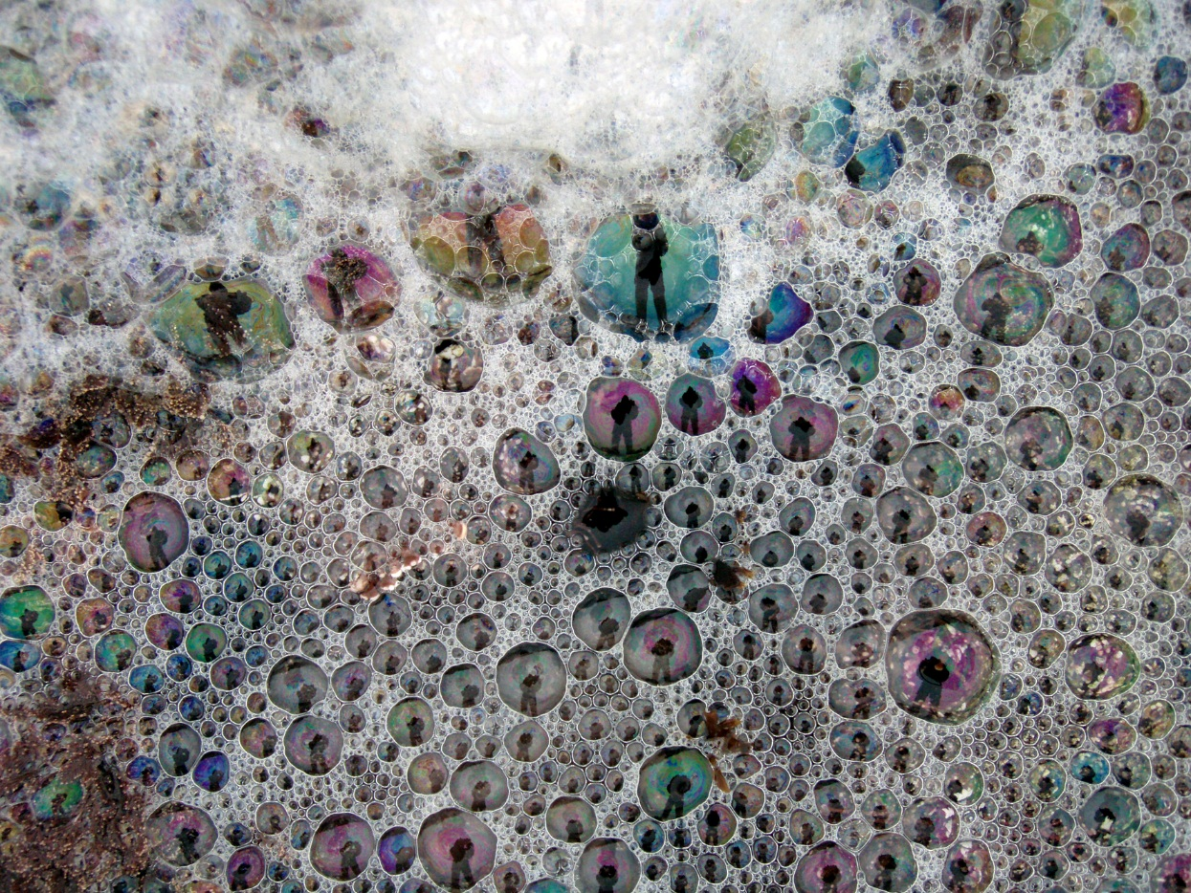
Surface Tension, Surfactants, and Sea Foam: Day 1
Notes:
Authors: Sean Walstead, Scripps Institution of Oceanography; Alison Dickens, Lincoln High School, San Diego Unified District.
WHY: Surface tension is a property of liquids that causes the surface of a liquid to contract. Because of hydrogen bonding in water, its surface tension is very high. The effects of water's high surface tension can be seen all around us. Bubbles form more easily in a solution with lowered surface tension. The lowered surface tension allows air to separate the molecules forming a bubble wall and allows the bubble to expand. Surfactants in the ocean lower the water’s surface tension and increases sea foam persistence. Increased sea foam leads to increased bubble-mediated gas exchange between the ocean and atmosphere and increased marine aerosol production leading to cloud formation.
SUMMARY: In this 2-day lesson, students will learn about surface tension, surfactants, sea foam, and cloud nucleation through 2 PowerPoint lessons, 2 short demos, and 1 lab activity. The worksheets that accompany each PowerPoint lesson can either be used to guide conversation or finished as a homework assignment. In the first demonstration, fresh water and soapy water are agitated and differences are noted. This opening demo is meant to set the tone for the lesson. The second short demonstration investigates surface tension and asks students to try and fit as many drops of water on a penny as possible. The main activity investigates the effect of glycerin on bubble size and life span. During Day 2, data from the lab activity will be shared as a class between student groups. The remainder of the instruction period will be dedicated to a lesson surfactants, sea foam, and cloud nucleation.
PICTURE CREDIT: http://commons.wikimedia.org/wiki/File:Plankton_creates_sea_foam_3.jpg
WEBSITES USED IN THIS PRESENTATION: Day1: http://hyperphysics.phy-astr.gsu.edu/hbase/surten.html, http://en.wikipedia.org/wiki/Surface_tension
ADDITIONAL READING: Day 1: N/A. Day 2: Quinn, Bates, “The case against climate regulation via oceanic phytoplankton sulfur emissions”, Vol. 480 Nature, 2011. (included as pdf on SCC website)
CONTEXT FOR USE: This lesson is designed for a high school chemistry class. It is the second lesson in a sequence of 5 lessons aimed at covering interactions between the ocean and atmosphere. This presentation is for Day 1 of Lesson 2.
MISCONCEPTIONS: Day 1:
Objects that are supported by surface tension on the surface of a liquid are floating.
8.EVALUATION TIPS: Day 1: The Soapy and Sticky Bubbles activity requires about 25-30 minutes of classroom time. Data collection will be finished on Day 2 once data is shared as a class between student groups. Evaluation consists of a completed worksheet from both Day 1 and Day 2 and a completed lab worksheet.
9.TEACHING NOTES: Day 1: Use this PowerPoint lesson to introduce the concept of surface tension. Students will answer questions on the accompanying worksheet Lesson2_Day1_Worksheet.doc. Cartoon bubble graphics will appear throughout the presentation instructing students when to answer each question. At the end of this PowerPoint, students will perform the “Drops on a penny” demonstration. The surface tension PowerPoint and penny demo should take approximately 15 minutes. The remainder of class should then be dedicated to the Glycerin Bubbles activity.
10.TEACHING INSTRUCTIONS: Day 1:
-Have the Soapy Water demonstration setup prior to students entering the classroom.
-Teach the Day 1 lesson on surface tension. (15 min)
-Perform the Drops on a Penny Demo at the end of the Day 1 lesson. (5 min)
-Perform the Soapy and Sticky Bubbles activity. (25-30 min)

Slide 2
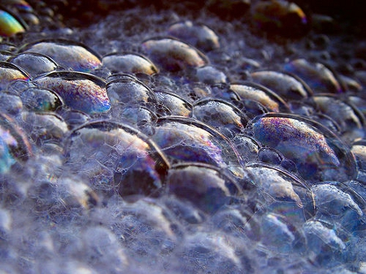
I. Demonstration – fresh water vs. soapy water
Answer question #1 now
Notes:
Directions: Fill two large beakers with water. To one of the beakers add some dish soap. Agitate both beakers of water with a mixing stick. Have students describe the similarities and differences when soapy water is agitated vs. fresh water.
Additional notes: Soap in the water is a surfactant that lowers surface tension. The lowered surface tension of the soapy water allows more bubbles to form and persist longer. Although surface tension is lowered, it is still present in the soapy water and this is why the bubbles are mostly spherically shaped.
Worksheet question 1: Describe the similarities and differences when soapy water is agitated vs. fresh water.
Answer: Small bubbles are formed in the fresh water when agitated, however they quickly rise to the surface and pop. Many more bubbles are formed when the soapy water is agitated. After the soapy water is agitated, bubbles remain on the surface of the liquid while the fresh water has very few or no bubbles on its surface when agitation is stopped.

Slide 3
II. Surface tension
Notes:
What did we learn in the opening demonstration (Sec. I)? Soap in the water lowers surface tension. The lowered surface tension of the soapy water allows more bubbles to form and persist longer. Although surface tension is lowered, it is still present in the soapy water and this is why the bubbles are mostly spherically shaped.
Now the rest of the class, we will focus on surface tension. You will see the headings at the top of each slide. Tomorrow’s lesson will be more diverse and talk about ocean surfactants, sea foam, cloud nucleation, and some ocean technology.
Tell the students that the headings on each slide will remind them which portion of the lesson they are in.
Discuss how yesterday’s lesson on the carbon cycle is related to surface tension. Surface tension has a big effect on the carbon cycle by allowing bubbles to form in the ocean (just like in the demonstration) and will affect how gas transfers from the atmosphere to the ocean. Before we talk about how surface tension plays a role in the ocean, however, this lesson is dedicated to entirely understanding surface tension as a physical property.

Slide 4
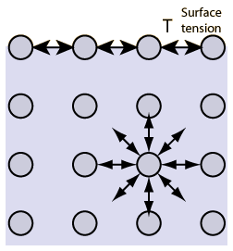
II. Surface tension
The cohesive forces between molecules down into a liquid are shared with all neighboring atoms. Those on the surface have no neighboring atoms above, and exhibit stronger attractive forces upon their nearest neighbors on the surface. This enhancement of the intermolecular attractive forces at the surface is called surface tension.
Notes:
This slide introduces the concept of surface tension. Most students will be unfamiliar with this concept. Students will need to thoroughly understand this slide before moving on. The next few slides will ask the students to apply their new understanding of surface tension. Ask questions and make sure students are all in agreement.
Individual molecules are represented by circles in the diagram. If for instance, the liquid shown above is water, the intermolecular forces between molecules are dominated by hydrogen bonding. This results in water having very high surface tension. However, intermolecular forces are present in all types of liquids even if hydrogen bonding is not present. An example of weak attraction between molecules is in isopropyl alcohol. The alcohol still exhibits surface tension, but not to the extent that pure water does.
Additional information:
This is might good opportunity to review with students the difference between covalent bonds, hydrogen bonds, dipole-dipole bonds, and London (van der Waals) forces.
covalent bonds – sharing of pairs of electrons between atoms.
hydrogen bonds – the attraction between the lone pair of an electronegative atom and a hydrogen atom that is bonded to either nitrogen, oxygen, or fluorine
dipole-dipole bonds – electrostatic interactions of permanent dipoles in molecules
London dispersion force – attractions/repulsions of quantum-induced instantaneous polarization caused by correlated movements of the electrons in interacting molecules
Photo credit: http://hyperphysics.phy-astr.gsu.edu/hbase/surten.html (2012)

Slide 5
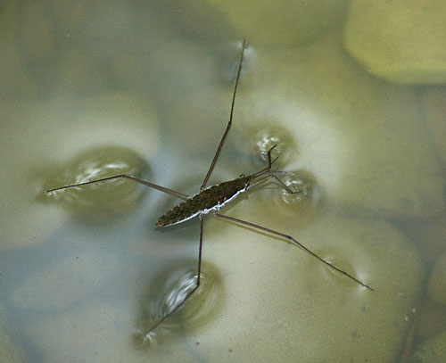
II. Surface tension
For the figure below, describe what is happening and where the effects of surface tension can be seen.
Answer question #2 now
Notes:
Now the students will have a chance to see surface tension in action. This slide should be treated more as a guided discussion about where the effects of surface tension can be seen. The next slide will have 5 examples of surface tension for the students to describe without teacher assistance.
Additional notes: Surface tension has the dimensions of force per unit length or as energy per unit area. The answer uses the term weight instead of mass when describing the insect. It is appropriate to compare the force due to surface tension with another force such as insect weight. For instance, a small animal that would sink in water on Earth might be able to walk on water on a planet with lower gravitational acceleration because of the reduced magnitude of weight associated with that mass. Also the longer legs of the insect lowers its weight per unit length as well.
Worksheet question 2: Water strider. Describe what is happening and where the effects of surface tension can be seen.
Answer: The water strider is an insect that can walk on water. The weight of the water strider is not high enough to overcome the force of surface tension in water. If a human were to walk on water, we would sink to the bottom because our weight is strong enough to break the intermolecular forces between water molecules causing the surface tension.
Photo credit: Charles Lewallen, http://www.fcps.edu/islandcreekes/ecology/common_water_strider.htm

Slide 6
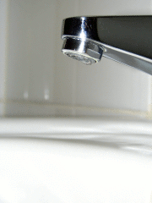
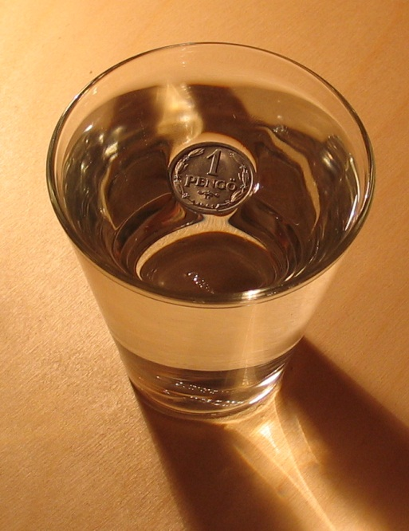
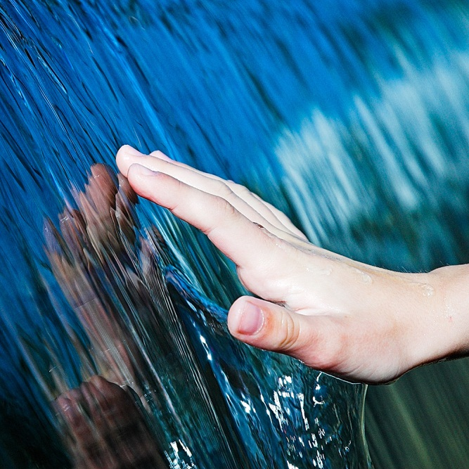

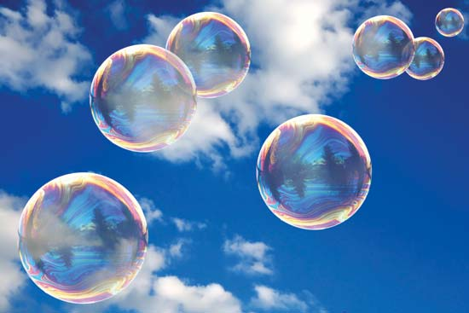
II. Surface tension
For each of the figures below, describe what is happening and where the effects of surface tension can be seen.
A
B
C
D
E
Answer question #3 now
Notes:
Worksheet question 3: For each of the figures (A-E), describe what is happening and where the effects of surface tension can be seen.
Answer:
A. The water is not streaming from the faucet, rather it is forming distinct spherical droplets.
B. The force due to surface tension of the liquid is high enough to keep the coin floating on the surface.
C. As the water runs down the hand, it forms distinct sheets and streams near the base of the palm.
D. Instead of forming a thin film, the water on the leaf beads up and forms distinct droplets of water.
E. The surface tension of the soapy solution keeps the bubbles spherically shaped.
Photo credits:
A.http://upload.wikimedia.org/wikipedia/commons/thumb/b/bd/Water_drop_animation_enhanced_small.gif/90px-Water_drop_animation_enhanced_small.gif
B. http://media-2.web.britannica.com/eb-media/71/123771-004-DC13D5ED.jpg
C. http://upload.wikimedia.org/wikipedia/commons/5/5e/SurfaceTension.jpg
D. http://www.all-hd-wallpapers.com/wallpapers/nature/376561.jpg
E. http://media-2.web.britannica.com/eb-media/19/153119-004-AF31413D.jpg

Slide 7
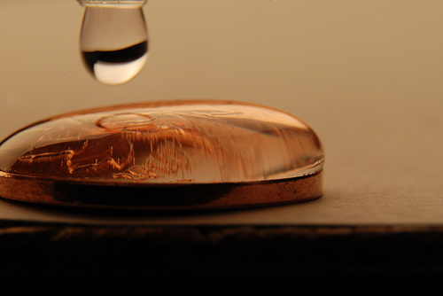
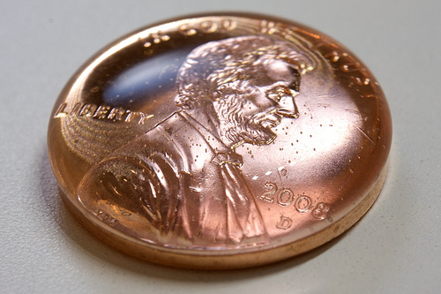
II. Surface tension
Answer questions #4 and #5 now
Drops on a Penny demo
Hypothesize how many drops of water you can fit on your penny.
Use the dropper at your table and count how many drops of water you can fit on your penny
Notes:
Directions: At this point, students should each be given a penny, a dropper, and a glass of water. Have the students hypothesize about the number of drops that can fit on a penny and then perform the demo.
Worksheet question 5: How did the water look on the penny before it spilled off? Explain how surface tension plays a role in giving the water this shape.
Answer: Before it spilled off, the water formed a round spherical shape. In fact the side of the water appeared to slightly extend over the side of the coin. Surface tension is an attractive force between liquid molecules. The high surface tension of water allows water molecules to “stick” to each other and stay on top of the coin rather than sliding off.
Photo credits:
Left: http://www.factfixx.com/wp-content/uploads/2011/06/surface-tension-water-penny.jpg
Right: http://3.bp.blogspot.com/-N2-NE8Wm4c8/UEzMbtVULYI/AAAAAAAAABc/6VnqBGu3plo/s1600/pennie+with+water.jpg

Slide 8
II. Surface tension
Drops on a Penny demo
If the water was hotter, would you be able to fit more or less drops on the penny?
Answer question #6 now
Notes:
Directions: The students at this point have not been told the explicit relationship between surface tension and temperature. In question #6 they take a guess at the relationship between surface tension, temperature, and number of drops on the penny. On the next slide, a graph shows that surface tension decreases with increasing temperature.
Worksheet question 6: If the water was hotter, would you be able to fit more or less drops on the penny? Why? Use your knowledge of surface tension to make an educated guess.
Answer: Answers here will vary, however the correct answer is given below to question #7 after the plot of surface tension vs. temperature is shown.

Slide 9
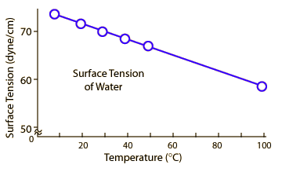
II. Surface tension
Drops on a Penny demo
If the water was hotter, would you be able to fit more or less drops on the penny?
Answer question #7 now
Notes:
The plot above shows temperature in degrees Celsius plotted on the horizontal axis and surface tension (in units of force per length) on the vertical axis. The surface tension of water is 72 dynes/cm at 25 ºC. It would take a force of 72 dynes to break a surface film of water 1 cm long. Surface tension decreases with temperature. Hot water is a better cleaning agent because the lowered surface tension allows the water molecules to better fit into cracks and grooves.
Worksheet question 7: After seeing the plot of surface tension vs. temperature, would your answer to the previous answer stay the same or change? Why? Use words like average kinetic energy, intermolecular forces and surface tension.
Answer: If the water was hotter, less drops would fit on the penny. Surface tension is responsible for holding the water molecules together instead of sliding off the coin. As the figure shows, surface tension decreases with increasing temperature. Temperature is a measure of the average kinetic energy of atoms within matter. Hotter water implies that the water molecules are moving fast past one another. This weakens the average force of hydrogen bonding between molecules because individual hydrogen bonds are being broken more frequently by faster moving molecules.
Photo credit: http://hyperphysics.phy-astr.gsu.edu/%E2%80%8Chbase/fluids/imgflu/surten3.gif

Slide 10
Conclusions
Surface tension is a cohesive force
Water has high surface tension
Temperature affects surface tension
Notes:
The purpose of this lesson is to introduce the concept of surface tension. Temperature can affect the strength of surface tension. In subsequent lessons we will see that the addition of chemicals known as surfactants can also change the strength of surface tension. Remind students that the concepts learned in this lesson will be appear again in an ocean context in the next few lessons.

Slide 11
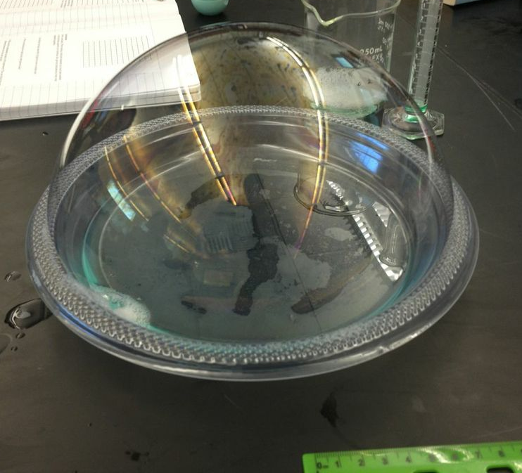
II. Surface tension
Soapy and Sticky Bubbles
Now we will perform an activity to see how dish soap and glycerin affects the properties of bubbles
Notes:
Directions: Students will now complete the Soapy and Sticky Bubble activity. That activity is found in the document Lesson2_SoapyStickyBubblesActivity_Worksheet.doc
Additional notes: The Day 2 PowerPoint contains information about surfactants and bubbles. In order to preview that lesson, you may wish to pause at this slide and talk about how dish soap enables the bubble in the picture to be formed. Surfactants are molecules that position themselves between water molecules. This results in hydrogen bonds being unable to form, which lowers surface tension. Because of lowered surface tension, a large bubble can be formed because the water molecules are able to spread apart. Despite the surface tension being lowered, surface tension still exists and the bubble has a spherical shape because of attraction between water molecules.
There is no answer key given to the activity worksheet since most of the lab involves data collection and recording. However the discussion questions can be answered with the following information. Bubbles pop when the bubble wall becomes so thin due to evaporation that a hole forms and the bubble wall collapses. Glycerin is hygroscopic, which means it is able to hold water molecules from the surrounding environment. This slows evaporation and allows the bubble to have a longer life span. Glycerin also has a high viscosity. This causes water from the bubble wall to drain more slowly off the top and slow thinning of the bubble wall. This also will increase the sticky bubble’s life span.

