Slide 1
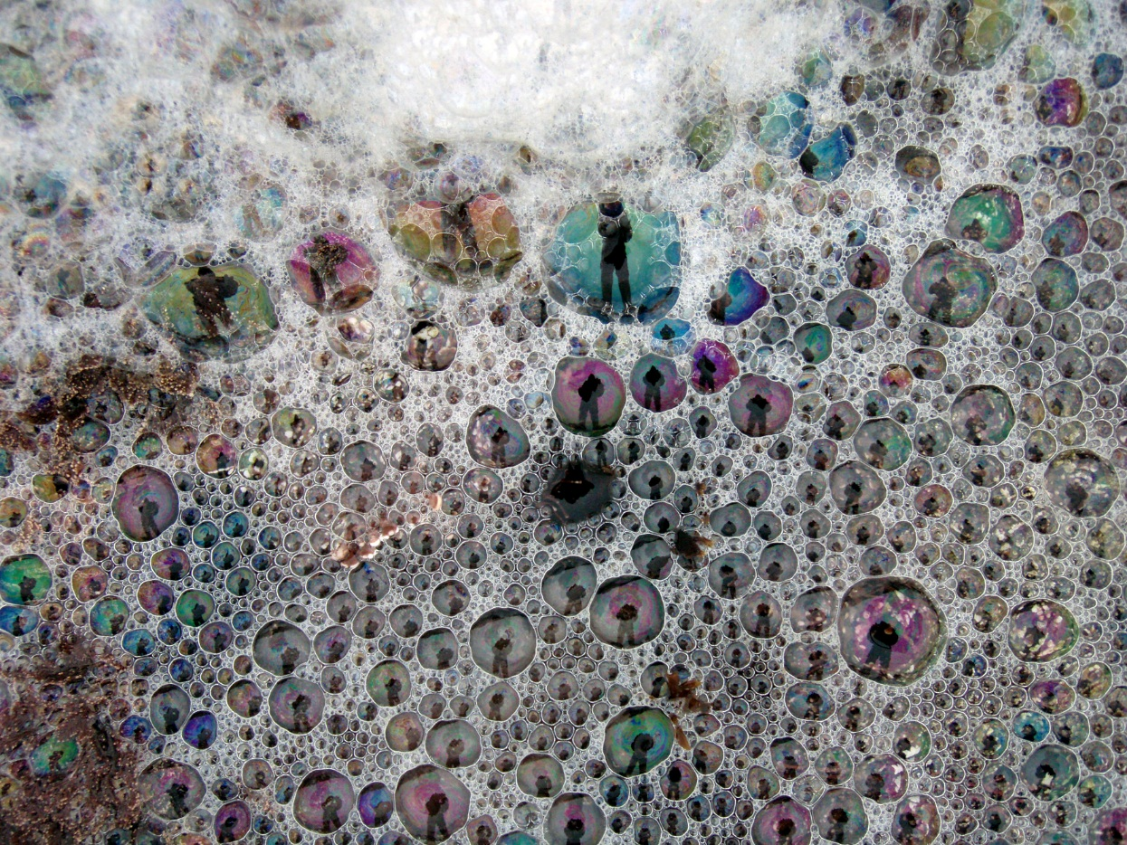
Surface Tension, Surfactants, and Sea Foam: Day 2
Notes:
Authors: Sean Walstead, Scripps Institution of Oceanography; Alison Dickens, Lincoln High School, San Diego Unified District.
WHY: Surface tension is a property of liquids that causes the surface of a liquid to contract. Because of hydrogen bonding in water, its surface tension is very high. The effects of water's high surface tension can be seen all around us. Bubbles form more easily in a solution with lowered surface tension. The lowered surface tension allows air to separate the molecules forming a bubble wall and allows the bubble to expand. Surfactants in the ocean lower the water’s surface tension and increases sea foam persistence. Increased sea foam leads to increased bubble-mediated gas exchange between the ocean and atmosphere and increased marine aerosol production leading to cloud formation.
SUMMARY: In this 2-day lesson, students will learn about surface tension, surfactants, sea foam, and cloud nucleation through 2 PowerPoint lessons (this being the second), 2 short demos, and 1 lab activity. The worksheets that accompany each PowerPoint lesson can either be used to guide conversation or finished as a homework assignment. In the first demonstration, fresh water and soapy water are agitated and differences are noted. This opening demo is meant to set the tone for the lesson. The second short demonstration investigates surface tension and asks students to try and fit as many drops of water on a penny as possible. The main activity investigates the effect of glycerin on bubble size and life span. During Day 2, data from the lab activity will be shared as a class between student groups. The remainder of the instruction period will be dedicated to a lesson surfactants, sea foam, and cloud nucleation.
PICTURE CREDIT: http://commons.wikimedia.org/wiki/File:Plankton_creates_sea_foam_3.jpg
WEBSITES USED IN THIS PRESENTATION: Day1: http://hyperphysics.phy-astr.gsu.edu/hbase/surten.html, http://en.wikipedia.org/wiki/Surface_tension
ADDITIONAL READING: Day 1: N/A. Day 2: Quinn, Bates, “The case against climate regulation via oceanic phytoplankton sulphur emissions”, Vol. 480 Nature, 2011. (included as pdf on SCC website)
CONTEXT FOR USE: This lesson is designed for a high school chemistry class. It is the second lesson in a sequence of 5 lessons aimed at covering interactions between the ocean and atmosphere. This presentation is for Day 2 of Lesson 2.
MISCONCEPTIONS: Day 2:
All surfactants are commercially produced.
Evaporation is the only mechanism responsible for cloud formation.
When a bubble bursts, only the contained air is ejected outward.
8.EVALUATION TIPS: There is a student worksheet that accompanies this PowerPoint lesson. Currently, the presentation is setup so that prompts appear throughout the slides to inform students when to answer certain worksheet questions. Instead of completing worksheets, any of the worksheet questions can be answered by brainstorming in groups and sharing ideas with the class. Students may perform think-pair-share exercises when answering the worksheet questions, use whiteboards, or simply finish the questions as homework.
9.TEACHING NOTES: Day2: Use this PowerPoint lesson to introduce the concept of surfactants and sea foam. Students will answer questions on the accompanying worksheet Lesson2_Day2_Worksheet.doc. Cartoon bubble graphics will appear throughout the presentation instructing students when to answer each question. The presentation starts with the sharing of class data from the Soapy and Sticky Bubbles activity. After computing a class average, the students should be allowed 15-20 minutes to finish the activity worksheet.
The rest of the period is dedicated to this presentation regarding surfactants and sea foam. Many of the slides in this presentation can be used as prompts to discuss the results of the Soapy and Sticky Bubbles activity. In that activity, students should notice that dish soap allows bubbles to be formed and that glycerin further extends their size and life span.
10.TEACHING INSTRUCTIONS: Day 2:
- In the Day 2 PowerPoint there is a slide for classroom data collection from the Soapy and Sticky Bubbles activity. Collect and share data. If the class period is long, allow time to finish the lab worksheet (5-20 mins)
- Teach the Day 2 lesson on surfactants, sea foam, and cloud nucleation (30 mins)

Slide 2
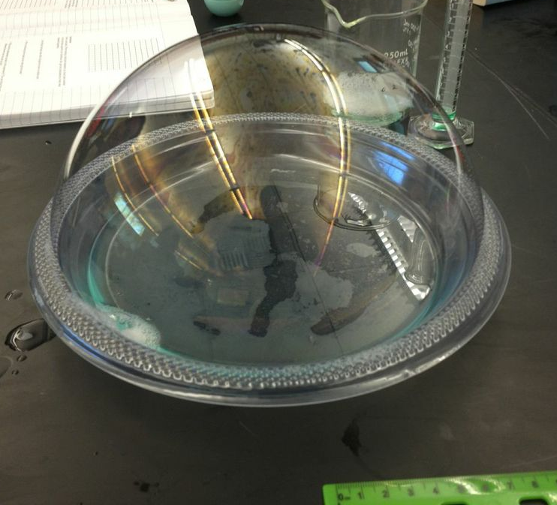
II. Surface tension – Soapy and Sticky Bubbles
Now we will share data as a class and complete your lab worksheets.
Notes:
The first part of class will continue the topic of surface tension. When the students have finished sharing data as a class, they should understand that LOWERED surface tension through the addition of surfactants leads to longer lasting more stable bubbles.
Directions: Students should take out their activity worksheets from the day before. The class will share data now and they will be able to finish the figures in the worksheet and answer the questions.

Slide 3
II. Surface tension – Soapy and Sticky Bubbles (class data)
 | Solution 1: soapy |  | Solution 2: soapy and sticky
Group Number | Avg. height (cm) | Avg. life span (sec) | Avg. height (cm) | Avg. life span (sec)
1
2
3
4
5
6
7
8
9
10
11
12
13
14
15
Class Average
Notes:
Directions: Ask each group to tell you their average height and life span for the bubbles of each solution. Record those values in the table above. Once a class average has been computed, the students will be able to finish the graphs in their activity worksheet.
The remaining PowerPoint and associated worksheet should take about 20 minutes to complete. This allows about 20 minutes now for students to finish and turn in the activity worksheets. There are slides in this presentation that will be good talking points to discuss the results of the activity.
Additional notes: The data should reflect that bubbles formed from the soapy and sticky solution had a higher average height and a longer life span. Bubbles pop when the bubble wall becomes so thin due to evaporation that a hole forms and the bubble wall collapses. Glycerin is hygroscopic, which means it is able to hold water molecules from the surrounding environment. This slows evaporation and allows the bubble to have a longer life span. Glycerin also has a high viscosity. This causes water from the bubble wall to drain more slowly off the top and slow thinning of the bubble wall. This also will increase the sticky bubble’s life span.

Slide 4
III. Surfactants and ocean surfactants
Notes:
Now that the concept of surface tension has been covered, the next topic will be surfactants and ocean surfactants. Surfactants are chemicals that lower the surface tension of water. We will see that the majority of surfactants in the ocean are naturally formed. This enhances the persistence of sea foam which will be the next topic in Sec. IV. Sea foam is important for marine cloud production and air-sea gas exchange between the ocean and atmosphere.

Slide 5
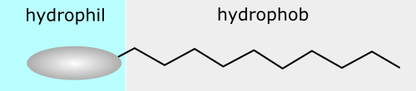
III. Surfactants and ocean surfactants
Surfactants are compounds that lower the surface tension of water
surfactant
Answer question #1 now
Notes:
This slide introduces the definition of surfactants. Surfactants are usually organic compounds that are amphiphilic, meaning they contain both hydrophobic grounds (their tails) and hydrophilic groups (heads). Surfactants will diffuse in water and adsorb at interfaces between air and water. This alignment of surfactants at the surface modifies the surface properties of water like surface tension.
Worksheet question 1: Draw how you would expect 5 surfactant chains (an example is shown below) to align themselves at an air-water interface.
Answer: The surfactants will align themselves so that the hydrophilic end is submerged in water and the hydrophobic end is in the air.

Slide 6
III. Surfactants and ocean surfactants
World production: 15 Mton/yr
Half of that production is soaps
What makes the other half?
    biological productivity
Common types
Sodium stearate
4-(5-Dodecyl) benzenesulfonate
?
Notes:
This slide highlights the fact that biological processes are responsible for half of the world’s surfactant production.
Recall how the surfactant in question 1 looks. Have you seen that type of shape before? In biology, phospholipids are surfactants that made up the cell membrane of eukaryotic cells. Therefore besides the commercial manufacturing of soaps, the other half of world surfactant production is through biological processes.
Human manufactured surfactants (soaps) are used for commercial applications. However much of the naturally produced surfactants exist in the ocean. It is those surfactants that will enhance bubble production in the ocean.
Additional information:
Sodium stearate is the most common component of soap.
Revenues from the global production of surfactants was $24.33 billion in 2009.

Slide 7
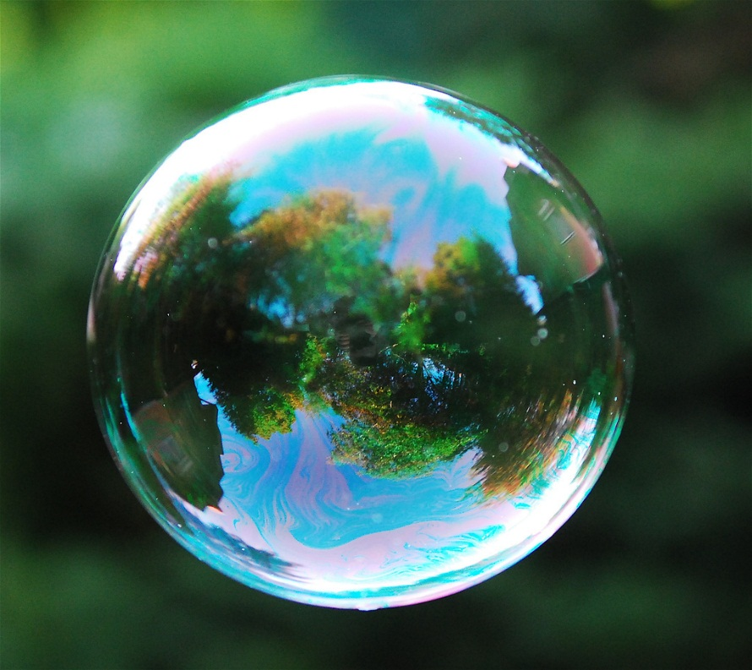
III. Surfactants and ocean surfactants
What role do surfactants play on bubbles?
Hint: there is still surface tension between water molecules, but the soap has lowered its effect
Answer question #2 now
Notes:
The relationship between surface tension, surfactants, and bubbles can be confusing for students. The reason for a bubble’s round shape is the surface tension in the soapy solution uniformly pulling adjacent bubble wall molecules together. Even though a soap or surfactant is present and surface tension has been lowered, surface tension still exists. The lowered surface tension allows the bubble to expand in volume. Pure water would not be able to sustain a shape like in the picture because the surface tension is too high.
Ask students to recall the soapy and sticky bubble activity. Ask them if the bubbles they created would be possible without the addition of dish soap? Ask to see if they understand the role of glycerin. Glycerin helps the water molecules resist evaporation and slows draining of the bubble cap under gravity. Those two effects both keep the bubble wall from thinning and forming a hole.
Worksheet question 2: Would you be able to blow a bubble from fresh water alone? What would happen? How does adding a surfactant like dish soap allow bubbles to be formed? Use words like surface tension, surfactant, and intermolecular forces.
Answer: A bubble could not be blown from surfactant-free water. The high surface tension of water does not allow the water molecules to be stretched enough to allow air inside. However when a surfactant has been added, like dish soap, the surface tension of water is lowered by disrupting the intermolecular forces between water molecules. This allows air to fill the bubble and the bubble wall to be stretched against the contractive tendency of surface tension. Surface tension, while lowered however, still tends to contract the water molecules together, resulting in the bubble having a spherical shape.
Photo credit: http://queerlychristian.files.wordpress.com/2012/12/advent_bubble3.jpg

Slide 8
IV. Sea foam
Notes:
Remind students that surface tension is normally high for water. However the presence of naturally produced surfactants in the ocean will lower that water’s surface tension. Regions of the ocean where biological productivity is especially high will experience greater concentrations of surfactants. Collections of bubbles together is known as foam. Sea foam is the froth and suds on the surface of the ocean.

Slide 9
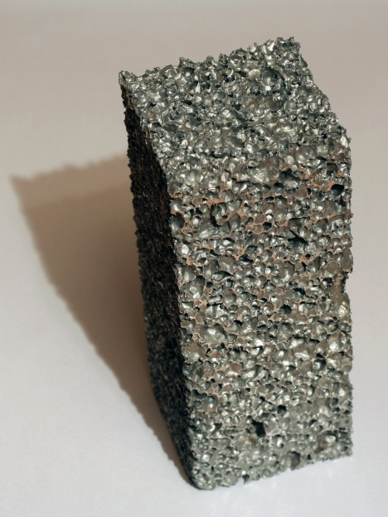
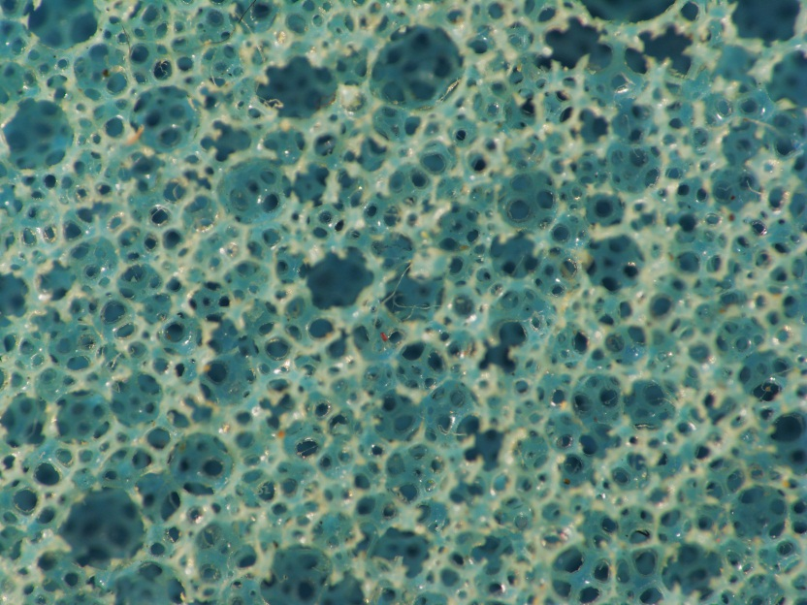
IV. Sea foam
Answer question #3 now
What is foam?
    A substance that is formed by trapping pockets of gas in a liquid of solid
Commercial foams
?
Notes:
Before introducing sea foam, first the definition of foam is given with some examples.
Additional notes: Foams are both naturally occurring and commercially manufactured. Some everyday experiences students may have with foams include packing peanuts, a dish sponge, certain memory foam matrasses, certain basketball/running shoes. The foam on the left is aluminum foam and the foam shown on the right is plastic foam. Specific surfactants are used in the manufacturing process to generate those foams. The heading on the slide says sea foam however, and so from this point on, we will be considering naturally occurring foam in the ocean and not commercial foam.
Worksheet question 3: Initial ideas. What is foam?
Answer: Foam is a substance that is formed by trapping pockets of gas in a liquid of solid.
Photo credits: left: http://upload.wikimedia.org/wikipedia/commons/f/fc/Aluminium_foam.jpg
right: http://upload.wikimedia.org/wikipedia/commons/5/55/FoamedPlastic.jpg

Slide 10
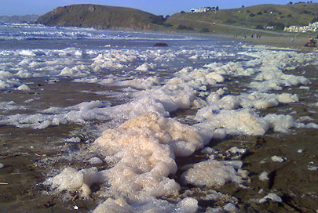
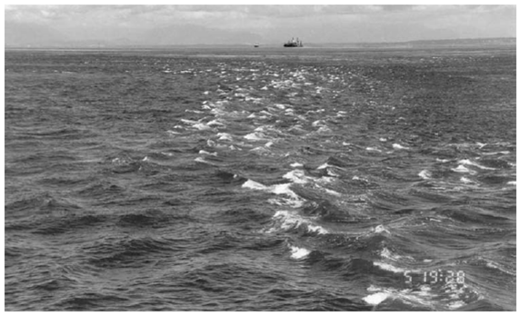
IV. Sea foam
Answer question #4 now
Which situation involving sea foam is more important to air-sea gas transfer and cloud formation?
A
B
Notes:
Now the topics of surface tension, surfactants, and foam will be discussed in an ocean context.
Directions: First ask a student to describe out-loud each picture. Picture A shows foam formed from breaking waves in the surf zone and residing on a local beach. Picture B shows multiple wave breaking events in the open ocean in the Stuart Island tidal front.
Worksheet question 4: Which situation (A or B) is more important to air-sea gas transfer and cloud formation? Why?
Answer: Situation B is more important to air-sea gas transfer and cloud formation. This is because wave breaking like in case B, known as white-capping is happening all throughout the world’s ocean basins. Shoaling waves that break on shore and generate foam occurs only along the coastline and so the amount of foam generated there is small compared to foam generated in open ocean white-capping.
Photo credits: left: http://vistadenada.files.wordpress.com/2011/03/sea_foam.jpg
Right: Baschek et. Al., Journal of Marine Research, 64, 483-515, 2006.

Slide 11
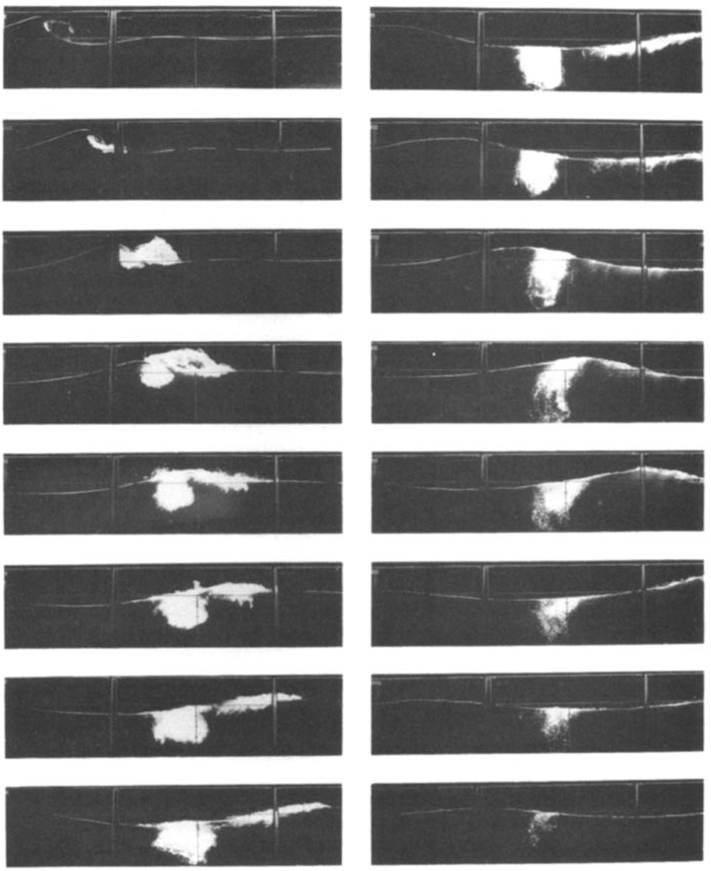
IV. Sea foam
Wave breaking
Answer question #5 now
Lamarre (1993)
Notes:
The images of sea foam shown on the previous slide don’t just magically appear. The foam is a product of wave breaking. Just how does foam form when a wave breaks? The time series images on this slide show that process. The slides are ordered from top to bottom, left column first then right column. A description of wave breaking is given in the worksheet answer below.
Worksheet question 5: Describe in your own words how bubbles and foam are created during wave breaking.
Answer: The wave in the figure above is propagating from left to right in each panel. The wave is shown to steepen so much that the crest overturns and by the third panel intersects the wave face. This type of breaking wave is known as a plunging breaker. When the air above the wave face is totally enclosed by the crest, it is entrained in the water and immediately fragments into much smaller bubbles. The buoyant rising of those bubbles occurs even after the majority of wave energy propagates downstream past the position where it broke. The life-span of the bubbles sitting on the surface after wave breaking will depend on the concentration of surfactants and other chemicals in the water.

Slide 12
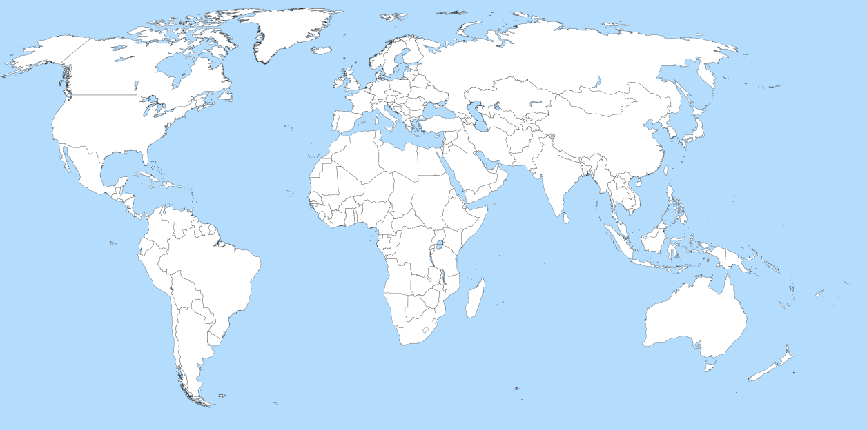
IV. Sea foam
Whitecapping
Answer question #6 - #8 now
Notes:
When a wave breaks in deep water it is known as white-capping.
So just where does wave breaking and whitecap formation occur in the world? This slide is meant to introduce the idea that wave breaking occurs all over the ocean all the time, not just at coastlines. They should understand that waves are breaking on the surfaces of deep oceans right now, when they are in bed, when they are eating breakfast, all the time!
Additional information: Wave breaking plays a number of related roles in air-sea interaction. These include limiting the height of surface waves, being a source of vorticity and turbulence, dissipating surface-wave energy, generating ocean currents by transferring momentum flux, enhancing gas transfer via surface turbulence and bubble entrainment.
Worksheet question 6: Where does the majority of wave breaking events occur in the ocean?
Answer: As described earlier, the majority of wave breaking events occur in the open ocean.
Worksheet question 7: How is increased biological productivity in the ocean similar to adding dish-soap to water?
Answer: Dish-soap is a commercial surfactant. Increased biological productivity in the upper ocean also is a production source of surfactants, mostly from phospholipids that make up the cell membrane. Thus you would expect more bubbly and foamy conditions with increased biological productivity.
Worksheet question 8: How is agitating the water in the opening demo yesterday similar to the effect of wind blowing over the ocean?
Answer: Wind blowing over the ocean supplies energy and a momentum flux to the wave field. This is synonymous with transferring momentum flux to water by stirring with a rod like in the opening demo.
Photo credit: Baschek et. Al., Journal of Marine Research, 64, 483-515, 2006.

Slide 13
V. Cloud nucleation
Notes:
So what is the ultimate fate of sea foam on the ocean surface? One important mechanism is marine cloud nucleation. Marine clouds play an important role in the Earth’s climate by shading the planet from incoming solar radiation. Today’s lesson will discuss cloud formation due to bursting bubbles, however subsequent lessons will introduce that bubbles formed from breaking waves is important for air-sea gas transfer.

Slide 14
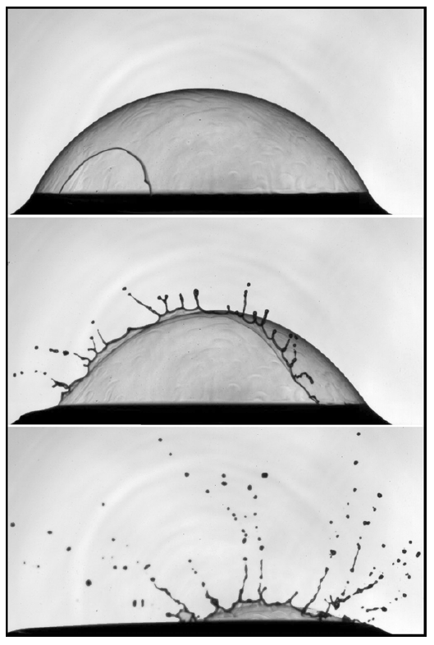


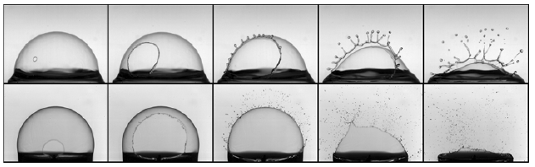
V. Cloud nucleation
Bursting bubbles
Answer question #9 now
Lhuissier, Villermaux (2011)
Notes:
The foam that is generated from breaking waves does not persist indefinitely. Instead the bubbles will burst. Air is not the only thing that escapes from bursting bubbles. Tiny droplets of the bubble wall are accelerated outward from the bursting bubble.
On the next slide we will discuss the importance of spray from bubbles in the production of clouds.
Worksheet question 9: Describe in your own words what happens as a bubble bursts.
Answer: The bubble wall becomes significantly thin due to evaporation and downward drainage. Then a small hole forms somewhere in the bubble cap. The hole grows larger as the force due to surface tension pulls liquid molecules back down to the air liquid interface. As the bubble cap collapses, small fragmented droplets form spray and fly away from the bubble in strands known as ligaments.
Photo credit: Lhuissier and Villermaux, Bursting bubble aerosols, J. Fluid Mech. 696, 5-44. 2011.

Slide 15
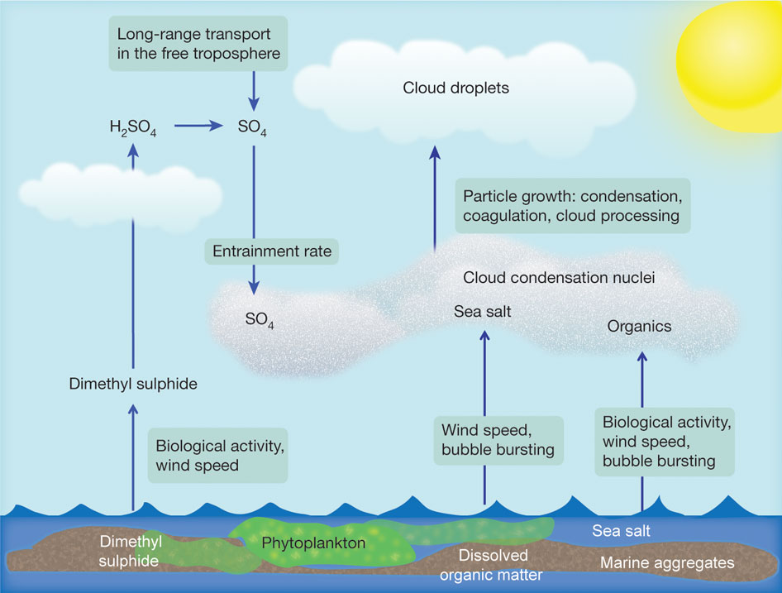
V. Cloud nucleation
The spray from bursting bubbles in sea foam are important for marine cloud formation!
Answer question #10 now
PK Quinn & TS Bates Nature 480, 51-56 (2011) doi:10.1038/nature10580
Notes:
This drawing shows major sources and production mechanisms for cloud condensation nuclei in the remote marine boundary layer. Cloud condensation nuclei are tiny particles in the air which water vapor attaches to and can eventually grow large enough in size and number to form clouds.
Bursting bubbles are not made from pure water. The water in the outward traveling particles in a bursting bubble contain sea salt and organic matter. Notice that those two particles are listed as cloud condensation nuclei.
Although not formed from bursting bubbles, on the next slide we will look at the process of SO4 formation in the air from Dimethyl sulphide. This process is interesting because it forms a feedback loop. The nature (positive/negative) of the feedback loop is still an ongoing research topic.
Additional information: The source article is online with this lesson as a resource: Lesson2_ResearchArticle_Nature10580.pdf. Cloud condensation nuclei (CCN) can affect the amount of solar radiation reaching Earth’s surface by altering cloud droplet number concentration and size and, as a result, cloud reflectivity or albedo. CCN are atmospheric particles that are sufficiently soluble and large enough in diameter to take up water vapor and serve as nuclei for cloud droplet formation. For the range of water supersaturations typical of marine boundary layer (MBL) clouds and the chemical composition of marine aerosols, the CCN population is dominated by particles between 40 and 300 nm in diameter. Although particles larger than 300 nm will activate to form cloud droplets regardless of composition, there are relatively few particles of this size. It is therefore the particles less than 300 nm in diameter that determine the CCN concentration in the remote MBL and that have the potential to change cloud properties.
Worksheet question 10: What three particulates are highlighted as important for cloud nucleation? Which of these particulates result from bursting bubbles?
Answer: Important cloud condensation nuclei are sulfate (SO4), sea salt, and organic matter. Sea salt and organic particulates result from bursting bubbles.
Photo credits: PK Quinn & TS Bates Nature 480, 51-56 (2011) doi:10.1038/nature10580

Slide 16
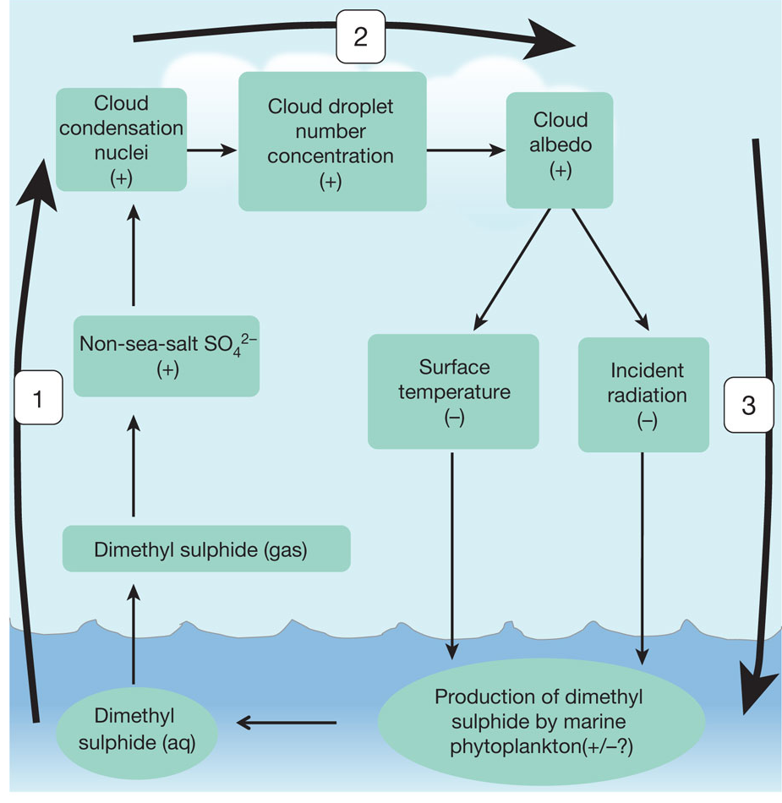
V. Cloud nucleation
Feedback loop involving dimethyl sulphide
PK Quinn & TS Bates Nature 480, 51-56 (2011) doi:10.1038/nature10580
Notes:
Now we will focus on the feedback loop involving dimethyl sulphide (DMS). DMS is the most abundant biological sulfur compound emitted to the atmosphere. Emission occurs over the oceans by phytoplankton. DMS is also produced naturally by bacterial transformation of dimethyl sulfoxide. Although the production of cloud condensation nuclei from dimethyl sulphide gas is highlighted here and its effect on solar radiation and surface temperature, we could replace this process with the production of cloud condensation nuclei from bursting bubbles as well.
This figure shows an example of a climate feedback loop involving marine aerosols. In this case we are examining the impact of dimethyl sulphide production on climate. The important step to highlight are numbers 2 and 3. Albedo is the amount of incoming solar radiation reflected back to space. Albedo will be highlighted later in the unit. Increased albedo means less solar radiation is heating the Earth.
By forming clouds, surface temperature and incident radiation are both lowered. The effect this has on DMS production by phytoplankton is unknown and still and active research topic.
Just like the DMS loop shown here, bubbles in the ocean and the spray from them, although small, contribute significantly globally to cloud production and thus are an important control on the Earth’s climate!
Photo credits: PK Quinn & TS Bates Nature 480, 51-56 (2011) doi:10.1038/nature10580

Slide 17
VI. Technology
Notes:
In Lesson 1, it was mentioned that there is large uncertainty in estimating global carbon fluxes in the carbon cycle. Now we will briefly mention one way scientists are actively trying to measure white cap coverage on the ocean. Those measurements are used in climate modeling including the fate of atmospheric CO2.

Slide 18
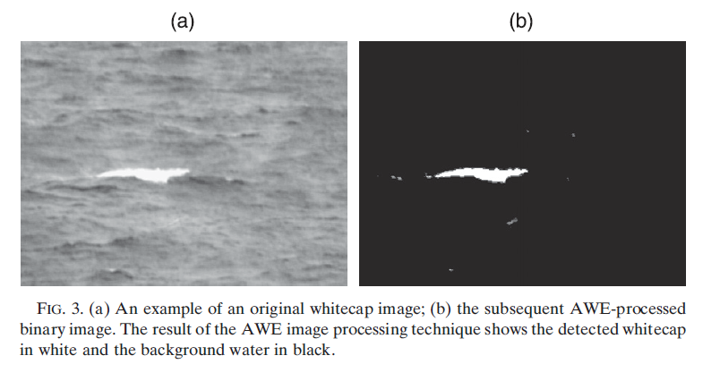
VI. Technology
How can we measure whitecapping
Callaghan (2009)
Notes:
Open ocean whitecapping, and the associated wave breaking event that caused them are so significant to physical and chemical properties of the ocean that scientists are currently working on new ways to quantify them. On this slide, a figure from a paper by Callaghan in the Jour. of Atmos and Ocean Tech, shows how scientists automate with computers the process of measuring ocean white caps. The photo on the left is a satellite image and run through an AWE (automated whitecap extraction (AWE)) process to result in the detected whitecap on the right. By automating this process, scientists can analyze many more satellite images than could be by hand.
Photo credit: Callaghan and White, Journal of Atmospheric and Oceanic Technology, 2009.

Slide 19
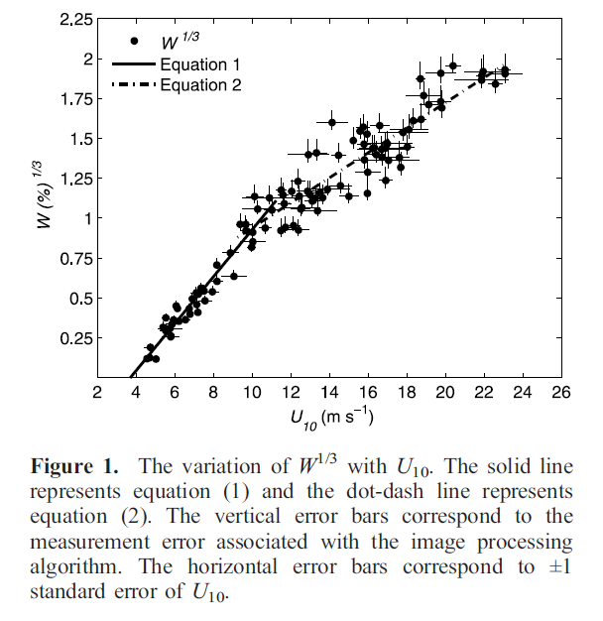
VI. Technology
Whitecap coverage vs. wind speed
Answer questions #11 - #13 now
Notes:
This figure shows how whitecap coverage varies with wind speed. Increasing wind implies that more waves will be breaking, which will then generate more foam and white caps. Several hundred images may make up one W point shown above. This reduces the error bars on the associated data points. Wind speed, shown on the horizontal axis is measured from a reference 10 m above the ocean surface.
Additional information about the figure is given in answers to the worksheet questions below. Wave breaking has been shown to be proportional to the cube of wind speed. Therefore in the figure whitecap coverage raised to the 1/3 is plotted vs. wind speed for the relation to look linear.
Why is it important to quantify how much sea foam exists on the ocean surface? We will discuss in lesson 4 that bubble production plays an important role in air-sea gas transfer. This has implications for how carbon is transferred globally in the carbon cycle.
Worksheet question 11: W is the percentage of ocean surface covered in sea foam. U₁₀ is the wind speed 10 m above the ocean surface. What are the units for both W and U₁₀?
Answer: The units on W are percentage. The units on U₁₀ are meters/sec.
Worksheet question 12: What happens to the percentage of ocean surface covered in sea foam as the wind speed increases? Why do you think this is true?
Answer: As the wind speed increases, the percent of ocean surface covered in white caps increases. This is because the wind transfers energy and momentum flux into the wave field which makes waves steepen. Once waves reach a critical steepness, they break and transfer that momentum flux into ocean currents.
Worksheet question 13: Would you say the relationship between W and U₁₀ is linear? Why or why not?
Answer: The relationship between W and U₁₀is nonlinear. In fact on the vertical axis, W is not plotted, but W^(1/3). This forces the graph to appear linear which is easier to read. In certain regimes, like between U₁₀= [2,12] m/s, W^(1/3) is linear with U₁₀. and again between U₁₀= [12,24], W^(1/3) is linear with U₁₀.
Photo credit: Callaghan and White, Journal of Atmospheric and Oceanic Technology, 2009.

Slide 20
Conclusions
Surfactants lower surface tension
OCEAN Surfactants are naturally occurring
Surfactants allow the persistence of sea foam
Bubbles role in marine cloud production
Notes:
The concept of surface tension has been extended to the topics of surfactants, sea foam, and marine cloud production. Surfactants in the ocean are byproducts of biologic productivity. Thus regions of the world’s ocean where there is high biologic productivity will contain high levels of surfactants.
The persistence of sea foam is important for air-sea gas transfer. Also when bubbles in sea foam burst, they release tiny particles in the air that may contain salt or biologic material. Those particles are important for the production of marine clouds. Those clouds then shade the planet and lower surface temperatures. The affect of lowered surface temperature on marine cloud production is still an active research topic.

