Slide 1

Properties of Gases
Notes:
Notes for this slide: So far in the unit, we have discussed the carbon cycle, surface tension, and sea foam. Carrying through with that theme, we would like to see how the gas inside of bubbles in the ocean behaves. The behavior of air entrained at the ocean surface as bubbles obey fundamental gas laws. So for this lesson as well as the activity day in the next class period, students will be learning about properties of gases. The next major lesson will be focused on air-sea gas transfer, which is one of the fluxes discussed in the lesson on global carbon cycle.
Authors: Sean Walstead, Scripps Institution of Oceanography; Alison Dickens, Lincoln High School, San Diego Unified District.
WHY: As one of the four fundamental states of matter, gases are everywhere. Earth’s atmosphere contains a mixture of gases that helps heat the planet and protect us from incoming space debris like small asteroids and meteorites. The air we breathe is made up of a mixture of gases. Dissolved gases in the ocean support life there. Understanding how gases interact with each other and with other states of matter is crucial to understanding relationships between the ocean and atmosphere.
SUMMARY: This inquiry-based lesson on the properties of gases spans two-days and contains 10 demonstrations/activities. The descriptive portion of the lesson occurs on Day 1 and details the physical characteristics of gases and emphasizes qualitative learning of the gas laws. While the initial demonstrations are teacher guided at the front of the class, Day 2 allows students to rotate around stations, perform demonstrations themselves, and form conclusions about what has occurred based on their understanding of the gas laws. On Day 1 the students create a learning tool, the PTV stick, which can be during the inquiry-activities to help students remember the relationship between the properties of a gas. The Gas Law Activity demonstrations allow students to witness first-hand the relationships between temperature, pressure, and volume of a gas.
PICTURE CREDIT: http://g4.img-dpreview.com/71E2657DD14148E49F2815089E6BC233.jpg
WEBSITES USED IN THIS PRESENTATION: American chemical society, www.ams.com
ADDITIONAL READING: N/A
CONTEXT FOR USE: This lesson is designed for a high school chemistry class. It is the third lesson in a sequence of 5 lessons aimed at covering interactions between the ocean and atmosphere. This presentation is for Day 1 of Lesson 3.
MISCONCEPTIONS:
- Gases possess less mass (“lower weight”, or, “no weight”) than solids and liquids.
- Air has no mass.
- Air does not normally exert any pressure on objects because you can’t feel it.
- Gases are not matter because they are invisible.
8.EVALUATION TIPS: For the inquiry activity on Day 2, students will complete worksheets that accompany each activity station.
9.TEACHING NOTES: Day1: Have materials ready for the PTV sticks and Gas has Mass demonstration. Prepare 2 or 3 of the guided demonstrations planned for the Gas Laws Activity day to be performed on Day 1. This will allow students the more time when they are rotating between stations. Pass out the student worksheets.
10.TEACHING INSTRUCTIONS: Day 1:
1.) Introduce qualitatively the properties of gases and gas laws through the PowerPoint lesson Lesson3_GasLawsLesson_PPT.pptx.
2.) Complete the PTV stick exercise on slide 11 of the PowerPoint lesson. For an added level of inquiry, do not show the students how the PTV sticks work, instead have students perform a "think-pair-share" exercise to try and understand how the stick could be used to remember the gas laws.
3.) Perform the Gas has Mass demos.
4.) Perform 2 or 3 of the guided demonstrations planned for the Gas Laws Activity day. This will allow students more time on Day 2 when they are rotating between stations and it will also allow students to familiarize themselves with the format of the worksheets to be completed at each station.
5.) Assign groups for Day 2.

Slide 2
Physical characteristics of gases
Fundamental state of matter
Fill their containers
Compressible
Low density
Exerts constant pressure its container
Notes:
Gas is one of the four fundamental states of matter. The other 3 being, solid, liquid, and plasma. Students will probably want to discuss plasma even though it is not the topic of the lesson. Plasma is by far the most common phase of ordinary matter in the universe. Our sun and all stars are made of plasma, which contain charged particles.
The other properties are straightforward and should not cause any confusion with students.
Next the properties of temperature, volume, pressure, and mass will be discussed. Students should understand those properties before attempting to learn the gas laws.

Slide 3
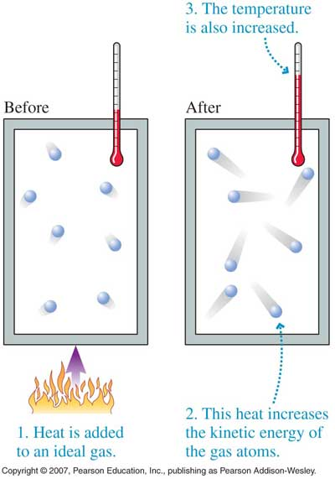
Properties of gases
Temperature:
a measure of the average kinetic energy of molecules in a gas
Notes:
Whether or not notes are taken on this lesson, before advancing to the next slide, each student should be comfortable with the property being discusses.
Temperature is commonly measured in degrees Celsius (ºC), degrees Fahrenheit (ºF), and Kelvin (K)
Additional notes: the definition given for temperature is valid for any object regardless of its physical state. It may be helpful for students to consider some common temperatures in nature.
room temperature: 20 ºC = 68 ºF = 293 K
water freezes: 0 ºC = 32 ºF = 273 K
water boils: 100 ºC =212 ºF = 373 K
absolute zero: -273 ºC = -459.4 ºF = 0 K
melting point of gold: 1064 ºC = 1948 ºF = 1337 K
freezing point of carbon dioxide: -78.5 ºC = -109 ºF = 194.5 K
Photo credit: http://whs.wsd.wednet.edu/faculty/busse/mathhomepage/busseclasses/apphysics/studyguides/chapter11_2008/Images/11_08Figure.jpg

Slide 4
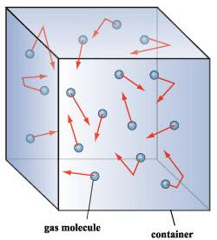
Properties of gases
Volume:
the amount of space an object occupies.
Notes:
In the case of a gas, the substance will fill its container. The red arrows show that gas is constantly in motion. Without a container it is impossible to quantify the volume of a gas.
Photo credit: http://isite.lps.org/sputnam/LHS_IB/IBChemistry/UNIT5ChemReactions/IBU4States.htm

Slide 5
Properties of gases
Pressure:
the effect of a continuous force applied to a surface. Pressure is the amount of force acting per unit area.
Notes:
Pressure may be a new concept for students. Tell students to think of pressure as how strong something pushes against an area. As an example tell students to push an eraser or other blunt object into their palm. Nerves in our hand can sense pressure which is the force of the object being pushed into our hands spread over the area of contact.
In a similar way, gas molecules are always colliding randomly with their container. Those collisions add up to an overall pressure. Thus in a gas, pressure is related to the number of collisions of individual gas molecules with the walls of its container.
The SI unit for pressure is the Pascal (Pa) or 1 N/m²
Standard atmospheric pressure = 1 atm = 101,325 Pa
Photo credit: http://isite.lps.org/sputnam/LHS_IB/IBChemistry/UNIT5ChemReactions/IBU4States.htm

Slide 6
Properties of gases
Mass:
the amount of matter in an object
Notes:
Mass is the amount of matter in an object. The SI unit for mass is the kilogram (kg).
Weight is the downward force of an object due to its mass under the effect of gravitational acceleration. Explain to students that if they traveled to a planet with one half the gravitational acceleration as Earth, they would weigh half of their weight on Earth but they would still contain the same amount of mass.
Photo credit: http://isite.lps.org/sputnam/LHS_IB/IBChemistry/UNIT5ChemReactions/IBU4States.htm

Slide 7
Gas Laws
The temperature, pressure, and volume of a gas are related:
      pressure and volume: Boyle’s law
      volume and temperature: Charles’ law
      pressure and temperature: Gay-Lussac’s law
Notes:
Now that the properties describing gases has been introduced, the next step is to discuss how those properties are related in gases. These relationships are very well understood and are named after scientists who first investigated them.
This presentation will not detail the mathematical formulas describing each law. Only a qualitative description is given.

Slide 8
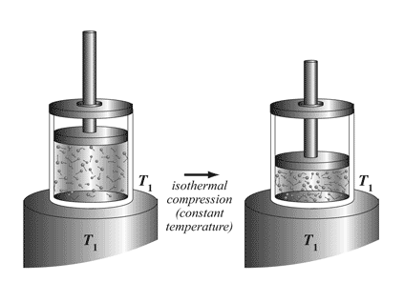
Gas Laws
  pressure and volume: Boyle’s law
  P and V are inversely
  proportional
Notes:
Pressure and volume are inversely proportional. As an example: As volume decreases, pressure increases. As volume increases, pressure decreases.
The figure is a good example of Boyle’s law. Students should recognize that the number of gas molecules in the container is not changing. As a result, when the piston is lowered and the volume decreases, there will be increased collisions between gas molecules and the container walls.
Photo credit: http://wikipremed.com/01physicscards600/263a.gif

Slide 9
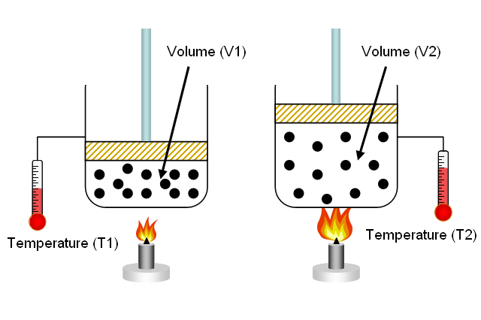
Gas Laws
  volume and temperature: Charles’ law
  V and T are directly
  proportional
Notes:
Volume and temperature of a gas are directly proportional. As an example: As temperature increases, volume increases. If volume has decreased, then temperature has decreased.
Remember that gas temperature is a measure of the average kinetic energy of gas. This means that as a gas is heated, the gas molecules will move faster. Faster molecules will make more collisions with the container walls, and if allowed to expand will do so. The diagram on the right shows how increasing the temperature of a gas makes the piston raise higher. If the piston was not allowed to move, the pressure would instead increase. That is the topic of the next slide.
Photo credit: http://www.aculator.com/formula/temp/Volume_from_Charles_law.png

Slide 10
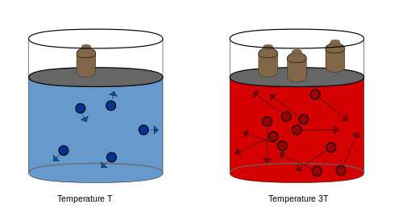
Gas Laws
  pressure and temperature: Gay-Lussac’s law
  P and T are directly
  proportional
Notes:
Pressure and temperature are directly proportional. As an example: As temperature increases, pressure also increases. If pressure has decreased, then temperature has decreased. Notice that the container is not allows to change volume. As a result, increasing the temperature of a gas will increase collisions with the container wall, raising its temperature.
Note that although it looks like the cylinders contain a liquid, the blue and red are simply meant to depict cold and hot gas.
Photo credit: http://upload.wikimedia.org/wikipedia/commons/thumb/8/84/Temperature_Pressure_law.svg/500px-Temperature_Pressure_law.svg.png

Slide 11

Gas Laws
A helpful way to remember the gas laws
PTV stick
P T V
P T V
P T V
Decide which two properties you would like to compare
We would like to compare pressure and volume
If pressure increases, then volume decreases as temperature is held constant
Notes:
Directions: Pass out popsicle sticks to students. As a teaching option, you could not tell the students how the PTV sticks work. Instead you could have students perform a “think-pair-share” exercise to try and understand how the stick could be used to remember the gas laws.
How the PTV stick works:
Hold your finger over the gas property that remains constant. This will reveal only the two properties you are interested in.
An increase or decrease in one of the two visible properties (pivot the stick up or down) will tell you how the second gas property changes.
Photo credit: http://upload.wikimedia.org/wikipedia/commons/thumb/8/84/Temperature_Pressure_law.svg/500px-Temperature_Pressure_law.svg.png

Slide 12


Gas has Mass demo (adapted from American Chemical Society acs.com)
Basketball
Place the deflated ball on the balance to get the initial mass.
Ask students if they think the ball will weigh more or less after you pump air into it.
Pump as much air into the basketball as you can and then put it back on the balance
Notes:
This demonstration is easy to perform in class. If you do not have access to all the supplies, a video of the demonstration is available on the next slide. The mass of the basketball may exceed the upper limit on how much mass the scale can measure. In this case it would be more appropriate to use a triple beam balance.
Question to students: The basketball weighed more after it was inflated with air than when it was deflated. How does this show that gas is matter?
Answer: The increase in mass is a result of the air pumped into the basketball.
Photo credit: http://www.middleschoolchemistry.com/lessonplans/chapter1/lesson5

Slide 13
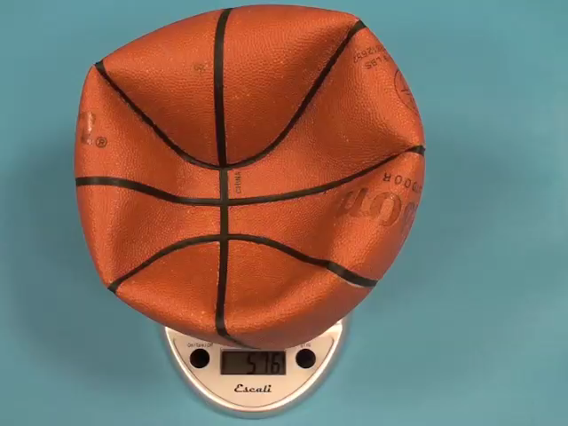
Gas has Mass demo (adapted from American Chemical Society acs.com)
Basketball
Notes:
If all the materials are not available for the demonstration, this video will show the increase in mass after the basketball has been inflated.
Photo credit: http://www.middleschoolchemistry.com/lessonplans/chapter1/lesson5

Slide 14
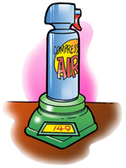
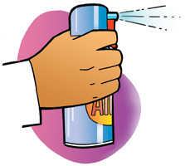
Gas has Mass demo (adapted from American Chemical Society acs.com)
Can of compressed gas
Place a can of compressed gas on a scale and check its mass.
Ask students whether it will weigh more, less, or the same if you squeeze the trigger and let some gas out.
Shoot gas out of the can for a few seconds and then place the can back on the scale.
Notes:
This demonstration is easy to perform in class. If you do not have access to all the supplies, a video of the demonstration is available on the next slide.
Question to ask students: The can weighed less after some gas was shot out of the can. How does this show that gas is matter?
Answer: Because the can weighed less after gas was released, this shows that some of the initial mass of the can of compressed air included the mass of air inside.
Photo credit: http://www.middleschoolchemistry.com/lessonplans/chapter1/lesson5

Slide 15
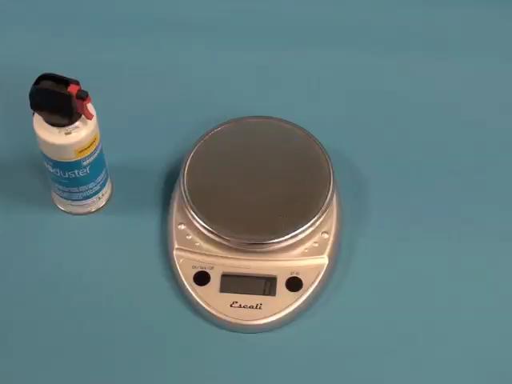
Gas has Mass demo (adapted from American Chemical Society acs.com)
Can of compressed gas
Notes:
If all the materials are not available for the demonstration, this video will show the decrease in mass after some air has been released from the can of compressed air.
Photo credit: http://www.middleschoolchemistry.com/lessonplans/chapter1/lesson5

Slide 16
Conclusions
Properties of gases
Gas laws relate temp, pressure, and volume
PTV stick is a helpful memory tool
Gas has mass
Notes:
Properties of gases have been described. Students should be familiar with these properties from previous science classes.
The gas laws (Boyle’s, Charles’, Gay-Lussac's) have been introduced qualitatively. No formulas are given for the gas laws. Only qualitative understand is required for the gas law activity day. If your science class focuses on mathematical relationships, those can be separately taught before the gas law activities.
The PTV stick is helpful in remembering how the properties of pressure, temperature, and volume are related. Students should keep the PTV stick in their notebook for use in the gas law activity day.
Because students cannot see or touch gas, some may think it does not have mass. Others may think that because air is “light” (low density) it will lower the mass of the basketball instead of increase it. While the density of the basketball does decrease, its total mass increases.

