Slide 1

Gas Law Activities
Notes:
Authors: Sean Walstead, Scripps Institution of Oceanography; Alison Dickens, Lincoln High School, San Diego Unified District.
WHY: As one of the four fundamental states of matter, gases are everywhere. Earth’s atmosphere contains a mixture of gases that helps heat the planet and protect us from incoming space debris like small asteroids and meteorites. The air we breathe is made up of a mixture of gases. Dissolved gases in the ocean support life there. Understanding how gases interact with each other and with other states of matter is crucial to understanding relationships between the ocean and atmosphere.
SUMMARY: This inquiry-based lesson on the properties of gases spans two-days and contains 10 demonstrations/activities. The descriptive portion of the lesson occurs on Day 1 and details the physical characteristics of gases and emphasizes qualitative learning of the gas laws. While the initial demonstrations are teacher guided at the front of the class, Day 2 allows students to rotate around stations, perform demonstrations themselves, and form conclusions about what has occurred based on their understanding of the gas laws. On Day 1 the students create a learning tool, the PTV stick, which can be during the inquiry-activities to help students remember the relationship between the properties of a gas. The Gas Law Activity demonstrations allow students to witness first-hand the relationships between temperature, pressure, and volume of a gas.
PICTURE CREDIT: http://g4.img-dpreview.com/71E2657DD14148E49F2815089E6BC233.jpg
WEBSITES USED IN THIS PRESENTATION: N/A
ADDITIONAL READING: N/A
CONTEXT FOR USE: This inquiry activity is designed for a high school chemistry class. It is the third lesson in a sequence of 5 lessons aimed at covering interactions between the ocean and atmosphere. This presentation overviews the activity stations that the students will be working with. This PowerPoint can be used either as a teacher aid or the videos can be substituted for a station if some of the required materials are unavailable.
MISCONCEPTIONS:
- Gases possess less mass (“lower weight”, or, “no weight”) than solids and liquids.
- Air has no mass.
- Air does not normally exert any pressure on objects because you can’t feel it.
- Gases are not matter because they are invisible.
8.EVALUATION TIPS: For the inquiry activity on Day 2, students will complete worksheets that accompany each activity station.
9.TEACHING NOTES: This PowerPoint is not to be taught in its entirety to students. The first 3 slides should be shown to students so that they have an idea of what their worksheets will look like and how to fill them out. Day 2: The materials for each activity station must be setup ahead of class. Convenient station titles have been prepared and can be put at each station and are found in the file Lesson3_GasLawsActivity_StationTitles.doc. For the Egg in the Bottle activity, the bottle should be tested first to ensure that the bottle opening is large enough to allow the egg inside without crushing it.
10.TEACHING INSTRUCTIONS: Day 2:
1.) Perform any remaining guided demonstrations at the front of class. Allow students time to complete the worksheets for those demos.
2.) Allow students to rotate between the 4 gas law activity stations. For an additional level of inquiry, do not tell the students what to do at each station. Only tell the students the objective and have each group use the properties of gases to decide on an action plan that achieves the objective.

Slide 2
Gas Law Activities
Students will form groups of 3-4 people.
There are 4 guided demonstrations that will be conducted in front of the class. There are 4 student demonstrations that each group must complete.
Groups will rotate through the active stations spending about 7-8 minutes per station.
At each station, students must perform the activity and complete an associated worksheet.
Notes:
It may be helpful to show this slide and the next to students.
The guided demonstrations are: Marshmallow in a jar, Soda can in ice water, Egg in the bottle, Balloon in the bottle. These should be performed by the teacher at the front of the class. The soda can and balloon in bottle both require about 5-7 minutes just for the water to boil on a hot plate. To save time they are performed as a class. If the opening to the bottle is too small, the egg may be crushed and split apart when it is pulled into the bottle. Because the number of eggs are limited, that activity is suggested as a class activity.
The student demonstrations are: Marshmallow in a syringe, Balloons in water, Candle in water, Cotton fireball.
Based on classroom availability of some materials, you may need to modify which activities are performed as a class (guided) or in groups (student). For most of the activities there is an accompanying video in this presentation which shows the desired objective. The video could take the place of performing the demonstration. Those activities which take longer have before and after pictures instead of a video.

Slide 3
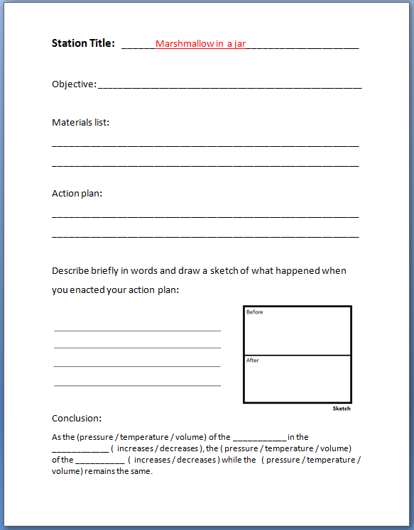
Gas Law Activities
Worksheet to be completed at each station
Station Title: The title of each activity center. Use the appropriate worksheet corresponds to the activity title at each station.
Objective: The goal of the activity center. This is given on a card at each station.
Materials list: A list of the materials present at each station.
Action plan: A one-sentence summary of the procedure to be performed.
Description/sketch: A description and sketch of what happened after the action plan was enacted. Try and focus your description on the motion and behavior of individual gas particles.
Conclusion: A summary statement where the appropriate gas properties are circled and descriptive blanks are filled in.
Notes:
It may be helpful to show this slide to students. You may wish to perform 1-3 of the activities/videos and complete the worksheet as a class. This will demonstrate to students what is expected when they complete the worksheets independently.
Directions: Students should have 8 stations worksheets. 4 for the guided demonstrations and 4 for the active demonstrations.
Additional notes: If you would like to add an additional level of inquiry, only tell the students the objective and have each group use the properties of gases to decide on an action plan that achieves the objective.

Slide 4
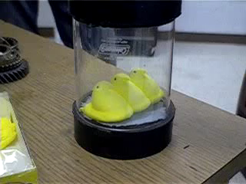
Marshmallow in a jar
Objective: Expand the marshmallow in the jar without touching it.
Materials list: marshmallow, jar, vacuum
Action plan: Put the marshmallow in the jar, seal it, and turn on the vacuum.
Notes:
Directions: students should copy the objective, materials list, and action plan into the appropriate worksheet. Each guided demonstration can either be performed in class or students can watch the accompanying video. Students should complete the remainder of the worksheet before moving on to the next guided demonstration.
Video credits: http://youtu.be/6bGndBjus8M

Slide 5
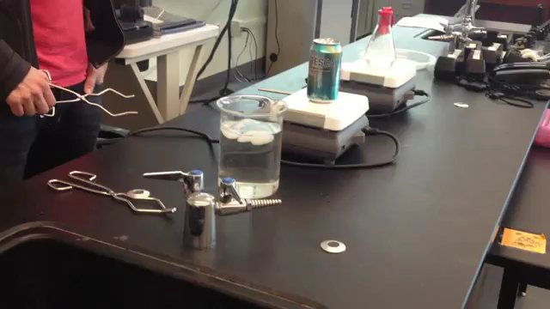
Soda can in ice water
Objective: Crush the empty soda can without squeezing it with your hands.
Materials list: soda can with 1 cm of water inside, tongs, a hot place, ice water
Action plan: Heat the can until the water boils, then invert the can and dip it in the ice bath.
Notes:
Tips: Because there is boiling water in the can, it will be very hot. Be careful not to touch any part of the can with your hands. Also it takes about 6-7 minutes for water to boil on a hot-plate. Allow yourself enough time for the water to boil.
Photo credit: Walstead/Dickens SCC GK12 2013

Slide 6
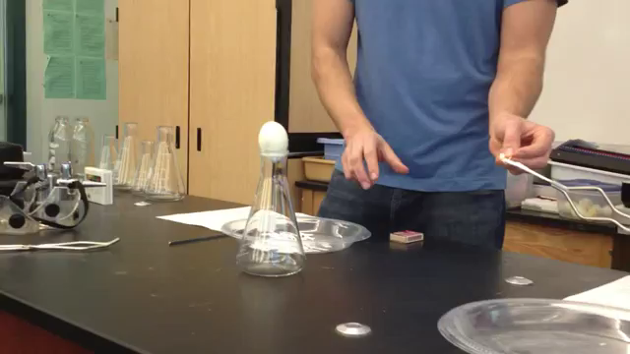
Egg in the bottle
Objective: Get the egg inside the bottle without using your hand to push it through.
Materials list: glass bottle, hard-boiled peeled egg, matches, strips of paper
Action plan: We will light a strip of paper on fire, drop it in the bottle, then place the egg on top while the flame is still lit.
Notes:
Getting the egg out: If the egg does not break apart as it enters the bottle, getting the egg out can be a lesson on the properties of gases as well. Ask students to suggest how they might get the egg out. The egg enters the bottle in the first place because the gas in the bottle has a lower pressure than the gas outside the bottle. One way to increase the pressure of the gas inside the bottle is to blow air back in the bottle with your mouth. It’s a little tricky because you have to allow enough room for the egg to come out of the bottle while also blowing in the bottle. This is best accomplished by putting your fingers around the bottle opening to make a seal and blowing into your hand.
Photo credit: Walstead/Dickens SCC GK12 2013

Slide 7
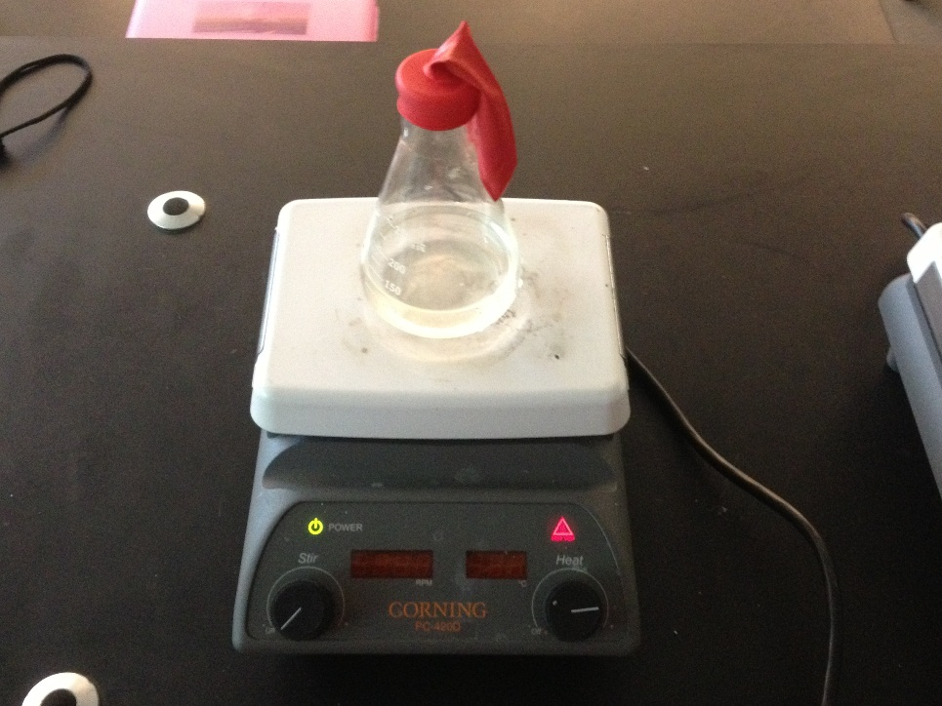
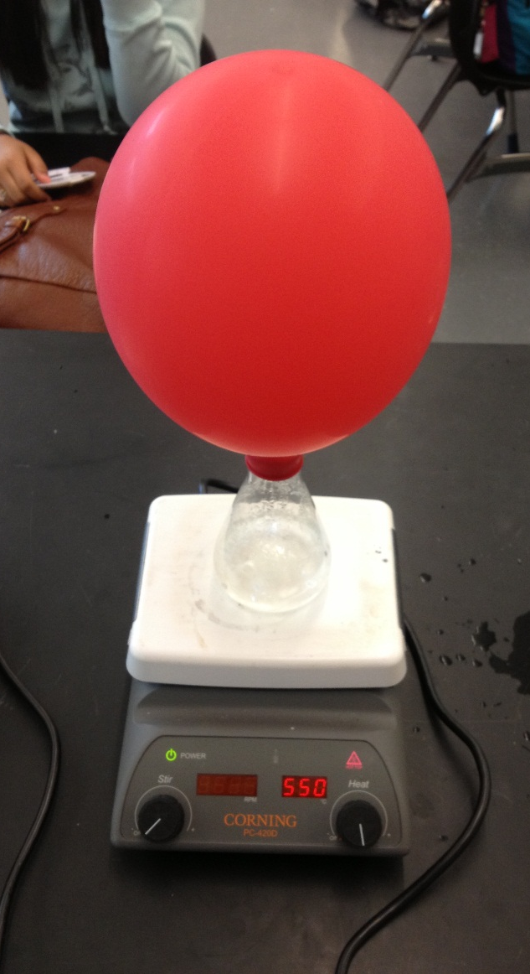
Balloon on the bottle
Objective: Inflate the balloon on the bottle without blowing into it.
Materials list: An Erlenmeyer flask, water, hot plate, balloon, tongs
Action plan: Attach a balloon to the neck of the flask. Heat the flask until the water boils.
Notes:
Tips: It may take 20 minutes for the balloon to fully inflate. Allow yourself enough time for the demonstration to complete.
Photo credit: Walstead/Dickens SCC GK12 2013

Slide 8
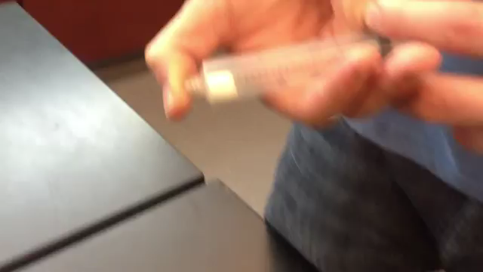
Marshmallow in a syringe
Objective: Change the marshmallow’s volume while keeping it inside the syringe.
Materials list: Syringe, marshmallow
Action plan: We will push and pull the plunger top of the syringe so that the marshmallow changes volume.
Notes:
Tips: Do not let air escape the syringe while either increasing or decreasing the volume. To return the marshmallow to normal size at atmospheric pressure at any time, just release your thumb from the tip of the syringe.
Photo credit: Walstead/Dickens SCC GK12 2013

Slide 9
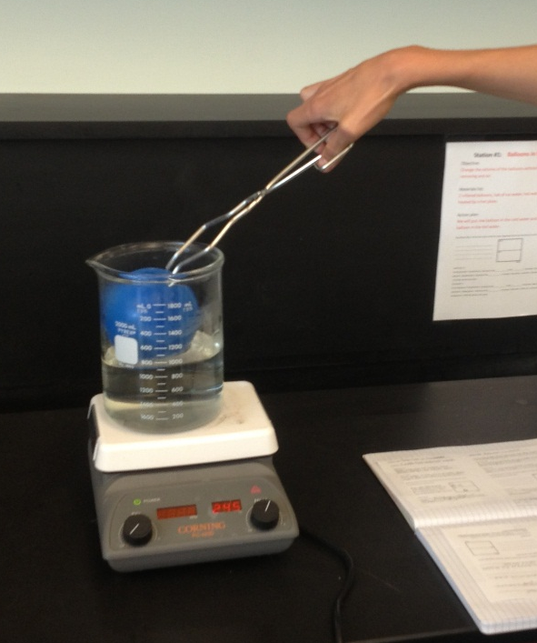
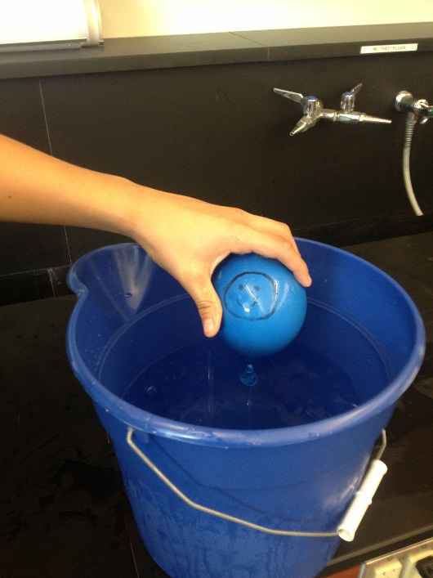
Balloons in water
Objective: Change the volume of the balloons without adding or removing any air.
Materials list: 2 inflated balloons, tub of ice water, hot water being heated by a hot plate.
Action plan: We will put one balloon in the cold water and one balloon in the hot water.
Notes:
Tips: It may be hard to notice a volume change with a small balloon. Try drawing a smiley face or a symbol on the balloon with known dimensions. Use a ruler to see if the symbol changes length.
Photo credit: Walstead/Dickens SCC GK12 2013

Slide 10
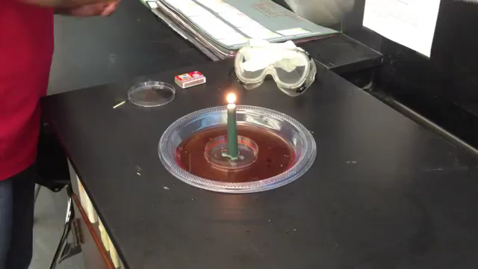
Candle in water
Objective: Raise the level of the water without touching it or adding more water.
Materials list: A dish of colored liquid, a candle, matches, a beaker.
Action plan: We will light the candle and place the beaker over it upside down.
Notes:
Tips: Drip some hot wax into the plastic dish to keep the candle from falling over.
Photo credit: Walstead/Dickens SCC GK12 2013

Slide 11
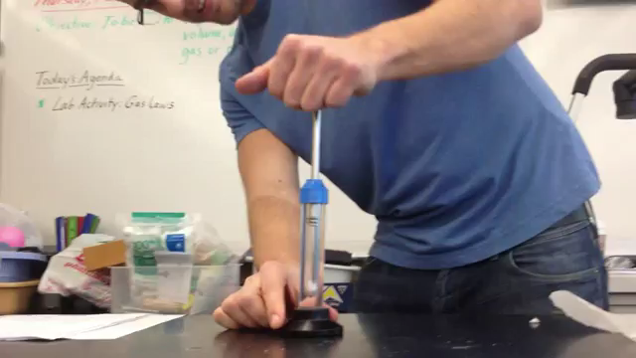
Cotton fireball
Objective: Ignite the cotton ball without using matches or a lighter.
Materials list: Cotton ball, glass cylinder, plunger.
Action plan: We will push the plunger so that the volume of the cylinder decreases.
Notes:
Tips: It may take some practice in getting the cotton to ignite. The piston must be slightly lubricated in order to completely seal the cylinder chamber. In the video above, chapstick (lip balm) was used.
Additional notes: Instead of building your own fire syringe, you can purchase them online for about $15 each from many websites by searching “fire syringe”.
Photo credit: Walstead/Dickens SCC GK12 2013

