Slide 1
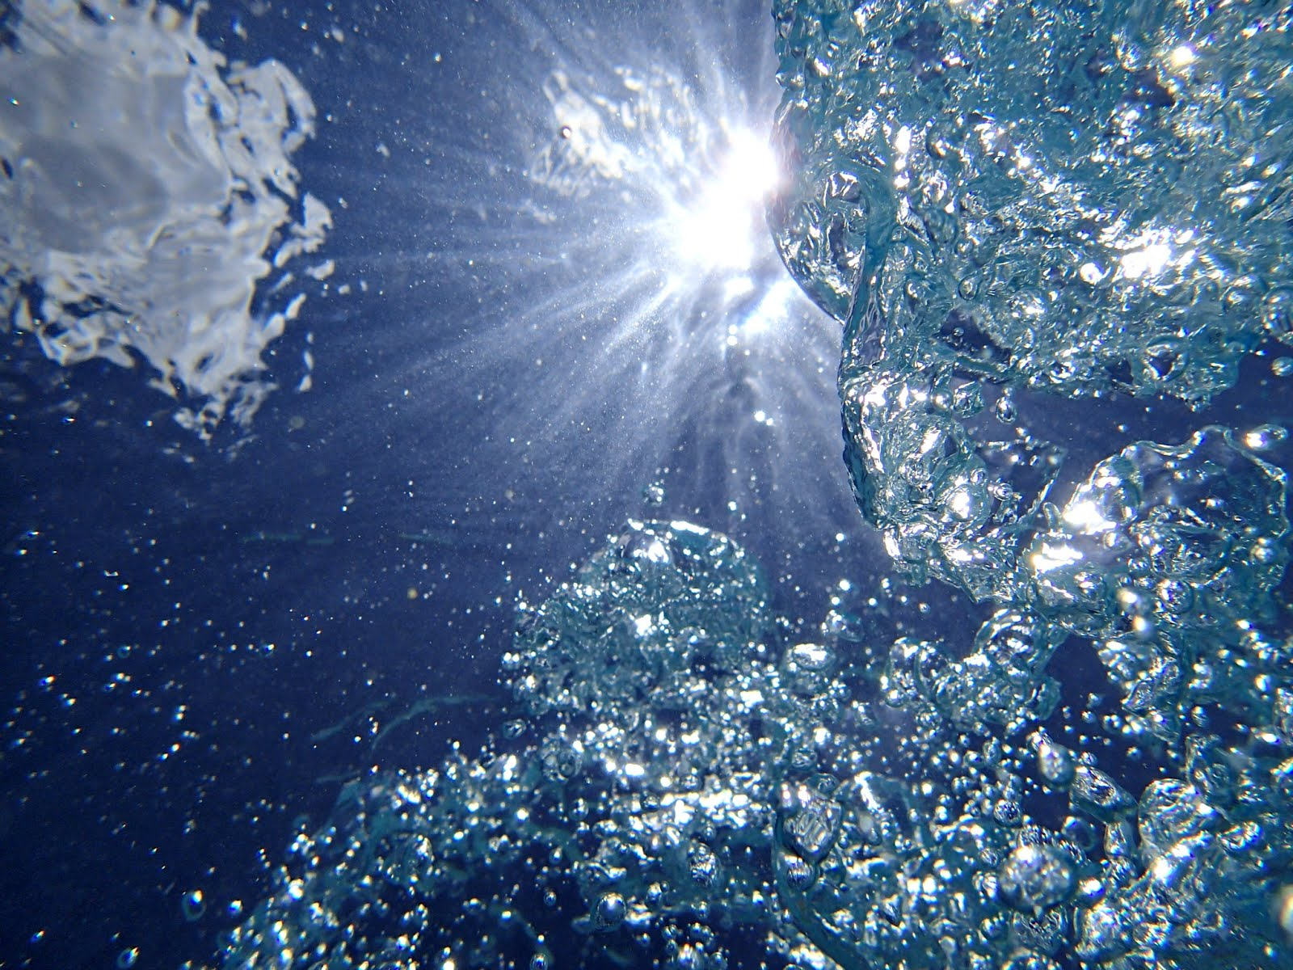
Air-sea Gas Transfer
Notes:
Notes for this slide: Ask students to remember back to the global carbon cycle. There were many reservoirs of carbon. The transfer of carbon between reservoirs is known as a flux. Today we are going to talk about one of those pathways; air-sea gas transfer. Why do we care about this flux? Excess CO2 is put into the atmosphere by the burning of fossil fuels and deforestation. Where does it all go? The ocean is one of the major sinks for anthropogenic CO2. Because we are talking about atmospheric gas, all of the properties of gases we have encountered previously still apply. So how does gas actually enter the ocean from the atmosphere and what are the components of a model that can be used to quantify that carbon flux? That question will be answered in the lesson today.
Authors: Sean Walstead, Scripps Institution of Oceanography; Alison Dickens, Lincoln High School, San Diego Unified District.
WHY: In the last 20-25 years, considerable attention has been placed on the influence of increasing greenhouse gases on global warming. Quantitative estimates of the role of the oceans in taking up increases in CO₂ are based in part on global budgets that involve considerable uncertainty.
SUMMARY: This PowerPoint presentation and accompanying worksheet will detail the aspects of deriving an appropriate air-sea gas transfer model on a global scale. Topics that will be addressed include the global carbon cycle, oceanic dissolved gas concentrations, the dynamics of wave breaking, the mechanics involved in bubble formation, and the technology used to collect data on a global scale. To set the framework for learning about air-sea gas transfer, students will perform an activity in which they examine how gases can be dissolved in liquid.
PICTURE CREDIT: http://fc09.deviantart.net/fs70/f/2010/198/a/6/Bubbles_in_the_sun_by_ComradeDmytro.jpg
WEBSITES USED IN THIS PRESENTATION: http://oceanflux-ghg.blogspot.com/2012/11/observing-gas-transfer-between-ocean.html
ADDITIONAL READING:
Wallace and Wirick, Nature 356, Large air-sea gas fluxes associated with breaking waves. 1992
Deane and Stokes, Nature, Scale dependence of bubble creation mechanisms in breaking waves. 2002.
Callaghan and White, Journal of Atmospheric and Oceanic Technology, 2009.
Baschek et. Al., Journal of Marine Research, 64, 483-515, 2006.
6.CONTEXT FOR USE: This inquiry activity is designed for a high school chemistry class. It is the fourth lesson in a sequence of 5 lessons aimed at covering interactions between the ocean and atmosphere.
7.MISCONCEPTIONS:
- Gases cannot dissolve in liquids.
- Global carbon flux values are perfectly known quantities with little uncertainty.
8.EVALUATION TIPS: There is a student worksheet that accompanies this PowerPoint lesson. Currently, the presentation is setup so that prompts appear throughout the slides to inform students when to answer certain worksheet questions. Instead of completing worksheets, any of the worksheet questions can be answered by brainstorming in groups and sharing ideas with the class. Students may perform think-pair-share exercises when answering the worksheet questions, use whiteboards, or simply finish the questions as homework. Also there is a worksheet for the Dissolving Liquids activity.
9.TEACHING NOTES: No prep is required other than having the materials ready to use for the Undissolving Gas activity.
10.TEACHING INSTRUCTIONS:
1.) Perform the Undissolving Gas activity to provide a framework for students to start thinking about gases dissolving in the ocean.
2.) Teach the presentation on Air-sea Gas Transfer and instruct students to follow the on-screen prompts to answer the associated worksheet questions.

Slide 2
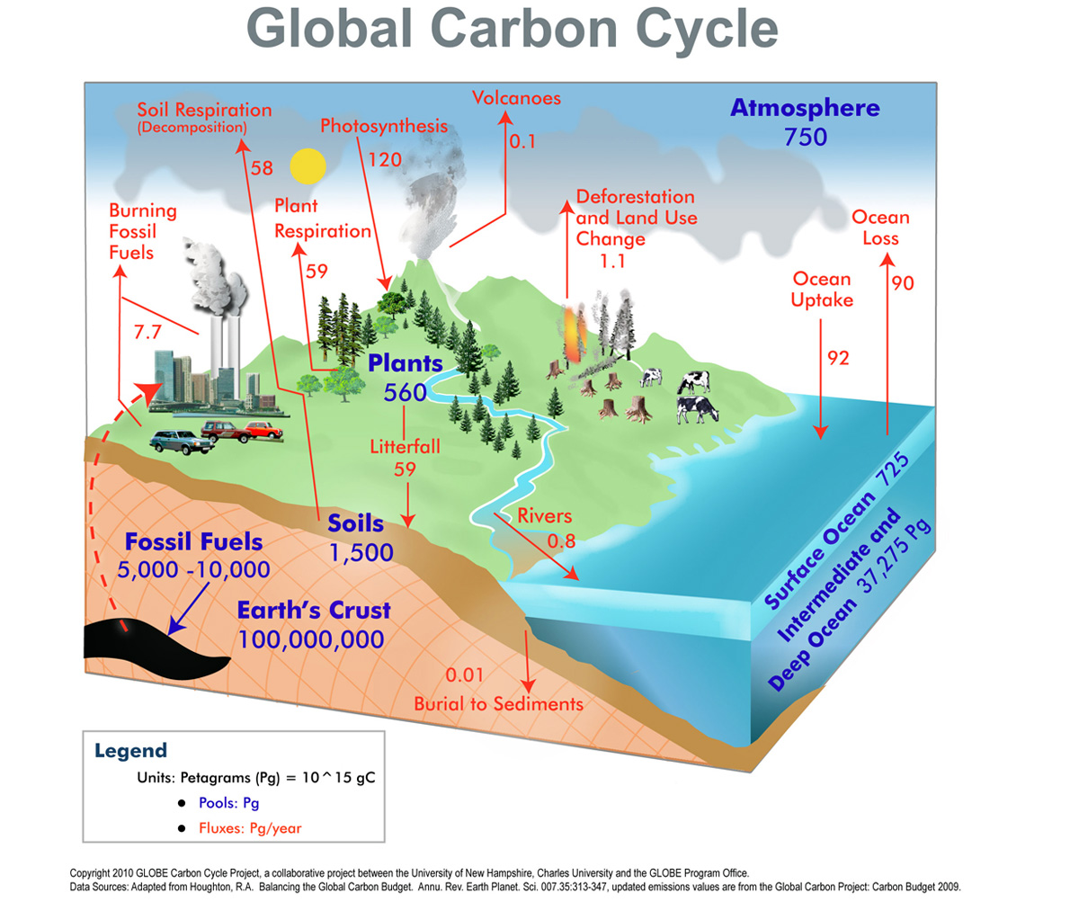
Answer questions #1 and #2 now
Notes:
This diagram is the same from the first lesson on the global carbon cycle. Highlight the anthropogenic CO₂ input to atmosphere circled on the left. This is one of the few fluxes in the global carbon cycle that humans have control over. Also deforestation is a human-derived flux. Carbon dioxide is input to the atmosphere from the burning of fossil fuels. What happens to it? Well, some of it enters the ocean. How much gas transfer actually occurs between the ocean and atmosphere?
Today’s lesson focuses on estimating this flux. In the last 20-25 years, considerable attention has been placed on the influence of the increase in greenhouse gases on global warming. Even today, the exact mechanisms responsible for air-sea gas transfer are not completely understood.
Quantitative estimates of the role of the oceans in taking up increases in CO2 are based in part on global budgets that involve considerable uncertainty. For moderately soluble gases such as CO2 and O2, the transfer across the air-sea interface at lower wind speeds is controlled by the aqueous boundary layer and is parameterized in terms of a gas transfer velocity. At higher wind speeds, above 10-12 m/s say, there is a relatively sharp increase in gas diffusion across the air-sea boundary. This increase in transfer velocity has been attributed to the onset of breaking and bubble entrainment.
Wind speed and bubble entrainment is just one piece of a model of air-sea gas transfer. Wind speeds all over the world must be known! That’s not a trivial task. The modeling work becomes very complicated very quickly.
Better understanding of air-sea gas transfer processes have depended to a great extent on laboratory studies, which may not faithfully represent the full complexity of the wind-driven sea surface. Therefore more ongoing theoretical, laboratory, and ocean work is required to better understand the complete interaction between atmospheric gases and dissolved gases in the ocean.
Worksheet question 1: On average is the ocean a source or sink for global carbon? What chemical form (molecular structure) is the carbon that enters the ocean from the atmosphere?
Answer: On average, the ocean is a sink for global carbon. The carbon that enters the ocean from the atmosphere is carbon dioxide. Although methane is an important atmospheric gas composed of carbon, its solubility in water is much less than that of carbon dioxide.
Worksheet question2: Do you think it is reasonable for all global transfer of carbon between the ocean and atmosphere to be represented by one number?
Answer: Attributing a global carbon flux to a single number is helpful because it puts that process in perspective to other global processes. However averaging a carbon flux into just one number ignores the many complicated processes contributing to that flux and does not reflect any spatial or temporal variability.
Reference: Melville, Annu. Rev. Fluid Mech., The role of surface-wave breaking in air-sea interaction, 1996.
Photo credit: http://www.wrsc.org/sites/default/files/images/2012/ccdiagram.jpg

Slide 3
Effect of anthropogenic CO₂ in the ocean
Largest natural reservoir
Absorbs 1/3 of excess CO₂
Future absorption
surface ocean acidity (pH)
NOAA (2012) from
http://earthref.org/SCC/lessons/2010/carbon/
Notes:
The ultimate fate for anthropogenic CO2 in the atmosphere will be absorption into the ocean. This is why we are concerned about how the gas transfers and how much will transfer annually. The bulleted list below expands on the points on the slide.
Global oceans are the largest natural reservoir for excess CO₂
1/3 of excess CO₂ each year is absorbed in ocean
Over next millennium, 90% of CO₂ added to atmosphere will be absorbed by ocean
By middle of this century (2050), surface ocean acidity (pH) and carbonate ion decreases are expected to be greater than those experience during the transition from ice ages to warm ages.
Additional notes: Calcium carbonate is an important mineral in the world's ocean, and in global carbon cycling. The majority of marine organisms that form shells/skeletons make them out of calcium carbonate (CaCO₃). This works, because the ocean is saturated with respect to carbonate (CO₃²⁻) several kilometers down in the ocean, and Ca²⁺ is abundant and distributed equally among ocean basins. This means that wherever the ocean is saturated with respect to carbonate, minerals made of calcium carbonate will not dissolve. As a consequence, vast swaths of the ocean floor are composed almost entirely of the calcium carbonate skeletons of phytoplankton, continental shelves are littered with clam and mussel shells, and it forms the foundation of the only structure built by a living organism (other than humans) visible from space: coral reefs. Increased ocean acidity makes it more difficult for marine organisms like coral to produce their calcium carbonate shells.
Reference: Daniel Richter and Jon Corbin, http://earthref.org/SCC/lessons/2010/carbon/

Slide 4
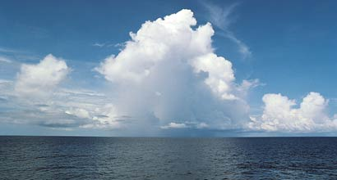
Air-sea gas transfer
How does gas from the atmosphere get into the ocean?
1. Direct diffusion
2. Bubble-mediated gas transfer from air entrained in breaking waves
Answer question #3 now
Notes:
Directions: Ask students to brainstorm answers to the question (worksheet #3), then reveal the answers.
Worksheet question 3: Brainstorm ideas about how gas is transferred from the atmosphere to the ocean. Write your ideas below.
Answer: The majority of gas transfer occurs through direct diffusion and bubble-mediated gas transfer from air entrained in breaking waves.
Additional notes:
diffusion: Movement of a fluid (gas is a fluid) from an area of higher concentration to an area of lower concentration. Diffusion is a result of the kinetic properties of particles of matter. The particles will mix until they are evenly distributed.
air entrainment: gas that is trapped

Slide 5
Air-sea gas transfer
Answer question #4 now
2-box model: diffusion
Indicate with arrows (up/down) the net flux of oxygen gas
O₂ reservoir
O₂ reservoir
O₂ reservoir
95% O₂ saturation
100% O₂ saturation
102% O₂ saturation
Notes:
This 2-box model is a good starting point for a model to describe air-sea gas fluxes because it is so simple. Before we start building up an advanced model of ocean-atmosphere gas transfer, let’s start with the basics; diffusion.
Scientists always start with a simple model and increase the complexity as necessary. In the 2-box model, the orange boxes could represent the ocean, while the black boxes could represent the atmosphere. Even though carbon dioxide is an important gas because it is a greenhouse gas, the atmosphere is composed of other important gases as well like oxygen.
Therefore we are considering the diffusion of oxygen, but really we could be talking about any water soluble atmospheric gas (like CO2).
Water may be oxygen deficient (hypoxic, anoxic) if it has been out of contact with the atmosphere for a very long time or the rate of decomposition or respiration in the oxygen is greater than the rate of photosynthesis. Water may be super saturated with oxygen if air from bubbles have been forced in the water by turbulence and breaking waves.
Worksheet question 4: Indicate with arrows (up/down) the net flux of oxygen gas.
Answer: Left: down, Middle: no arrows, even though gas in equilibrium between two reservoirs diffuses up and down, the rates of diffusion are the same and so the net diffusion (flux) is zero. Right: up.

Slide 6
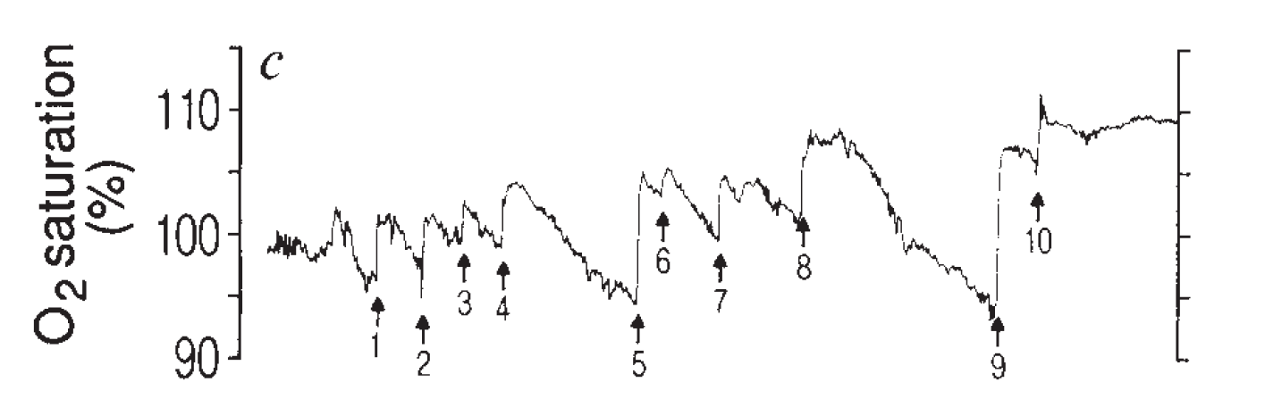
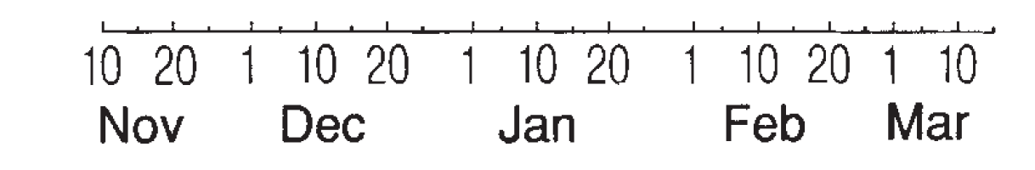
Air-sea gas transfer
Dissolved oxygen (O₂) data:
Middle Atlantic Blight
Answer question #5, #6, and #7 now
Wallace and Wirick (1992)
Notes:
Let’s look at some real data for dissolved gases in the ocean. This slide shows dissolved oxygen in the Atlantic Ocean over a period of about 5 months. Ask the students if this data record shows oxygen to be constant valued over the sampling period. There are sharp spikes (numbered with arrows) when the dissolved oxygen levels rapidly increase. Then they slowly decrease again.
Ask students to answer the corresponding worksheet questions. Then the explanation for this data is given on the next slide.
Additional information: Dissolved oxygen was measured from two Endeco Model 1133 pulses polarographic O2 sensors from a mooring in 38 m of water in a mid-shelf location. The sensors were located at 19 m and 34 m depth. Only the data from the 19 m deep sensor is shown. Dissolved oxygen saturation is plotted vs. day for about 5 months. Although it looks like a single event is causing the spike in dissolved oxygen, those spikes occur over a period of hours and are the combined result of many wave breaking events.
Worksheet question 5: What are the units on the horizontal and vertical axes?
Answer: The horizontal axis represents time and the units are days. The vertical axis represents dissolved oxygen saturation and the units are percent.
Worksheet question 6: Describe the trend for this data. What seems to happen every 7-10 days?
Answer: Dissolved oxygen rapidly increases above 100% saturation every 7-10 days. Then the saturation levels slowly and uniformly drop until another spike in dissolved oxygen saturation.
Worksheet question 7: Would you think a simple 2-box model is sufficient to describe this data?
Answer: No, a simple 2-box model would not explain the rapid spikes in dissolved oxygen concentration. The model must be extended.
Reference: Wallace and Wirick, Nature 356, Large air-sea gas fluxes associated with breaking waves. 1992

Slide 7
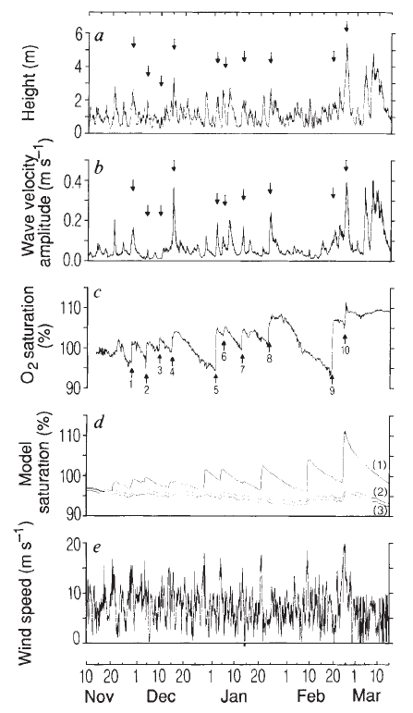
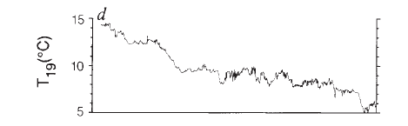
Air-sea gas transfer
Answer questions #8 and #9 now
Distinct events occur at the same time
Wallace and Wirick (1992)
Notes:
So let’s now try and figure out what’s going on with the dissolved oxygen record. Let’s plot some additional parameters.
In addition to the dissolved oxygen saturation shown on the previous slide (and top figure of this slide), also plotted are significant wave height, temperature, wave velocity amplitude, and wind speed. The horizontal time axis is the same for all figures and is only shown explicitly on the dissolved oxygen plot.
Scientists use the word correlation to describe how well 2 data sets are related. For instance if several repeatable and predictable events occur at the same time between two data sets, that data is correlated. So which data is correlated with the spikes in dissolved oxygen? It happens to be wave velocity amplitude and wave height.
So what is happening? The answer corresponds to worksheet question #9. The strong relationship with wave parameters suggests that the sudden O2 increases were produced by wave breaking and consequent injection of air. The “recovery” periods would represent periods of net outgassing after the air injection process was switched off.
So modeling ocean air-sea gas flux is not as simple as a 2-box diffusion model! It looks like we need to know about how waves break and how air is entrained in breaking waves. That will be the focus of the next 5 or so slides.
Worksheet question 8: Additional data is shown for sea surface height, wave velocity, temperature, and wind speed. Which other data seems related to the dissolved oxygen record? Note: for data to be correlated (related) it does not have to look identical, there must be distinct events happening at the same time.
Answer: Temperature is definitely uncorrelated with the dissolved ocean data. A weak correlation exists between wind speed and dissolved oxygen data. The strongest correlation is between both wave velocity and wave height and dissolved oxygen.
Worksheet question 9: Why would fast moving waves be related to dissolved oxygen concentration? What is happening here to explain the behavior in dissolved oxygen?
Answer: The strong relationship with wave parameters suggests that the sudden O2 increases were produced by wave breaking and consequent injection of air. The “recovery” periods would represent periods of net outgassing after the air injection process was switched off.

Slide 8
Modeling air-sea gas transfer
2-box diffusion model is not sufficient, we need additional components
Model components:
Dissolved gas model
Bubble model
Dynamic model
Notes:
So the simple 2-box diffusion model is not sufficient to describe dissolved oxygen (and consequently other atmospheric gases like CO2).
The more advanced model being outlined on this slide describes one used by Liang et. Al. (2011) to simulate bubbles and dissolved gases in the ocean. Note that this particular model to describe air-sea gas transfer combines 3 individual models.
For the sake of time, we will only investigate the dynamic model. What effect does wave breaking have on air-sea gas transfer? That will be the focus of the next few slides.
The students should be encouraged that they are already familiar with many of the model components. The dissolved gas model describes diffusion and acid/base chemistry. The bubble model uses the ideal gas law to predict their behavior. The dynamic model is most likely the model component that students are least familiar with. The next few slides will clarify how ocean dynamics like wave breaking are treated.
Dissolved gas model is similar to the 2-box model, describes gas exchange between the atmosphere through the ocean surface and bubbles. Includes acid/base chemistry of the ocean as well.
Bubble model describes how bubble depth, radius, and number of entrained gas molecules changes in time according to the properties of gases and gas laws.
Dynamic model: describes water flows in an ocean boundary layer. The water velocity field can be a steady current or contain turbulent events like breaking waves.

Slide 9
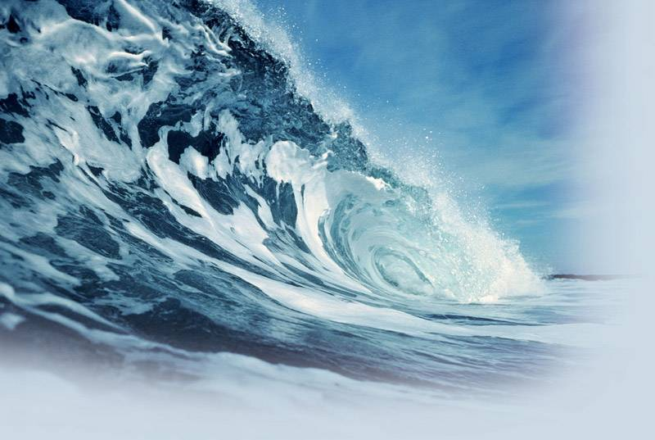
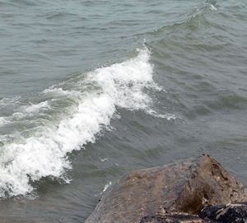
Parts of the dynamic model: waves
Plunging breaker
Spilling breaker
Notes:
Now we will discuss the role of wave breaking in air-sea gas exchange. First, what do breaking waves in the ocean look like? Generally speaking there are plunging breakers and spilling breakers.
Plunging breaker: a plunging wave occurs when the ocean floor is steep or has sudden depth changes, such as from a reef or sandbar. The crest of the wave becomes much steeper than a spilling wave, becomes vertical, then curls over and drops onto the trough of the wave, releasing most of its energy at once in a relatively violent impact.
Spilling breaking: When the ocean floor has a gradual slope, the wave will steepen until the crest becomes unstable, resulting in turbulent whitewater spilling down the face of the wave. This continues as the wave approaches the shore, and the wave's energy is slowly dissipated in the whitewater. Because of this, spilling waves break for a longer time than other waves, and create a relatively gentle wave. Onshore wind conditions make spillers more likely.
Do we need to differentiate between these two types of waves in our air-sea gas exchange model? As we will see in the next few slides, we actually do not. Both waves result in similar predictable bubble clouds.

Slide 10
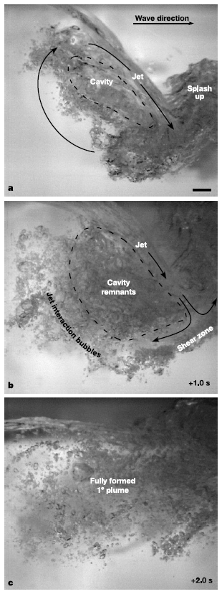
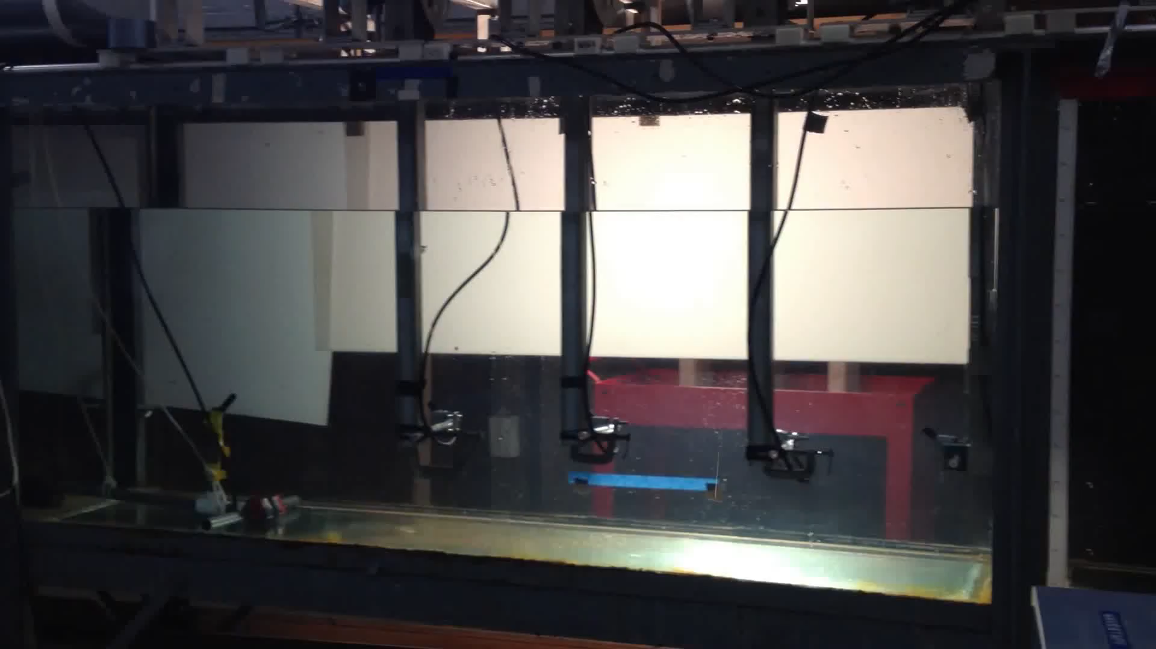
More plunging breakers
Walstead (2013)
Deane and Stokes (2002)
Notes:
To further demonstrate what breaking waves look like, there is a video on the left and high speed camera images on the right.
Both examples shown are plunging breakers. The mechanisms for the wave breaking event in both the video and the image are the same. Each wave steepens until the wave crest overturns and plunges into the wave face entraining air and forming bubbles.
References:
image: Deane and Stokes, Nature, Scale dependence of bubble creation mechanisms in breaking waves. 2002.
Video reference: Sean Walstead (2013)

Slide 11
We are interested in air-sea gas transfer
Are the bubbles produced in each case the same size?
Plunging breaker
Spilling breaker
Notes:
We will answer the question, “Are the bubbles produced in each case the same size?”, in the next 2 slides.
Breaking waves in the open ocean create dense plumes of bubbles that can extend 0.5m or more below the surface and have void fractions of air exceeding 10%. The bubbles in the plumes range in size from tens of micrometers to centimeters, and are known to be important for a number of diverse phenomena, including the enhanced transport of gases across the ocean surface, ambient noise generation, the production of aerosols, and the scavenging of biological surfactants.
The single most important property of the bubbles is their size distribution. The distributions and dynamics of bubbles in the upper ocean tens to hundreds of seconds after their formation are fairly well understood.
Reference: Deane and Stokes, Nature, Scale dependence of bubble creation mechanisms in breaking waves. 2002.

Slide 12
Challenge
How many times can a paper be folded in half?
Answer question #10 now
Notes:
This challenge presents an analogy to wave breaking and bubble formation that students can concretely identify with.
The answer is given on the next slide.
Directions: Pass out equal sized slips of paper to each student. Ask the students to count how many times the paper can be folded in half. Have students share their results discuss why the paper cannot be ripped indefinitely.
Worksheet question 10: How many times can the paper be ripped in half, stacked, and ripped again.
Answer: Most students will find that they can fold the paper no more than 7 or 8 times.

Slide 13
We are interested in air-sea gas transfer
Are the bubbles produced in each case the same size?
Plunging breaker
Spilling breaker
Answer question #11 now
Yes!
Notes:
So how is folding paper related to bubble formation? Turbulence causes the bubbles in breaking waves to fragment repeatedly (analogous to you folding the paper) until eventually they are so small that surface tension becomes too strong to overcome (analogous with the paper being too thick). This means that regardless of how a wave breaks, the bubble sizes are guided by surface tension.
Remind students that surface tension was covered in lesson 2 and is resurfacing in terms of bubble production in the ocean. Is surface tension constant throughout the whole ocean? No! Biological productivity tends to result in a higher level of surfactants in the ocean. This lowers surface tension and has an impact on bubble production during wave breaking.
Worksheet question 11: How is this paper folding exercise analogous to bubble formation during wave breaking? What is keeping the very small bubbles from splitting?
Answer: Turbulence causes the bubbles to fragment repeatedly (analogous with you ripping the paper) until eventually they are so small that surface tension becomes too strong to overcome (analogous with the paper being too thick)

Slide 14
Modeling air-sea gas transfer
So how far have we come with our model?
Total air-sea gas model components:
Dissolved gas model:
Bubble model:
Dynamic model:
We have described how waves behave and the type of bubbles that are produced
Notes:
Now we now know that bubbles formed during wave breaking will have a predictable size distribution. Why is this important? Well our dynamic model will need to include the effects of wave breaking on air-sea gas exchange. We need to know bubble size in order to know the actual surface area per dispersed volume that diffuses gas. This uses known diffusion constants and gas concentrations. Actually measuring bubble gas diffusion rates directly is difficult.

Slide 15
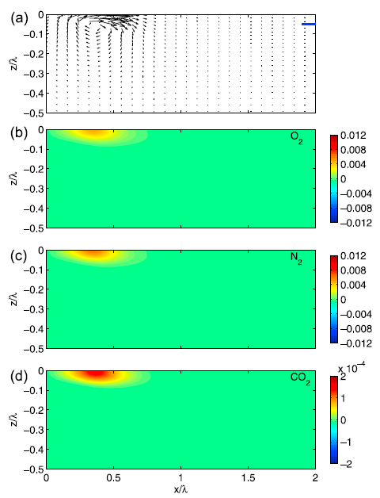
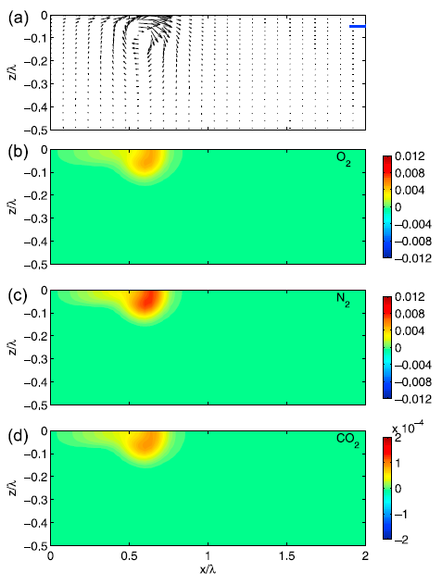
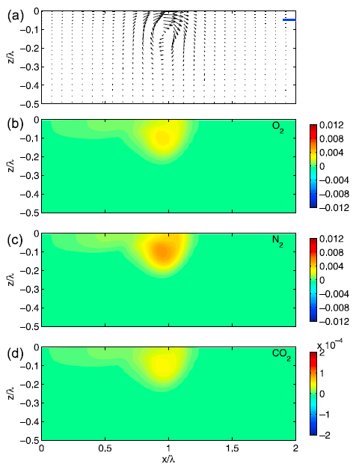
Let’s look at some model results
CO₂ Saturation levels after wave breaking
t = 3 sec
t = 15 sec
t = 70 sec
Liang, et. al. (2011)
Bubbles obey the ideal gas law
Remember your PTV sticks!
Answer questions #12, #13 and #14 now
Notes:
So far we have only highlighted some of the modeling aspects of 1 component (dynamic model) of an entire air-sea gas transfer model. The other components of the model are based on known physics and chemistry of acids and bases, ideal gas laws, bubble behavior models.
Let’s take a look at some results from an actual complete air-sea gas model.
The top panel in each 3 figures show the water velocity field after wave breaking. The swirling motion is a familiar feature common with breaking waves. The lower panels in each 3 figures show dissolved carbon dioxide saturation. In both cases horizontal and vertical axes represent horizontal and vertical wave channel distance respectively. The time above each figure refers to time since the wave breaking event.
The dissolved gas concentration increases (shown has red and orange) because of the air entrained during the wave breaking event. As bubbles persist in the water, gas dissolves from inside the bubble to the surrounding water. If the bubbles were to be advected (moved) to greater depths by currents, the bubble volume would decrease because of increased pressure (Boyle’s law!). Decreased bubble volume would increase gas flux from the bubble to the water because the ratio of surface area to volume would increase.
Worksheet question 12: Does pressure increase or decrease as you go deeper in water? What happens when you dive to the bottom of a pool?
Answer: Pressure increases as you go deeper in water. This is because there is increased force due to the weight of water overhead as you go deeper. When you dive to the bottom of a pool, you can feel the increased pressure on your inner ear.
Worksheet question 13: Assuming the temperature of the upper ocean is constant, what happens to bubble volume as a bubble goes deeper in the water? Hint: your answer to the previous question will help.
Answer: As a bubble does deeper in water, the ambient pressure increases. This results in the bubble volume decreasing.
Worksheet question 14: Saturation levels. According to the simulations after a wave breaks, do dissolved carbon dioxide levels increase or decrease?
Answer: After a wave breaks, dissolved carbon dioxide levels increase. Those higher dissolved oxygen concentrations persist even 70 seconds after the wave breaking event.
Reference: Liang et. Al., Jour. Geophysical Research 116, Modeling bubbles and dissolved gases in the ocean, 2011.

Slide 16
Notes:
The model on the previous slide only accounts for the effect of ONE breaking wave. But waves are constantly breaking over all parts of the world’s oceans! The problem is getting complicated again!
We need to be concerned about the combined effect of all the waves in all the oceans. That seems hard! The flux value of 92 Pg/year given on this slide incorporates and averages ocean events from all over the planet.
We need advanced technology to give information about ocean conditions on a global scale. The next slide will highlight some of the technology scientists use to make estimates of gas transfer.

Slide 17
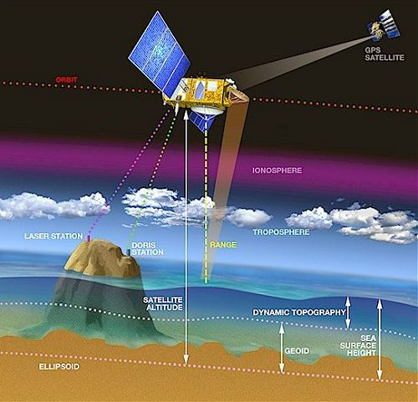
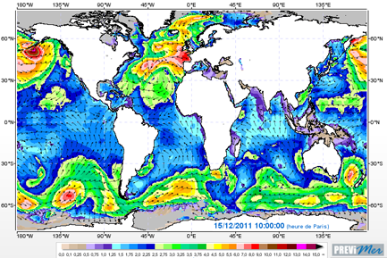
Satellite altimeters
Satellite altimeters can measure the slope of waves generated by wind.
Significant Wave Height (m) forecast for December 15, 2011, 10:00 Paris local time, the winter storm Joachim over Europe is clearly marked.
Notes:
Satellites provide scientists with a means for monitoring physical processes all over the globe. They operate by sending electromagnetic radar information down to the ocean and then analyzing how it is reflected back to the satellite. In this way satellites can provide information about wave steepness and wave height.
Recent studies show a relationship between air-sea gas transfer and wave steepness. An example of data from a satellite altimeter
The plot above shows wave height at a given moment on December 15, 2011. The red swirls indicate very high sea height and are indicative of storms. Wave breaking and air entrainment will be very high in those regions. All that data must be incorporated into a model if air-sea gas fluxes are to be estimated on a global scale.
Photo credit:
satellite: http://www.altimetry.info/images/alti/principle/methode_en.jpg
Significant wave height map: http://oceanflux-ghg.blogspot.com/2012/11/observing-gas-transfer-between-ocean.html

Slide 18
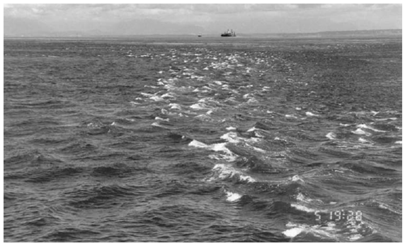
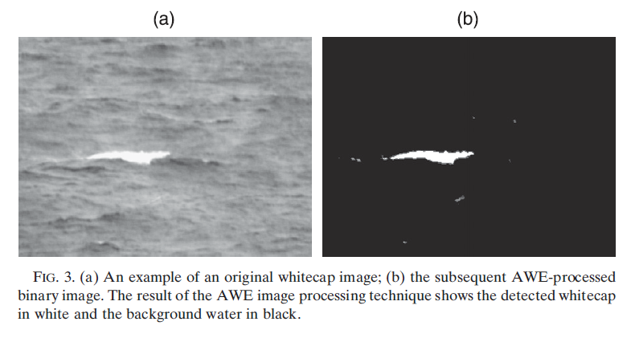
Imaging technology
Do all bubbles transfer gas equally?
  Use the satellite image whitecapping model
Baschek (2006)
Callaghan (2009)
Notes:
But satellite altimeters do not entirely answer the whole question! Because CO₂ is only slightly soluble in water, wave slope measurements from satellite altimeters do not answer the entire question. Bubble mediated gas transfer must be taken into account.
Do all bubbles transfer gas equally?
Bubbles may transfer gas differently depending on the type of water they are in. Ocean water with high biologic productivity and thus high levels of surfactants may contain sea foam that persists for longer periods of time.
Recent work uses camera imaging from satellites to detect how much sea foam exists on the ocean surface. Those measurements can be cross-referenced with satellite altimeters that measure sea surface slope.
Additional information: On this slide, the figure on the left is from a paper by Callaghan in the Jour. of Atmos and Ocean Tech. It shows how scientists automate with computers the process of measuring ocean white caps. The photo on the left is a satellite image and run through an AWE (automated whitecap extraction (AWE)) process to result in the detected whitecap on the right. By automating this process, scientists can analyze many more satellite images than could be by hand.
Photo credit:
Callaghan and White, Journal of Atmospheric and Oceanic Technology, 2009.
Baschek et. Al., Journal of Marine Research, 64, 483-515, 2006.

Slide 19
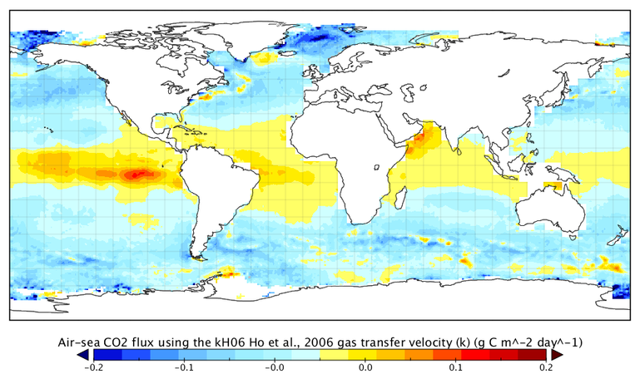
Who actually does this?
Oceanflux Greenhouse Gases project
(funded by European Space Agency)
Notes:
At this point, we have discussed some of the aspects in building a large-scale model of air-sea gas transfer on a global scale. Shown in this figure are the actual results of such a global air-sea gas transfer model. The map shows the daily mean of air-sea carbon dioxide flux averaged over an entire year.
The most obvious feature of the map is that gas transfer is not uniform across the entire planet!
Negative flux (blue) indicates gas flux from air to sea ,while positive flux (red) indicates gas flux from sea to air. Clearly CO2 gas flux is not constant across the planet. The net transfer of CO2 in the polar regions may be due to increased gas solubility of cold ocean water vs. warm water. Also storms in the Arctic may increase wave action which would increase bubble-mediated gas transfer. In the tropics, net gas flux is from ocean to air. This may be due to warmer ocean temperatures.
The research presented on this slide is from the Oceanflux Greenhouse Gases project which is funded by the European Space Agency.
Photo credit: http://www.oceanflux-ghg.org/

Slide 20
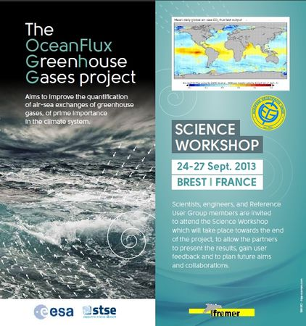
Air-sea gas transfer
Who cares?
Policy makers
Biologists
Car manufacturers
Climate scientists
Green technology engineers
Fisheries management
Power supply companies
Shipping industry
Notes:
So who cares about air-sea gas transfer?
Policy makers
Biologists
Car manufacturers
Climate scientists
Green technology engineers
Fisheries management
Power supply companies
Shipping industry
A notice for a science workshop is presented to show students that this is a very active and ongoing research topic.
The ultimate fate of anthropogenic CO2 is absorption into the ocean. The better we understand that process of air-sea gas transfer, the better we can make policies and technologies to deal with increasing carbon dioxide in our atmosphere.
Photo credit: http://www.oceanflux-ghg.org/

Slide 21
Conclusions
Fate of anthropogenic CO₂ is in ocean
2-box model not sufficient
Bubbles and breaking waves must be included
Global measurement techniques
Air-sea gas flux model results
Notes:
In this lesson we have details aspects of a global air-sea gas exchange model. Why do we care about such a model? The ultimate fate of anthropogenic CO2 is absorption in the ocean. Increasing atmospheric carbon dioxide levels will make the ocean more acidic and less able to support calcium carbonate shelled organisms. Understanding just how gas enters the ocean from the atmosphere will help scientists make better predictions about the ocean’s response to increased carbon dioxide levels in the atmosphere.
We showed that a simple 2-box diffusion model is not sufficient in describing global air-sea gas transfer.
This is because bubbles and breaking waves must be included. Air entrainment from breaking waves is a major mechanism for the transfer of gas from the atmosphere to the ocean.
In order to quantify gas fluxes on a global scale, advanced technology such as satellite cameras and altimeters must be used to observe ocean phenomenon.
We have shown the results of one research group’s model of air-sea carbon dioxide gas transfer. The flux of carbon dioxide from ocean to atmosphere is not uniform across the planet. This is why averaging all of those flux values into one single number to describe air-sea gas transfer does not really explain the entire story of what is going on.

Slide 22
Air-sea gas transfer
Answer questions
#15 and #16 now
Notes:
Worksheet question 15: Are there any additional components to an air-sea gas transfer model that were not mentioned you feel should be considered?
Answer: Answers will vary. Possible answers include considering the role of ocean biology in ocean gas concentration, using accurate weather data to help predict gas transfer, better knowledge of specific ocean chemistry affecting gas transfer like surfactants and local acidity.
Worksheet question 16: Recall on the global carbon cycle diagram that carbon flux to and from the ocean and atmosphere were represented by a single number. Other fluxes that are represented by a single number are carbon input to the atmosphere from the burning of fossil fuels. What do you think are some components of the model used to determine that value?
Answer: Answers will vary. Possible answers include knowing the specific distribution (quantity) of manufacturing facilities, traffic and car patterns, the carbon output of cars, the type of fossil fuel being burning at power plants, etc.

