Slide 1
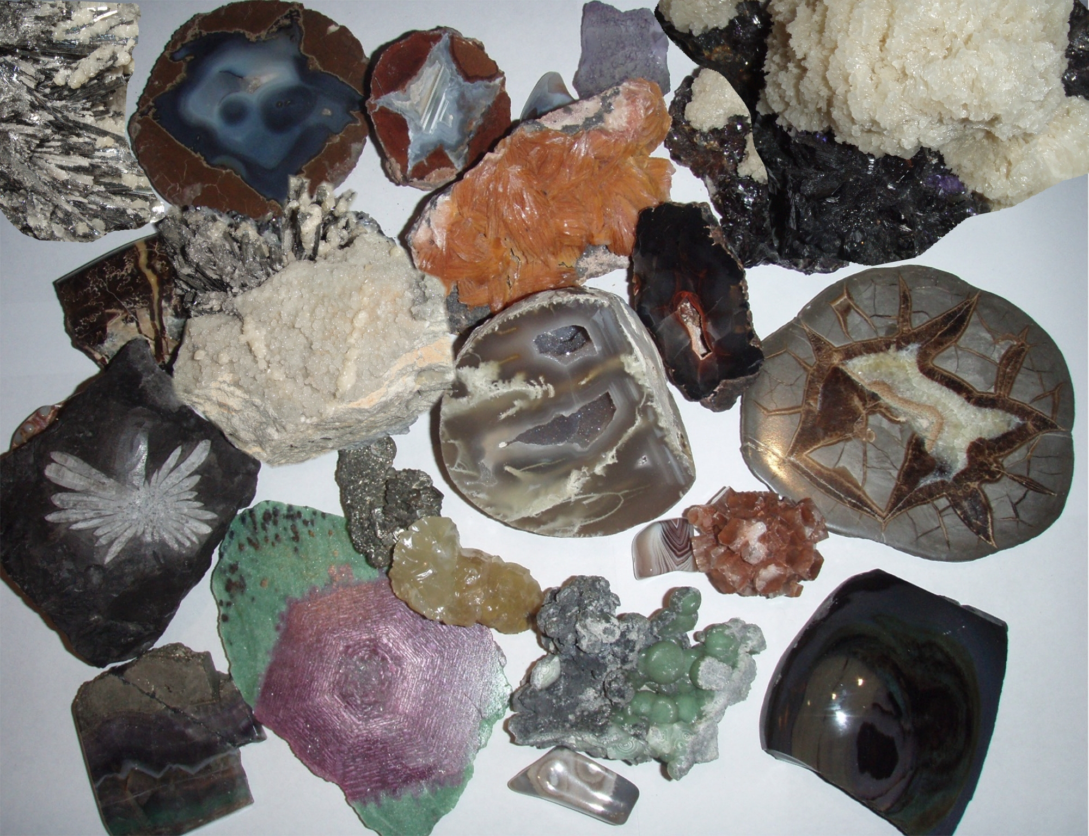
Key Question:
What are rocks and minerals?
How are they different?
http://earthref.org/SCC
Notes:
Title Slide Notes:
Have students answer the key question in their notes. Give them 5-10 minutes to write the question and their answer in their notebooks. Then ask them what they know and list ideas on the board. See if they can determine different types of rocks and minerals and what might make them different.
AUTHORS:
Natalie Juda – Scripps Institution of Oceanography, Joe Krupens – University City High School
WHY:
Rocks and minerals are used in many forms in our lives including road material, industrial applications, electronics, makeup, food, and jewelry. This presentation will inform students of types and how to identify them.
SUMMARY (< 100 words):
This lesson is an introduction to rocks and minerals. The focus is to help students learn what rocks and minerals are and how to distinguish between them. An activity introducing students to analytical observation and description of rocks and minerals follows a short introductory lecture. Students use critical thinking to use limited information on each type of rock to make educated guesses as to which rock belongs to what category. This lesson leads into deeper explorations of each rock type in subsequent lessons, culminating in how they all relate to each other.
PICTURE/GRAPHICS CREDITS:
Picture taken from wikipedia: http://en.wikipedia.org/wiki/File:Different_minerals.jpg
WEBSITES USED IN THIS PRESENTATION:
Good images of rocks and minerals as well as associated information can be found at
http://skywalker.cochise.edu/wellerr/VGM/intro.htm
ADDITIONAL READING:
A good reference book at a level for first year university geoscience students is Essentials of Geology, by Lutgens, Tarbuck and Tasa.
CONTEXT FOR USE:
This is geared toward a 9th grade class with a low level of knowledge of earth science. It is meant to follow after a unit on volcanoes and the students should have prior knowledge of plate tectonics as well. This is one part of a larger unit on rocks in general as this is one of the three main rock types along with sedimentary and metamorphic.
MISCONCEPTIONS:
Rock types are unrelated to each other
All rocks are the same and it’s hard to tell how they originated
Rocks and minerals are the same; distinguishing them is not important
Minerals are not important in my life
EVALUATION TIPS:
For this lesson students examine rocks and minerals using the Rock + Mineral descriptions worksheet and should be able to fill out the mineral section of the Rock Identification Guide.
TEACHING NOTES.
This unit is formulated to fit a 5 “E” learning method format. Students “engage” when answering a key question in their notes and sharing their ideas with the class. Following this, an activity is introduced where students “explore” a particular aspect of the lesson, in this case an exploration of rocks and minerals and basic identification. Students then “explain” what they learned and are evaluated using a worksheet “Rock + Mineral Descriptions”. The next three lessons expound upon rocks in much greater detail with additional activities to “extend” and be “evaluated” again.

Slide 2
Rock-Forming Mineral Groups
 | Chemical Formula | Example | Comments
Native Element | C S Au | Diamond Sulfur Gold | Jewelry, industry Acid Jewelry
Oxide | Fe₂O₃ | Hematite | Ore of iron
Sulfide | PbS FeS₂ | Galena Pyrite | Ore of lead Fool’s gold
Carbonate | CaCO₃ | Calcite | Limestone, marble
Silicate | SiO₂ (Na, Ca)AlSi₂O₈ | Quartz Plagioclase | Most common minerals, Gemstones, makeup, foods, sand, etc.
http://earthref.org/SCC
Notes:
Table of common rock-forming mineral groups with chemical formulas, examples, and uses
This table includes the main groups of minerals in the first column on the left. Descriptions of chemical formulas, examples, and comments follow in each column to the right.
First help the student with the definition of a mineral: A mineral is made of chemical elements (or molecules) that are arranged in a particular pattern that repeats itself to make a crystal structure. They are solid, naturally occurring, and non-organic. Each mineral has a chemical formula. The table shows rows of five general categories of minerals based upon the structure of the chemical formula comprising each mineral (native element, oxide, sulfide, carbonate, silicate). The columns contain information about the minerals including the chemical formula, examples corresponding to the chemical formulas listed and comments about each of the examples, particularly related to their use.
Some minerals have the same chemical formula, but a different crystal structure (e.g. graphite and diamond are both minerals made solely of carbon atoms but they are arranged in different structures that give them different properties). This property, known as polymorphism, will be covered in a later slide.
Native elements include most metals (not alloys) and others like diamond and sulfur, and are made of only one element. Other minerals are compounds, formed from a combination of elements in a chemical formula.
The other groups of minerals are named for the common compound to which other elements are bonded (e.g. oxides – elements bonded with oxygen, sulfides – elements bonded with sulfur, silicates – elements combined with silicon and oxygen, carbonates – elements combined with carbonate a chemical compound consisting of one carbon atom combined with three oxygen atoms). It may be helpful to list these general categories with the compounds which give each its name on the board for visual correlation between the two as in the table below.
The examples of native elements are diamond, sulfur and gold, each with distinct properties though made of only the one element. Diamond is a particular arrangement of carbon atoms with very strong covalent bonding that is responsible for its famous properties, in particular, hardness and thermal conductivity. These properties are what allow diamond to be useful as abrasive. In addition its clear brilliance make it particularly attractive for jewelry, especially wedding rings. Sulfur is a nonmetal. Its primary uses are to make sulfuric acid for industrial purposes and as a fertilizer. It is also used in incendiaries such as matches and gunpowder. In addition, its strong smell has useful properties such as odorizing natural gas. Gold is a metal that doesn’t react with other elements easily, thus it is most often found in its native element form instead of in compounds with other elements. Its softness and brilliant color are bases of its use as a basis for currency and for jewelry.
Hematite and galena are examples of oxides and sulfides. Many of these minerals are ores of metal elements and are mined to extract the metals useful in many industrial purposes (such as steel beams in buildings, car frames, electronic components and many other industrial appliances and other applications).
Pyrite is the most common sulfide mineral and has a similar color to gold, so is often confused for gold. It is useful in the production of sulfuric acid which forms when the mineral is chemically weathered.
Carbonates like calcite make up limestone and marble and are useful in building materials, including Portland cement, road aggregate, and building stones, as well as a great material for sculptures and ancient buildings.
However, the most common minerals are silicate minerals (make up over 90% of the earth’s crust). These have the most widespread properties though they are made of mainly silicon and oxygen atoms. The differences occur due to the different structures and arrangements of the minerals with different bonds. Clays make up most of the soils on earth and are important for building materials. Some of the clay minerals are used in kitty litter as they absorb water well, while others are used to thicken foods such as milkshakes.

Slide 3
Mineral Identification
Crystal Form
Cleavage
Luster
Streak
Hardness
Color
Other Properties…. Taste, smell, feel, tenacity, reaction to acid, magnetism,
http://earthref.org/SCC
Notes:
List of properties of minerals used for identification
Each mineral has its own particular set of physical properties that allow us to identify them including their crystal form (structure), cleavage or fracture (how it breaks), luster (the shine), streak (the color of the rock when finely powdered), hardness, color, and other properties.
Crystal form or habit is the term used to refer to the common shape of crystals of the mineral. Many minerals have a distinctive shape, though some have several different forms.
Cleavage is related to the crystal structure of the mineral, i.e. how the molecules are bonded together to form the crystal. Cleavage is the tendency of a mineral to break along planes of weakness (where weak bonds occur within the mineral structure).
Luster is a property associated with the general appearance of the mineral, i.e. how light reflects off the surface of the mineral. Metals have a metallic luster. Other common lusters are glassy, pearly, greasy, silky and earthy, each evoking a different appearance.
Streak is the color of the mineral when powdered. The minerals are generally rubbed against unglazed porcelain to create a powder, however minerals with a hardness greater than the porcelain will not powder in this manner.
Hardness is a measure of the resistance to scratching. As mentioned above related to streak, certain minerals are harder than others and when rubbed together one may scratch the other while the other is scratched. Minerals are divided into categories of relative hardness using the Mohs hardness scale from weakest to hardest (1= talc, 2=gypsum, 3=calcite, 4=fluorite, 5=apatite, 6=orthoclase, 7=quartz, 8=topaz, 9=corundum, 10=diamond). Other measures of hardness often used in the laboratory are fingernail (2.5), copper penny (3.5), wire nail (4.5), glass and knife blade (5.5), and streak plate – the porcelain used for creating a streak (6.5).
Color is usually the most easily distinguishable characteristic of a mineral. However, it is not very diagnostic in identifying minerals as slight impurities in the mineral structure may change the color (e.g. quartz can be clear but also tinted many other colors such as pink, purple, yellow, gray, even black). Sometimes a single sample of a mineral may contain many colors. Therefore, color may even be misleading and is not commonly used as a diagnostic tool.
Some other properties include taste, smell, feel, tenacity, reaction to acid, and magnetism. Taste can be used to identify rock salt due to its salty flavor. Smell is diagnostic especially for minerals like sulfur with a particularly strong diagnostic odor. Feel, simply touching the surface of a mineral, can also be diagnostic, (e.g. graphite has a greasy feel, talc has a soapy feel). Tenacity is the mineral’s toughness (resistance to breaking or deforming). Minerals with ionic bonds such as halite (rock salt) and fluorite tend to be brittle and break when struck. In contrast, minerals with metallic bonds are malleable (easily hammered into different shapes). Some are elastic and can snap back to their former shape (e.g. micas), and some are sectile (can be cut into small shavings, like talc).
Some minerals, like calcite and other carbonates react to acid (they fizz when a drop of dilute HCl acid is dropped onto the mineral’s surface). Other minerals are magnetic, such as magnetite.

Slide 4
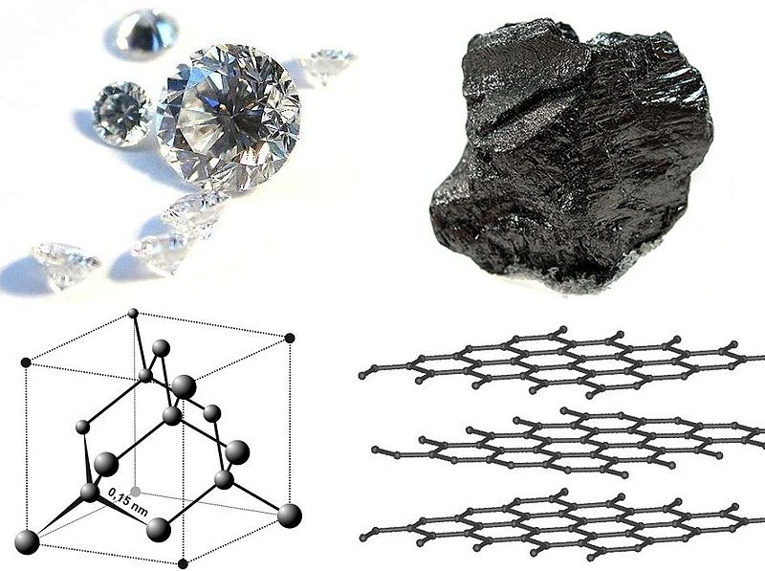
Polymorphs of Carbon
http://earthref.org/SCC
Notes:
Polymorphs of Carbon
Notes: Top left is a picture of diamond, top right is graphite. On the bottom left is the configuration of carbon atoms in diamond, and on the left is the configuration in graphite.
Some minerals have the same chemical formula, but a different structure (e.g. graphite and diamond are both minerals made of carbon atoms but they arranged in different structures that give them different properties). This is known as polymorphism as it relates to many forms of the same element (poly comes from the Greek for many, and morph comes from the Greek for change form).
Diamond is the hardest natural substance and is prized not only for making jewelry (engagement rings and the like), but also as an abrasive substance (like sandpaper using small diamond crystals rather than sand grains, you can abrade very hard surfaces that other materials cannot alter). The abrasive quality of diamond is most often in a paste form for polishing hard materials, or on cutting tools (the edges of saws are often covered in small particles of diamond in order to be able to cut through hard substances).
Graphite was commonly used as pencil lead and thus, is a very soft substance, since rubbing against paper or other material produces a powder that leaves a mark upon the material it touches.
These two substances are almost polar opposites in their properties, yet they are made of the same substance, carbon. Have students hypothesize about what makes them different.
Strong bonds in every direction of the structure in diamond make it a hard substance as the bonds are hard to break, and in graphite strongly bonded layers of carbon have weak bonds between layers allowing the material to break along the weak bonds (why graphite is so soft and was used as pencil lead).
Picture from wikipedia:
http://en.wikipedia.org/wiki/File:Diamond_and_graphite2.jpg

Slide 5
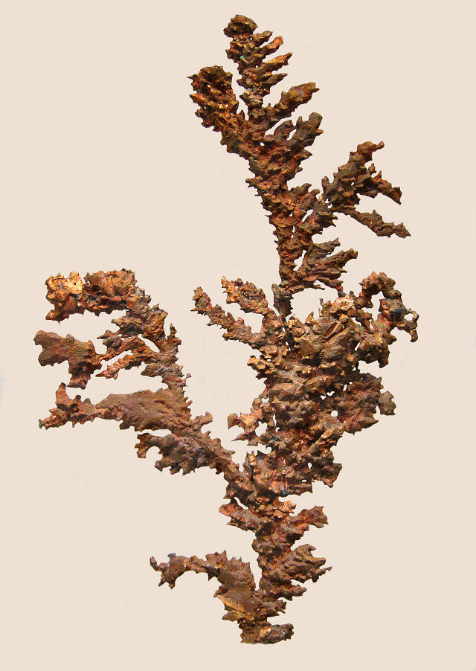
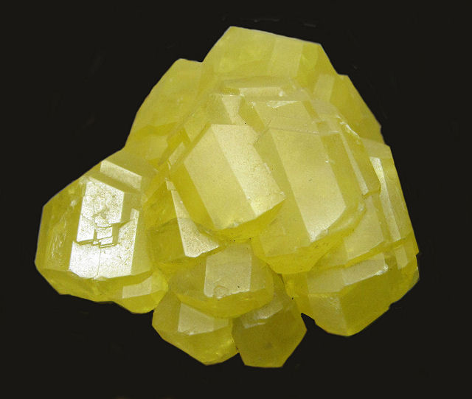
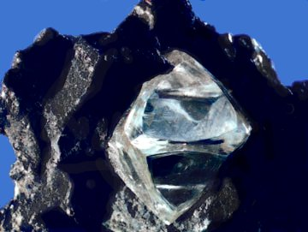
Native Elements
Sulfur - S
Diamond - C
Native Copper - Cu
http://earthref.org/SCC
Notes:
Native Elements
Notes:
Top left picture is sulfur, bottom left is diamond, and right picture is copper.
Native elements include most metals (not alloys) and others like diamond and sulfur, and are made of only one element. Other minerals are compounds, formed from a combination of elements in a chemical formula.
The examples of native elements are diamond, sulfur and gold, each with distinct properties though made of only the one element. Diamond is a particular arrangement of carbon atoms with very strong covalent bonding that is responsible for its famous properties, in particular, hardness and thermal conductivity. These properties are what allow diamond to be useful as abrasive. In addition its clear brilliance make it particularly attractive for jewelry, especially wedding rings. Sulfur is a nonmetal. Its primary uses are to make sulfuric acid for industrial purposes and as a fertilizer. It is also used in incendiaries such as matches and gunpowder. In addition, its strong smell has useful properties such as odorizing natural gas. Copper is a metal with strong conductive properties making it useful in wiring (conducting electrical signals) and in cookware (conducting heat from the stove to the food faster than most other materials). While copper may be found as a native element, it is also commonly bonded with sulfur to form sulfides. However, gold is a metal that doesn’t react with other elements easily, thus it is most often found in its native element form instead of in compounds with other elements. Its softness and brilliant color are bases of its use as a basis for currency and for jewelry.
Some metal deposits are formed through hydrothermal processes. As magma cools in the crust, volatiles like water and ions which are not incorporated into the crystalline structures of the silicate minerals forming the igneous rock are expelled as hydrothermal solutions. These hot fluids are rich in metals and other elements. When the fluids cool the metals and other elements precipitate out forming mineral deposits with high concentrations of metals that are economically valuable.
Pictures of copper and sulfur courtesy of R.Weller from Cochise College.
Picture of diamond is from wikipedia: http://en.wikipedia.org/wiki/File:Rough_diamond.jpg

Slide 6
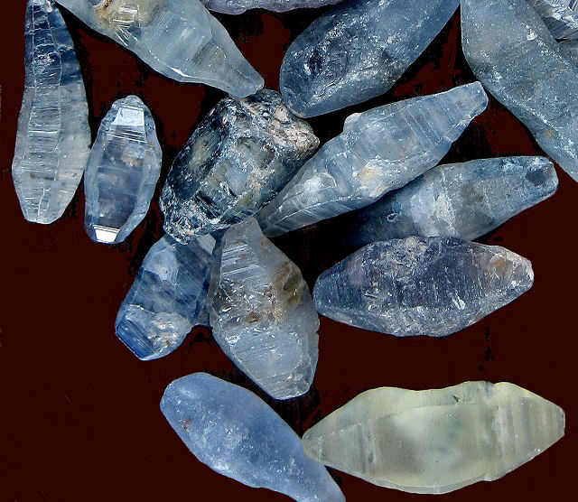
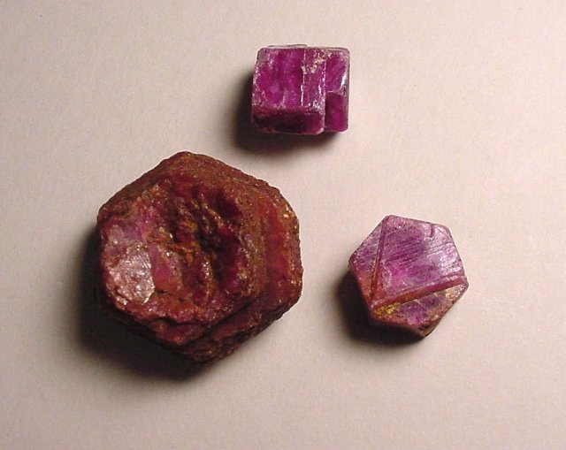
Oxides
Corundum: Al₂O₃
Sapphire and Ruby
http://earthref.org/SCC
Notes:
Oxides
Notes:
Top left image is of sapphires and the bottom right is an image of rubies.
Sapphires and rubies are gems of the same mineral, corundum. However, the color of the mineral, when in gem quality, gives each its separate name (each color is due to the slight addition of different elements to the general structure of the mineral – titanium and iron in sapphire and chromium in ruby). There are also corundum that are not of gem quality, and therefore do not have specific names. To be classified as gems, the minerals are as homogenous as possible, with the same clarity, color, and other properties throughout. Usually minerals occur in conjunction with others mixed together in rocks. Gems are usually those crystals more isolated so they can grow on their worn and not contain inclusions of other minerals.
Oxides are important economically as many are ores of metals, especially iron. Other uses of oxides are as gemstones (e.g. sapphire and ruby). Corundum is also very hard (9 out of 10 on the Mohs hardness scale), and as a more economical choice than diamond, it is often used in abrasives.
Oxides are minerals that contain oxygen (O) in some combination with other elements.
Pictures courtesy of R.Weller from Cochise College.

Slide 7
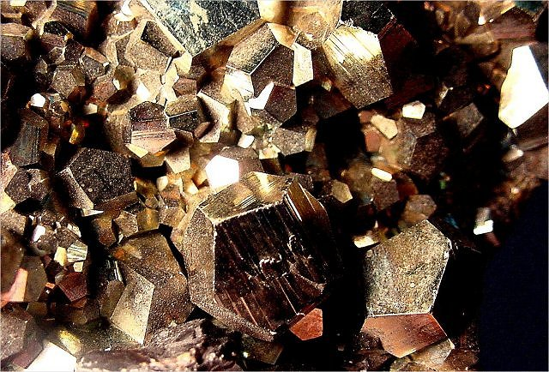
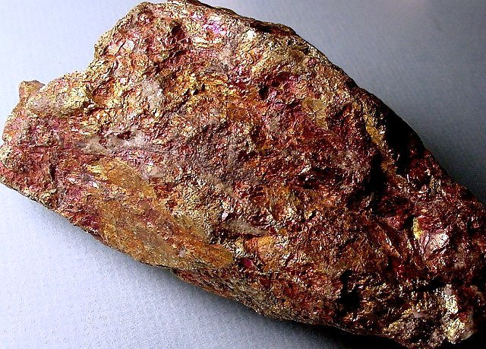
Sulfides
Pyrite - FeS₂
Bornite (Peacock Ore) – Cu₅FeS₄
http://earthref.org/SCC
Notes:
Sulfides
Notes:
Top left image is of pyrite pyritohedron crystals, while the bottom right image is of bornite.
Sulfides are minerals that contain sulfur (S) in some combination with other elements, usually metals.
Sulfides are important economically as many metals are bonded with sulfur to form sulfides. Many of these minerals are ores of metal elements and are mined to extract the metals useful in many industrial purposes (such as steel beams in buildings, car frames, electronic components and many other industrial appliances and other applications).
Pyrite is the most common sulfide mineral and has a similar color to gold, so is often confused for gold. It is useful in the production of sulfuric acid which forms when the mineral is chemically weathered.
Bornite is a mineral ore (it contains copper and iron bonded to sulfur).
Pictures courtesy of R.Weller from Cochise College.

Slide 8
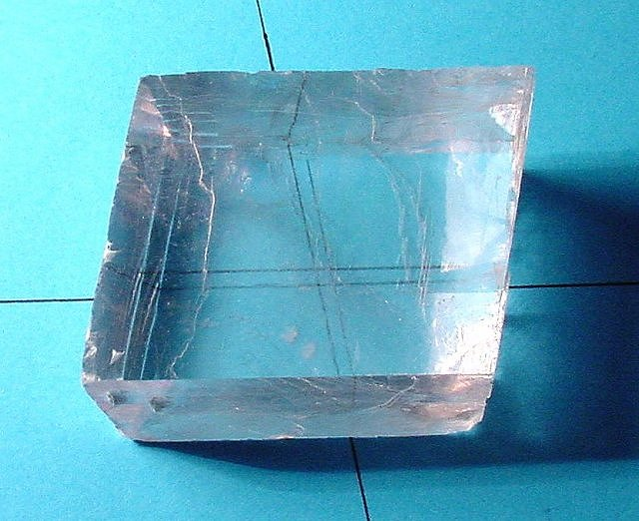
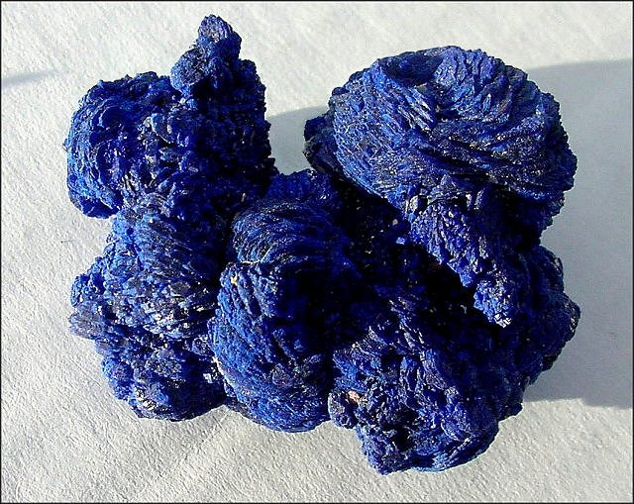
Carbonates
Calcite – CaCO₃
Azurite - Cu₃(CO₃)₂(OH)₂
http://earthref.org/SCC
Notes:
Carbonates
Notes:
The picture on the top left is calcite, and the picture on the bottom right is azurite.
Carbonates are minerals that contain carbonate, a chemical compound consisting of one carbon atom combined with three oxygen atoms (CO₃⁻), in some combination with other elements. They dissolve in acid and that property can be used to identify this mineral (i.e. a drop of acid causes the mineral to fizz).
The top picture of calcite shows a very interesting optical property of that mineral called double refraction. If a clear cleaved fragment of calcite (often referred to as "Iceland spar") is placed over a drawing of two crossed lines, inside the fragment
it will appear that the lines have doubled. In simpler terms, light passing through the calcite travels at different speeds depending on the direction through the crystalline structure. A light ray entering calcite is split into two separate rays, each travelling a slightly different path to create two separate images.
This optical property is also known as birefringence.
Carbonates like calcite make up limestone and marble and are useful in building materials, including Portland cement, road aggregate, and building stones. In addition, marble especially was a great material for building and sculpting in ancient times due to its softness (easily carved into the desired shapes).
(from http://skywalker.cochise.edu/wellerr/mineral/calcite/calcite1.htm)
Pictures courtesy of R.Weller from Cochise College.

Slide 9
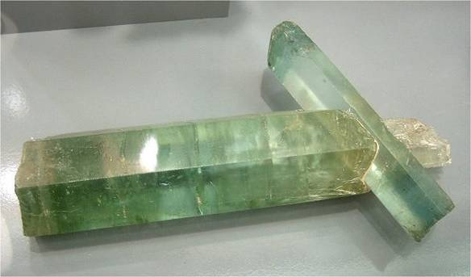
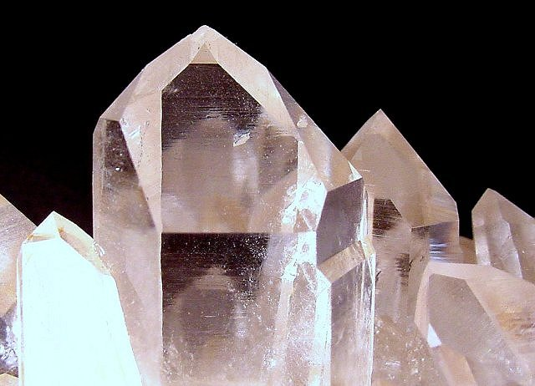
Silicates
Beryl - Be₃Al₂Si₆O₁₈
Quartz- SiO₂
http://earthref.org/SCC
Notes:
Silicates
Notes:
The picture on the top left is beryl, while the picture on the bottom right is quartz.
Silicates are minerals that contain the elements silicon (Si) and oxygen (O) in some combination with other elements. The most basic is of course, quartz (SiO2).
Beryl can be many colors including emerald green, pale green, light blue, yellow, white, pink. It has a vitreous or resinous luster and is translucent to subtranslucent. Crystals are usually 6-sided prisms capped with flat surfaces. Beryl when gemstone quality include emerald and aquamarine.
These are only examples of two gem quality specimens, but plain silicates are much more common. In fact, silicate minerals are the most common minerals on the earth’s surface (making up over 90% of the earth’s crust). These have the most widespread properties though they are made of mainly silicon and oxygen atoms. The differences occur due to the different structures and arrangements of the minerals with different bonds. Most silicates are formed through igneous processes (formed through the cooling and crystallization of a magma). However, some of the most common are clays (have a sheet structure and are formed by weathering of other silicate minerals) which make up most of the soils on earth and are important for building materials. Some interesting uses of clay minerals are in kitty litter as they absorb water well, and as thickener of foods such as milkshakes.
Pictures courtesy of R.Weller from Cochise College.

Slide 10
Three Categories of Rocks
Igneous
Sedimentary
Metamorphic
http://earthref.org/SCC
Notes:
Rock Types
Notes:
So far we studied minerals, and now we move on to rocks as rocks are made of minerals. What is the difference between rock and mineral?
A rock is a mixture of one or more minerals (or fragments of other rocks or fossils). Rocks are divided into three types based on how they form. Go over each type, listing them on the board if they did not volunteer the names. Have the students deduce what method forms each type based on their name (igneous similar to ignite so it has to do with heat, sedimentary from sediment which is fragments of rock so these are composed of fragments of rock, metamorphic means changing form so these rocks form by changing form from another type of rock).
1) Igneous - formed by the crystallization of molten magma above or below the surface.
2) Sedimentary - formed by the deposition of minerals or other rock fragments by rivers, wind, in lakes or the sea
3) Metamorphic - formed by the re-crystallization or deformation of a rock when heat and pressure are applied.

Slide 11
Importance of Rocks & Minerals
Fundamental building blocks of Earth
Used in all aspects of daily life
Important clues for the history of Earth
Important to our health
http://earthref.org/SCC
Notes:
Importance of rocks and minerals – review of why we want to study them and lead in to rock and mineral description activity.
The planet on which we live is made of rocks and minerals. They are the building blocks of the Earth and without them we would have to planet to inhabit.
Rocks and minerals form many of the resources we use in our daily lives. They are especially important as resources of ores and oil and gas, for both industry and energy production. Our roads are paved with rock materials. Our electronics are made of many different materials including rare minerals in the small components, to petroleum in the plastic casing. Minerals are often found in make-up and other health and beauty related products. Metals are used in conducting electricity and other uses. Many buildings are made of rocks or rock products. In addition to being useful, rocks and minerals are used for decorative purposes, in sculptures, jewelry, etc. In order to better manage the earth’s resources we must first learn about the rocks and minerals in which they are found.
Rocks contain clues about the history of the earth including indications of past climate, continent configuration, surface features, structure of the interior of the earth, etc.
Rocks and minerals also affect our health. Many of the minerals we know as nutrients come from rocks originally. The rocks weathered to create the soil in which plants grow. The minerals are taken in by the plants and stored. When we eat plants or animals which ate plants, we in turn eat the minerals that originally came from the rocks and minerals of the earth.
Now we will begin an activity which will allow students to get a taste of what rocks and minerals look like and to see if they can identify the differences between them that allow us to classify them as one type or another. By examining a set of rocks and minerals, observing properties they have just learned in class, they will attempt to identify which are rocks and which are minerals. They will also try to differentiate between different rock types, though this will be covered in more detail in the following lessons.
Hand out sets of rocks and minerals. This unit was designed for a class set up to use the Stories in Stone activities. Therefore, the set of rocks and minerals used include 10 samples per table of 4 students (1 – schist, 2 – halite, 3 – granite, 4 – quartz, 5 – basalt, 6 – galena, 7 – slate, 8 – obsidian, 9 – shale, 10 – conglomerate). However, other samples may be used. It is best to have a variety of samples (an approximately even number of each type: mineral, igneous, sedimentary, metamorphic). Have the students write the numbers and the corresponding name of rock or mineral in a table (Rock + Mineral Descriptions document). Then they should describe each sample and try to determine whether it is a rock or mineral, and if possible, what kind of rock it is based on their new knowledge of how each is formed. Magnifying lenses may be helpful, but not necessary at this stage.

