Slide 1
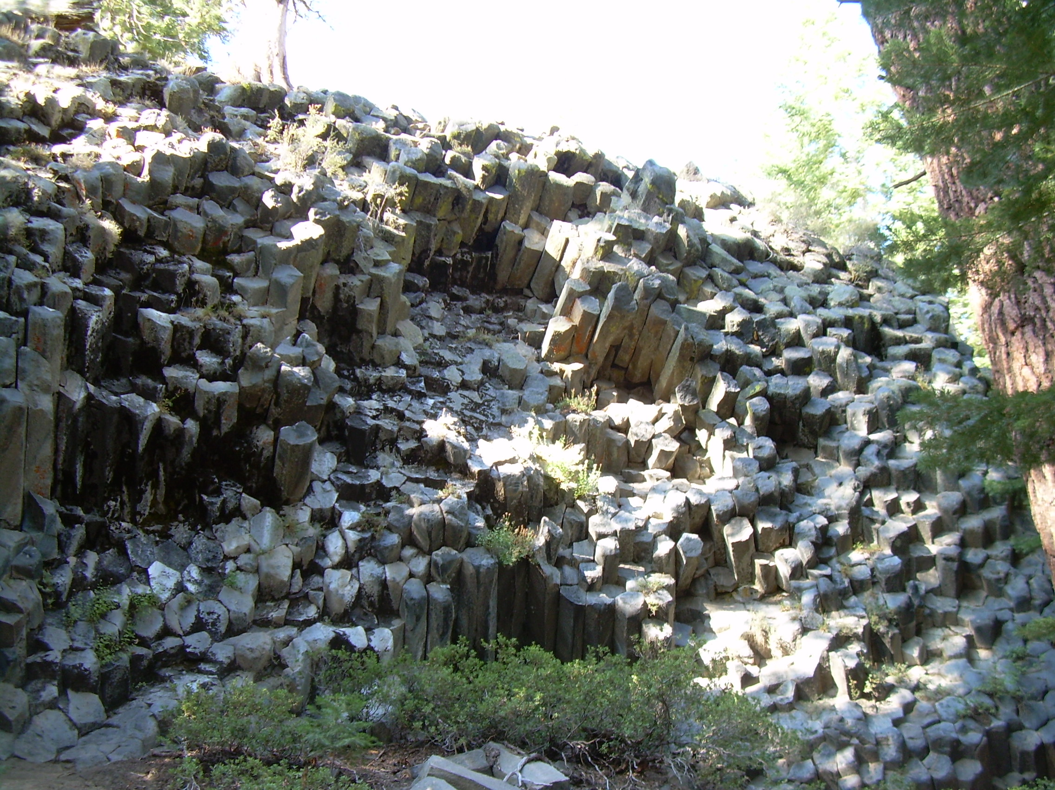
Igneous Rocks
http://earthref.org/SCC
Notes:
Introduce igneous rocks once more after answering the key question and setting up the Crystallization Activity. Set up the activity while students are answering the key question.
Key question: How are igneous rocks formed? Give them 5-10 minutes to write the question and their answer in their notebooks. Then ask them what they know. Make sure they understand that igneous rocks can form from lava or magma (on the surface as discussed in the volcanoes unit, but also underneath the surface). Have them hypothesize what differences they might notice between the two types. Have them write what igneous rocks are in the Description section of the Igneous rock portion of their Rock Identification Guide.
Photo taken by Natalie Juda at Devil’s Post Pile National Monument, California.
Title Slide Notes:
AUTHORS:
Natalie Juda – Scripps Institution of Oceanography, Joe Krupens – University City High School
WHY:
Igneous rocks are the products of volcanism and related processes which capture students’ imaginations. Some are used to create classic structures and sculptures. This presentation will inform students how these rocks formed and what locations they are found in.
SUMMARY (< 100 words):
The focus of this lesson is to understand processes which govern the formation of igneous rocks, ways to classify them, and the plate tectonics related environments. The first will be undertaken by having students participate in a crystallization activity using a chemical melt which upon cooling forms crystals of varying sizes over varied time periods. Students will then examine a suite of igneous rock samples to relate the activity to real life. Finally, the students will then relate the pressure, temperature conditions under which igneous rocks form to plate tectonics environments and volcanoes.
PICTURE/GRAPHICS CREDITS:
Picture taken by Natalie Juda (co-author of this presentation).
WEBSITES USED IN THIS PRESENTATION:
Good figures regarding igneous rock formation can be found at
http://hays.outcrop.org/GSCI100/lecture24s.html
Animations can be found at
http://www.classzone.com/books/earth_science/terc/content/investigations/es0603/es0603page05.cfm?chapter_no=investigation
ADDITIONAL READING:
A good reference book at a level for first year university geoscience students is Essentials of Geology, by Lutgens, Tarbuck and Tasa.
The crystallization activity was adapted from Stories in Stone a GEMS Teacher’s Guide for grades 4-8.
CONTEXT FOR USE:
This is geared toward a 9th grade class with a low level of knowledge of earth science. It is meant to follow after a unit on volcanoes and the students should have prior knowledge of plate tectonics as well. This is one part of a larger unit on rocks in general as this is one of the three main rock types along with sedimentary and metamorphic.
MISCONCEPTIONS:
Mantle is liquid magma
Magma originates at the core
Igneous rocks form on the surface of volcanoes
Igneous rocks form very quickly
EVALUATION TIPS:
For this lesson students fill out the igneous rock section of the Rock Identification Guide.
TEACHING NOTES. This unit is formulated to fit a 5 “E” learning method format. Students “engage” when answering a key question about their initial ideas of igneous rock formation in their notes and sharing their ideas with the class. Following this, the crystallization activity is introduced where students “explore” the relationship between crystal size and cooling rate. Students then orally “explain” what they learned to the class. With additional information provided by the teacher through the PowerPoint lecture, the students have a better understanding of the concept. To “extend”, the students apply their new knowledge to a second activity involving the analysis of individual igneous rock samples, furthering their knowledge. Finally, they are “evaluated” through verbal communication of understanding and a worksheet summarizing the knowledge learned (igneous rocks section of the Rock Identification Guide).

Slide 2
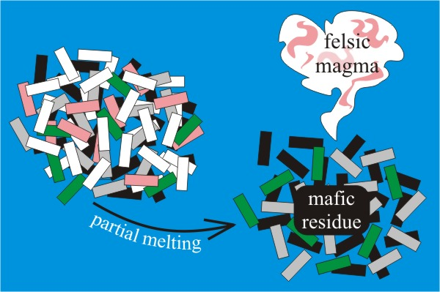
Mafic – magma or igneous rock rich in magnesium (Mg) and iron (Fe) and generally dark
Felsic - magma or igneous rock rich in feldspars and silica and generally light
Partial Melting
Partial Melting – process by which different minerals in rock melt at different temperatures
Fractional Crystallization – reversed process of partial melting
http://earthref.org/SCC
Notes:
Partial Melting and Fractional Crystallization
This slide illustrates the concepts of Mafic and Felsic rocks as well as the key processes that are responsible for their formation, partial melting and fractional crystallization.
Explain the terms mafic and felsic first and tell the student that this is used to divide igneous rocks into two basic classes. Then shift to the processes that form these rocks with the schematic diagram of partial melting (the original rock on the left side undergoes partial melting and you are left with two separate items on the right side of the diagram, the resulting melt of felsic minerals which is the product of the partial melting, and the remaining solid residue made of more mafic minerals). The original rock or mantle (on the left side of the diagram) has a complex composition (each colored bar can represent a different type of mineral in a hypothetical igneous rock – e.g. white for quartz, pink for potassium feldspar, grey for plagioclase feldspar, black for pyroxene, and green for olivine as these are the general colors for these minerals commonly found in igneous rocks). Amongst those minerals, olivine and pyroxene contain lots of iron and magnesium and those are minerals you typically found in mafic rocks. The other ones are more typical for felsic rock. Felsic minerals tend to melt at lower temperatures than the mafic ones others.
As the rock is heated, the minerals with the lowest melting temperatures will melt first (in the diagram, this is represented by the white and pink colored minerals which form the “felsic magma” on the right side of the diagram leaving behind the minerals with higher melting temperatures remaining crystalline, labeled “mafic residue”).
At this point you may remind the students of the volcanoes unit and how we learned that color in volcanic rocks was due to the amount of silica as silica is white or clear in color, so rocks with more silica will be lighter in color than those with less silica.
Here you can review information learned in the volcanoes unit and the introductory lesson that is relevant to this especially processes by which a magma can be formed (e.g. temperature, pressure, fluids)
Partial melting is the opposite process of fractional crystallization which will be further discussed on the next slide. Partial melting is the process by which a melt is formed from the mantle while fractional crystallization starts with a melt and cools forming different minerals that make up igneous rocks.
Image from: http://www.nvcc.edu/home/cbentley/105/billy_goat_trip.htm courtesy of Callan Bentley

Slide 3
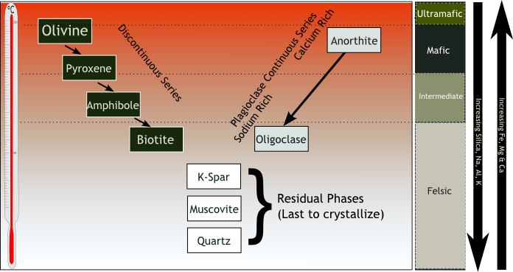
Bowen’s Reaction Series
http://earthref.org/SCC
Notes:
Bowen’s Reaction series
This slide shows a schematic image that illustrates how magmas crystallize in particular the order in which minerals form. This crystallization sequence is also called the Bowen’s Reaction series, indicated by the mineral names that crystallize first (top) and the sequence in which they form, mafic minerals on the right and felsic minerals on the right and the bottom of the series. The thermometer on the left gives an indication of which minerals crystallize at the highest and lowest temperatures. The box on the right hand side gives the composition of the magmas from which these minerals crystallize. The mineral crystallizing at the highest temperature is olivine that is made up entirely of Magnesium, Iron and silica, the most mafic mineral we can find in a magma. The crystallization of Olivine pulls these elements out of the magma, reducing its Mg and Fe. The subtraction of these elements from the melt obviously dramatically reduces the amount of these elements in the residual melt, but it also increases the Na, K, Ca and Al. That makes the residual melt more felsic, and as a results felsic minerals begin to crystallize, beginning with Anorthite which is a plagioclase made of Ca, Al, and Si. Removal of these elements will effectively enrich Na and K. As the crystallization process proceeds, other mafic minerals will form, first pyroxene, then Amphibole and finally biotite, and the plagioclase will increasingly incorporate more Na, in addition to the Ca. The crystallization of the Bowen’s series minerals will make the residual magma more Felsic, as it cools. The typical changes in element abundances are indicated by the arrows on the right hand side, increasing Si Al and K as temperatures decrease and higher Fe and Mn (and Ca) at higher temperature and more mafic magmas.
Ask the students which crystallize first, mafic or felsic minerals.
Diagram from:
http://en.wikipedia.org/wiki/File:Bowen%27s_Reaction_Series.png
Note: It might be difficult for some students to understand why an element like Na can increase in the melt when you take out Mg. You can give them a numeric example with four different colors of MM’s, calculate the percentages, and then take out all of the green ones (for olivine), and calculate the percentages anew. It will be clear that the percentages of the other MM’s will increase even though there is still the same number of them.

Slide 4
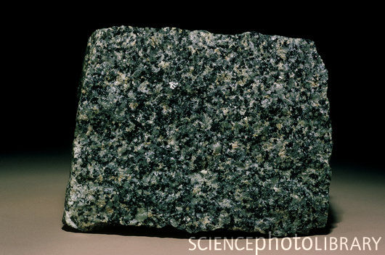
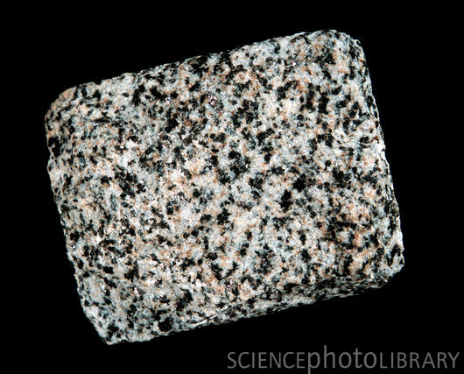
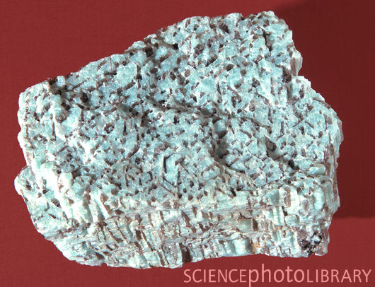
Mafic Igneous Rocks
Intermediate Igneous Rocks
Felsic Igneous Rocks
http://earthref.org/SCC
Notes:
Classifying igneous rocks based on color – (mafic to felsic)
Photos from upper left to bottom right: mafic (sample of gabbro), intermediate (sample of diorite), felsic (sample of granite). All photos are of intrusive rocks to not cause confusion (all have large grain size but the color is distinctive of the rock type).
This slide should help student visually see the difference between classes of rock based on color. This is a generalization as some mafic minerals are light in color and some felsic minerals are dark, but usually the color is indicative. It also serves as an introduction to intrusive and extrusive rocks
Students should describe what they see. What are the similarities and differences between the three pictures? Do they notice that in each of the pictures there are splotches of different colors, all about the same size? Can they give a generalization about the overall color of each of the rocks?
From our previous discussion about fractional crystallization and Bowen’s reaction series, and given the scenario that all of these rocks formed from one magma but represent states at different temperatures which of the three do they think crystallized first (at higher temperature) and can they order them?
Mafic rocks are generally darker in color than those more felsic. This is due to the fact that minerals that have more magnesium (Mg) and iron (Fe) are darker in color than those high in silica and feldspars.
They may see spots of different colors. Have them tell you that they are different minerals with different colors. Emphasize that intermediate rocks can have more mafic and more felsic minerals so you can have dark and light colors together. Intermediate rocks have color between the mafic and felsic and also have compositions in between.
Felsic rocks have light color due to the high proportion of silica. The minerals which make up felsic rocks include feldspars and quartz as well as other minerals which have a high silica content. The pink color seen in these rocks is from the high proportion of certain feldspars which have a pink color due to impurities in the crystal structure. Mention that not all felsic minerals are light in color (e.g. biotite is dark) so overall the rock is lighter but there may still be darker minerals present.
Photos from:
Gabbro - http://www.sciencephoto.com/image/78653/530wm/C0014251-_Hornblende_Gabbro,_Massachusetts_-SPL.jpg
Diorite – http://www.sciencephoto.com/image/169467/530wm/E4170304-Diorite_igneous_rock-SPL.jpg
Granite - http://www.sciencephoto.com/image/169480/530wm/E4170318-Graphic_granite_rock-SPL.jpg

Slide 5
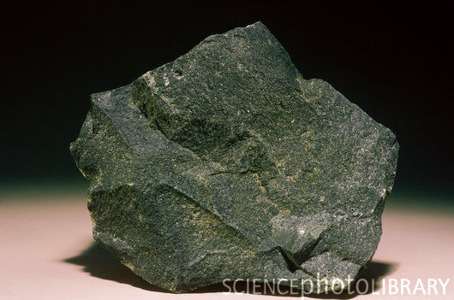
Extrusive – an igneous rock formed at the Earth’s surface
Intrusive – an igneous rock formed beneath Earth’s surface
http://earthref.org/SCC
Notes:
Classifying igneous rocks based on crystal size (intrusive vs. extrusive)
This slide acts as a good point to return to the crystallization activity started at the beginning of the period. First, go through the slide and have the students understand the concepts, then return to the activity for them to apply the new knowledge to the activity.
The upper photo is basalt, a mafic extrusive rock. The lower photo is gabbro, a mafic intrusive rock. This is an important distinction that is different from the previous division of igneous rocks. Here the rocks are divided based on crystal size rather than by color. Both of the rocks on the slide may be made of the same minerals and have a similar overall color, however they differ in the size of crystals.
Have students write the definitions of these two new words in their notes. As discussed at the beginning of class, remind them that igneous rocks can be formed from magma and lava. They may have made the connection that the ones made from lava form faster than those from magma. They may correctly conclude that a bigger crystal takes more time to form than a smaller one. Hence, rapid cooling produces smaller crystals and a fine-grained igneous rock implies rapid cooling. Have them describe what differences would be seen in rocks made from lava vs magma. Now have them use their new words to relate extrusive to fast cooling and intrusive to slow cooling. Have them try to figure out what differences that would make in the rocks that they can observe.
This is a good time to return to the crystallization activity started at the beginning of class. By now their magma analogs will have cooled sufficiently for them to examine and they will have new knowledge of what properties may be exemplified by their experiments. Have them return to the spoons with the drying or dried salol and have them examine them using the microscope and note the differences between the two spoons. Which spoon represents the formation of intrusive and which extrusive? What were the main differences? They may say color (if some of the salol was burnt or if one hasn’t completely dried it may be clear still and not white). They may also say the opposite from what you expect (remember that the salol may actually form fans of small crystals that look like one large crystal to students so they reverse the observation you hope they would find).
Get the students to make observations - did they notice that the crystals formed faster in one spoon than another? If so, what about the size of these crystals compared to the other? They should be able to see that those formed faster (on ice) formed smaller crystals. What does the ice represent? This is quicker cooling at the surface (the ice is cooler than room temperature, just like the air at the surface is cooler than in the interior of the earth, so the spoon on the ice represents lava cooling – extrusive rock, while the spoon not on the ice represents magma cooling – intrusive rock).
Photos from
Basalt - http://www.sciencephoto.com/image/78651/530wm/C0014249-_Basalt,_Somerset_County,_New_Jersey_-SPL.jpg
Gabbro - http://www.sciencephoto.com/image/78653/530wm/C0014251-_Hornblende_Gabbro,_Massachusetts_-SPL.jpg

Slide 6
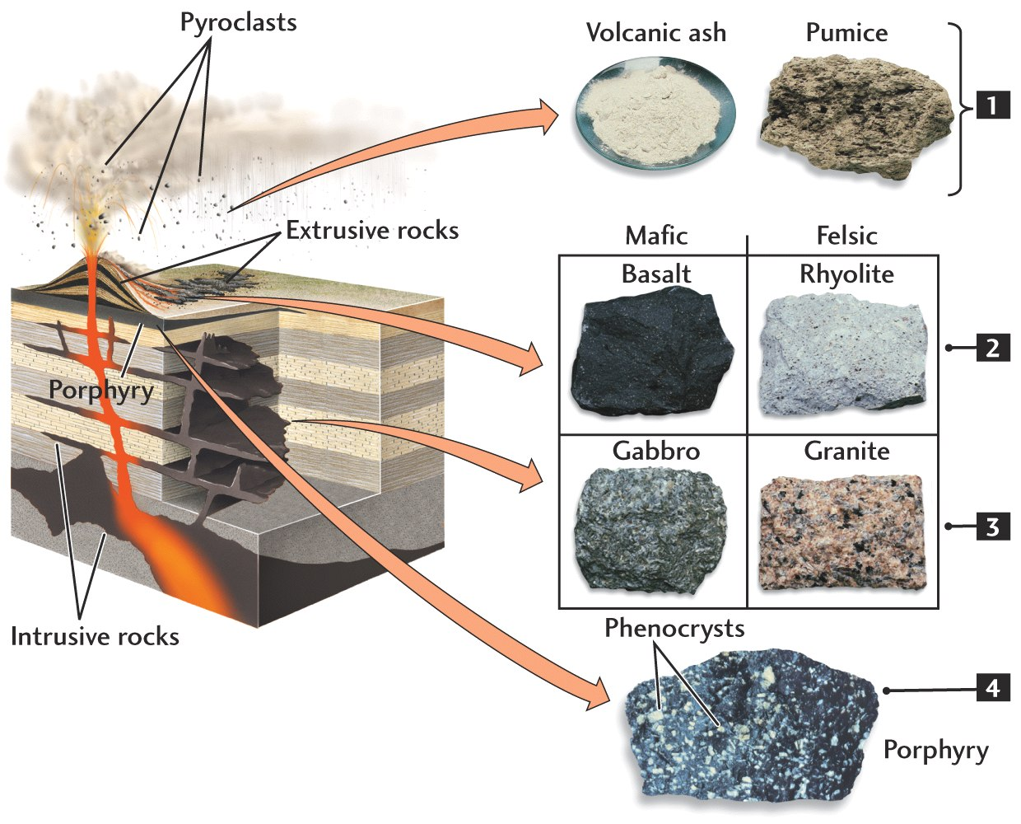
http://earthref.org/SCC
Notes:
Anatomy of a volcano with igneous rock related products and locations
This is a schematic diagram of a volcano and the associated rock types found in different locations due to different methods of formation.
Students should already know the word pyroclastic from the volcanoes section learned previously so you can start at the top of the diagram. Have them look at the pyroclasts in the volcano image and then follow the arrow to show them images of the rocks formed from pyroclasts. They also now know the difference between intrusive and extrusive rocks and can see on this diagram where those rocks are formed.
Ask the students to look at the pictures of the rocks (basalt, rhyolite, gabbro, granite). Use the arrows to guide their view from the schematic of the volcano to the rocks to help them make the connection between the location and the rocks formed. They should know all but gabbro from previous lessons on volcanoes. Ask them which are the extrusive and which the intrusive and what the differences are in the pictures. Extrusive rocks are those igneous rocks formed at the earth’s surface. Intrusive rocks are formed beneath the earth’s surface. Make sure the students realize that extrusive rocks can be felsic or mafic, and intrusive the same, but that the difference between intrusive and extrusive is not the color but the grain size.
Finish on porphyry which are rocks with large crystals in a fine matrix (background) so they are sort of in between the intrusive and extrusive as they have aspects of both) as the larger crystals were formed at depth and cooled slowly but were taken to the surface by magma erupting , and the magma cooled around the crystals at the surface much quicker forming a finer grained matrix surrounding larger grains.
Diagram from:
http://hays.outcrop.org/images/rocks/igneous/press4e/figure-05-03.jpg

Slide 7
How to classify igneous rocks:
Light Dark
 | Felsic | Intermediate |  | Mafic | Ultramafic
Coarse | Granite | Diorite |  | Gabbro | Peridotite
Fine | Rhyolite | Andesite |  | Basalt
Vesicular | Pumice |  | Scoria
Glassy | Obsidian*
Rock Color
Notes:
Classification of Igneous rocks based on color and texture with practical activity
This was the beginning of the second day of igneous rocks. The student should remember from the previous day’s lesson the terms intrusive, extrusive, felsic, mafic. After an introduction to textures using the diagram, an activity with rocks follows where the students can apply the diagram to real examples.
The diagram shows how igneous rocks are classified. Horizontally from left to right the rocks range in color from light (felsic) to dark (mafic). Vertically from top to bottom the rocks range from coarse (intrusive) to fine grained (extrusive) with additional textures (vesicular and glassy). Stress the importance of the two methods of classifying igneous rocks (color and texture).
Have them provide the definitions of the words felsic, mafic, intrusive, extrusive to make sure they understood the topics covered the day before. Explain how we have names for the textures we see and ask them what size crystals are in extrusive and intrusive rocks. Tell them that we use the terms coarse grained and fine grained to describe those two types of rock and ask them which would describe which. They should write that generally extrusive rocks are fine grained and intrusive rocks are coarse grained. Then explain that rocks can have a mix of grain sizes, most often large crystals in a background of smaller crystals, which we call porphyritic (they should write that porphyritic are those with a mixture of large and small crystal sizes). Have them think about what we know about the size of crystals? How can you get large crystals and small crystals in the same rock? Slow and fast cooling together?
Vesicular is another classification given to rocks with a high percentage of vesicles (holes formed where gas bubbles were trapped in the rock as it cooled). Pumice is a felsic vesicular rock which can float because the high amount of gas trapped. Scoria also has many vesicles but the rock is denser and cannot float (in general felsic rocks are less dense than mafic due to the minerals that make up each type).
Then ask them why some could be called glassy – and have they seen any rocks in their kits that were glassy (obsidian). How can we form a rock that has no crystals? Get answers, then tell them that obsidian is made of very viscous magma, so viscous that the gases trapped inside do not even create bubbles. Also, the viscosity keeps crystals from forming as it cools. There are glasses that form on basalts (especially on the seafloor where hot magma hits cold water) that form differently. Here, the change in temperature causes such quick cooling of the magma, forming rock so fast that crystals can’t form.
To better understand the properties of rocks, an activity examining real examples of these different categories will be used. Students will use the table to try to identify the type of rock they are examining and give it a name. Pass a rock to each table. Try to have examples of most of the rocks in the table (obsidian, granite, scoria, basalt, rhyolite, granite, gabbro, peridotite at the least and hopefully also andesite and diorite). Give the students at each table 5 minutes to describe their rock – remind them to look at the color, the size of the grains and the other textures just mentioned. They can look in the microscope as well to see the crystals. Then have each group tell you what they saw, how they would name the rock, whether it was intrusive or extrusive and why they think that, while you show their rock to the class. If you have the intermediates as well as the felsic rocks you may get an overlap as they can’t compare their rocks to others to see if it’s more intermediate or more felsic. Accept answers based on their explanations. They should use the knowledge gained during this activity and previous lecture to fill in the igneous section of the rock identification guide.
Note: While this diagram is correct overall, some advanced students may find it confusing to see obsidian amongst light rocks. Obsidian, glass of thyolitic composition is actually black from tiny dark minerals dispersed through the glass that make opaque

Slide 8
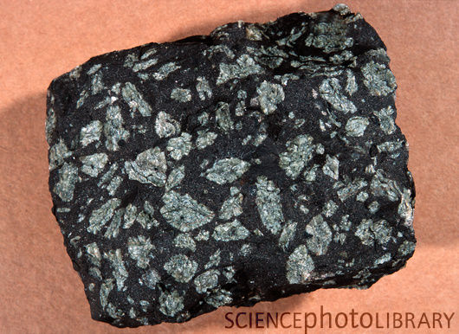
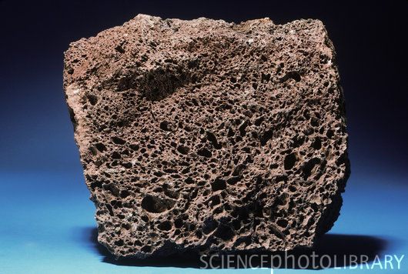
Animations
How are the different textures of igneous rocks formed?
http://earthref.org/SCC
Notes:
Common textures of igneous rocks – a review
These are images of some common textures of igneous rocks (clockwise from top left: fine grained, porphyritic, coarse grained, and vesicular).
This slide reviews textures of igneous rocks
Ask them what texture they have, one by one. Ask them which are intrusive or extrusive and what makes them different (e.g. gas for the difference between the scoria and the basalt). Ask for any further ideas on how you can get a rock with both large crystals and small ones (porphyritic). Show them the animations and explain how each is formed (there are three animations, but the lava flow has details about fine grained texture and vesicle formation). The animations show how different textures are formed in settings where igneous rocks form. One shows how rocks cool at depth. Another shows how rocks cool at the surface, and the third shows how porphyritic rocks form. Brief explanations for each formation are shown in the animations. Some of the animations run very quickly so you can show them the full run through and then again, pausing to explain the steps involved. You can ask them why the animation runs faster when forming the extrusive rock – does it mimic the rate of cooling to form the rock? After the animations ask them where they would find each one and how was it formed to get them to prove they were paying attention.
Photos from
Basalt - http://www.sciencephoto.com/image/78651/530wm/C0014249-_Basalt,_Somerset_County,_New_Jersey_-SPL.jpg
Gabbro - http://www.sciencephoto.com/image/78653/530wm/C0014251-_Hornblende_Gabbro,_Massachusetts_-SPL.jpg
Scoria - http://www.sciencephoto.com/image/78661/530wm/C0014259-_Scoria,_Klamath_Falls,_Oregon_-SPL.jpg
Porphyritic basalt - http://www.sciencephoto.com/image/169469/530wm/E4170306-Porphyritic_texture_in_an_igneous_rock-SPL.jpg
Animations from
http://www.classzone.com/books/earth_science/terc/content/investigations/es0603/es0603page05.cfm?chapter_no=investigation

Slide 9
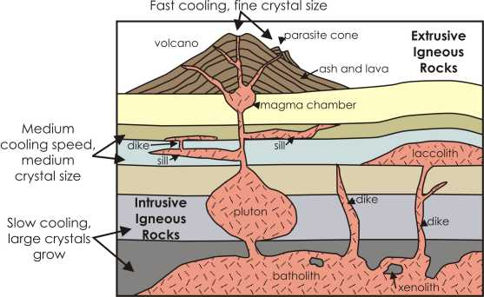
http://earthref.org/SCC
Notes:
9
Igneous structures
This slide shows different structures formed when magma rising to the surface cools at different depths. You may explain as below, how the magma continues to try to rise to the surface and utilizes the surrounding geology to its advantage, thereby forming different structures. Fractures and divisions between rock layers are exploited by the magma as it is easier for the magma to travel along than through layers.
As magma rises to the surface it may stop during its ascent to the surface at some depth. When a large body of magma cools at depth it forms a batholith (these can be very large, e.g. the Sierra Nevada mountain range are made from rocks forming a batholith). Offshoots or smaller bodies of magma form smaller features. A generic smaller mass of intrusive igneous rock is called a pluton. As the magma attempts to ascend further, it may form different features, and the closer to the surface the faster the magma cools causing rocks to form with smaller crystals. When the magma cools in vertical fractures structures known as dikes form, however, when the magma cools along horizontal planes, sills form. Sometimes the magma forming a sill may inflate, pushing up the layers of rock above it, creating a domed structure known as a laccolith. When intrusive rocks pass through surrounding rock, they often rip off chunks of the surrounding rock. Some are melted and assimilated into the intrusive rock, but some remain in their original form and are called xenoliths (xeno means foreign, so they are rocks not formed from the main magma body, but come from elsewhere). As the magma continues to rise to the surface it often pools near the surface before the pressure build and the magma erupts. This pool of magma that fuels a volcano is known as a magma chamber. The surface feature formed by the eruptive material is known as a volcano. Different layers may form a volcano, both explosive products (e.g. ash) and more effusive flows (e.g. lava). The magma from the magma chamber may not always erupt from the main vent at the top of a volcano. When it erupts from a vent on the side of the volcano it may form a parasite cone (a small cone of volcanic material erupted from a secondary location to the main volcano).
This slide also reiterates the cooling rate relation to crystal size, showing a range from the surface (fastest cooling and smallest crystal size) to deeper. The deeper the intrusion, the slower the cooling and the larger the crystals formed.
Diagram from http://www.outreach.canterbury.ac.nz/resources/geology/glossary/igneous.jpg

Slide 10
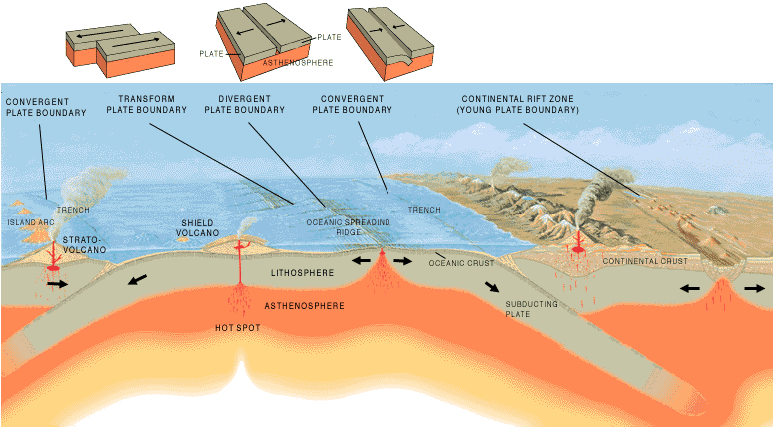
Animations
Relation of Igneous Rocks to Plate Tectonic Boundaries
http://earthref.org/SCC
Notes:
Relation of igneous rocks to plate tectonics
Notes:
This is a diagram of plate tectonics to remind students of the different types of plate boundaries and possible locations of igneous rock formation. The students have seen this before when discussing volcanoes and plate tectonics.
First, review plate tectonics and how this may be related to igneous rocks.
Ask students how igneous rocks are related to plate tectonics. Ask what would help them relate the plates to igneous rocks that they’ve already learned. They should remember the relation of volcanoes to plate tectonics since magma and lava are related to volcanism and igneous rock formation. Try to get them to volunteer the following information about volcanism at the three most common locations. If necessary or have time, then show them the animations to remind them. Get them to think not only of the volcanic products (extrusive), but intrusive as well in each location.
Next, review locations where volcanoes form since we know from previous slides that igneous rocks are formed in locations related to volcanism.
There are three types of locations where volcanoes can be found: subduction zones, spreading centers, and hotspots. The students should record this list in their notes.
Have the students hypothesize whether the volcanism will be the same at each of the three locations.
Subduction happens when one tectonic plate dives beneath another. As the oceanic plate subducts under either other oceanic crust (though less dense and usually younger than that which subducts) or continental crust, the water and other volatiles in the sediment and rocks which make up the subducted crust is released due to the increased temperature and pressure as it goes deeper. This addition of water into the overlying mantle causes “flux melting” as the water released from the sediment into the mantle decreases the melting temperature of the mantle and allows it to melt. As the magma rises to the surface through the crustal rocks, it fractionates (fractional crystallization occurs), so the more mafic minerals crystallize while the residual melt becomes increasingly more felsic as it rises to the surface. Thus, there may be intrusives from mafic to felsic, as well as extrusives ranging in composition. Most subduction related volcanoes erupt andesitic (intermediate) lavas, but in the earlier stages basaltic eruptions may occur. Also, in rare cases, the magma differentiates to the extent that rhyolitic lavas erupt.
The volcanoes formed are often composite cones like Mt. Rainier in Washington or those that make up the Andes in South America.
Though these are distinctive surface expressions of magmatism, most volcanic activity on earth occurs at spreading centers. This is the location where new crust is made. At mid ocean ridges the plates move apart allowing the underlying mantle to rise and the resulting decrease in pressure of the mantle rocks allow the mantle to melt. The melt rises and forms a magma chamber and as the minerals crystallize the melt residue intrudes into the rock above it to erupt at the surface forming pillow basalts (extrusive). The rock intrudes vertically to form planar features known as dikes which cool under the surface but close to it (we call this hypabyssal as it is near surface but still beneath). The subsequent pulse of magma intrudes into the previous dikes, often splitting them in two, pushing the parts in two separate directions on the two plates. While this occurs, the edges of the magma chamber also cool and crystallize, though slower than the magmas above, forming a coarse grained rock called gabbro (intrusive) while the dikes and pillows are finer grained basalt.
This explains why ocean crust is mafic, as there is no continental crust to rise through, just magma constantly resupplied with more melt from the mantle so there is little fractional crystallization occurring.
Hotspots can occur in the middle of plate boundaries. They form as a columns of hot, buoyant mantle material rise and produce enough melt that can break through the crust to form a volcano. As the plate moves, the column of mantle material stays in one place and the magma from the mantle must break through in another place in the crust. As the plate continues to move, a chain of volcanoes is formed.
Hot Spot Lesson plan
http://earthref.org/ERDA/783/
Diagram from
http://pubs.usgs.gov/gip/dynamic/Vigil.html
Animations from
http://esminfo.prenhall.com/science/geoanimations/animations/35_VolcanicAct.html

Slide 11
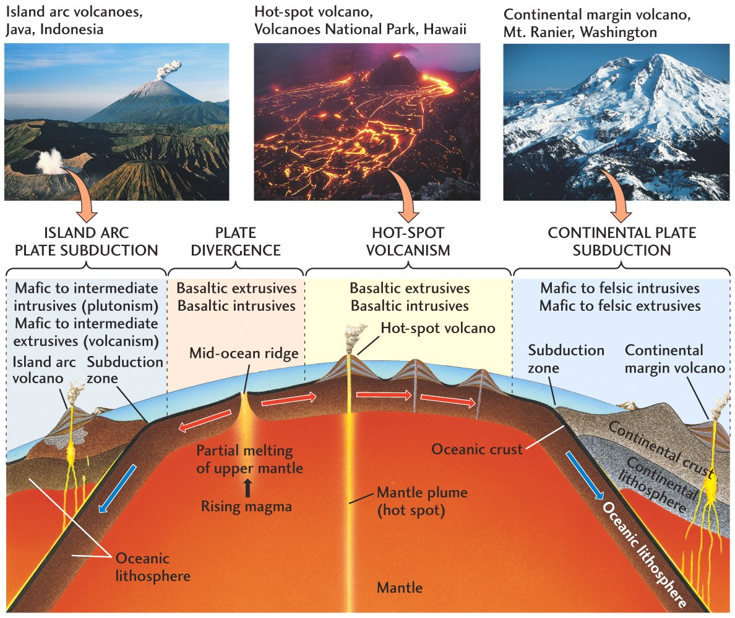
Mid-ocean Ridges
http://earthref.org/SCC
Notes:
11
Rock types associated with locations of plate tectonic related magmatism
This diagram gives an overview of igneous rock formation in oceanic settings and plate tectonics.
Review magmatism at mid-ocean ridges, hot spots and subduction zones.
This diagram shows different igneous rock types related to four different plate boundary types (from left to right: island arc subduction, plate divergence, hot spot volcanism, and continental subduction).
Have students look at the intraoceanic arc (left) and continental arc (right). Explain the differences in rock types. At subduction zones (edges of the figure) the subducting lithosphere releases volatiles causing melting which then migrates up through the lithosphere erupting on the surface as volcanoes. The difference in rock types at each type of subduction zone depends on the type of crust and lithosphere through which the magma ascends; the thicker continental lithosphere allows more differentiation of the magma before eruption so there is a wider range of compositions that occur than those erupted/formed in oceanic lithosphere and crust).
Hot spots on oceanic crust (e.g. Hawaii) and divergent boundaries have mafic rock types due to their thinner mafic crust. When hotspots occur on continents the resulting igneous rocks are often highly differentiated (e.g. Yellowstone hotspot has rhyolite lava flows) as the magma rises through it partially melted the continental crust and then erupted.
They may want to write in their notes what kinds of rocks are associated with which location and ask them again why the two subduction zones differ (effect of thickness and composition of continental crust). The continental subduction zones can have felsic compositions due to the increased thickness of crust through which the magma must ascend before erupting at the surface. As it rises it may undergo fractional crystallization, leaving more mafic residues at depth and erupting more felsic magmas.
Again, they can relate the photos of volcanoes with the magmatism produced, and the rock types (putting together their knowledge from volcanoes and from igneous rocks and plate tectonics).
Image from: http://hays.outcrop.org/GSCI100/lecture24s.html

Slide 12
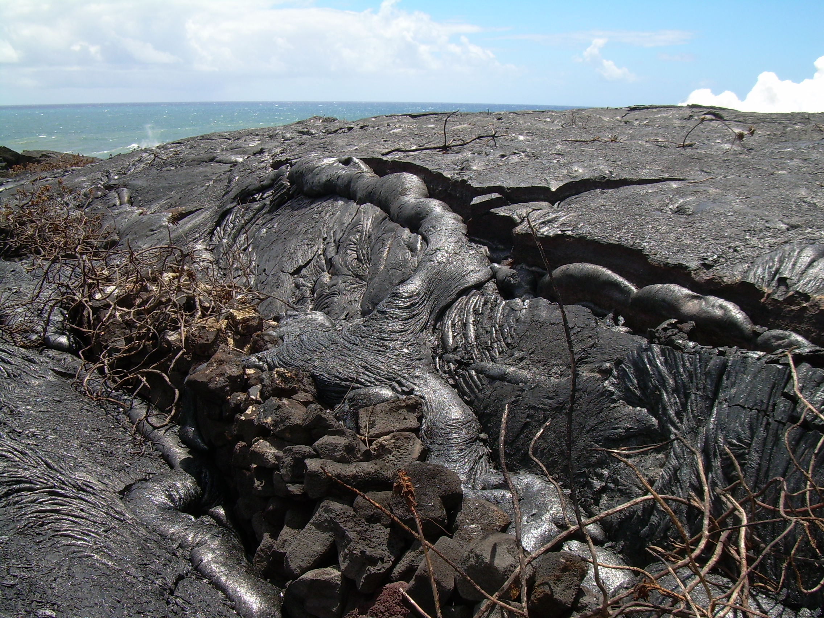
Overview
Igneous rock formation
  Crystal size and other textures
  Color
Igneous rock classification
Locations where igneous rocks form
http://earthref.org/SCC
Notes:
Overview of igneous rock lesson
Notes:
Picture of lava flows in Hawaii overtaking man-made stone wall and trees.
Igneous rocks form through the crystallization of liquid rock (magma or lava).
The slower the cooling the larger the crystals can grow before the rock solidifies and this happens when cooling occurs at higher temperatures (such as those within the earth – creating intrusive rock, compared with those at the surface – creating extrusive rock.
The color of the igneous rock depends on the minerals present. The minerals in the rock depend on fractional crystallization. Igneous rocks form through the process of fractional crystallization as the minerals with higher crystallization temperatures crystallize out of the melt first. More mafic rocks are generally made of darker minerals (minerals containing more Mg and Fe), while felsic rocks are made of lighter colored minerals (minerals containing more Si and less Mg and Fe).
Igneous rocks can be classified into general categories based on color and texture (particularly grain size). Observations of grain size, color, vesicles, and proportions of crystals of certain composition help classify igneous rocks.
The texture of igneous rocks is related to how they were formed (i.e. small crystals in surface rocks and large crystals in deep rocks, also porphyritic texture is indicative of two –stage cooling first deep and then at the surface). Igneous rocks are associated with volcanoes and occur where volcanism occurs. This is usually at or near plate boundaries or hot spots. Different locations may have different magma compositions, producing different rock types.
Picture credit: Natalie Juda

