Slide 1
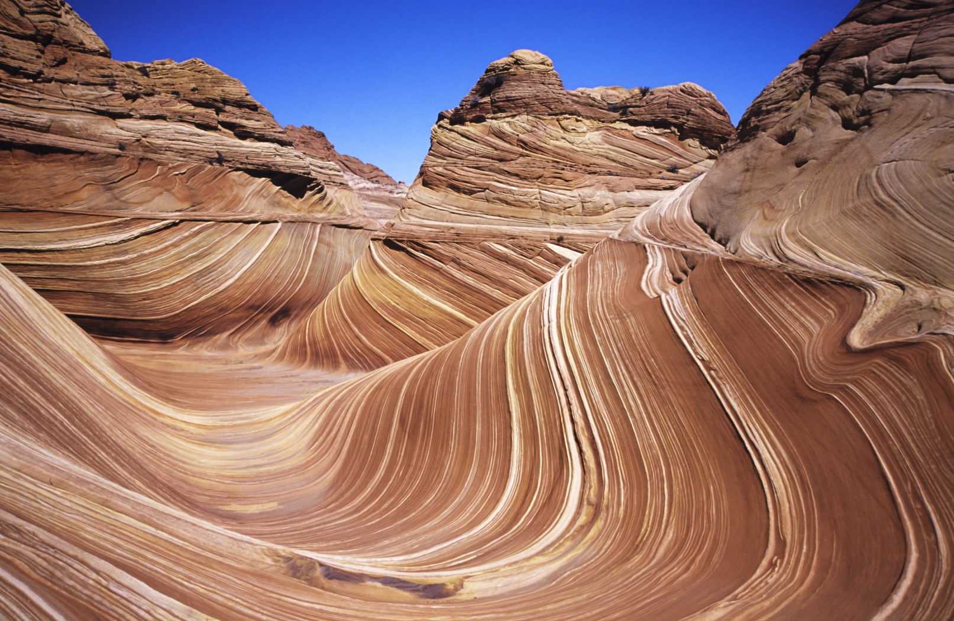
Key Question:
What do you know about sedimentary rocks?
Notes:
Have students answer the key question in their notes. Give them 5-10 minutes to write the question and their answer in their notebooks. Then ask them what they know and list ideas on the board. See if they can determine different types of sedimentary rocks and processes of sedimentary rock formation.
AUTHORS:
Natalie Juda – Scripps Institution of Oceanography and Joe Krupens – University City High School
WHY:
Most of the Earth’s natural gas and oil resources are located within sedimentary rocks. Coal is a sedimentary rock. Sediments contain all of the fossils that help us understand how life on earth evolved. They form in locations on the Earth people see every day and have distinctive characteristics that show where they formed.
SUMMARY (< 100 words):
The focus of this lesson is to understand processes which govern the formation of sedimentary rocks, ways to classify them, and the locations in which they form, particularly which plate tectonics related environments. The first steps will be undertaken by having students participate in a sedimentation activity using a different sized particles suspended in water and settled. Students will then examine a suite of sedimentary rock samples to relate the activity to real life. Finally, the students will then relate the rocks to plate tectonics environments, especially depositional environments.
PICTURE/GRAPHICS CREDITS:
Picture from http://en.wikipedia.org/wiki/File:TheWave_1600pixels.jpg
WEBSITES USED IN THIS PRESENTATION:
n/a
ADDITIONAL READING:
A good reference book at a level for first year university geoscience students is Essentials of Geology, by Lutgens, Tarbuck and Tasa.
CONTEXT FOR USE:
This lesson plan is designed for a ninth grade Earth Science class. This section of the unit may take one to two days. The activities may be modified to better fit the classroom with more or less materials and monitoring. This is best taught as part of a larger unit on the rock cycle. It is designed to follow a unit on volcanism, as the third in a series of lessons on rocks (following an introduction and igneous rocks) leading to metamorphic rocks and a final lesson on the rock cycle bringing all the types together. Prior knowledge of plate tectonics and is essential to the understanding of this lesson.
MISCONCEPTIONS:
Weathering and erosion are the same
Sedimentary rocks form only through compression
Sediment is just particles that settle out of water
Chalk/limestone confusion
EVALUATION TIPS:
Make note of student participation in discussions and volunteering information within the lesson. Written evaluation consists of the sedimentary rocks portion of the Rock Identification guide
TEACHING NOTES.
This unit is formulated to fit a 5 “E” learning method format. Students “engage” when answering a key question in their notes and sharing their ideas with the class. Following this, an activity is introduced where students “explore” a particular aspect of the lesson, in this case how sedimentary rocks are formed, what different types the students know, where they find them etc.. . Students then “explain” what they learned. With additional information provided by the teacher in the form of a powerpoint, the students have a better understanding of the concept. To “extend”, the students apply their new knowledge to a second activity, furthering their knowledge, regarding sediment deposition. Finally, they are “evaluated” through verbal communication of understanding and a worksheet summarizing the knowledge learned (sedimentary rock section of the Rock Identification Guide).

Slide 2
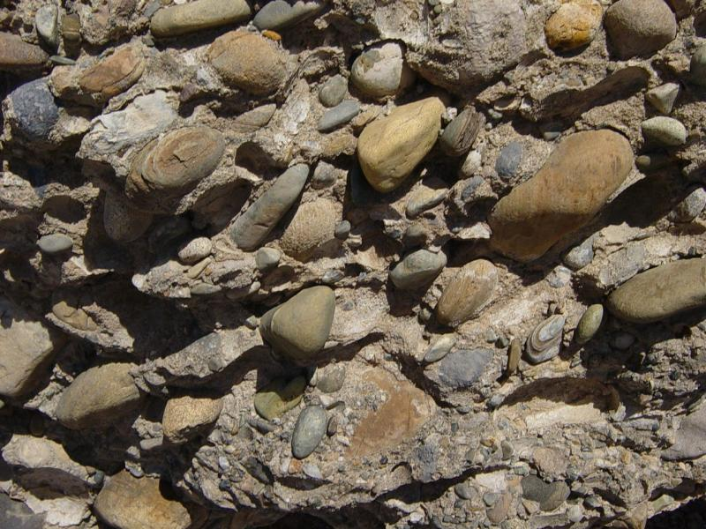
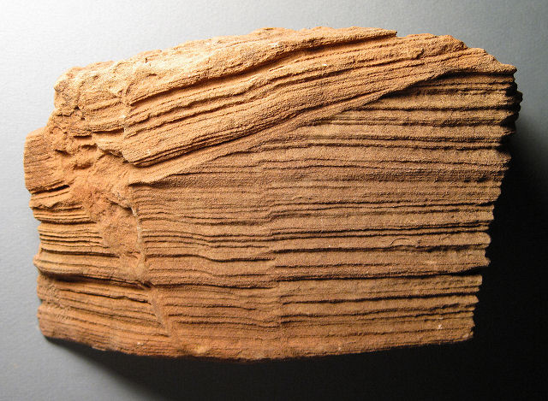
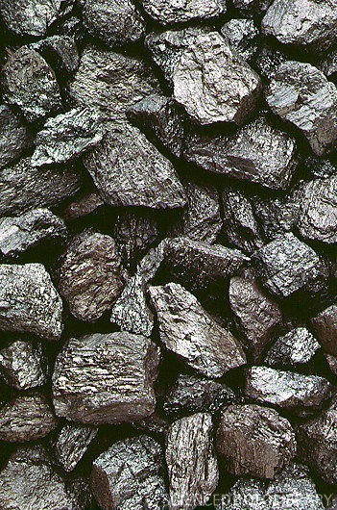
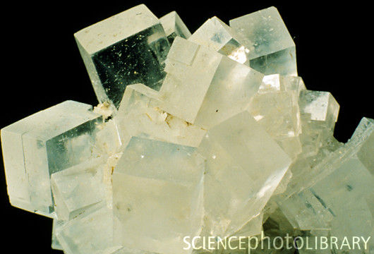
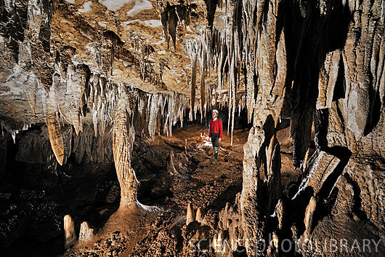
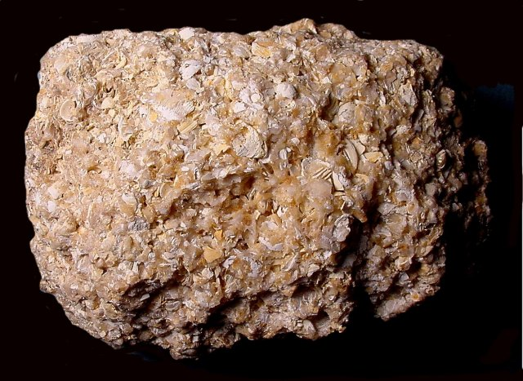
Types of Sedimentary Rock:
Clastic
Non-clastic
  Chemical
  Organic
Notes:
Categories of Sedimentary Rocks
Notes:
Photos clockwise from upper left are conglomerate, sandstone, cave limestone, coal, coquina, and rock salt (aka halite).
Have the students write the kinds of sedimentary rock in their notes or on the Rock Identification guide and leave space for the definitions.
This slide is an overview of types of sedimentary rock with examples of particular rocks and gives students new words to help hypothesize how they are divided into the types. Each type will be covered on a separate slide following this initial discussion.
Ask if they can think of ways to form a chemical rock or organic rock just from the names given, and if they know any examples.
They may have heard of organic food, or in other contexts. This relates to organisms, plants or animals,etc. And organic sedimentary rocks are formed from the remains of plants or animals.
They also may remember from the igneous rocks lesson that we used a chemical in the crystallization activity. How did the rocks form from the chemical? Similar to this cooling crystallization, crystals may form through drying of liquid instead of cooling, as the fluid evaporates.
Remind them of pyroclastic material from the volcanoes unit. The word pyroclastic contains the word clastic. Can they figure out what clastic means? Clastic refers to fragments of rock, so clastic rocks are made from fragments of other rocks. This means that the non-clastic rocks are not made from fragments of rock, but through other means.
Think about the rocks we saw in trays the other day. Can you think of any that fit the descriptions given here? – conglomerate is clastic, shale is clastic. Do they know any others? Limestone? Sandstone? Etc.
Now that they know a bit about clastic/non-clastic distinction, we will go over the different types in more detail in the following slides.
Images
Coquina – Photo credit: to R.Weller/Cochise College
Coal – www.sciencephoto.com
Cave – www.scienceph
Rock Salt – www.sciencephoto.com
Cross-bedded sandstone - http://skywalker.cochise.edu/wellerr/rocks/sdrx/6cross-bedding1137.JPG
Conglomerate - http://en.wikipedia.org/wiki/File:Conglomerate_Death_Valley_NP.jpg

Slide 3
Chemical
Chemical – a sedimentary rock that forms when minerals precipitate from a solution or settle from a suspension
Notes:
Chemical Sedimentary Rocks
Notes:
The upper left picture is a cave in limestone with carbonate stalagmites (bottom up) and stalactites (top down). The lower right picture is rock salt.
This slide covers chemical sedimentary rocks, which are precipitated from a solution.
Have them explore how these features formed. Make sure they know what precipitate means so they understand how these rocks are formed.
Ask if they know any examples. Salt deposits and similar rocks (e.g. gypsum) are formed through evaporation and are called evaporites.
Though most limestone is formed from the shells of animals, some limestone can be formed through precipitation, such as the formation of stalagmites and stalactites from the precipitation of carbon dioxide from groundwater inside a cavern of limestone. Also, small round ooids of limestone form when grains are moved through currents in water supersaturated in calcium carbonate, causing layers of calcium carbonate to precipitate on the grains. Again, most carbonate rocks are formed through living processes (when some animals die their carbonate shells fall through the water column and accumulate on the seafloor; when the shells are microscopic the resulting rock is called chalk, when macroscopic – coquina).
Pictures from www.sciencephoto.com

Slide 4
Organic
Organic– sedimentary rock that forms from the remains of plants or animals
Notes:
Organic Sedimentary Rocks
Notes:
The picture is coal, an example of organic sedimentary rock, made from organic matter as the remains of plants or animals.
Have them write the definition in their notes. Ask if they know any examples.
Coal is made of organic matter, primarily plants and bacteria that partially decompose them in environments lacking in oxygen. Once accumulated, the plant material becomes buried under layers of sediment, compacting and heating over time to become harder rock.
Coquina - Photo credit: to R.Weller/Cochise College
Coal – www.sciencephoto.com

Slide 5
Clastic
Clastic – sedimentary rock that forms when fragments of preexisting rocks are compacted or cemented together
Notes:
Clastic Sedimentary Rocks
Notes:
The upper left picture is cross-bedded sandstone. The lower right picture is conglomerate. These are examples of clastic sedimentary rocks.
Have them examine the pictures while brainstorming to determine how each was formed. What are the characteristics of each? Have them think about the size of particles, proportions of different sized particles, bedding, shape of particles, etc. Once they determine how they may have formed, they can write the definition in their notes .
Have them think back to the rocks they looked at (rock and mineral set) and if they remember rocks that were made of other rocks. Explain conglomerate (mix of clast sizes) and sandstone. Make sure they know that the particles can be microscopic to very large (e.g. like a house). Discuss with the students the relationships between fragment size and the energy it takes to move them. Then speculate on how they may have been deposited (such as fast moving streams/creeks or an ocean beach for a high energy system vs. a slow muddy river or a lake for a low energy system). You may not be able to exactly tell where the rock was deposited, but you do know about the energy level of the sedimentary process.
Cross-bedded sandstone - http://skywalker.cochise.edu/wellerr/rocks/sdrx/6cross-bedding1137.JPG
Conglomerate - http://en.wikipedia.org/wiki/File:Conglomerate_Death_Valley_NP.jpg

Slide 6
Write in your notes:
What are the three types of sedimentary rock?
And give an example of each
Notes:
Reinforcement slide for the three sedimentary rock types
Notes:
Reminder to students to write the three types in their notes with an example of each: clastic, chemical, organic.
To better understand the different sedimentary rock types, introduce a hands-on activity where they can examine rocks and determine which category they belong in.
Pass out sedimentary rock samples to each table (e.g. shale, sandstone, conglomerate, breccia, limestone, chalk, coquina, coal, halite).
Give the students at each table 5 minutes to describe their rock amongst themselves – remind them to look at the materials they’re made of, the color, the size and shape of the particles using hand-lenses or microscopes to look at finer features. Then have each group tell the class what they saw, how they would name the rock, whether it was clastic or non-clastic chemical or non-clastic organic and why they think that, while you show their rock to the class. Have the students fill in what they can on the sedimentary rock portion of their rock identification guide worksheet.

Slide 7
Key Question:
Where do sedimentary rocks form? Do the different types form in different locations?
Notes:
Introduction to second day of sedimentary rocks lecture
Notes:
This is a photograph of the rock formation in the Navaho Sandstone known as the Wave in Arizona It is an example of cross-bedded sandstone.
Have the students examine the image and ask them to explain why it would be called cross-bedded. The layers are inclined (not horizontal as most layering forms).
Have students answer the key question in their notes and try to answer it to the best of their ability.
This is the beginning of the sedimentary settling activity.
Set up the experiment.
Put three petri dishes on each table, each with a different sized sediment (e.g. small gravel (2-5mm), coarse grained sand [1-2 mm], and fine grained sand (0.25-0.5mm). Have students describe in on the activity handout the characteristics of each – list the color, size, and shape of the particles and any other distinguishing characteristic they observe.
Have the students answer the hypothetical questions on the handout about settling and layering that may occur depending on whether settling from water, or shaking when dry.
Conduct the activity. It would be helpful to demonstrate in order to have them conduct the activity correctly and not create a mess.
Students should vigorously shake the wet test tube to suspend all the sediment in the water then set the test tube aside in the beaker in order to allow the sediment to settle.
Students should write down their observations on the worksheet and hypothesize reasons for what they see happening and what properties of the material that they listed earlier have the greatest impact on the changes they see.
Students should also shake the dry test tube from side to side (much more gently than for the wet test tube). They should again make observations and determine what properties of the material that they listed earlier have the greatest impact on the changes they see.
Once completed, the students should compare the patterns in each test tube and give reasons for the similarities or differences they observed.
Start powerpoint by asking if they know three types of sedimentary rock (or to repeat what they learned earlier if they figured during the discussion of the key question).
Picture from http://en.wikipedia.org

Slide 8
Sedimentary Rock Formation
Step 1: Make the raw materials for a sediment via weathering or erosion
Step 2: Deposit the sediment
Step 3: Turn the sediment into rock through compaction and cementation
Animations
Notes:
Steps to form a sedimentary rock
Notes:
Explain how a rock is formed from sediment or other particles (chemicals or organic material).
First, smaller particles of material are formed through weathering of larger materials. The particles are then transported through erosion to places where they can accumulate and are deposited. Once deposited they may be compressed through addition of materials above or cemented through the passage of fluids through a rock which may precipitate material between grains “gluing” them together.
Make sure they know the definitions of the bold words. Have them come up with definitions of the words and only explain if they have questions
Weathering is the physical breakdown and chemical decomposition of rock materials at the earth’s surface – ice wedging, organic, exfoliation, oxidation, carbonation, hydrolysis, organic acid, acid precipitation
Erosion is the transport of materials at the surface.
How are sediments transported? – water, wind, ice, etc.
Where are sediments deposited? – basins, lakes, oceans, deserts (general topography at lower elevation than the origin of the material) .
Deposition occurs not just from suspension in water, but also from air, or ice. Compaction is the compressing of rock to reduce the volume of material. Therefore, air or water from between grains may be removed through this process.
Cementation is the precipitation of minerals from water passing between sediment grains and “glue” the grains together
Animations from:
www.classzone.com/books/earth_science/terc/content/investigations/es0602/es0602page02.cfm

Slide 9
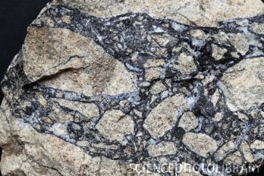
Clastic rocks are classified by the size, angularity, and sorting of the particles
Shale – clay (<1/256 mm), silt (1/256 – 1/16 mm)
Sandstone – 1/16 – 2 mm
Conglomerate or Breccia – mix of large and small sizes of particles (large ones can be any >2 mm)
Animation
Notes:
Characteristics used in classification of sedimentary rocks
Notes:
The picture on the left is conglomerate, and on the right is breccia. The grain sizes of both rocks are similar (a mix of large and small) but the difference is in the shape of the particles (rounded particles for conglomerate, angular particles for breccia).
This slide covers aspects of sedimentary rocks that help classify them including size, angularity and sorting.
The students should discuss what they would do were they given the rocks on the slide and told to determine how they formed (like a detective determining how someone died). What properties would they look at? What could they tell them about how the rocks formed?
For example, students could remember the settling activity from the previous day. There, the rock fragments arranged themselves into layers. However, the two images shown first (conglomerate and breccia) have a mix of different sized particles all jumbled together. How could that happen? What about the shape of the particles – what would that tell you about how they formed (or how far the particles have traveled from their original location)? Later, you can compare the sandstone (animated to appear within the powerpoint) with the breccia to compare how a rock can be so homogenous vs heterogeneous.
Size:
How do you get smaller sizes of particles? Weathering and erosion. Weathering is the breakdown of rocks at the earth’s surface, either physically or chemically. Erosion is the movement of material by wind, ice, water
The size of the particles indicates the time or distance from where the original rocks were situated
Angularity:
What’s the difference between the two pictures? They both have a mix of large and small particles. Have them talk about the shape of the clasts. Rounded clasts are found in conglomerates, while angular clasts are found in breccias.
What could the roundness of the grains indicate?
Angularity is the aspect of sedimentary rocks that deals with the roundness of sediment grains. The clasts collide with others as they are transported. What happens to their shape when things continue to collide? - the further sediments are transported, the more they collide with other particles, the more they are rounded.
The more rounded, the further from the source they are likely to be (e.g. breccias are usually found in rock slides where the rock was broken and fell a small distance and the fragments are angular, while conglomerates often are stream/river bed deposits where the rock fragments have tumbled through the water for a long distance, abrading against each other to round the edges over time before deposition).
Sorting:
Within the powerpoint, click to show the sandstone image next to the breccia. Have the students answer besides size and angularity, how these two rocks differ.
The sandstone is made of all the same sized particles, while the breccia has a wide variety of sizes. The sandstone is “well sorted” while the breccia is “poorly sorted”. Sorting may indicate the environment in which the sediment was deposited (e.g. windblown deposits are usually better sorted than aqueous ones). Also, sorting is more common further from the source of the sediment. Closer to the sediment and with faster deposition the sediments are usually poorly sorted (like the breccia).
The animation shows one example of transport of sediment. As the particles move in the stream they knock into each other and break into smaller particles and round their edges, and when they settle out different particles settle out at different locations due to the energy of the stream (the lower the energy the smaller the particle settles out). Thus, if we look at a rock from the very right side of the image it may be a well sorted mudstone (only small particles).
Breccia - http://www.sciencephoto.com/image/147234/350wm/C0084312-Gneiss_and_sphalerite_breccia-SPL.jpg
Conglomerate - http://en.wikipedia.org/wiki/File:Conglomerate_Death_Valley_NP.jpg
Sandstone: http://skywalker.cochise.edu/wellerr/rocks/sdrx/6cross-bedding1137.JPG
Animation:
http://www.classzone.com/books/earth_science/terc/content/investigations/es0602/es0602page02_popup4.cfm

Slide 10
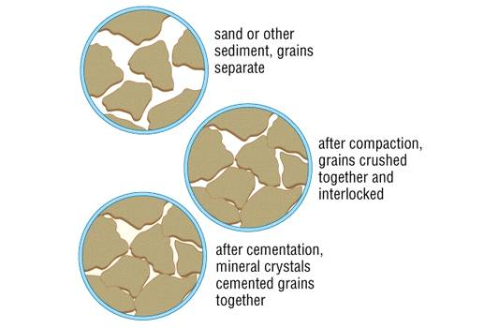
Notes:
Cementation and Compaction
Notes:
This diagram explains the two processes by which the sediment becomes a rock.
Compaction occurs when sediments are compressed (usually by further layers depositing above). The material (usually air or water) in between the particles (pore spaces) is squeezed out under this pressure, compacting the sediment. Another method of turning loose sediment into rock is cementation. This occurs when a fluid (usually some sort of water with dissolved minerals within it) passes through the pore spaces between the sediment grains and deposits minerals as it dries. This mineral formation can “stick” the grains together. Both processes can apply to the same rock.
Image from http://media.tiscali.co.uk/images/feeds/hutchinson/ency/c00775.jpg

Slide 11
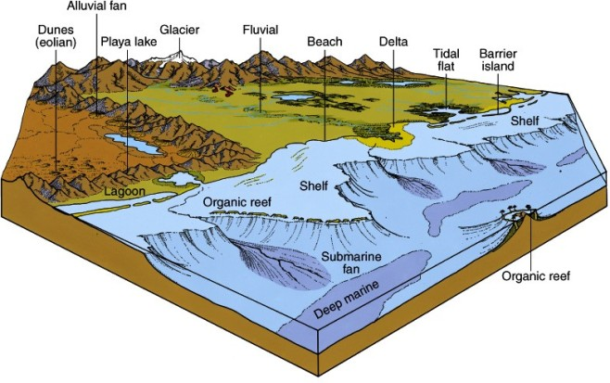
Depositional Environments for Sedimentary Rock
Notes:
Depositional Environments of sedimentary rock formation
Notes:
This is a diagram of depositional environments for sedimentary rocks. Note, the pointer for the playa lake is pointing at the mountains instead of a playa lake.
Have the students try to figure out where the sediments are transported, and where they are deposited.
Where are sediments deposited? How are they transported there? Have students say where deposition may occur and what process brought sediment to that location.
All of the locations on the diagram are locations where sediment may be deposited. Therefore, the locations where transport occur are places leading to those depositional environments. We know of three methods of transport – ice, water, wind. Where would each occur and where would the sediment transported in each manner be deposited?
For example, the glacier transports sediment entrained in the ice as it moves and as it melts sediment is deposited in the resulting glacier valleys.
At the base of mountains material transported by rivers is deposited in lakes or in the streams themselves (fluvial). The sediment may also travel further down the river and be deposited in floodplains of the river, the delta, or even in the submarine fan.
In the desert lack of ice or water means air is the method of transport. Winds blow the sand into dunes.
Image from
http://explanet.info/Chapter02.htm

Slide 12
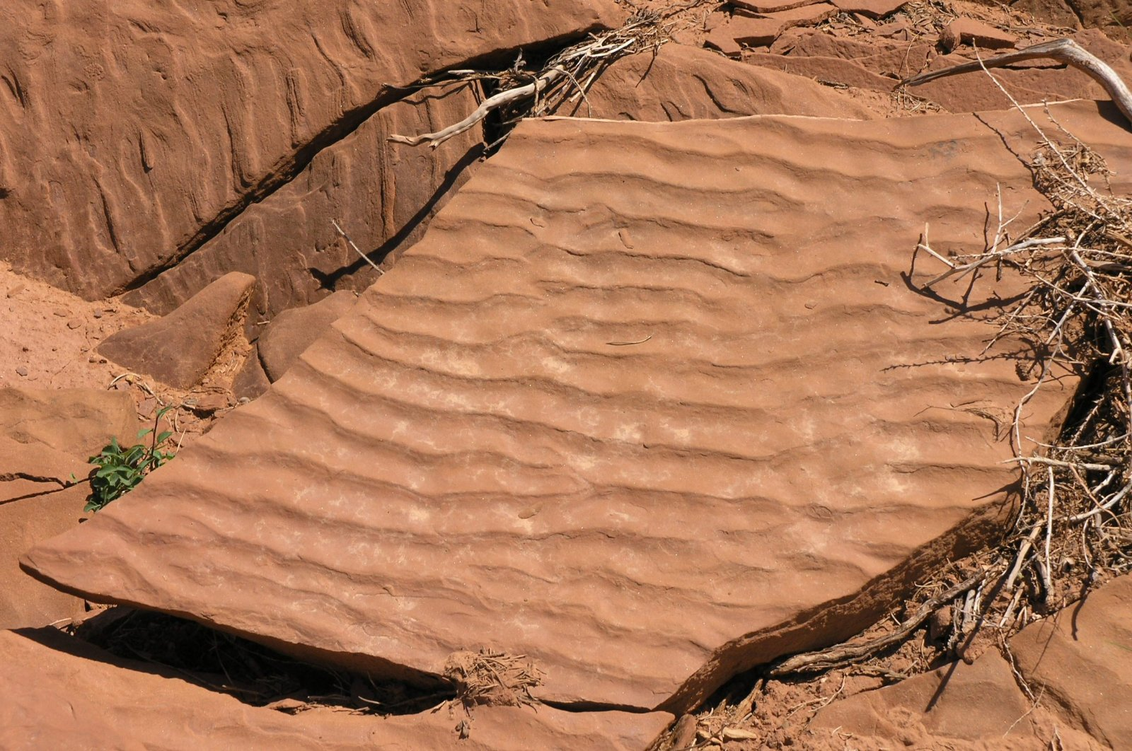
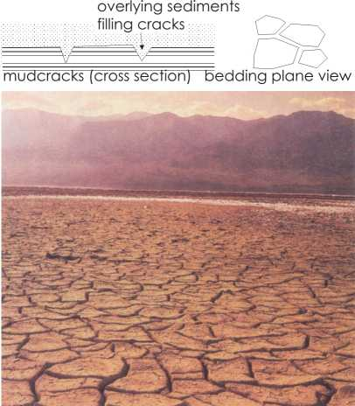
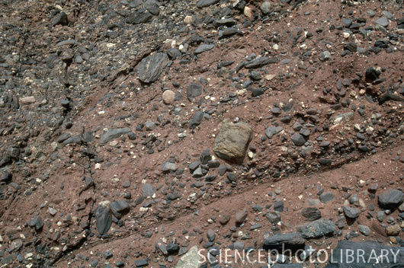
Sedimentary Structures
Stratification
Graded bedding
Crossbedding
Ripple marks
Mudcracks
Fossils
Notes:
Sedimentary Structures
Notes:
Sedimentary structures provide more information about the depositional environments in which sedimentary rocks formed.
First show the students the images of different sedimentary structures. Have them brainstorm about what they see in each picture and what it could mean in terms of the location in which the rock formed.
The top left image is of crossbedding. This occurs when deposition of sediments also involves partial erosion of the material is deposited on. It is most common in regions where a current causes ripples or dunes and the windward side (the side from which the current is moving) of the ripple is eroded and then deposits on the leeward side of the ripple (the back side of the ripple). It often occurs where the direction of movement changes (e.g. wind direction changes so sand dunes move in different directions). Other locations where this occurs is in river deltas (the outlets of the river are always shifting), and some stream channel deposits.
The top right image is of ripple marks. These small waves of sand develop on the surface of a sediment layer when water or air moves over the surface. The ridges form perpendicular to the direction of motion.
The bottom left image is of mudcracks. These form when wet mud or clay dries and shrinks. Locations where these occur alternates between wet and dry conditions such as tidal flats, shallow lakes, and desert basins.
The bottom right image is of graded bedding. Layers have a range of grain sizes and they are ordered from largest particles on the bottom to smallest on the top. They happen during quick deposition from water carrying a variety of sizes of particles. When a fast current loses energy the largest particles settle out first.
After describing the layering in this image, ask whether they have seen this layering before? They should realize that this distribution of particles is similar the layering they formed in their sediment settling activity. They suspended different sized particles in water during the mixing (shaking or stirring) and it settled quickly, with successive settling of increasingly smaller particles. Can they think of how the grading could be reversed (largest particles on top of successively smaller particles)? If you shake a bowl of tortilla chips or different nuts, the larger ones often migrate to the top. This is why over time even if you remove large stones in a garden, new ones appear after some time. The smaller particles can fall in between larger ones.
Can they think of any other indications of the past environment in which a rock formed?
What about fossils? Fossils indicate the type of organisms living in the environment at the time the rocks were forming. They are useful in determining past environmental conditions. They should also remember that fossils were used to correlate different regions of the world together to help determine the theory of plate tectonics (e.g. regions of south America and Africa have the same freshwater or land fossils in rocks of the same age, so the two continents had once been one that later split apart).
Once they have described the pictures, show the list and explain the ones they have yet to identify.
Stratification is the most common characteristic feature of sedimentary rock. Layers, “strata” or “beds” are unique layers within a rock, each representing different conditions during which the sediment was deposited.
Cross-bedded sandstone photograph from
http://skywalker.cochise.edu/wellerr/rocks/sdrx/6cross-bedding1137.JPG
Ripple marks photo from
http://en.wikipedia.org/wiki/File:Ripple_marks_in_Moenkopi_Formation_rock_off_of_Capitol_Reef_Scenic_Drive2.jpeg
Mudcracks- http://www.outreach.canterbury.ac.nz/resources/geology/glossary/mudcracks.jpg
Graded bedding photo from www.sciencephoto.com

Slide 13
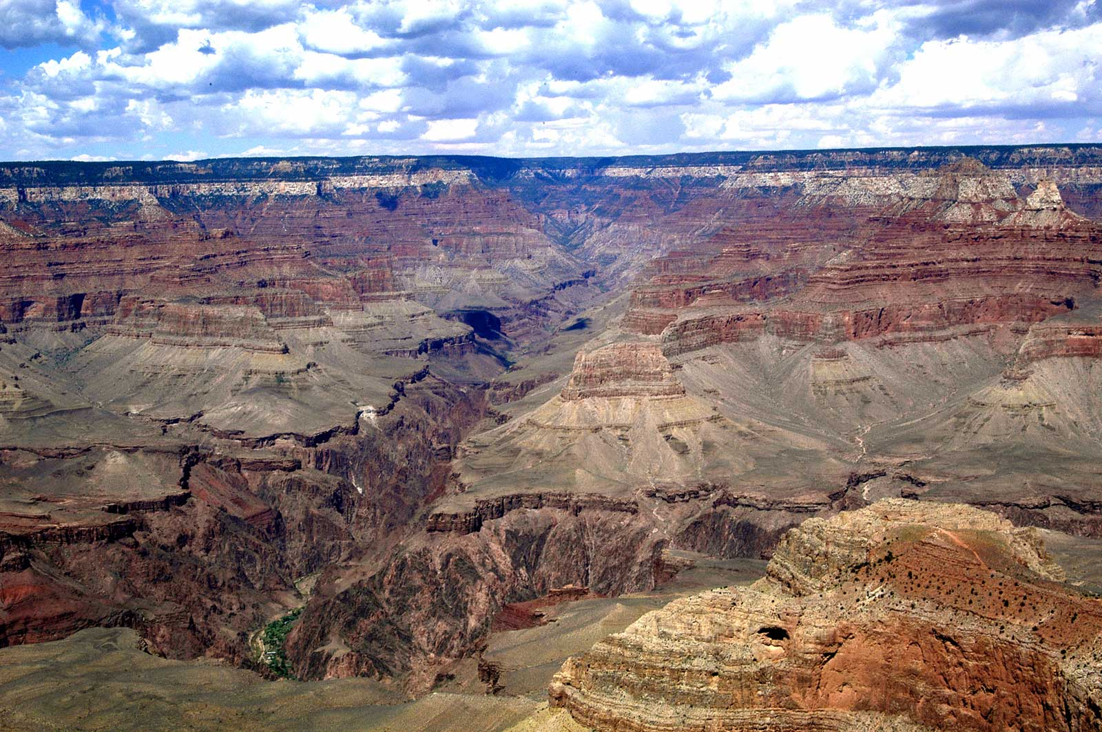
Overview
Three types of sedimentary rock
How sedimentary rocks are formed
Clastic rock characteristics
Depositional environments
Sedimentary structures
http://earthref.org/SCC
Scripps Classroom Connection
Notes:
Sedimentary Rocks Overview
Notes:
Review here what the students learned in this segment
There are three types of sedimentary rocks, clastic, chemical and organic.
These three types are formed in different ways: Chemical sedimentary rocks are precipitated from a solution. Organic sedimentary rocks are made up of the remains of plants or animals. Clastic sedimentary rocks are formed from fragments of rock formed through weathering, transported through erosion, deposited and then compacted or cemented in order to turn the sediment into rock.
Clastic rocks are characterized through examination of the size of the particles, the angularity, and the sorting. Rocks with smaller particles and more rounded particles tend to be found further from their origin than ones with larger more angular particles. Sorting indicates the environment in which they were deposited.
Depositional environments are where sediments are deposited and transformed into sedimentary rocks.
Sedimentary structures indicate the depositional environment in which they form. For example, ripple marks only form where wind or currents of water pass over sediment.
Picture from: http://www.atpm.com/11.08/from-atpm-readers/images/arizona-grand-canyon-vista.jpg

