Slide 1
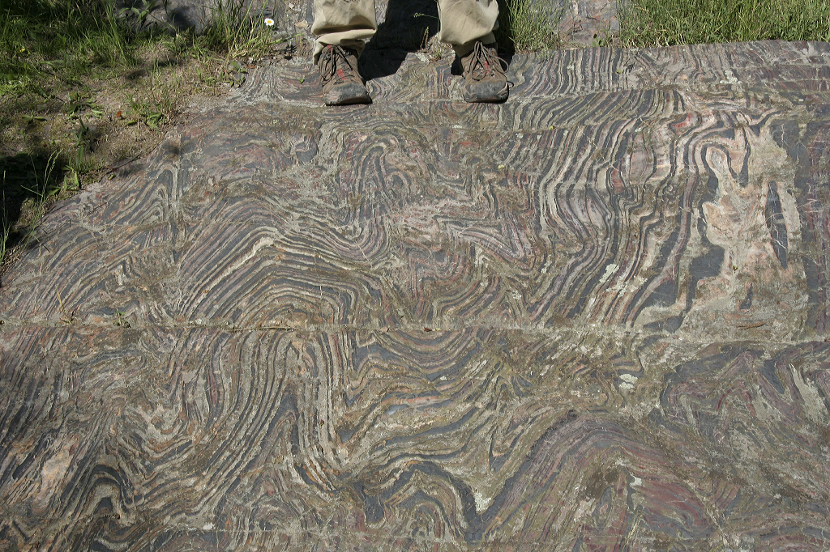
Key Question:
What is a metamorphic rock?
How is it formed?
Notes:
Notes: This is a photograph of contorted BIF (banded iron formation) near Soudan Mine, MN.
The person’s boots are in the image to give a scale of the folding. This is a photograph of an interesting metamorphic texture.
Students write the key question in their notes and answer with what they know and then volunteer information when asked.
Metamorpshism is a change in rock due to changes in temperature or pressure.
The students ideas may be written on the board to generate discussion to get further at the definition and processes involved in metamorphism. Make sure the students understand that during metamorphism rocks remain solid (do not melt completely) but they do change due to temperature and pressure.
Photo credit: Natalie Juda
Title Slide Notes:
AUTHORS:
Natalie Juda – Scripps Institution of Oceanography, and Joe Krupens – University City High School
WHY:
Many metamorphic rocks are interesting to the general public due to their layering, folding, and mineralogy. Some are used for kitchen countertops, to create beautiful interiors of classic buildings and sculptures. This presentation will inform students how these rocks formed and what locations they are found in.
SUMMARY (< 100 words):
The focus of this lesson is to understand processes which govern the formation of metamorphic rocks, ways to classify them, and the locations in which they form, particularly which plate tectonics related environments. The first will be undertaken by having students participate in a deformation activity using sugar as a proxy for rock and changing them using temperature and pressure to change the resulting rock formation. Students will then examine a suite of metamorphic rock samples to relate the activity to real life. Finally, the students will then relate the pressure, temperature conditions that form metamorphic rocks to locations where they can form, especially plate tectonics environments.
PICTURE/GRAPHICS CREDITS:
Natalie Juda, photo taken of folded BIF (banded iron formation) outside Soudan Mine, MN in 2006. All photos in this presentation were taken by a coauthor, Natalie Juda or were taken from www.sciencephoto.com
WEBSITES USED IN THIS PRESENTATION:
For animation of metamorphism see the second to last step in this series:
http://www.classzone.com/books/earth_science/terc/content/investigations/es0602/es0602page02.cfm
ADDITIONAL READING:
A good reference book at a level for first year university geoscience students is Essentials of Geology, by Lutgens, Tarbuck and Tasa.
A helpful powerpoint containing more detailed information presented by Professor John Winter from Whitman College (author of an incredible college textbook An Introduction to Igneous and Metamorphic Petrology­) is found at www.whitman.edu/geology/winter/Petrology/Ch%2021%20Intro%20to%20Met.ppt
CONTEXT FOR USE:
This lesson plan is designed for a ninth grade Earth Science class. This section of the unit may take one to two days. This is best taught as part of a larger unit on the rock cycle. It is designed to follow a unit on volcanism, as the third in a series of lessons on igneous and sedimentary rocks leading to a final lesson on the rock cycle bringing all the types together. Prior knowledge of plate tectonics and is essential to the understanding of this lesson. The first activity using clay to model metamorphism may take 20 minutes. The second activity, examining metamorphic rocks, should take 5 minutes for the students to examine and describe their rocks and 15-20 minutes for them to present their findings.
MISCONCEPTIONS:
Metamorphism relating to metamorphosis in animals
All metamorphic rocks are banded or folded
Heat and temperature are the same
EVALUATION TIPS:
For this lesson students fill out the metamorphic rock section of the Rock Identification Guide.
TEACHING NOTES.
This unit is formulated to fit a 5 “E” learning method format. Students “engage” when answering a key question about their previous understanding of metamorphism in their notes and sharing their ideas with the class. Following this, an activity is introduced where students “explore” several processes by which metamorphic rocks can change. Students then “explain” what they learned. With additional information provided by the teacher, the students have a better understanding of the concept. To “extend”, the students apply their new knowledge to a second activity, furthering their knowledge. Finally, they are “evaluated” through verbal communication of understanding and a worksheet summarizing the knowledge learned.

Slide 2
How to make a metamorphic rock
Take any kind of rock
Cook at 150 to ~600°C
    Above ~650°C rocks start to melt
Bury to 2-45 km (pressure of 1-15 kb)
Apply water--wet rocks metamorphose at lower temperatures than ‘dry’ rocks
Notes:
Agents by which a metamorphic rock is formed
Notes:
Begin with making sure the students know what metamorphism is and whether any and all rocks can be metamorphosed.
Metamorphic rocks are those changed by temperature, pressure and fluids. The minerals in the rock can change in size (grow or shrink), and can change into different minerals more stable in the metamorphic conditions than those under which the original rock formed, For example, under very high pressure graphite can change into diamond.
Sometimes diagenesis (a sedimentary process of changing rock once it has been deposited) can be confused for metamorphism. For examples, a sandstone undergoing diagenesis is cementated and compacted just enough to change the sediment into rock. However, in metamorphism the rock gets recrystallized completely eliminating the pore space between the sand grains, transforming it into a quartzite.
Think about how we made a melt from the mantle which was solid rock. In metamorphosing rocks, we can change these same properties (temperature, pressure, addition of water), just not to the extent to get the rock to melt. Also, in this case, we increase the pressure to get changes to occur, not decrease it like we form melt at mid-ocean ridges. Remember, melts are generally near 1000deg C so 800deg C is lower than rock melting temperatures.
The next slide contains the simplified version of this information for students to take down in their notes.

Slide 3
Factors Controlling Metamorphism
Primary:
Temperature
Pressure
Secondary:
Presence of hydrothermal fluids
Notes:
Factors Controlling Metamorphism
Notes:
Students should make sure they have this information written in their notes. The most important factors for metamorphism are temperature and pressure. The presence of water is secondary as it facilitates metamorphism but the other factors must first be present to make changes begin.
Make sure they can figure out what hydrothermal means – hydro (water), thermal (heat)
Important to note: heat and temperature are not the same. Two objects of different composition and size may have the same temperature but have more or less heat due to the size and type of material. Temperature is a measure of thermal energy (i.e. heat).
More detail:
Increased temperature causes vibration of ions within a mineral. As temperature changes, these vibrations intensify allowing atoms to move more easily within the crystal structure of the mineral, changing the minerals into forms that are more stable at the new temperature, or growing the present minerals. The overall composition of the rock remains essentially the same as previously, but the configuration changes.
The heat within the earth is mostly produced through radioactive decay and thermal energy remaining from the formation of the planet. The deeper in the earth, the higher the temperature (the rate is known as the geothermal gradient). Thus, when rocks are buried under layers of other rock or through subduction, they are heated as well as buried (increased pressure). Heat can also be brought into contact with rocks through igneous intrusions.
Pressure increases with depth due to the weight of overlying rock. This pressure is from all sides, not just from the surface down. This is known as confining pressure, and it is the most common pressure effect on rock. Rocks can also be subjected to directed pressure in select locations where one direction of stress on the rock is greater than others. Rocks under directed pressure tend to be flattened or folded. This type of pressure is most common in tectonic environments, especially convergent boundaries where the pressure is in the direction of plate motion.
Fluids can facilitate recrystallization of minerals as ions can move more easily in fluids than solids, and therefore can migrate more easily between crystals. Fluids can also dissolve material from one location (higher stress) and deposit it through precipitation in other locations (lower stress). Therefore, in locations where there is directed pressure, fluids play a critical role. Water is present in minerals and in the pore space between grains of sedimentary rock. With increased temperature, the water is released from the crystal structure. With lower changes in pressure and temperature the water may remain within the rock, but with greater changes, the water can migrate away from the original rock and may change rocks a distance away from the source of the water.
Detailed information from Essentials of Geology, by Lutgens, Tarbuck and Tasa

Slide 4
Pressure
  Confining Pressure: same pressure from all directions.
  Directed Pressure: unequal pressure from different directions
Notes:
Types of pressure related to metamorphism
Notes:
Ask them if they can think of different ways pressure can be applied to rock before showing the two types (animated to come in separately).
Make sure they put this information in their notes
Have them think where these conditions occur – buried rocks have confining pressure, while rocks in convergent zones where the pressure is directed in the direction of plate motion
Have them think what might happen to a rock under these conditions – how the resulting rock would be different under these different conditions.

Slide 5
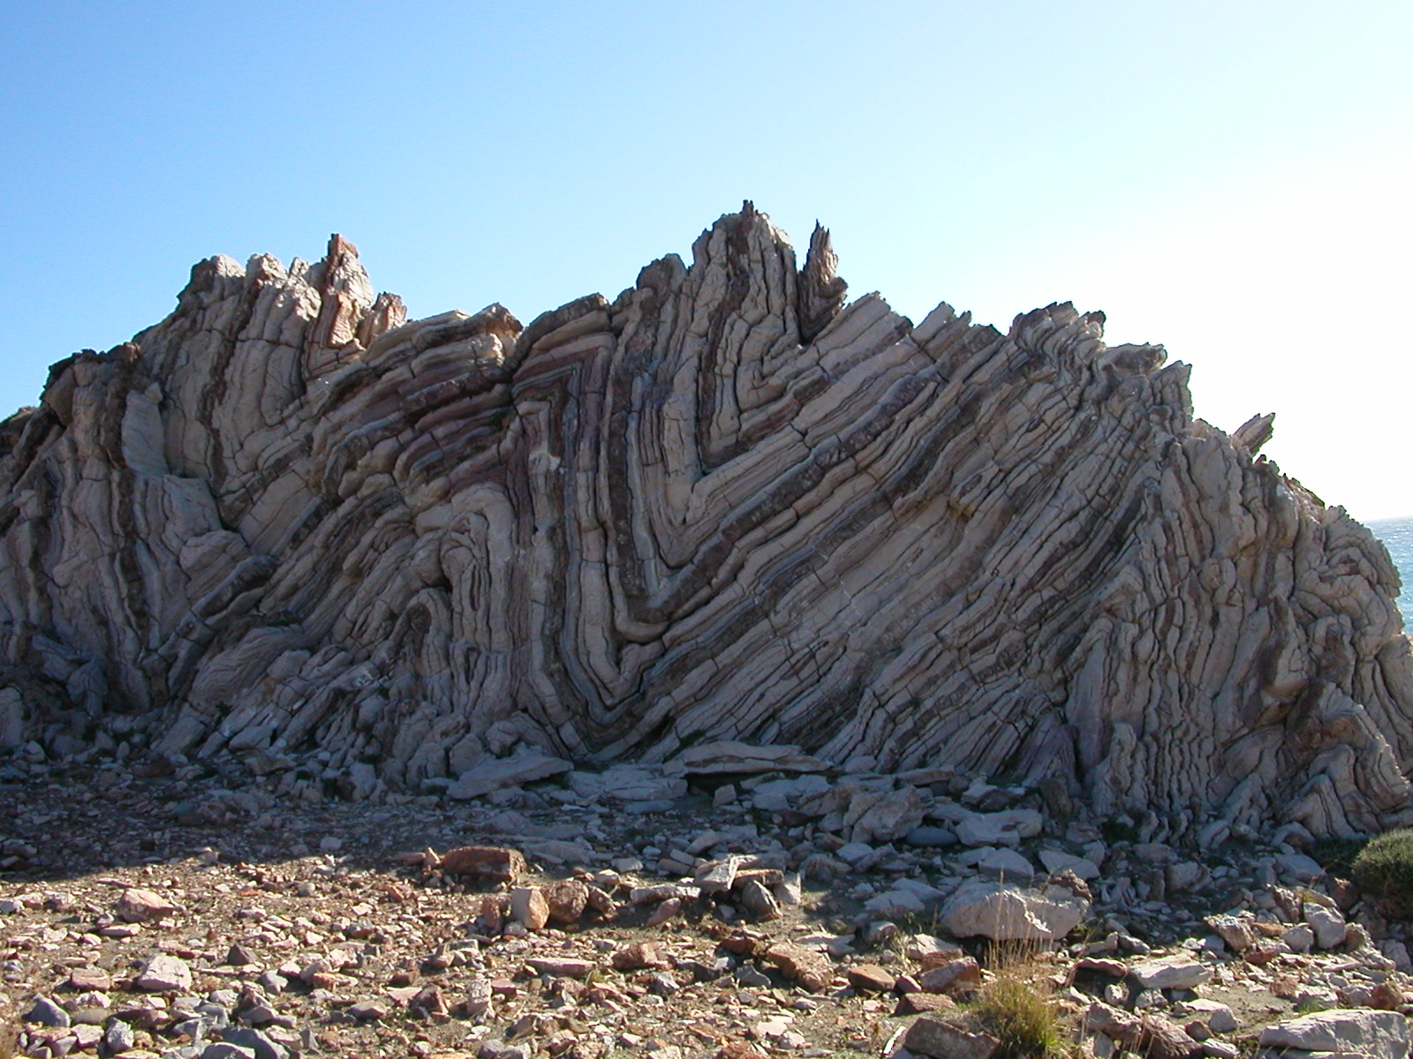
Directed Pressure
Notes:
Deformation of rock
Notes:
Picture of folds from Crete created during convergence of the African and European plates. Total height of the folds is about 3 meters.
Under certain conditions, when tectonic pressure is applied (in this case a convergent margin) rocks can be warped and folded, while under conditions this directed pressure causes a foliation throughout the rocks (as will be discussed further in later slides). This is a local effect, only at plate boundaries where directed pressure occurs. Ask the students how this formed. What were the original rocks? Were they layered? Could they have not been layered?
This rock was most likely originally sedimentary flat layers. Then the stress regime changed and a directed pressure caused the thin layers to fold. This occurred when the plates in the region converged, crumpling the flat layers into folds (somewhat like how cars crumple upon collision).
This occurred while the rock was still buried at depth with high temperature, as the layers behaved in a ductile fashion. If the layers of rock were at a lower temperature, they would have behaved in a brittle manner and fractured rather than folded. Subsequent erosion and uplift has exhumed these folds until they were exposed at the surface.
Picture credit: Natalie Juda

Slide 6
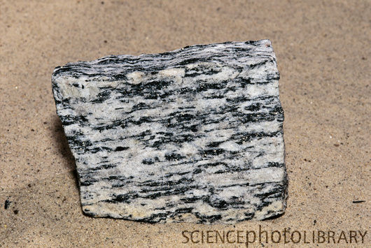
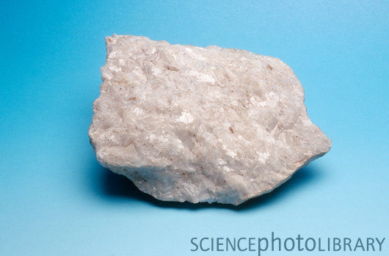
Metamorphic Rock Textures
  Foliated: minerals are arranged in layers or bands
  Non-Foliated: not layered; minerals grow in the same size and shape
Animation
Notes:
Metamorphic Rock Textures
Notes: The upper photo is of gneiss, a strongly foliated rock with banding of separate minerals. The bands are typically <1cm thick. The lower photo is of quartzite, a non-foliated metamorphic rock.
The bullet points appear first. After you explain both textures, have the students postulate what the rocks representing each texture might look like and then show them the photos.
Pass around samples of metamorphic rocks (foliated rocks like shale, schist, gneiss, and a non-foliated rock like marble or quartzite) so they can see and feel these rocks. Have them try to explain the differences between the samples. If you have enough samples for each table to have one, give them 5 minutes to talk amongst their group and come to a decision about what kind of metamorphic rock it is and how it may have formed. Then have each group present their rock and their explanation to the rest of the class.
Foliated:
Minerals align in bands under directed pressure. The original rock may have minerals that have alignment (longer in one direction than another) so they align under conditions that cause the minerals to change orientation
Also, the original rock may have already had layers of minerals or fragments
Show the animation on metamorphism (second to last animation in this rock cycle series). It shows how minerals are flattened due to the pressure direction.
Non-foliated:
The original rock may have been made of only one type of mineral or made of minerals with an equant shape (not elongate in any direction, so harder to align due to directed pressure).
Animation from website: http://www.classzone.com/books/earth_science/terc/content/investigations/es0602/es0602page02.cfm
Photos from website:
www.sciencephoto.com

Slide 7
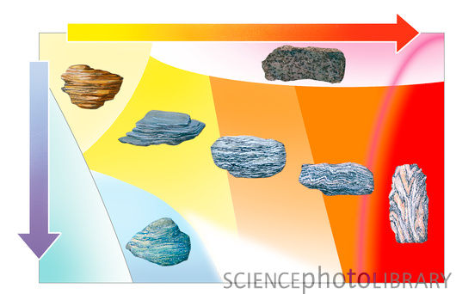
Foliation becomes more distinct with increased temperature and pressure
Crystals grow larger
Foliation (layering) becomes more obvious
Order schist, slate and gneiss with increasing foliation and explain why.
Notes:
Foliation type in relation to temperature and pressure
Notes:
This slide explains how temperature and pressure affect how metamorphic rocks change.
This diagram illustrates the relative changes in temperature and pressure that different types of metamorphic rock undergo during their formation. The horizontal arrow indicates increasing temperature from left to right. The vertical arrow indicates increasing pressure (and depth) from top to bottom. The rock types are positioned in the diagram according to the conditions in which they form. At top right is Hornfels, a rock typically related to contact metamorphism(i.e. for the same pressure the rock changes due to increased temperature from coming in contact with a hot magma intrusion). The rock type at bottom left is blueschist (i.e. a rock little changed in temperature but with a large increase in pressure, such as rocks subducted down a trench). The rocks types across the center are (from left to right): shale, slate, schist, gneiss and migmatite (all of these are affected by both temperature and pressure, and increasing foliation occurs with greater levels of pressure and increased temperature). With a little heat and pressure a slate forms with thin plates of clays and other clay and silt sized crystals. With increased temperature and pressure the rock becomes more foliated (large mica flakes are aligned along with other minerals) creating a rock called a schist. With further increase in temperature and pressure the minerals segregate into bands of individual minerals in the form of a gneiss. A migmatite has the highest temperature and pressure of the metamorphic rocks, causing parts of the rock (certain minerals) to melt within the rock.
Hand out a metamorphic rock to each table. Allow the groups to determine what properties the rock has (i.e., what minerals they recognize, the presence of foliation or not, and if foliated, and what intensity of foliation they observe – this last may require a comparison with the rocks other groups are analyzing). Each group should then report to the class what they observed and a possible name of the rock (slate, schist, gneiss, etc.).
Diagram from www.sciencephoto.com

Slide 8
Effects of Hydrothermal Fluids
Rocks contain liquids and gases
Fluids dissolve and transport ions throughout large regions of rock
Rocks change chemically into different mineralogy and texture
Notes:
Effects of Hydrothermal Fluids
Notes:
Rocks contain “hydrothermal fluids”, mixtures of liquids, gases, and supercritical fluids (characteristics of both gases and liquids).
When magma solidifies such fluids may be released. Also, some fluids are formed through metamorphic processes as the minerals in rocks release fluids. In addition, groundwater can percolate deep into the crust.
The fluids enable ion migration through large bodies of rocks. They can strip away ions from some minerals through chemical reactions, and then migrate to a further rock and react again substituting some of the dissolved ions for others.
Thus, the presence of fluids can change the chemical composition of the rock without much heat and pressure applied.

Slide 9
Two Types of Metamorphism
Contact
Regional
Notes:
Intro to second day of metamorphism, Types of Metamorphism
Notes:
Start of second day. Start with Key question: How do the three factors controlling metamorphism act on rocks (each on their own or in combination)? At what tectonic setting might these conditions occur?
Start powerpoint lecture:
Ask students what they think the difference is between the two types. What do the words mean?
These are distinctions made on the basis of the amount of area affected as well as the processes involved.
Contact – changes in rock due to contact with heat (usually intruding magma). This only happens locally, at or near the location where rock is in contact with magma or other sources of heat)
Regional – changes in rock due to changes in a large area (region) in temperature (due deep burial or compression from tectonic forces and subsequent adjustment of temperatures and pressure to geothermal gradients.

Slide 10
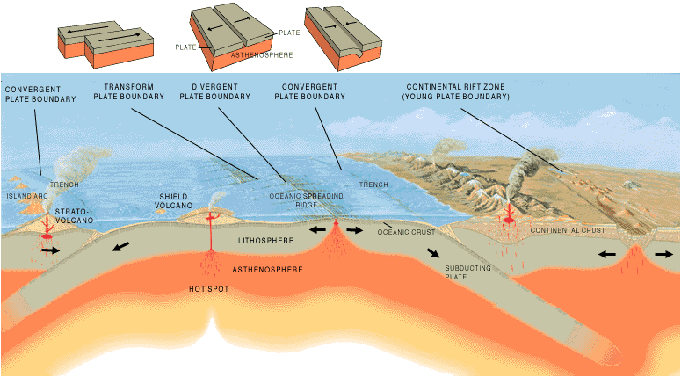
Relation of Metamorphic Rocks to
Plate Tectonics
Notes:
Metamorphism related to Plate Tectonics
Notes:
This is a USGS diagram of plate tectonics to remind students of the different plate boundaries and possible locations of metamorphism
Make sure the students remember the three ways to get metamorphism – temperature, pressure and hot water
In relation to plates, where could you get each of these to occur?
Temperature – from contact with molten rock
Pressure – buried under enough layers of rock to change the rock, or in locations where there is pressure from one direction (convergent plate boundaries)
Hot water – think where there is water that is heated (e.g. ocean ridges where seawater circulates near the magma, also groundwater near magma, or water released from water-bearing minerals and rocks due to heating rock)
The geothermal gradient is the rate of increasing temperature with respect to increasing depth within the Earth. Away from plate boundaries the gradient is approximately 25-30 degrees Celsius per kilometer of depth. However, at plate boundaries this changes.
At ridges and rift valleys (areas of extension) as well as other areas of magmatism, there are high geothermal gradients (up to 200 degrees per kilometer) due to contact with hot magma upwelling to the surface or shallow depths.
In contrast, at subduction zones the geothermal gradient is generally lower due to the thrusting of cold, water saturated rocks beneath existing crust.
As shown in the next slide, where crust thickens and mountain building occurs (e.g. convergent margins, particularly continent-continent collision), the increased pressure of thicker layers of rock cause more metamorphism. Also, these locations may have intrusions of magma which increase the temperature of rocks.
Areas away from plate boundaries are typically characterized by burial metamorphism as more and more layers of rock form and are subsequently buried beneath the next youngest layer until at a depth where the pressure can metamorphose the rock.
Now introduce the Sugar Metamorphism activity. This allows students to explore the methods of metamorphic rock formation by manipulating the sugar in ways similar to the natural processes.
Diagram from
http://pubs.usgs.gov/gip/dynamic/Vigil.html
http://duke.usask.ca/~reeves/prog/geoe118/geoe118.012.html

Slide 11
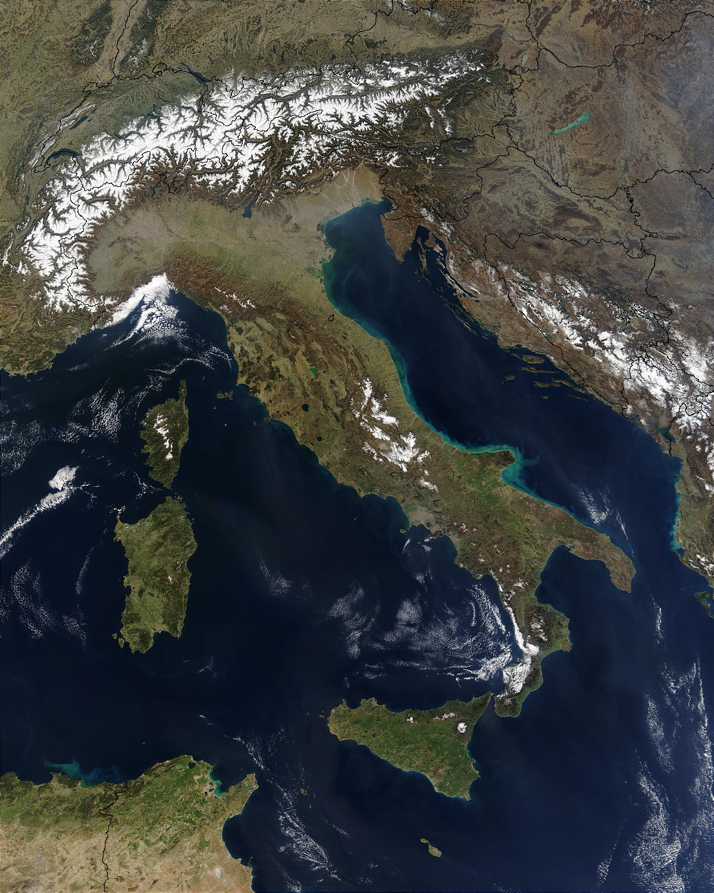
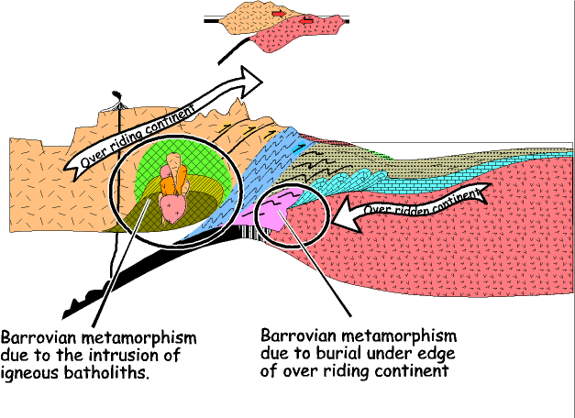
Metamorphism: Tectonic Settings
Notes:
Tectonic Settings of Metamorphism
Notes:
The picture on the left is a googleEarth image of Italy. On the right is a schematic cross section of the Alps, mountains created through the convergence of two plates.
This is an example of a tectonic setting where different types of metamorphism can occur at the same location (plate boundary)
In this example, there is contact metamorphism related to heat where intrusions occurred (on the overriding continental plate on the left side of the slide). This magmatism is created through the subduction related convergence. There is also metamorphism due to increased overlying pressure more regionally as rocks are buried deeper due to subduction.
What other locations (related to plate tectonics) can the students think of where metamorphism occurs?
Picture from googleEarth
Diagram from: http://slohs.slcusd.org/pages/teachers/rhamley/Rocks%20and%20Plates/lecture16.html

Slide 12
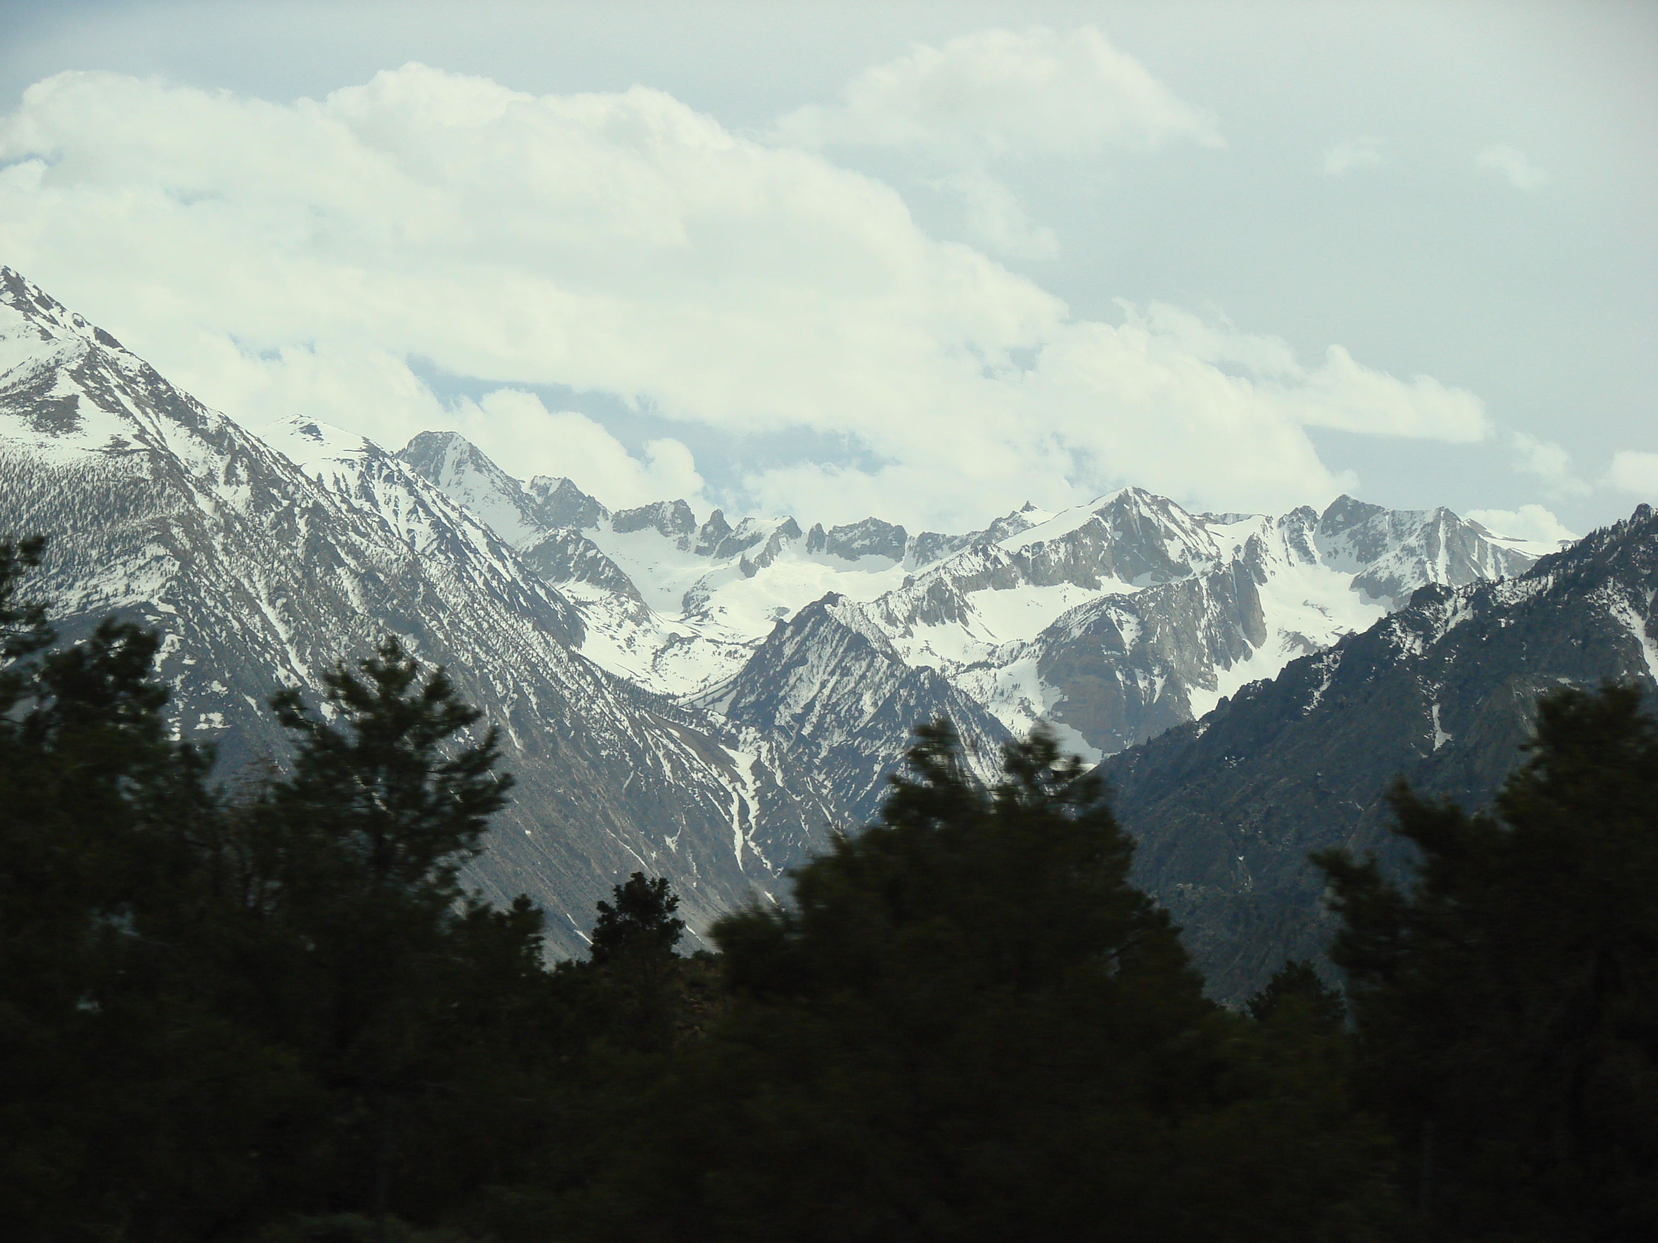
Tectonics and the Rock Cycle:
Uplift and Erosion
Notes:
Uplift and Erosion – exposure of Metamorphic rocks to the earth’s surface
Notes:
This is a photograph of the Sierras from the East (taken at Minaret lookout point at the entrance to the road leading down into the valley to Devil’s Post Pile National Monument from the Mammoth area).
When mountains form, they are create a high topography which is more easily eroded – more surface area and the change in topography helps the force of gravity erode rock. With erosion of mountains, material is moved off the high topography into areas of low topography. This unburdens the rock forming the mountains, and they rebound , lifting up due to the loss of weight above. Over time as the mountains erode and continue to uplift, the metamorphic rock formed deep in the earth can be exposed on the surface and start to erode as well.
Photo credit: Natalie Juda

Slide 13
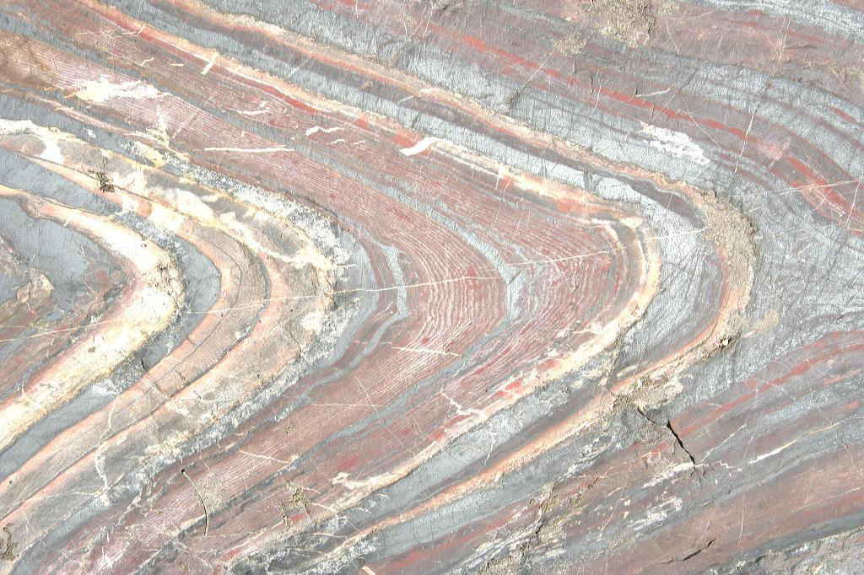
Overview
Metamorphism involves a change in rock
Metamorphism occurs under three conditions
Metamorphic rocks are classified into two main groups
There are two overall categories of metamorphism according to how they are formed, and the area of rock affected
Notes:
Overview of Metamorphism
Notes:
This is a photo of folded BIF (banded iron formation) from near Soudan Mine, MN.
Make sure the students understand that metamorphism changes rock through temperature and pressure and some fluids but the rock remains essentially solid (parts may melt, but the whole rock does not melt).
Also, heat, pressure and water metamorphose rock under the right set of conditions. Depending on the setting, a different combination of the three agents causes different metamorphic rocks to form.
Different pressure conditions (confining or directed) create different textures in metamorphic rock (non-foliated and foliated, respectively).
Metamorphism can have different effects – local and only temperature-related as in contact metamorphism, and broad as in regional metamorphism (with varied methods of metamorphism including temperature, pressure, and fluids as well).
Picture credit: Natalie Juda

