Slide 1
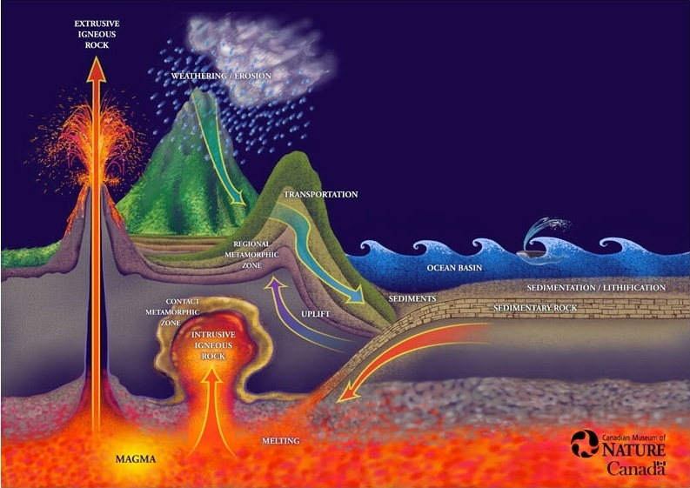
Rock Cycle
http://earthref.org/SCC
Notes:
Title Slide Notes:
This powerpoint follows the sugar rock cycle activity and serves as a bridge into the use of the concept map and as a vehicle for explaining the Wilson Cycle and plate reconstructions in order to relate the rock cycle to plate tectonics.
AUTHORS:
Natalie Juda – Scripps Institution of Oceanography, Joe Krupens – University City High School
WHY:
Individual rock types do not exist in isolation. Rocks on the earth are constantly changing from one type to another (though often on geologic time scales of millions of years). Understanding the form and shape of the earth today is dependent on understanding of how things formed and changed previously and how they may change in the future.
SUMMARY (< 100 words):
This lesson is a summation of knowledge gained over the course of the unit bringing together the rock cycle and plate tectonics. It is a combination of activities and analysis to determine formation processes as well as classification of rocks. The first activity allows students to manipulate a proxy for rocks in order to better understand how the separate rock types discussed previously are related to each other and to plate tectonics. The second activity tests knowledge and skill in identifying and classifying rocks. Finally, the rock cycle is related to plate tectonics through the Wilson Cycle and plate reconstructions.
PICTURE/GRAPHICS CREDITS:
Image from the Canadian Museum of Nature
WEBSITES USED IN THIS PRESENTATION:
ADDITIONAL READING:
A good reference book at a level for first year university geoscience students is Essentials of Geology, by Lutgens, Tarbuck and Tasa.
CONTEXT FOR USE:
This is geared toward a 9th grade class with a low level of knowledge of earth science. It is meant to follow after a unit on volcanoes and the students should have prior knowledge of plate tectonics as well. This is the final part of the larger unit on rocks in general and sums up the knowledge gained over the unit by relating all the rock types to each other through different processes. This lesson is focused on activities, the first using sugar as a proxy for rock crystals/fragments in order to manipulate it in the way rocks are manipulated through different processes on the earth to change from one type to another. The second activity is a final examination identifying rocks and minerals using a guide and knowledge gained over the course of the unit. This will be used in conjunction with plate reconstruction animations to relate the rock cycle to the plate tectonics cycle known as the Wilson cycle.
MISCONCEPTIONS:
Rock types are unrelated to each other
Rocks and minerals are the same; distinguishing them is not important
Rocks can only change to one other rock type
Rocks don’t change
EVALUATION TIPS:
For this lesson students fill out the worksheet with the sugar rock cycle activity and then fill in the concept map of the rock cycle after a brief introduction to the concept map by the instructor using the powerpoint presentation. Students also fill in a sheet comprising of their final rock identification including their own descriptions, their determinations of rock type and sub-category of rock type each rock corresponds to as well as a rock name based on the previous information.
TEACHING NOTES. This unit is formulated to fit a format using the 5 “E” learning method. Students “engage” when questioned about the relationship between all the rock types they learned about. Following this, the sugar rock cycle activity is introduced where students “explore” a particular set of steps in the rock cycle. Students then “explain” what they have learned using the two rock cycle worksheets. To “extend”, the students apply their new knowledge to a second activity, the final rock identification and classification, and finally they are “evaluated” through their written assignments.

Slide 2
IGNEOUS ROCK
SEDIMENT
MAGMA
METAMORPHIC ROCK
SEDIMENTARY ROCK
http://earthref.org/SCC
Notes:
Introduction to the Rock Cycle Concept Map
Notes:
This slide serves as a guide to the students as to how to start filling in the concept map.
Before handing out the concept map, have students help determine what the main items should be. They should remember the three rock types (these appear first in the ppt animation). Next, students should determine how they are related. For example, how can you change an igneous rock into a sedimentary rock (i.e. is it possible to use one process to affect this change)? You first need to make a sediment from the igneous rock and then the sediment can be changed into sedimentary rock (so you need sediment to be added to the cycle). Again, to make an igneous rock, you need a magma, so you need to produce a magma from other rock first (so you need to add magma to the cycle). Therefore you can move clockwise and use one process to transform each element into the next one. The next slide will be used help determine which processes are used in this transformation.

Slide 3
Processes by which you can transform rocks from one type to another
Igneous to Sedimentary:
  Need to make sediment from igneous rock first:
    Weathering and Erosion
  Then transform sediment into sedimentary rock:
    Cementation and Compaction
Sedimentary to Metamorphic:
  Change sedimentary rock into metamorphic rock:
    Heat and Pressure
Metamorphic to Igneous:
  Need to make a magma first before you can make an igneous rock:
    Melting
  Then transform magma into igneous rock:
    Cooling and Crystallization
http://earthref.org/SCC
Notes:
Processes by which rock types can transform into other rock types
Notes:
This slide helps determine which processes are used to transform rocks from one type to another using the clockwise cycle starting from igneous rock. Students give ideas and once they determine the correct answer, the teacher may click in the powerpoint to get the subcategories and processes to appear. They appear in order from the top of the page.

Slide 4
IGNEOUS ROCK
COOLING and CRYSTALLIZATION
WEATHERING and EROSION
SEDIMENT
MAGMA
MELTING
CEMENTATION and COMPACTION
METAMORPHIC ROCK
HEAT and PRESSURE
SEDIMENTARY ROCK
http://earthref.org/SCC
Notes:
Repeat of previous slide within the concept map
Notes:
This slide reiterates the points covered in the previous slide. The clockwise cycle from igneous rock is supplied and students should name the processes for each arrow in the cycle. Teacher may click on each box to get the processes to appear within once the students name it (they appear in order starting from the top in clockwise rotation). Once the students determine the five different processes, they will be able to fill out their own concept maps with the correct processes.

Slide 5
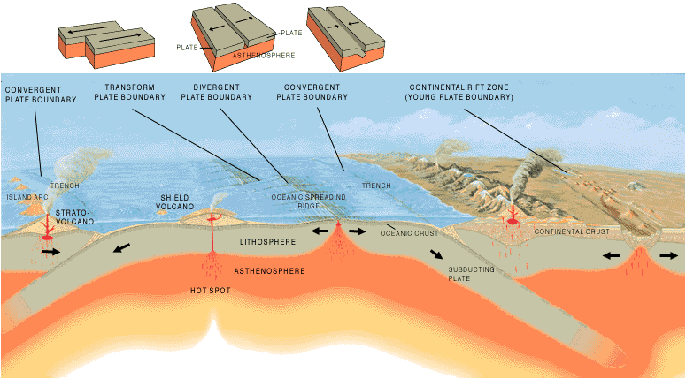
Wilson Cycle
Animations
How Plate Tectonics Relate
to the Rock Cycle
http://earthref.org/SCC
Notes:
Wilson Cycle – relation of rock cycle to plate tectonics
Notes:
Several times in the history of the earth all the continents have come together to form a supercontinent. Continental rifting causes the supercontinent to break up and a new ocean basin to form in between the separate continents (this is similar to what happened in the Gulf of California – it is now spreading apart with Baja California on one side and the rest of Mexico on the other). At some point the spreading lasts long enough for the ocean crust at the edge of the continent to age and sink and start to subduct, causing a change in tectonic environments. This onset of subduction causes the ocean basin to start to shrink and contract, bringing the continents closer together. Under certain conditions, the continents continue to approach one another until they collide in a continent-continent collision creating one large continent once more. This process occurs on a large scale, starting with supercontinents but also within each continent that breaks off from the supercontinent.
The Wilson cycle (this tectonic cycle) also is related to the rock cycle as different rocks form in different tectonic settings. Over the course of earth’s history, one location may have experienced many different environments and thus, many different rock types.
Notes:
The link connects to a youtube video animation of the Wilson cycle.
Diagram from
http://pubs.usgs.gov/gip/dynamic/Vigil.html
Animation from http://www.youtube.com/watch?v=I_q3sAcuzIY

