Slide 1
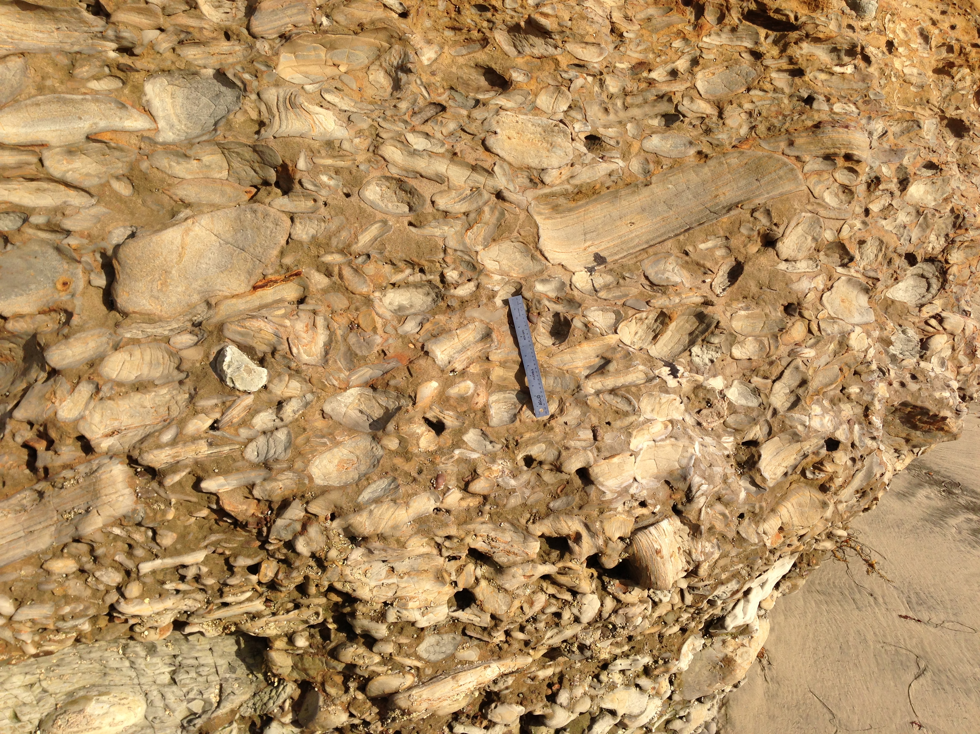
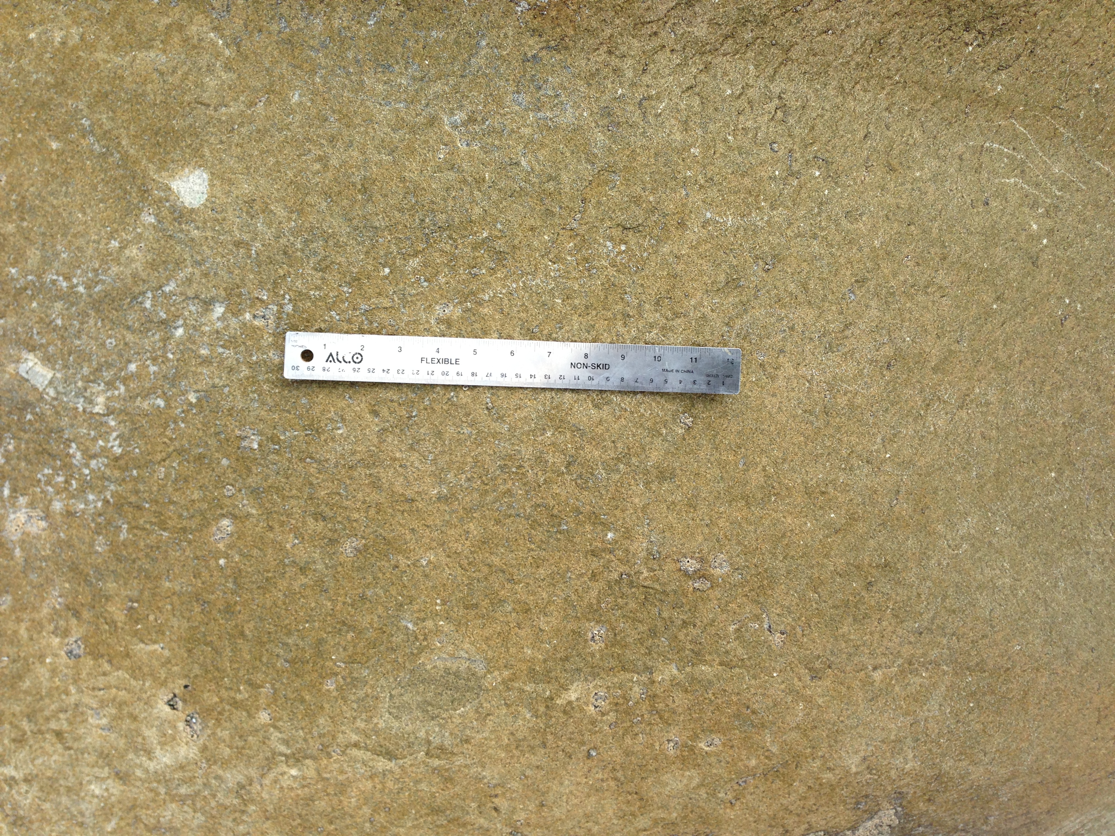
Energy & Grain Size
Notes:
This slide is for the instructor
AUTHORS: Jillian Maloney, Scripps Institution of Oceanography and Jerry Ruiz, Dana Middle School, San Diego, CA
WHY: This lesson and associated activity show students how different sizes of sediment are influenced by variable energy of water flow. Grain size is one of the major characteristics of sedimentary rocks that geologists look at when trying to understand how the rock was formed. Did the rock form at a beach? In a river? In the deep sea? Was it formed by glacial, river, or wind driven processes? These are some questions that grain size can help answer.
SUMMARY: Grain size and energy are linked because different amounts of energy are required to transport different sizes of sediment grains. You can imagine that a large boulder would take more energy to move than a grain of sand, for example. Therefore, geologists can look at grain size to determine the energy involved in moving the sediment. This in turn can tell us something about the environment. For example, a lake is generally much calmer than a flooding river, so we would expect to find smaller grains in a lake deposit than in a river flood deposit. In this lesson, students will conduct an activity to test how much energy it takes to move different sizes of sediment grains.
PICTURE/GRAPHICS CREDITS: Credits given on each individual slide.
WEBSITES USED IN THIS PRESENTATION: NA
ADDITIONAL READING: NA
CONTEXT FOR USE: This lesson was designed for a 6th grade science class and is lesson 2 of 7 in a unit on “Sedimentary Rocks: Recorders of earth’s past environments.” The unit is meant to be taught after students have learned the rock cycle, as it focuses on a specific part of the cycle. The lessons build on one another and are best taught in order. Details on the complete unit can be found at earthref.org/SCC/. For this particular lesson on energy and grain size, we had the students work in pairs for the activity, but groups up to 4 should be ok if you are limited by supplies. Required materials are listed on Slide 2 of this presentation.
MISCONCEPTIONS: 1. All sedimentary rocks form in the same environment. 2. Rocks in high energy environments are small because they get broken apart.
EVALUATION TIPS: Slide 6 can be used to evaluate student learning after the activity.
TEACHING NOTES. Slide notes are contained within each slide. Please view the 5E lesson plan for additional information (2_5E_GrainSize.docx).
LESSON DOCUMENTS:
2_GrainSize.pptx
2_5E_GrainSize.docx
2_GrainSizeProcedures.docx
-----------------------------------------------------------------------------------
This Slide:
Figure: These are images of two different sedimentary rocks to illustrate different grain sizes. On the left is a conglomerate and on the right is a sandstone. The same ruler is imaged in each picture for scale. Clearly, the rock on the left has much larger grains than the one on the right. Conglomerate rocks have a significant amount (>30%) of large (>2 mm) sediment grains. Sandstones contain mostly sand sized sediment grains (1/16-2 mm).
Photo credits: J. Maloney

Slide 2
Materials
Water table for each group of 2-4 students.
Tub or basin to catch water and sediment that runs from the water table.
Three different types of sediment with different grain sizes (small, medium, large) – see notes for examples.
Three cups to dispense water with different output levels (low, medium, large) – see notes for examples.
>100 mL beaker for each group.
Notes:
This slide is for the instructor
These are the materials you will need for the activity.
-The water table should have a drain at one end that is not obstructed, so water can drain out.
Sediment Types:
We used sand, small pebbles, and larger pebbles. You could use other sizes as long as they are three different sizes and you get a spread of grain sizes that range from easily movable to very difficult to move on the water table. You want only the smallest to move with a “Low Flow,” the smallest and middle to move with the “Medium Flow,” and the largest to move only a little with the “Large Flow.” Ideally, with the large flow, most of the small pile will be wiped away and the sediment in the largest pile will only move a little.
Flow Control:
To regulate the flow, we used plastic cups and a funnel. The “Low Flow” plastic cup had a small hole in the bottom, the “Medium Flow” had a larger hole in the bottom, and the funnel was used as the “Large Flow.” Labeling each cup/funnel will make it easier for students to follow directions. You could use three cups with different size holes, or three funnels with different size holes. If you are using a hose or faucet, you will need to instruct students how far to turn on the water to achieve each flow level.
See Slide 4 for experiment set-up.

Slide 3
Engage Activity
1.
2.
3.
4.
5.
6.
http://www.youtube.com/watch?v=NDXtPC3Z0Gc 0:00
http://www.youtube.com/watch?v=kYUpkPTcqPY 1:58
http://www.youtube.com/watch?v=MY4wweCqrBk 0:00
http://www.youtube.com/watch?v=oNBX7Ag2Wgc 0:30
http://www.youtube.com/watch?v=lmqsPSzNX_c 0:00
http://www.youtube.com/watch?v=VJTNupx8MpM 0:00
Notes:
ENGAGE
This slide is for the instructor
Directions for instructor:
1. Show these video comparisons and ask students to vote on which one demonstrates higher energy. Show in pairs 1 vs. 4, 2 vs. 5, and 3 vs. 6. The times next to the links indicate when to start the video. Videos don’t need to be watched for the entire duration, just long enough for students to observe the environments. In video #2, make sure you watch long enough for students to see cars being moved by the river. For the voting, you could ask students to raise their hands, walk to one side of the room or the other, or use in classroom technology.
Linked videos show the following environments:
Big waves (note the power of the surf to erode the beach and move rocks)
Flooding river (note mud makes water brown, cars float because there is so much air in them)
Big waterfall (discuss power to erode)
Small waves (only small grains move)
Calm river (notice water is moving slowly, no rapids, clear water)
Trickling waterfall (slow flow, only moves small grains)

Slide 4
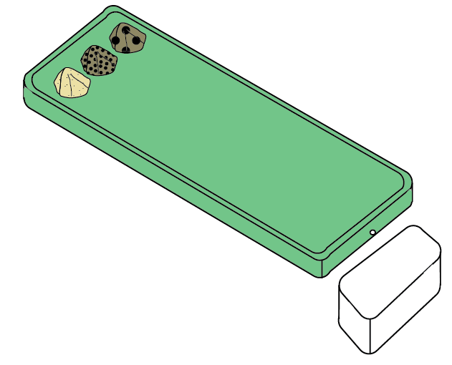
Which takes more energy to move –
large or small sediment grains?
Notes:
EXPLORE/EXPLAIN
This slide is for students (optionally – also shown on procedural handout “2_GrainSizeProcedures.docx”)
Directions for the instructor:
Hand out the document “2_GrainSizeProcedures.docx” and ask students to read it.
Use the visual on this slide to explain the experiment question and set-up (see information below).
Have students write the question in their notebooks and write their initial ideas. Correct answers don’t matter, but they should have a good idea that large things take more energy to move than small things based on the movies in the Engage activity (Slide 3).
Experiment set-up and Figure description:
The green box is a water table. The three piles of sediment are piles of different grain size sediment. We used sand, small pebbles, and larger pebbles. You could use other sizes as long as there are three different sizes. You also need to test the level of flow you use over the three types of sediment. You want only the smallest to move with a “Low Flow,” the smallest and middle to move with the “Medium Flow,” and the largest to move only a little with the “Large Flow.” Ideally, with the large flow, most of the small pile will be wiped away and the largest pile will only move a little. Set the end of the water table with the three piles higher (prop up with an object) so the water flows down towards the hole in the water table and into the catch basin below. We set the water tables on lab counters with the drain hanging over the edge and the catch basin on the floor under the drain. To regulate the flow, we used plastic cups and a funnel. The “Low Flow” plastic cup had a small hole in the bottom, the “Medium Flow” had a larger hole in the bottom, and the funnel was used as the “Large Flow.” Labeling each cup/funnel will make it easier for students to follow directions. See the document “2_GrainSizeProcedures.docx” for details on the procedures. It’s a good idea to model the set-up and first part of the procedures for the students before they begin the activity on their own. Image credit: J. Maloney

Slide 5
Data Table:
 | Sand | Small Pebbles | Large Pebbles
Low Flow
Medium Flow
Large Flow
How much sediment moves?
-None
-A Little
-A Lot
-All
Notes:
EXPLORE/EXPLAIN
This slide is for students
Directions for instructor:
This is an example data table for the activity. Have the students copy down the table in their notebooks.
Explain that students will qualitatively describe how much sediment moves during each stage of the experiment and record their descriptions in the corresponding boxes of the data table. The descriptive choices are provided below the table. For example, students should ask themselves, “How much sand moves with the ‘Low Flow?’” and fill in the corresponding box.
Remind students to pay attention not only to the amounts that are moving, but also to the amounts that are left behind with each flow. This may help students to understand that in a high energy environment, small sediment is not able to fall to the ground and be deposited. Small grains can sink to the ground only if there is very low energy.

Slide 6
Grain Size
Conglomerate
Sandstone
Based on your experiment results, which of the rocks pictured above formed in a higher energy environment (notice ruler for scale)?
2. What evidence did you use to answer question 1?
Notes:
EVALUATE/EXTEND
This slide is for students
Directions for instructor:
Ask students to answer the two questions at the bottom of the slide. They can do this as a Think, Pair, Share in their notebooks, or as an exit slip.
Answers:
Conglomerate formed in a higher energy environment.
The conglomerate has much larger grains than the sandstone and it takes higher energy to move larger pieces of sediment.
EXTEND DISCUSSION:
Q: In what kinds of environments would you expect to find very large grains? What about very small grains? In the picture on this slide, how do you think the conglomerate was formed?
A: Examples of high energy environments are landslides and fast-moving, mountainous rivers – this is where you would find large sediment grains. Examples of low energy environments are lakes and slower-moving meandering rivers – this is where you find small sediment grains. Imagine you are in a flooding river, like in the video from the engage activity. The water is very strong and muddy, which means the flow is too strong for small grains to settle out. You are surrounded by lots of large slow-moving rocks and all the small grains are flying by as the water washes them away. As the flooding slows down and the energy decreases, the big rocks stop moving (are deposited) around you, but the river still has enough energy to move all the small grains away. You are left with a deposit of mostly large sediment grains. Now you can imagine that the river empties into a lake. As the flowing river meets the calm lake, most of the sediment still suspended in the water will fall out, because the lake water is not moving with enough energy to keep It going. As the water flows farther from the river, you are only left with very small sediment grains. These will only fall out of the water (be deposited) where there aren’t strong currents near the middle of the lake.
-----
Figures: These are images of two different sedimentary rocks, that illustrated different grain sizes. On the left is a conglomerate and on the right is a sandstone. The same ruler is imaged in each picture for scale. Clearly, the rock on the right has much larger grains than the one on the right. Conglomerate rocks have a significant amount (>30%) of large (>2 mm) sediment grains. Sandstones contain mostly sand sized sediment grains (1/16-2 mm). Photo credits: J. Maloney

