Slide 1
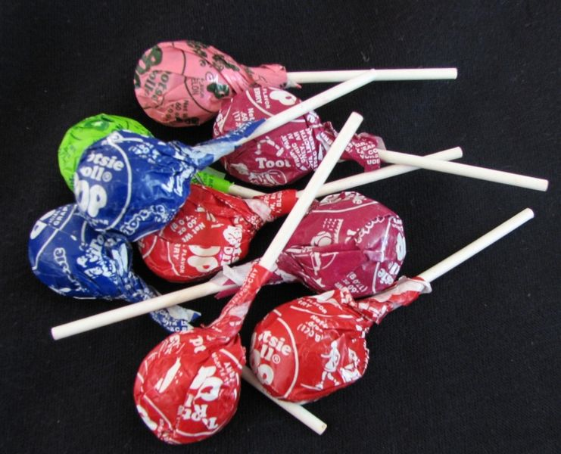
Rounding
Notes:
This slide is for the instructor
AUTHORS: Jillian Maloney, Scripps Institution of Oceanography and Jerry Ruiz, Dana Middle School, San Diego, CA
WHY: This lesson and associated activity show students how the shape of sediment grains, in particular the presence of sharp edges, can tell us about whether and for how long the grains have been transported. This in turn can tell us about where sedimentary rocks formed. Is a rock with rounded grains more likely from a landslide deposit, or from a beach deposit? Students will be able to look at sedimentary rocks and infer something about where the rock was formed based on the shape of the grains.
SUMMARY: This lesson focuses on a characteristic of sedimentary rocks that geologists use to learn about the conditions where the rock was formed. This lesson is designed to have students learn that the shape of sediment grains in sedimentary rocks can tell us about how long the sediment has been moved around on the earth’s surface. Through this lesson, students will learn to describe the shape of sediment grains, classify those grains using a scale, and estimate how long sediment has traveled on earth’s surface. Students will then be able to relate the shape of sediments to the type of environment where the rock was formed.
Additional Background: Roundness can also be related to what type of mineral or rock the grain is made of (some are more resistant than others), to the size of the sediment grain (larger grains can be easier to round than smaller grains), and to the method of transport (wind, wave, and river transport have variable effects on sediment roundness). This lesson will only focus on the relationship between roundness and length of transportation.
PICTURE/GRAPHICS CREDITS: Credits given on each individual slide.
WEBSITES USED IN THIS PRESENTATION: NA
ADDITIONAL READING: NA
CONTEXT FOR USE: This lesson was designed for a 6th grade science class and is lesson 3 of 7 in a unit on “Sedimentary Rocks: Recorders of earth’s past environments.” The unit is meant to be taught after students have learned the rock cycle, as it focuses on a specific part of the cycle. The lessons build on one another and are best taught in order. Details on the complete unit can be found at earthref.org/SCC/. For this particular lesson on rounding each student conducted the activity individually. Required materials are listed on Slide 2 of this presentation.
MISCONCEPTIONS: 1. Sediment shape is mostly related to the energy of the environment
EVALUATION TIPS: Slide 6 discusses evaluation strategies for this lesson.
TEACHING NOTES. Slide notes are contained within each slide. Please view the 5E lesson plan for additional information (3_5E_Rounding.docx).
LESSON DOCUMENTS:
3_Rounding.pptx - This presentation provides instructions for the lesson and useful slides for use in the classroom.
3_5E_Rounding.docx - This lesson plan breaks the lesson down into the 5E components – each “E” is referenced in the notes of this Powerpoint presentation.
-----------------------------------------------------------------------------------
This Slide:
Figure: In this activity, students will use lollipops as models to observe how sediment changes shape as it is transported. We used Tootsie Pops in our class. Image credit: http://en.wikipedia.org/wiki/Tootsie_Pops

Slide 2
Materials
One lollipop for each student.
Notes:
This slide is for the instructor.
These are the materials you will need for the activity.
Lollipops need to have some texture so students can see the shape change when they suck on them. For example, we used Tootsie Pops because they have a ridge around the outside. Emphasize that the lollipop is going to be a model for a sediment grain. The ridge on the lollipop represents a sharp edge on a sediment grain. You could use rock candy to help students better make the connection between the lollipop and roughness of a sediment grain.

Slide 3
Sediment Transport
https://www.youtube.com/watch?v=RJxOI0uUIAw
As the sediment grains move, what do you think happens to their shape?
Notes:
ENGAGE
This slide is for students
Directions for instructor:
1. Using the link provided, play this video and ask students to describe what they see happening to the sediment particles. This can be done individually in notebooks and shared out, or as a group on the board. The primary thing you want students to notice is that as the sediment moves, the grains are rubbing and bumping against each other. This happens as they bounce, roll and slide along the bottom. They might also notice that the water is brownish and this is because there are very small sediment grains in the water that can’t sink to the bottom because the current is moving too fast. This is a good opportunity to remind the students about the previous lesson – but make sure you make the distinction grain size = ENERGY, roughness/shape = TRANSPORT TIME
2..Then ask students to write the question at the bottom of the slide in their notebooks and answer in a think, pair, share. Correct answers don’t matter here, just emphasize that we’ll try to answer this question with an experiment.
-----
Figures:
This video shows sediment grains being transported in water with a current. The video shows smaller grains of sediment being transported in the water column as seen in the murky character of the water. This is known as suspended transport. In the video, larger grains are being transported along the bottom of the current, in contact with the sediment particles below. This is known as bedload transport. Animation credit: http://www.weru.ksu.edu/new_weru/multimedia/movies/dust003.mpg

Slide 4
Lollipop Data Table:
Time (minutes) | Description & Drawing
1
2
3
4
Bite
1
2
3
4
Notes:
EXPLORE
This slide is for students
Students should copy this data table into their lab notebooks.
Directions for instructor:
Explain experiment set-up:
In our experiment, the lollipop represents a sediment grain, and our mouths represent a river. When the lollipop moves across surfaces of our mouth, it’s like when sediment grains move along the earth’s surface on the bottom of a river. You can make the analogy with the previous video too. We are going to be observing how the SHAPE and SURFACE ROUGHNESS (not size) of the lollipop changes the longer we suck on it. The students will start with a lollipop that has some texture (e.g., a ridge on a Tootsie Pop). Make sure to emphasize that student should be observing how the ridge changes and they should record this in their data table. The instructor will keep the time and after each 1 minute interval, students will remove the lollipops from their mouth and describe and/or draw the shape. After four minutes, ask students to take a little bite, emphasizing that they shouldn’t bite the entire lollipop off the stick. They still want to have most of the lollipop remaining on the stick. They will then describe their lollipop next to the word “Bite” in the data table, and you will begin timing minute intervals as the students suck on the lollipops again. After the bite, the lollipop should have jagged edges and as they continue to keep the lollipop in their mouths for the last four minutes, those ridges should become more smooth or rounded.
2. At the end of the experiment, ask students to share with the class how their lollipop changed the longer they sucked on it. Here are some example questions that could be used in discussion to get students thinking about the experiment results. They could also be used more formally for evaluation purposes:
Q: Based on your results, what do you think happens to rocks the longer they travel along earth’s surface in a river? Why?
A: – They get smoother because they bounce, roll, and slide across the ground and other sediment, which knocks off their jagged edges. You might use the analogy of using sandpaper to smooth wood.). You may need to remind them that in the experiment the lollipop represents a rock, or sediment grain and their mouths represent the earth’s surface.
Q: Draw their attention to when they took a bite of the lollipop. What does this represent in terms of rocks?
A: When a rock breaks.
Q: What happens after you continue to suck on the lollipop after you bit it?
A: Gets smoother again.
Q: Based on your experiments, do you think you could tell the difference between a rock that just broke and a rock that had been moving in a river for a long time? How?
A: Broken rock would be more jagged shaped than a rock that moved in a river because when rocks first break they are jagged and then they are smoothed out as they move down a river.

Slide 5
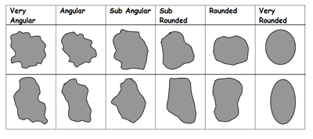
Rounding Chart
Very
Angular
Sub-Angular
Sub-Rounded
Rounded
Very
Rounded
Angular
Short
Transport Time
Long
Notes:
EXPLAIN
This slide is for students.
Directions for instructor:
Explain that this is a chart geologists use to classify the shape of sediment grains. For geologists the term “rounded” means “smooth,” not necessarily circular. The term “angular” means “rough” or “jagged.”
Geologists can use the shape of the grains to determine how long the sediment has been moving around on the surface of the earth, for example in a river. Just like with the lollipops, rocks get smoother, or more “rounded” the longer they are transported. A good way to describe this is that angular rocks have just recently been broken off of a bigger rock, like a mountain. This is similar to when the students took a bite of their lollipop. It broke and had jagged, angular edges. If that rock is then moved down a river, or pushed back and forth by waves at the beach, the rock will become smoother, like their lollipop did as they sucked on it.
Ask students to look at their lollipop at the end of the experiment and match it to the images in the chart. They can write the corresponding descriptive term in their notebooks. Let students know that there is a bit of a judgment call on which word best describes the shape because people have different perceptions. There is no perfect or correct answer, but students should pick the category they think best fits the shape.
Optionally, show a couple examples of rocks with different “roundness” and ask students to vote on the best description using the chart.
-----
Figure: This is a chart used by geologists to classify the shape of sediment grains within a sedimentary rock. Image credit:: http://www.geography-fieldwork.org/icefieldwork/fluvioglacial/stage2.htm

Slide 6
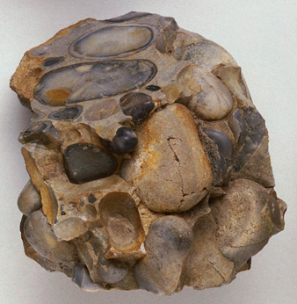
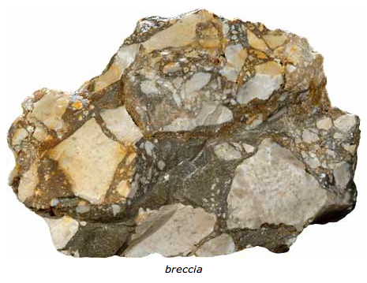
Roundness
Breccia
Conglomerate
Using the rounding chart, which rock has rounder grains?
Based on your lollipop experiment, which rock has grains that have been
transported for a longer time? What evidence supports your answer?
Notes:
EVALUATE/EXTEND:
This slide is for students.
Directions for instructor:
These are two rocks that have different shaped grains. The rock names are Breccia and Conglomerate. On an exit slip or as think, pair share, ask students to answer the two questions at the bottom of the slide.
Answers:
Conglomerate has rounder grains.
Conglomerate has grains that have been transported longer because they are rounder than the grains in the breccia.
EXTEND DISCUSSION:
Q: In what kinds of environments do you think you would find angular grains? What about rounded grains? For example, do you think sediment from a landslide would have rounder, or more angular sediment than sand at a beach?
A: A landslide would have more angular grains, because they have just been broken off from a cliff or mountain. You would expect to find rounded grains at the beach because they are continuously being moved back and forth by the waves. Generally in a river, you see more angular grains upstream near the source of the river (close to the mountains) and rounder grains farther down the river. This is because grains near the source of the river haven’t been transported very much from when they broke off the mountain, whereas grains farther down the river have traveled greater distances and been smoothed out in the process.
----
Figures: These are images of two different sedimentary rock types – Breccia and Conglomerate. Both have a significant amount (>30%) of large sediment grains (> 2mm), but “breccia” more specifically describes rocks with large angular grains.
Breccia photo credit: http://flexiblelearning.auckland.ac.nz/rocks_minerals/rocks/breccia.html
Conglomerate photo credit: http://depthome.brooklyn.cuny.edu/geology/core332/geofield.htm

