Slide 1
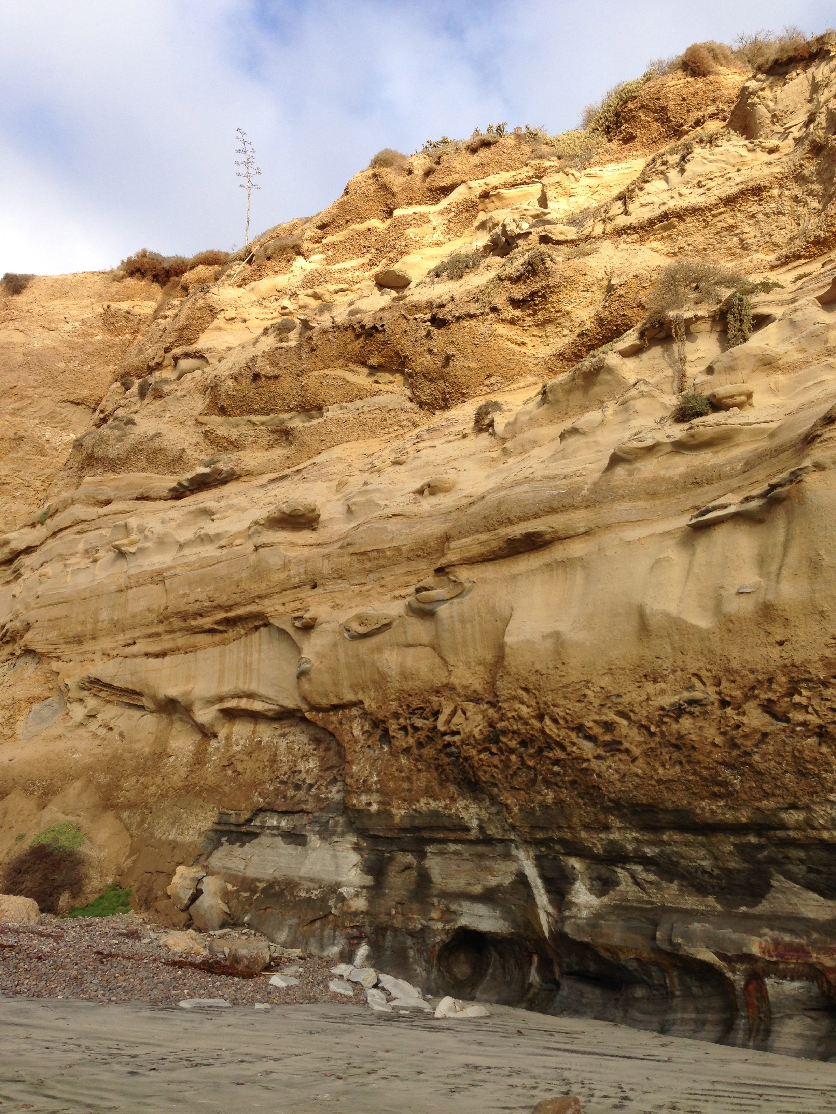
Cliff Stratigraphy
Notes:
This slide is for the instructor
AUTHORS: Jillian Maloney, Scripps Institution of Oceanography and Jerry Ruiz, Dana Middle School, San Diego, CA
WHY: Geologists study layers of rocks to learn how the environments of earth have changed through time. This branch of geology is known as stratigraphy. Based on the characteristics of sedimentary rocks, including grain size, rounding, fossils, and geochemistry, geologists can infer information about the environment where the rock was formed. In this way we can learn about ancient climates, prehistoric animals, and past tectonic movements of earth’s lithosphere (hard outer shell).
SUMMARY: Students will act as geologists, collecting evidence from rock layers in the cliff pictured in this slide. They’ll compile the evidence into a stratigraphic column, which is a graphical representation of rock layers that geologists use to describe rocks they study in the field. This is a complex lesson, with many parts, but will give students the experience of how geologists actually look at and learn from sedimentary rocks.
PICTURE/GRAPHICS CREDITS: Credits given on each individual slide.
WEBSITES USED IN THIS PRESENTATION: NA
ADDITIONAL READING: Here are links to more information on the rock formations seen in the cliff and used in this lesson:
Ardath Shale - http://www.geology.sdsu.edu/localgeology/formations/ardath_shale.html
Scripps Formation - http://www.geology.sdsu.edu/localgeology/formations/scripps_formation.html
CONTEXT FOR USE: This lesson was designed for a 6th grade science class and is lesson 5 of 7 in a unit on “Sedimentary Rocks: Recorders of earth’s past environments.” The unit is meant to be taught after students have learned the rock cycle, as it focuses on a specific part of the cycle. The lessons build on one another and are best taught in order. Details on the complete unit can be found at earthref.org/SCC/. This lesson will probably take two 50 minute class periods. Alternatively, students could start the activity in class and finish it for homework, but because it’s a complex activity there will likely be lots of questions. This lesson requires access to computers.
MISCONCEPTIONS: 1. Earth’s environments have always been the same.
EVALUATION TIPS: Students will be creating their own stratigraphic columns, which can be used for evaluation.
TEACHING NOTES. Slide notes are contained within each slide. Please view the 5E lesson plan for additional information (5_5E_CliffStratitgaphy.docx).
LESSON DOCUMENTS:
5_Cliff_Stratigraphy.pptx
5_Cliff_Stratigraphy_Activity.pptx
5_StratColumnKey.docx
5_5E_CliffStratigraphy.docx
-----------------------------------------------------------------------------------
This Slide:
Figure:
This is a photo of a cliff on the beach in La Jolla, California, north of Scripps Institution of Oceanography. These sedimentary layers were deposited during Eocene time (34-56 million years ago). The rocks include the Ardath Shale at the base of the cliff – grayish color and the Scripps Formation above – yellowish-brown. Photo credit: J. Maloney

Slide 2
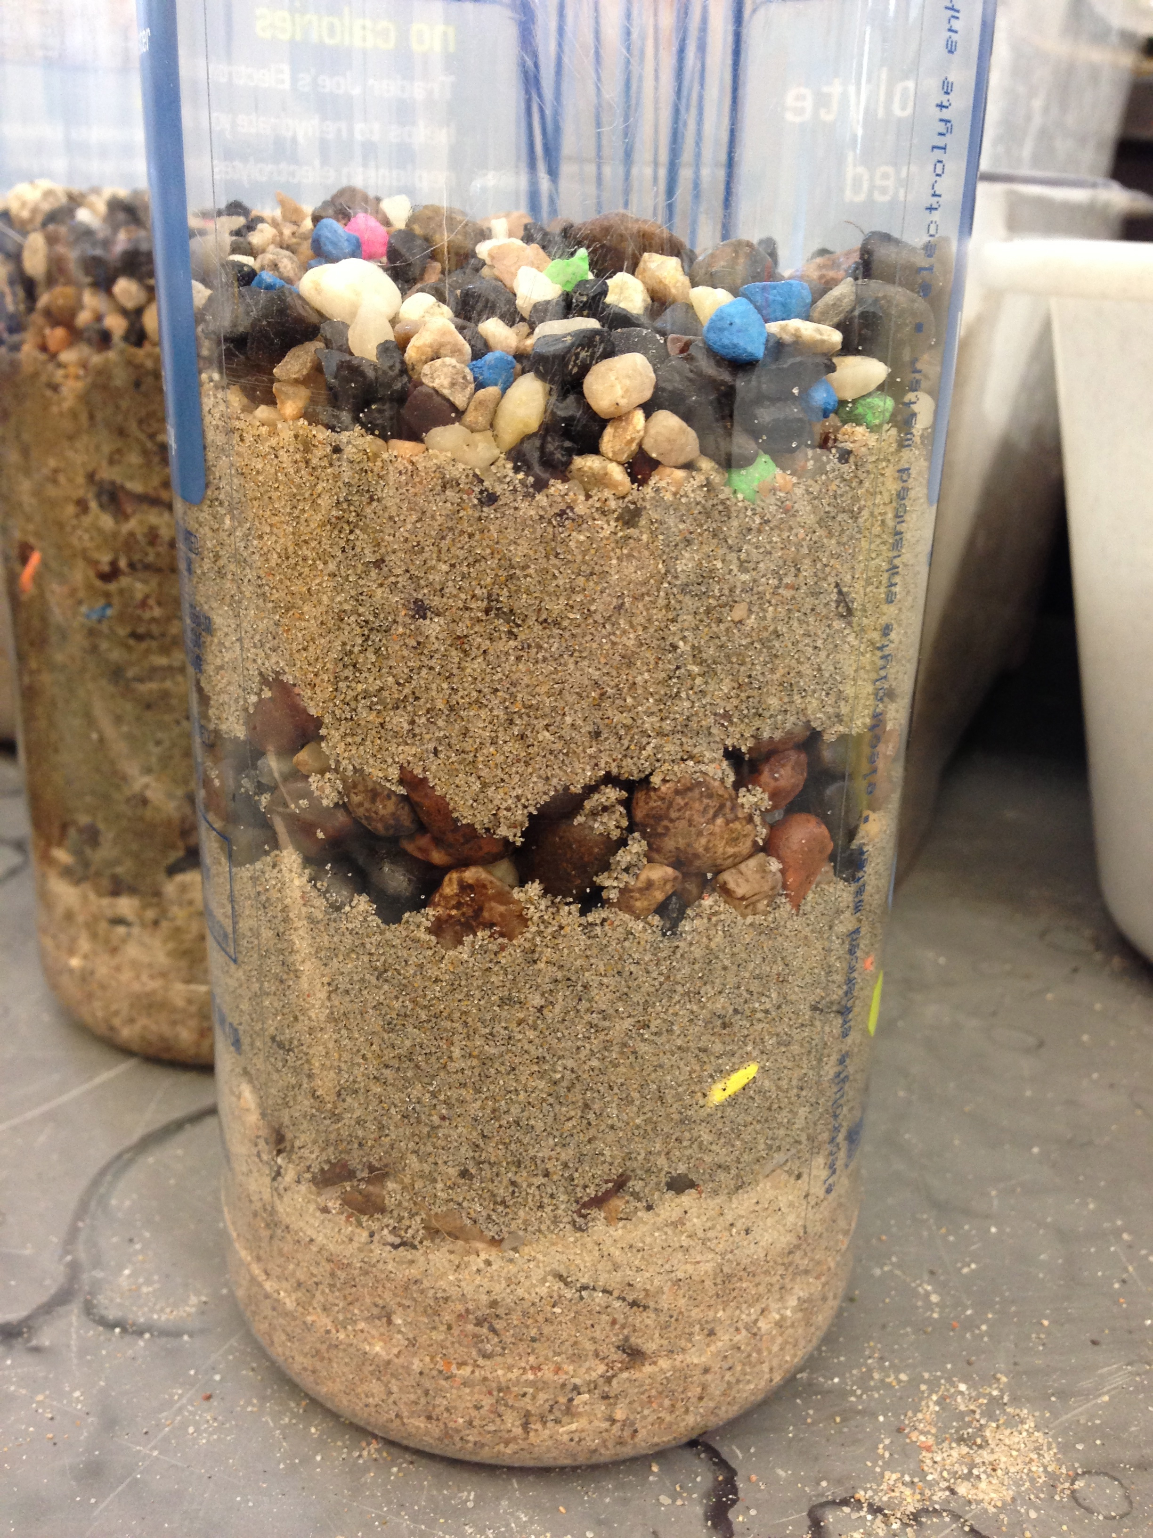
Notes:
ENGAGE
This slide is for students
Directions for instructor:
This is an image from the previous lesson where students made their own sedimentary layers. Ask students to look at their sediment layers and their drawing of the layers.
Q: After these sediment layers are deposited, what happens to turn them into rocks?
A: Compaction and cementation
Q: Has anyone ever seen layers of different sedimentary rocks? If so, where and what do they look like?
A: If you live in an area with sedimentary rock exposures, you could remind them of where they are to see if they’ve seen them. Good places to think about are natural cliffs or canyons, or man-made road-cuts where hillsides have been cleared to expose rocks.
2. Explain that the drawing they made is what geologists call a “stratigraphic column,” or “strat column” for short. When geologists go to study rocks in nature, they draw these strat columns to represent the rocks.
3. Move on to the next slide which has an example of a section of sedimentary rock layers and an example strat column.
-----
Figures:
Left - In this activity, students will deposit different layers of sediment into a clear cylinder. The cylinder shown here is a 1 L water bottle and contains 6 different sediment layers that each represent a different environment. Students use grain size, rounding, and fossils to match sediment types to environments. Photo credit: J. Maloney
Right – This is an example of a graphical representation of the sediment column on the left. Students will make their own representations. This column is similar to a stratigraphic column that geologists use to represent rock layers in the field. Shape and size of sediments are represented graphically, as well as fossils contained in each layer. Image credit: J. Maloney

Slide 3
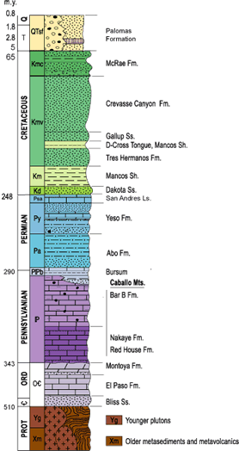
Stratigraphic Column
Cliff
or “Strat” Column
Notes:
ENGAGE
This slide is for students.
Directions for instructor:
Explain the images to the students - On the left is an example of a sequence of sedimentary layers observed at a cliff on the beach. Students have seen this image in the previous lesson. On the right is an example of at stratigraphic column, or strat column. The strat column is a graphic representation of a sequence of rocks a geologists studies in nature. Geologists make observations about the rocks they see and then make these columns so they can visualize and remember what the rocks looked like when they saw them in nature. They also use them to show other people what the rocks are like even if they can’t go see them in nature. This is just like the diagram students drew of their sediment layers. They used different symbols to represent different grain sizes, grain shapes, and fossils. You could ask students what they notice about the column (colors, symbols) and what they think the different characteristics represent (age, type of rock).
-----
Figures:
Left -This is a photo of a cliff on the beach in La Jolla, California, north of Scripps Institution of Oceanography. These sedimentary layers were deposited during Eocene time (34-56 million years ago). The rocks include the Ardath Shale at the base of the cliff – grayish color and the Scripps Formation above – yellowish-brown. Photo credit: J. Maloney
Right – This is an example of a strat column representing a sequence of rocks in New Mexico. This column illustrates the principles of a strat column, but DOES NOT represent the cliff picture on the left. The numbers along the left side of the column represent the ages of the rocks. The first word column gives the names of the geologic time period. The next word column gives the geologic symbol for each rock (often used to show rocks on geologic maps). The next column shows colored rectangles filled with different symbols. The colors are related to the rocks age grouping and correspond to the colors used to map the rocks on a geologic map. They symbols tell us what kind of rock is being represented. For example, the brick-type symbols indicate a carbonate rock, while the speckled symbols represent a sandstone rock. Geologists generally use a common set of symbols to represent different rock types so that it’s easy to understand one another’s strat columns. Some examples of these symbols are shown on Slide 19. The next column lists the name of each rock layer, or “formation (Fm).” Image credit: http://geoinfo.nmt.edu/tour/state/elephant_butte/home.html

Slide 4
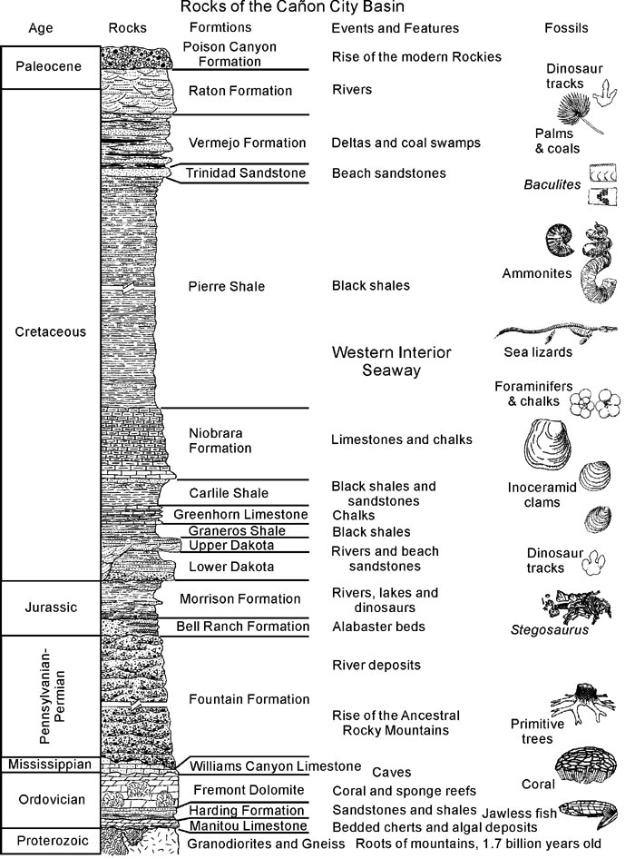
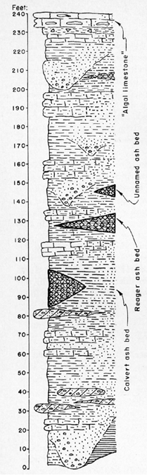
Strat Columns
Fossils
channels
Notes:
ENGAGE:
This slide is for students
Directions for instructor:
These are other examples of strat columns to give students an idea of what they’ll be making. There are two things to make sure you point out. 1. On the left strat column, there are examples of how you might illustrate that a layer of rock has channels, or lenses of some other rock type within it. The students will see a rock layer that has this characteristic, so they need to know how to graphically represent it. 2. The right strat column has a fossils description to the right. Geologists often use symbols that look similar to the actual organism to show that a rock contains fossils. These are sometimes drawn next to the column (as seen here), and sometimes drawn within the rock symbol rectangle. Students will be given information about fossils in their rock layers, so they will need to include the fossil information on their strat columns. Some example fossil symbols are shown on Slide 19.
-----
Figures:
Left: This strat column describes a section of rock from Kansas. The numbers on the left indicate the thickness of the measured section. The symbols that fill the rectangular boxes describe the different rock types. This particular section has lots of lens or channel shaped deposits (indicated by large arrows). This shows how you can represent a rock layer that is mainly one type of rock, but that has some lens shaped areas filled with a different type of rock. Image credit: http://www.kgs.ku.edu/Publications/Bulletins/96/04_geol.html
Right: This column describes a section of rocks from Colorado. The first column gives geologic time period name, the second column gives rock symbols, the third column gives rock names, the forth column gives additional description, and the last column gives fossils found in the rock layers. Image credit: http://www.handsontheland.org/garden-park/geology.html

Slide 5
5
4
3
2
1
Present day beach
Notes:
EXPLORE
This slide is for students
Directions for instructor:
This image shows the students how the rock layers are divided for their project. The students will use this image to make a strat column for the rocks in the cliff. This is also the first slide in the Powerpoint file “5_Cliff_stratigraphy_Activity.pptx” that the students will use for the activity. The layers are separated by white lines and numbered in white. The bottom is present day beach sand and is not included as a layer. Students will use the “5_Cliff_stratigraphy_Activity.pptx” to gather evidence about each of these rock layers. Within the Powerpoint there will be slides that describe the grain size and shape, fossil content, and other characteristics. Students will work through, layer by layer, to gather the evidence from the rocks as a geologist would. You can emphasize that they are acting like detectives – collecting evidence to figure out where the rocks were made.
You can now have the students look at the “5_Cliff_stratigraphy_Activity.pptx” on their computers. Students can work individually or in pairs, but each student should make their own data table and strat column. Ask them to think about and answer the following questions as a group:
Q: What are some ways the numbered layers look different from each other?
A: color, texture, patterns
Q: If you were a geologist and wanted to know where these layers formed, what kind of evidence would you look for?
A: grain size, grain shape, fossils (these are ones students should know about from their previous lessons), some students might also know that some rocks dissolve with acid – you can add that scientists can also learn about rocks by studying their chemistry.
3. Give students a couple minutes to look through the activity slides to get an idea of how the activity works. The activity slides are structured as follows:
-First slide shows cliff image with layers divided by white lines and numbered in white (exactly the same as the image on this slide above).
-Students will examine details about each layer, starting with number one and working their way up.
-For each layer, there are three descriptive slides for students to collect evidence from. First, there is a slide indicating which layer students will be looking at by having the number in red, the next slide will have zoomed in pictures of the rock and details about the grain size, and the last slide will have pictures and information about fossils. Using these slides, students will collect data for each layer and fill in a data table (example on the next slide).
4. Move on to the next slide where students will create a data table in their notebooks.
-----
Figures:
This is a photo of a cliff on the beach in La Jolla, California, north of Scripps Institution of Oceanography. These sedimentary layers were deposited during Eocene time (34-56 million years ago). The rocks include the Ardath Shale at the base of the cliff – grayish color and the Scripps Formation above – yellowish-brown. Photo credit: J. Maloney

Slide 6
Data Table
Layer ID | Grain Size (mm) | Other characteristics (layers, acid) | Rounding | Sediment Type | Rock Name | Fossils
1
2
3
4a 4b
5
Notes:
EXPLORE
This slide is for students
Directions for instructor:
Have students copy this data table into their notebooks. They do not need to copy the black writing above the table – this is just for you to use in explaining the table.
After the students have copied the table, walk through it with them. This will be where the students record all their evidence they collect from the Powerpoint “5_Cliff_stratigraphy.pptx.” The Layer ID refers to the numbers of the rock layers in their activity (from the image on the previous slide). Students will find information on Grain Size and Other characteristics from the slides in their activity Powerpoint. For the next three categories (Rounding, Sediment Type, and Rock Name), the students will need their Powerpoint activity along with the document “5_StratColumnKey.docx.” The document contains 3 different charts that are shown on the next two slides (Grain Size Chart, Rounding Chart, and Rock Names Chart). Student will find information on Fossils in the activity Powerpoint. You will walk through all the steps with the students for Layer 1 on subsequent slides.
Move on to the next slides to explain the charts.

Slide 7
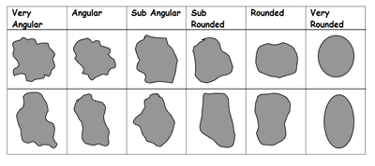
Grain Size Chart
Grain Size (mm) | Sediment Type
> 256.0 | Boulder
64.0 – 256.0 | Cobble
4.0 – 64.0 | Pebble
2.0 - 4.0 | Gravel
0.062 – 2.0 | Sand
0.004 - 0.062 | Silt
< 0.004 | Clay
Rounding Chart
Very
Angular
Angular
Sub-Angular
Sub-Rounded
Rounded
Very
Rounded
Notes:
EXPLORE
This slide is for students
Directions for instructor:
Explain the grain size chart. Students will use this chart to fill in the Sediment Type column of the data table. On the chart, students will find the grain size in millimeters listed in the first column that matches the grain size they listed in their data table (from the Powerpoint activity). Then they will look across to the Sediment Type column and find the word used to describe this size sediment. This word (e.g., boulder, cobble, pebble, etc…) will be the word they write in the Sediment Type column on their large data table. Note that in some cases, they might have a range of sediment sizes, and so will have to list more than one sediment type on their data table. For example, if the sediment sizes are from 2-64 mm, what sediment type would you use? A: Both gravel and pebble.
Explain the rounding chart. Students will use this chart to fill in the Rounding column of the data table. In some cases, the Powerpoint activity will tell you directly what the rounding of grains is, but in other cases you’ll have to look at the shape of the grains and match them with this chart to find the closest matching shape. Then use the words above the shape (e.g., Very Angular, Angular, Sub-Angular, etc…) to fill in the “Rounding” column on the data table.
-----
Figures:
Top – This chart is based on the Udden-Wentworth scale of grain sizes that geologists typically use to define classes of sediments. The left column shows grain size in mm and the right column are the corresponding size classes.
Bottom- This is a chart used by geologists to classify the shape of sediment grains within a sedimentary rock. Image credit:: http://www.geography-fieldwork.org/icefieldwork/fluvioglacial/stage2.htm

Slide 8
Rock Names Chart
Sediment Type | Rounding | Other | Rock Name
Gravel, Pebble, Cobble | Sub-rounded to Very Rounded |  | Conglomerate
Gravel, Pebble, Cobble | Sub-angular to Very Angular |  | Breccia
Sand | -- |  | Sandstone
Silt | -- |  | Siltstone
Clay | -- |  | Claystone
Clay or Silt | -- | Breaks along layers | Shale
Skeletal/Shell fragments | -- | Dissolves with acid | Limestone
Notes:
EXPLORE
This slide is for students
Directions for Instructor:
Explain this chart to the class. Students will use this chart to fill in the Rock Name column on their data table. After filling in rest of the columns in the data table, students will take that information and use this chart to determine what the name of the rock should be. First they will look at the Sediment Type from their data table and find the same sediment type on this chart. (e.g., Clay). If there are two rows that have the right sediment type (e.g., Clay) students will need to move to the next rows to figure out which one is the best one. For example, with Clay, one row says “breaks along layers” and one does not. So students will look back to their data table and find out if their rock has that characteristic. If it does, they will choose “Shale” as their Rock Name and fill in their data table. If it doesn’t break along layers, they will write “Claystone” in their data table. Remind students to look at ALL the information they’ve gathered, not just the sediment types. For example, if they have a rock with gravel, pebble, and cobble size sediment, there are two possible rock names – conglomerate or breccia. Students need to look at information on the sediment rounding to determine which name is the better choice. For some rock names, rounding will matter (Congolmerate vs. Breccia) and for some there are special characteristics that determine the rock name (Shale or Limestone). Rock names that don’t have anything written in those columns don’t depend on those characteristics.
Move on to the next slide where you will model the activity for the first layer.

Slide 9
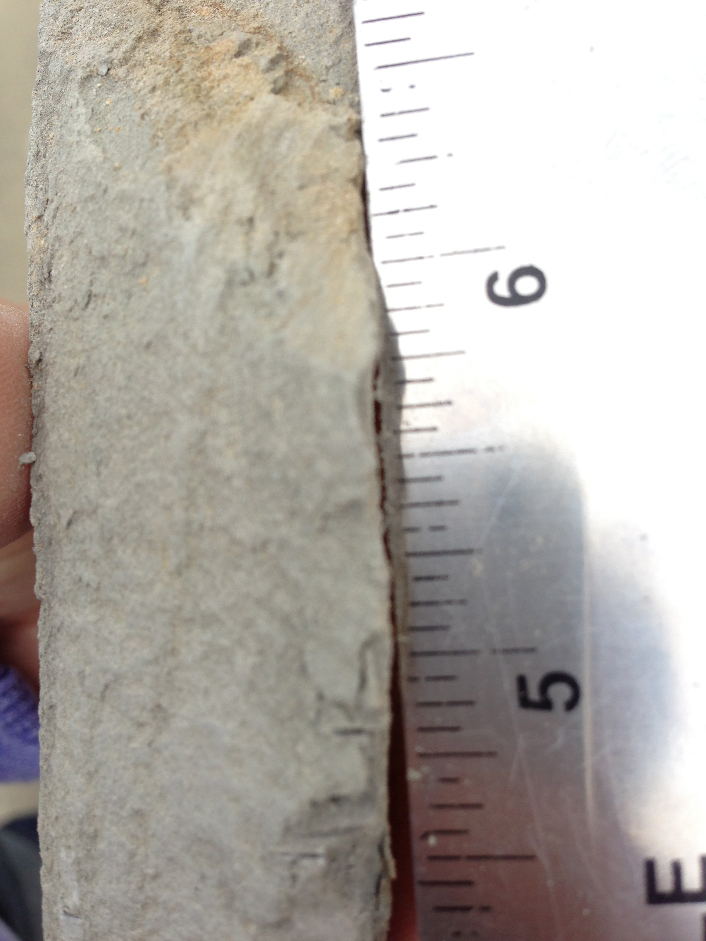
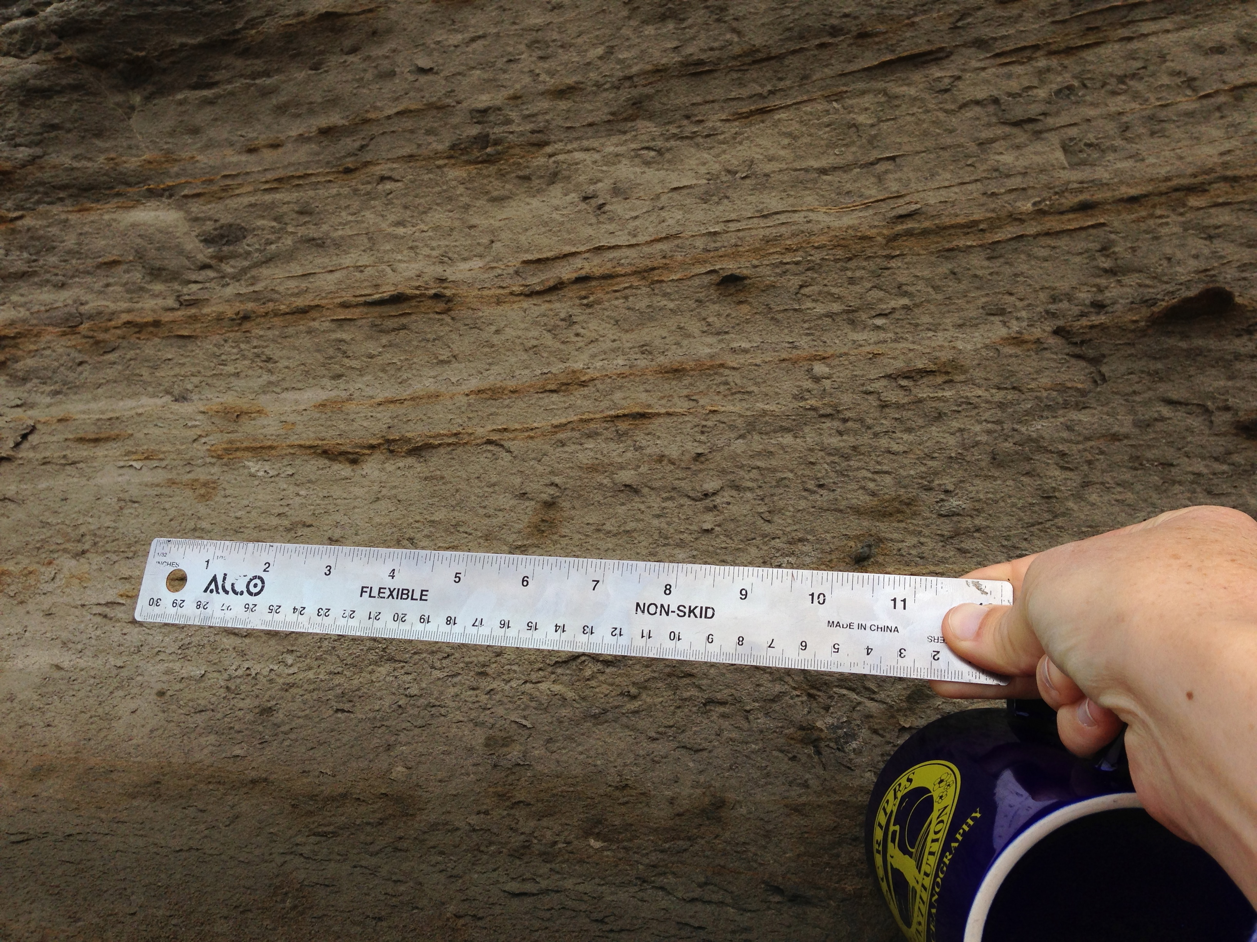
1. Sediment
-Grain size < 0.004 mm
-Rock breaks into thin pieces along layers
-Does not dissolve with acid
-Can’t see rounding (leave blank)
Notes:
EXPLORE
This slide is for students
Directions for instructor:
Now you’ll walk through the activity for the first layer. Students can follow along in their “5_Cliff_stratigraphy_Activity.pptx” and should fill in their data tables as you do.
This first slide tells us lots of information about the rock. First we see the grain size is <0.004 mm (you can’t actually see the grain size from the photos because they are too small). Let’s put that into the data table – next slide.

Slide 10
Data Table
Layer ID | Grain Size (mm) | Other characteristics (layers, acid) | Sediment Type | Rounding | Rock Name | Fossils
1 | < 0.004
2
3
4a 4b
5
Notes:
EXPLORE
This slide is for students
Directions for instructor:
You can just put up a blank data table and fill it in as you go, or use these slides with pre-typed information. In either case, we are putting the grain size in the corresponding column and row for layer 1.
Next slide – what else did we learn about layer 1?

Slide 11
1. Sediment
-Grain size < 0.004 mm
-Rock breaks into thin pieces along layers
-Does not dissolve with acid
-Can’t see rounding (leave blank)
Notes:
EXPLORE
This slide is for students
Directions for instructor:
We see that the rock breaks into pieces along layers, doesn’t dissolve with acid, and that we can’t tell how round the grains are.
Next slide – fill in the data table with that information.
-----
Figures: Images of Layer 1 (Ardath Shale) from the cliff north of Scripps Institution of Oceanography. Photo credit: J. Maloney

Slide 12
Data Table
Layer ID | Grain Size (mm) | Other characteristics (layers, acid) | Sediment Type | Rounding | Rock Name | Fossils
1 | < 0.004 | Layers, breaks along layers, not dissolve in acid |  | ---
2
3
4a 4b
5
Notes:
EXPLORE
This slide is for students
Directions for instructor:
Now we have some extra characteristics to fill in, and we know that we won’t be able to learn about rounding – you can put an x or dashes here to remind you.
Next slide – how can we find the right sediment type? Go to the Grain Size Chart…

Slide 13
Grain Size Chart
Grain Size (mm) | Sediment Type
> 256.0 | Boulder
64.0 – 256.0 | Cobble
4.0 – 64.0 | Pebble
2.0 - 4.0 | Gravel
0.062 – 2.0 | Sand
0.004 - 0.062 | Silt
< 0.004 | Clay
Rounding Chart
Very
Angular
Angular
Sub-Angular
Sub-Rounded
Rounded
Very
Rounded
Notes:
EXPLORE
This slide is for students
Directions for instructor:
Q: What is the grain size for layer 1 in millimeters?
A: < 0.004 mm
Q: Based on that, what is the sediment type?
A: Clay
Next slide – fill in the data table.
-----
Figures: (Repeated from previous slides so students can use it to explore grain sizes.)
Top – This chart is based on the Udden-Wentworth scale of grain sizes that geologists typically use to define classes of sediments. The left column shows grain size in mm and the right column are the corresponding size classes.
Bottom- This is a chart used by geologists to classify the shape of sediment grains within a sedimentary rock. Image credit:: http://www.geography-fieldwork.org/icefieldwork/fluvioglacial/stage2.htm

Slide 14
Data Table
Layer ID | Grain Size (mm) | Other characteristics (layers, acid) | Sediment Type | Rounding | Rock Name | Fossils
1 | < 0.004 | Layers, breaks along layers, not dissolve in acid | Clay | --
2
3
4a 4b
5
Notes:
EXPLORE
This slide is for students
Directions for instructor:
Continue filling in data table. Now we can put clay in the sediment type column. We can’t describe rounding on clay size sediment, so we skip that. If we had larger sediment, we’d compare it to the rounding chart and fill in the rounding column.
Next slide – What is the name of this rock? Go to the Grain Size Chart…

Slide 15
Sediment | Rounding | Other | Rock Name
Gravel, Pebble, Cobble | Sub-rounded to Very Rounded |  | Conglomerate
Gravel, Pebble, Cobble | Sub-angular to Very Angular |  | Breccia
Sand | -- |  | Sandstone
Silt | -- |  | Siltstone
Clay | -- |  | Claystone
Clay-Silt | -- | Breaks along layers | Shale
Skeletal/Shell fragments | -- | Dissolves with acid | Limestone
Notes:
EXPLORE
This slide is for students
Directions for instructor:
Ask students to look at their data tables and try to figure out the rock name for layer 1. Remind them to use ALL the evidence they have to find the best answer. In this case, Shale is the best answer because the sediment size is correct and the extra information that the rock breaks along layers makes shale a more specific answer than claystone.
Next slide - Fill in Shale on the data table

Slide 16
Data Table
Layer ID | Grain Size (mm) | Other characteristics (layers, acid) | Sediment Type | Rounding | Rock Name | Fossils
1 | < 0.004 | Layers, breaks along layers, not dissolve in acid | Clay | -- | Shale
2
3
4a 4b
5
Notes:
EXPLORE
This slide is for students
Directions for instructor:
Now we can put shale in the Rock name column.
Next slide – the last column is fossils – go back to the activity Powerpoint and find the fossil slide for layer 1.

Slide 17
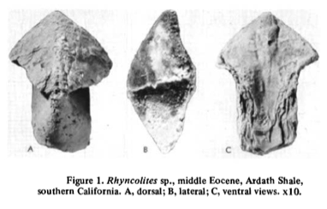
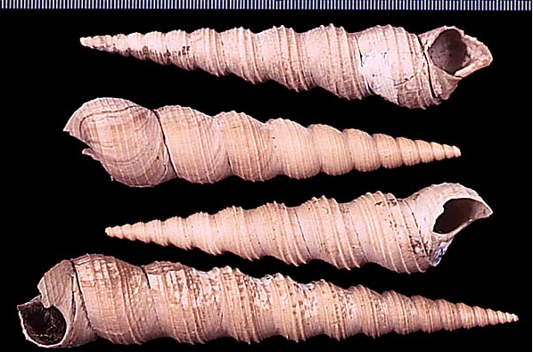
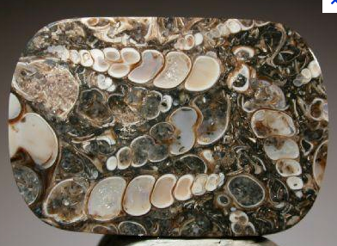
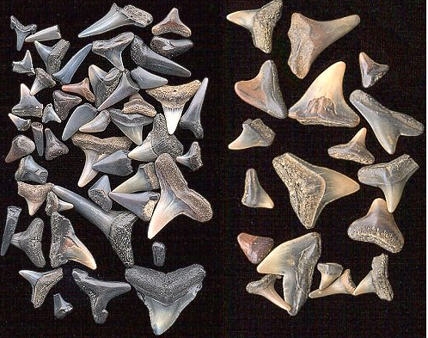
1. Fossils
Jaw bone from octopus/squid type animal
Shells from snails (Molluscs)
Shark and ray teeth
Notes:
EXPLORE
This slide is for students
Directions for instructor:
This slide provides the students with information on fossils found in the sedimentary rock layer. Have students find this slide and look at the information.
Next slide – students can fill in the Fossils column on their data table
----
Figures:
Snails - http://www.google.com/imgres?hl=en&client=safari&sa=X&tbo=d&rls=en&biw=2021&bih=1425&tbm=isch&tbnid=zMR_LXzB2agXgM:&imgrefurl=http://www.ucmp.berkeley.edu/tertiary/pli/bodjong.html&docid=_oUHiAYY4DMeJM&imgurl=http://www.ucmp.berkeley.edu/tertiary/pli/bodjong/turritella.jpg&w=600&h=400&ei=BkucUJ-GAanYigKxy4Eo&zoom=1&iact=hc&vpx=620&vpy=347&dur=300&hovh=183&hovw=275&tx=178&ty=133&sig=107351531844110770054&page=1&tbnh=146&tbnw=209&start=0&ndsp=85&ved=1t:429,r:16,s:0,i:137
http://stoneplus.cst.cmich.edu/fossiliferous.htm
Jaw – Teichert & Stanley, 1975, Geology
Shark teeth - http://geology.about.com/od/fossilstimeevolution/ig/fossil-pictures/shark-teeth.htm

Slide 18
Data Table
Layer ID | Grain Size (mm) | Other characteristics (layers, acid) | Sediment Type | Rounding | Rock Name | Fossils
1 | < 0.004 | Layers, breaks along layers, not dissolve in acid | Clay | -- | Shale | Snail shells, octopus jaw bone, shark and ray teeth
2
3
4a 4b
5
Notes:
EXPLORE
This slide is for students
Directions for instructor:
Now students have filled in all the information for Layer 1 and can move on to complete the rest of the layers on their own (or in pairs). The next part of the lesson is to take the information from their completed tables and make a stratigraphic column. The instructions for that are on slides 20-22. You may want to break this lesson into 2 parts, but if you think some students will finish the data table quickly and will need to move on to the column, you should give those instructions before telling students to finish their data table.
Make sure you note that layer 4 has two different types of rock within the same layer – this is similar to what we saw on one of the stratigraphic columns on slide 4 – a layer, with lens or channel shaped sections of a different kind of rock.
The answer key for the data table is on the next slide.

Slide 19
Layer ID | Grain Size (mm) | Other characteristics | Sediment Type | Rounding | Rock Name | Fossils
1 | <0.004 | Layers, Doesn’t dissolve with acid | Clay | -- | Shale | Molluscs, shark teeth, octopus bones
2 | 4.0- >256.0 | Doesn’t dissolve with acid | Pebble, Cobble, Boulder | Sub-angular | Breccia | Molluscs, shark teeth, octopus bones
3 | 0.08 | Doesn’t dissolve with acid | Sand | Rounded | Sandstone | Molluscs, bony fish
4a 4b | 0.08 4-256 | Doesn’t dissolve w acid Channel shaped | Sand pebble, cobble | Rounded Rounded to very rounded | Sandstone Conglomerate | Molluscs, bony fish, wood
5 | 4-256 | Doesn’t dissolve with acid | Pebble, cobble | Rounded to very rounded | Conglomerate | Wood, bones, teeth
Notes:
EXPLORE
This slide is for the instructor
This is the answer key for the activity.

Slide 20
Column
Fossils
5
5
4
4
3
3
2
2
1
1
Present day beach
Notes:
EXPLAIN
This slide is for students
Directions for instructor:
This is a framework for a strat column representing the cliff. Students will need to make this basic framework, or something similar, and then fill it in with the information from their data table. They should put rock symbols within the column and fossil symbols to the right of the column. Example symbols are on slide 21 and are provided to the students in the 5_StratColumnKey.docx document.
-----
Figures:
This is a photo of a cliff on the beach in La Jolla, California, north of Scripps Institution of Oceanography. These sedimentary layers were deposited during Eocene time (34-56 million years ago). The rocks include the Ardath Shale at the base of the cliff – grayish color and the Scripps Formation above – yellowish-brown. Photo credit: J. Maloney

Slide 21

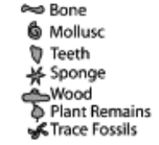






Stratigraphic Column Symbols
Sandstone
Shale
Limestone
Lenses or Channels
Conglomerate or Breccia
Rounded
Angular
Notes:
EXPLAIN
This slide is for students
Directions for instructor:
These are examples of symbols students can use to fill in their strat columns. These are also provided to the students in the 5_StratColumnKey.docx document.
The next slide shows an example of what a completed column might look like.

Slide 22


5
4
3
2
1
Present day beach
Notes:
EVALUATE:
This slide is for students
Directions for instructor:
This is an example of a strat column the students might make. You can encourage them to use colors if they want, or to make their won fossil symbols. In evaluation, you want to make sure they’ve including information about they rock type and fossils. They should also reflect differences in rounding, where applicable (layers 2 and 5). Layer 4 should have lenses of different type sediment.
As an additional evaluation tool, ask students to label the oldest and youngest rock layers. A: Oldest is the bottom and youngest is the top.
-----
Figures:
This is a photo of a cliff on the beach in La Jolla, California, north of Scripps Institution of Oceanography. These sedimentary layers were deposited during Eocene time (34-56 million years ago). The rocks include the Ardath Shale at the base of the cliff – grayish color and the Scripps Formation above – yellowish-brown. Photo credit: J. Maloney

